Slide 1
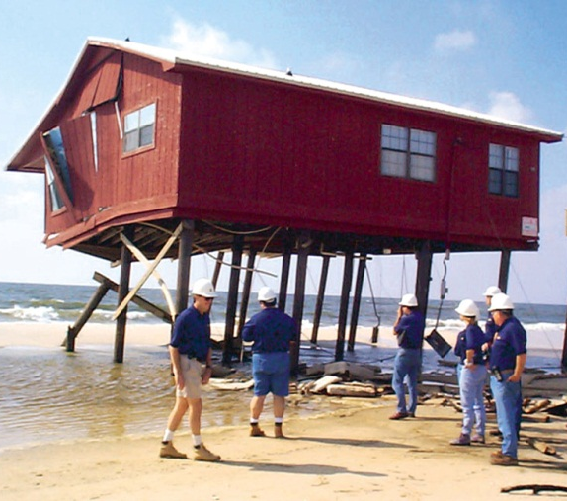
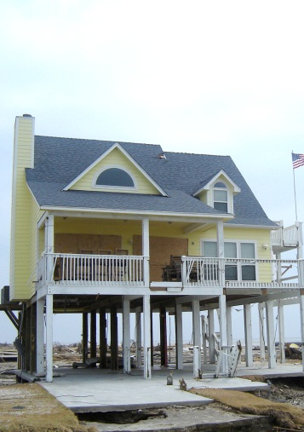
New Jersey Reconstruction, Rehabilitation, Elevation, and Mitigation (RREM) Program Pre-Bid Conference Round 2

Slide 2
Agenda
Welcome and Introductions
Rehabilitation, Reconstruction, Elevation, and Mitigation (RREM) Program Managers
RREM Program Description
Counties Affected
Contractor’s Role
General Contractor Prequalification Pool Development
Program Implementation

Slide 3
RREM Program Description
HUD Grant and NJ Allocation to RREM
Initial allocation for RREM Program is $600,000,000 and an estimated 4,000 homes to be served
RREM Program Includes:
Single-Family, Owner-Occupied properties
Maximum Program benefit is $150,000 per applicant
Program allows for homeowners to add their own funds and/or insurance proceeds on top of the $150,000 maximum Program Benefit

Slide 4
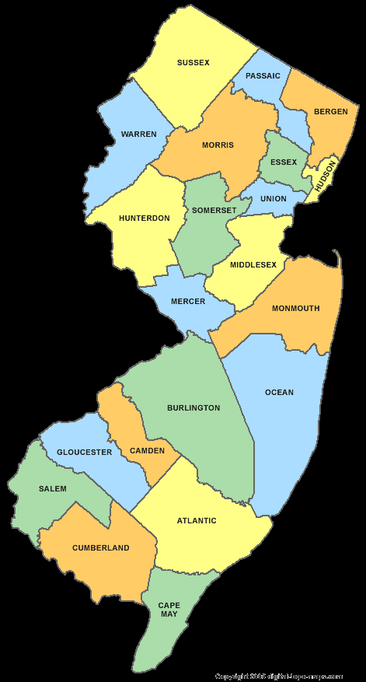
RREM Program Description
RREM Program Description
Counties Affected
Bergen
Essex
Hudson
Union
Middlesex
Monmouth
Ocean
Atlantic
Cape May

Slide 5
RREM Program Description
General Contractor’s Role in RREM
Primary goal is to assist with the recovery of New Jersey residents negatively impacted by Superstorm Sandy
Accomplished through:
Customer service with applicants
Quality construction performance
Efficient and timely construction timeframes
Coordinate with RREM Program Managers on scope of work (SOW) development
General Contractors are not to take direction from homeowners on SOW questions/changes
Change orders only through written approval from RREM Program Managers
Once SOW signed off by RREM Program Managers, no add-ons permitted

Slide 6
General Contractor Prequalification Pool Development
Updates to this solicitation can be found at:
New Jersey Department of Community Affairs website
New Jersey Builders Associate website
reNEWJERSEYstronger website

Slide 7
General Contractor Prequalification Pool Development
General Contractor Prequalification Requirements
All required registrations in place to conduct residential construction/repairs in New Jersey
Minimum bonding capacity of $1,000,000
Financially solvent and adequately capitalized
Minimum of 5 years experience as a General Contractor building residential homes (unless modular builder with commercial experience)
Demonstrated ability to properly address LBP and ACM in residential construction
Demonstrated ability to complete homes in 90 days or less
Compliance with HUD Section 3 Requirements
Management Processes and Procedures in place to ensure General Contractor’s success in Program
General Contractors must clearly indicate their interest in rehabilitation and/or reconstruction projects
General Contractors must clearly indicate in which of the nine impacted counties they would like to participate (any or all)

Slide 8
General Contractor Prequalification Pool Development
EVENT | DATE/TIME
Posting of Request for Qualifications Second Pool | July 17, 2013
Mandatory Conferences for Round 2 (must attend one) Cape May (Flanders Hotel, 719 East 11th Street, Ocean City New Jersey 08226) Ocean County (Toms River Holiday Inn, 631 Clifton Avenue, Toms River, New Jersey 08753) Union City, Monmouth County (650 Toole Avenue Municipal Building, Union Beach, New Jersey 07735) Bergen County (Renaissance Meadowlands, 801 Rutherford Avenue, Rutherford, New Jersey 07070) | July 18, 2013/10:00 a.m. July 18, 2013/3:00 p.m. July 19, 2013/9:00 July 19, 2013/2:00 p.m.
Deadline for written questions for Second Qualified Contractor Pool | July 22, 2013 3:00 p.m. Answered July 24, 2013
Deadline for submission of Request for Qualifications to be considered in Second Pool | July 31, 2013/ 3:00 p.m. (EDT)
Evaluation Period/Second Qualified Contractor Pool Announced | July 31, 2013, through August 9, 2013
Third Deadline for Request for Qualifications for Third Pool of Qualified Contractors | August 19, 2013
Final Planned Deadline for Request for Qualifications for Fourth Pool of Qualified Contractors | September 17, 2013

Slide 9
Prequalification Response
Responses required to be 25 pages or less (not including appendices or attachments)
Technical/narrative proposal to be a separate volume from cost volume – 2 distinct parts to be delivered
Questions/clarifications sought due no later than July 22, 2013
General contractors and all subcontractors must not be listed on the Excluded Parties Listing Service (Federal debarment list) or on the State of New Jersey debarment list

Slide 10
General Contractor Prequalification Pool Development
Pricing Exercise in Solicitation
Pricing conducted to determine contractor’s cost estimating capabilities only
Pricing is not performed on a floor plan that will be constructed in the New Jersey RREM Program

Slide 11
General Contractor Prequalification Pool Development
HUD Section 3
What is Section 3?
“Under Section 3 of the HUD Act of 1968, wherever HUD financial assistance is expended for housing or community development, to the greatest extent feasible, economic opportunities will be given to Section 3 residents and businesses in that area.”
The State of New Jersey will publish their Section 3 plan and requirements at a later date, but contractors will be expected to comply with the State’s policy.
Includes Section 3 new hires and Section 3 businesses

Slide 12
General Contractor Prequalification Pool Development
Additional Selection Intervals for more GCs
If General Contractors are not able to respond to this solicitation in the timeframe allotted, additional opportunities will be available. Tentatively, the solicitation will be re-opened on the following dates:
August 19, 2013
September 17, 2013
Contractor workshops will be conducted following each additional selection interval.

Slide 13
General Contractor Prequalification Pool Development
Solicitation Responses shall be consistently evaluated and scored in accordance with the following criteria:
Cost (20 percent);
Qualifications and Experience (55 percent);
References (15 percent); and
Overall clarity and completeness of Solicitation Response (10 percent).
TO BE CONSIDERED FOR THE QUALIFED CONTRACTOR POOL A RESPONDENT MUST SCORE AT LEAST A 65% ON PUBLISHED CRITERIA.

Slide 14
Program Implementation
Schedule for awards
Anticipate first NTP in late Summer/early Fall 2013
Performance and payment bonds required for each property assigned. Original bonds required prior to issuance of any NTP to General Contractors.
90 day completion deadlines for Reconstruction
Substantial progress deadlines along the way to ensure contractors are making satisfactory progress on homes prior to 90 day deadline.
Passed 33% inspection within first 30 days of NTP
Passed 66% inspection within first 60 days of NTP
Passed Final inspection within 90 days of NTP

Slide 15
Program Implementation
Rehab and Modular construction:
90 day completion deadlines
Substantial progress deadlines along the way to ensure contractors are making satisfactory progress on homes prior to 90 day deadline.
Passed 50% inspection within first 45 days of NTP (For modular house on the ground)
Passed Final inspection within 90 days of NTP

Slide 16
Program Implementation
Contractor Workshop to be conducted following identification of Prequalified Contractor Pool
Additional Program requirements regarding implementation to be presented to contractors during this workshop.

