Slide 1


NJDEP
Division of Air Enforcement
Diesel Enforcement Program
Regulatory Review, Green Trucks, TRUs
NJ State Police Training Center, Robbinsville, NJ
May 4, 2016
Presented by – Ralph Bitter, Supervisor, Diesel Enforcement
ACE Academy
New Jersey Department of Environmental Protection
Graphics in this presentation have been sourced from the internet and are royalty and copyright free to the best of my knowledge.

Slide 2
“Idling”
Running the engine without propelling the motor vehicle.
>3
N.J.A.C.
7:27-14
Diesel-powered
Motor
Vehicles
N.J.A.C.
7:27-15
Gasoline-powered
Motor
Vehicles
Idling for more than 3 minutes is prohibited, with some exceptions.

Slide 3
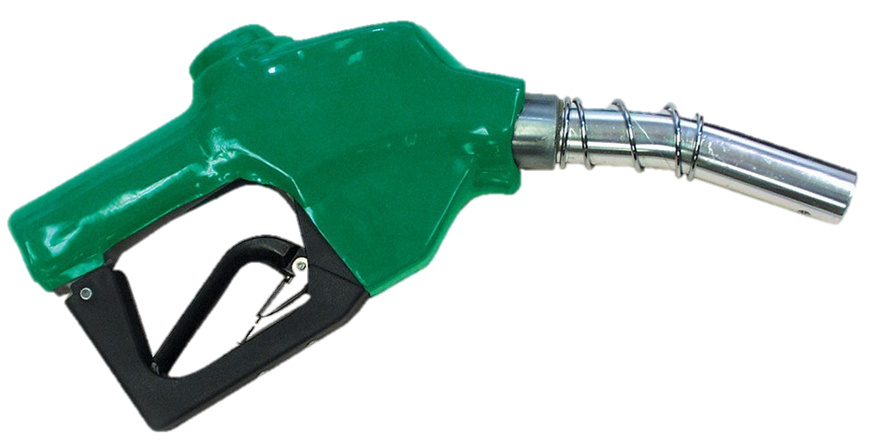
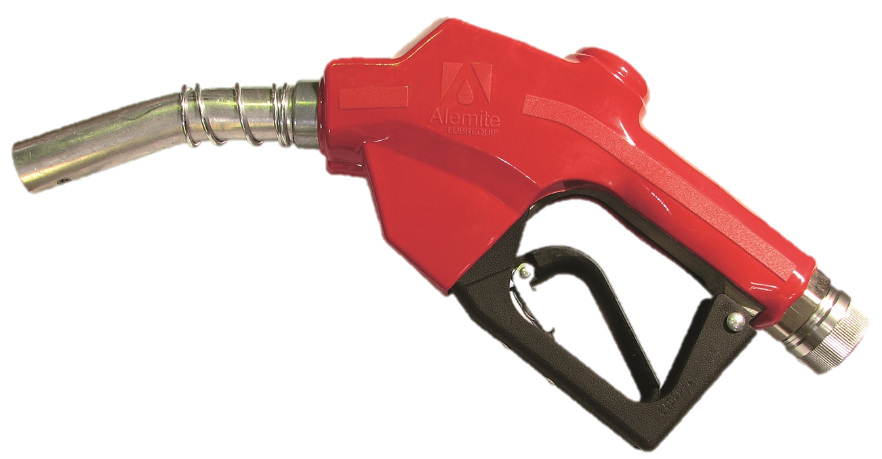
“Diesel/gasoline-powered”
means utilizing a diesel or gasoline engine.
“Gasoline” includes:
gasoline, natural gas,
Liquefied petroleum gas, propane,
alcohol, fuel blends AND hydrogen!

Slide 4


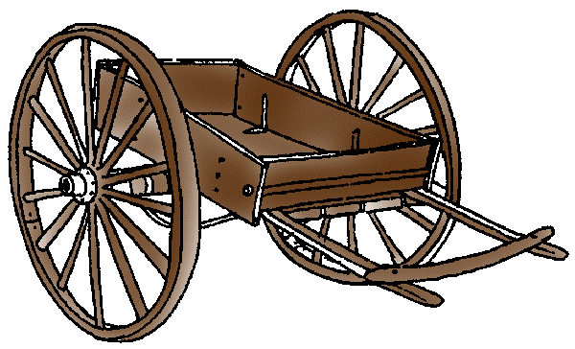


“Motor vehicle” means all vehicles propelled otherwise than by muscular power…
to Hell

Slide 5
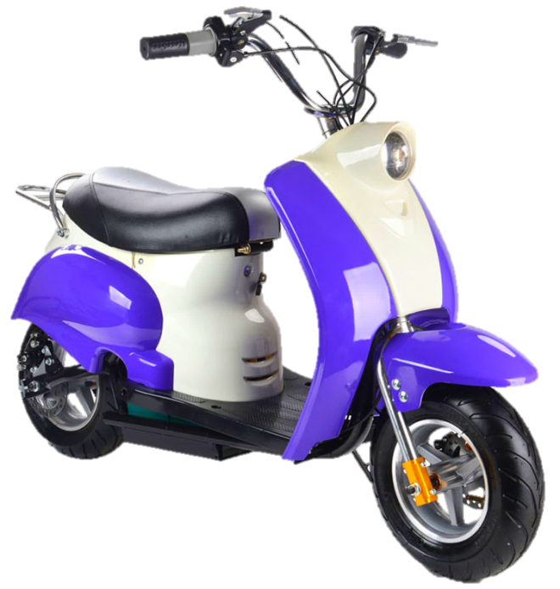

…excepting motorized bicycles and such vehicles as run only upon rails or tracks.

Slide 6
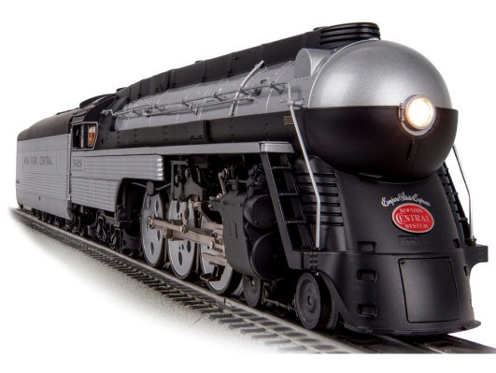
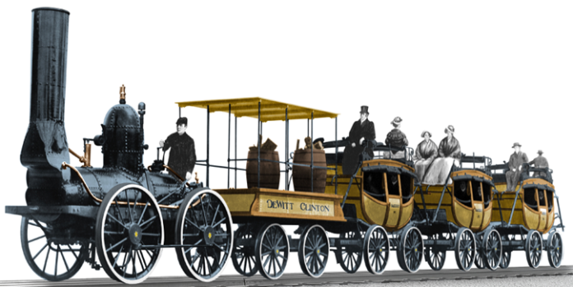


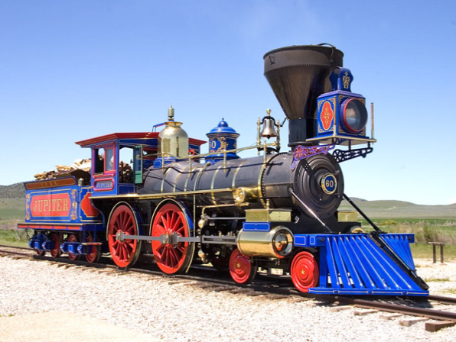
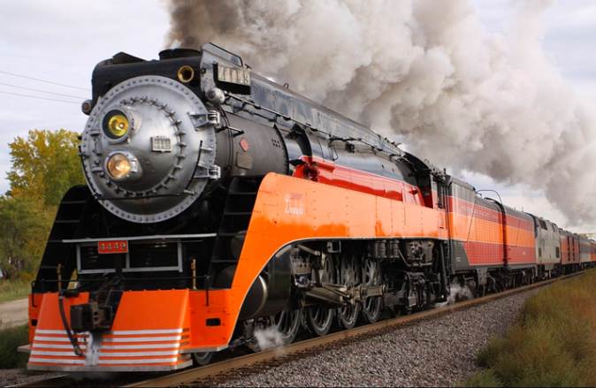
Federal Preemption – no enforcement on locomotives

Slide 7
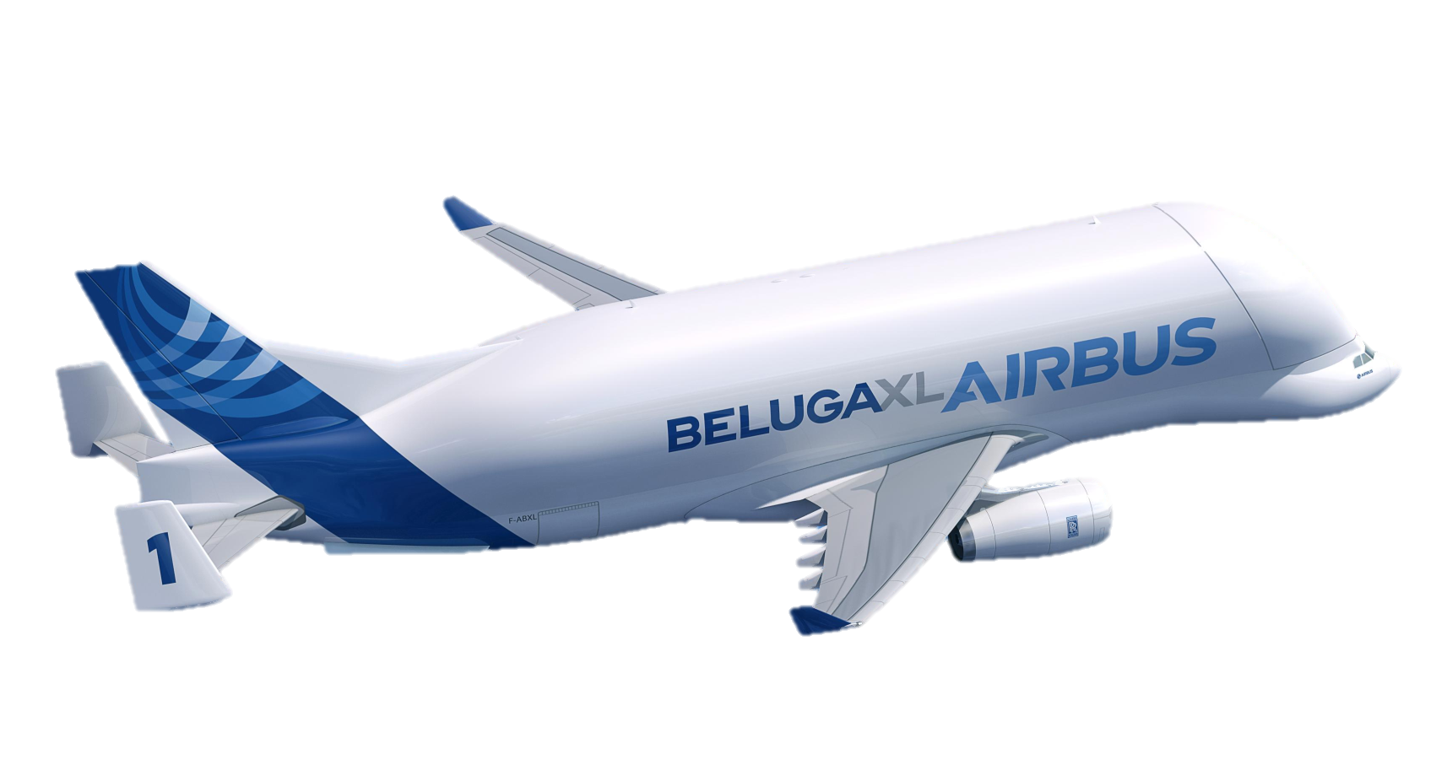
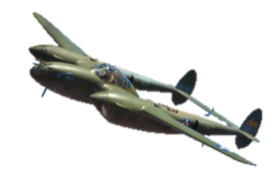
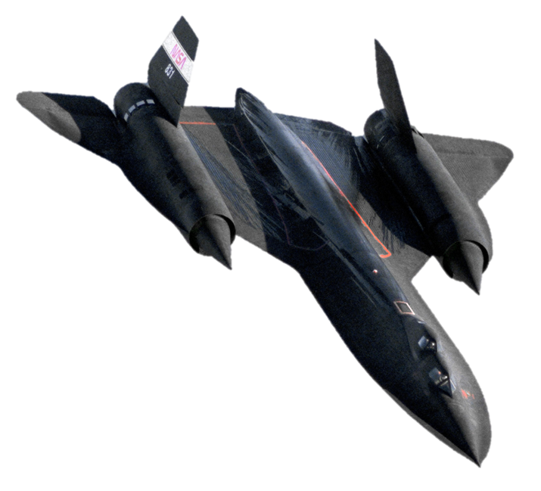
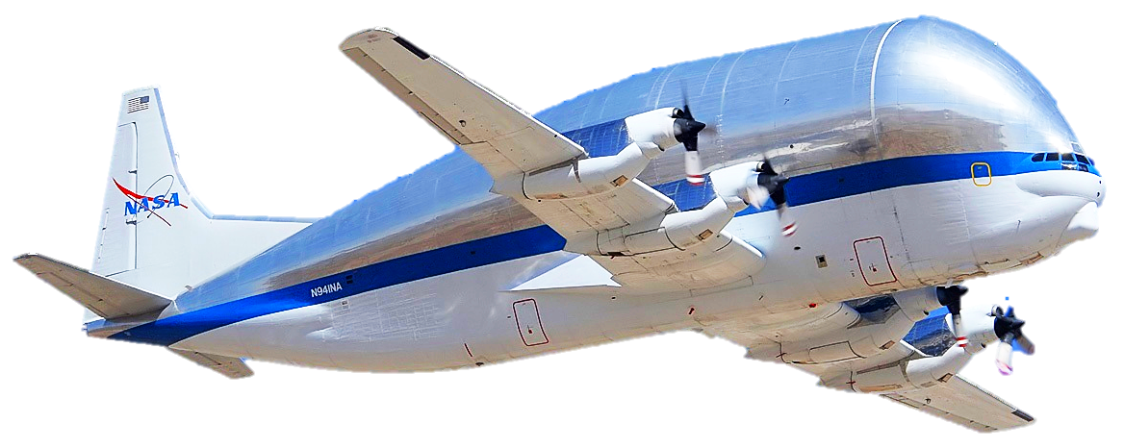
Federal Preemption

Slide 8
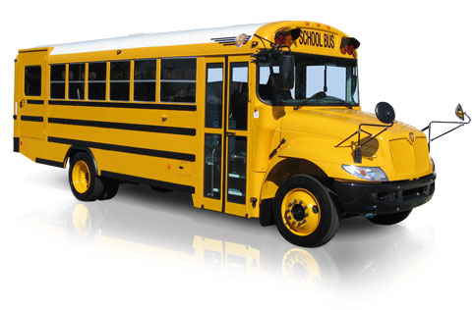
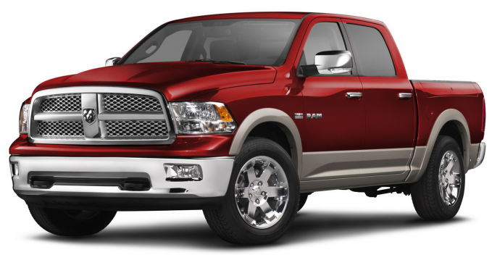
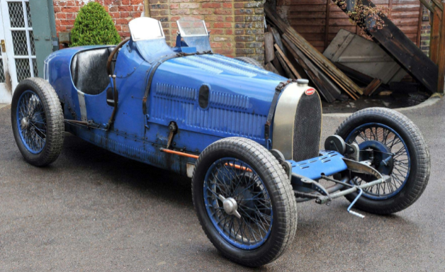
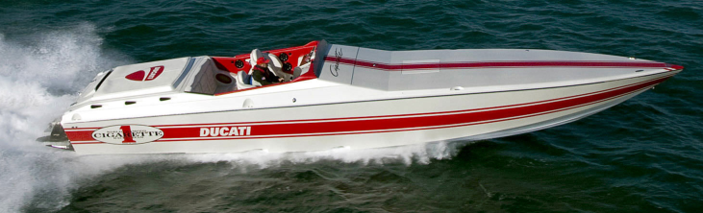
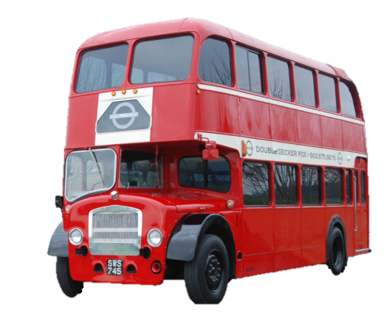
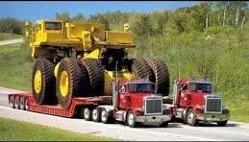
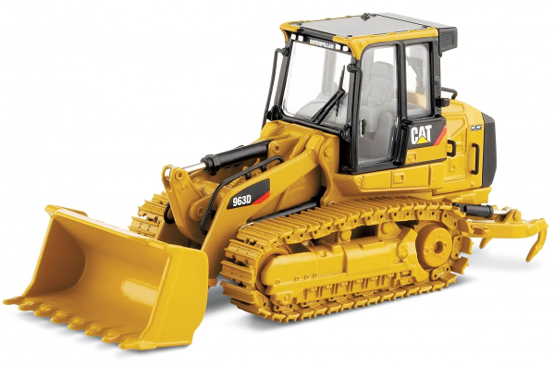
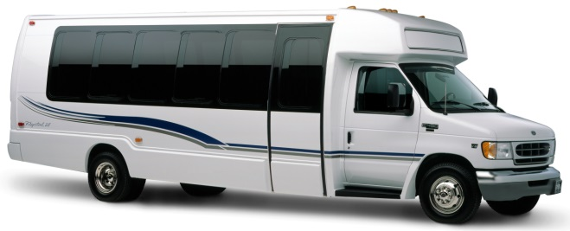

Slide 9
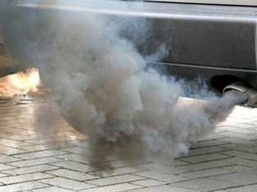



WHY ?!
Exhaust fumes are TOXIC!
Idling can burn up to one gallon per hour!
…and wastes natural resources.

Slide 10
NJDEP
Division of Air Enforcement
Diesel Enforcement Program
“Green Label” Trucks

Slide 11


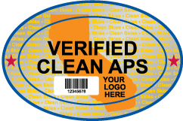
“Green Label” Trucks
USEPA approved technologies - includes idling limiters.
CA NOx limit at idle – OR 5 minute auto-shutoff.
Unlimited use – if the main engine is shut off.

Slide 12
NJDEP
Division of Air Enforcement
Diesel Enforcement Program
Transport Refrigeration Units (TRU)

Slide 13
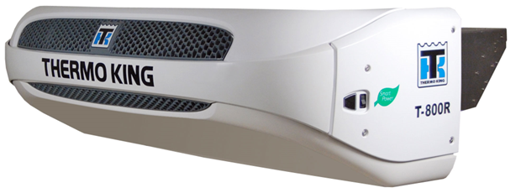
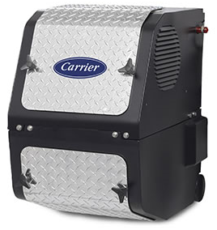
Transport Refrigeration Units (TRU)
Transportation refrigeration units (TRUs) are gasoline and diesel powered cooling units that are installed on vehicles used to transport produce, meat, dairy products, and other perishable goods. TRUs are found on refrigerated vans, trucks, trailers, railcars, and shipping containers.
The TRU gasoline or diesel engines drive either mechanical or electric compressors. Sometimes an APU is utilized to power the trailer in transit. Some TRUs are equipped with electric standby systems (ESS), which allow them to use “shore-power” – electricity provided by the facility where they are housed.

Slide 14
TRU Systems
Vehicle mounted:
Alternator and direct belt drive – drive engine dependent
Auxiliary diesel and APU – a modular unit utilizing the vehicles fuel tank
Self contained
  may have their own fuel supply or tap into the vehicles fuel tank
  may have electric standby systems (ESS) to use “shore-power”
Trailer (Reefer) mounted:
Self contained
  have their own fuel supply and exhaust system
  may have electric standby systems (E/S) to use “shore-power
Containers:
Self contained
  have their own fuel supply and exhaust system
  have electric standby systems (ESS) to use “shore-power

Slide 15
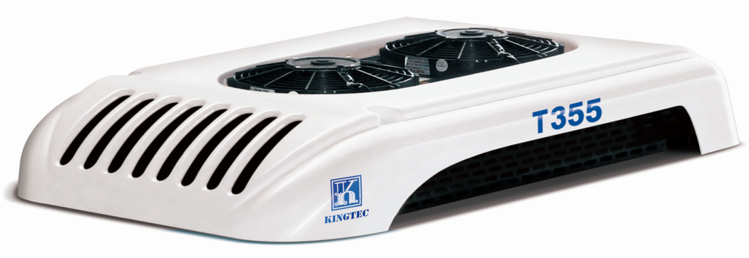

Vehicle Mounted Systems
Alternator and direct belt drive:
drive engine dependent
Typically roof-mounted
Light duty vehicles
Idling exempt when in use
Auxilliary Diesel and APUs:
Engine on-board
Typically frame-mounted
Utilizes the vehicles fuel
Medium to heavy-duty vehicles
Idling exempt

Slide 16
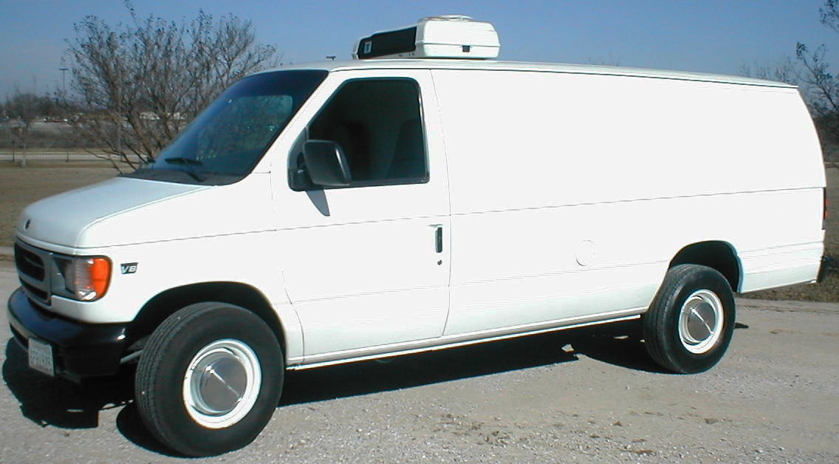
Typical roof-mount – exempt.

Slide 17
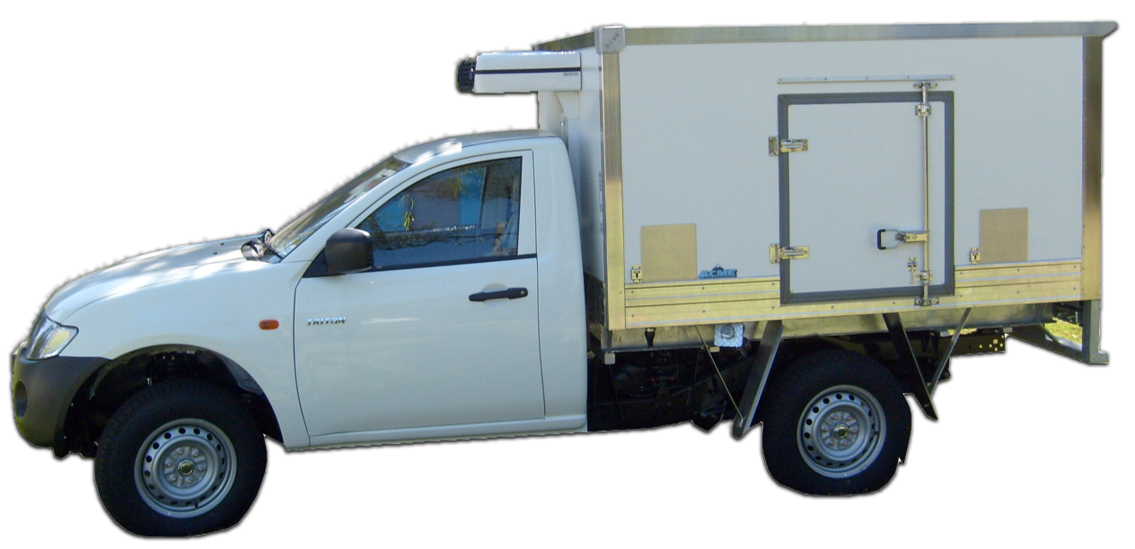
May be plug-in.
Look for fuel tank tap.

Slide 18
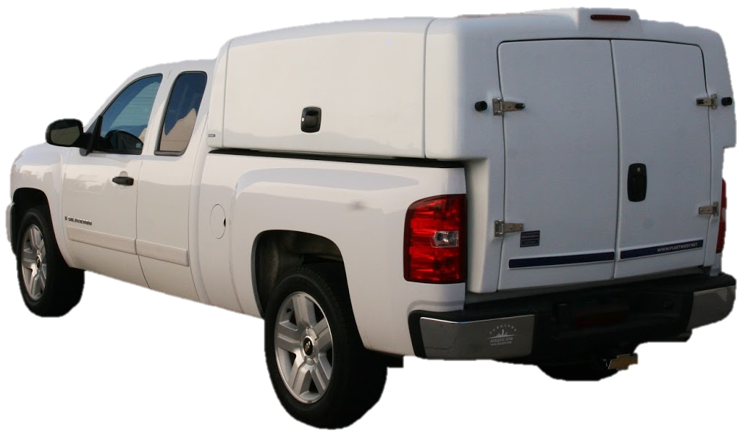
Likely just an insulated box, but the refrigeration unit may be inside. Likely electric - check for connections.

Slide 19
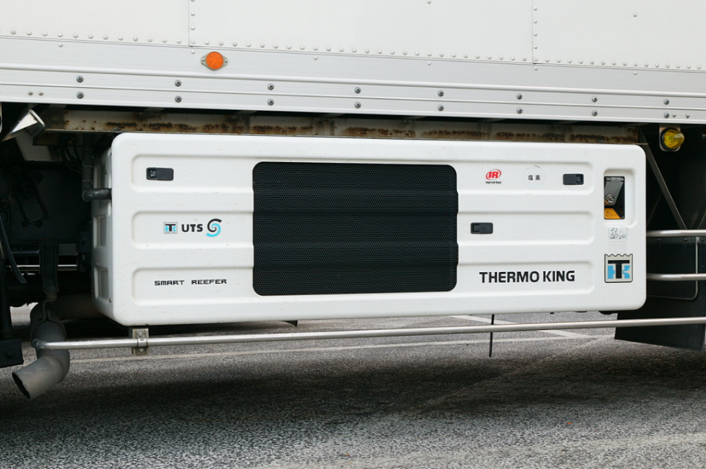

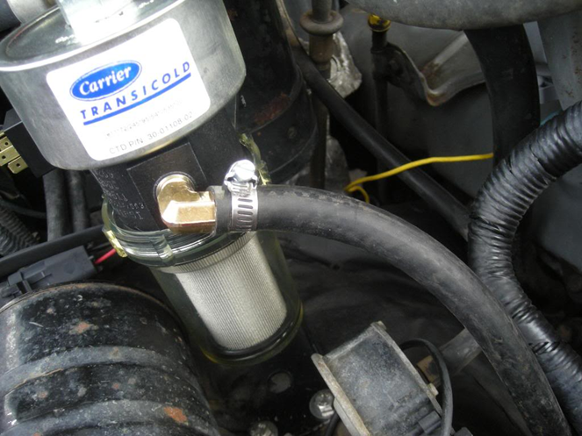
Vehicle Mounted Systems
Self contained:
  Body or frame-mounted
  Medium to heavy-duty vehicles
  Typically may have their own fuel supply, some tap into the vehicles fuel tank
  may have electric standby systems (ESS) to use “shore-power”
  Vehicle NOT idling exempt

Slide 20
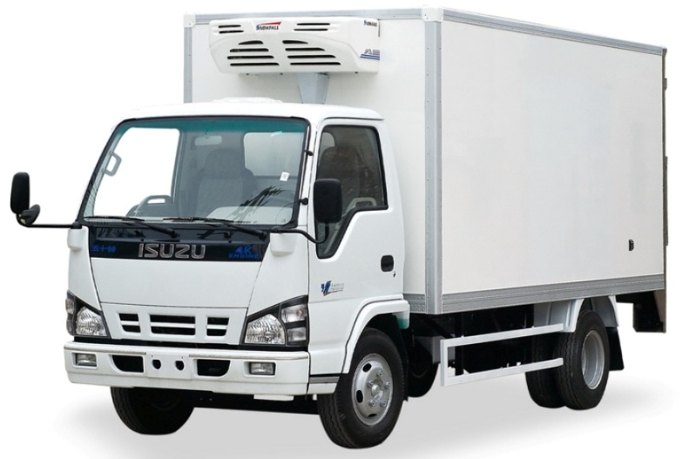
Self-Contained Units
This may be a frame mounted fuel tank.

Slide 21
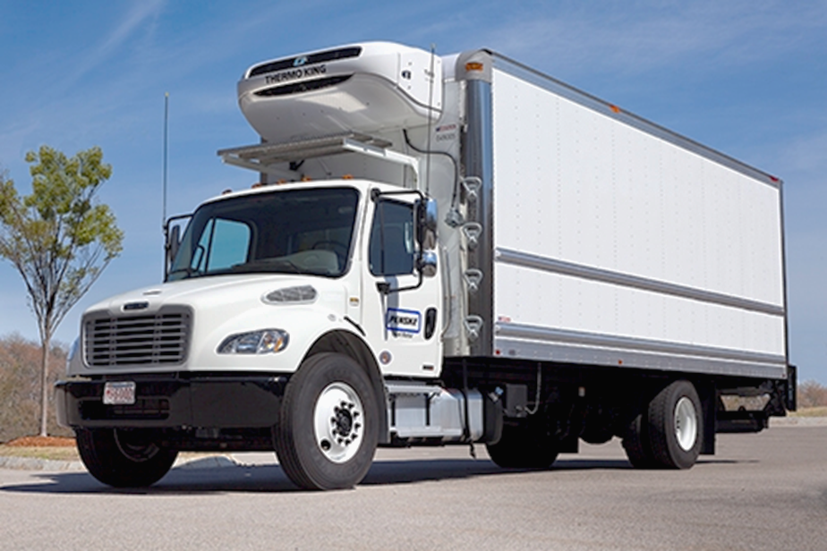
Note shore-power connection and frame-mounted tank

Slide 22
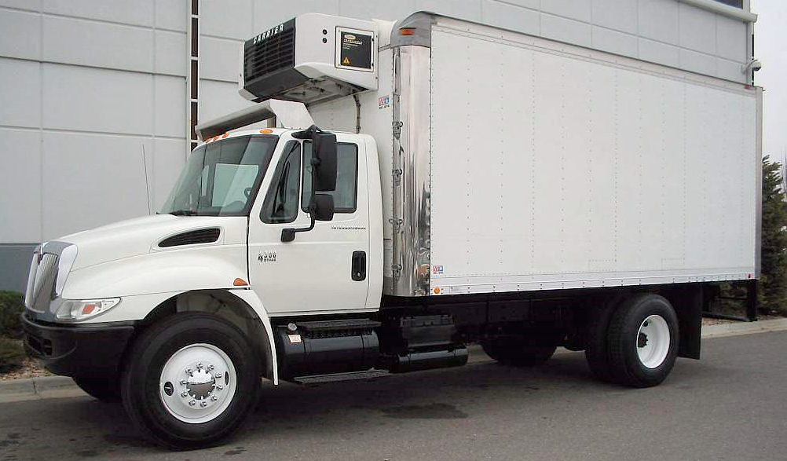
TRU Fuel Tank

Slide 23
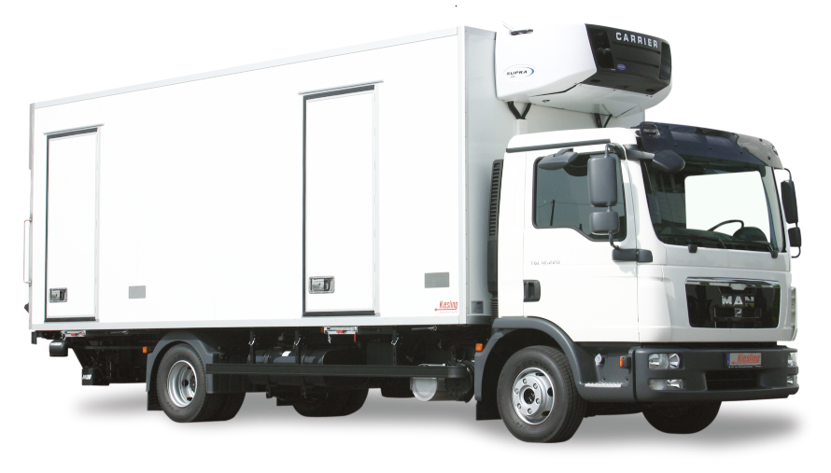
Guard rails are an indicator for TRU tanks.
Note the frame-mounted tank behind the rail.

Slide 24
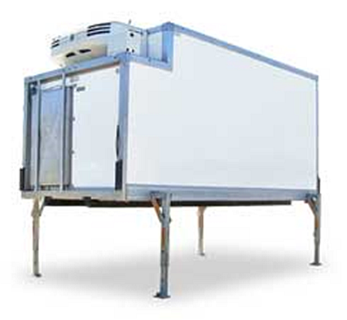
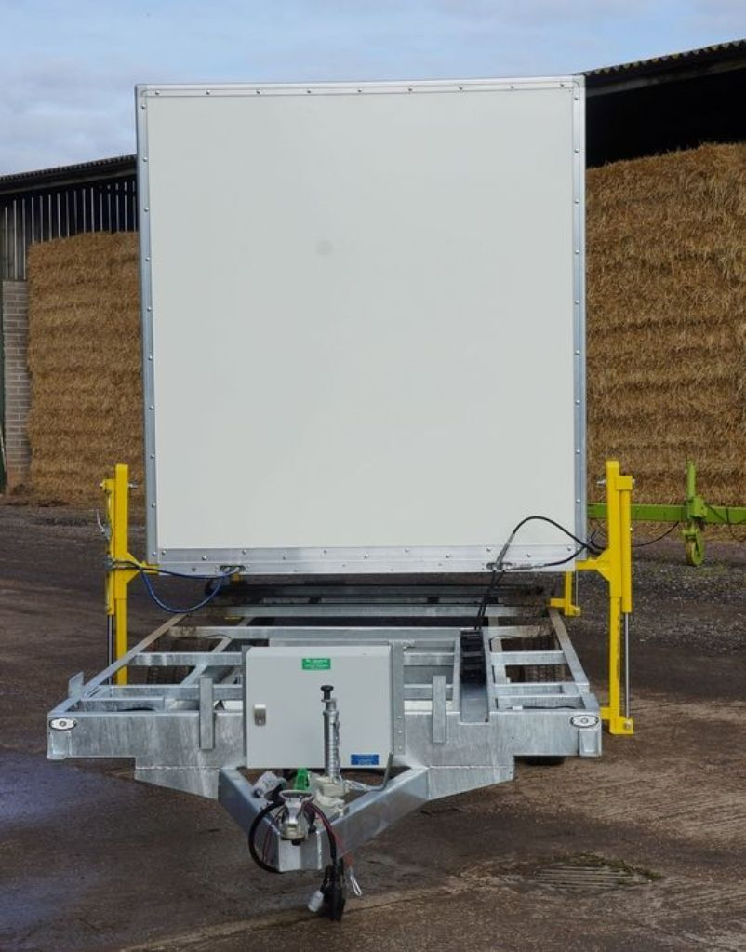

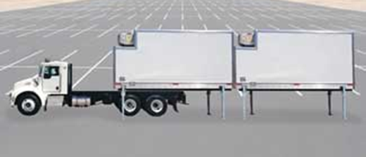
Demountable truck/trailer bodies

Slide 25
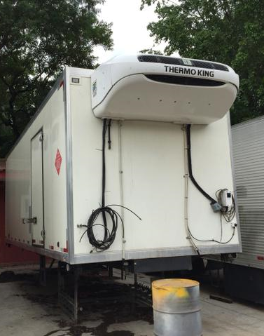
Self-contained TRU – Frame mounted body
Umbilical with fuel line – look for connection to the trucks fuel tank
Shore-power line
Evaporator drains
Commonly mounted on trucks, sometimes a frame trailer.
The truck is NOT exempt.

Slide 26
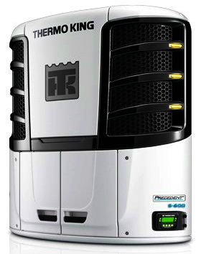

Trailer-Mounted Units
Self contained:
  body or frame-mounted
  have their own fuel supply
  may have electric standby systems (EES) to use “shore-power”
  Tractor NOT idling exempt

Slide 27
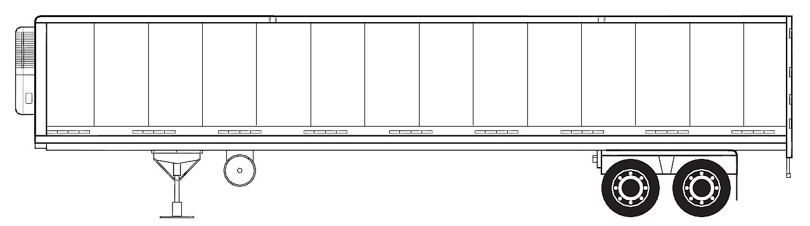
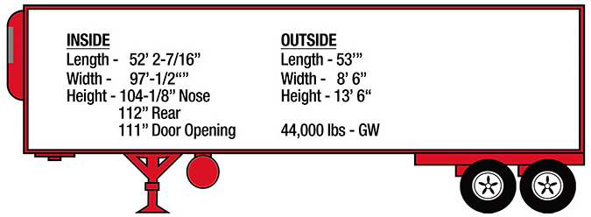
A typical long-haul refrigerated reefer.
TRU
TRU Fuel Tank

Slide 28
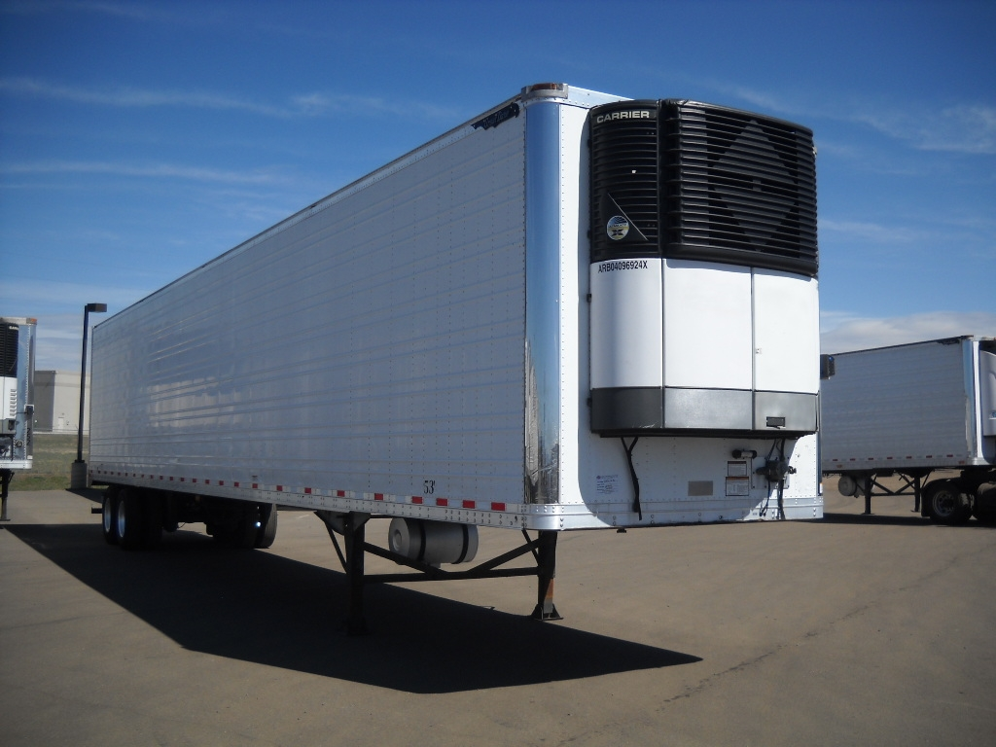
TRU Tank behind landing gear.

Slide 29
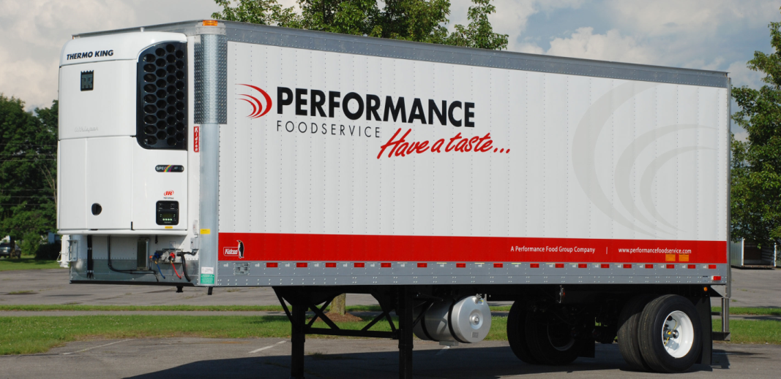

Slide 30
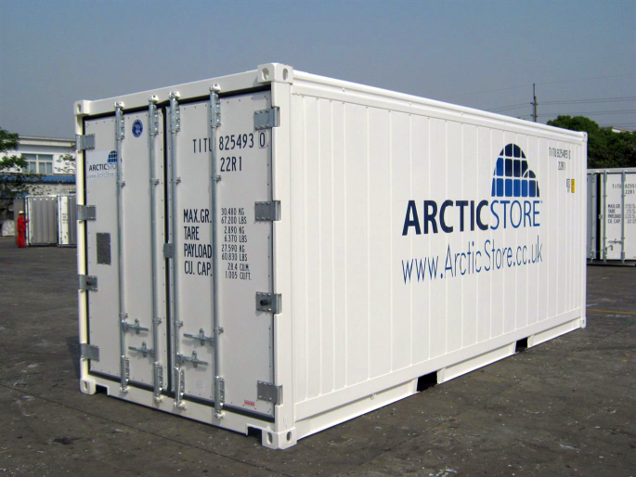
Shipping Containers
A portable cold storage container.
The tractor is NOT exempt when it’s being transported.

Slide 31
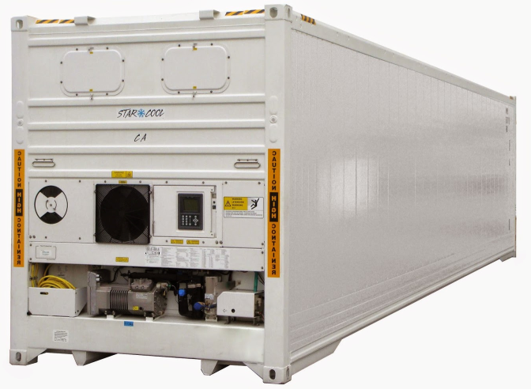
Built-in TRU container

Slide 32
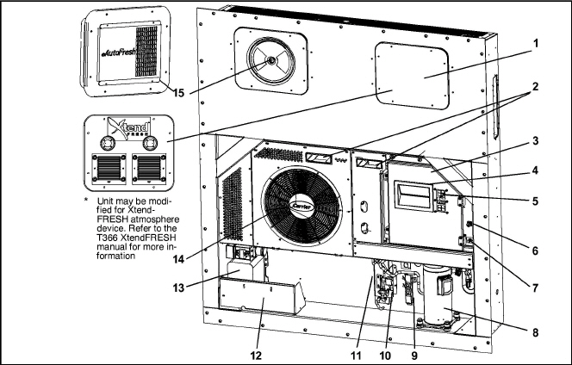
Refrigeration Unit - Front Section
1. Access Panel (Evap. Fan #1) 9. Supply Temperature Supply/Recorder Sensor Assembly (STS/SRS)
2. Fork Lift Pockets 10. Economizer
3. Control Box 11. Ambient Temperature Sensor (AMBS)
4. Unit Display 12. Power Cables and Plug (Location)
5. Key Pad 13. Autotransformer
6. Remote Monitoring Receptacle 14. Condenser Grille
7. Start−Stop Switch, ST 15. Upper Fresh Air Makeup Vent Panel (Evap. Fan #2)
8. Compressor

Slide 33
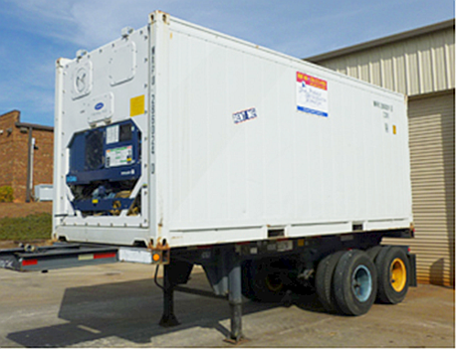
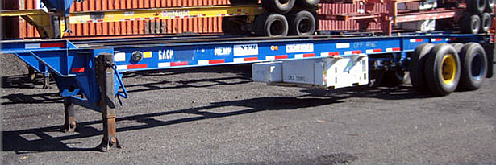
Modal chassis mount
Integrated TRU
Under chassis TRU

Slide 34
Checklist
Dedicated fuel tank
Self contained or separate power source - not the vehicles engine
Tap to vehicle fuel tank
Ask:
Does the vehicle engine have to be running for the A/C to work?

Slide 35
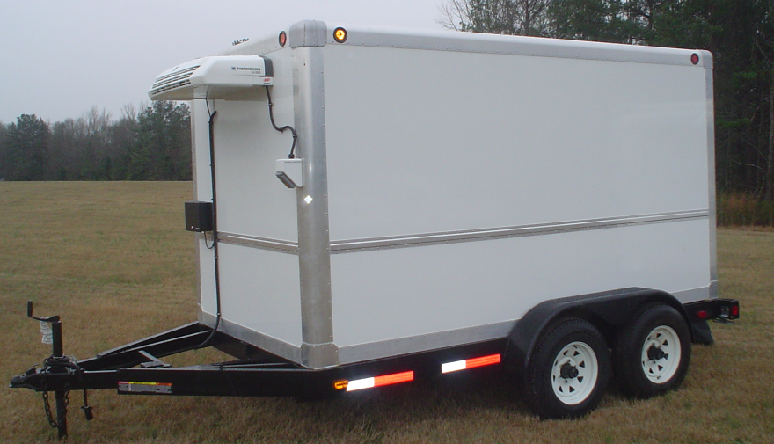
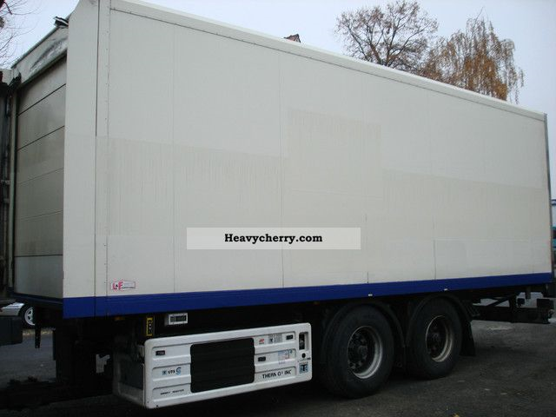

Is the vehicle exempt?

Slide 36

Critics Choice
We don’t care as long as it stays cold!

Slide 37


For more information:
Ralph Bitter, Supervisor
Diesel Enforcement
609-292-6429
ralph.bitter@dep.nj.gov

