Slide 1
Idling Regulations & Idling Enforcement
Mark Burghoffer
Greg Davis

Slide 2
What is idling?
The New Jersey DEP definition of idling is:
Idling is an operating mode where the vehicle engine is in operation while the vehicle is stationary at any location.
(gasoline and diesel defined slightly differently)

Slide 3
Why enforce excessive idling?
To reduce air and noise pollution
On-road mobile sources produce:
51-64% of New Jersey’s CO emissions*
20-23% of New Jersey’s volatile organic compounds (VOC)*
51-58% of New Jersey’s overall NOx emissions*
11% of New Jersey’s fine particulate emissions*
33% of air toxics**
*http://www.state.nj.us/dep/baqp/inventory.html
**http://www.nj.gov/dep/airtoxics/sourceso05.htm

Slide 4
Other benefits of reduced idling:
- Less fossil fuel use
- Less equipment wear/maintenance

Slide 5
New Jersey’s idling regulations:
- Were adopted in 1986
- Are found here:
NEW JERSEY ADMINISTRATIVE CODE
TITLE 7
CHAPTER 27
SUBCHAPTER 14 (diesel)
SUBCHAPTER 15 (gasoline)
Last revision was in 2009

Slide 6
How much idling is allowed?
No person shall cause, suffer, allow, or permit the engine of a diesel or gas powered motor vehicle to idle for more than 3 consecutive minutes if the vehicle is not in motion.
However, exceptions allow additional idling when…

Slide 7
Idling exceptions
- Vehicle being actively serviced or repaired.
- Below 25 F° for up to 15 minutes (no exception in New Jersey for high heat)
- Busses while it is actively discharging or picking up passengers may idle for 15 consecutive minutes in a 60-minute period
- Motor vehicle idling in traffic, In queue or congestion. (i.e. bank drive-thru, dump truck loading)
- Cargo refrigeration requiring engine power (most are self powered and therefore not exempt)

Slide 8
More idling exceptions
- Vehicles actively using Hydraulic/mechanical equipment such as: lift gates, movable beds, compactors, cement trucks, hydraulic rams etc.
- A vehicle equipped with a sleeper berth and model year 2007 or newer engine, or has been retrofitted with a diesel particulate filter.

Slide 9
Parking spaces with available electrification technology
Diesel-powered motor vehicles may not idle for more than three consecutive minutes when parked in a parking space with available electrification technology.

Slide 10
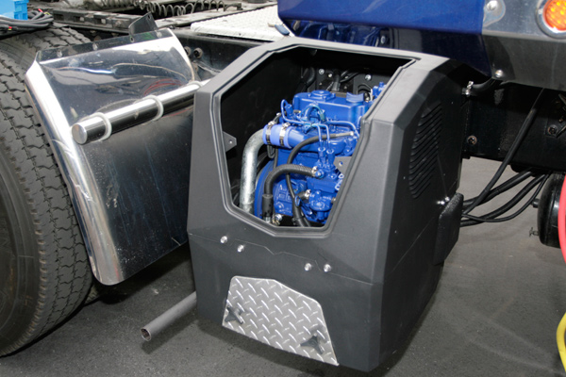
Auxiliary Power Units
The operation of technology designed to reduce engine idling, such as auxiliary or alternate power units (APUs), generator sets, and bunk heaters are accepted, provided the vehicle’s main engine is not operating.

Slide 11
Who enforces idling?
- The DEP
- The EPA
- Health Departments
- Police (Motor vehicle statute C. 39:3-70.2)

Slide 12
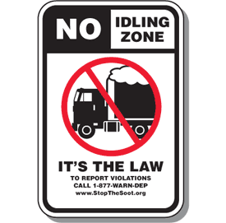
When a violation is found
- Both the driver and the facility where the idling took place are cited and fined
- Only the driver is fined if anti-idling signs are clearly posted

Slide 13
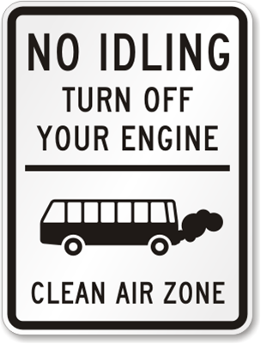
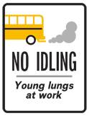
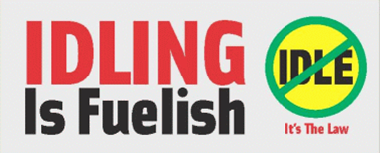
Anti idling signs are recommended
- Remind drivers to turn off engines
- Lower risk of penalties

Slide 14
Penalties
1st offense: Passenger vehicle registration = $100 each vehicle
Commercial vehicle registration = $250 each vehicle
Subsequent offenses: $200 - $1,500 each vehicle
Multiple vehicles and/or offenses can result in large penalties…

Slide 15
Penalty examples
Boston-Based Bus Company Agrees To $650,000 Penalty For 234 Violations of the Clean Air Act and Anti-Idling Regulations; (Boston, Mass. – August 4, 2009) – Paul Revere Transportation LLC, a bus company based in Boston, has agreed to pay a $650,000 civil penalty after being found liable by a jury in June for violating federal and state clean air laws for idling their buses for extended periods of time, the Justice Department and U.S. Environmental Protection Agency announced today.
Waste Hauler Pays $195,000 for Truck Idling in Massachusetts; (Boston, Mass. – Aug. 13, 2008) - Allied Waste Services of Massachusetts will pay a $195,000 penalty to settle an environmental enforcement case brought by EPA and the U.S. Department of Justice for excessive motor vehicle idling.
Source: www.epa.gov

Slide 16
More penalty examples
Bus Companies Will Pay More Than $237,000, Settling Environmental Violations in Three New England States; (Boston, Mass. - January 10, 2007) - Three bus companies in Conn., R.I. and Mass., jointly owned and operated by Peter Pan Bus Lines, will pay $237,179 in penalties and will install new filters on most of their buses to settle violations of federal clean air and clean water rules.
Cash Up in Smoke: Another Bay State Waste Hauler Cited for Idling; (Boston, Mass. – Oct. 29, 2008) – For the third time this year, EPA has cited a Massachusetts waste hauler for exceeding the state’s five minute idling limit. Waste Management of Massachusetts, Inc. will pay a penalty of $27,200 for excessive idling at its Stoughton, Taunton and West Boylston, Mass. depots. In total, EPA has collected $329,500 in penalties for idling violations from Capitol Waste Services, Allied Waste Services, and Waste Management.
Source: www.epa.gov

Slide 17
Typical idling locations
- Schools/sensitive populations
- Bus and truck yards
- Industrial parks
- Along roadways
- Seaports/airports
- Stadiums/arenas/public attractions
- Rest stops
- Any location identified by a citizen complaint

Slide 18
DEP idling investigations
When is the DEP enforcing idling?
- During scheduled idling surveillance
- In response to citizen complaints
- If idling is identified during other field assignments.

Slide 19
DEP idling investigations
- Typically conducted in marked state vehicles (stickers and tags)
- Inspectors clock vehicles
- Usually the driver & facility manager is notified immediately with a Notice of Violation (NOV)
- Some drivers are served a NOV by registered mail when: Uncooperative NOV is refused Driver is unavailable (sleeping or unoccupied vehicle)

Slide 20
Common misunderstandings
- Charging air brakes is not exempt (unless the mfg. specs indicates charge time is >3minutes)
- Turbo/supercharger cool-down is not exempt (unless the mfg. specs indicates charge time is >3minutes)
- Diesel Particulate filter regeneration is not exempt (unless following mfg. specs)
- Repairs

Slide 21
More common misunderstandings
- Does auxiliary equipment need engine power
- Refrigeration systems
- Vehicle can’t restart or is in disrepair

Slide 22
Resources
- Idling complaints: Call the DEP 24-hour Hotline: 877-WARN-DEP
- NJ Idling regulations: www.state.nj.us/dep/aqm/
- General info and to buy anti idling signs: www.stopthesoot.org

