Slide 1
Landfills Air Pollution
Air Compliance and Enforcement
Jeff Meyer

Slide 2
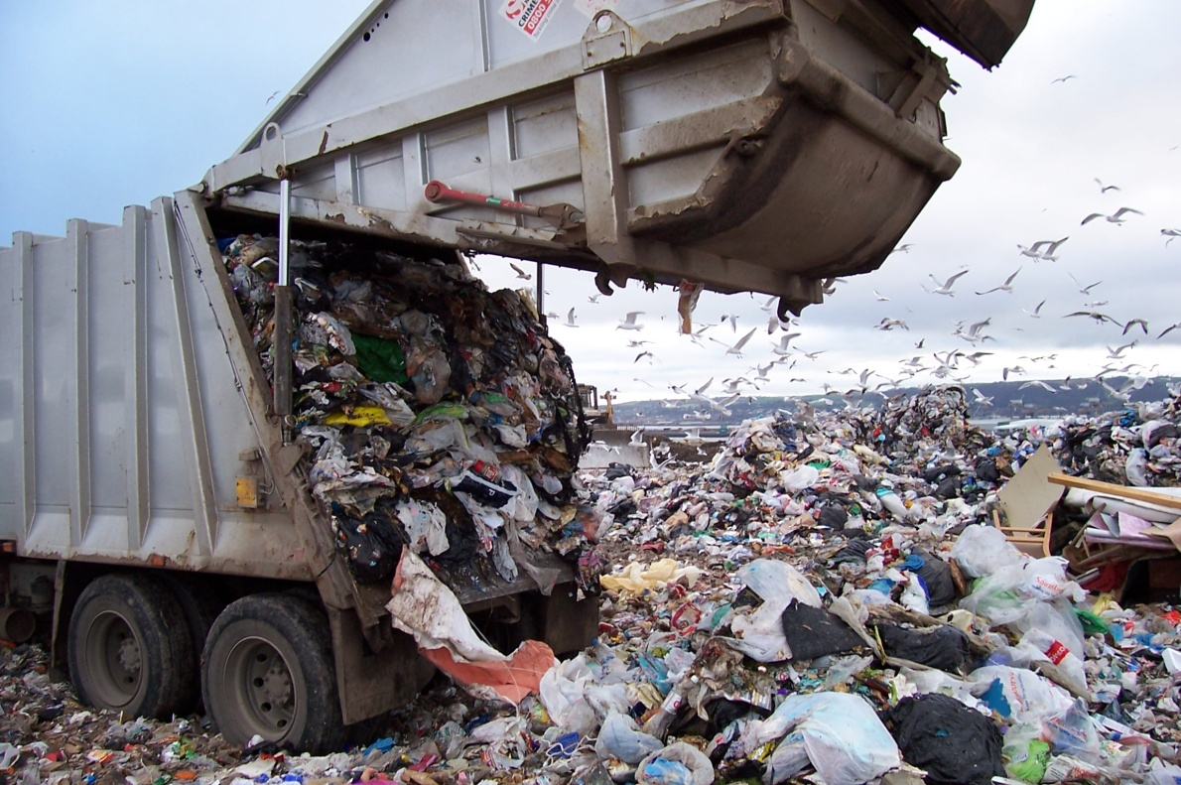
Overview
Landfill Overview
Emissions
Permit Applicability
Potential to Emit
Permit Requirements
Federal Regulations

Slide 3
Landfill Overview
846 Landfill sites in New Jersey
830 Closed and no longer accepting waste
13 Active Commercial Landfills
3 “Active Private Landfills

Slide 4
NJDEP APROVED COMMERCIAL SANITARY LANDFILLS
Landfill | NJEMS PI # | Class | City | Waste Types | Phone Number
Atlantic County UA | 143393 | I | Egg Harbor Township | 10,13,13C,23,25,27 | (609) 272-6950 (609) 646-5500
Burlington County | 150098 | I | Mansfield /Florence Twps. | 10,13,13C,23,25, 27,27I | (609) 499-5303
Cape May Cty MUA | 154930 | I | Upper Twp./Woddbine Borough | 10,13,13C,23, 25,27,27I | (609) 861-5701 (609) 465-9026
Cumberland County IA | 133530 | I | Deerfield Twp. | 10,13,13C,23,25, 27,27I | (856) 825-3700
Gloucester County IA | 132199 | I | South Harrison Twp. | 10,13,13C,23,25, 27,27I | (856) 478-6045
Keegan Landfill (NJMC) | 133571 | II | Kearny | 13,13C,27 | (201) 460-4678
Middlesex County UA | 132314 | I | East Brunswick | 10,13,13C,23, 25,27, TRMW (1-7) | (732) 246-4313
Monmouth County | 133927 | I | Tinton Falls | 10,13,13C,23, 25,27,27I | (732) 922-8686
Ocean County LF Corp | 133642 | I | Manchester | 10,13,13C,23,25, 27,27I, TRMW (2-7) | (732) 657-5100
Pennsauken -PCFACC | 132037 | I | Pennsauken | 10,13,13C,23, 25,27,27I | (856) 663-2772 www.pcfacc.com/psl.htm
Salem County UA | 132608 | I | Alloway Township | 10,13,13C,23, 25,27,27I | (856) 935-7900
Sussex County | 132675 | I | Lafayette Township | 10,13,13C,23, 25,27,27I, TRMW (2-7) | (973) 579-6998
Warren County | 132759 | I | White Township | 10,13,13C,23, 25,27,27I, TRMW (2-7) | (908) 453-2174 ext.223

Slide 6
NJDEP APPROVED OPERATING PRIVATE SANITARY LANDFILLS
Landfill | ID# | Class | City | Waste Types
DuPont A&B | 1713B | II | Deepwater | 13,27
Hercules | 1436B | II | Kenvil | 13,13C, 23,27
Phillipsburg Associates III | 2119E | II | Phillipsburg | 13,27

Slide 7
Landfill Air Emissions
Primary source: Landfill itself
LFG is a by-product of the decomposition of municipal solid waste (MSW):
~50% methane (CH4)
~50% carbon dioxide (CO2)
<1% non-methane organic compounds (NMOCs)
Hazardous air pollutants (HAP)
Greenhouse gases (GHG)
Volatile organic compounds (VOC)
Other non-organic compounds (e.g. hydrogen sulfide)
Gas generation, including rate and composition, proceeds through phases. Phase duration rate of gas generation varies with landfill conditions, i.e.:
Waste composition
Design
Cover materials
Climatic conditions
Other sources: Combustion products from engines, flares, turbines, boilers, and particulate from roads and waste handling.

Slide 8
Landfill Gas (LFG) Concerns
May contribute to ground level ozone formation
Cause an odor nuisance
Cause a fire potential due to methane migration
Contribute to toxics and HAPs in ambient air which can cause health problems
Contribute to climate change problems due to large emissions of carbon dioxide and methane.

Slide 9
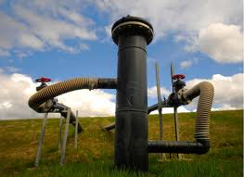
LFG Collection Systems
Active collection systems
pressure gradient created by use of mechanical
blowers or compressors in order to extract LFG .
Passive collection systems Active System
natural pressure gradient created by the increased pressure within the landfill from LFG generation to mobilize the gas for collection or venting.
Which type of system depends upon the landfill characteristics & operating practices.
Gas extraction wells may be installed at the landfill perimeter, but are typically installed within the refuse of a landfill.
depth and spacing of wells vary with landfill characteristics and operations (i.e., lined or unlined, waste type, LFG generation, etc.)
Offsite migration probes are often installed at the landfill perimeter for monitoring the operation of the collection system.

Slide 10
FLIR (Forward Looking Infrared) Video of landfill gas from different points

Slide 11
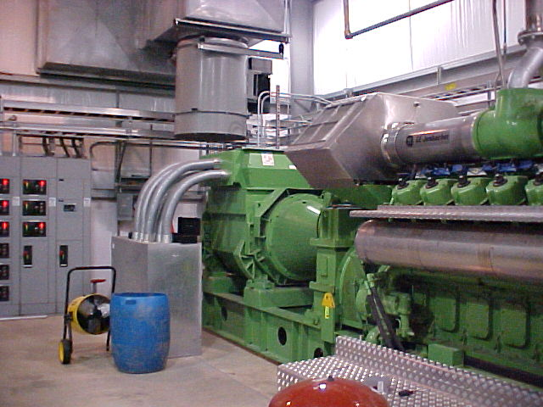
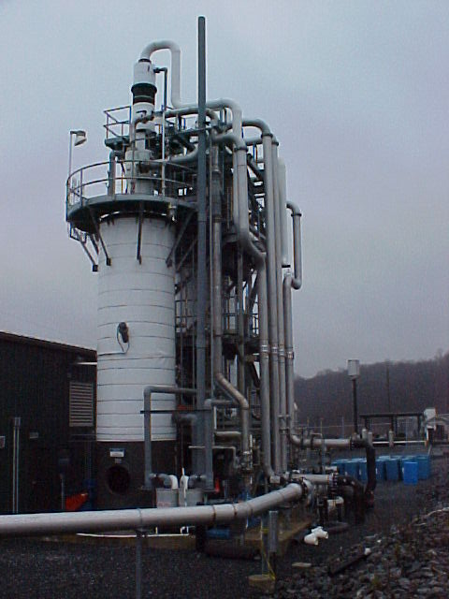
LFG Control & Treatment
Combustion
Energy Recovery OR No Energy Recovery
gas turbines flares (open or enclosed)
internal combustion engines
boiler-to-steam turbine systems
Purification
use of adsorption, absorption, and membranes to
remove water (H2O), CO2, H2S,NMOCs, and siloxanes.
Can process LFG to pipeline quality natural gas

Slide 12
Who needs an Air Permit?
NJAC 7:27-8: PERMITS AND CERTIFICATES FOR MINOR FACILITIES (AND MAJOR FACILITIES WITHOUT AN OPERATING PERMIT)
8.2(c) Any equipment or source operation that may emit one or more air contaminants, except (CO2), directly or indirectly into the outdoor air and belongs to one of the categories listed below, is a significant source (and therefore requires a preconstruction permit and an operating certificate), unless it is exempted…
8.2(c)17. Equipment used for the purpose of venting a closed or operating dump, sanitary landfill, hazardous waste landfill, or other solid waste facility, directly or indirectly into the outdoor atmosphere including, but not limited to, any transfer station, recycling facility, or municipal solid waste composting facility;

Slide 13
NJAC 7:27-22: OPERATING PERMITS
7:27-22.2 Applicability
(a) 1. A facility which emits or has the potential to emit a Hazardous Air Pollutant (HAP) in an amount which equals or exceeds the amounts listed in (a)1i through iv below. For the purposes of this paragraph, the calculation of potential to emit shall include fugitive emissions, as defined at N.J.A.C. 7:27-22.1.
i. 10 tons per year of any HAP;
ii. 25 tons per year of any combination of HAPs;
iii. Such lesser quantity of any HAP as the EPA may establish by rule, pursuant to 42 USC 7412(a)(1), as the threshold amount for a major HAP facility.
iv. Such quantity of any radionuclides as the EPA may establish by rule.
OR……

Slide 14
NJAC 7:27-22: OPERATING PERMITS
7:27-22.2 Applicability
(a)2. A facility which emits or has the potential to emit any of the air contaminants listed below in Table 1, in an amount which equals or exceeds the threshold amount for that contaminant. Emissions of carbon dioxide (CO2) are not to be used in determining applicability under this section.
Air contaminant Threshold Level
Carbon Monoxide 100 tons per year
PM-10 100 tons per year
TSP 100 tons per year
Sulfur Dioxide 100 tons per year
Oxides of Nitrogen 25 tons per year
VOC 25 tons per year
Lead 10 tons per year
Any other Air Contaminant, except CO2 100 tons per year
**Shall include fugitive emissions if facility falls under stationary source categories regulated by a standard promulgated under 42 U.S.C. 7411, Standards of Performance for New Stationary Sources. However, for a facility in this category, fugitive emissions need only be included when calculating the potential to emit those air contaminants which EPA has regulated for that stationary source category.

Slide 15
Potential to Emit
How do I determine potential to emit?
Potential to Emit (PTE)-max amount of emissions that can be generated by the landfill and all its associated equipment (flares, generators, etc.) at max physical capacity. PTE is very different from actual emissions.
Uncontrolled landfill emissions-primarily Methane (CH4) and Carbon Dioxide (CO2), which are greenhouse gases and must be included in the calculation of Carbon Dioxide Equivalents (CO2e), and some Non-Methane Organic Compounds (NMOC).
Can do the calculations manually using information from EPA’s AP-42 document at www.epa.gov/ttn/chief/ap42/ch02/index.html, chapter 2.4, using default or site-specific data.
Alternative- use EPA’s LandGEM model (available at the same Web address), which is a Microsoft Excel spreadsheet-based model that calculates annual emissions of total LFG, CH4, CO2, and NMOC using user inputs. The model uses information from AP-42 for gas concentrations, but also allows additional user input if site specific data is available.
Also account for the additional emissions that result from the combustion of LFG units that burn fuel other than LFG
Emission factors are in AP-42, depending on the type of combustion equipment. Be sure to document the source of all emission factors used for all calculations.

Slide 16
NJDEP Air Quality Permitting Program State of the Art (SOTA) Manual for Equipment Used to Vent Landfills
Developed June 2010
Made public but is still DRAFT
Used for guidance
Each landfill permit application is evaluated on a case by case basis
SOTA applies to:
all newly constructed, reconstructed or modified equipment
emits contaminants in excess of their SOTA thresholds
used for the purpose of venting a closed or operating dump, sanitary landfill, hazardous waste landfill, directly or indirectly into the outdoor atmosphere which are subject to the SOTA provisions of the New Jersey Administrative Code (N.J.A.C.) 7:27-8 and N.J.A.C. 7:27-22.

Slide 17
Emissions-SOTA Applicability
When accounting for the emissions to determine SOTA applicability….
Potential to Emit Emissions for the equipment should include, but may not be limited to
all collected air contaminant emissions that are discharged through a stack through passive or active venting
all uncollected air contaminant emissions that are not emitted to the atmosphere through a stack.

Slide 18
SOTA Thresholds-Preconstruction Permit
SOTA thresholds for source operations which must obtain a Preconstruction Permit pursuant to N.J.A.C. 7:27-8 can be found in Appendix I.
Appendix I, Table 1 lists the SOTA threshold for “any air contaminant” as 5 tons per year (tpy).
“Any air contaminant” is defined in this section as: any 112 (r) contaminant; any stratospheric ozone depleting substance, or any greenhouse gas except carbon dioxide (CO₂).
Consequently, the SOTA threshold for methane is 5 tpy.

Slide 19
SOTA Thresholds-Operating Permit
The SOTA thresholds for source operations which must obtain an Operating Permit, pursuant to N.J.A.C. 7:27-22, can be found at N.J.A.C. 7:27-22.35 (b)
Threshold for Hazardous Air Pollutants are the de minimis levels specified by the EPA pursuant to 42 U.S.C. §7412(g) and the threshold for any other air contaminant is 5 tpy.
N.J.A.C. 7:27-22 defines “Air contaminant” as any substance, other than water or distillates of air, present in the atmosphere as solid particles, liquid particles, vapors or gases

Slide 20
SOTA Performance Levels
SOTA performance levels are not a substitution for complying with any applicable regulations contained in the N.J.A.C. 7:27.
Other sections of N.J.A.C. 7:27 which may be applicable include, but may not be limited to, the following:
1) N.J.A.C. 7:27-5 “Prohibition of Air Pollution (includes odor provisions)”
2) N.J.A.C. 7:27-7 “Sulfur”
3) N.J.A.C. 7:27-17 “Control and Prohibition of Air Pollution by Toxic Substances”
4) N.J.A.C. 7:27-18 “Control and Prohibition of Air Pollution from New or Altered Sources Affecting Ambient Air Quality (Emission Offset Rules)”
5) N.J.A.C. 7:27-19 “Control and Prohibition of Air Pollution by Oxides of Nitrogen.”

Slide 21
SOTA Performance Levels: Landfills Subject to MACT (Maximum Achievable Control Technology )
Pursuant to N.J.A.C. 7:27-8.12(e)3 for preconstruction permits and pursuant to N.J.A.C. 7:27-22.35(c) for operating permits:
If subject to 40 CFR 63, Subpart AAAA, then compliance with all of the provisions of that MACT standard is equivalent to SOTA for any HAPs.
This applies solely to the emissions of individual HAPs. Other contaminants and contaminant categories, such as total suspended particulates and total volatile organic compounds, may be subject to other requirements.

Slide 22
SOTA Performance Levels: Landfills not subject to MACT OR Landfills subject to MACT that have contaminants that are not HAPs emitted in excess of SOTA levels
METHANE:
No control device is necessary for methane if the landfill gas methane concentration is < 20% by volume or the landfill gas flow rate is < 5 cubic feet per minute (ft³/min), as measured at the venting or extraction well.
SOTA performance standards for methane emissions, where the methane concentration is ≥ 20% by volume and the landfill gas flow rate is ≥ 5 cubic feet per minute (ft³/min), refer to table on following slide…..

Slide 23
SOTA performance stds for methane emissions, where methane concentraction ≥ 20% by vol. & landfill gas flow rate is ≥ 5 ft3/min.
Landfill Gas Methane Concentration (LGMC)-LGMC (% by volume) / Landfill Gas Flow Rate(LGFR) (ft³/min) - * | SOTA Performance Standards
1. LGMC ≥ 20%; and < 35%; and 2. LGFR ≥ to 5 ft³/min. | Spark ignited flare or equivalent
1. LGMC ≥ 20%; and 2. LGFR ≥ 5 ft³/min and < 150 ft³/min. | Spark ignited flare or equivalent
1. LGMC ≥ 35%; and 2. LGFR ≥ 150 ft³/min. | 1. A. Landfill Gas Collection Efficiency of at least 75%; or B. Methane concentrations of 500 ppmv, for instantaneous surface monitoring and 25 ppmv for integrated surface monitoring; and 2. A. Destruction and Removal Efficiency of at least 98%; or B. Less than 20 parts per million by volume dry basis (ppmv), as equivalent hexane, corrected to 3% oxygen at the outlet of the combustion unit.
* as measured at the venting or extraction well

Slide 24
Table continued…
Instantaneous surface monitoring: monitoring to determine the methane concentration in excess of background & obtaining the reading at the time of the measurement. Such monitoring may include taking a sample 0-3 inches above the landfill and using a portable flame ionization detector to instantaneously measure the methane concentration.
Integrated surface monitoring : monitoring a set number of landfill grids to determine the methane concentration. Such monitoring may include taking a sample 0-3 inches above the landfill and collecting that sample over an 8-10 hour period.

Slide 25
SOTA Performance Standards -VOCs
Refer to the previous table for Methane SOTA Performance Standards.

Slide 26
NO_{x} SOTA Performance Standards
Oxides of Nitrogen (NO_{x}): shall be achieved if the LGMC* is ≥ 35% and the LGFR* ≥ 150 ft³/min:
*LGMC -Landfill Gas Methane Concentration
*LGFR- Landfill Gas Flow Rate
Type of Combustion Device | NO _{x} SOTA performance standards
Flare | 0.025 pounds per Million British Thermal Unit
Internal Combustion Engine | 0.6 grams per brake horsepower-hour
Turbine | 25 ppmvd @ 15% O₂

Slide 27
SO₂ SOTA Performance Standards
Sulfur dioxide (SO₂): shall be achieved if the LGMC* ≥ 35% and the LGFR* ≥ 150 ft³/min:
A minimum 95% removal of all sulfur compounds, extracted by the landfill gas collection system, prior to the combustion device; or
A maximum SO₂ concentration of 310 parts per million, by volume, corrected to 0 (zero) % oxygen at the stack of the combustion device.
*LGMC -Landfill Gas Methane Concentration
*LGFR- Landfill Gas Flow Rate

Slide 28
CO SOTA Performance Standards
Carbon monoxide: shall be achieved if the LGMC* ≥ 35% and the LGFR* ≥ 150 ft³/min:
*LGMC -Landfill Gas Methane Concentration
*LGFR- Landfill Gas Flow Rate
Type of Combustion Device | CO SOTA performance standards
Flare | 0.06 pounds per Million British Thermal Unit
Internal Combustion Engine | 2.5 grams per brake horsepower-hour
Turbine | 130 ppmvd @ 15% O₂

Slide 29
Total Suspended Particulates(TSP)/PM-10/Opacity SOTA Performance Standards
Total Suspended Particulates(TSP)/PM-10/Opacity: shall be achieved if the LGMC* ≥ 35% and the LGFR* ≥ 150 ft³/min:
*LGMC -Landfill Gas Methane Concentration
*LGFR- Landfill Gas Flow Rate
Type of Combustion Device | TSP/PM-10/Opacity
Flare | 1. Designed and operated consistent with the requirements in 40 CFR 60.18; and 0.06 pounds per Million British Thermal Unit or PM-10 emissions; and 2. 10% opacity, not including startup and shutdown
Internal Combustion Engine | 10% opacity, exclusive of condense water vapor, not including start-up and shut-down
Turbine | 10% opacity, exclusive of condense water vapor, not including start-up and shut-down

Slide 30
ODORS
Several reduced sulfur compounds are emitted from landfills - have the potential to cause significant off-site problems, such as odors or health impacts.
Compounds include, but are not limited to, hydrogen sulfide (H₂S), methyl mercaptan (CH₃SH), dimethyl sulfide ((CH₃)₂S), carbon disulfide (CS₂) and dimethyl disulfide ((CH₃)₂S₂).
Compounds are not classified as criteria pollutants, toxic compounds, or hazardous air pollutants & do not have a SOTA emissions threshold.
However, their emissions should be incorporated into any SOTA analysis for SO₂ since one mechanism used to control the reduced sulfur compounds is combustion, which results in the creation of SO₂.

Slide 31
ODORS
All source operations covered by preconstruction permit must meet the air pollution odor provisions at N.J.A.C. 7:27-5 “Prohibition of Air Pollution” and N.J.A.C. 7:27-8.3(j).
All source operations covered by an Operating Permit must meet the air pollution odor provisions at N.J.A.C. 7:27-5 and 7:27-22.16(g)8.
No permittee shall allow any air contaminant, including those detected by sense of smell to be present in the outdoor atmosphere in a quantity and duration which is, or tends to be, injurious to human health or welfare, animal or plant life or property, or which would unreasonably interfere with the enjoyment of life or property………

Slide 32
Available Technologies-Methane and VOCs
The following technologies could be used to control both methane and volatile organic compounds
Continuous spark ignited flare, with a minimum spark interval of at least every 2 seconds and continuous electronic spark ignition sequence.
Enclosed Flame Thermal Oxidizer with appropriately designed air intake modulators
Internal Combustion Engine – reciprocating or a combustion turbine in which power, produced by heat and/or pressure produced by combustion is converted to mechanical work.
Combustion Turbine

Slide 33
Available Technologies - NO_{x}
The following technologies could be used to control NO_{x} :
Low NO_{x} Burners
Selective Catalytic Reduction
Non-Selective Catalytic Reduction
Good Combustion Practices

Slide 34
Available Technologies –SO₂
The following technologies could be used to control SO₂:
Wet scrubbing
Activated carbon used to remove the reduced sulfur compounds from the flue gas stream prior to combustion.
Other adsorption media used to remove the reduced sulfur compounds from the flue gas stream prior to combustion.

Slide 35
Available Technologies- CO
The following technologies could be used to control CO:
Thermal oxidizer
Catalyst

Slide 36
Exclusions
HAPs, TXS, and any other contaminant besides methane, VOC, carbon monoxide, nitrogen oxide(s), sulfur dioxide, and total suspended particulates/PM-10/Opacity emitted above SOTA thresholds will be evaluated on a case by case basis pursuant to N.J.A.C. 7:27-8.12(e)5 for preconstruction permits and pursuant to N.J.A.C. 7:27-22.35(c)5 for operating permits, unless the landfill is subject to MACT provisions.

Slide 37
Federal Regulations
NSPS CFR Part 60 Subpart Cc
NSPS CFR Part 60 Subpart WWW
NESHAP 40 CFR 63 Subpart GGG
NESHAP 40 Part 63 Subpart AAAA

Slide 38
NSPS CFR Part 60 Subpart Cc
Applies to existing MSW landfill for which construction, reconstruction, or modification commenced before May 30, 1991.
Landfills closed prior to November 8, 1987 are not regulated by Subpart Cc
Cc has same requirements as and refers to WWW
No size cut-off for Cc applicability
Applies to open and closed landfills
DOES NOT APPLY TO NJ BECAUSE THERE IS NO STATE PLAN
(refer to 40CFR62 Subpart GGG instead)

Slide 39
NSPS CFR Part 60 Subpart WWW
Subpart WWW applies to:
MSW landfills that commenced construction, reconstruction or modification after May 30, 1991
Modification: increase in volume design capacity by either horizontal or vertical expansion
No size cut-off for WWW applicability
Applies to open and closed landfills

Slide 40
WWW Requirements
All sources, regardless of size must submit a design capacity* report on the capacity of the landfill
Submit amended report if “small” landfill increases capacity ≥ 2.5 million megagrams or million cubic meters
Due 90 days after date of commencing construction/modification /reconstruction
*Design capacity is maximum amount of waste a landfill can ultimately accept.

Slide 41
Design Capacity Report-WWW
Required information to be submitted:
Map or plot of landfill, identifying all areas where solid waste may be landfilled, includes closed areas
Maximum design capacity
If specified in permit issued by state, copy may be submitted as part of report
If not in permit, calculate using good engineering practices, provide calculations in report.

Slide 42
Design capacity is ≥ 2.5 million megagrams and 2.5 million cubic meters – WWW cont.
Calculate NMOC (nonmethane organic compounds) emission rate
< 50 megagrams/yr
Submit annual emission report and recalculate annually using method in the rule.
Stop when emission rate ≥ 50, requirements below, OR stop when landfill is permanently closed
Submit a closure notification when closed.
≥ 50 megagrams/yr
Submit collection & control design plan within 1 yr
Install collection & control system as per WWW 60.752(b)(2)
Shall be capable of meeting emission guidelines within 30 months after date NMOC emission rate report showed NMOC emissions ≥ 50 megagrams/yr

Slide 43
Applicability Table-WWW based on §§ 60.33c(a) and 60.752
Design Capacity (Million Mg &/or Million m3) | Emissions (Mg/yr NMOC) | Design Capacity Report Required | Periodic NMOC Emission Reports Required | Controls Required | Title V Permit Required
<2.5 | < 50 | Yes | No | No | *
<2.5 | ≥ 50 | Yes | No | No | *
>2.5 | < 50 | Yes | Yes | No | Yes
>2.5 | ≥ 50 | Yes | Yes | Yes | Yes
* part 70 or 71 requires a permit if the landfill is a major source as defined in part 70 or 71 or is subject to part 70 or 71 for some other reason (e.g., subject to another NSPS or NESHAP). A landfill is a major source and requires a title V permit if the air emissions are > 100 tons/yr or the HAP emissions are >10 tons/yr for one HAP or 25 tons/yr for a combination of HAP's or if it emits major source levels of criteria pollutants such as VOC (major source thresholds are different for attainment and nonattainment areas--see the definition in 40 CFR section 70.3(a)).

Slide 44
CFR Part 62 Subpart GGG
Applies to landfills that commenced construction, reconstruction, or modification before May 30, 1991 and..
Accepted waste at any time since November 8, 1987 OR has additional waste capacity for future waste deposition
Does not apply to landfills that submitted negative declaration (defined in GGG 62.14351) letter as per GGG 62.14352(c) and
Emissions, procedures, test methods, monitoring, reporting, and recordkeeping requirements refer WWW.
In addition, facility must submit “increments of progress” reports, which are due within 10 days of completing each increment (refer to next slide)
Design capacity < 2.5 million megagrams or million cubic meters
Not required to obtain operating permit unless required to under another rule.

Slide 45
Table 3 to Subpart GGG of Part 62—Generic Compliance Schedule and Increments of Progress
Compliance date applies to landfills with design capacities ≥2.5 million megagrams and 2.5 million cubic meters that are subject to this subpart
Alternative dates can be submitted for approval
Design capacity < 2.5 million megagrams or million cubic meters
No schedule to achieve increments
Increment | Date - after initial NMOC emission rate report or 1st annual emission rate report showing NMOC emissions ≥ 50 Mg/yr.
Increment 1-Submit final control plan | 1 year
Increment 2—Award Contracts | 20 months
Increment 3—Begin on-site construction | 24 months
Increment 4—Complete on-site construction | 30 months
Increment 5—Final compliance | 30 months

Slide 46
NESHAP Part 63 Subpart AAAA
State of NJ delegated authority
Applicability
Applies to existing and new MSW landfills
Accepted waste since November 8, 1987 or has additional capacity for waste deposition and meets one of the following:
Major source (as defined in 40 CFR 63.2 of Subpart A)
Co-located with a Major source (as defined in 40CFR 63.2 of Sub A)
Area source landfill that has a design capacity ≥ 2.5 million Mg and 2.5 million cubic meters & estimated uncontrolled emissions ≥ 50 MG/yr NMOC as calculated per WWW
OR Accepted waste since November 8, 1987 or has additional capacity for waste deposition, that includes a bioreactor and meets one of the following:
Major source (as defined in 40 CFR 63.2 of Subpart A)
Collocated with a Major source (as defined in 40CFR 63.2 of Sub A)
Area source landfill that has a design capacity ≥ 2.5 million Mg and 2.5 million cubic meters and not permanently closed as of 1/16/2003

Slide 47
Compliance Dates - AAAA
Existing affected sources-commenced construction or reconstruction before November 7, 2000. (Were to comply by 1/16/2004).
New affected sources –commenced construction or reconstruction after November 7, 2000. (Were to comply by 1/16/2003).
If a major source or co-located with a major source or an area source landfill that has a design capacity ≥ 2.5 million Mg and 2.5 million cubic meters & estimated uncontrolled emissions ≥ 50 MG/yr NMOC as calculated per WWW
Comply by date required to install collection and control system by WWW or by EPA approved and effective State plan, whichever is later
No longer have to comply when do not have to apply controls as per WWW, the Federal plan, or EPA approved and effective State plan

Slide 48
Compliance Dates AAAA- Bioreactor
*Were to comply by 1/16/2004 if existing or by 1/16/2003 if new affected source.
If own/operate a bioreactor, landfill not permanently closed as of 1/16/2003 and has a design capacity ≥ 2.5 million Mg and 2.5 million cubic meters …
If existing affected source (were to run collection & control by 1/17/2006)
Install a collection & control system that meets WWW, the Federal plan, or EPA approved and effective State plan, whichever earlier
If new affected source OR existing and didn’t initiate liquid addition to bioreactor until after 1/17/2006
Install collection & control system before initiating liquids addition
Operate gas collection & control system w/in 180 days of- liquid addition OR achieving moisture content of 40% by wt (refer to AAAA 63.1980(g) and (h) for calculation details), whichever is later
No longer have to comply if: meet control system removal criteria, bioreactor meets criteria for nonproductive area, or bioreactor portion of landfill is closed as per WWW. If closed, submit closure report.

Slide 49
Requirements - AAAA
Comply with WWW or the Federal plan, or EPA approved and effective State plan
Except annual report described in WWW (60.757(f))-submit every 6 months
For approval of collection & control system alternatives refer to WWW
If own/operate a bioreactor, landfill not permanently closed and has a design capacity ≥ 2.5 million Mg and 2.5 million cubic meters – additional requirements
Develop and maintain SSM plan (Startup, Shutdown, Malfunction plan)
Submit initial semiannual compliance report & performance test results described in WWW (60.757(f)) w/in 180 days after required to operate collection & control system
If submit semiannual compliance report for bioreactor and conventional portion of landfill, may delay submittal of report for bioreactor-refer to AAAA 6.1980(f)(1) through (3)

Slide 50
Questions????

