Slide 1
Supplemental Environmental Projects
Presented by:
ACEacademy
New Jersey Department of Environmental Protection

Slide 2
Supplemental Environmental Projects
Policy was approved by Assistant Commissioner of Compliance & Enforcement on December 5, 2011
Can be found at : www.nj.gov/dep/transformation/enforcement/seprule.html

Slide 3
What is a Supplemental Environmental Project (SEP)?
Environmentally beneficial project that respondent agrees to perform as part of settlement – Administrative Consent Order
Environment or public health must be primary beneficiary
Must include measureable environmental benefits

Slide 4
A SEP is not…
A project that would have been needed to comply with an enforcement order for a specified source
Used to totally mitigate penalty

Slide 5
How?
Respondent proposes at time of settlement
Review by Department for approval/modification/rejection
Incorporated into binding enforcement agreement (ACO)

Slide 6
Relationship of SEP to Violation
Reduces the adverse impact to health and environment of affected area
Reduces likelihood that similar violations would reoccur in the future
Must consider the community impacted, otherwise an indirect SEP can be considered

Slide 7
Impact on Penalty
For each dollar spent on SEP, one dollar is deducted from the penalty settlement amount up to 75%( 50% for WPCA)
  – Example: Penalty $125,000
  – Settlement : $100,000
  – SEP amount $75,000 (75% of settlement)
25% of settlement amount (50% for WPCA) must be paid in monetary form ($25,000)

Slide 8
Not Acceptable for SEP
Monetary Donation
DEP or other state agency managing/ controlling funds
Any promotion/publication of SEP must clearly indicate that it was completed as part of an enforcement action

Slide 9
Categories of SEP approved
Pollution Reduction
Pollution Prevention
Remediation
Environmental Enhancement

Slide 10
Diesel Oxidation Catalyst
Notes:
Pollution reduction
SEP funding ~$10,000

Slide 11
Solar
Notes:
Pollution prevention
46 kW solar system
SEP funding $295,000 – school raised the remainder of the money.

Slide 12
Idle Air
Notes:
Pollution prevention
SEP funding ~$1 million.

Slide 13
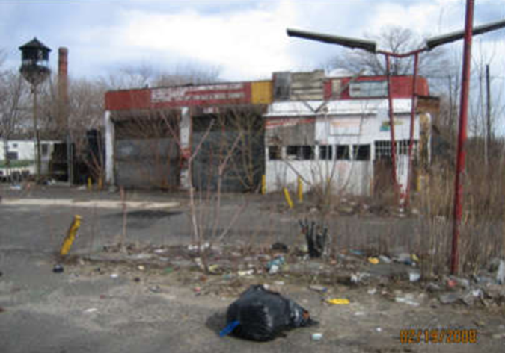
Abandoned Gas Station – Camden, NJ
Notes:
Remediation
Part of Rain Garden SEP

Slide 14
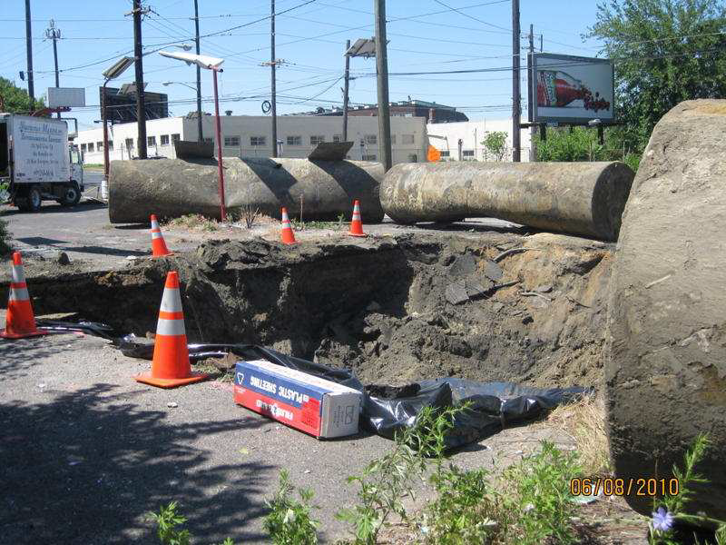
UST Removal
Notes:
Remediation
Part of Rain Garden SEP

Slide 15
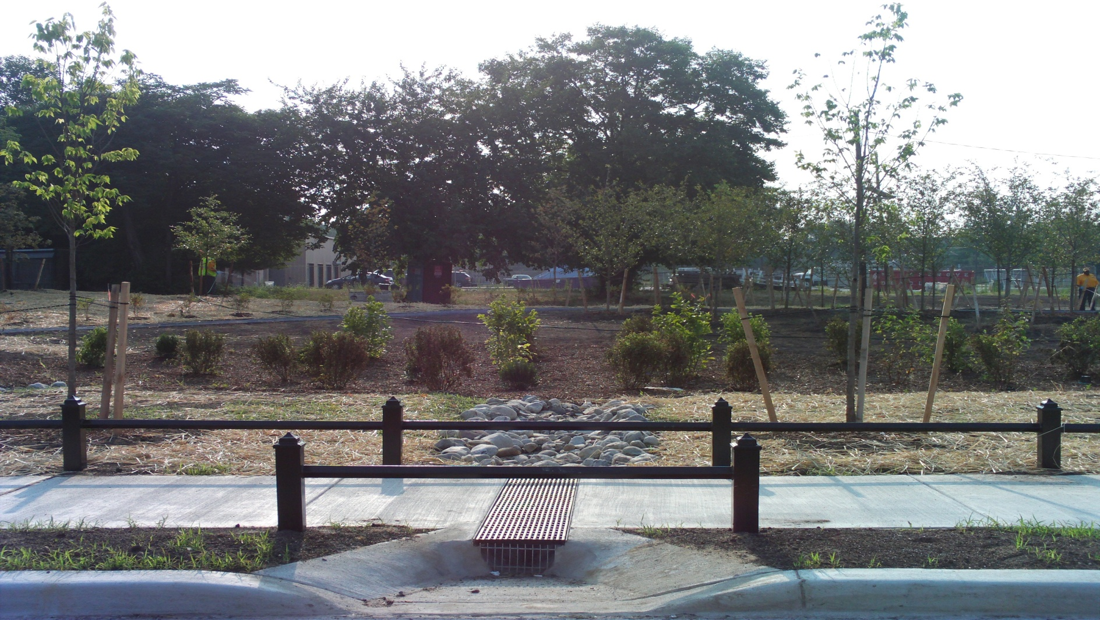
Stormwater from Street Directed to Rain Garden
Notes:
Environmental Enhancement
Located in an area with CSO problems. Helped alleviate some flooding in the area by re-directing rain water to garden up to 1 million gallons per year.

Slide 16
Green Space and Park Improvement
Notes:
Environmental Enhancement
Purchased 4 properties – demolished houses, re-graded, reseeded, and deed transferred to township
SEP funding $625,000

Slide 17
Barnegat Bay SEP
Buffer Plantings and Signage along Schoolhouse Branch of the Metedeconk River in Ocean County Park, Lakewood
Penalty from stack test violations

Slide 18
Other Examples
Rebates for Hybrid Cars
Indirect SEP
Diesel Particulate Filter
Electrification

Slide 19


