Slide 1

Top 10 Issues with Electronic Submittals
Presented by – Hiram Oser
ACE academy
New Jersey Department of Environmental Protection

Slide 2
10

Slide 3
10. Internet browsers that are compatible with NJDEP Online.

Slide 4
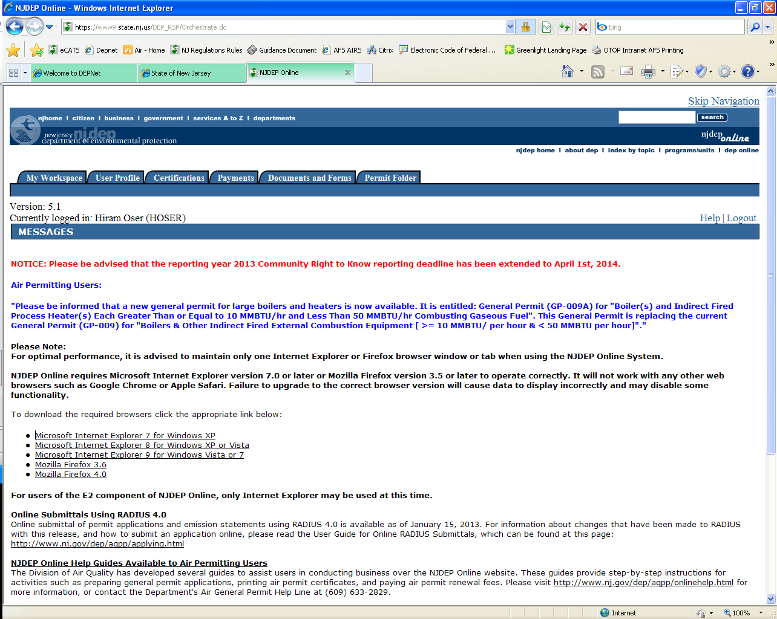

Slide 5

Good – IEv7

Slide 6

Good – MFv3.5

Slide 7

Wrong

Slide 8

Wrong

Slide 9
9

Slide 10
9. What do I do when I lose my Login info or PIN number?

Slide 11
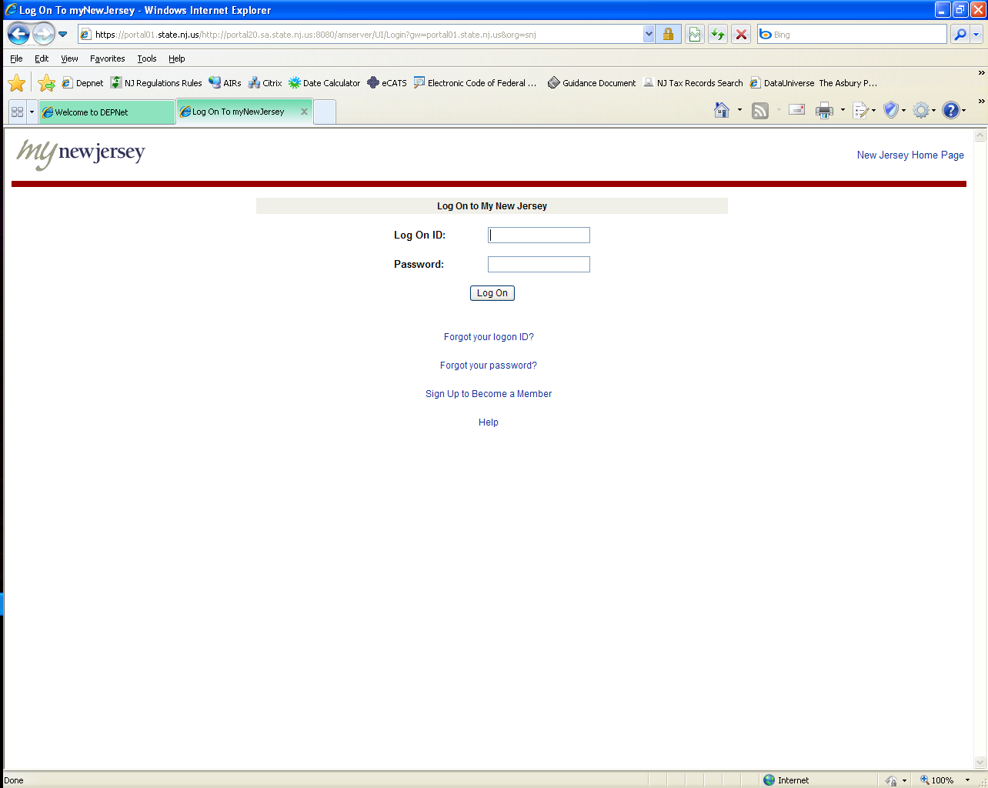

Slide 12
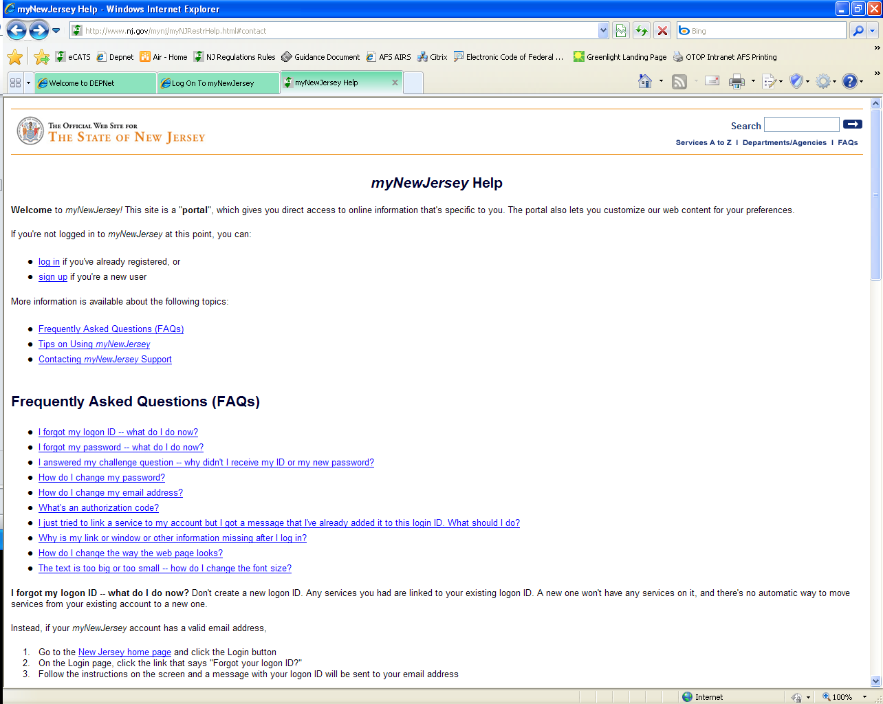

Slide 13
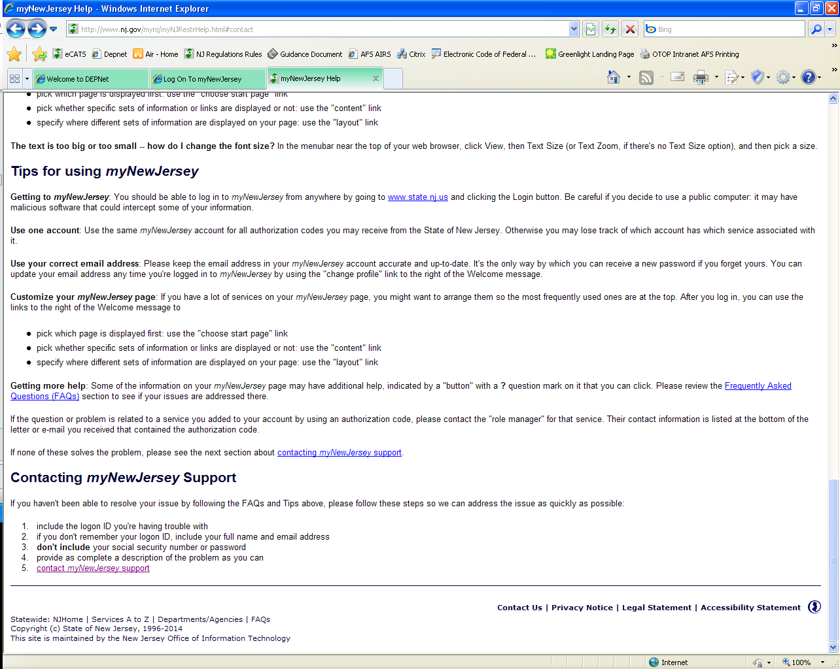

Slide 14
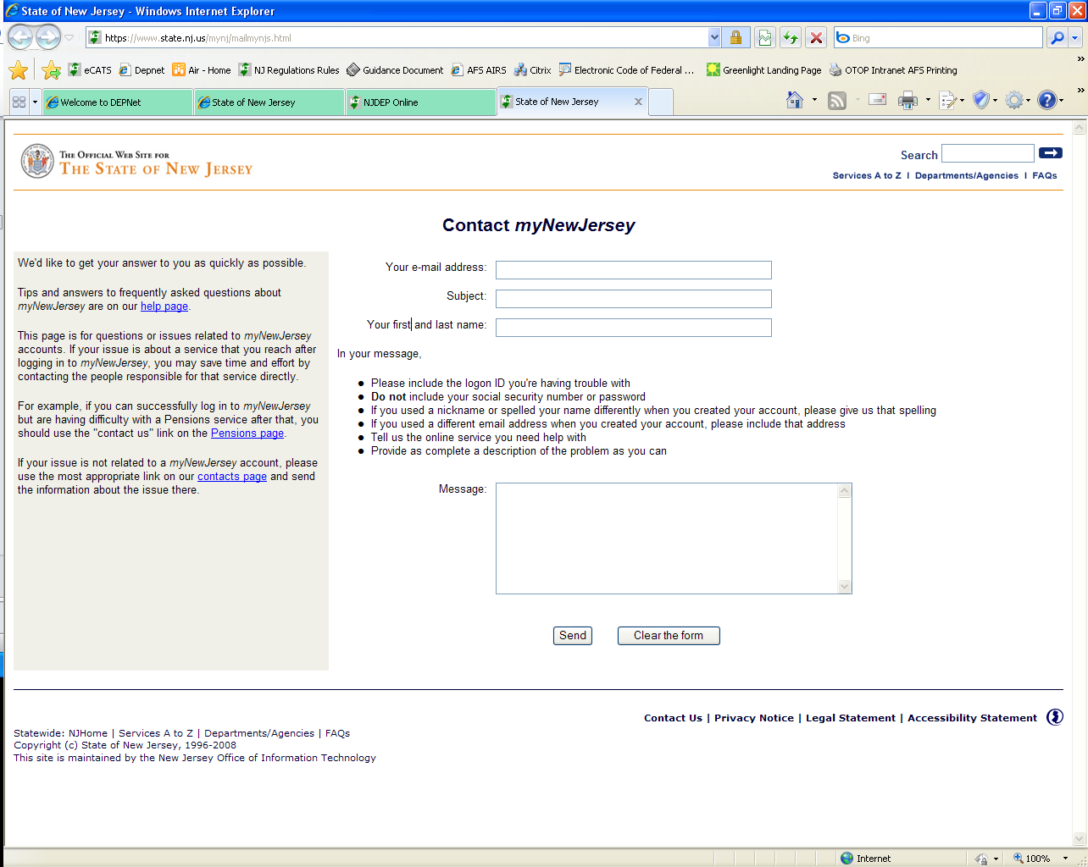
https://www.state.nj.us/mynj/mailmynjs.html

Slide 15
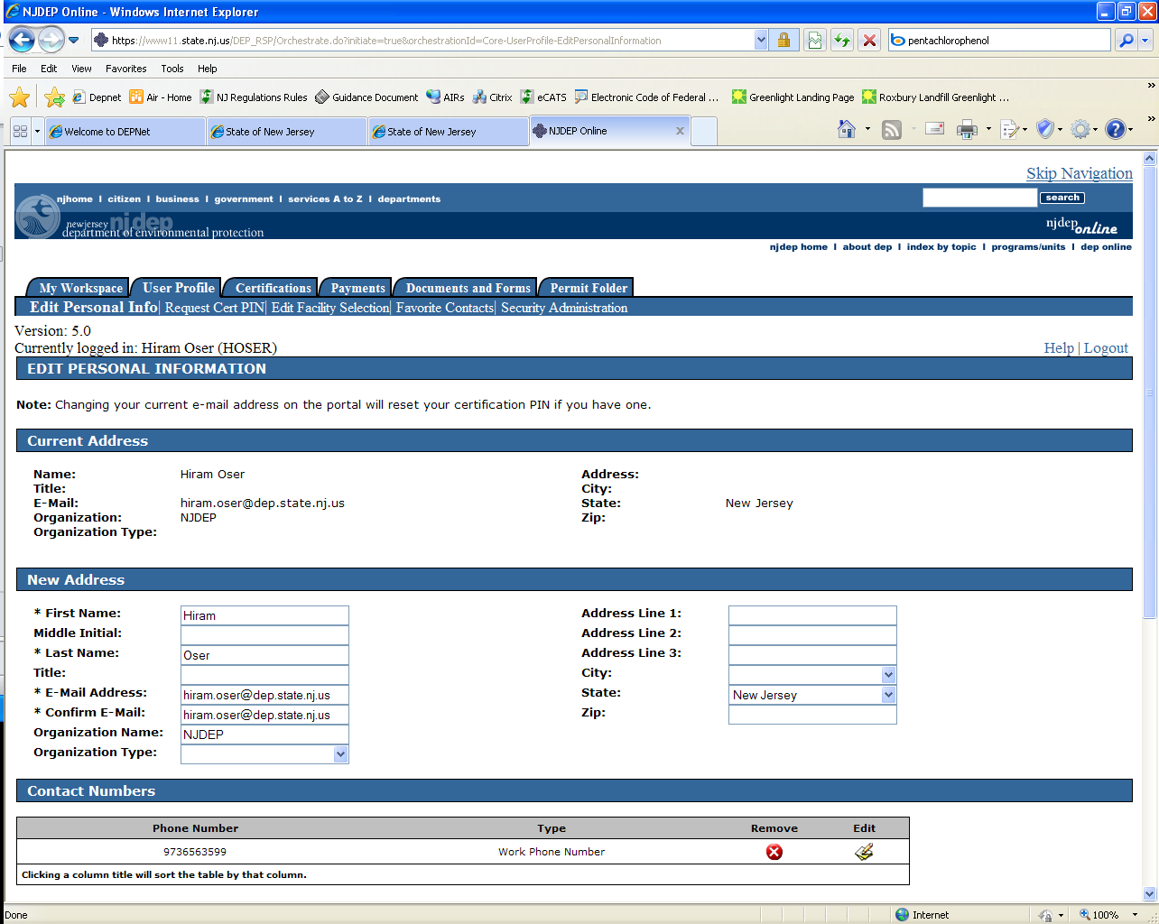

Slide 16
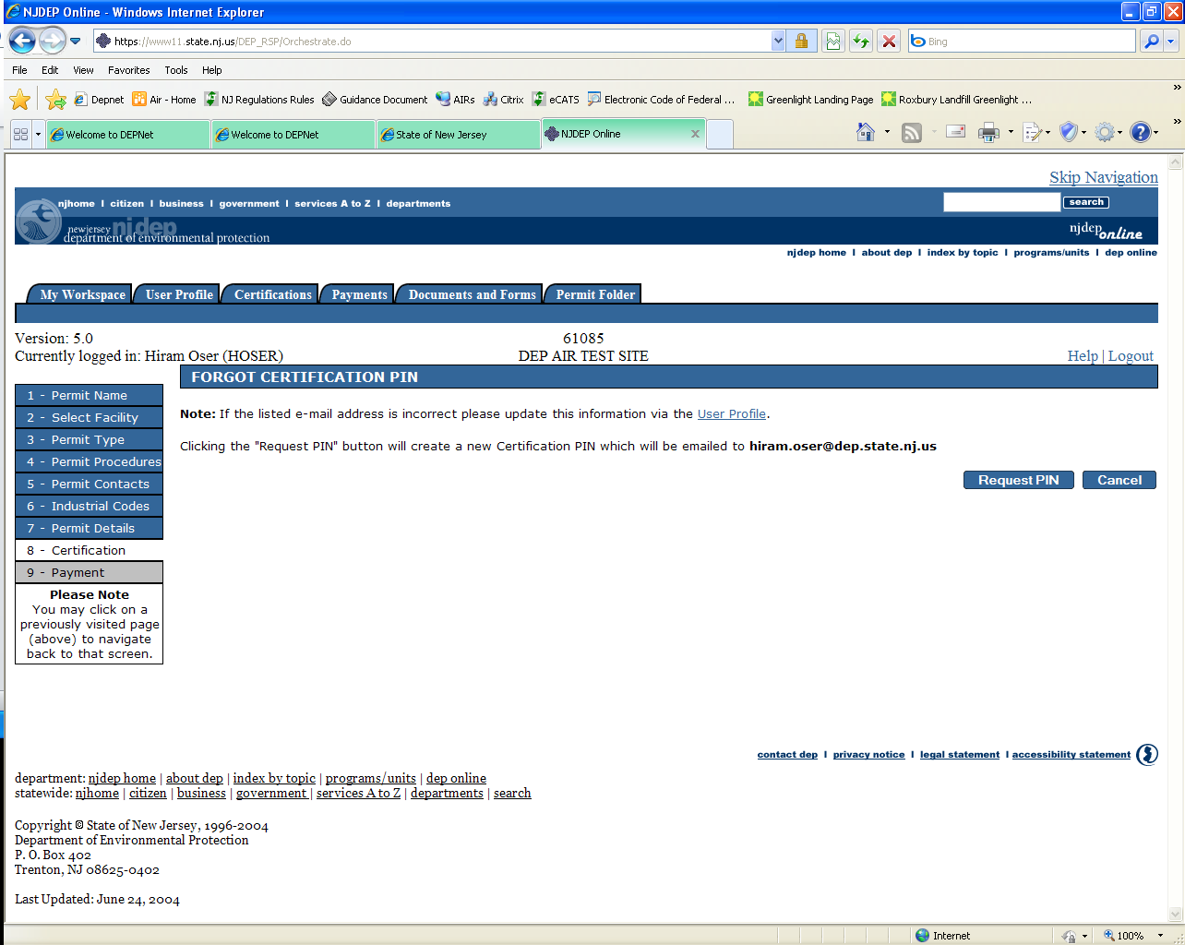

Slide 17
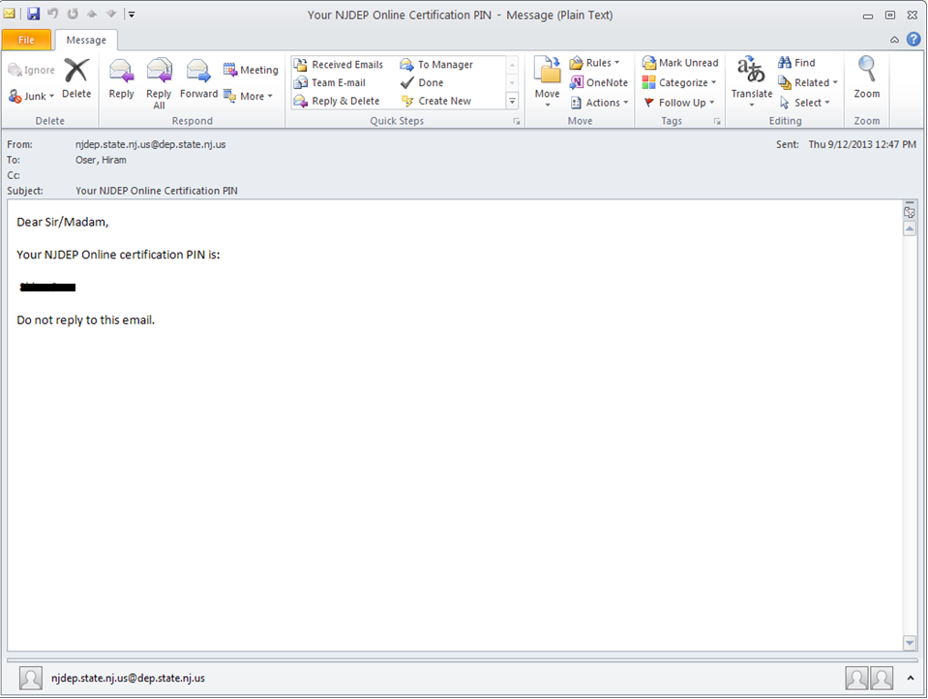
Old Portal Email Address: njdep.state.nj.us@dep.state.nj.us
New Portal Email address: portalcomments @dep.state.nj.us

Slide 18
8

Slide 19
8. Annual Compliance Certification spreadsheet must be downloaded from the NJDEP Portal.

Slide 20
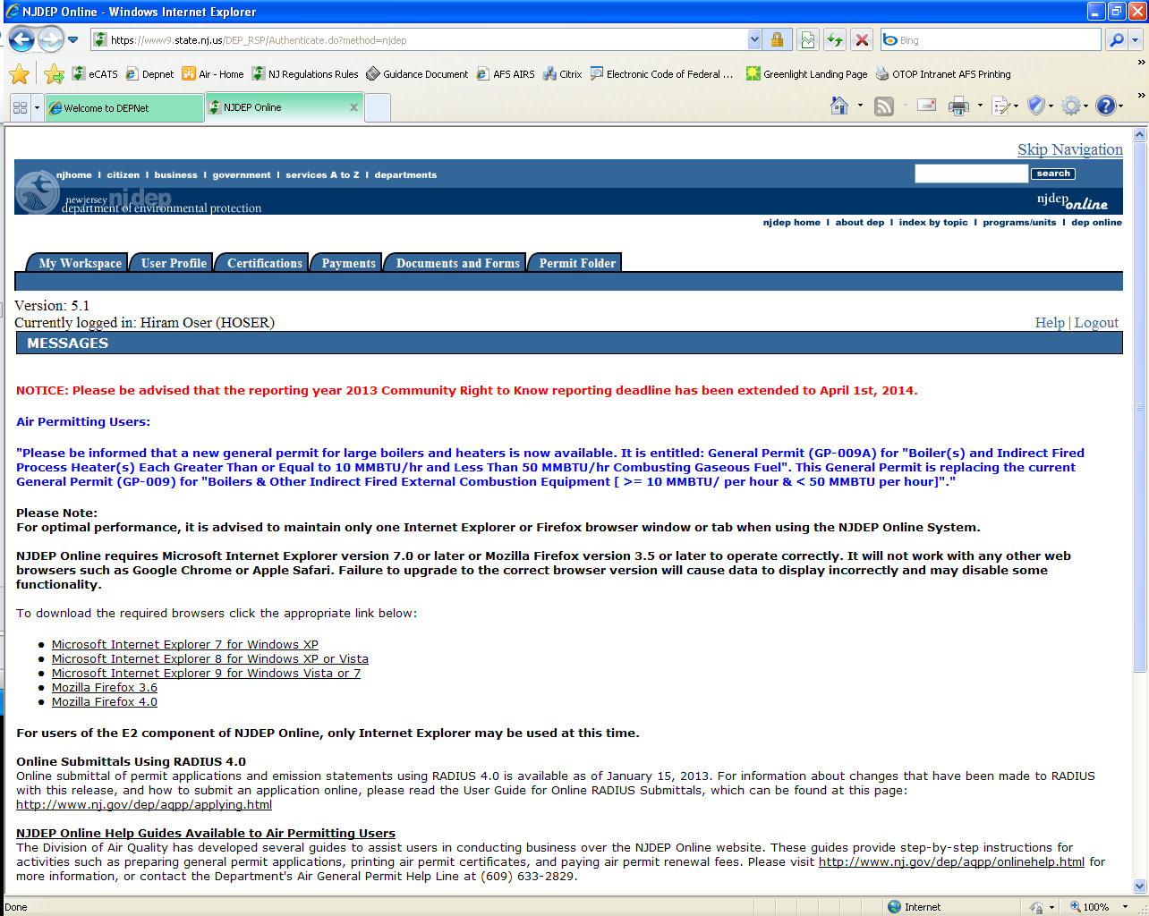

Slide 21
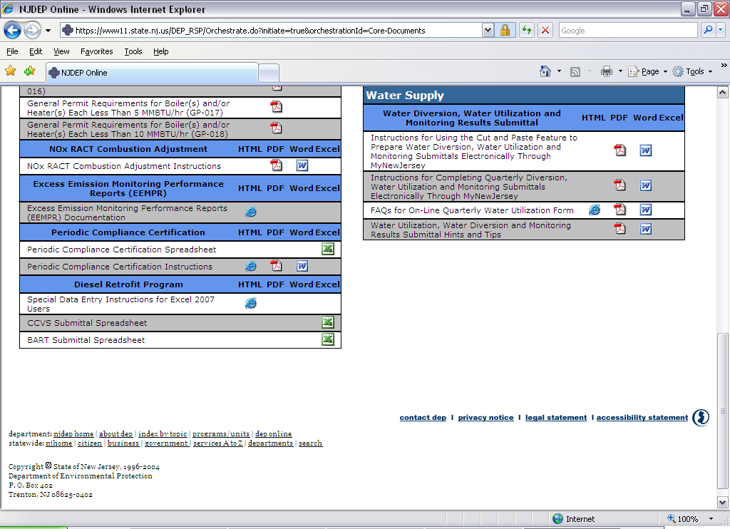

Slide 22
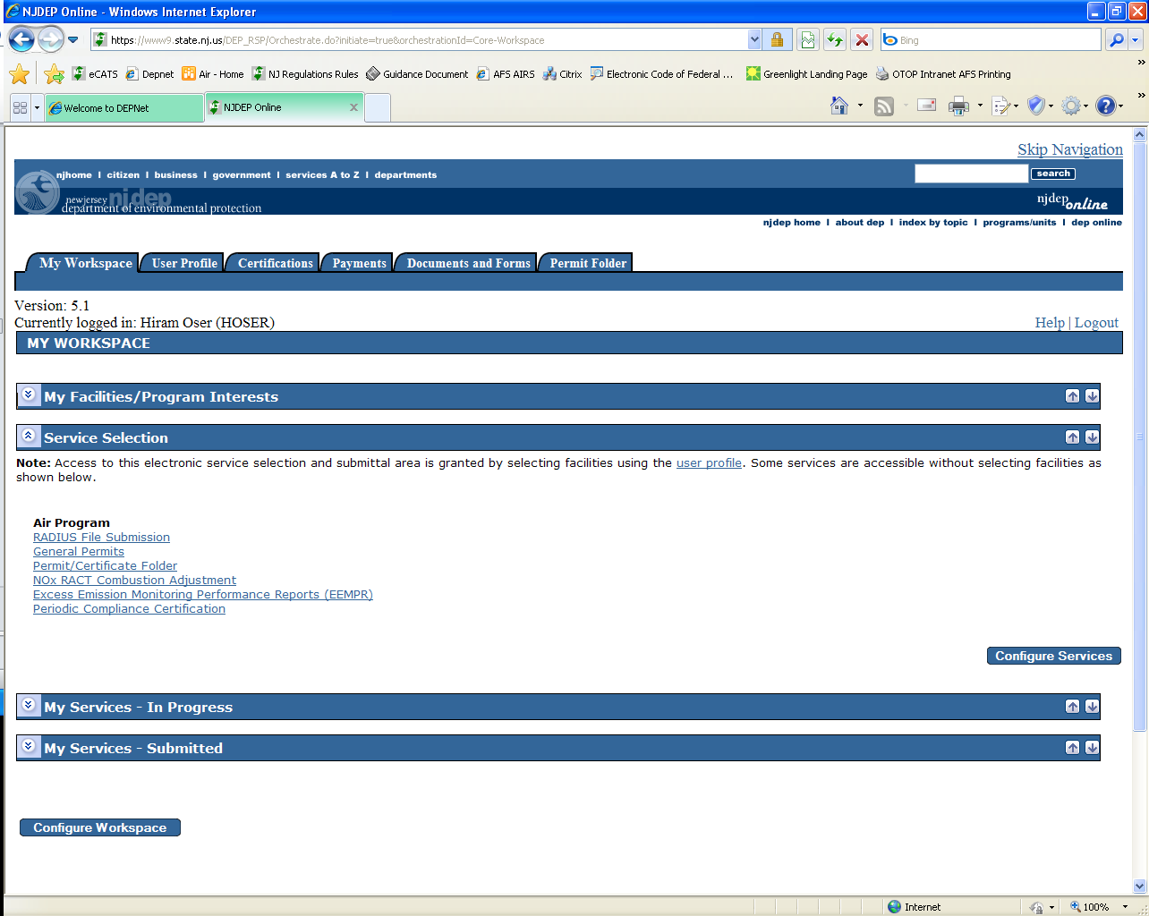

Slide 23
7

Slide 24
7. How do I get the paper forms of the Annual Compliance Certification?

Slide 25
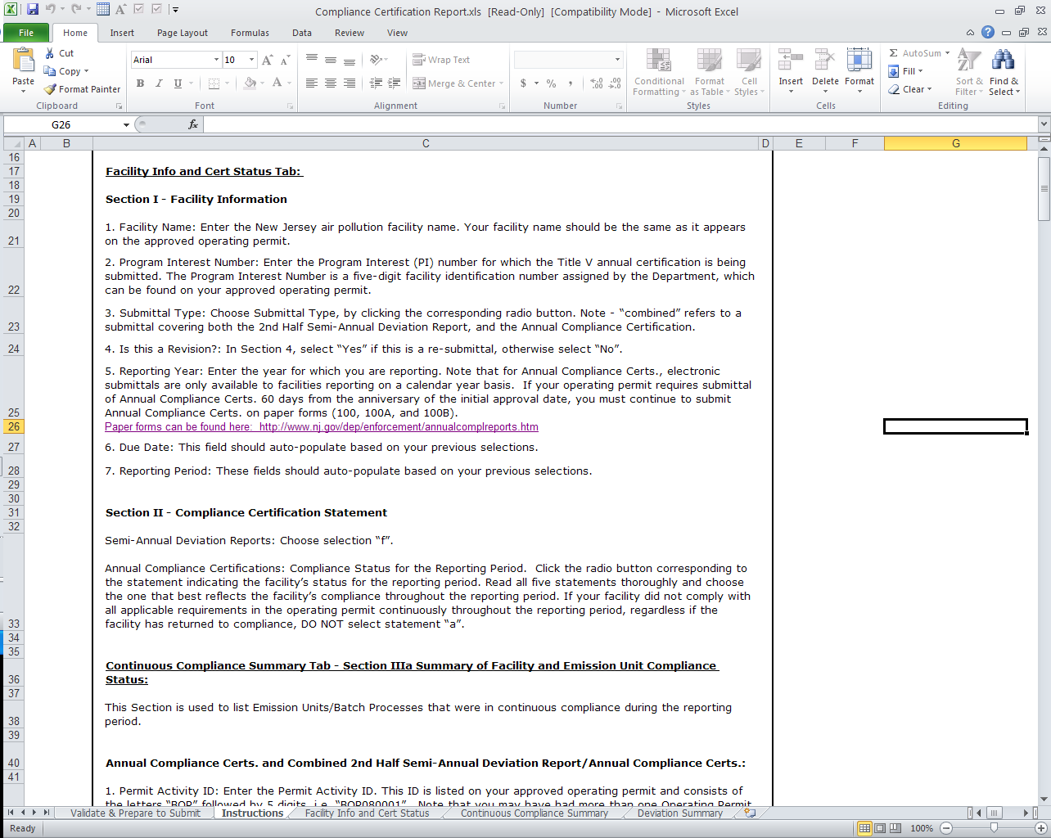

Slide 26
5. Reporting Year: Enter the year for which you are reporting. Note that for Annual Compliance Certs., electronic submittals are only available to facilities reporting on a calendar year basis. If your operating permit requires submittal of Annual Compliance Certs. 60 days from the anniversary of the initial approval date, you must continue to submit Annual Compliance Certs. on paper forms (100, 100A, and 100B).
Paper forms can be found here: http://www.nj.gov/dep/enforcement/annualcomplreports.htm

Slide 27
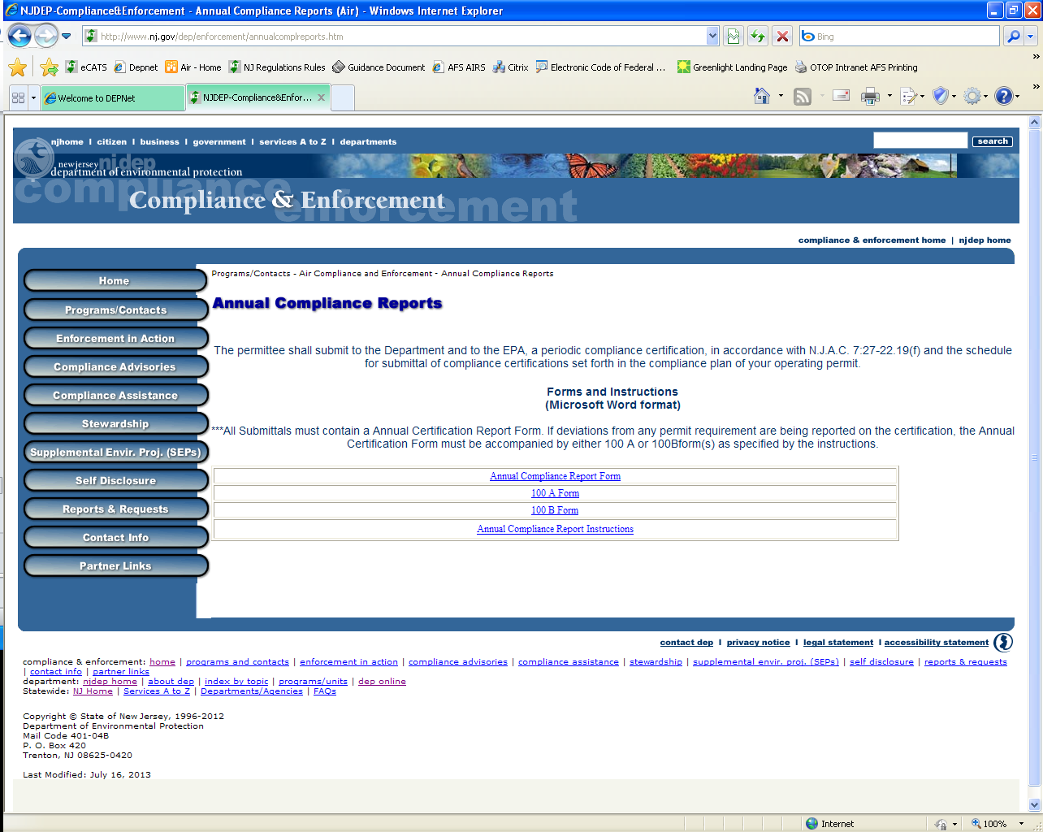

Slide 28
6

Slide 29
6. Do not change the file name or file type when saving to the computer.
For example: save as .xls rather than .xlsx

Slide 30
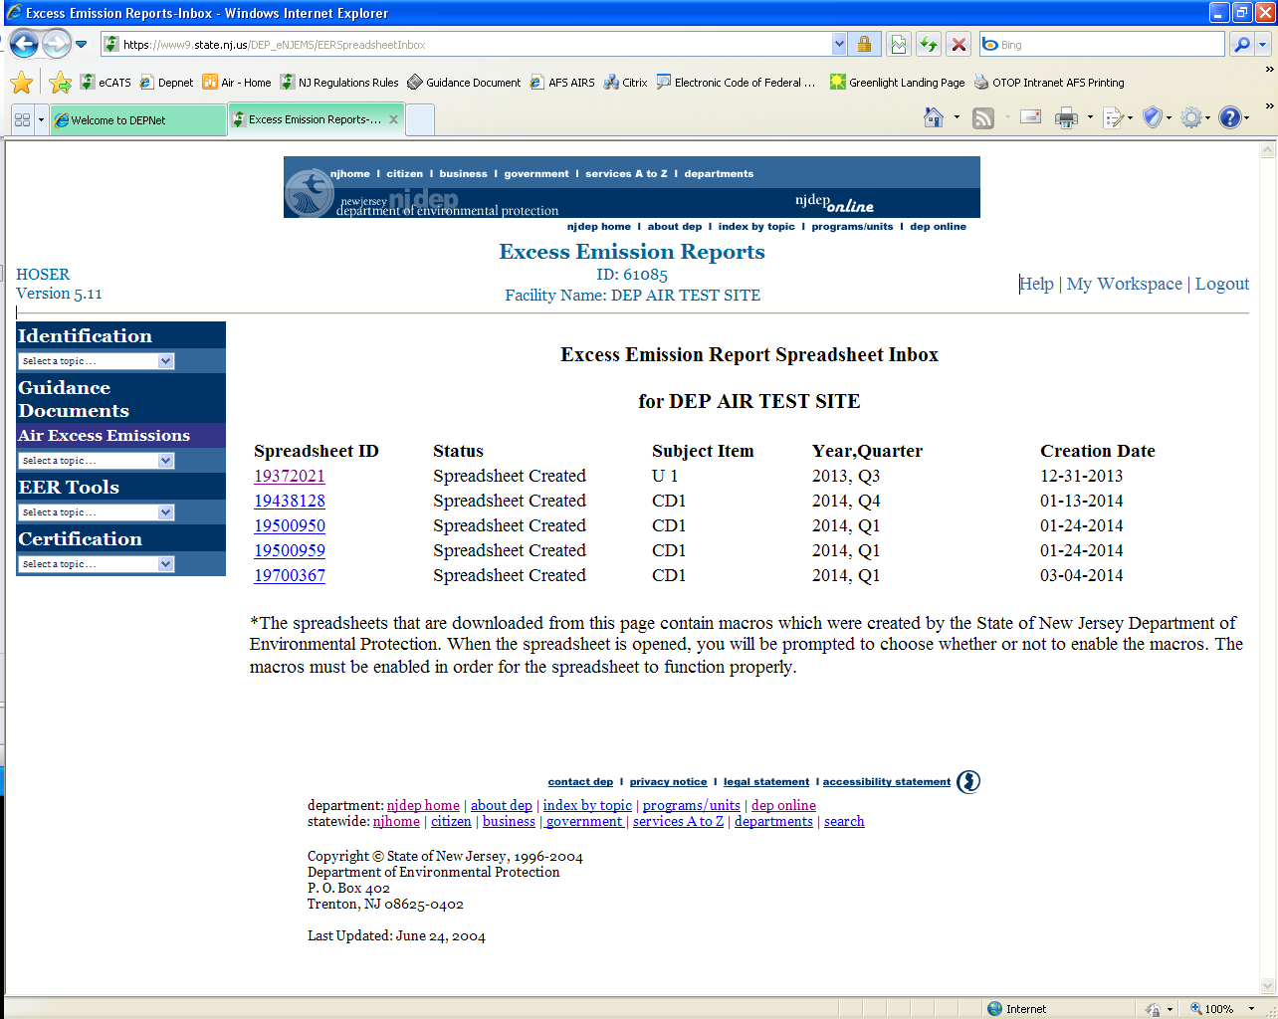
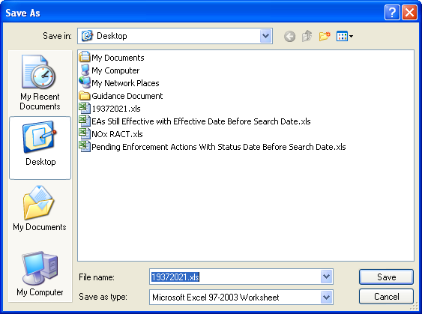

Slide 31
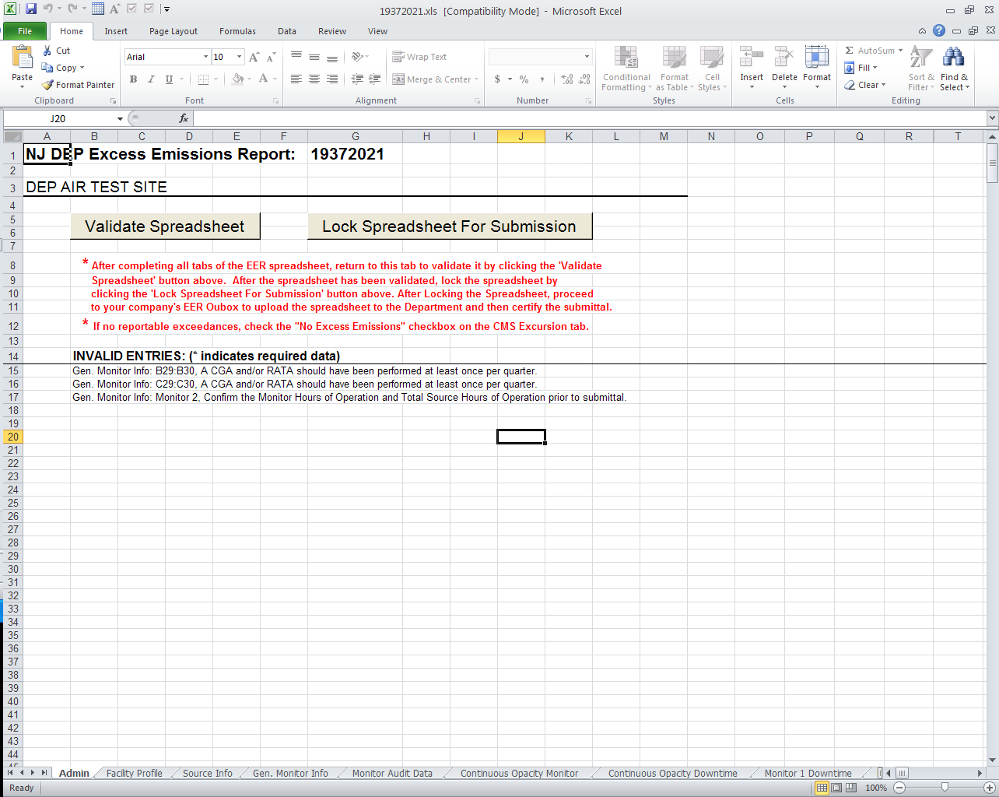
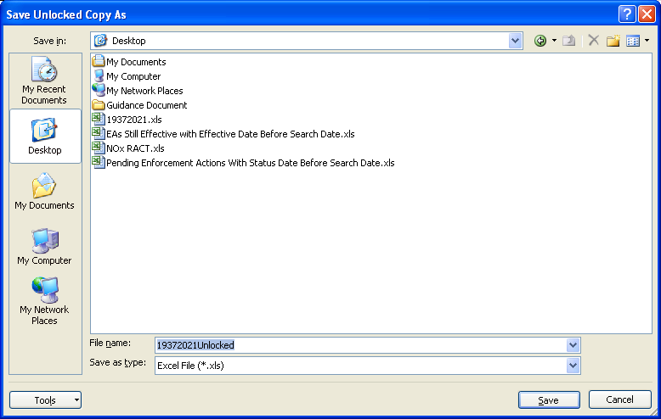

Slide 32
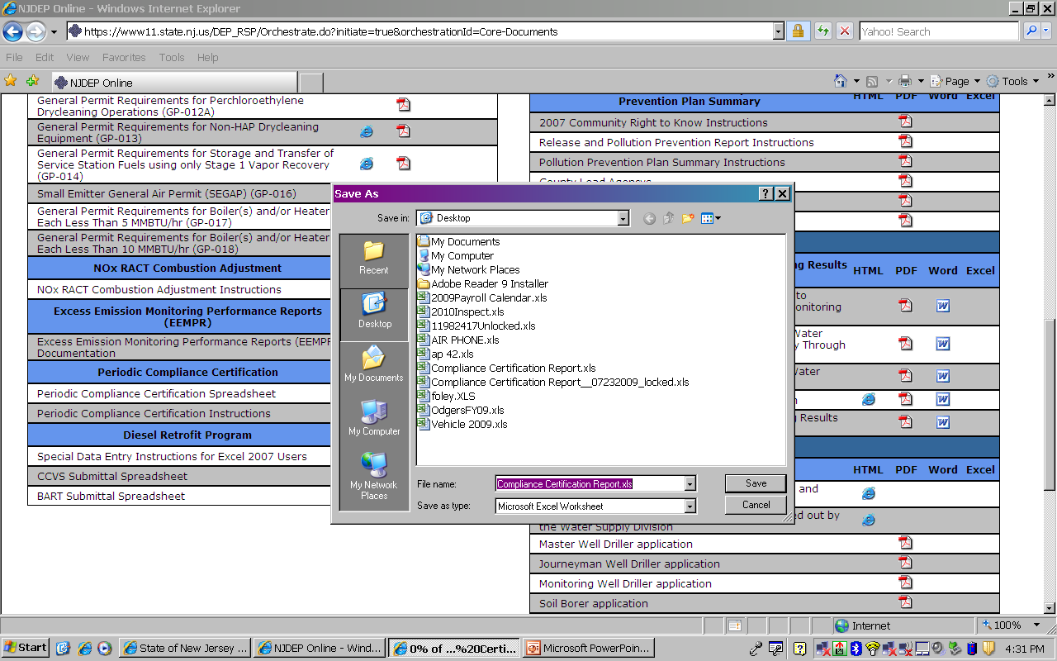
Do not change file name

Slide 33
5

Slide 34
5. Enable Macros.

Slide 35
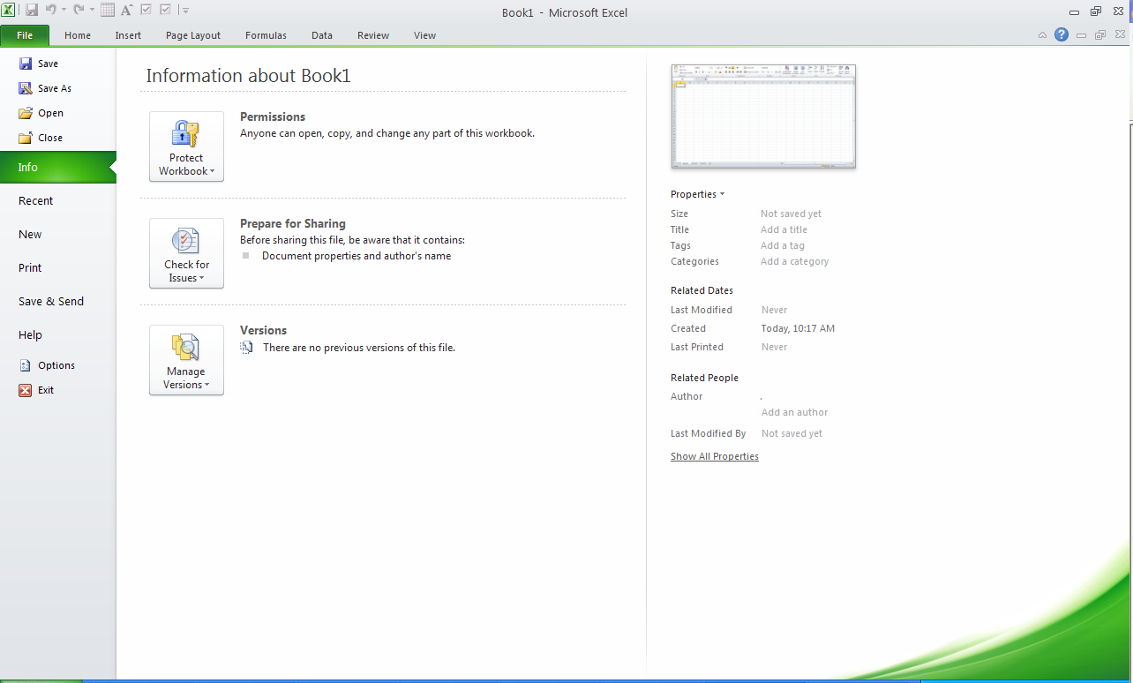

Slide 36
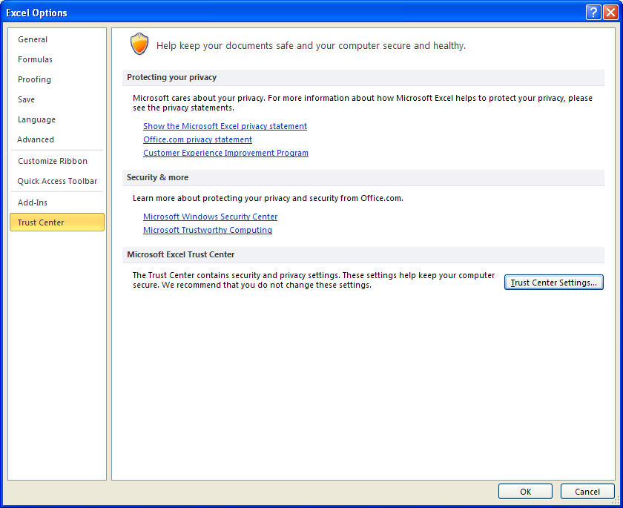

Slide 37
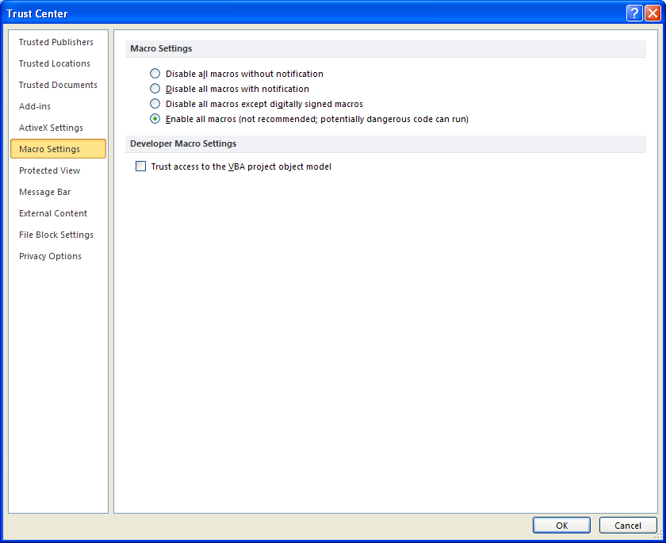

Slide 38
Open Excel Spreadsheet, Always Enable Macros
(Microsoft Office 2003)
MACROS: Upon opening the Excel Spreadsheet, always click Enable. You may need to lower security in order to enable Macros.
Go to Tools
Macros
Security
Low

Slide 39
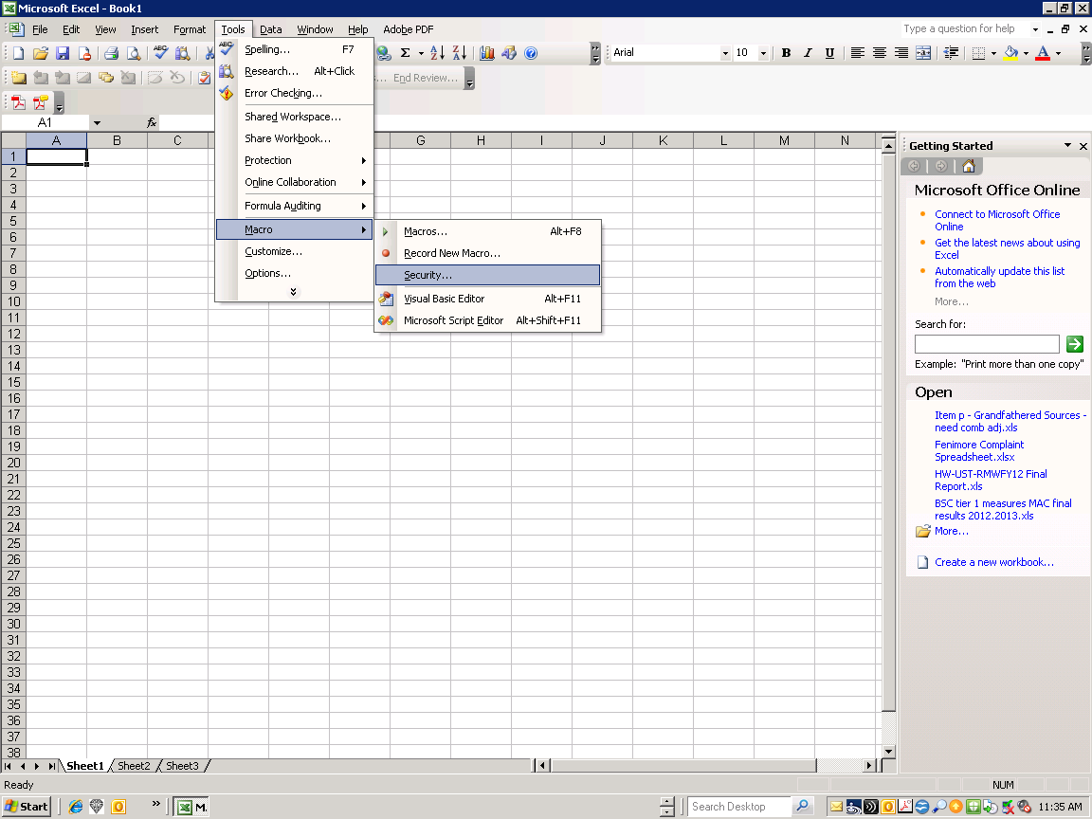

Slide 40
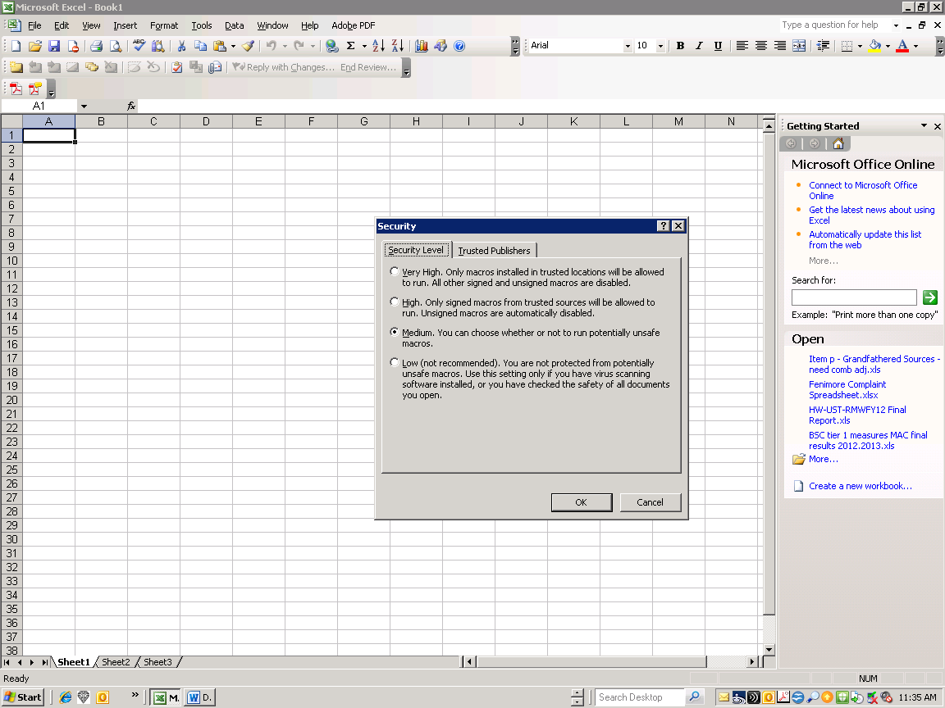

Slide 41
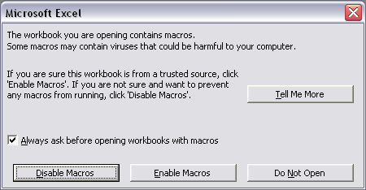
Open Excel Spreadsheet, Always Enable Macros
(Microsoft Office)
Notes:
Spreadsheet won’t work properly if Macros are disabled.

Slide 42
4

Slide 43
4. The source monitor downtime reported on the “General Monitor Info Tab” has to match the downtime reported in the “Monitor Downtime tab”.

Slide 44
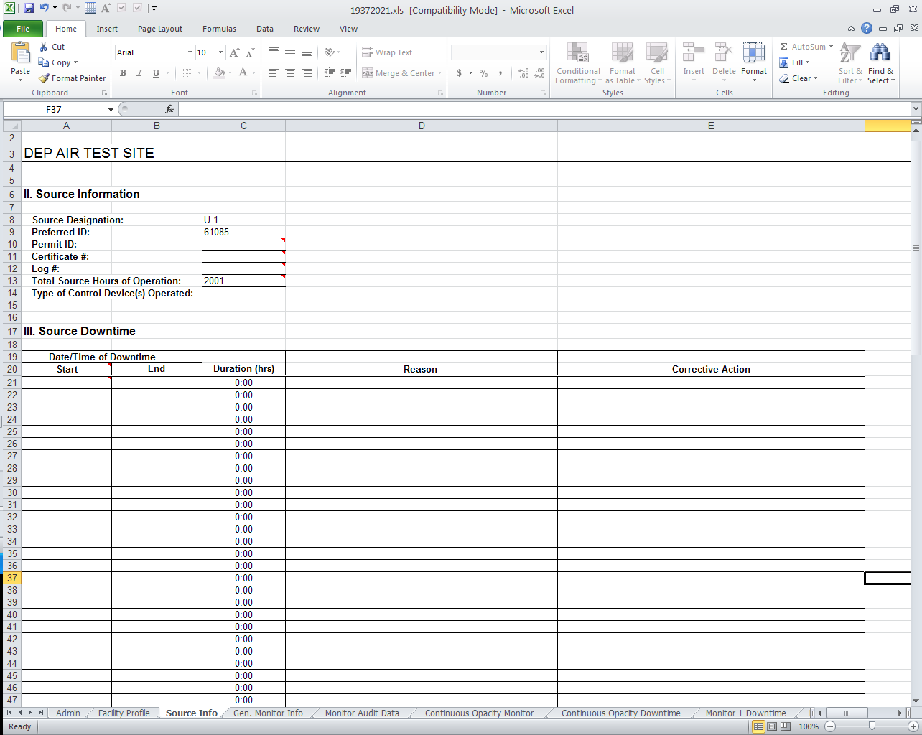

Slide 45
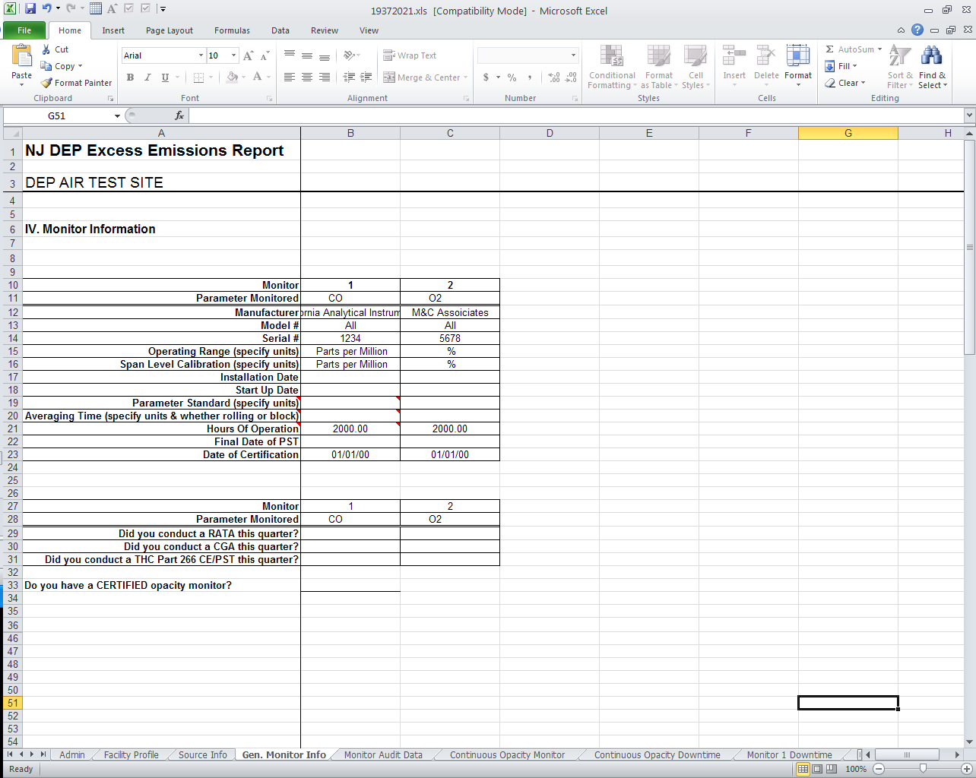

Slide 46
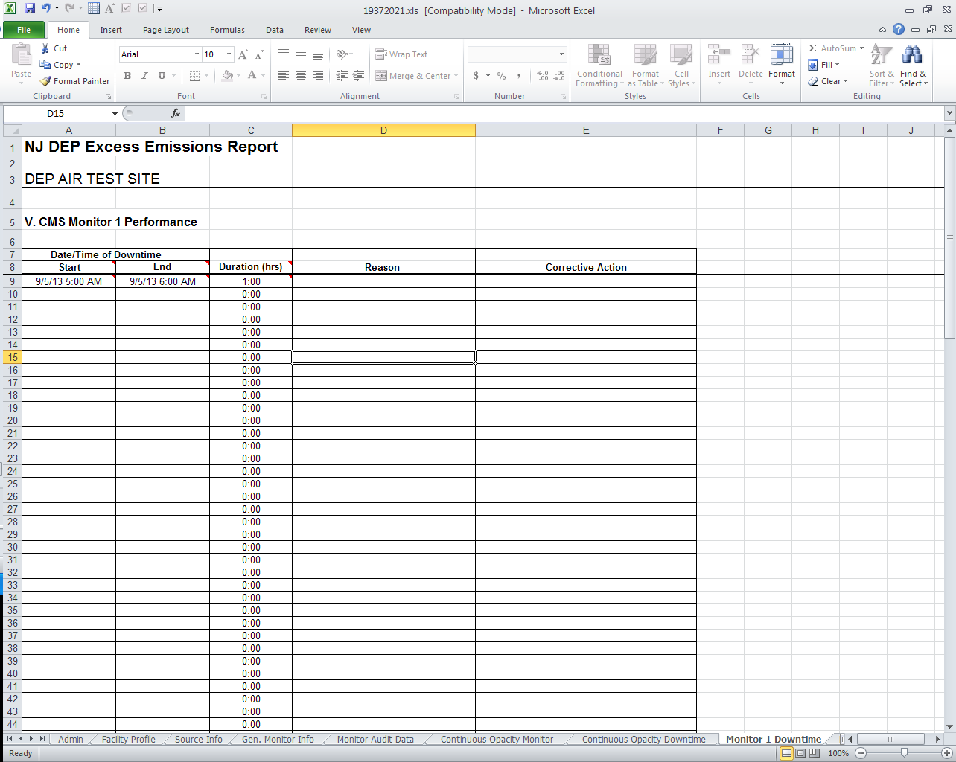

Slide 47
Use the red triangle on the top right corner of each cell to find out what info and format is required.

Slide 48
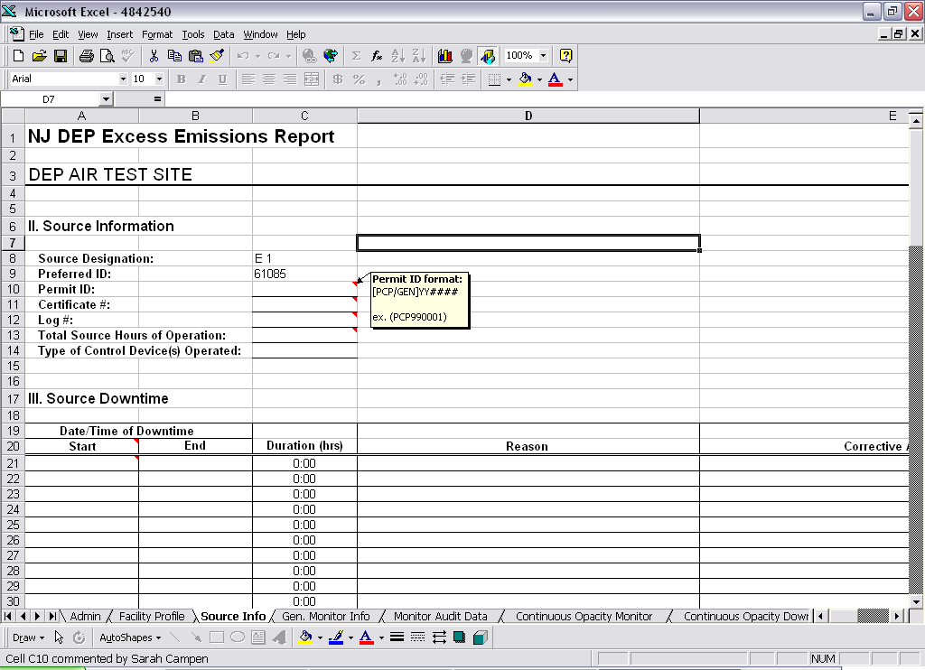

Slide 49
3

Slide 50
3. Annual Combustion Adjustment portal now can auto calculate lb/MMBTU.

Slide 51
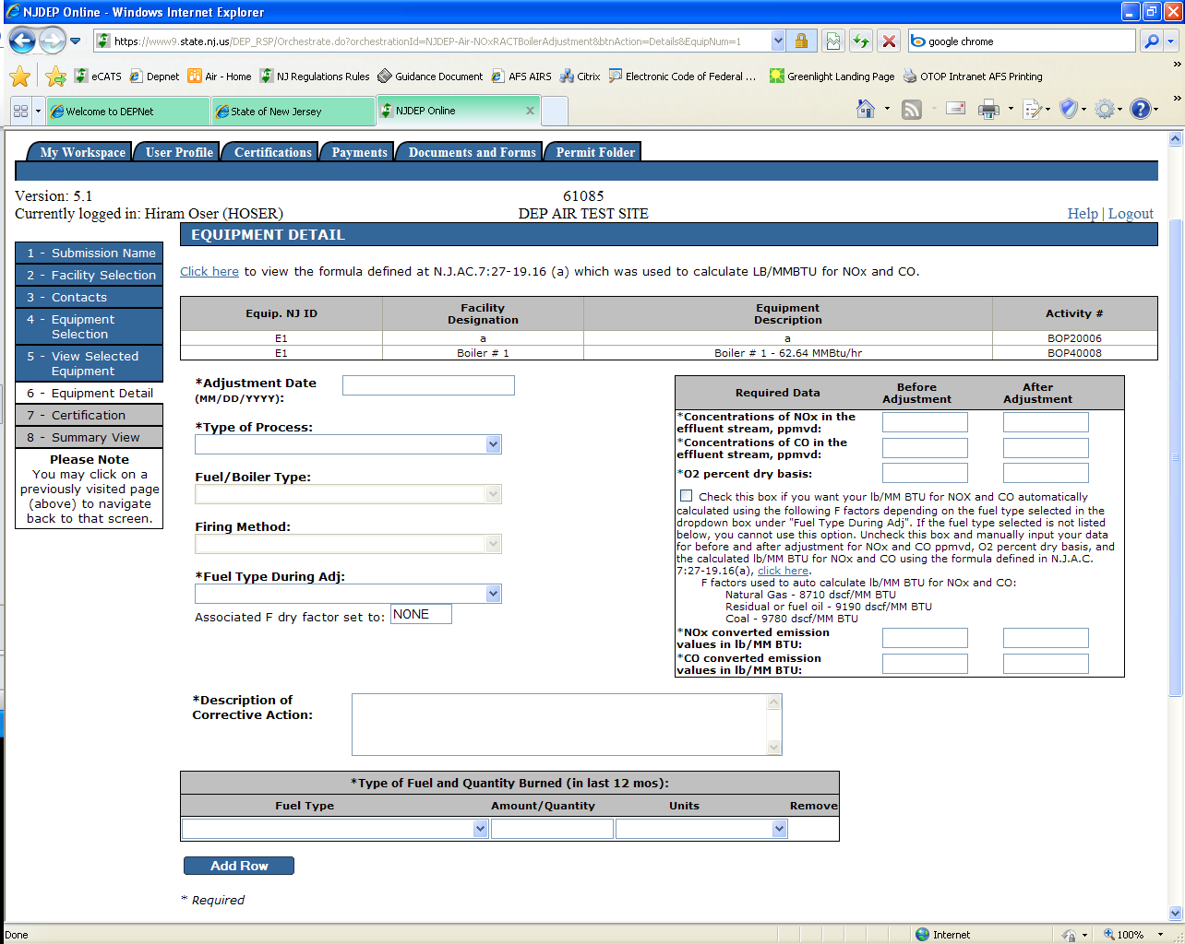

Slide 52
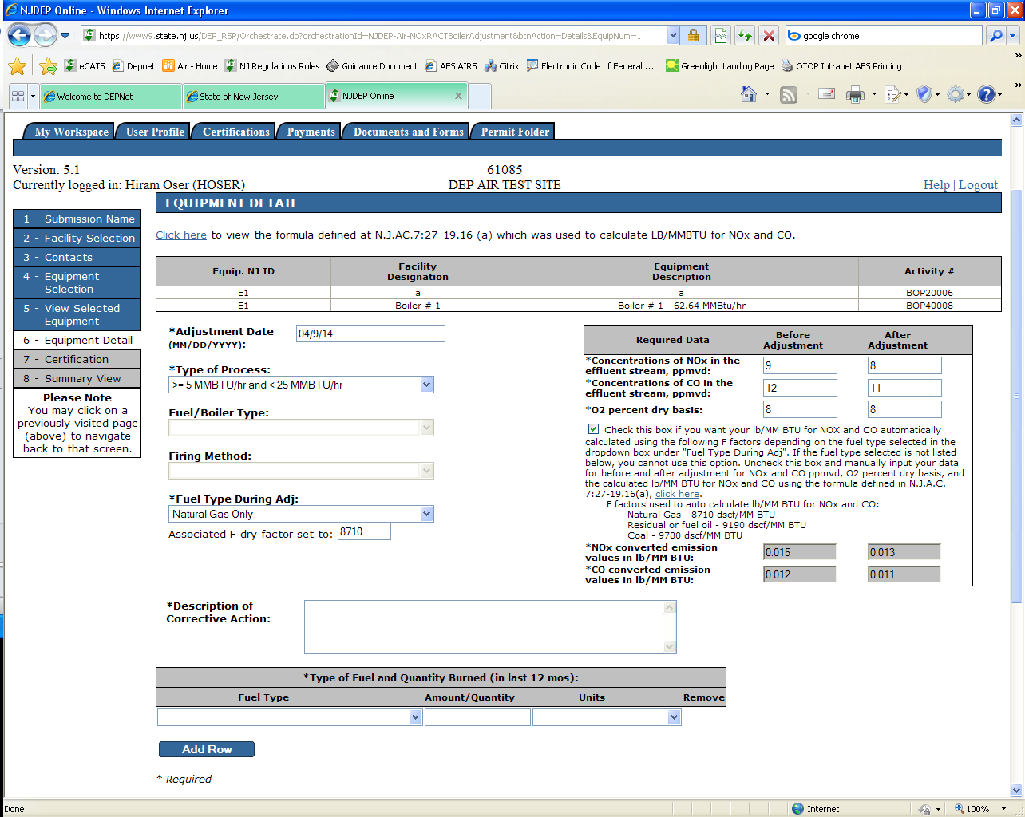

Slide 53
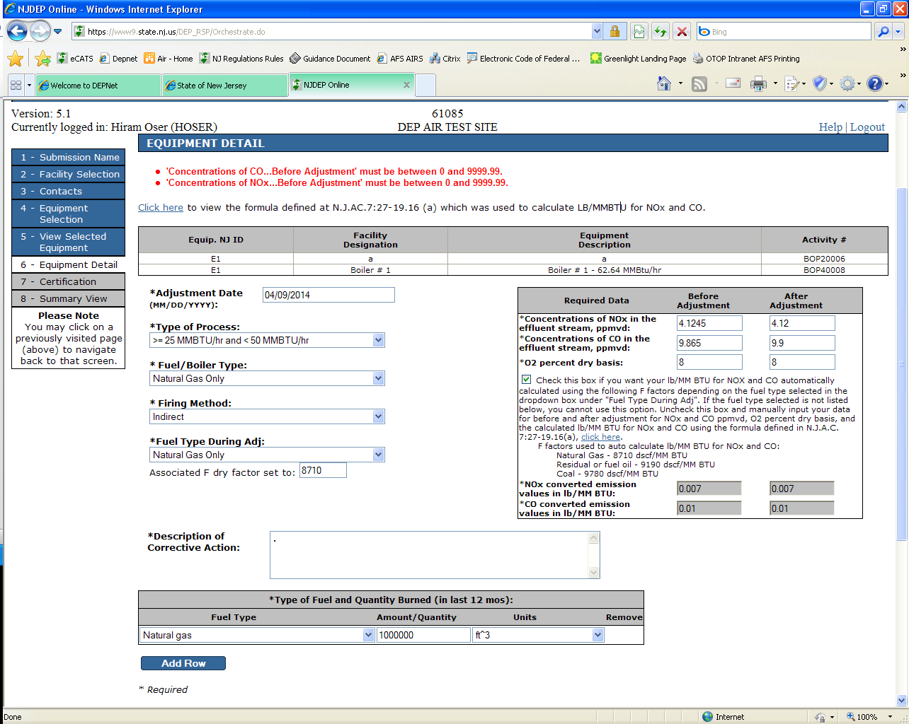
No
Yes

Slide 54
2

Slide 55
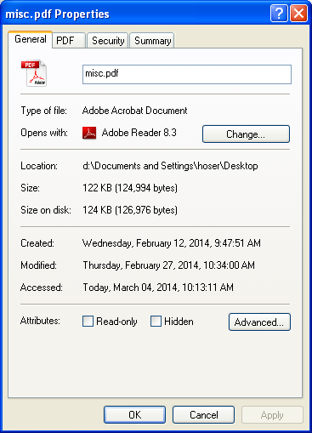
2. Attachments for electronic submittals should be under 2 MB.

Slide 56
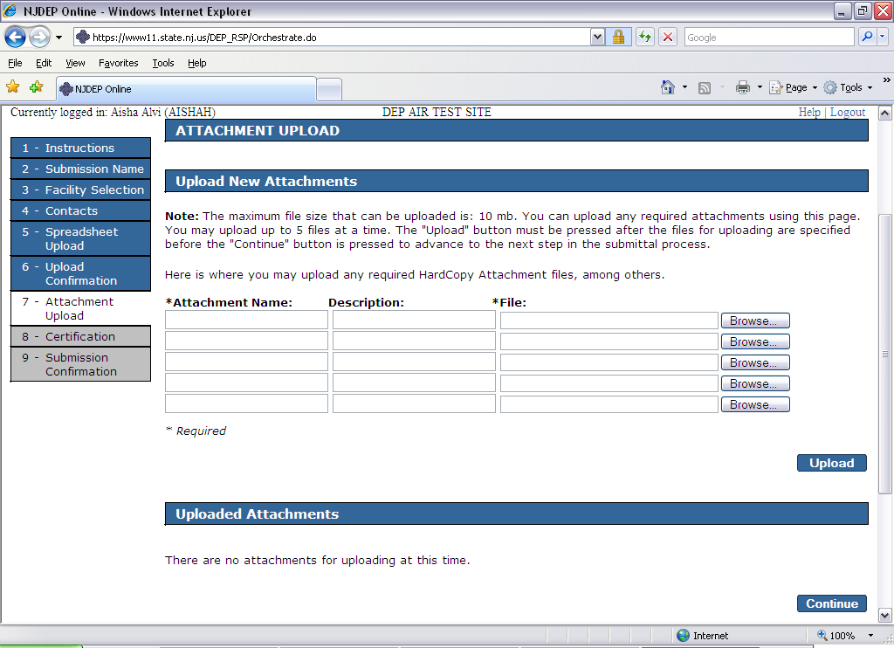

Slide 57
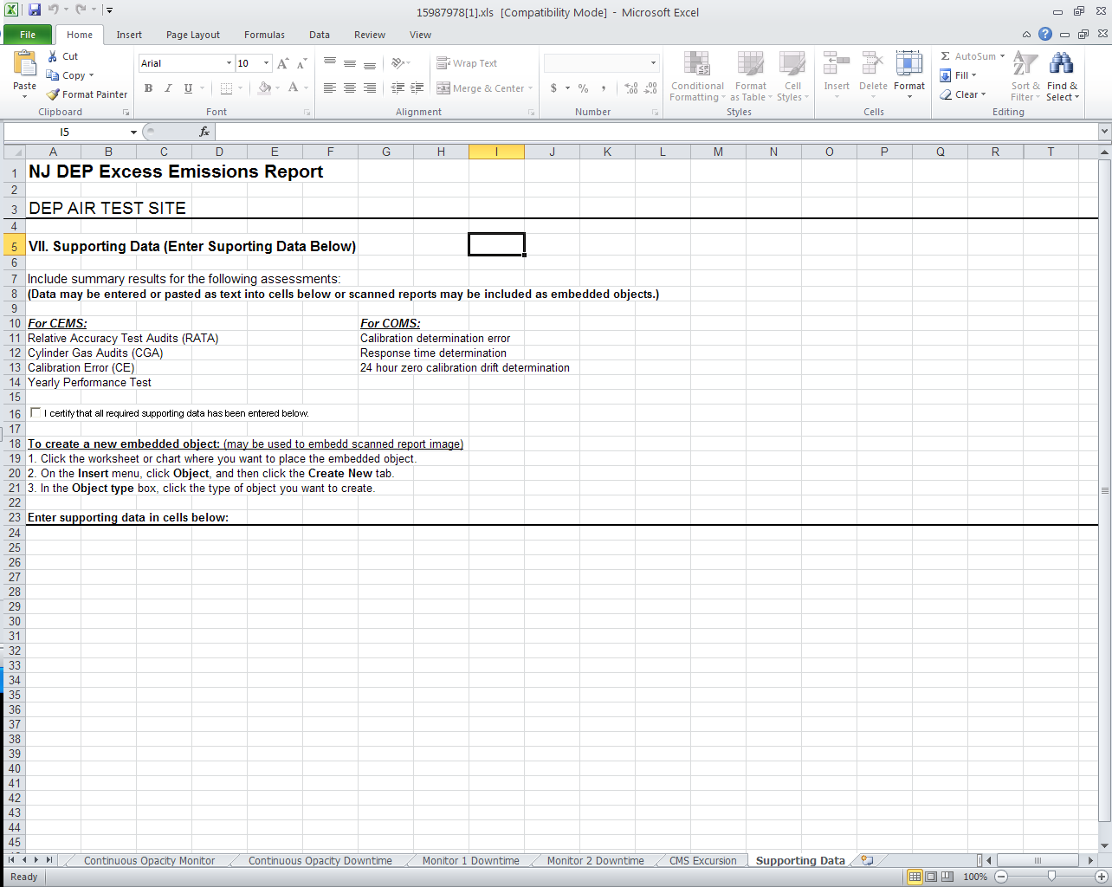

Slide 58
1

Slide 59
1. After both individuals certify the submittal click on the ‘Continue’ button to finish.

Slide 60
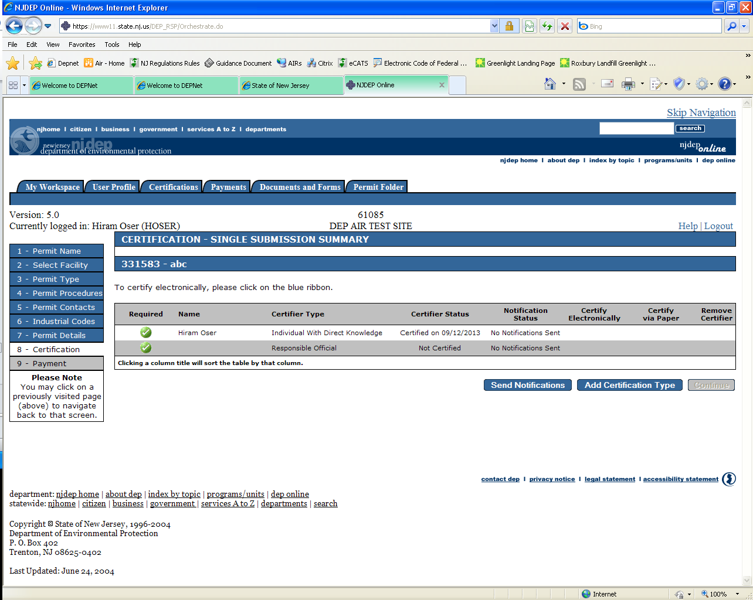

Slide 61
AIR Compliance & Enforcement Regional Contact Information:
Northern Regional Office
Vanessa Day, Manager
phone (973) 656-4444 7 Ridgedale Ave
fax (973) 656-4080 Cedar Knolls, NJ 07927 (Bergen, Essex, Hunterdon, Hudson,
Morris, Passaic, Somerset, Sussex,
Union, and Warren counties)
Central Regional Office
Christopher Odgers, Manager
phone (609) 292-3187 Mail Code 22-03A Mail Code 22-03A
fax (609) 292-6450 PO Box 420 401 East State St (Burlington, Mercer, Middlesex, Trenton, NJ 08625-0420 Trenton, NJ 08625 Monmouth, and Ocean counties) (Standard Mail) (FedEx/UPS)
Southern Regional Office
Mary Toogood, Interim Manager
phone (856) 614-3601 2 Riverside Drive - Suite 201
fax (856) 614-3613 Camden, NJ 08103
(Atlantic, Camden, Cape May,
Cumberland, Gloucester, and Salem counties)

