Slide 1
Start Strong: Fall 2022 Administrations <Insert District Name> <Insert Date Of Presentation>
Support in
IdentifyingStudent
Needs

Slide 2
Start Strong Assessment Overview
Start Strong Fall 2022 assessments:
Produced information to be used as a standards-based complement to the resources used by educators in their classrooms to evaluate the needs of students.
Were administered quickly, in person, and provided immediate results.
Start Strong Fall 2022 assessments do not:
Replace local standards-based benchmark assessments districts may already have in place.
Replace the spring 2023 New Jersey Student Learning Assessments (NJSLA) statewide summative assessments or are predictive of their results.

Slide 3
Start Strong Test Design
Based on a subset of prioritized prior-year academic standards to provide a data point on the level of support a student may need to engage in grade-level content.
Example: Grade 5 ELA Start Strong assessment is aligned to a subset of the NJSLS for Grade 4 ELA.
Example: Algebra I Start Strong assessment is aligned to Grade 8 learning standards relevant to algebraic concepts.
Used released high-quality items from the NJSLA item bank
Contained efficient question types to produce on-demand results for educators
Could be administered in 45–60 minutes
Note: The test design, which allowed for shortened testing time and immediate results, means that Start Strong results must be interpreted and used differently than NJSLA results. They do not cover the breadth and depth of standards as seen on the NJSLA and do not support the same comparisons or inferences about student proficiency.

Slide 4
Start Strong Grade And Content Alignment (1 of 4)
English language arts - Grade Enrollment
If the student is currently enrolled in.... | the student should be assigned the Start Strong... | which is based on...
Grade 4 | ELA04 | Grade 3 ELA content
Grade 5 | ELA05 | Grade 4 ELA content
Grade 6 | ELA06 | Grade 5 ELA content
Grade 7 | ELA07 | Grade 6 ELA content
Grade 8 | ELA08 | Grade 7 ELA content
Grade 9 | ELA09 | Grade 8 ELA content
Grade 10 | ELA10 | Grade 9 ELA content

Slide 5
Start Strong Grade And Content Alignment (2 of 4)
Mathematics – Grade Enrollment
If the student is currently enrolled in... | the student should be assigned the Start Strong... | which is based on... | and the student should be provided the... | and...
Grade 4 | MAT04 | Grade 3 Math content | N/A | No calculator
Grade 5 | MAT05 | Grade 4 Math content | N/A | No calculator
Grade 6 | MAT06 | Grade 5 Math content | Start Strong Math Grade 6 Mathematics Reference Sheet | No calculator
Grade 7 | MAT07 | Grade 6 Math content | Start Strong Math Grade 7 Mathematics Reference Sheet | Four-function calculator
Grade 8 | MAT08 | Grade 7 Math content | Start Strong Math Grade 8 Mathematics Reference Sheet | Four-function calculator

Slide 6
Start Strong Grade And Content Alignment (3 of 4)
Mathematics – Course Enrollment
If the student is currently enrolled... | the student should be assigned the Start Strong... | which is based on... | and the student should be provided with the... | and...
Algebra I | ALG01 | Grade 8 Math content with a focus on standards relevant to algebraic concepts | Start Strong Algebra I and Geometry Mathematics Reference Sheet | Scientific calculator
Geometry | GEO01 | Grade 8 Math content with a focus on standards relevant to geometric concepts | Start Strong Algebra I and Geometry Mathematics Reference Sheet | Scientific calculator
Algebra II | ALG02 | Algebra I content | Start Strong Algebra II Mathematics Reference Sheet | Graphing calculator

Slide 7
Start Strong Grade And Content Alignment (4 of 4)
Science – Grade Enrollment
If the student is currently enrolled in... | the student should be assigned the Start Strong... | which is based on... | and should be provided with the... | and...
Grade 6 | SC06 | Grade 3 through 5 Science content | N/A | Four-function calculator
Grade 9 | SC09 | Middle School Science content | Periodic Table of Elements | Scientific calculator
Grade 12 | SC12 | High School Science content | Periodic Table of Elements | Graphing calculator

Slide 8
Start Strong Result Interpretation Considerations (1 of 2)
When publicly reporting assessment results, consider the impacts of COVID-19 on learning.
Districts should not compare any individual student/school/district Start Strong data to any NJSLA data.
Please note that the Start Strong assessments were not designed to predict future student performance on the NJSLA, nor was it designed to estimate what score a student would have received if they had taken the NJSLA in spring 2022.

Slide 9
Start Strong Result Interpretation Considerations (2 of 2)
Start Strong assessments provide a data point to support:
District-level curriculum planning and revisiting prerequisite concepts and skills
Evaluating scope and sequence based on distribution of student support needs
Providing professional learning supports for differentiation and scaffolding based on student results, aligned to principles and practices outlined in the NJDOE Learning Acceleration Guide
Using the Individual Student Reports (ISRs) for conversations between parents and educators on where their child might need support at the beginning of the school year

Slide 10
District And School Context That Impacted Start Strong Data
The Department encourages districts to clearly and prominently provide information about the context of Start Strong data, including its limitations as a result of the pandemic or other factors.
As always, assessment data should be analyzed alongside other important measures of student outcomes, like benchmark assessments, teacher-created formative assessments, and attendance data to provide a more complete perspective on resources, support, and student success.

Slide 11
Example: Results in Context Start Strong Fall 2022 School- & Grade-Level Outcomes English Language Arts Grade 4 — Support Levels
ELA 04 | More Support Needed (Count) | More Support Needed (Percentage) | Some Support Needed (Count) | Some Support Needed (Percentage) | Less Support Needed (Count) | Less Support Needed (Percentage)
Blue Elementary | 50 | 41.67% | 50 | 41.67% | 20 | 16.67%
Green Elementary* | 30 | 37.5% | 40 | 50% | 10 | 12.5%
Orange Elementary*1 | * | * | * | * | * | *
Critical Data Considerations: Due to periods of individual and/or school quarantine during the testing window, test results from Green and Blue Elementary Schools may not be representative of the student population. Results are for reporting purposes only and should not be used to draw conclusions about student performance or for comparison purposes.
Note 1: Orange Elementary School’s testing population for ELA Grade 4 did not meet the threshold for reporting. Results are suppressed to protect student privacy as per suppression rules.

Slide 12
<Insert District Name>’s Number of Students Tested Start Strong Fall 2022 Administrations
English Language Arts | Students Tested
ELA04
ELA05
ELA06
ELA07
ELA08
ELA09
ELA10
Total
Mathematics | Students Tested
MAT04
MAT05
MAT06
MAT07
MAT08
Algebra 1
Geometry
Algebra 2
Total
Science | Students Tested
SC06
SC09
SC12
Total
Note: “Students Tested” represents individual valid test scores for English Language Arts, Mathematics and Science.

Slide 13
<Insert District Name>’s Start Strong Fall 2022 Administrations English Language Arts — Support Levels
Grade | More Support Needed (Count) | More Support Needed (Percentage) | Some Support Needed (Count) | Some Support Needed (Percentage) | Less Support Needed (Count) | Less Support Needed (Percentage)
4
5
6
7
8
9
10
Note: Percentages may not total 100 due to rounding.

Slide 14
<Insert District Name>’s Start Strong Fall 2022 Administrations Mathematics —Support Levels
Grade | More Support Needed (Count) | More Support Needed (Percentage) | Some Support Needed (Count) | Some Support Needed (Percentage) | Less Support Needed (Count) | Less Support Needed (Percentage)
4
5
6
7
8*
Algebra 1
Geometry
Algebra 2
*Approximately 30,000 New Jersey students in grade 8 participated in the Algebra I assessment. Thus, Math 8 outcomes are not representative of grade 8 performance as a whole.

Slide 15
<Insert District Name>’s Start Strong Fall 2022 Administrations Science — Support Levels
Grade | More Support Needed (Count) | More Support Needed (Percentage) | Some Support Needed (Count) | Some Support Needed (Percentage) | Less Support Needed (Count) | Less Support Needed (Percentage)
6
9
12
Note: Percentages may not total 100 due to rounding.

Slide 16
<Insert District Name>’s Start Strong Fall 2022 School- & Grade-Level Outcomes English Language Arts Grade 4 — Support Levels
ELA04 | More Support Needed (Count) | More Support Needed (Percentage) | Some Support Needed (Count) | Some Support Needed (Percentage) | Less Support Needed (Count) | Less Support Needed (Percentage)
School A
School B
School C
School D
School E
School F
School G
School H
Note: Percentages may not total 100 due to rounding.

Slide 17
<Insert District Name>’s Start Strong Fall 2022 School- & Grade-Level Outcomes English Language Arts Grade 5 — Support Levels
ELA05 | More Support Needed (Count) | More Support Needed (Percentage) | Some Support Needed (Count) | Some Support Needed (Percentage) | Less Support Needed (Count) | Less Support Needed (Percentage)
School A
School B
School C
School D
School E
School F
School G
School H
Note: Percentages may not total 100 due to rounding.

Slide 18
<Insert District Name>’s Start Strong Fall 2022 School- & Grade-Level Outcomes Mathematics Grade 4 —Support Levels
MAT04 | More Support Needed (Count) | More Support Needed (Percentage) | Some Support Needed (Count) | Some Support Needed (Percentage) | Less Support Needed (Count) | Less Support Needed (Percentage)
School A
School B
School C
School D
School E
School F
School G
School H
Note: Percentages may not total 100 due to rounding.

Slide 19
<Insert District Name>’s Start Strong Fall 2022 School- & Grade-Level Outcomes Mathematics Grade 5 — Support Levels
MAT05 | More Support Needed (Count) | More Support Needed (Percentage) | Some Support Needed (Count) | Some Support Needed (Percentage) | Less Support Needed (Count) | Less Support Needed (Percentage)
School A
School B
School C
School D
School E
School F
School G
School H
Note: Percentages may not total 100 due to rounding.

Slide 20
<Insert District Name>’s Start Strong Fall 2022 School- & Grade-Level Outcomes Science Grade 6 — Support Levels
SC06 | More Support Needed (Count) | More Support Needed (Percentage) | Some Support Needed (Count) | Some Support Needed (Percentage) | Less Support Needed (Count) | Less Support Needed (Percentage)
School A
School B
School C
School D
School E
School F
School G
School H
Note: Percentages may not total 100 due to rounding.

Slide 21
Comparison of <School Name>’s Start Strong Fall 2022 Administration English Language Arts to <District Name>’s Percentages
Grade | School: More Support Needed | District: More Support Needed | School: Some Support Needed | District: Some Support Needed | School: Less Support Needed | District: Less Support Needed
4
5
6
7
8
9
10
Note: Percentages may not total 100 due to rounding.

Slide 22
Comparison of <School Name>’s Start Strong Fall 2022 Administration Mathematics to <District Name>’s Percentages
Grade | School: More Support Needed | District: More Support Needed | School: Some Support Needed | District: Some Support Needed | School: Less Support Needed | District: Less Support Needed
4
5
6
7
8
Algebra I
Geometry
Algebra II
Note: Percentages may not total 100 due to rounding.

Slide 23
<Insert District Name>’s Subgroup Start Strong Fall 2022 Administrations English Language Arts— Percentages
Subgroup | More Support Needed | Some Support Needed | Less Support Needed
District
Subgroup
Subgroup
Subgroup
Subgroup
Subgroup
Subgroup
Subgroup
Note: Percentages may not total 100 due to rounding.

Slide 24
<Insert District Name>’s Subgroup Start Strong Fall 2022 Administrations Mathematics —Percentages
Subgroup | More Support Needed | Some Support Needed | Less Support Needed
District
Subgroup
Subgroup
Subgroup
Subgroup
Subgroup
Subgroup
Subgroup
Note: Percentages may not total 100 due to rounding.

Slide 25
<Insert District Name>’s Subgroup Start Strong Fall 2021 Administrations Science — Percentages
Subgroup | More Support Needed | Some Support Needed | Less Support Needed
District
Subgroup
Subgroup
Subgroup
Subgroup
Subgroup
Subgroup
Subgroup
Note: Percentages may not total 100 due to rounding.

Slide 26
Notable Achievements
Develop as needed

Slide 27
Intervention Strategies
Develop as needed

Slide 28
New Town District Subgroup Start Strong Fall 2022 Administrations Algebra I— Percentages
Sample Data
Subgroup | More Support Needed | Some Support Needed | Less Support Needed
District | 39 | 26 | 36
Students with Disabilities | 57 | 26 | 17
English Learners | 60 | 31 | 9
Economically Disadvantaged Students | 54 | 20 | 25

Slide 29
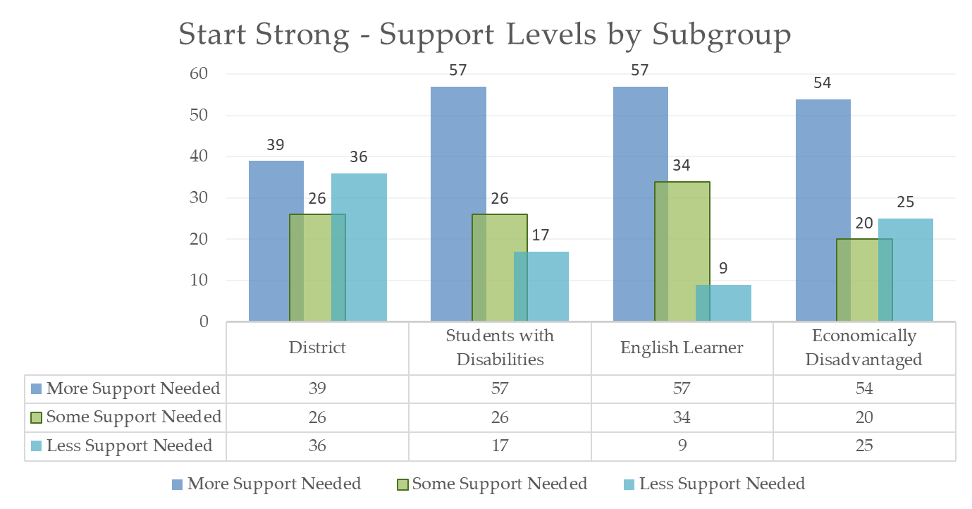
Subgroup Charts
Sample Chart

