Slide 1

Intervention for families
Train the Trainer Intervention to improve safety of our children in NJ

Slide 2
Mission
NJIFF
Goals of program:
  To reduce death in the pediatric population due to the following preventable causes:
    Sudden Unexplained Infant Death Syndrome
    Choking
    Poisoning
    MVC
    Carbon monoxide/ fire

Slide 3
Audience
NJIFF
  Home care RNs
  Firefighters
  Police
  First responders
  Emergency Medical Technicians
  Paramedics
  Any persons that visit homes of our tiniest victims

Slide 4
Partners
NJIFF
Developed as part of a collaborative of NJ Emergency Nurses Association and NJDOH/NJ Emergency Medical Services for Children.

Slide 5
NJIFF
Objectives
Evaluate a home for risk factors for SUIDs, choking, accidental ingestion, carbon monoxide poisoning in children.
Propose resources to families to reduce risks in the pediatric population.
Support the mission of NJIFF by sharing education and reporting interventions to EMS-C quarterly.

Slide 6
Plan
NJIFF
Begin with centralized education and set up programs.
  Train trainers
    They train providers
  Identify coordinators
    Provide easy to distribute resources, report on quantity of materials given out monthly
  Provide resources (set up a website to track and support resources)
Notes:
Coordinators should market and use media to share message.
Share stories on the website.
Monthly report on program.
Follow up/ seek help for difficult cases.

Slide 7
Plan
NJIFF
Begin with centralized education and set up programs.
  Ideas from first group at Jersey Shore (Meridian) EMS meeting
  Squads share resources with groups
    Mom to moms
    PTA
    etc
Notes:
Coordinators should market and use media to share message.
Share stories on the website.
Monthly report on program.
Follow up/ seek help for difficult cases.

Slide 8

Plan
NJIFF
These groups offer the “second set of eyes” to community members to identify issues and provide resources
Notes:
Coordinators should market and use media to share message.
Share stories on the website.
Monthly report on program.
Follow up/ seek help for difficult cases.

Slide 9
Case
A 6 week old infant is enroute via Basic Life Support
Arrives in ED with a female EMT kneeling on stretcher, performing CPR with tears running down her cheeks…..

Slide 10
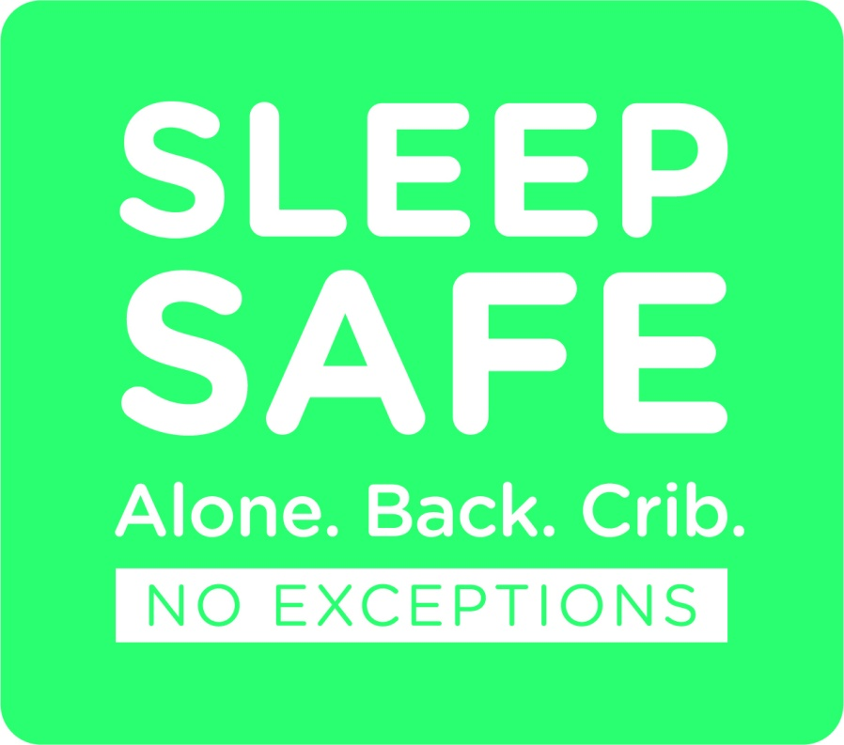
SUIDS
NJIFF
FACTS
SUIDS includes SIDS, accidental suffocation/strangulation, infections or abnormal heart rhythms.
2012 data (www26.state.nj.us)
  13 deaths due to SIDS in NJ
  41 deaths due to infection in NJ
  8 deaths due to accidental strangulation/suffocation in bed in NJ
Notes:
62 babies that died that could have been prevented.

Slide 11
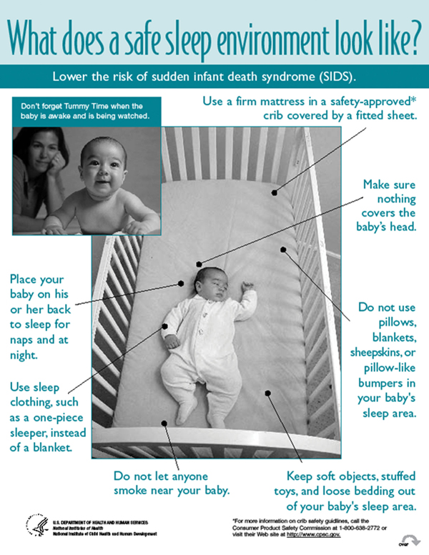
SUIDS
NJIFF
Research (www.nichd.nih.gov/sts)
No smoking around or not around baby
Get immunizations
Back to sleep
Firm surface
Don’t overheat
Breast feeding
Supervised tummy time
No sleeping in adult bed/ sofa
Notes:
Smoking: decreases fetal oxygenation, stays in clothing (even if you smoke out doors).
Immunizations: Prevent diseases which can be transmitted to infants that do not yet have immunity. In parents, adult and child visitors immunizations are not always up to date and immunity can wane with time. Babies can catch diseases from the visitors and diseases will kill them (pertussis, diptheria, meningitis)
Back to sleep: babies who sleep on their bellies are 5-7 times more likely to die from SIDS, babies on sides 2 times more likely.
Firm surfaces: babies have big heads and small flexible airways. The large back of their head can push forward in a car seat, bouncer, and occlude the airway.
Overheating: A good rule is what the adult wears, so should baby. Babies cannot cool selves or remove blankets and get overheated which can cause them to stop breathing. No additional blankets, pillows, NO BUMPERS, stuffed animals in bed as these can occlude the babies airway.
Breastfeeding: supports immunity in neonate, provides perfect nutrition (prevents obesity, asthma, allergies). Decreases risk of SIDS
Tummy time: Important to develop neck muscles, but should be supervised. Newborns cannot lift/move head well and can suffocate.
No co-bedding: Sleeping with caretakers is dangerous and many parents have unknowingly rolled over onto their newborn and found baby dead. There are co-bedding devices that can provide a safe sleep surface and allow baby to be near by or use a bassinette. The best practice is to put baby in the bassinette if adult is sleepy, many babies suffocate while sleeping in adult arms.

Slide 12
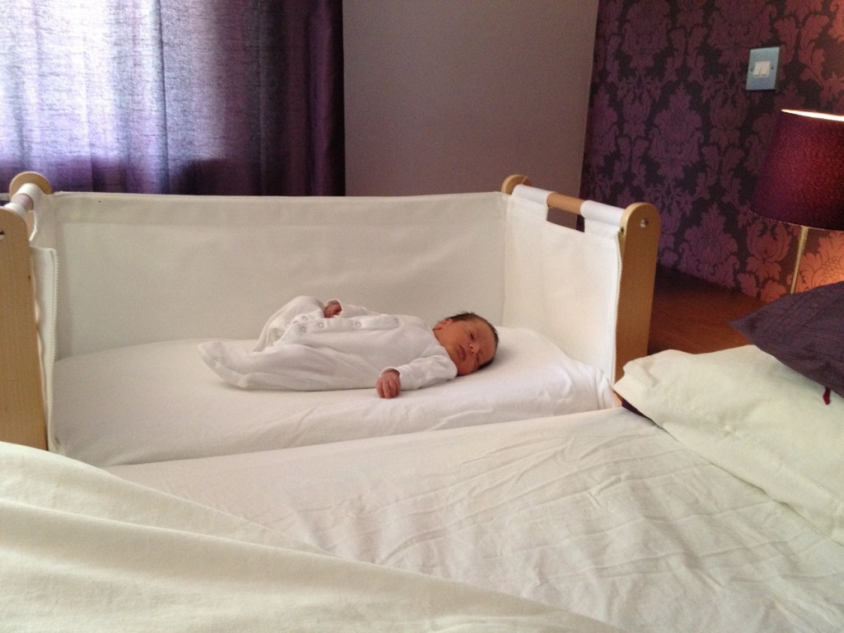

SUIDS
NJIFF
What to do
ASK/LOOK
Notes:
Ask: Can I assess your house for safety and make recommendations while I am here?
Look for: smoking, signs of sleep surface, choking hazards, carbon monoxide detectors, smoke detectors, medications left out/ in reach.

Slide 13
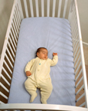
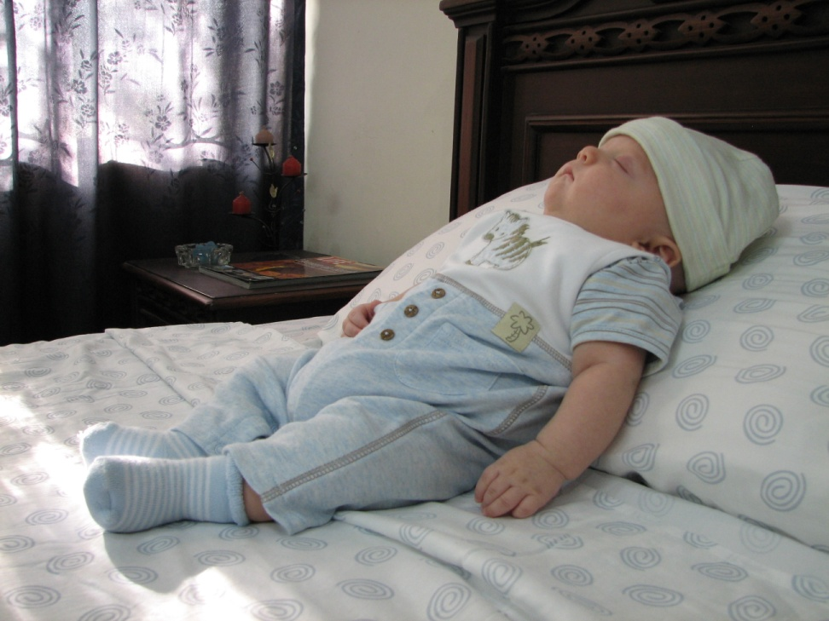
SUIDS
NJIFF
ASK/LOOK
ASK/LOOK

Slide 14
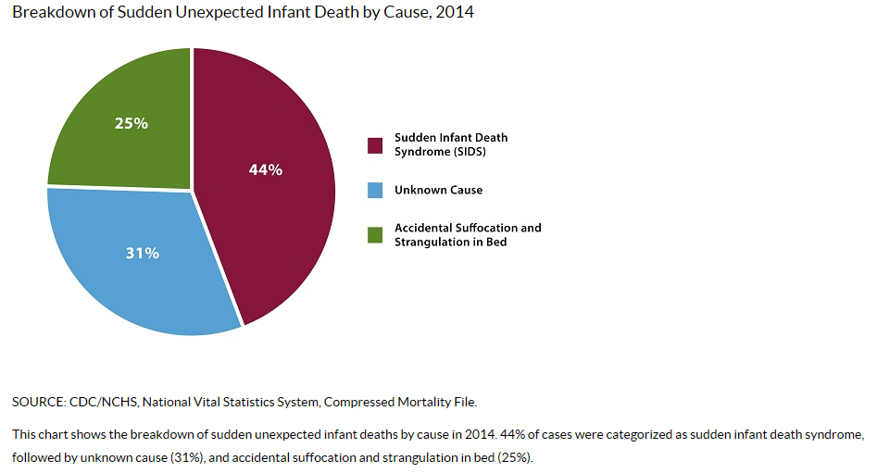
SUIDS
NJIFF
Resources
Safe to Sleep ® website
  Free education
  Information
Babyboxuniversity ®
  Baby boxes when education completed
Cribs for kids ® website
  Door hangers
  Discount cribs
CDC.gov/sids website
  Statistics
NJ quit connection ®/ Mom’s quit connection ®
Notes:
Atlanticare, central NJ consortium are partners
3) If there are NO PARTNERS IN YOUR AREA or the partners in your area do not provide Pack ‘n Plays:
As a national infant safe sleep organization located in Pittsburgh, PA, Cribs for Kids® strives to make sure that all babies have a safe place to sleep. Unfortunately, it is financially impossible for us to supply every new parent in every state with free safe sleeping environments. However, we continue to work hard every day to expand our chain of Cribs for Kids® Partners across the country so that families can be helped in all communities.
If you do not have a partner in your area the final option available would be for us to pass our product discount through Graco onto you for $49.99 plus $13.00 shipping, though you may be able to find a basic unit with the bassinet feature in a local department store. If you wish to order through us, please click on the Paypal link below and your Pack ‘n Play will be shipped directly to your residence:
PURCHASE A CRIB NOW:

Slide 15
Case
BLS arrives on scene to a multi vehicle collision where a 2 year old is found in the front seat of the vehicle.
Severe depressed area noted on front of child’s head.

Slide 16
Case
2 Vehicle collision scene
6 year old child in back seat with only a lap belt
Pulses present
When extricating child, lower half of body moves separately from upper half, pulses lost enroute

Slide 17
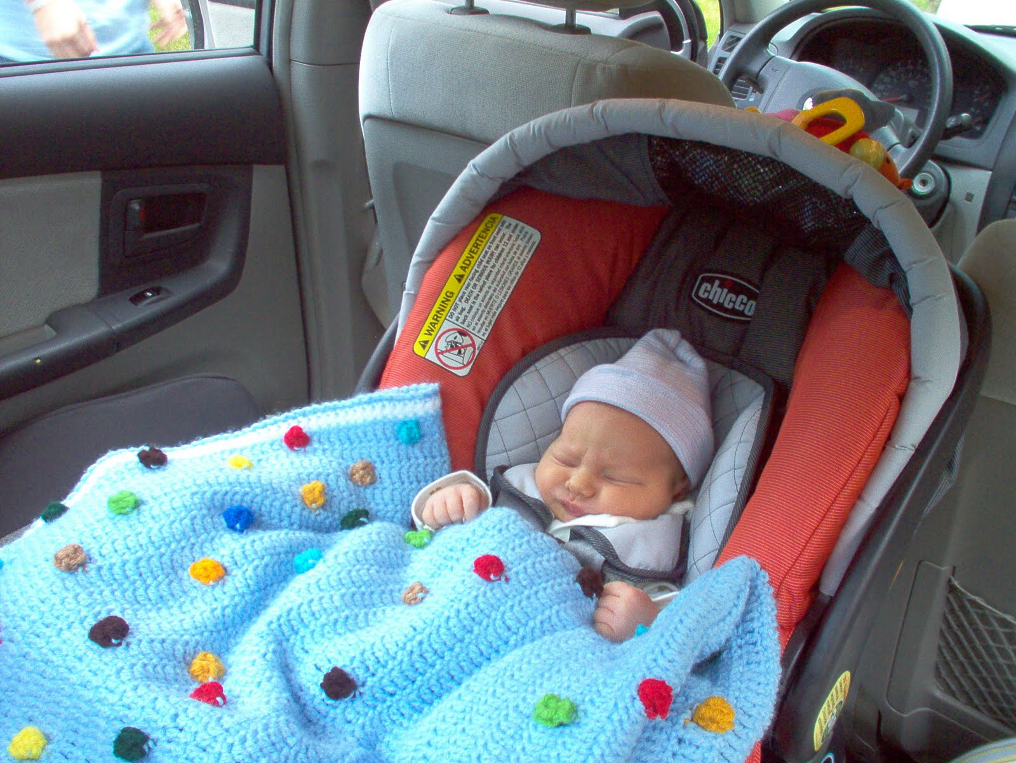
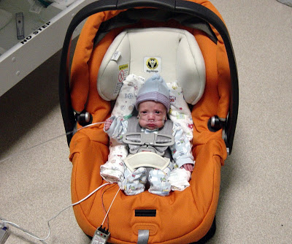
Car Seats
NJIFF
ASK/LOOK
ASK/LOOK

Slide 18
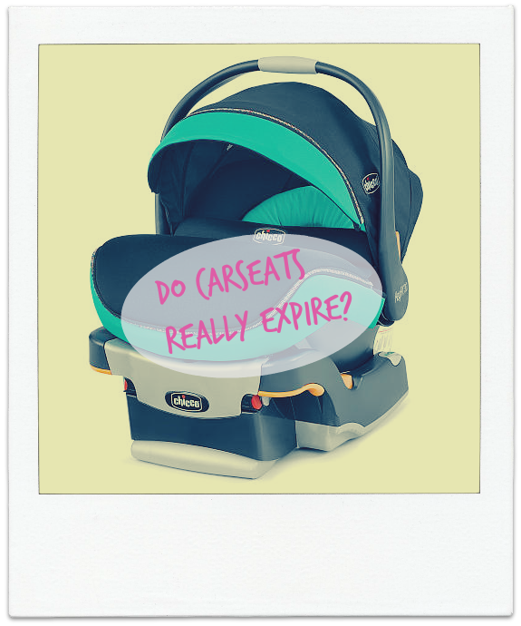
Car Seats
NJIFF
What to do
Ask/Look
2 & 30
  Rear facing, 5 point harness
4 & 40
  Front and five until upper limit of seat
Under 8 & 57 (inches)
  Belt and booster
Over 8 & 57
  Rear with belt
Notes:
Ask if they have a car seat, NJEMS-C has access to free car seats and you can request them.
LOOK in the car and assess if they have a car seat, is it in the proper position for the age of child.
Legislation - P.L. 2015, c.50
The following recommendations will provide the safest way to transport your child according to the American Academy of Pediatrics and the National Highway Traffic Safety Administration (NHTSA). Additionally it will ensure compliance to the New Jersey Child Passenger Restraint Law. (Title 39:3-76.2a) Any child under the age of 8 years old and a height of 57 inches shall be secured as follows in the rear seat of a motor vehicle:
a.A child under the age of 2 years and 30 pounds shall be secured in a rear-facing seat equipped with a 5-point harness.
b.A child under the age of 4 years and 40 pounds shall be secured as described in (a) until they reach the upper limits of the rear-facing seat, then in a forward-facing child restraint equipped with a 5-point harness.
c.A child under the age of 8 and a height of 57 inches shall be secured as described in (a) or (b) until they reach the upper limits of the rear-facing or forwardfacing seat, then in a belt positioning booster seat.
d.A child over 8 years of age or 57 inches in height must be properly secured by a seat belt. If there are no rear seats, the child shall be secured as described above in the front seat except that no child shall be secured in a rear-facing seat in the front seat of any vehicle that is equipped with an active passenger-side airbag. The aforementioned is acceptable if the airbag is de-activated.
Call EMS-C for car seats (they are grant funded)

Slide 19

Car Seats
Resources
NJDOH
  Grant funded car seats available

Slide 20
Case
Medics arrive to the scene of a “respiratory distress” call
Severe distress note, intubation attempted, but something is blocking the airway
Child is purple and limp with no pulses upon arrival to ED
ED provider removes a flesh colored “bouncy ball” from airway with much difficulty
Child dies 24 hours later

Slide 21
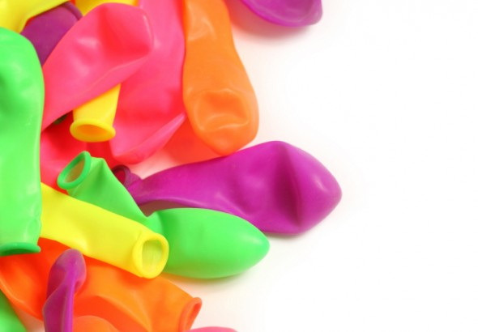
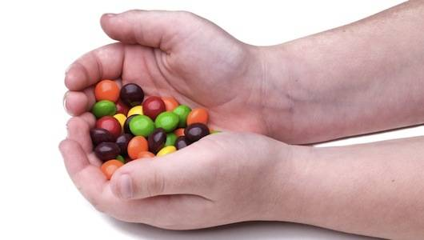
Choking
NJIFF
What to do
Ask/Look
Notes:
Free infant anytime CPR kits are available through AHA grants.
ASK about small parts, small toys
look for items that place infants at risk and if seen discuss them.
Provide a CPR friends and family kit to anyone with an infant

Slide 22
Case
Mom calls 911 for altered mental status in her 3 year old
EMS arrives to find unresponsive
1 hour after all attempts in hospital child dies
Officers at house find a prescription of a grandparent’s medication open and lying on top of a dresser with drawers open like steps.

Slide 23
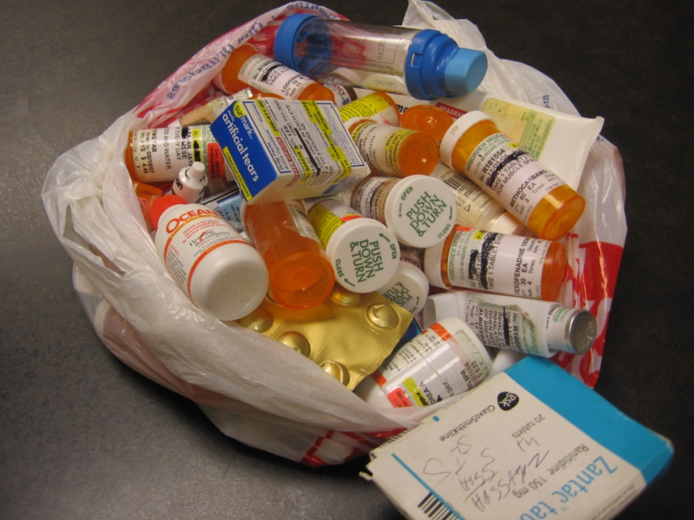
Poisoning
NJOSI
What to do
Ask/Look
Do you have poison control number posted?
Where are your medications (prescription/over the counter) secured?
Do you have expired medications?
Where are cleaning supplies?
Where is laundry detergent?
Notes:
Ask to LOOK under sinks/ cabinets that are not locked
Ask about prescription caps
Ask about expired medications, narcotics, sedatives
Look on tops of dressers,
Look in bathroom cabinets

Slide 24
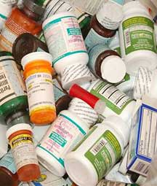
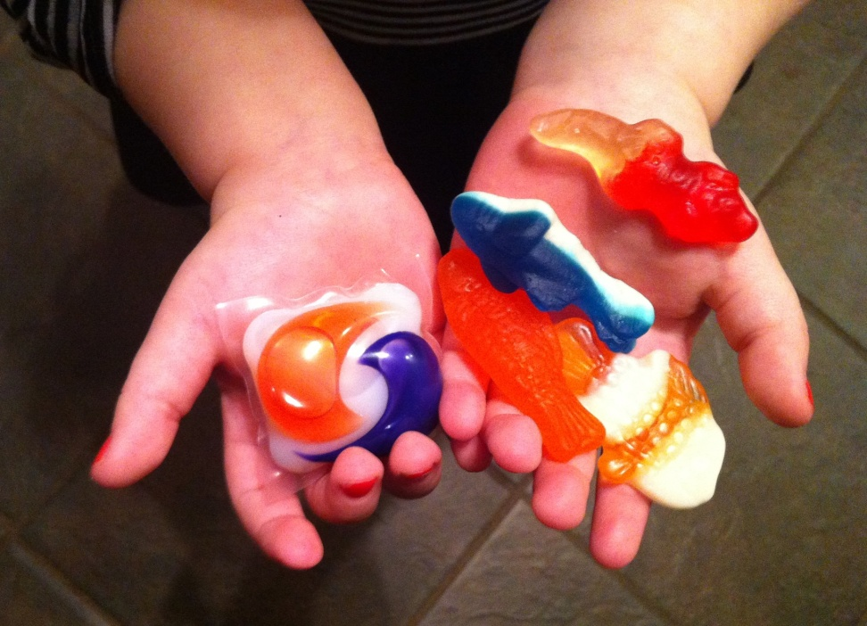
Poisoning
NJIFF
Ask/Look
Ask/Look

Slide 25
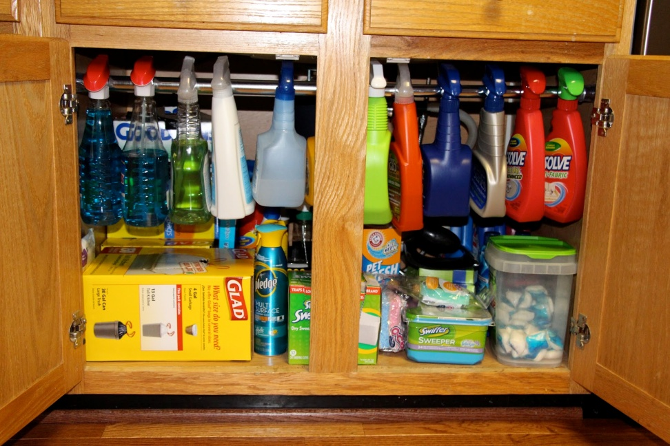
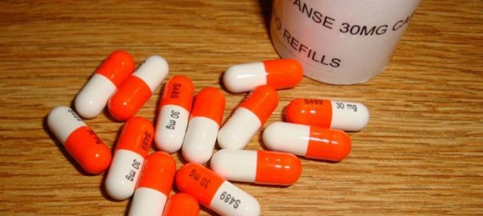
Poisoning
NJIFF
Ask/Look
Ask/Look

Slide 26

Poisoning
NJIFF
Resources
www.njpies.org
  Free stickers
  Brochures
  Downloadable handouts

Slide 27
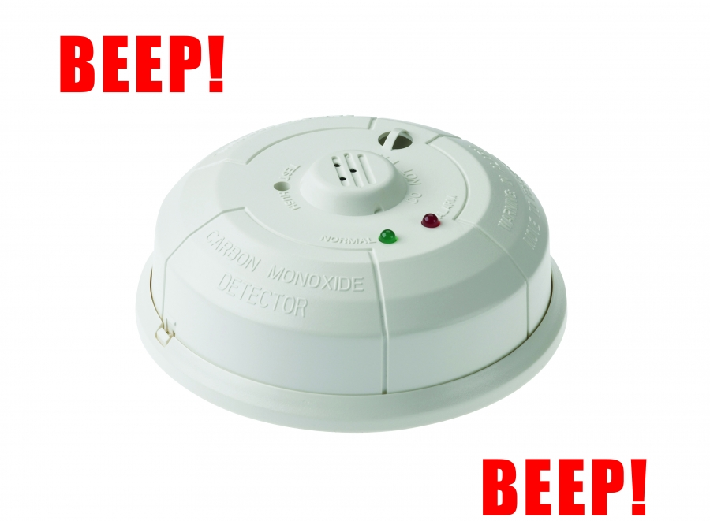
Carbon Monoxide
Smoke Detectors
NJIFF
What to do
Ask/Look
When did you last check battery?
Change battery every time daylight savings time changes.

Slide 28

NJIFF
Resources
Carbon monoxide poisoning brochures/ information
Classes
  on line for children
Coloring pages

Slide 29
Resources
NJIFF
Emergency Medical Services for Children
Names/ Numbers
Cribs for kids (cribs and information you can keep on site for needs)
Car Seats (grant funded)
See Binders (you may copy)
Eric Hicken,CPM, EMT-P
EMSC Program Manager
NJDOH/OEMS
PO Box 360
Trenton, NJ 08625
Phone: 609-633-7777
Direct: 609-984-9630
eric.hicken@doh.nj.gov
BlackBerry: 609-331-1405
Fax: 609-633-7954
www.nj.gov/health/ems

Slide 30
NJIFF
Safe sleep sheets/info
Containers/packaging
https://www.cpsc.gov/Safety-Education/Safety-Education-Centers/cribs
https://www.nichd.nih.gov/sts/Pages/default.aspx
  Brochures, information, training
https://www.cpsc.gov/safety-education/safety-guides/containers-and-packaging#resources

Slide 31
On the NJIFF webpage
NJIFF
Brochures you can print
This power point for you to use with training
Contact information to report monthly to EMS-C your activities
Note: You may also download this from website

Slide 32
NJIFF
https://www26.state.nj.us/doh-shad/query/result/infantfetal/Infant/InfMortRate.html
https://www.nichd.nih.gov/sts/Pages/default.aspx
http://www.nj.gov/lps/hts/childseats/index.html

