Slide 1
FY24 EOF 2023 Summer Contract & Budget Training
OFFICE OF THE SECRETARY OF HIGHER EDUCATION (OSHE)
Educational Opportunity Fund (EOF)

Slide 2
Purpose of this Workshop
To provide an overview of the changes to the EOF Summer Contract and Budget Documents (Contract Attachment B2)
To review the allowable expenditures for the 2023 Summer Program
Review the process of completing the 2023 Summer Budget and submission deadlines

Slide 3
OSHE/EOF Central Staff
Dr. Hasani Carter
Hasani.Carter@oshe.nj.gov
Peter Collazo
Peter.Collazo@oshe.nj.gov
Hema Patel
Hema.Patel@oshe.nj.gov
Catherine Sackey
Catherine.Sackey@oshe.nj.gov
Dr. Stephanie Shanklin
Stephanie.Shanklin@oshe.nj.gov
OSHE Finance
Tiffany Hazzard
Tiffany.Hazzard@oshe.nj.gov
Kevin Kobylowski
Kevin.Kobylowski@oshe.nj.gov

Slide 4
FY24 EOF Program Contracts
Notes:
FY24 contract includes 2023 Summer Program Allocations AND FY24 Academic Year Allocations
Please note that EOF summer payments cannot be executed until a signed contract has been received.
Programs should use this information to develop their respective budgets attachments.

Slide 5
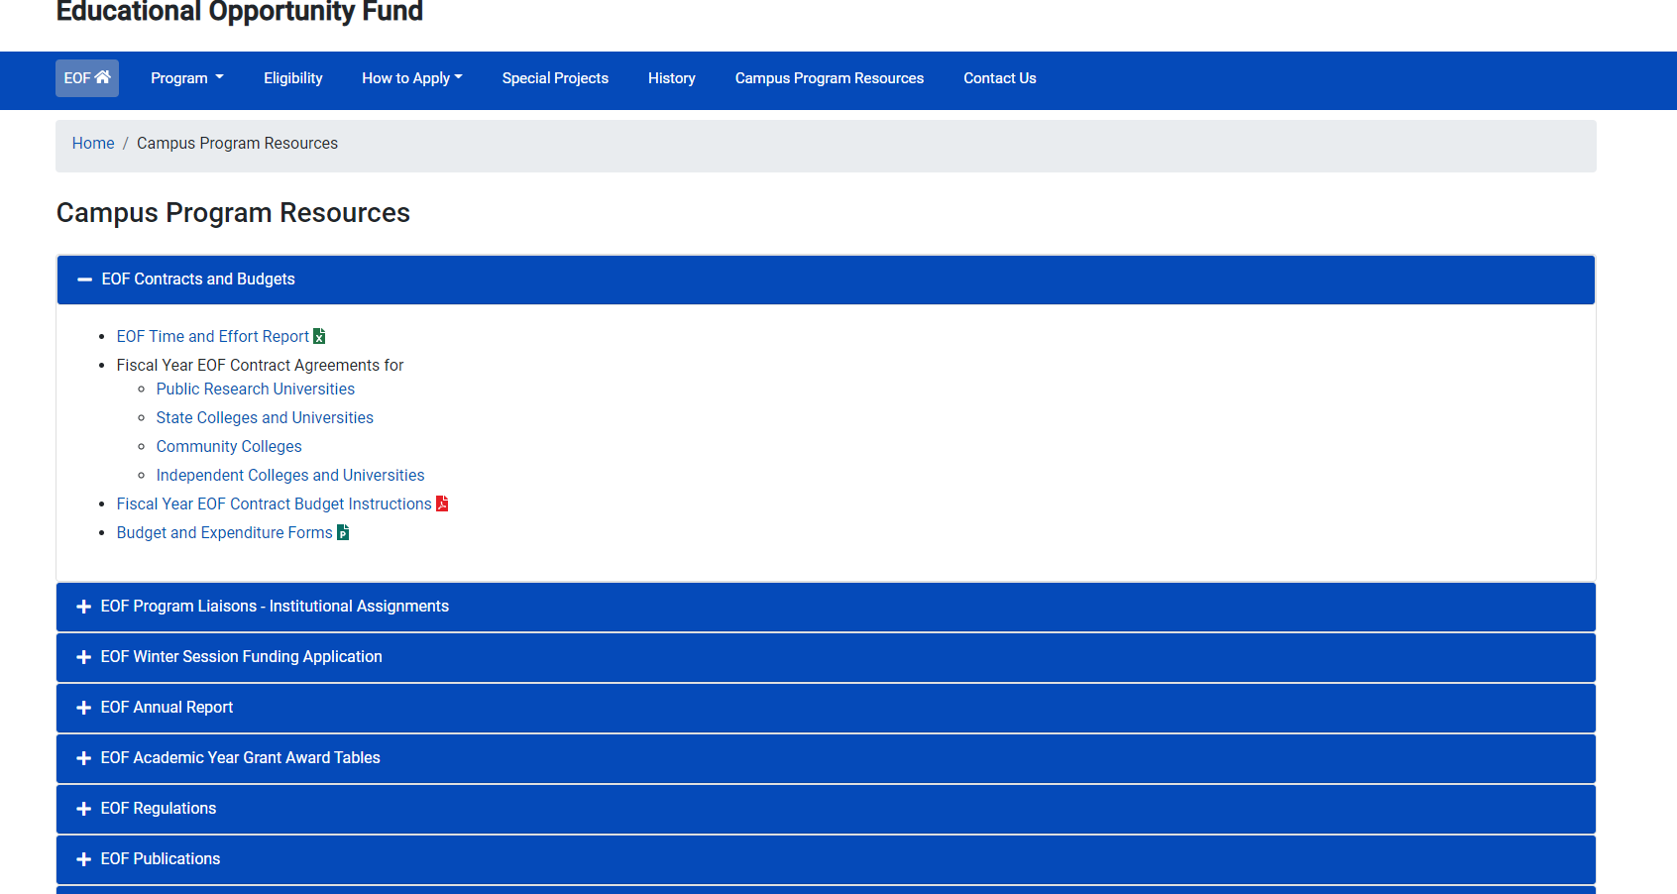
FY24 EOF Program Contracts
Notes:
Where can you find EOF FY24 program contracts and budget documents?
All EOF Contract Budget Attachments can be found on the EOF Campus Program Resources webpage, within the EOF Contracts and Budgets section:

Slide 6
FY24 EOF Program Contracts

Slide 7
Changes to the Summer Budget Template
Programs must start on the initial tab. The budget now includes a spend down function. EOF special programs that only provide support to renewals must start on the initial tab and put your allocation at the top.
Program Support and COE tabs have been combined into one tab. This allows for a more efficient assessment of costs associated with initials versus renewals.
- “Narrative Description” appears next to all items listed on the Initials and Renewals tab. Items must include a clear educational purpose and where appropriate, any associated pre- and post-activity assessments that will be conducted.
Programs must report on all EOF students supported during the summer.
Programs must report Summer TAG funds.
Notes:
- On the old B2 contract attachment, Program Support and Cost of Education items were previously listed on separate tabs.
- On the revised B2, Program Support items appear in non-highlighted text. Cost of Education items now appear in green highlighted text.
- If additional tab(s) may be added if it will help programs provide the appropriate level of details needed within narrative description section for any items listed on the budget.

Slide 8
Disbursement of 2023 Summer Funds and Budget Modifications
Payment Distribution:
For 2023 Summer: Programs will receive 100% of their Article 3 and Article 4 funds. Funds may not be sent until we receive a signed Contract.
Example of 2023 Summer Program payee reference format = EOF SUM323 FY23/4 (Inst./Program Name) PMT
Summer Program Budget Modification Deadline:
Due to variable lengths of Summer Sessions, OSHE/EOF defines the last day of the EOF summer program as the day before your institution’s Fall 2023 term.
Remain aware of any anticipated under-expenditures/cost savings on a weekly basis.
Re-purpose any available funds immediately with a budget modification request to the OSHE/EOF office.

Slide 9
Summer Article III - Allowable Expenditures
The EOF Article III summer program grant shall be applied to the student’s educational costs.
Such costs shall include the participating institution’s educational budget and/or instructional costs as follows:
Tuition charged per student or instructional costs (instructors’/teaching assistants’ salaries), but never both for any single course
Fees, room & board, books, educational supplies, transportation, and childcare, as well as stipends and insurance
Salaries and room and/or board for professional, graduate, and/or peer tutors
Educational materials used to support instruction
Notes:
All programs will receive both Article 3 and Article 4 funding for the Summer.
Programs were informed about how the 2022 Summer Program allocations were determined during the EOF Board meeting and the EOF Post-Board town-hall meeting.
Summer Article 3 funds may be used for both EOF Program Support and Cost of Education items for initials and renewals. Per 9A:11-6.3(b):
The EOF Article III summer program grant shall be applied to the student’s educational costs.
Funds awarded for the summer session are to be used solely for courses and educational costs that occur during the summer session.
Courses taken during the summer session must be recorded on the students’ academic transcripts as completed during the summer session.
In the summer, such costs shall include whatever constitutes the participating institution’s educational budget and/or instructional costs as follows:
1. Tuition charged per student or instructional costs (that is, instructors’ and teaching assistants’ salaries), but never both for any single course;
2. Fees, room and board, books, educational supplies, transportation, and child care, as well as stipends and insurance;
3. Salaries, and room and/or board for professional, graduate, and/or peer tutors; and
4. Educational materials used to support instruction.
Summer Article 4 funds can only be used on the EOF Program Support tab (i.e. toward program support). It may not be used to pay for Cost of Education items (i.e. the items highlighted in green on the Initials or Renewals tab).
Programs are reminded that the regulations that govern the usage of EOF Article 4 funds remain the same throughout the year.

Slide 10
Summer Article IV - Allowable Expenditures
EOF Article IV Funds are to be used for EOF Program Support activities.
Article IV program support funds shall not be used for the following items:
Cost of Education Items (highlighted in green on Initials/Renewal Tabs). Student costs covered by a student’s financial aid package
The cost of instruction for which students are charged tuition
Fringe benefits for AY student assistants, part-time personnel, campus EOF administrator/director, or 12-month EOF staff at public senior institutions; fringe benefits in excess of 21% of the salaries paid by EOF funds for 12-month EOF staff at community colleges and independent institutions
The purchase of equipment/hardware
Transportation of students for normal commuting costs
For additional details, please refer to EOF Regulations (N.J.A.C. 9A:11-6.10) (Pgs.37-38)
Notes:
All programs will receive both Article 3 and Article 4 funding for the Summer.
Programs were informed about how the 2022 Summer Program allocations were determined during the EOF Board meeting and the EOF Post-Board town-hall meeting.
Summer Article 3 funds may be used for both EOF Program Support and Cost of Education items for initials and renewals. Per 9A:11-6.3(b):
The EOF Article III summer program grant shall be applied to the student’s educational costs.
Funds awarded for the summer session are to be used solely for courses and educational costs that occur during the summer session.
Courses taken during the summer session must be recorded on the students’ academic transcripts as completed during the summer session.
In the summer, such costs shall include whatever constitutes the participating institution’s educational budget and/or instructional costs as follows:
1. Tuition charged per student or instructional costs (that is, instructors’ and teaching assistants’ salaries), but never both for any single course;
2. Fees, room and board, books, educational supplies, transportation, and child care, as well as stipends and insurance;
3. Salaries, and room and/or board for professional, graduate, and/or peer tutors; and
4. Educational materials used to support instruction.
Summer Article 4 funds can only be used on the EOF Program Support tab (i.e. toward program support). It may not be used to pay for Cost of Education items (i.e. the items highlighted in green on the Initials or Renewals tab).
Programs are reminded that the regulations that govern the usage of EOF Article 4 funds remain the same throughout the year.

Slide 11
Tuition & Fees = Credits Earned
If a student is charged for “X” credits, then this number of credits should appear on the student’s transcript for the Summer program.
For example:
Student is registered for 9 credits.
EOF funds are used to pay for 9 credits.
Student’s transcript should show that the student was enrolled for 9 credits during the Summer session.
Notes:
If the course is an enrichment course with no credits earned toward the degree, then this should be properly documented (i.e. Developmental Math 0001; 3 credits (P/F)).
If a student attempts 9 credits and only earns less than 9 credits due to not passing a course, then this should also be reflected on the student’s transcript for the summer.
If a EOF renewal student completed their FAFSA for the 2021-2022 academic year and the ONLY reason the student was not eligible for an EOF AY grant was due to the student having reached the maximum number of EOF AY payments, then this student may be considered for EOF Summer Funding support.

Slide 12
Stipends: Article III Funds
Cost of education purposes only (supplies, commuter costs, textbooks, etc.)
Programs must have documentation to reflect how the amount was determined (ex: cost of actual textbooks, mileage reimbursement rate, on-campus meal plan price, etc.)
OSHE/EOF does not determine stipend award levels
Should not wait until the end of the summer session to seek adjustments to stipends.
Institutions/EOF campus programs assume all liability associated with the distribution of stipends (i.e. future financial aid eligibility for independent students, taxes, etc.).
May not be used to reimburse or pay a student directly for taking a course at another institution

Slide 13
Special Circumstances: Courses at Another Institution
Should seek to establish a formal arrangement/agreement
Must be at an institution that participates in EOF
Allow for the institution to be billed directly for the student’s enrollment at another institution/program
Ensure appropriate documentation between institutions for audit purposes

Slide 14
Completing the 2023 Summer Budget: The Basics of the Budget
Instructions for completing the budget template are located in the template file – the tab is labeled “Directions to Complete”
Review the FY24 contract and 2023 Summer allocations to ensure you are working with the correct figures.
Program Directors should work with your OSHE/EOF program liaison if you have any questions regarding the development of your budget and allowable expenses.

Slide 15
Completing the 2023 Summer Budget: Summer Budget Template
A walk-through of how to properly complete the 2023 Summer Budget Template
(Contract Attachment B2)
https://www.nj.gov/highereducation/EOF/EOFBudgetForms/FY24Contracts/FY2024EOF2023SummerB2ContractAttachment.xlsx
Notes:
Summer Program
Support Services
Personnel salaries & wages (do not include instructors’ salaries for cost of instruction if students are charged tuition for the course)
Educational materials & supplies (do not include cost of textbooks for initial & renewal summer program participants)
Other administrative costs
Initial & Renewal
Cost of Education
Tuition
Fees
Room
Board
Books
Stipends
Insurance

Slide 16
Completing the 2023 Summer Budget: Final Checklist for Submission
Provided Institution/EOF Program Name
Provided the total number of initial and renewal students on the respective tabs
Provided the appropriate Narrative Descriptions per budget category utilized, including a breakdown of the expenses summarized by the total
Utilized full allocation for the 2023 Summer Program

Slide 17
EOF Document Submissions
All Documents must be submitted via email to EOF@OSHE.NJ.GOV. Institution can include new tabs within this workbook to provide additional details but must not make any unapproved changes to the tabs provided.
Email Subject Line: SCHOOL/Program NAME 2023 B2 Summer Budget
- Ex: New Jersey State College Health Careers Program 2023 B2 Summer Budget
File Naming Convention: School/Program NAME 2023 B2 Summer Budget
- Ex. New Jersey State College Health Careers Program 2023 B2 Summer Budget

Slide 18
Completing the 2023 Summer Budget
A final version of your EOF 2023 Summer Budget (Contract Attachment B2) must be e-mailed to EOF@OSHE.NJ.GOV
and the EOF Executive Director by:
June 12, 2023
C1 Contract Attachment (Final Summer 2023 Expenditure Report) must be e-mailed to EOF@OSHE.NJ.GOV
and the EOF Executive Director by:
September 21, 2023

Slide 19
EOF Program Liaison Assignments
HASANI CARTER | PETER COLLAZO | HEMA PATEL | STEPHANIE SHANKLIN
Email: hasani.carter@oshe.nj.gov | Email: peter.collazo@oshe.nj.gov | Email: hema.patel@oshe.nj.gov | Email: stephanie.shanklin@oshe.nj.gov
Rutgers University - Camden | County College of Morris | Bergen Community College | Atlantic Cape Community College
Rutgers University - College of Nursing | Felician University | Brookdale Community College | Caldwell University
Rutgers University - Graduate Bio-medical | Middlesex College | Essex County College | Camden County College
Rutgers University - Graduate Education Prep | Monmouth University | Fairleigh Dickinson University - Florham | Centenary University
Rutgers University - Graduate Studies (except Bio-medical) | Ramapo College of New Jersey | Fairleigh Dickinson University - Metropolitan | Drew University
Rutgers University - New Jersey Medical School | Rowan School of Osteopathic Medicine (SOM) - Graduate (Only) | Hudson County Community College | Georgian Court University
Rutgers University - Newark | Rowan School of Osteopathic Medicine (SOM) - Pre-Matric | Kean University | Montclair State University
Rutgers University - ODASIS | Rowan School of Osteopathic Medicine (SOM) - Summer Prep | Mercer County Community College | Montclair State University - Bloomfield
Rutgers University - Office of EOF Administration | Rowan University - Camden | New Jersey City University | Montclair State University - Health Careers Program
Rutgers University - Robert Wood Johnson Medical School | Rowan University - Cooper Medical School - Graduate (Only) | New Jersey Institute of Technology | Rider University
Rutgers University - School of Arts and Sciences (New Brunswick) | Rowan University - Cooper Medical School - PULSE Program | Ocean County College | Rowan College at Burlington County
Rutgers University - School of Engineering | Rowan University - Glassboro | Passaic County Community College | Rowan College of South Jersey - Cumberland
Rutgers University - School of Environmental and Biological Sciences | Rowan University - Graduate Bio-medical | Raritan Valley Community College | Rowan College of South Jersey - Gloucester
Rutgers University - School of Health Professions | Saint Peter's University | Sussex County Community College | Seton Hall - Law
Rutgers University - School of Pharmacy | Salem Community College | The College of New Jersey | Seton Hall University - Main
Rutgers University - Summer Grads | St. Elizabeth University | Union College of Union County, NJ | Seton Hall University - Pre-Legal
 | Stevens Institute of Technology | Warren County Community College | Seton Hall University - Pre-Med/Pre-Dent Plus
 | William Paterson University |  | Stockton University - Atlantic City
 |  |  | Stockton University - Galloway

Slide 20
Campus Program Resources
OSHE/EOF Website
http://www.state.nj.us/highereducation/EOF/EOF_Program_Resources.shtml

Slide 22
Thank You! We look forward to working with you

