Slide 1
Division of the Deaf and Hard of Hearing Communication Access Grants
Elizabeth Hill, Executive Director
NJ Department of Human Services
Division of the Deaf and Hard of Hearing

Slide 2
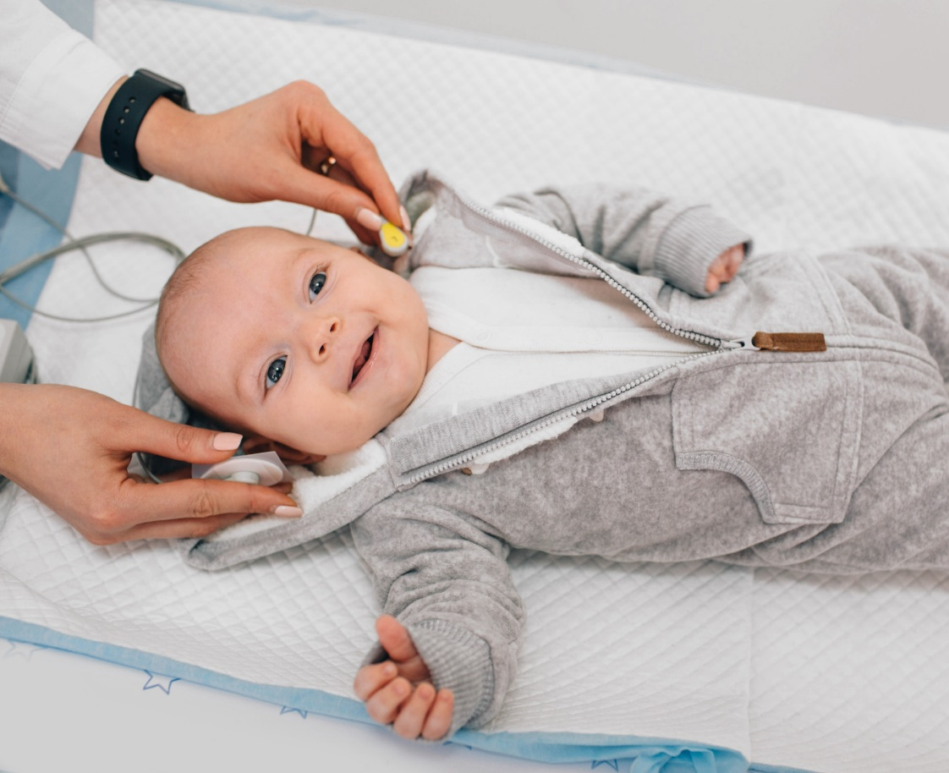
Communication Access Grants
Statistics:
An average of 2-3 per 1,000 newborns have difficulty hearing
Deaf and hard of hearing individuals make up approximately 28% of the disability community.
Approximately, 500,000 sign language users in the United States
Deaf, hard of hearing, and deaf-blind residents face communication and language barriers in accessing county and community-based services, critical health/emergency information, public services, and public educational programming.

Slide 3
Communication Access Grants
Unique funding opportunity to address communication and language barriers, and;
Promote inclusion of deaf and hard of hearing residents in local and county-based services and programs
Counties are eligible to receive up to $75,000.

Slide 4
Communication Access Grants
Installation of hearing induction loops.
Installation of public videophones and associated connectivity costs.
Expanding access to sign language interpreter services.
Expanding access to captioning services.
Development and/or provision of community/educational/or healthcare-related programming or services accessible in American Sign Language (ASL).

Slide 5
Communication Access Grants
Potential areas to consider for the funding opportunities:
Municipal and county government agencies
County libraries, county jails, county courthouses
Local community centers
Independent living centers
Community theaters
Non-profit organizations focused on health equity
Parent-run organizations/groups

Slide 6
Communication Access Grants
Encouraged to fund multiple initiatives
Ideas for consideration:
Sign language interpreters for emergency services ex: Hurricane Ida
Installation of hearing induction loops for county libraries, municipal buildings, county courthouses
County library may host ASL children’s story hour
Installation of public videophones for the county jail for telecommunications
Sign language interpreters for deaf and hard of hearing children to participate in parent-led or community-based sports
Non-profit organization may propose converting health content in ASL and produce ASL video series ex: breast cancer awareness, HIV/AIDS prevention, addiction and mental health services

Slide 7
Summary
Timeline:
February 11, 2022 Release of RLI
February 25, 2022 DHS prospective Respondent presentation
March 15, 2022 Deadline for receipt of Letters of Interest (LOI)
March 29, 2022 Announcement of selected awardee(s)
Email LOIs to Daniel Prupis at Daniel.Prupis@dhs.nj.gov no later than 5:00 pm on March 15, 2022
For more information, visit: https://www.nj.gov/humanservices/providers/grants/rfprfi/RFPfiles/DDHH%20RLI.pdf

