Slide 1
New Jersey Victims of Crime Act (VOCA) Grant Program
Department of Law and Public Safety
Division of Criminal Justice
State Office of Victim Witness Advocacy

Slide 2
Agenda
Introductions
Overview and Eligibility
Application Process – Programmatic Requirements
Project Narratives
Application Process – Budget Requirements
Allowable Costs, Budget Detail Form, and Budget Narrative
Match Funds
Application Documents
Common Errors
Review

Slide 3
Funding Source
The VOCA Formula Grant Program was created under the 1984 Victims of Crime Act (VOCA).
The Crime Victims’ Fund is supported by fines levied on offenders convicted of federal crimes, not by taxpayers.
DOJ, Office for Victims of Crime (OVC).
3

Slide 4
Purposes of VOCA Funding:
Support direct services to crime victims
respond to the emotional and physical needs of crime victims.
assist primary and secondary victims of crime stabilize their lives after a victimization.
assist victims to understand and participate in the criminal justice system.
provide victims of crime with a measure of safety and security.

Slide 5
Who is Eligible to Apply?
A crime victim assistance program that:
is operated by a public agency or a nonprofit organization
demonstrates—
(i) a record of providing effective services to victims of crime and financial support from sources other than the Crime Victims Fund; or
(ii) substantial financial support from sources other than the Fund; *New Programs 25-50% non federal source.
utilizes volunteers in providing services
promotes, within the community served, coordinated public and private efforts to aid crime victims
assists crime victim with VCCO applications for compensation benefits
does not discriminate against victims because they disagree with the way the State is prosecuting the criminal case

Slide 6
Examples of Eligible Agencies
Victim services organizations
Criminal justice agencies
Religiously-affiliated organizations
Hospitals and Emergency Medical facilities
*Please Note: The above must either be a public agency or a nonprofit organization.

Slide 7
Nonprofit Status
ONLY Nonprofits and Public Agencies are eligible recipients of VOCA funding.
Therefore, if your organization is NOT a nonprofit organization in New Jersey, then it is currently ineligible to receive VOCA funding.
You may learn the required steps in forming a nonprofit in the State by visiting the NJ Department of the Treasury’s website.
http://www.state.nj.us/treasury/taxation/rsb100.shtml

Slide 8
Overview of VOCA Requirements
No charges for services.
Maintain victim confidentiality.
Serve victims of federal crimes.
Assist victims in filing claims with the Victims of Crime Compensation Office (VCCO).
Use volunteers.
Provide match.

Slide 9
Funding Information
Award Amount: Up to $300,000 maximum for each project.
Match Amount: $75,000 20% match (cash or in-kind) is required for public & private nonprofit agencies.
Grant Period: 20 months
January 1, 2018 – August 31, 2019

Slide 10
VOCA Application Process
Part I.
Programmatic Requirements

Slide 11
VOCA Application Categories & Point Allocations
a. Agency Background, Mission, Experience & Capability -10 points
b. Problem Statement/Needs Assessment - 15 points
c. Project Description, Goals, Objectives & Methods - 30 points
d. Partnership/Collaboration/Coordination of Services - 10 points
e. Project Management and Staff - 10 points
f. Data Collection, Performance Measures, and Evaluation - 10 points
g. Budget and Budget Narrative - 15 points
***The Budget and Budget Narrative sections are separate from the overall proposal/project narrative.
Total Possible Points: 100

Slide 12
Project Narratives

Slide 13
What is a Project?
A specific, connected set of activities designed for a specific purpose
With a beginning and an end
Explicit objectives and a predetermined cost
Aligns with the agency’s mission
A project is NOT a position:
e.g. “The Bilingual Case Manager Project”

Slide 14
Agency Background, Mission, Experience, and Capability. 10 points
What is the agency’s mission, background and experience?
How does the agency’s mission, background and experience relate to the proposed project?
How does the agency’s knowledge and capability demonstrate experience in providing victim services to the target population?
Has the agency been funded for similar projects?
What were the outcomes of those projects? Were the objectives met?
Notes:
Section helps you establish credibility
Organization’s purpose
Long range goals
Current programs and activities – discuss current funded VAG projects if any
Public Agencies must cite statutory authority

Slide 15
Problem Statement/Needs Assessment. 15 points
Who is the target population?
What the are the needs and characteristics of the target population?
What is the geographic area you intend to serve?
What are the needs and environmental conditions of this geographic area ?
What services currently exist targeting this population and area?
Are there gaps in services? Are there barriers to services?
How do you know this? What statistics and facts substantiate the need?
What is the issue you seek to address?

Slide 16
Project Description Goals, Objectives, and Work Plan (Action Strategy) 30 points
Provide a one page overview or summary of the project.
*Helpful Tip: Some chose to write this page after all other application narratives are completed.
1) Briefly describe the overall solution to the need or issue.
2) Briefly reiterate the need or issue the organization has recognized and is prepared to address.
What will take place?
Where will it operate?
How long will it operate?
Who will staff it?
Who will benefit?

Slide 17
Project Work Plan Form Goals, Objectives, and Work Plan (Action Strategy) 30 pts Please ONLY use the PROJECT WORK PLAN FORM below, which is provided in the application.

Slide 18
Project Work Plan (Action Strategy)
24
Project Name
Objective | Activity | Projected Start-up and Completion Dates | Person Responsible
Each Objective | List, in order, the activity that will be completed to achieve each objective. | Feasible time frame for the completion of each activity. | Staff member responsible for completing each activity.
Victims/Clients will know how to plan for safety after a Hotline Call. | Develop safety plan with victims. | January 1– December 31. | Advocate Jane Doe
“ | Reinforce safety plan through Q and A with victim. | January 1– December 31. | Advocate Jane Doe
Victims/clients will participate fully in the criminal case. | Hire 3 advocates by January 31. | January 1– January 31. | Project Manager John Doe
“ | Train 3 advocates by February. | January 1 – February 15. | Project Manager John Doe

Slide 19
Partnership, Collaboration, and Coordination of and Linkages to Services. 10 points
How will partnerships or coalitions support this project?
Will the project be coordinated between two or more agencies?
If so, is there an MOU or affiliation agreement?
How does your agency intend to use volunteers for this project?
For the overall work of the agency?
Letters of Support
Notes:
3 letters of support
No form letters
Must be specific to the project

Slide 20
Data Collection, Performance Measures, and Evaluation. 10 points
How will the agency measure the progress of the project?
How will the agency measure the impact of the project?
How will you measure success?
What feedback will the agency ask for from the victim?
*What data will be used to determine if the objectives were achieved?
*Provide samples of evaluation tools and client feedback forms and/or evaluation forms.
Notes:
Who will collect the data?

Slide 21
Project Management and Staff 10 points
Who will manage the project?
Who is working on this project?
How are the staff qualified to manage and implement the project?
How much time will each spend working on the project?
Include Current Resumes and Job Descriptions.
Are they Full Time or Part Time?
For any staff listed in the budget under federal funding or match.

Slide 22
Performance Measures
Objective | Activity | Performance Data | Performance Indicator
100% of Hotline victims exiting will know how to plan for safety. | Develop safety plan with victims. | Number of victims served. Number of victims that created a safety plan. | % of victims that created a safety plan.
 | Reinforce safety plan through Q and A with victim. | Q and A form – some questions of ability to conceptualize and put into place a safety plan. | % of victims capable of putting plan into action in the future.
Assist victims fully participate in the CJ case. | Hire 3 advocates by January 31. | Number of advocates hired. Dates hired. | Number of advocates hired by Jan 31.
 | Train advocates by Feb 15. | Number of advocates trained. Training dates. | Number of advocates trained by Feb 15 .
Assist victims apply for VCCO benefits. | Assist all qualifying victims with crime compensation filings. | Number of qualifying victims. Number of victims assisted with cc filings. | % of qualifying victims assisted with cc filings.
 | Attend court sessions with all qualifying victims. | Number of qualifying victims. Number of court sessions attended. | % of qualifying victims accompanied to court.

Slide 23
VOCA Application Process
Part II.
Budget Requirements

Slide 24
Determining Allowable Costs for the Budget

Slide 25
Allowable Costs – GENERAL GUIDANCE
Costs must be:
reasonable,
allowable, and
necessary
for the project.

Slide 26
2015 DOJ Grants Financial Guide
2015 DOJ Grants Financial Guide replaces the OJP Financial Guide.
Applies to VOCA grants.
Available at:
https://www.justice.gov/ovw/file/892031/download

Slide 27
NEW VOCA FINAL RULE
Now effective for ALL VOCA subawards.
Expands allowable activities.
Expands allowable costs.
Available at:
https://www.federalregister.gov/documents/2016/07/08/2016-16085/victims-of-crime-act-victim-assistance-program

Slide 28
Some Newly Allowable Costs
Civil Legal Services
Actions (other than tort actions) that, in the civil context, are reasonably necessary as a direct result of the victimization
Relocation Assistance
Transitional Housing
Victim services to incarcerated victims (e.g., victims of sexual assault in prison)
Coordination activities
Leveraging community resources to provide more cost-effective direct services.
Indirect Costs

Slide 29
Other Budget Considerations with respect to Allowable Costs
Nonprofits may use VOCA to increase staff salaries
You may charge Overtime to the Grant
Training for Staff is ALLOWABLE
(e.g. sending staff to National, Regional or Local Conferences, Trainings, Workshops or hiring a consultant/trainer to hold an educational program at your Agency)
The costs to develop Training Programs is NOT allowable.

Slide 30
Allowable Direct Services Costs
Services that respond to the immediate emotional, psychological, and physical health and safety needs of victims, including, but not limited to:
Crisis intervention services
Accompanying victims to hospitals for medical examinations
Hotline counseling
Safety planning
Emergency food, shelter, clothing, and transportation
Short-term (up to 45 days) in-home care and supervision services for children and adults who remain in their own homes when the offender/caregiver is removed
Short-term (up to 45 days) nursing-home, adult foster care, or group-home placement for adults for whom no other safe, short-term residence is available
Window, door, or lock replacement or repair, and other repairs necessary to ensure a victim's safety
Costs of non-prescription and prescription medicine, prophylactic or other treatment to prevent HIV/AIDS infection or other infectious disease, durable medical equipment (such as wheel-chairs, crutches, hearing aids, eyeglasses), and other healthcare items in emergency situations
Emergency legal assistance, such as for filing for restraining or protective orders, and obtaining emergency custody orders and visitation rights

Slide 31
Allowable Direct Services Costs
Personal advocacy and emotional support—
Working with victims to assess the impact of the crime
Identification of victims’ needs
Case management
Management of practical problems created by the victimization
Identification of resources available to the victim
Provision of information, referrals, advocacy, and follow-up contact for continued services, as needed
Traditional, cultural, and/or alternative therapy/healing (e.g., art therapy, yoga)

Slide 32
Allowable Direct Services Costs
Facilitation of participation in criminal justice and other public proceedings arising from the crime—
Advocacy on behalf of a victim
Accompanying a victim to offices and court
Transportation, meals, and lodging to allow a victim who is not a witness to participate in a proceeding
Interpreting for a non-witness victim who is deaf or hard of hearing, or with limited English proficiency
Providing child care and respite care to enable a victim who is a caregiver to attend activities related to the proceeding
Notification to victims regarding key proceeding dates (e.g., trial dates, case disposition, incarceration, and parole hearings)
Assistance with Victim Impact Statements
Assistance in recovering property that was retained as evidence; and
Assistance with restitution advocacy on behalf of crime victims

Slide 33
Allowable Direct Services Costs
Legal assistance
Legal services provided on an emergency basis
Legal services that arise as a direct result of the victimization
Forensic medical evidence collection examinations
Forensic interviews
Transportation
Public awareness
Transitional housing
Relocation

Slide 34
Allowable Costs for Supporting Direct Services
Supporting activities for which VOCA funds may be used include, but are not limited to, the following:
Coordination of activities
Supervision of direct service providers
Multi-system, interagency, multi-disciplinary response to crime victim needs
Contracts for professional services
Automated systems and technology
Volunteer trainings
Restorative justice

Slide 35
Allowable Administrative Costs
Personnel Costs
Skills training for Staff
Training-related Travel
Organizational Expenses
Equipment and Furniture
Operating Costs
Supplies; Equipment use fees; Property insurance; Printing, photocopying, and postage; Courier service; Brochures that describe available services; Books and other victim-related materials; Computer backup files/tapes and storage; Security systems; Design and maintenance of Web sites and social media; and Essential communication services, such as web hosts and mobile device services.
VOCA Administrative Time
Leasing or Purchasing Vehicles
Maintenance, repair, or replacement of essential items
Project Evaluation

Slide 36
Counseling Agencies – Funding Information
Agencies providing therapeutic counseling services should coordinate with the Victims of Crime Compensation Office (VCCO) for reimbursement of eligible services.
Reasonable to use VAG funds for therapeutic counseling:
victims who are not eligible claimants with the VCCO
victims who need emergent crisis counseling
victims who are underserved
Notes:
Example: 12 sessions VAG; change over to VCCO client

Slide 37
Expressly Unallowable Costs
Lobbying
Research and studies
Active investigation and prosecution of criminal activities
Fundraising
Capital expenses
Compensation for victims of crime
Medical care
Salaries and expenses of management (unless they directly work on the project)

Slide 38
Budget
Itemize all costs on the budget detail forms
Costs must be specific
Provide quantity and costs
Show calculations
Explain how the item relates to the project

Slide 39
Supplanting
Federal funds cannot be used to supplant state and local funds that would otherwise be available for crime victim services.
See Section 1404(a)(2)(c), codified at 42 U.S.C. 10603(a)(2)(C).
May only use federal funds to enhance or expand services.
This clause applies ONLY to state and local public agencies.

Slide 40
Budget Detail - Personnel
List annual salary or hourly rate (include computation on total # of hours for the grant period)
List Title and Name of Employee.
If vacant, list vacant.
Discuss when position will be filled. Prorate anticipated salary costs.
Salaried person’s percentage of time MULTIPLIED by their annual salary = TOTAL GRANT FUNDS
New Jersey (2016) estimated value of volunteer time is $27.46 per hour *
Notes:
If salaried, list annual salary; if part-time, list hourly rate.
Again this is a very important section and make sure it is done properly.
.Make sure you list Personnel information under salaries and wages, % of time on the grant project, list annual salary and project total.
.Make sure salary doesn’t exceed % of time on the job.
.Again please have someone else check the calculations.
Example: If an employee makes $100,000 and works 50% on the project, the most the grant can pay for is $50,000. This can be in Salary, in Match or a combination of both, but can’t exceed $50,000 total for this example.
$100,000 multiplied by 50% = $50,000
$50,000 divided by $100,000 = 50%
Budget Detail - Fringe(Page 38)
.Make sure your fringe benefits figure is calculated on the salary grant is paying for and not the total salary of the employee if it is different.
.Make sure you don’t exceed % of time on the grant.
Example: Same example that we used on salaries part. Employee makes $100,000 and is on grant 50% of the time. This gives an amount of $50,000
and if the fringe rate is 20% the total fringe would be $10,000.

Slide 41
Personnel – FRINGE BENEFITS
Based off of TOTAL FUNDS amount in A1.

Slide 42
Purchase of Services
***New***
- Consultant Rate:
$81.25 per hour or $650 per 8 hour day

Slide 43
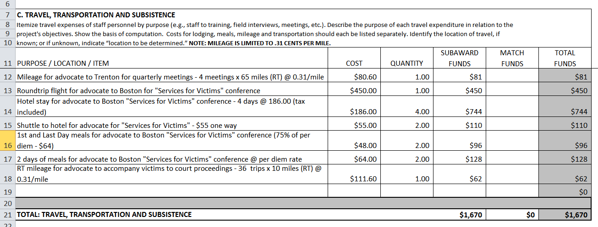
Travel
Mileage Reimbursement Rate = $.31 per mile
This rate cannot be charged in excess of the New Jersey State maximum of State Treasury Circular Letter, Automobile Mileage Reimbursement Rate, 01‑02‑OMB.

Slide 44
Supplies
***New***
Supplies = LESS than $5,000 regardless of useful life.
All tangible personal property other than those described in §200.33 Equipment.

Slide 45
Facilities

Slide 46
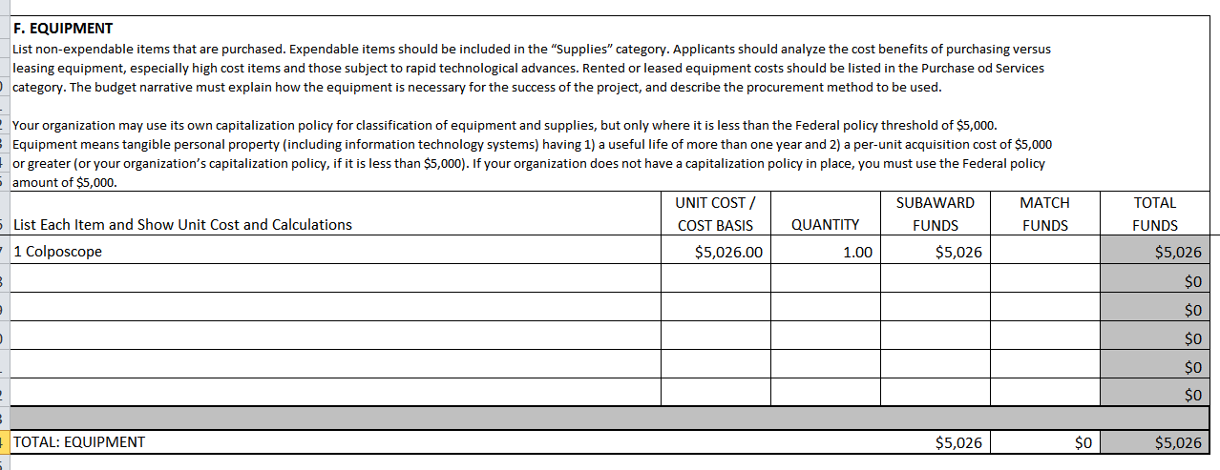
Equipment
***NEW***
Equipment = each single item totaling OVER $5,000
Tangible personal property (including information technology systems) having a useful life of more than one year

Slide 47
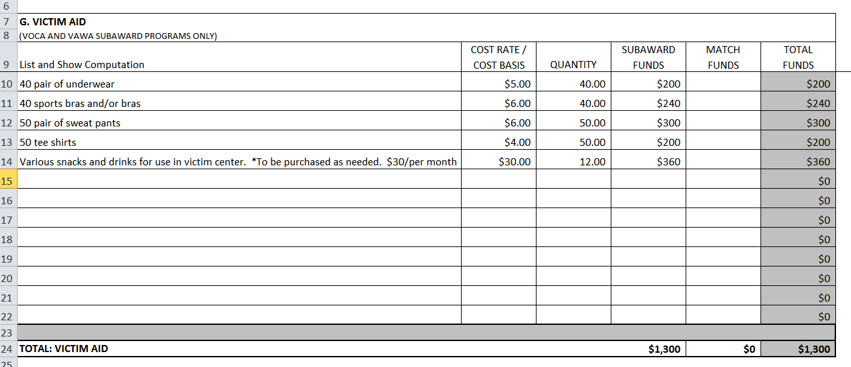
Victim Aid
Agency must develop fiscal policies for victim aid.
Fiscal policies must specify:
Eligibility
Intended use of items
Approval process
Access

Slide 48
Victim Aid – Gift Cards
***NEW***
No more than 1 percent of victim aid should be used for Gift Cards during the program's fiscal year.
Alcohol and tobacco may NOT be purchased with Gift Cards; Subgrantee must develop procedures to mark the Gift Cards, either with a sticker or a hand-written disclaimer, that states “No alcohol or tobacco may be purchased with this Gift Card.”
No Cash Gift Cards, such as Visa Gift Cards, are allowed.
Gift cards must be kept in a secure location and access to them must be restricted
A Gift Card distribution log must be maintained.

Slide 49
Matching Funds
A 20% match is required for public & private nonprofit agencies.
Match must come from non-federal sources.
Match can only be used for allowable costs and services under the VOCA Final Rule.
Match is not necessary for each line item or budget category.
Match can be Cash or In-Kind.
For In-Kind Match:
Explain calculations.
Examples of in-kind match/contributions to the project:
volunteer time
office space/utilities/phone
donations of equipment
office supplies
workshop/classroom materials
services which are necessary to the project

Slide 50
Formula to Calculate 20% Match
Federal Funds Requested $÷$Federal Percentage = Total Project Cost
Total Project Cost x Match Percentage = Required Match Amount
Example:
$300,000 (federal funds requested)
$300,000 $÷$ 80% = $375,000 (Total project cost)
$375,000 x 20% = $75,000 (Required Match)

Slide 51
Indirect Cost Rate 2 CFR 200.331, 200.414
Subgrantees may claim indirect costs.
Subgrantees have the following three options:
€ Option #1: Elect to use your approved, federally-recognized negotiated ICR.
€ Option #2: Elect to accept the 10% de minimis ICR, if your agency has NEVER had an ICR negotiated with the Federal Government.
€ Option #3: Elect not to seek indirect costs.

Slide 52
Indirect Costs Important Points to Remember
For Agencies using the De Minimis:
Costs must consistently be charged as indirect or direct across all programs; costs may not be double charged or inconsistently charged as both indirect or direct
For Agencies with an Indirect Cost Rate
The Subgrantee must submit a copy of its current ICR approval letter, detailing the rate agreed upon by your agency and the Federal government and its effective date, with the grant application.
For All Agencies
May elect to use a smaller percentage than either one’s ICR or the de minimis (10%) but, must specify this in the budget narrative.

Slide 53
Application
Documents

Slide 54
Subrecipient Check List
In Handout Folder
Applications MUST be complete
List of documents to be signed
Nonprofits must submit additional forms

Slide 55
Application Overview

Slide 56
Agency Specific Information
Charity Registration: If you do not have a current registration – request a letter from the Division of Consumer Affairs that states your agency is current.

Slide 57
Contact Information
Project Specific Contact
Complete contact information for each position listed.

Slide 58
Sources of Funds

Slide 59
Funding from DCJ Include VOCA and VAWA

Slide 60
Application Authorization
Authorized Official and Project Director MUST sign.

Slide 61
Major Forms

Slide 62
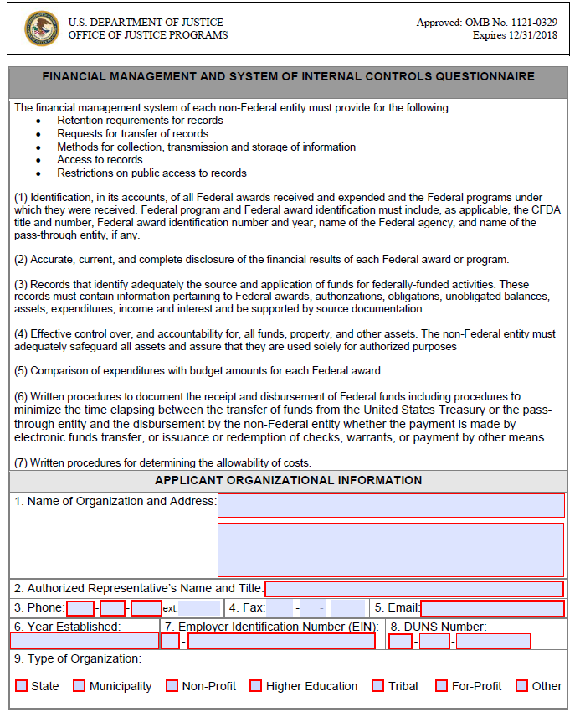
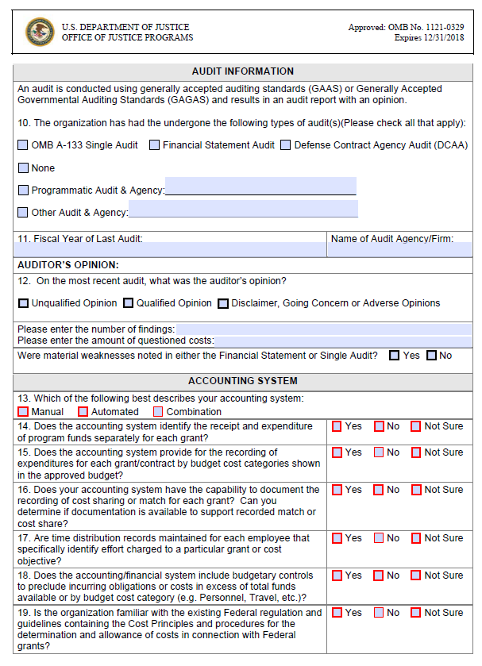
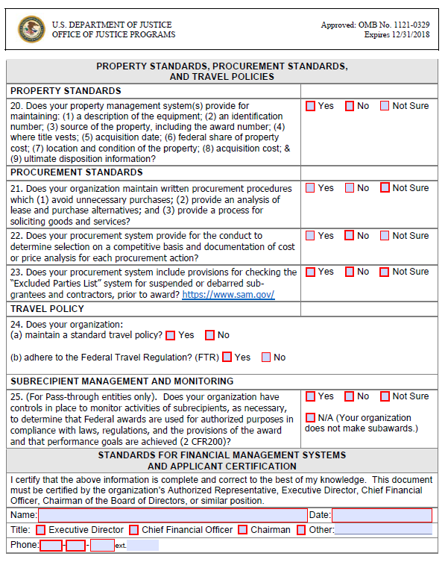
Accounting System and Financial Capability Questionnaire

Slide 63
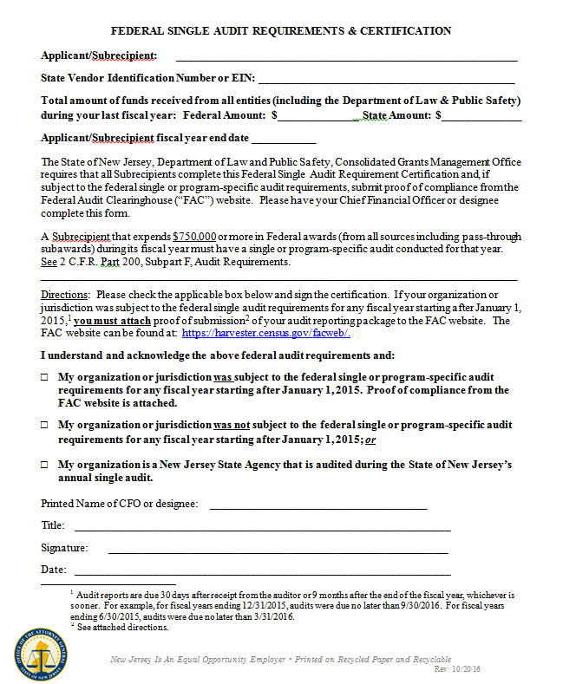
Federal Single Audit Requirements Certification
Make sure you print out and return “FAC” proof form
CFO MUST Sign

Slide 64
Proof of Compliance – Federal Single Audit Requirements

Slide 65
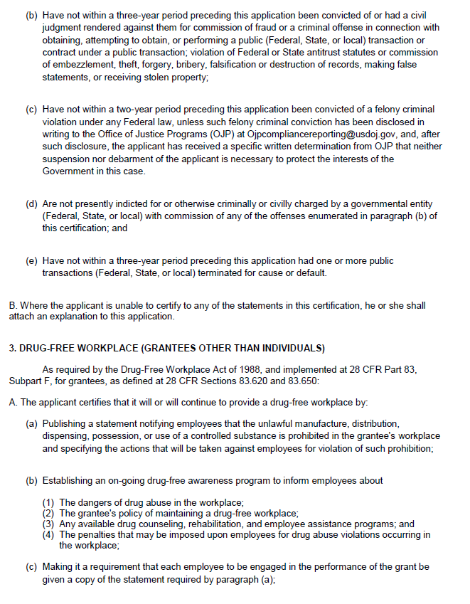
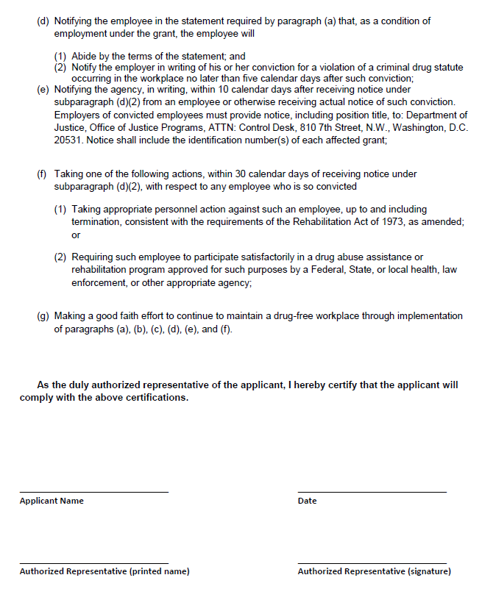
Certification Re: Lobbying, Debarment, Suspension …

Slide 66
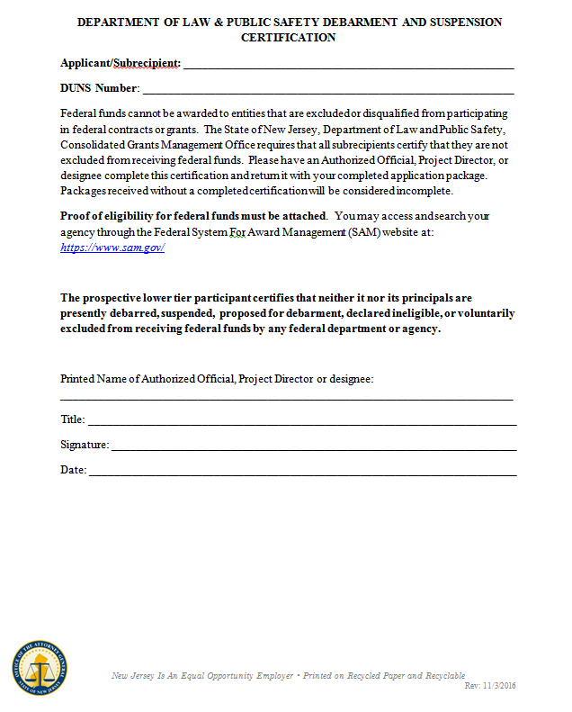
Department of Law & Public Safety Debarment and Suspension Certification
Must be Signed by Authorized Official or Project Director
Make sure you print out and return “SAM” form

Slide 67
Common Errors
Unsupported assertions in the Problem Statement
Discussing the project too generally “… during remainder of time we will provide direct services.”
Assuming the reader knows the Agency or the project
Math and Budget Errors
Missing signatures on forms
Missing or outdated letters of support
Missing or outdated resumes and job descriptions
Missing forms or forms not signed by Authorized Official
Unallowable and unreasonable costs
Late Submission = Disqualified

Slide 68
Helpful Tips
DO NOT USE OLD Narratives, Budgets, or Forms from previous grant applications.
Organize your application to correspond with the headers/sections of the application.
Go in order of the headers/sections in the application checklist.
This will eliminate reviewers hunting for information such as, “Problem Statement/Needs Assessment.”
Write your project narrative as if your audience knows nothing about your agency, project, or victim services.
Describe your project in detail and provide justification, statistics and explanations for the statements/assertions you make.
Use the checklist provided to make sure ALL documents are completed and submitted with the application.

Slide 69
HELPFUL TIPS
Submit one (1) original application and three (3) copies.
Make sure the correct amount of copies are submitted.
Do not submit double-sided originals.
Secure the application with butterfly clips.
Do not use binders, staples or cover pages.
Do not fax or email applications.

Slide 70
HELPFUL LINKS
NJ Dept of the Treasury – Nonprofit Organizations
http://www.state.nj.us/treasury/taxation/exemptintro.shtml
DOJ Grants Financial Guide
https://www.justice.gov/ovw/file/892031/download
VOCA Final Rule
https://www.federalregister.gov/documents/2016/07/08/2016-16085/victims-of-crime-act-victim-assistance-program
Office for Victims of Crime – Grants
https://ojp.gov/ovc/grants/

Slide 71
Where do I get application?
Applications are available at
www.njvw.org
www.njvw.org

Slide 72
Application Deadline
MUST be Postmarked by: Friday, September 15th or Hand-Delivered before 4:00 pm on September 15th
SEPTEMBER
15th

Slide 73
Where to send applications:
By Regular Mail:
NJ Division of Criminal Justice
State Office of Victim-Witness Advocacy
PO Box 085
Trenton, N.J. 08625-0085
By Hand Delivery or Overnight Mail:
NJ Division of Criminal Justice
State Office of Victim-Witness Advocacy
5th Floor – West Wing
25 Market Street
Trenton, N.J. 08625

Slide 74
Good luck with your application!
Any Questions?
Now is the time to ask.

