Slide 1
New Jersey Department of Transportation
New Jersey State League of Municipalities Conference
Atlantic City Convention Center
“On the Road Again”
November 14-16, 2017
Presented By:
The Division of Local Aid and Economic Development
New Jersey Department of Transportation

Slide 2
Fiscal Year 2018 Capital Program
$3.669 billion total
$2.302 billion NJDOT
$1.367 billion NJ Transit
$701 million NJDOT Local Systems Support:
Includes $322 million State Aid to counties and municipalities; $47.3 million Local Bridges; $30 million newly created Freight Impact Fund; $30 million Local Aid Infrastructure Fund; Safe Routes to Schools; Local Safety/High Risk Rural Roads; Culvert Inspections …

Slide 3
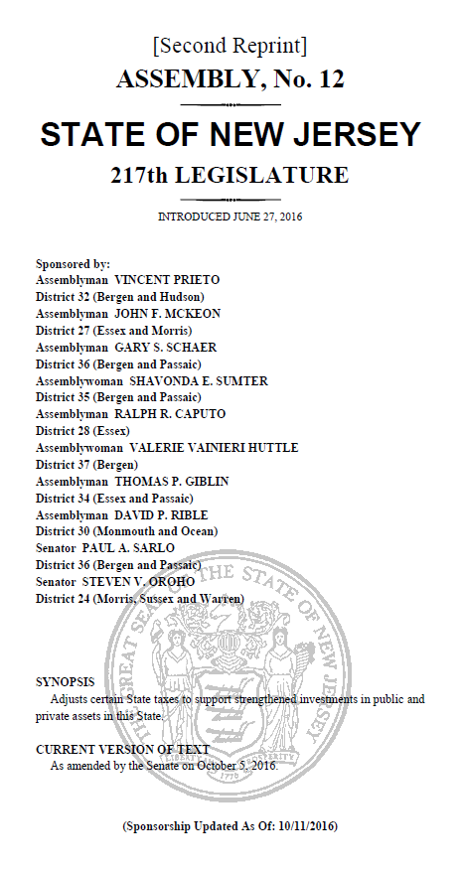
Transportation Trust Fund
October 2016-TTF Reauthorization
Increased Aid to Counties and Municipalities
$400 million legislated
$210 million increase
Municipal Aid-$150 million (Includes $10 million in Urban Aid)
County Aid-$150 million
Local Bridge Fund-$44 million
Local Aid Infrastructure Fund (LAIF) - $7.5 million
Local Freight Impact Fund-$28 million

Slide 4
Transportation Trust Fund
March 2017 - Supplemental Authorization
$400 million for infrastructure projects
$260 million for NJDOT projects
$140 million for NJ Transit
Local Programs - $30 million supplemental to be programmed in years 2018 - 2024

Slide 5
FY 2017 & FY 2018 STATE AID PROGRAMS
Program | FY 2017 Funding Levels | FY 2018 Funding Levels | Supplemental Allocation
Municipal Aid | $73.75 Million | $140.00 Million | $11,250,000
County Aid | $78.75 Million | $150.00 Million | $11,250,000
Transit Village | $1.0 Million | $1.0 Million | -
Safe Streets to transit | $1.0 Million | $1.0 Million | -
Bikeway | $1.0 Million | $1.0 Million | -
Local Bridges Future Needs(LBFN) | $25 Million | $44 Million | $3,300,000
Local Aid Infrastructure Fund(LAIF) | $7.5 Million | $7.5 Million | $562,500
Local Freight Impact Fund | $0.0 Million | $28.0 Million | $2,100,000
Urban Aid | $5.0 Million | $10.0 Million | -

Slide 6
NJDOT Local Aid Programs
State Funded Programs
Municipal Aid
County Aid
Local Bridges
Freight Impact Fund
Safe Streets to Transit
Transit Village
Bikeways
Local Aid Infrastructure Fund
Safe Corridors Highway Safety Fund*
Federal Funded Programs
Local Lead
Transportation Alternatives
Safe Routes to Schools
Highway Safety Improvement Program
Emergency Relief
High Priority Projects

Slide 7
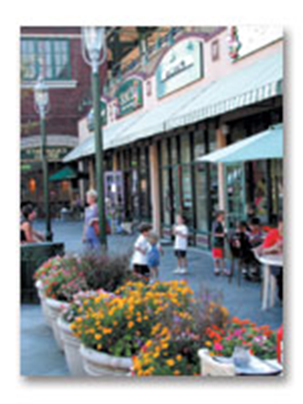
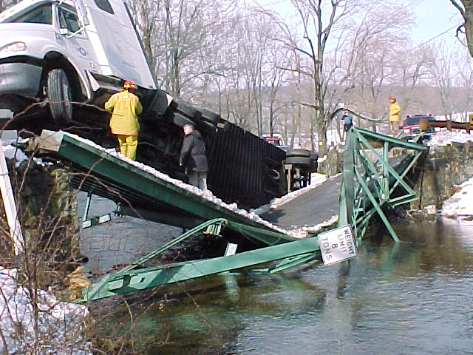
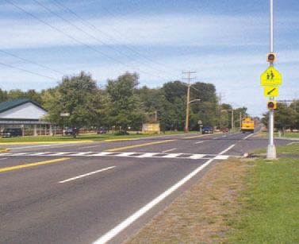
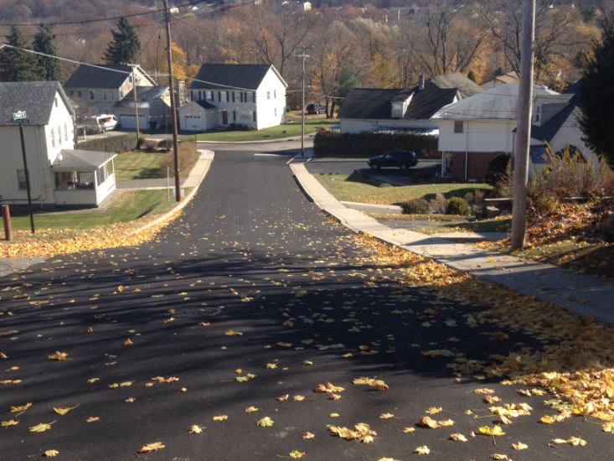
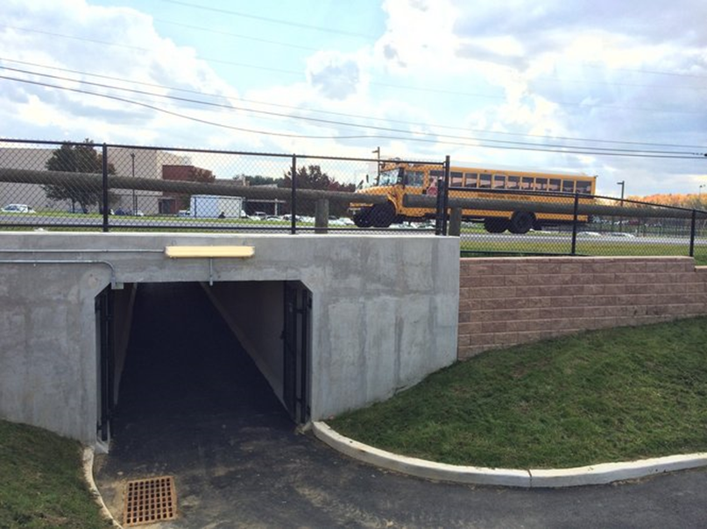
Local Aid Program Schedules
FY 2018 Municipal Aid
Request for applications– July 24, 2017
Application deadline-October 6, 2017
FY 2018 Bikeway, Transit Village, & Safe Streets to Transit
Request for applications– July 24, 2017
Application deadline-October 6, 2017
FY 2018 Local Bridge
Request for applications – October 30, 2017
Application deadline – December 29, 2017
FY 2018 Freight Impact Fund
Request for applications – September 26, 2017
Application deadline – December 19, 2017
FY 2018 County Aid Program
Request for applications – July 28, 2017
Application deadline-February 1, 2018
FY 2018 Highway Safety Program
Anticipated Program Announcement – November 2017
Safe Routes to School
TBD
Transportation Alternatives
TBD
Regional TAP Program
Application Deadline-August 22, 2017
Anticipated Grant Announcements–December 2017

Slide 8
State Aid Programs

Slide 9
State Aid Programs
Funded by the Transportation Trust Fund
Governed by Municipal Aid and County Aid regulations; N.J.A.C. 16:20A & 16:20B
Municipal Aid
Projects must be awarded to construction within 24 months of grant notification
75% of award/grant amount available at time of construction award
25% at construction completion and final acceptance
County Aid
Projects must be awarded to construction within 36 months of grant notification
100% available at time of construction award

Slide 10
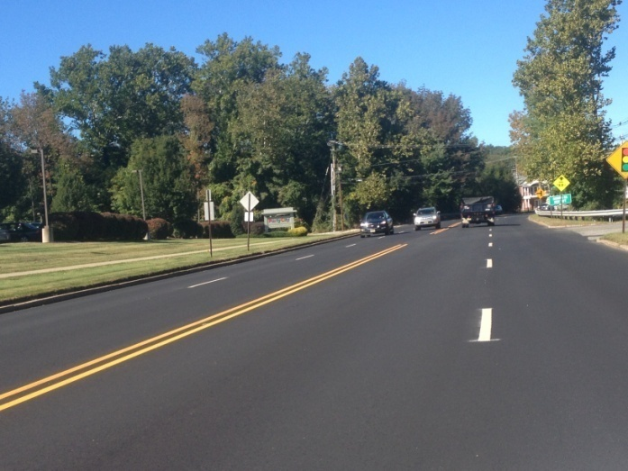
County Aid
All counties eligible
Non–competitive. Counties select projects.
FY 2017 -$78.75 M TTF
FY 2018 - $161.25 M TTF
Allocations based on county population and road mileage
Transportation projects including improvements to county owned roads and bridges

Slide 11
FY 2017 & FY 2018 COUNTY AID ALLOCATIONS
County | FY 2017 | FY 2018 | Supplemental Allocation | Total Increase
Atlantic | $3,433,500 | $6,540,000 | $490,583 | $3,597,083
Bergen | $6,654,500 | $12,675,300 | $950,623 | $6,971,423
Burlington | $4,989,800 | $9,504,300 | $712,834 | $5,227,334
Camden | $4,534,000 | $8,636,200 | $647,751 | $4,749,951
Cape May | $1,626,400 | $3,098,000 | $232,360 | $1,703,960
Cumberland | $3,890,100 | $7,409,800 | $555,684 | $4,075,384
Essex | $4,773,000 | $9,091,400 | $681,872 | $5,000,272
Gloucester | $3,690,600 | $7,029,700 | $527,210 | $3,866,310
Hudson | $3,160,500 | $6,020,000 | $451,553 | $3,311,053
Hunterdon | $1,979,000 | $3,769,400 | $282,741 | $2,073,141
Mercer | $2,678,200 | $5,101,500 | $382,551 | $2,805,851
Middlesex | $5,351,100 | $10,192,500 | $764,430 | $5,605,830
Monmouth | $4,956,000 | $9,440,100 | $708,012 | $5,192,112
Morris | $3,940,600 | $7,505,900 | $562,945 | $4,128,245
Ocean | $6,237,700 | $11,881,300 | $891,085 | $6,534,685
Passaic | $3,649,000 | $6,950,300 | $521,264 | $3,822,564
Salem | $2,399,200 | $4,569,900 | $342,738 | $2,513,438
Somerset | $2,834,900 | $5,399,900 | $404,942 | $2,969,942
Sussex | $2,522,900 | $4,805,500 | $360,431 | $2,643,031
Union | $3,445,500 | $6,562,800 | $492,218 | $3,609,518
Warren | $2,003,500 | $3,816,200 | $286,174 | $2,098,874
Total | $78,750,000 | $150,000,000 | $11,250,000 | $82,500,000

Slide 12
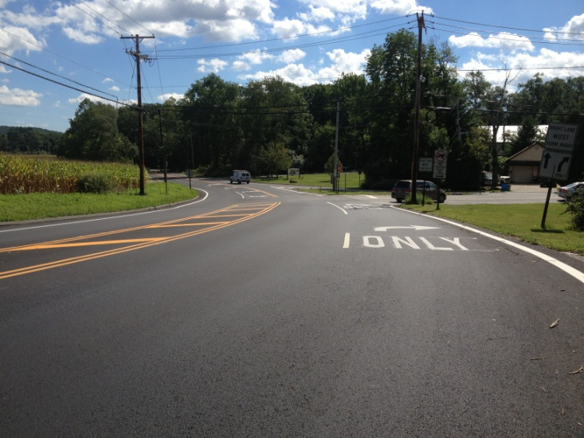
Municipal Aid
All municipalities eligible
Competitive application process
FY 2017 -$78.75 M TTF
FY 2018 - $150.25 M TTF
Road & bridge preservation, roadway safety, pedestrian safety, bikeways, mobility, and quality of life

Slide 13
COMPARISON OF FY 2017 & FY 2018 MUNICIPAL AID PROGRAMS WITH SUPPLEMENTAL ALLOTMENT
County | FY 2017 | FY 2018 | Supplemental Allocation | Total Increase
Atlantic | $2,926,749 | $5,555,863 | $446,453 | $3,075,567
Bergen | $6,894,225 | $13,087,342 | $1,051,661 | $7,244,779
Burlington | $4,338,616 | $8,236,016 | $661,823 | $4,559,223
Camden | $4,134,007 | $7,847,606 | $630,611 | $4,344,210
Cape May | $1,346,343 | $2,555,769 | $205,374 | $1,414,801
Cumberland | $1,509,044 | $2,864,625 | $230,193 | $1,585,775
Essex | $5,060,790 | $9,606,923 | $771,985 | $5,318,118
Gloucester | $2,677,146 | $5,082,040 | $408,378 | $2,813,272
Hudson | $3,319,687 | $6,301,780 | $506,393 | $3,488,485
Hunterdon | $1,916,346 | $3,637,809 | $292,324 | $2,013,787
Mercer | $3,084,937 | $5,856,151 | $470,584 | $3,241,798
Middlesex | $6,088,485 | $11,557,801 | $928,752 | $6,398,069
Monmouth | $6,193,126 | $11,756,442 | $944,714 | $6,508,031
Morris | $4,771,907 | $9,058,534 | $727,918 | $5,014,546
Ocean | $5,203,854 | $9,878,502 | $793,808 | $5,468,457
Passaic | $3,423,708 | $6,499,242 | $522,260 | $3,597,795
Salem | $828,632 | $1,572,997 | $126,402 | $870,766
Somerset | $3,148,536 | $5,976,881 | $480,285 | $3,308,631
Sussex | $1,793,255 | $3,404,145 | $273,547 | $1,884,437
Union | $3,740,046 | $7,099,749 | $570,516 | $3,930,218
Warren | $1,350,564 | $2,563,782 | $206,018 | $1,419,236
Total | $73,750,000 | $140,000,000 | $11,250,000 | $77,500,000
URBAN AID ALLOCATION FOR FY 2017 = $5,000,000
URBAN AID ALLOCATION FOR FY 2018 = $10,000,000

Slide 14
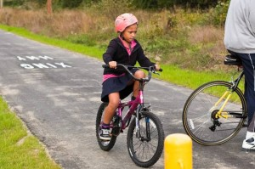
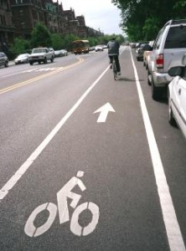
Bikeway Program
Municipalities and counties eligible
Competitive application process
$1M – TTF FY 2017/2018
Promotes bicycling as an alternate mode of transportation
Primary objective: 1,000 new miles of dedicated bike paths
Hopewell Township

Slide 15
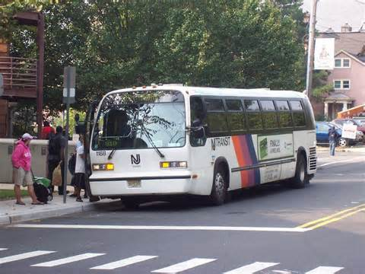
Safe Streets to Transit Program
Municipalities and counties eligible
Competitive application process
$1 M TTF - FY 2017/2018
Improves pedestrian access to transit facilities and all modes of public transportation

Slide 16
Transit Village Program
Designated Transit Villages are eligible (32 currently)
Competitive application process
$1.0M TTF – FY 2017/2018
Promotes transit oriented development for municipalities that have made a commitment to grow in the area surrounding a transit facility

Slide 17
Local Aid Infrastructure Funds
Municipalities and counties eligible
Non-competitive, need-based review process
Applications accepted throughout the year
$7.5 M – TTF FY 2017/2018
Established to address emergent or regional needs

Slide 18
Local Bridges
Counties eligible
$25.0 M TTF - FY 2017
$1.0M per County for FY 2017
Remaining $4.0M competitive based on cost benefit assessment
$47.3 M TTF - FY 2018
$1.0 M per County ($21.0 M)
50% Remaining-Percentage of Total Deck Area ($13.15 M)
50% Remaining-Percentage of Structurally Deficient Deck Area ($13.15M)
Eligibility Criteria: Structurally deficient, functionally obsolete, scour critical, and minor County owned bridges

Slide 19
Local Bridges
Program initiated in 2009
2623 county owned bridges
298 Structurally Deficient (SD) bridges at time of program implementation
158 Structurally Deficient bridges removed from county SD inventory
191bridge projects funded to date
273 SD bridges remained in inventory for FY 2017
Atlantic County
LBFN – Atsion Road Bridge
Construction Cost $963,745
Passaic County
LBFN - Clinton Road Bridge
Construction Cost $924,385

Slide 20
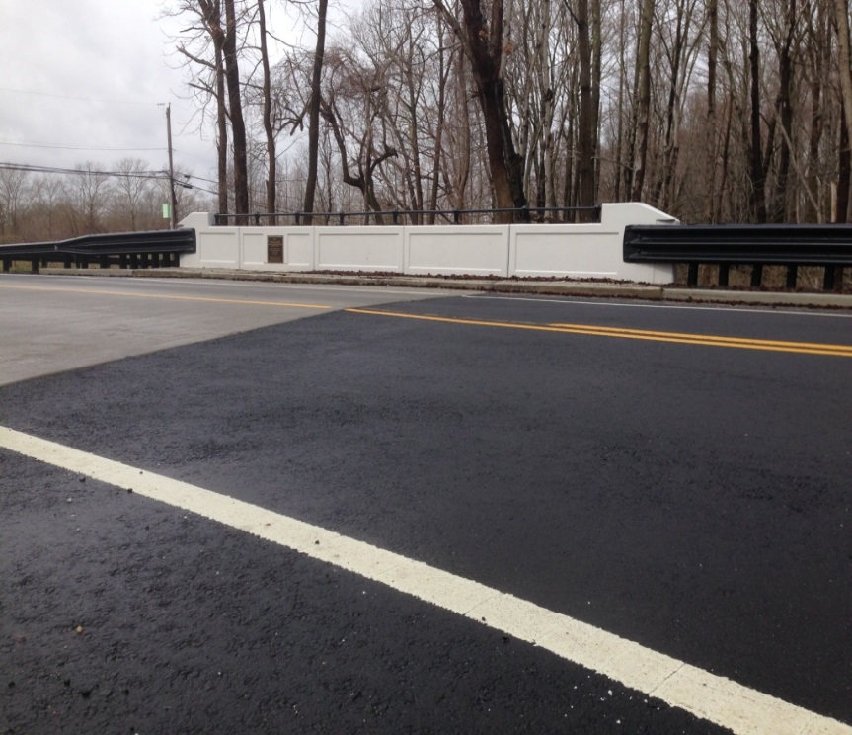
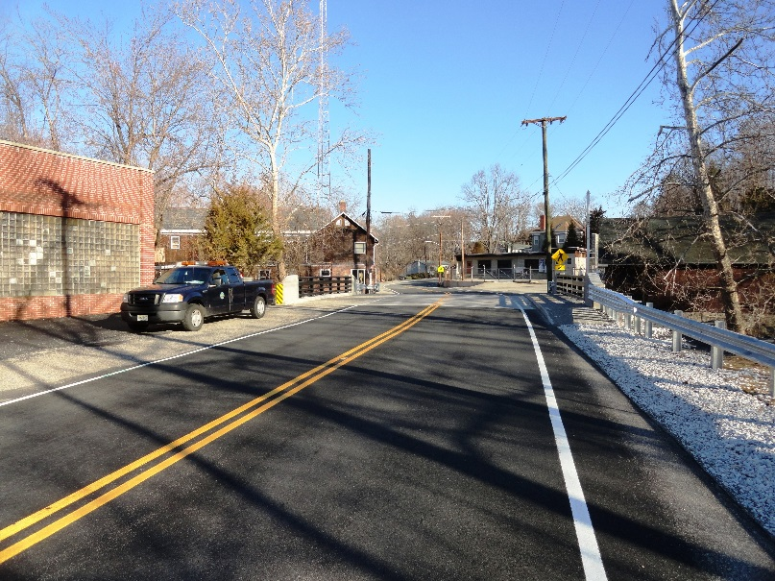
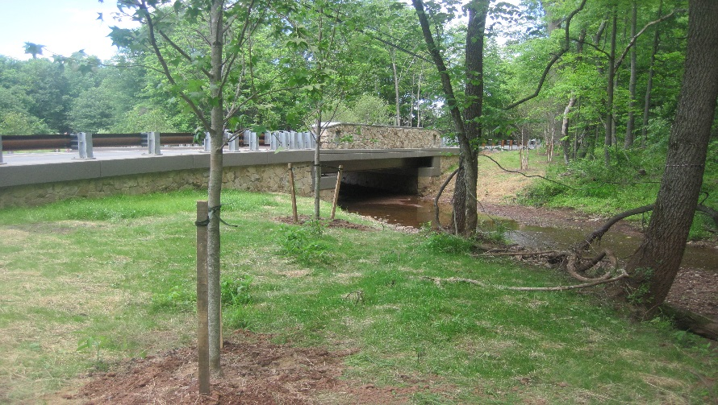
Local Bridges
Monmouth County
LBFN – Iron Ore Road at North Brook
Construction Cost - $822,319
Sussex County
LBFN – CR 631 over Walkill River
Construction Cost - $654,820
Somerset County
LBFN – River Road Bridge over Tributary to North Branch of Raritan River
Construction Cost - $811,501

Slide 21
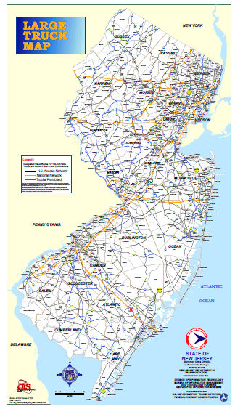
Local Freight Impact Fund
Provides aid to counties and municipalities for transportation projects that address the impacts of freight travel in local communities and on local transportation infrastructure

Slide 22
Local Freight Impact Fund
Competitive application based
FY 2018 - $30.1 M TTF
Eligible Projects
Under municipal/county jurisdiction
Provide access to freight corridors, port facilities, warehouse distribution centers, and other freight nodes
Minimum 5% large truck volumes
Project Categories
Pavement Preservation
Safety and Mobility
Bridge Preservation
New Construction

Slide 23
Federal Aid Programs

Slide 24
FY 2018 Federal Aid Programs
Safe Routes to School - $5.6 M
Transportation Alternatives - $13.4 M
Local Safety High/Risk Rural Roads Program $22 M
Local CMAQ Initiative $10.5M
MPO Local Lead Program (STP/State) $89.9M

Slide 25
Federal Aid Programs
Federal Funding Source-Recent Highway Bills
2012 Act - MAP 21
Moving Ahead for Progress in the 21st Century
2015 Act – Fast Act
Fixing America’s Surface Transportation Act

Slide 26
Federal Requirements
Governed by 23 CFR-Title 23- Highways
Funds provided on a reimbursement basis
NJDOT serves as the pass-through
Local Public Agencies (LPAs) are sub-recipients
NJDOT responsible for ensuring federal compliance
NJDOT responsible for ensuring project sponsors have adequate resources and internal controls to manage federal-aid projects

Slide 27
Transportation Alternatives
Eligible recipients
Local governments
Regional transportation authorities
Transit agencies
Natural resource or public land agencies
Tribal governments
Any other local or regional governmental entity with responsibility for oversight of transportation (other than an MPO or State agency)
Competitive application based process
$13.4 M programmed in FY 2018

Slide 28
Transportation Alternatives Eligible Categories
Provision of facilities for bicycles and pedestrians
Scenic or historic highway programs, including provision of tourist and welcome centers, scenic turnouts, overlooks and viewing areas
Landscaping and other scenic beautification
Historic preservation

Slide 29
Transportation Alternatives Eligible Categories
Rehabilitation of historic transportation buildings, structures, and facilities (including historic railroad facilities and bridges)
Preservation of abandoned railway corridors (including conversion to pedestrian and bicycle trails)
Environmental mitigation to address water pollution due to highway runoff or reduce vehicle-caused wildlife mortality while maintaining habitat connectivity

Slide 30
Transportation Alternatives Program Requirements
Project is Surface Transportation related
Meets at least one of the eligible categories
Includes Resolutions of Support
Includes local maintenance commitments
Requires Local Public Agency Responsible Charge

Slide 31
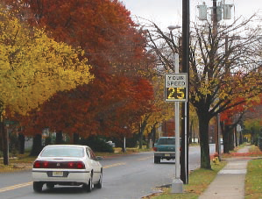
Safe Routes to School
Municipalities, counties & school districts eligible
Competitive application based process
Infrastructure projects only. Construction only.
$5.6 M programmed in FY 2018
Provides funds for projects that encourage and enable children in grades K-8 to walk and bicycle to school

Slide 32
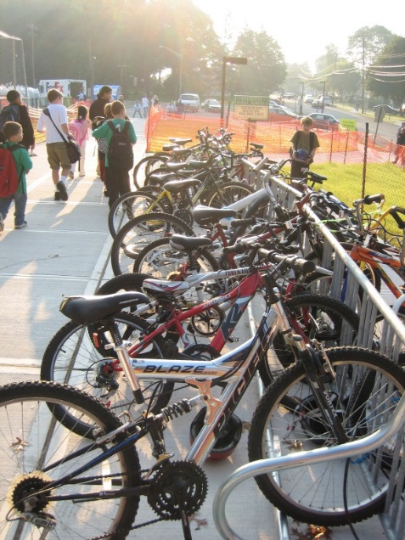
SRTS Selection Criteria
Within 2 miles of a K-8 school
Support from school board and municipality
Potential to improve safety
Potential to increase students walking or biking to school

Slide 33
Local Lead Program
MPO sub-regions eligible.
MPO project intake
Federal-aid routes and bridges eligible
$89.9M Federal/TTF Programmed in FY 18
Provides funds to advance projects through preliminary engineering, final design, right of way, and construction

Slide 34
Highway Safety Improvement Program
Includes Local Safety & High Risk Rural Roads Program – LS/HRRR
Goal is to significantly reduce traffic fatalities and serious injuries
Competitive, data driven, selection process administered by MPO’s
Projects must be supported by detailed crash data analysis
Funding for Design, ROW & Construction
Burlington County
HSIP – CR 528 & Old York Road
Construction Cost - $2.0 M

Slide 35
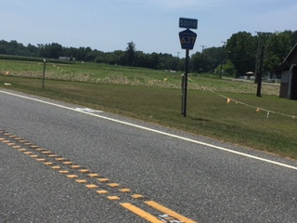
Highway Safety Improvement Program
9 Proven Countermeasures
Roundabouts
Corridor Access Management
Backplates with Retroreflective Borders
Longitudinal Rumble Strips and Stripes on 2-Lane Roads
Enhanced Delineation and Friction for Horizontal Curves
Safety Edge
Medians and Pedestrian Crossing Islands in Urban and Suburban Areas
Pedestrian Hybrid Beacons
Road Diets
Somerset County
HSIP – Promenade Boulevard
Construction Cost $804,443
Cumberland County
HSIP – Centerline Rumble Stripes
Construction Cost $1,556,396

Slide 36
Emergency Relief
Provides funds in response to natural disasters such as floods, hurricanes and severe storms
Federal-aid highways only
Emergency or temporary repairs & permanent repairs
Permits immediate repairs
Purpose is to restore essential traffic, minimize the extent of damage, or protect remaining facilities

Slide 37
Design Assistance Programs

Slide 38
Design Assistance
Program Highlights
Establishes a pool of design consultants for LPA’s use
LPA selects consultant from pool, develops scope of work, negotiates proposal, and enters into agreement directly with consultant
NJDOT provides funds on a reimbursement basis
Use of pool consultants is not mandatory
Disciplines limited to Highway and Traffic Engineering

Slide 39
Design Assistance
Program Benefits
Simplified procurement process for LPA’s
Shortened time and reduced costs
Improved quality and performance
Quicker NJDOT review times
Improved compliance with federal and state procurement requirements

Slide 40
http://www.state.nj.us/transportation/business/localaid/

Slide 41
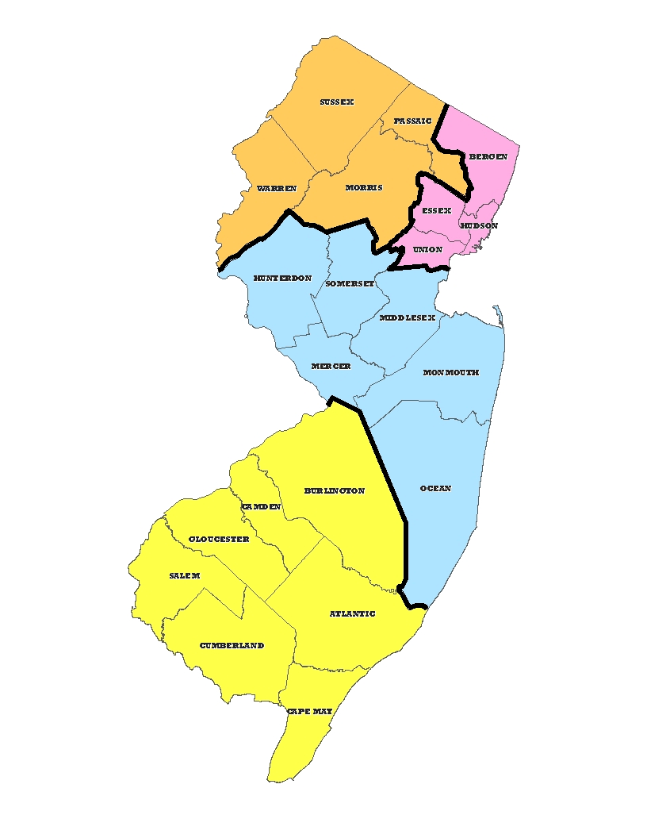
New Jersey Department of Transportation Local Aid and Economic Development
District 2
Richard Loveless
Eileen Schack
153 Halsey Street, 5th Floor
Newark, NJ 07102
973.877.1500
FAX: 973.648-4547
District 1
Joseph Birchenough
Roxbury Corporate Center
200 Stierli Court
Mount Arlington, NJ 07856
973.601.6700
FAX: 973.601.6709
District 3
1035 Parkway Ave
Trenton, NJ 08625
609.530.5271
FAX: 609.530.8044
District 4
Salim Mikhael
1 Executive Campus
Route 70 West
Cherry Hill, NJ 08002
856.486.6618
FAX: 856.486.6771
Main Office
1035 Parkway Avenue
Trenton, NJ 08625-06000
609.530.3640
FAX: 609.530.8044

