Slide 1
What’s New?
State and National FFA Updates
Kristianne M. Dowd
State FFA Specialist
Fall Food, Agriculture & Natural Resources Education
Professional Development Conference
September 27, 2019
Footer description area.

Slide 2
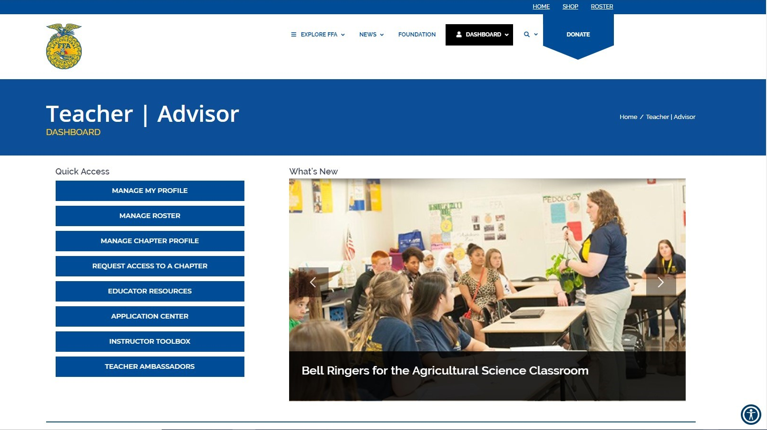
New Jersey FFA Association
FFA.org Teacher & Advisor Dashboard
Notes:
The new dashboard offers a collection of all materials that you may need. From the dashboard you can manage your personal profile, the chapter’s profile and the roster. It is important that you review your profile and the chapter profile in order to ensure that all information is accurate. This is where we compile the Ag Ed Directory from.
The roster system is the same.
Be sure to take advantage of the various educator resources that National FFA has available. They have a wide array of lesson plans that are ready to be incorporated into your classroom, activities such as bell ringers and guides, and resources to help assist in the management of your program. All materials with National FFA on SAE have been updated to the new SAE For All framework.
The application center remains the same on AET
The instructor toolbox is a compilation of links that you may need to utilize through the year.

Slide 3
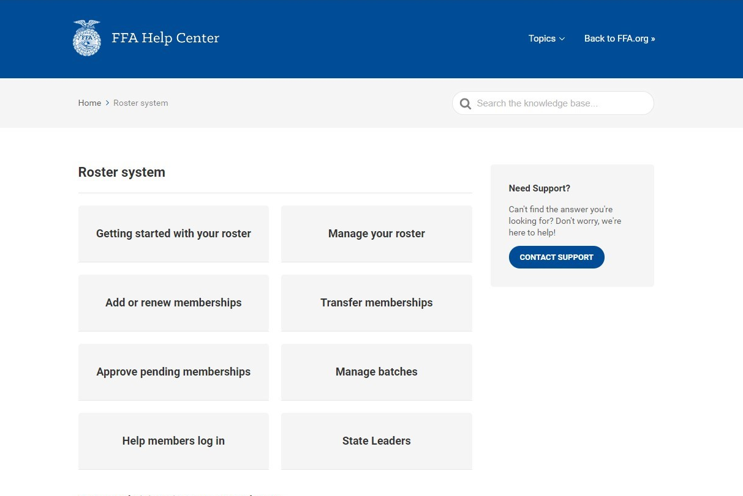
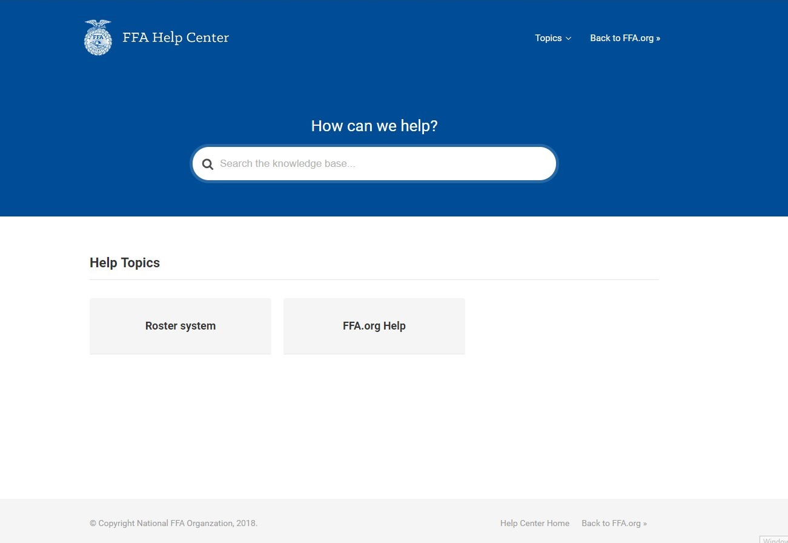
New Jersey FFA Association
Help.FFA.org
Log In Help
Notes:
While the roster system is the same, National FFA has created a new help center at help.ffa.org that can provide guidance as you complete your roster by November 1 in order to maintain your FFA Charter.
The ffa.org help tab can help you with any troubles you or your students may have when logging in.
Within the roster help center, there are eight different paths that National FFA has created that will walk you through the steps.

Slide 4
New Jersey FFA Association
Chapter Charter Requirements: POA
Due December 1
AET (mandatory in 2018-2019) – www.theaet.com
Online resources
Online portal that teacher and select students can access
LEAD participants will be provided hands-on instruction for entering the POA into AET
Bring a lap top
Assign at least one student in attendance to have access
Attend the 10:15 am session on Saturday to work along side your students
Must include goals and action plan
Should include the 5 activities you plan to participate in above the chapter level
To submit, generate a PDF and email it to ag.ed.registration@ag.nj.gov.
Superior Chapter & National Chapter Applications
Notes:
Another requirement of maintaining your FFA charter is of course the submission of your POA by December 1. Just like last year, all POAs must be developed in AET. A strong POA is the basis of quality superior and national chapter applications.
Schools attending LEAD with COLT participants must bring a laptop with internet capabilities to provide students the opportunity to work on the POA. Please have all students logged into AET prior to arrival at LEAD in order to ensure that there is enough time for them to work on the POA itself. Teachers are welcome to work along side their students during the 10:15 session on Saturday.

Slide 5
New Jersey FFA Association
Other Chapter Charter Requirements
Program Affiliation Contract (due September 30)
Chapter Officer List (due October 1)- Must be submitted via JotForm
Chapter Roster (November 1)- submitted through FFA.org
Chapter Constitution (due December 1)
Participate in at least five State/National FFA events
Career/Leadership Development Events
Leadership Conferences
State & National awards
2 Delegates to the State FFA Convention in May
Notes:
Please keep the chapter charter requirements in your calendar so that you are not missing them.

Slide 6
New Jersey FFA Association
JotForm: Participant Lists & Applications
Continue to submit your participant lists through JotForm
New applications will be going live on JotForm throughout the year https://www.jotform.com/NJFFA/cover-page
Member of the Month/Year
Nominating Committee Member
State Officer Candidate
State Convention Talent
Scholarships
Blue Jackets. Bright Futures.
Essay Event
Advisor of the Year
Most Improved FFA Chapter
FFA Week Event
Agricultural Awareness – NEW DUE DATE APRIL 1
8000 Hour Challenge
All new applications will have the Save and Edit Later Feature
Notes:
We will continue to utilize jotform in the office as the only way to submit participant lists. Over the summer, Jeremy Posluszny revamped some of our old applications and created new ones to be used this year. Instead of having individual cover pages for each application, there is one cover page where you select which application is being completed. Once you submit the cover page, you will then be provided with a link that takes you to the application.

Slide 7
New Jersey FFA Association
JotForm: Participant Lists & Applications
Continue to submit your participant lists through JotForm
New applications will be going live on JotForm throughout the year https://www.jotform.com/NJFFA/cover-page
Member of the Month/Year
Nominating Committee Member
State Officer Candidate
State Convention Talent
Scholarships
Blue Jackets. Bright Futures.
Essay Event
Advisor of the Year
Most Improved FFA Chapter
FFA Week Event
Agricultural Awareness – NEW DUE DATE APRIL 1
8000 Hour Challenge
All new applications will have the Save and Edit Later Feature
Notes:
All of the new applications do contain a save and edit later feature. When utilizing this feature, be sure to fill out all of the required items on the page you are currently on in order for it to be saved.
With the use of this new form, we will also be changing the due date of the Agricultural Awareness application to April 1. Chapters who are interested in competing will need to complete the application by that date and will no longer be required to bring the material to state convention.
Keep an eye out for these applications and references to the Cover Page and Form Selector in announcements.
I am in the process of saving our JotForms into PDF versions. These PDFs will be uploaded to the State Activity Guide to be used as a reference. NO PAPER COPIES OF THE APPLICATIONS WILL BE ACCEPTED. THEY MUST BE SUBMITTED THROUGH JOTFORM. These PDFs will be on the website as a guide for what information you may need prior to completing the application.

Slide 8
New Jersey FFA Association
National Awards & Recognition Program Updates
CDEs and LDEs are open to all grade levels of active membership (grades 7-12 at the time of qualifying) except for Conduct of Chapter Meetings and Creed Speaking LDEs
Meat Eval and Tech will now require four member teams in 2020
The Free Chapter Medal Program has been discontinued
National Agriscience Fair will only have 10 finalists per category division
There have been slight changes to a few Proficiency Areas for 2020
The Home and/or Community Development Proficiency Area is being updated to the Service-Learning Area
The Food Science and Technology Area has merged with other areas
The Grain Production Entrepreneurship and Placement Areas have been combined
Minor application updates will take place to accommodate electronic/online submission of Proficiency Awards, Agriscience Fair, National Chapter, and American Star
Notes:
We received an update this summer of a few changes that are upcoming for future competitions. As of a change a couple years ago, 7th and 8th graders are allowed to compete on the national level in all CDEs and LDEs. The only LDEs with age restrictions continue to be Creed Speaking and Conduct of Chapters.
Meat Eval will require 4 team members beginning at our Winter CDEs this year.
National FFA is no longer offering the Free Chapter Medal Program.
National FFA has also decided to realign a few of the proficiency areas. The Home and/or Community Development Area has been updated to the Service-Learning Area. You will no longer see a Food Science and Technology Area but it will instead be incorporated into other areas. Grain Production will now combine the entrepreneurship and the placement areas.
Keep an eye out for updated applications going live as there were some tweaks made to the current forms.

Slide 9
New Jersey FFA Association
SAE FOR ALL
Special Project of
Establishing minimum guidelines for SAE nationally
Standardizing SAE language and terminology
Focusing SAE on careers
Setting a foundation for SAE before launching a SAE
Attention to ag and workplace safety
Eliminating barriers to SAE
An SAE is not a direct connection to a FFA proficiency award
Not every SAE is degree worthy
Develop a student’s SAE based on their interests; not the resources they have at home
*Getting closer to requiring an AET record book
with all Degree applications
Notes:
SAE For All has been slowly unveiling over the past couple of years. This year, we sent seven state representatives to be trained in the new SAE For All framework. You will have opportunities throughout the year to learn more about the new framework from Brian and Amanda Hayes, Dale Cruzan, and Deanna Miller. Keep an eye on for emails regarding these opportunities.
Later today you will have the opportunity to hear from Brian and Amanda on the first portion of the new framework. At registration you received a compilation of all of the teacher SAE For All manuals. All teacher and student manuals can be accessed digitally through The Council’s website.

Slide 10
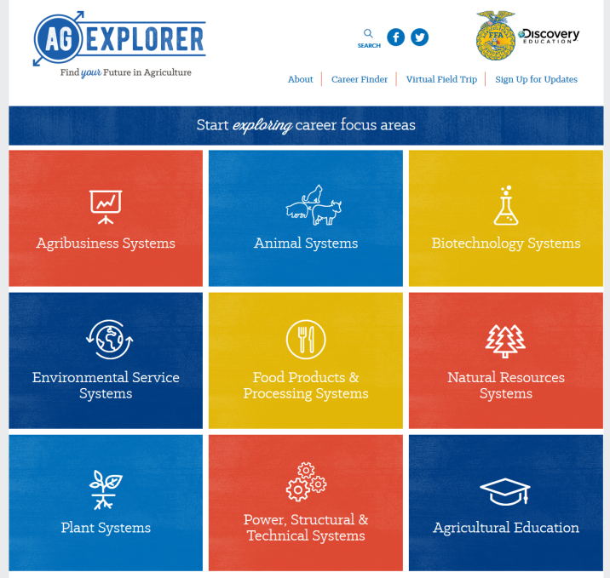
New Jersey FFA Association
FFA.org Educational Resources
Ag Explorer
Career Finder
Virtual Field Trip
Notes:
I just want to take the chance to remind you about the access that your students have to Ag Explorer. As the new SAE For All framework roles out, this resource may provide an easy way to incorporate some of the SAE aspects into your classroom lessons.

Slide 11
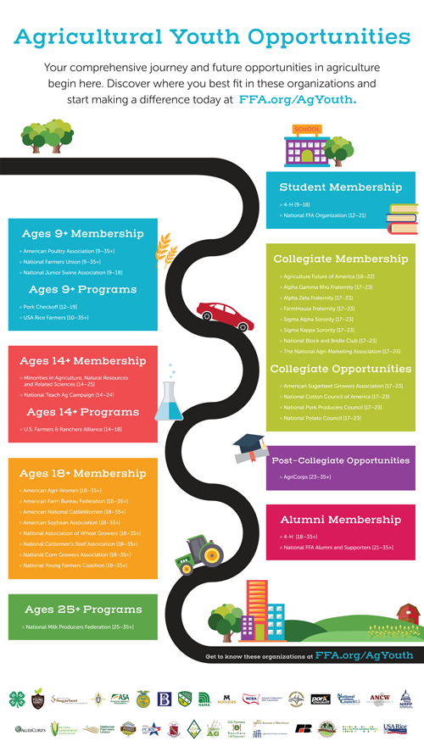
New Jersey FFA Association
FFA.org Educational Resources
Agricultural Literacy and Advocacy
https://www.ffa.org/ag-literacy-and-advocacy/
Hot Ag Topics
#SpeakAg Dialogues
Habitudes
Ag Youth Roadmap

Slide 12
New Jersey FFA Association
FFA Branding
Notes:
Please be sure that you and your affiliates are utilizing the correct emblems and branding for National FFA. National FFA has been stressing the importance of utilizing the correct FFA emblem and it is important that we follow through. Our emblem is very recognizable and it is important that we all utilize the same one to show consistency and unity.
While I will show you where to find the correct emblem to utilize as a chapter, I also wanted to show you why simply googling the emblem may not be the best option. When I googled FFA emblem 31 examples of the FFA emblem popped up at the top. Of those emblems, there are (click 17 times) 17 emblems that are in previous formats. One of the emblems (click) is not in alignment with the trademark for the FFA emblem. And one (click) has the wrong color saturations leading to a washed out emblem.

Slide 13
New Jersey FFA Association
FFA Branding
Do’s
Do use the current emblem
Do give the emblem prominence
Don’ts
Don’t use the former design
Don’t print the emblem smaller than 0.75″
Don’t digitally display the emblem smaller than 40 pixels
The FFA emblem stands on its own.
Never separate, silhouette, cover or clip the emblem.
Notes:
National FFA recently posted an article that covers some of the biggest misuses of the brand and created a couple of graphics to go along. On the top you will see the mention of utilizing the current emblem vs the old emblem.
The second image references the idea that the FFA emblem should always stand on its own and should never be split, silhouetted, covered or clipped.
Please be sure that you and your affiliates are utilizing the correct emblems and branding for National FFA. When you are having apparel or giveaways made, please be sure to provide the company with an up to date emblem.

Slide 14
New Jersey FFA Association
FFA Branding
Notes:
National FFA goes further in depth on their website and provides up to date downloads of the emblem. The Our Emblem link takes you to a basic breakdown of the National FFA’s brand policy including when and where to utilize the three or one color emblems, the brand colors including the hex code for National Blue and Corn Gold, and the font that National FFA utilizes throughout their publications.
The Downloads link offers even more guidance on how to utilize the National FFA Brand.

Slide 15
New Jersey FFA Association
FFA Branding
Notes:
Within the downloads tab, there are a few places that can be very helpful that I find myself referencing frequently.
In the style guide you will find the full breakdown of National FFA’s branding including proper logos, a further breakdown of the colors and typography, use of emblem crops, letterhead, business cards, and social media aspects.
The instructions link provides an explanation of the different formats that the emblem has been provided in and which to utilize depending on what you are working on.
In templates you can download letterhead and powerpoint templates.
Finally, in FFA emblem you will have the ability to download the emblem in formats such as .jpg, .png, .pdf, and .ai. With each format you will also find the tri-color emblem, and single color emblems in black, yellow and blue.

Slide 16
New Jersey FFA Association
State Website
State Activity Guide
Ag Education
Bulletin Board
Notes:
Just a reminder of where to find information on our website. On the Ag Education Bulletin Board you will find all the up to date announcements about events coming up. In the State Activity Guide you can find a listing of documents and links that all pertain to our state POA.

Slide 17
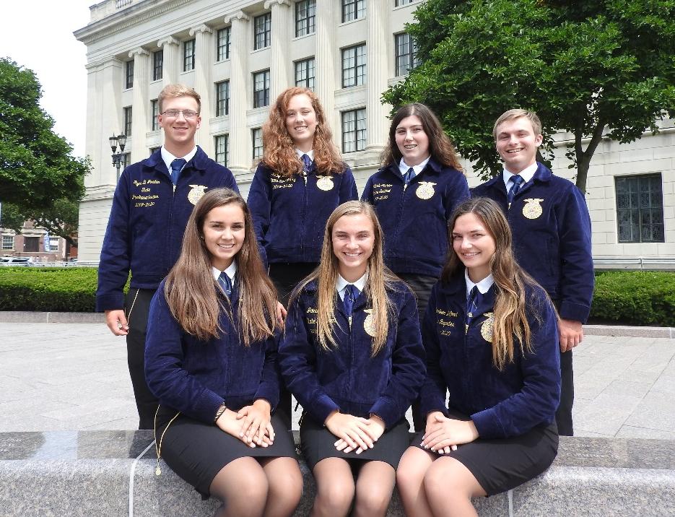
New Jersey FFA Association
2019-2020 State FFA Officer Team
Left to Right, Front to Back:
Talia Priore
State Treasurer
Jamie Specca
State President
Karleen Wilford
State Reporter
Ryan Jordan
State Parliamentarian
Kailyn Emmett
State Secretary
Nicole Sickler
State Sentinel
Owen Donnelly
State Vice President

