Slide 1
Agricultural Education Teachers Conference ~ September 29, 2017
Marie Barry, Acting Deputy Chief Academic Officer
Postsecondary Readiness & Partnerships
NJ Department of Education

Slide 2
Connecting Education to Industry

Slide 3
Topics
Data on Agriculture Education
  Programs
  Students
  Teachers
Statewide Initiative 65 by 25
Employer/Industry Connections

Slide 4


Slide 5
Students enrolled in Approved CTE AFNR Programs

Slide 7
Approved AFNR Programs

Slide 8
NJ Certified AFNR Teachers
70 certified teachers
39 hold the Teacher of Agriculture certification

Slide 9
Historical Comparison of Age of
CTE Teachers: All Career Clusters

Slide 10
Age of Agriculture Teachers
 | 2016
25th percentile | 36.0
50th percentile | 49.5
75th percentile | 58.0
Average Age | 47.4

Slide 11
Gender
Gender | All Career Clusters | Agriculture
Percent Male | 45.0% | 52.9%
Percent Female | 55.0% | 47.1%

Slide 12
Highest Education
 | Any CTE Career Cluster | Agriculture
Vocational | 4.8% | *
Associates | 1.5% | *
Bachelors | 49.2% | 65.7%
Masters | 37.9% | 21.4%
Doctoral | 0.9% | *
Other | 5.7% | *
* For confidentiality reasons, data with an n<10 have been suppressed.

Slide 13
Addressing the CTE Teacher Talent Pipeline

Slide 14
United States Department of Education
CTE Teacher Pathway Initiative Grant
The purpose of the CTE Teacher Pathway Initiative is to increase the supply of high school CTE teachers available to teach students in CTE programs that align to In-Demand Industry Sectors or Occupations.

Slide 15
United States Department of Education
CTE Teacher Pathway Initiative Grant
Partnering with county vocational schools and Career Pathways grantees to focus on two strategies:
  Industry fellow pathway for industry experts to co-teach with a certified CTE teacher.
  Pathway to transition academic teachers to CTE roles.

Slide 16
Industry Fellow Program
Grant funds will be used to create an industry fellow program to allow industry experts to co-teach with experienced CTE teachers.
  Districts will provide co-teaching opportunities for industry experts
  (or recent retirees).
  Industry fellow will spend at least 100 hours in the classroom over the course of one school year.
  Stipend will be paid to offset costs of entering the teaching profession, including cost of CE and 50-hour pre-service preparation.

Slide 17
CTE Teacher Bridge Program
Grant funds will be used to create a CTE Teacher Bridge program to transition academic teachers to CTE teachers.
  Districts will identify potential academic teacher with an interest in teaching CTE courses and a mentor CTE teacher.

Slide 18
CTE Teacher Bridge Program
  Academic teachers will complete a CTE Teacher Bridge program funded by the grant.
  Content knowledge and industry-valued credential (where available).
  Industry externships over the course of two summers.
  Mentorship by an experienced CTE teacher over the course of two school years.

Slide 19
Partners
Advance CTE
Brookdale Community College
8 Comprehensive High Schools (Career Pathways grantees)
21 County Vocational-Technical Schools
New Jersey Department of Labor and Workforce Development
New Jersey Business & Industry Association
New Jersey State Chamber of Commerce

Slide 20

Notes:
Marie B

Slide 21
Office of the Secretary of Higher Education Received Lumina Foundation Grant
New Jersey received a $100,000 attainment challenge grant from the Lumina Foundation to help increase the state’s postsecondary adult attainment rate to 65 percent by 2025.
To help our state implement a statewide communications campaign.
To develop a strategic framework representing input from various stakeholders from the P-20W pipeline.
Notes:
Marie V.

Slide 22

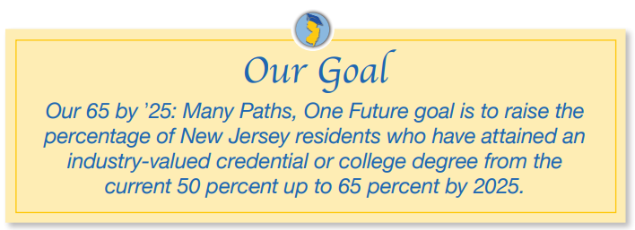
Notes:
Catherine

Slide 23

Postsecondary Credentials:
Associate’s and Bachelor's degrees or beyond.
Industry-valued credentials offered by high schools in partnership with colleges.
Apprenticeship programs that lead to college credit.
Industry-valued credentials offered to community college and four-year college students.
Awarding college credit based on work experience or military service.
Notes:
Marie B.

Slide 24

NJLWD Industry-Valued Credentials List
The Industry-Valued Credential List is updated quarterly as New Jersey employers and training providers share important changes with the state's multi-agency Credential Review Board as industry needs evolve.
Goal to dramatically increase the number of students who successfully complete career pathways.
NJ SMART data collection included industry-valued credentials for 2016-17.
http://careerconnections.nj.gov/careerconnections/prepare/skills/credentials/industry_valued_credentials.shtml

Slide 25
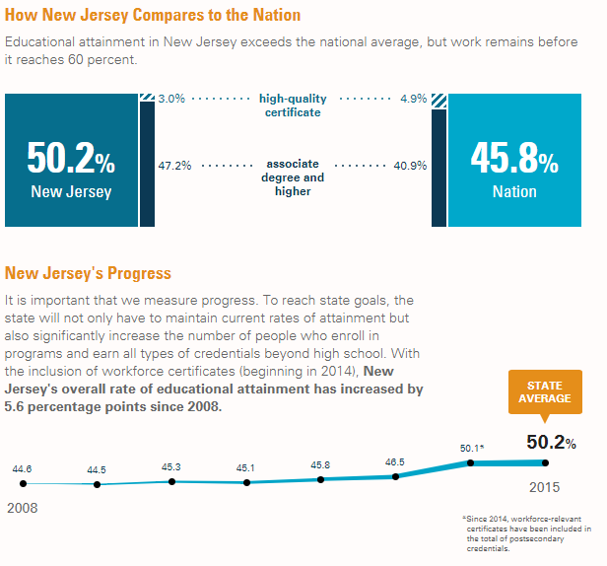
Source: “A Stronger Nation” Lumina Foundation http://strongernation.luminafoundation.org/report/2017/#state/NJ
Notes:
Marie V.

Slide 26
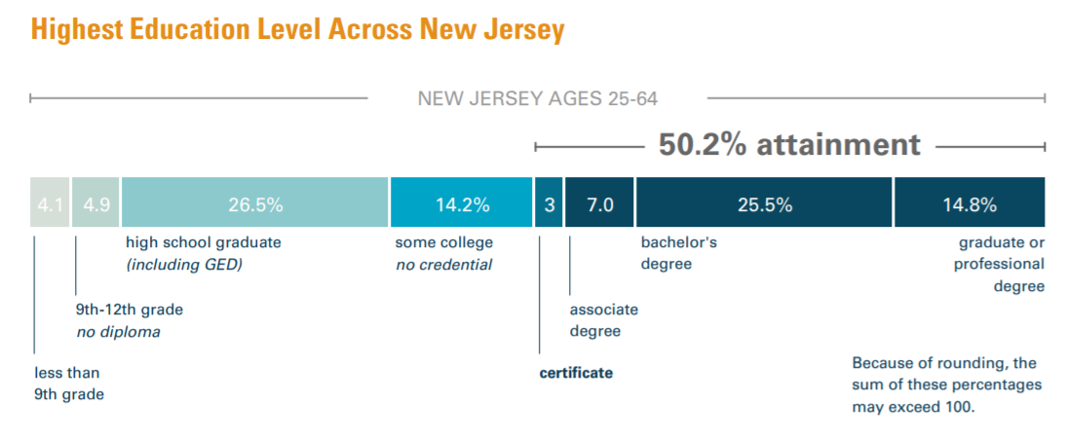
Source: “A Stronger Nation” Lumina Foundation http://strongernation.luminafoundation.org/report/2017/#state/NJ
Notes:
Marie V

Slide 27
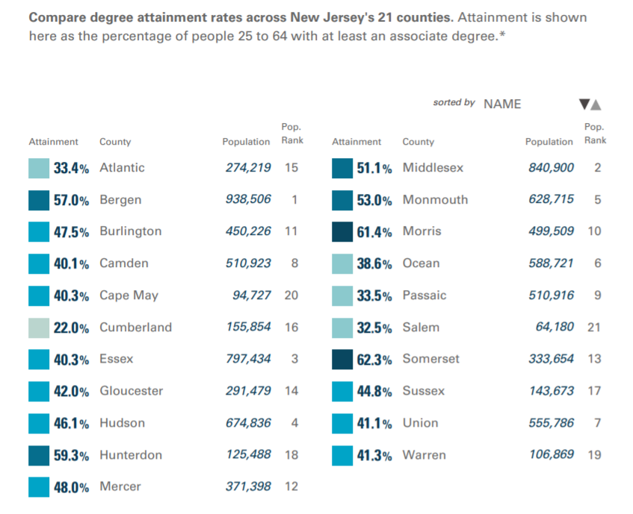
Source: “A Stronger Nation” Lumina Foundation http://strongernation.luminafoundation.org/report/2017/#state/NJ
Notes:
Marie V.

Slide 28
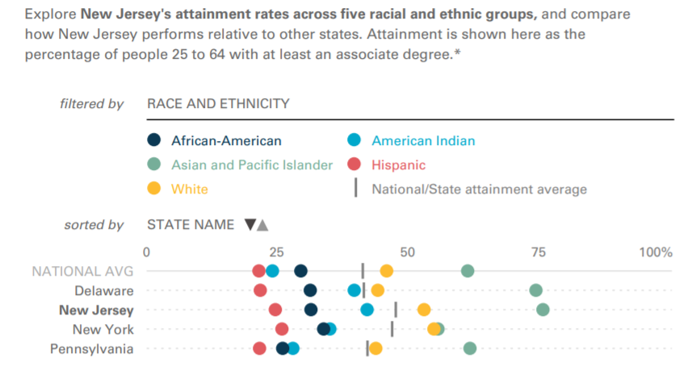
Source: “A Stronger Nation” Lumina Foundation http://strongernation.luminafoundation.org/report/2017/#state/NJ
Notes:
Marie V.

Slide 29
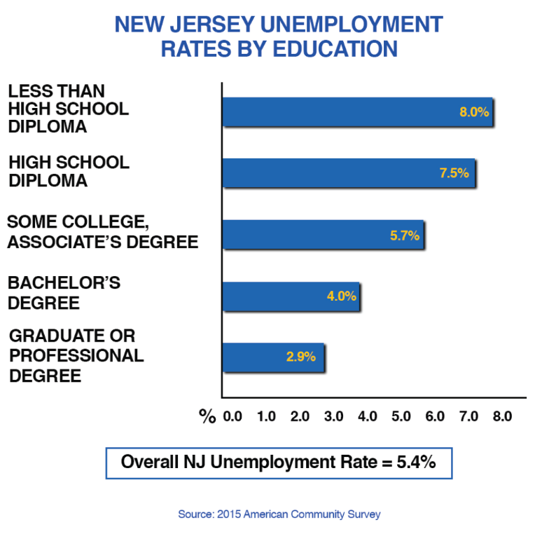
Notes:
Catherine S.

Slide 30
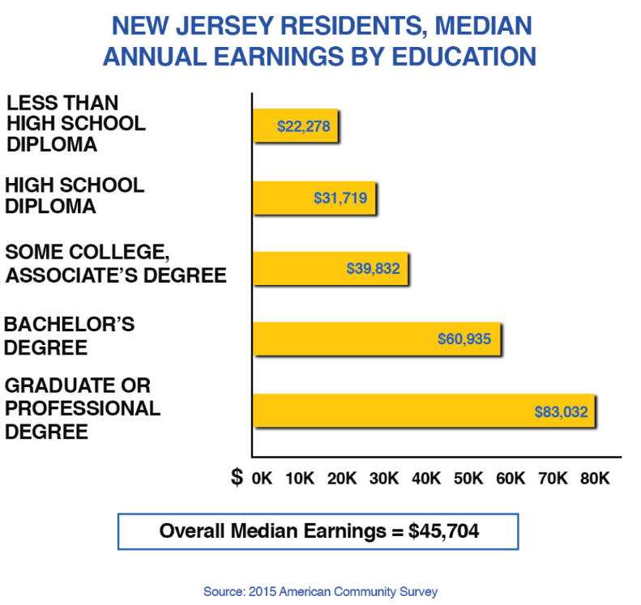
Notes:
Catherine S.

Slide 31
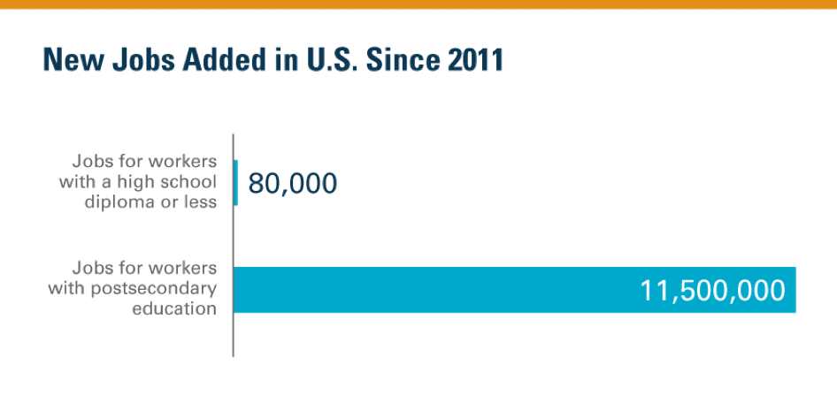
Source: “A Stronger Nation” Lumina Foundation (http://strongernation.luminafoundation.org/report/2017/#nation)
Notes:
Catherine S.

Slide 32
Cornerstones for Success
Notes:
Catherine

Slide 33
Cornerstones for Success
Provide career awareness for all students and adults.
Grow high school/college partnerships.
Expand credit-bearing credential programs in colleges and universities.
Strengthen two- and four-year college partnerships.
Notes:
Marie B.

Slide 34
Cornerstones for Success
Enhanced commitment to equity.
Make it easier for adults to earn a credential or degree.
Expand work experience programs for students.
Enhance the partnerships between business and education.
Notes:
Marie B.

Slide 35
Provide career awareness for all students and adults:
All individuals need access to high-quality, reliable information to make decisions about their education and their careers.
This information is provided by school and career counselors in middle schools, high schools and colleges.
Notes:
Marie B.

Slide 36
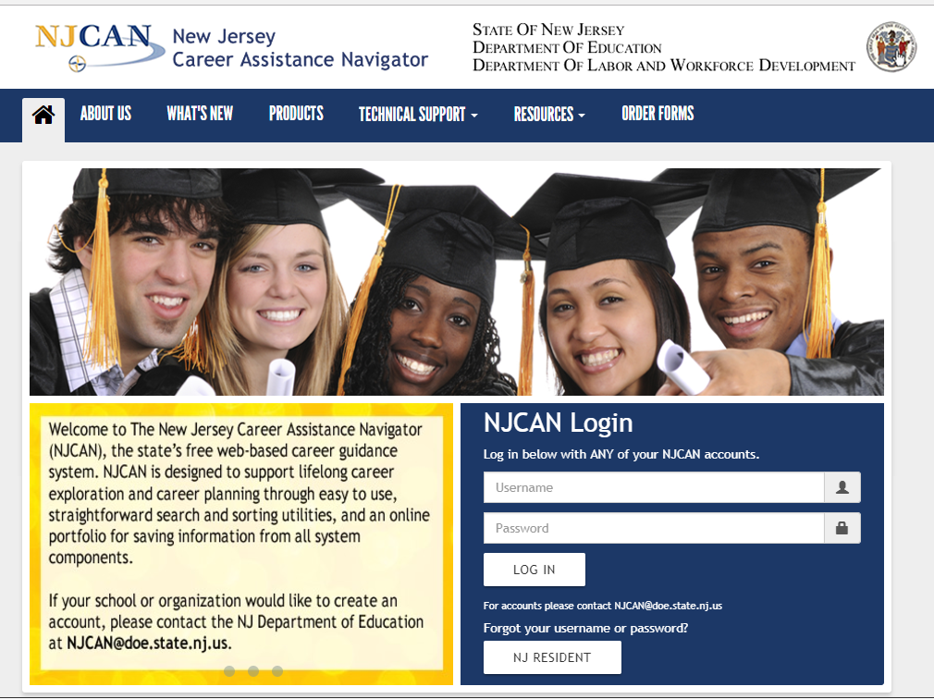
NJ Career Assistance Navigator www.njcan.org

Slide 37

Career Connections http://careerconnections.nj.gov/careerconnections/

Slide 38
Grow high school/college partnerships:
Provide students an opportunity to earn an industry-valued credential and college credit while in high school.
  Dual Enrollment
  Articulation Agreements
  CASE
Assist students to transition to college.
Notes:
Marie B.

Slide 39
CTE Students Earning College Credit
2015-2016
Agriculture, Food & Natural Resources 256 | Architecture & Construction 228 | Arts, A/V Technology & Communications 1,035 | Business Management & Administration 526 | Education & Training 71
Finance 168 | Health Science 2,122 | Hospitality & Tourism 773 | Human Services 120 | Information Technology 315
Law, Public Safety, Corrections & Security 729 | Manufacturing 256 | Marketing 162 | STEM 1133 | Transportation, Distribution & Logistics 391
TOTAL Students Earning College Credit 8,298
(Includes Government & Public Administration = 13)

Slide 40
Enhanced commitment to equity:
Recognizing the rich diversity of our population, we will:
identify the gaps in opportunity and attainment;
expand best practices to close equity gaps; and
continue to provide technical assistance to school districts through the Career Equity Resource Center (www.state.nj.us/education/cte/cerc/).
Notes:
Marie V.

Slide 41
Expand work experience programs for students:
Internships, apprenticeships, structured learning experiences (SLE), supervised agricultural experiences (SAE) and mentoring provide an opportunity for students to learn valuable skills on the job while helping to inform their career decisions.
Notes:
Catherine S.

Slide 42
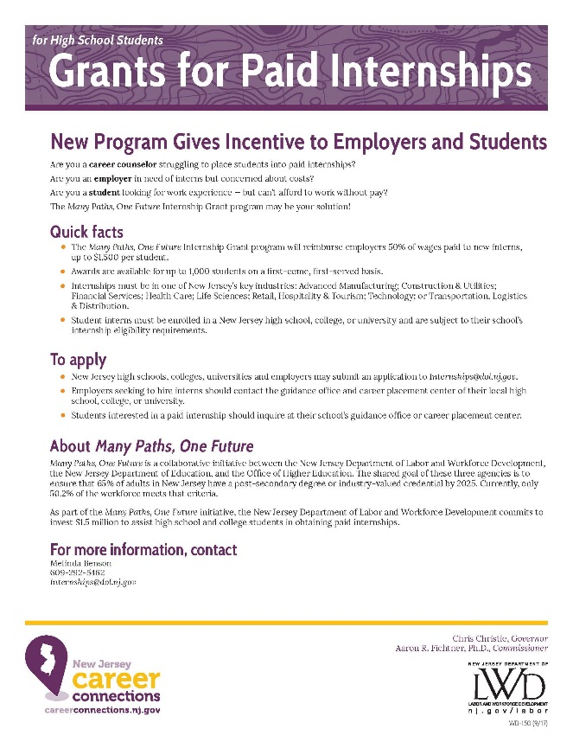
Many Paths, One Future Internship Grant Program
http://careerconnections.nj.gov/careerconnections/hire/hiring/paths/many_paths_one_future.shtml
Notes:
Catherine S.

Slide 43
Many Paths, One Future
Internship Grant Program
Awards are available for up to 1,000 students on a first-come,
first-served basis.
Will reimburse employers 50% of wages up to $1,500 per student.
Internships must be in one of New Jersey’s key industries.
Student interns must be enrolled in a New Jersey high school, college, or university and are subject to their school’s internship eligibility requirements.

Slide 44
Enhance the partnerships between business and education:
Advisory boards inform curriculum and instruction.
  Provide mentors
  SAE/SLE
  FFA (career development events)
Talent Networks
  Advanced Manufacturing (Food Processing)
  Life Sciences
Notes:
Catherine S.

Slide 45


Slide 46
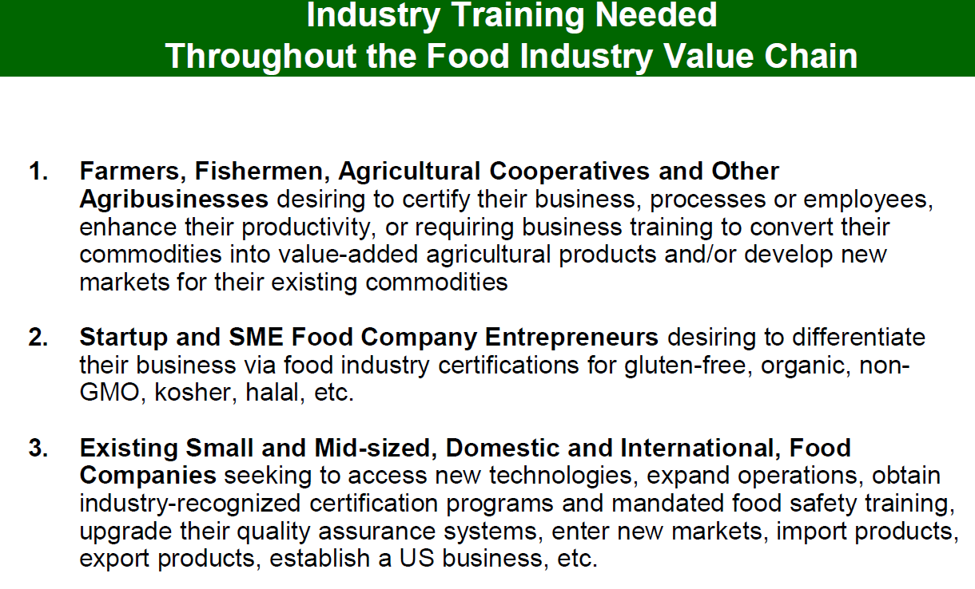

Slide 47
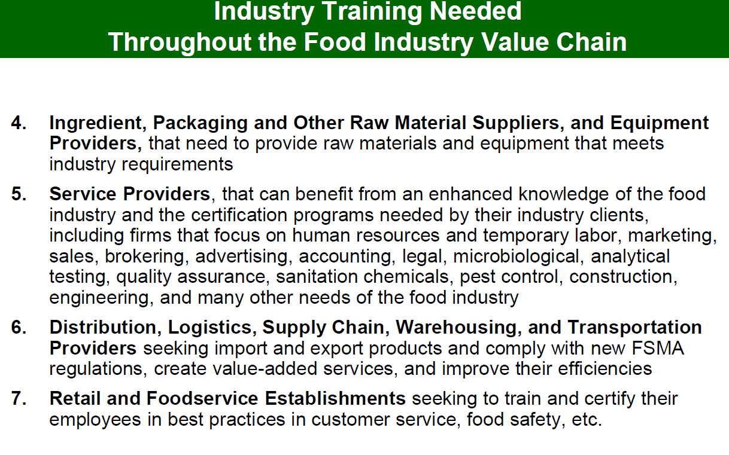

Slide 48
High-Quality,
Employer-Valued Partnerships
Collaborative partnerships.
Analysis of economic and workforce trends to inform curriculum (i.e., project-based learning, advisory committees).
Provide real-world experiences through internships, mentorships or apprenticeships.

Slide 49
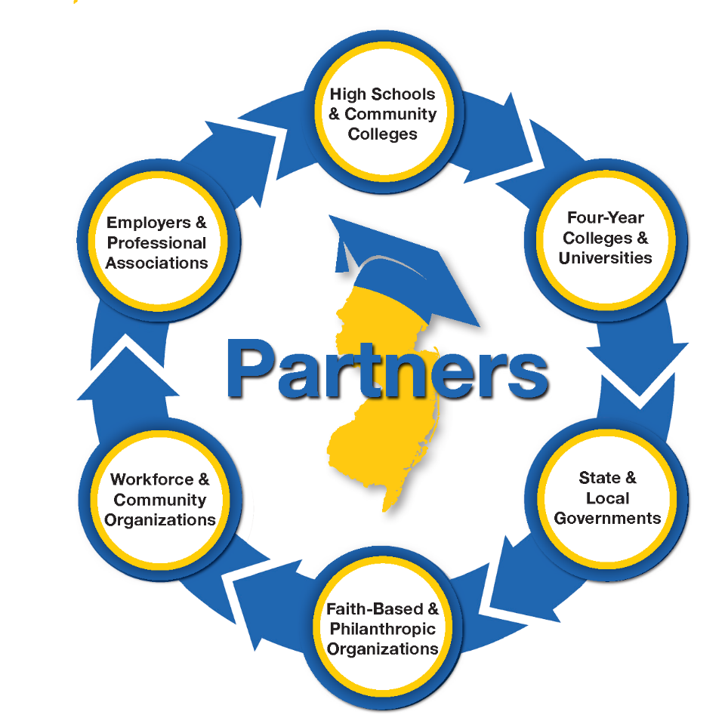
Notes:
Catherine

Slide 50

What You Can Do
Visit manypathsonefuture.org to become involved and
sign up for email updates.
Notes:
Marie B

Slide 51
Questions?

Slide 52




