Slide 1
What’s New?
State and National FFA Changes
Erin E. Noble
State FFA Specialist
Fall Agricultural Education
Professional Development Conference
September 29 ,2017
Footer description area.

Slide 2

New Jersey FFA Association
New Look to the Roster System on ffa.org
Due November 1
Chapter Requirements – National & State Required Data
  Chapter Profile Information
  Student/Member Roster Information
  Teacher/Advisor Profile Information

Slide 3
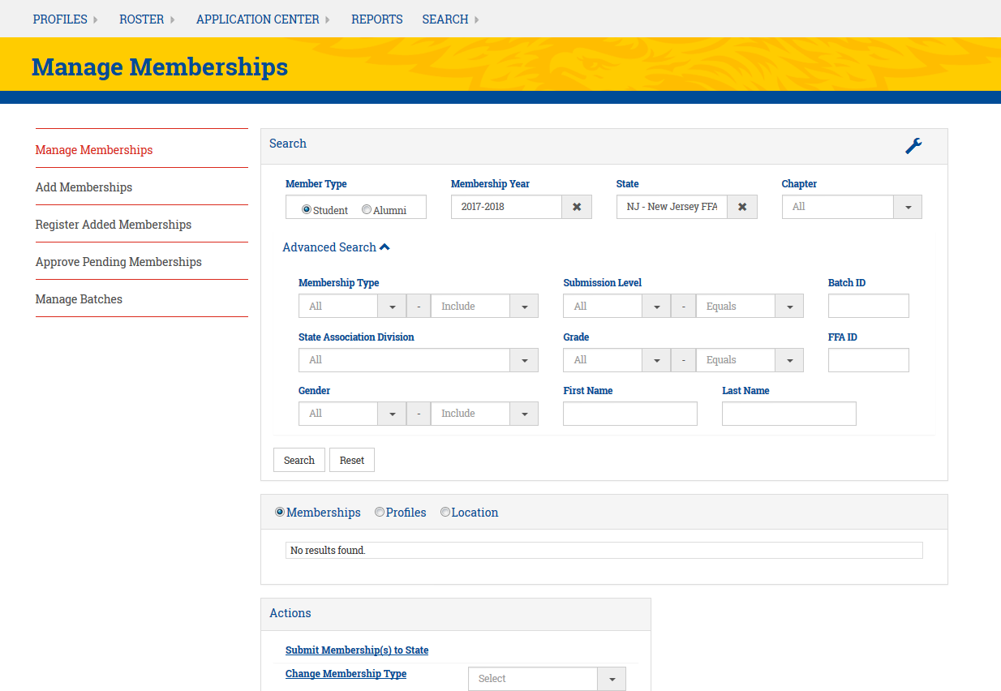
New Jersey FFA Association
New Look to the Roster System on ffa.org

Slide 4
New Jersey FFA Association
New Look to the Roster System on ffa.org
Due November 1
Chapter Requirements – National & State Required Data
  Chapter Profile Information
  Student/Member Roster Information
  Teacher/Advisor Profile Information

Slide 5
New Jersey FFA Association
New Look to the Roster System on ffa.org
My Profile
Chapter Profile
Alumni Chapter Profile

Slide 6
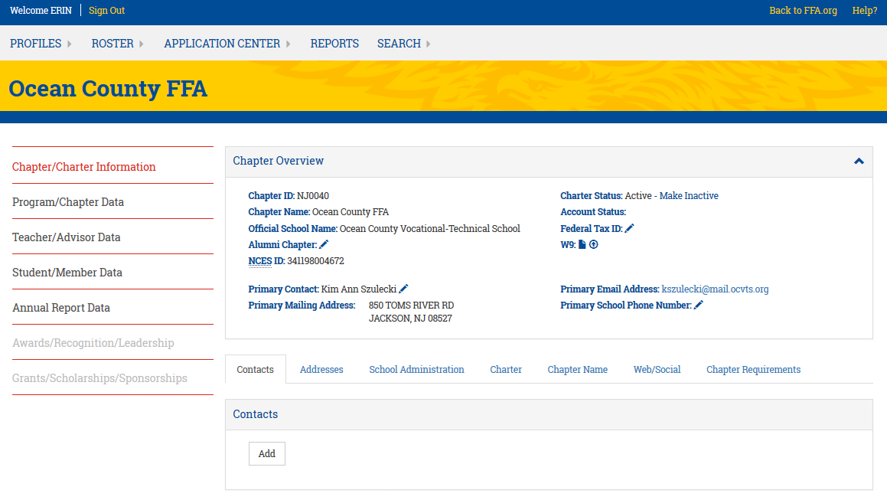
New Jersey FFA Association
New Look to the Roster System on ffa.org
Chapter Requirements

Slide 7



New Jersey FFA Association
New Look to the Roster System on ffa.org
Multiple Ways to Enter Students
  Member Self-Registration
  Export Previous Roster to National Template, Edit & Import
  Renew Returning Members On-Screen & Import New Members
  Renew Returning Members On-Screen & Manually Add New Members
  Download the National Template & Import All Members
  Manually Add All Members One at a Time
Please reference the help guides!

Slide 8
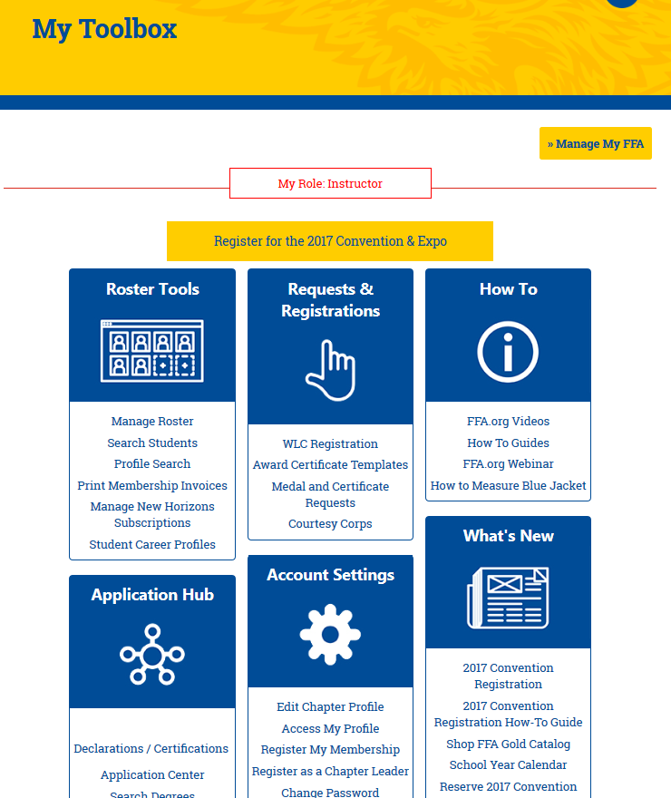
New Jersey FFA Association
New Look to the Roster System on ffa.org
How to Guides

Slide 9
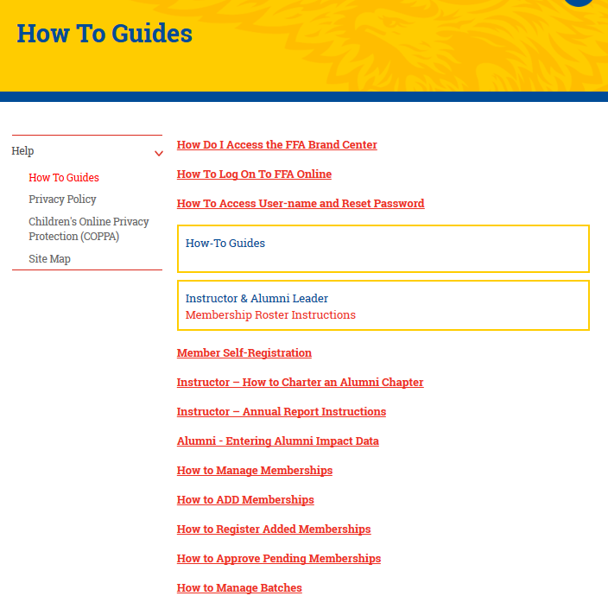
New Jersey FFA Association
New Look to the Roster System on ffa.org
How to Guides

Slide 10
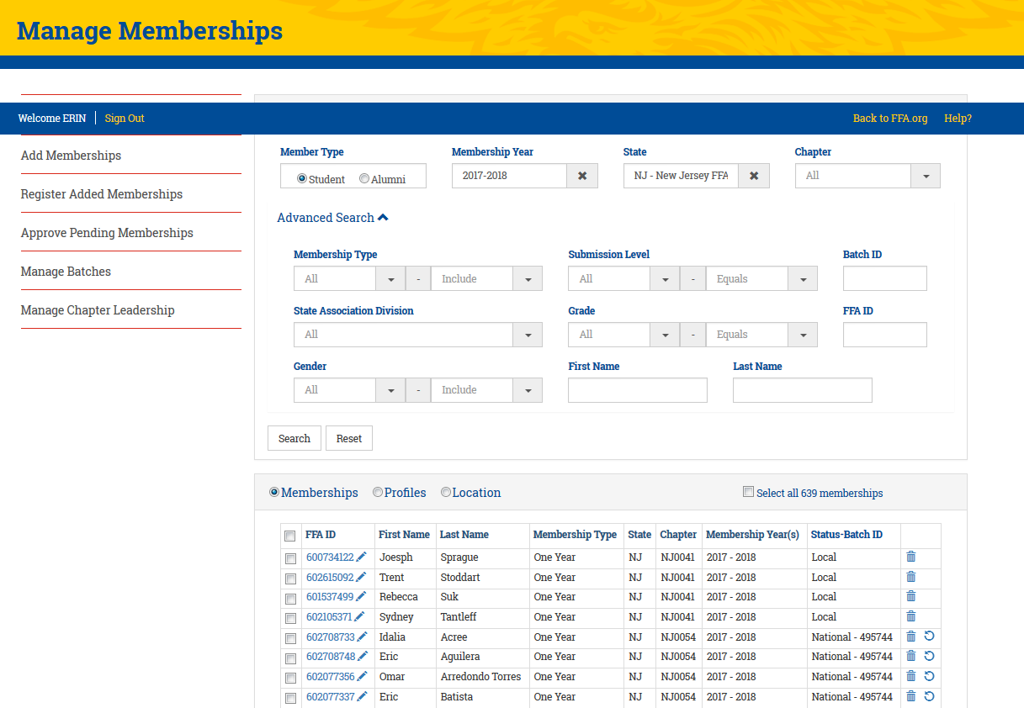
New Jersey FFA Association
New Look to the Roster System on ffa.org
Must say National

Slide 11
New Jersey FFA Association
New Chapter Charter Requirement: Constitution
Delegates at the 88th NJ State FFA Convention amended the New Jersey FFA Association Constitution
  Article I. Organization of Local Chapters
  Section C. #7 – Submit an updated local FFA chapter constitution to the State FFA Office by December 1
National Chapter Application (including Superior Chapter)
  Indicator #4 – The FFA chapter constitution and bylaws are up-to-date and approved by chapter members.
National Quality Program Standards
  Standard 3: Leadership and Personal Development Through FFA
  Quality Indicator #4 – The FFA Chapter constitution and bylaws are up-to-date and approved by chapter members.
  **Editable Template - https://tinyurl.com/njffaconstitutiontemplate

Slide 12
New Jersey FFA Association
Chapter Charter Requirements: POA
Due December 1
Strongly Encourage you to Utilize AET – www.theaet.com
  Online resources
  Online portal that teacher and select students can access
  LEAD participants will be provided hands-on instruction for entering the POA into AET
    Bring a lap top
    Assign at least one student in attendance to have access
    Attend the 10:15 am session on Saturday to work along side your students
Must include goals and action plan
Should include the 5 activities you plan to participate in above the chapter level

Slide 13
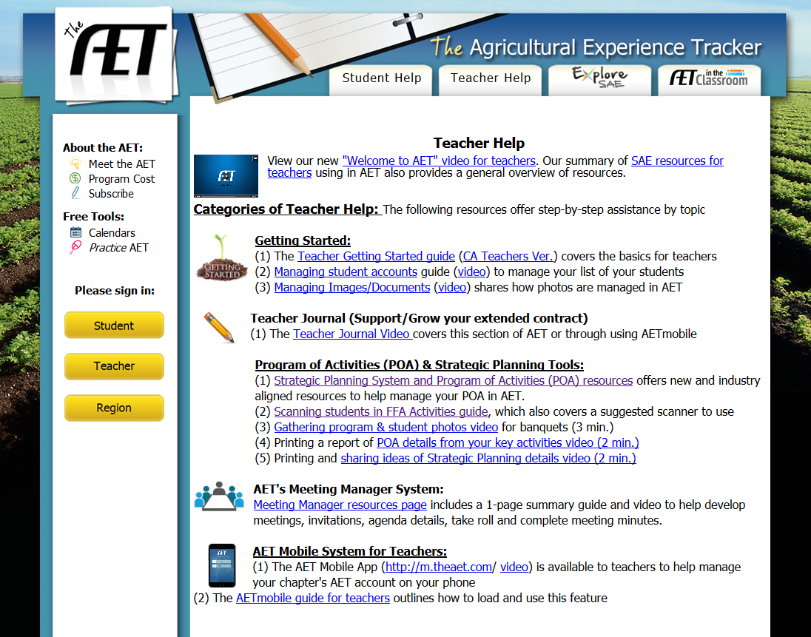
New Jersey FFA Association
Chapter Charter Requirements: POA
POA Resources

Slide 14
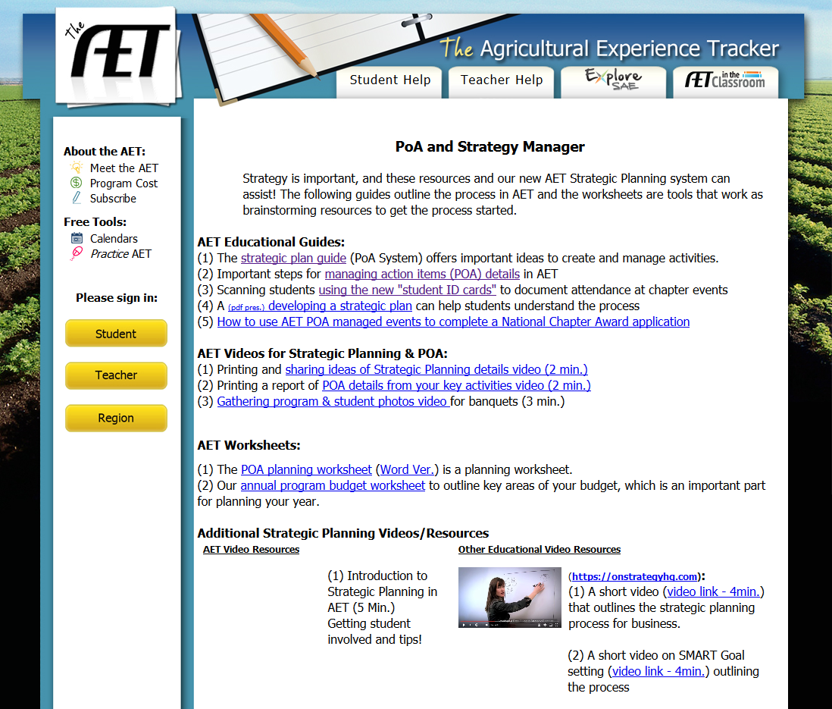
New Jersey FFA Association
Chapter Charter Requirements: POA

Slide 15
New Jersey FFA Association
Chapter Charter Requirements: POA
Due December 1
Strongly Encourage you to Utilize AET – www.theaet.com
  Online resources
  Online portal that teacher and select students can access
  LEAD participants will be provided hands-on instruction for entering the POA into AET
    Bring a lap top
    Assign at least one student in attendance to have access
    Attend the 10:15 am session on Saturday to work along side your students
Must include goals and action plan
Should include the 5 activities you plan to participate in above the chapter level
To submit, generate a PDF and email it to ag.ed.registration@ag.state.nj.us.

Slide 16
New Jersey FFA Association
Chapter Charter Requirements: Chapter Officer List
Due October 1
New form (using JotForm)
  Old form still will be accepted in 2017-2018

Slide 17
New Jersey FFA Association
Participant Lists & Applications: Jot Form
Member of the Month Application
  Save and Edit Later feature
    Complete cover page which will redirect to the application
    DO NOT submit more than one cover page
    Use the link that was emailed to make edits
    Similar process for State Convention Registration
Uploading Forms & Editing
  Retrieve the email confirmation from your original submission – be sure to share this confirmation with other teachers in your program (if applicable)
  Click “Edit Submission” at the bottom of the email
  Upload the forms and make edits accordingly (and remember to hit Submit)
  DO NOT submit a NEW form!

Slide 18
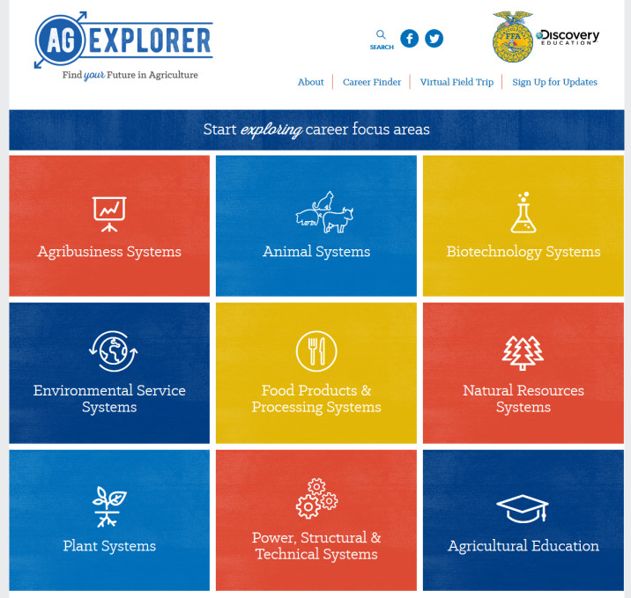
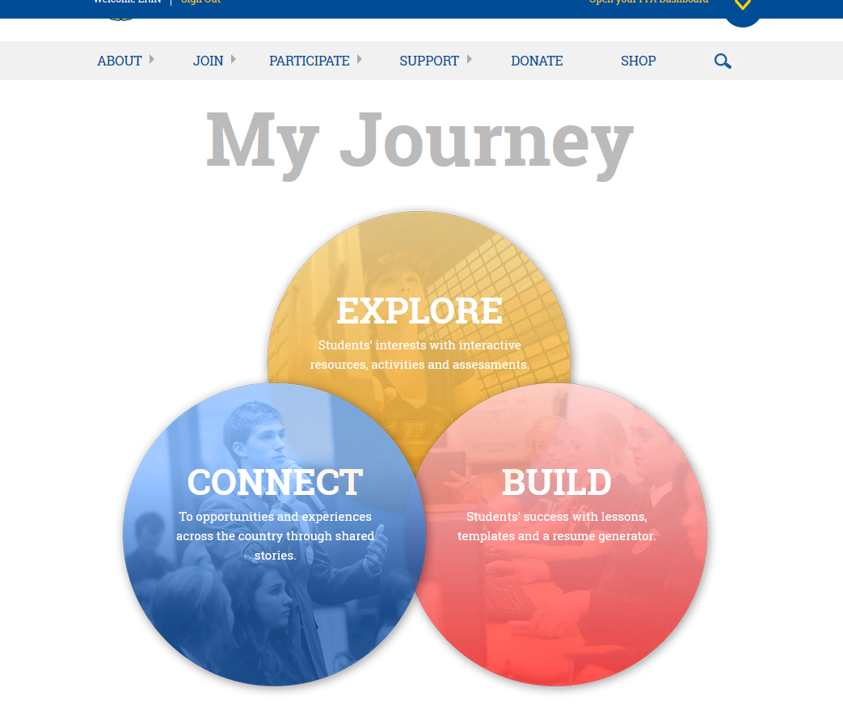
New Jersey FFA Association
FFA.org Resources
Ag Explorer
Career Finder
Virtual Field Trip
My Journey
Teacher & Student Resources
Resume Generator
SAE Resources
Archived Material

Slide 19


New Jersey FFA Association
FFA.org Resources
Living to Serve
Grants
Planning Guides
New Horizons
Teaching Guides
Archived Volumes
FFA in the USA

Slide 20

New Jersey FFA Association
2017-2018 State FFA Officer Team
Left to Right:
Ariel Norbeck
State Reporter
Kelsey Stockton
State Secretary
Allison Finn
State Parliamentarian
McKenna Moore
State Sentinel
Renee Stillwell
State President
Sarah Kelly
State Treasurer
Jeremy Posluszny
State Vice President

Slide 21

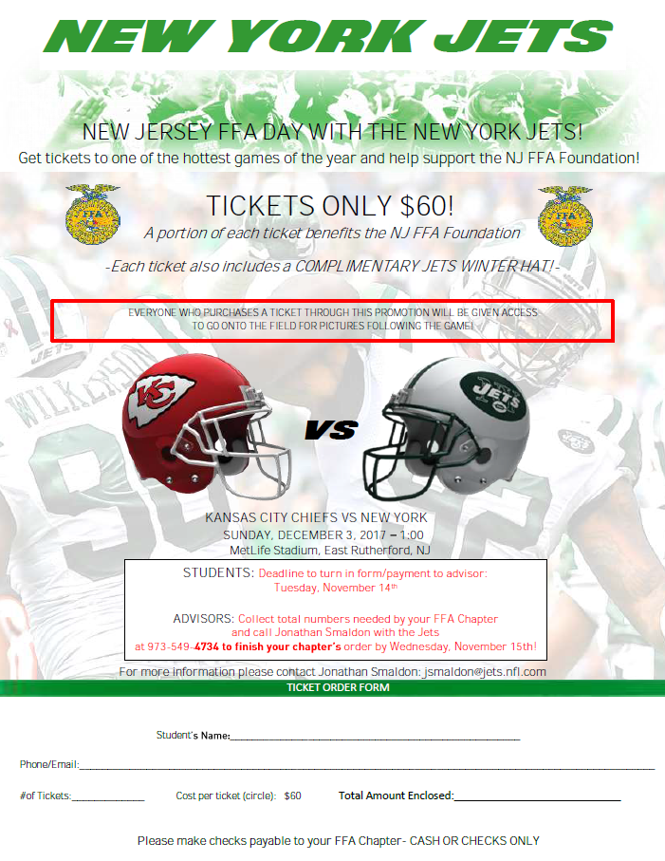
New Jersey FFA Association
Join Us for Our Exciting Upcoming Events
November 18, 2017
December 3, 2017

