Slide 1
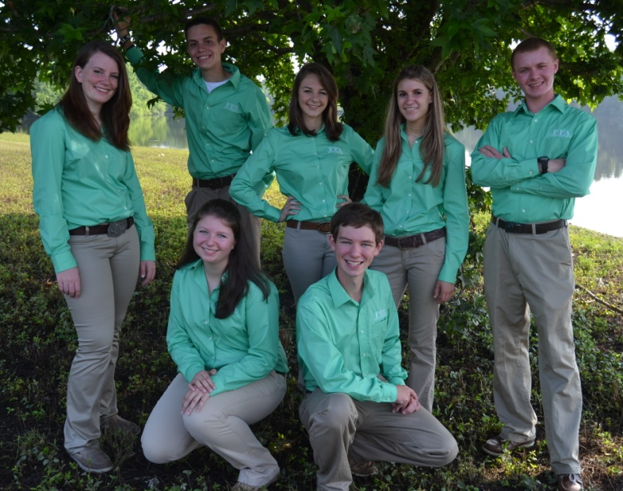

What’s Hot in FFA
Erin E. Noble
State FFA Specialist
September, 27, 2013
Fall Agricultural education professional development conference

Slide 2
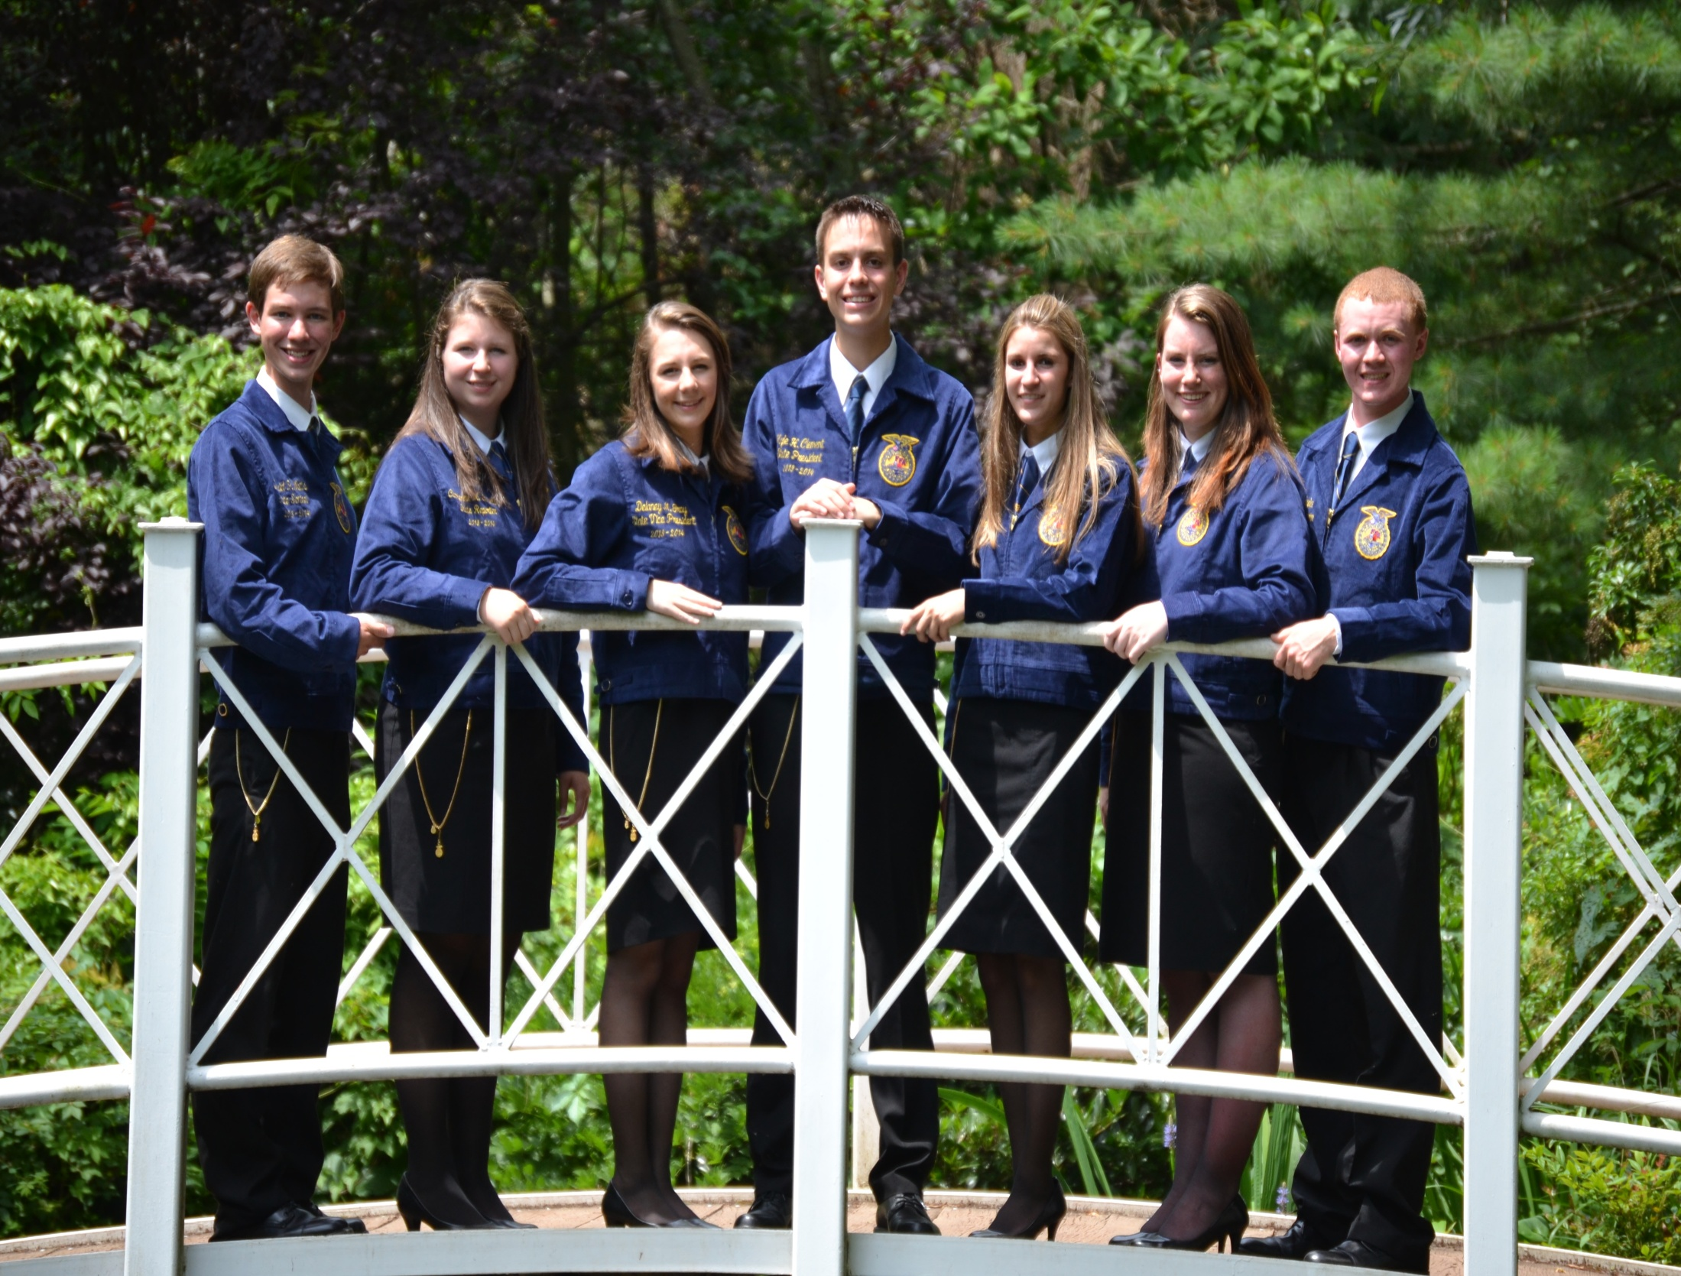
Catherine Cincotta
Kyle Clement
Kristianne Dowd
David Watts
Delaney Gray
Kelly Gangel
Stuart Faunce
2013 - 2014 New Jersey State FFA Officers

Slide 3
Leadership Experience And Development
October 11-12, 2013 @ Crowne Plaza Monroe/South Brunswick
        Chapter Officer Leadership Training (COLT)
        Leadership & Opportunities Conference (LOC)
        State Greenhand Conference (SGC)
  Record Attendance
        195 students/advisors/chaperones/staff

Slide 4
Chapter challenge
Advocacy Initiative
        Combines vital public relations concepts – Media Interview, Online Video, School & Community Outreach, and Social Media
        Mirrors National FFA’s State Officer Challenge
  Elimination of Public Relations Event and Video Public Relations Event
        Under-utilized events
        Celebrate chapters that embrace the importance of overall advocacy

Slide 5
National FFA Convention highlights
Statistics
        15 Chapters; 170+ attendees from NJ
        11 American FFA Degree Recipients
        4 Honorary American Degree Recipients
        2 Two-Star Chapters (Penns Grove & Allentown)
        8 Agriscience Fair Finalists (11 students total)
        4 Official Delegates
  Don’t Forget!
        Request Suite Tickets
        RSVP for the State Breakfast
        Submit Student Code of Conducts & Advisor Statement of Assurances

Slide 6
Chapter charter requirements
Requirements to Retain Chapter Charter
        Affiliation Contract – September 30
        Chapter Officer List – October 1
        Membership Rosters (AgCN) – November 1
        Program of Activities – December 1
        Participate in at least 5 state/national events
        Send 2 delegates to the State FFA Convention

Slide 7
Reminders
State Activity Guide
Ag Education Bulletin Board
Monthly Reminders
Send registration/materials to ag.ed.registration@ag.state.nj.us

Slide 8
Leadership poster series
$1 for 1; $10 for Set of 12
        Proceeds go to the NJ FFA Alumni to benefit state officer programming
        Order your classroom set today!
  New set each September
        Each state officer team will have their own poster series
        Highlights important leadership concepts

Slide 9
New jersey ffa leadership Opportunities
In-State
        State Greenhand Conference
        Leadership & Opportunities Conference
        Chapter Officer Leadership Training
        212° Conference
        State Officer Candidates’ School
        Advocacy and Legislative Leadership Day
        Hort Expo Workshops
        State FFA Convention
Out-of-State
        Washington Leadership Conference
        National FFA Convention

Slide 10
Convention challenges
Outgrowing Current Venue
Customer Service & Related Challenges
Increased Need for Outsourcing Services

Slide 11
Potential 2014 Convention Location & Dates
Wednesday, May 21 – Friday, May 23, 2014
Monmouth University – West Long Branch, NJ
700+ seat theater
In-house Services
Air Conditioned Dorms
Friendly Conference Staff

Slide 12
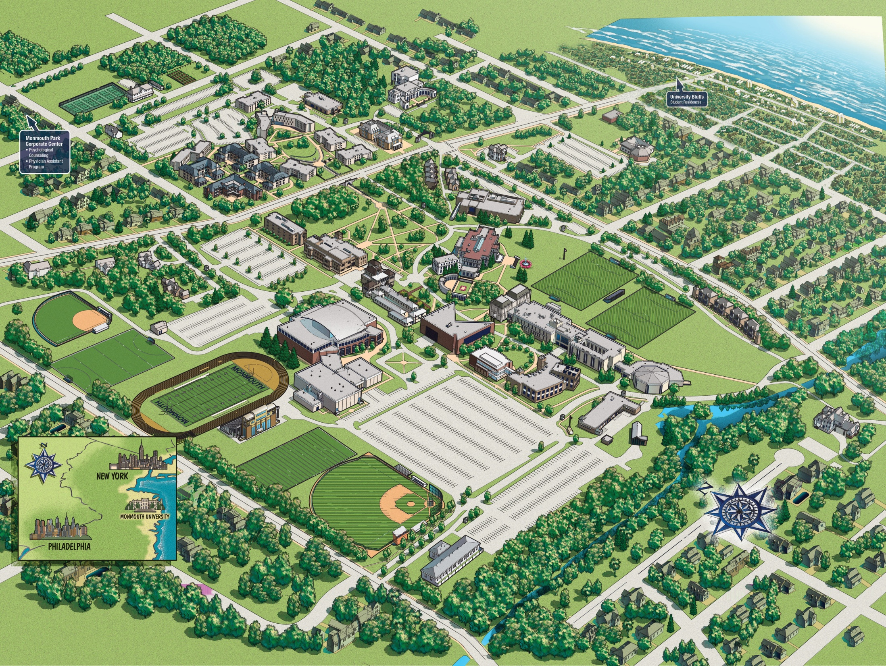
Monmouth University
West Long Branch, NJ

Slide 13
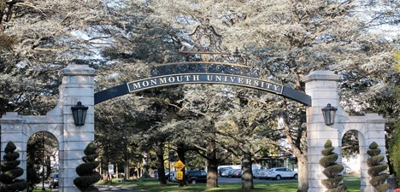

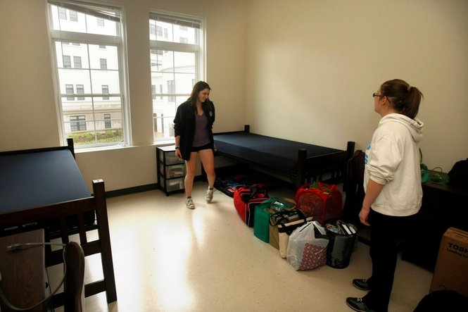
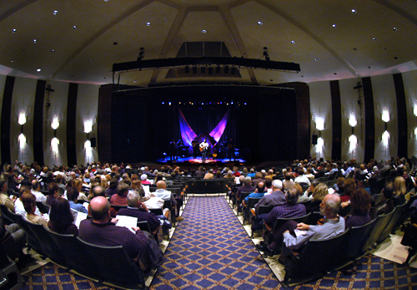
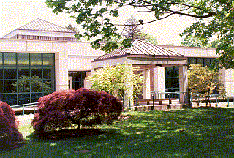
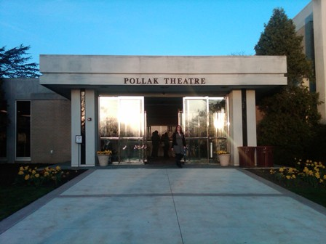

Slide 14

Miles Austin
Wide Receiver
Dallas Cowboys

Slide 15
Career Development Events
Handbook
        Rules have not changed
        Handbook will provide a one-stop shop for CDE rules
  60% Mastery for National Advancement Policy
        Increase expectations for national competitors
        Increase accountability for adequate team training

Slide 16
National FFA Initiatives
FFA Link
        Exclusive group of college students and young professionals connecting their love of agriculture with real world career skills
        Your connection to success – networking, leadership, career success
  Grants
        $1,000 SAE Grants – Due November 15, 2013
        Living to Serve Grants
          Food for All
          Environmental
          Rural Youth Development
        National Alumni Grants
AgCN
        Eventually, all National FFA applications will be submitted through AgCN.
        Chapter Rosters – MUST enter addresses before state will submit to National FFA
        Discover Ag Careers

Slide 17
Alumni Associate Membership
FREE
        Provided to members within five years of their graduation from high school (five year limit)
        Entitles member to receive electronic information from the National FFA Alumni Association
  AgCN
        Push student to Alumni using AgCN

Slide 18
We look forward to a great year!

