Slide 1
FFA Update
2012 Fall Ag Education Professional Development Conference

Slide 2
Workshop Preview
  New Jersey State FFA Officer Team Update
  National FFA Convention Highlights
  Chapter Charter Requirements
  Under Utilized Events
  NJ FFA Leadership Continuum
  Grant Opportunities from National FFA
  AgCN: Roster & Career Options
  Program Affiliation
  Reminders

Slide 3
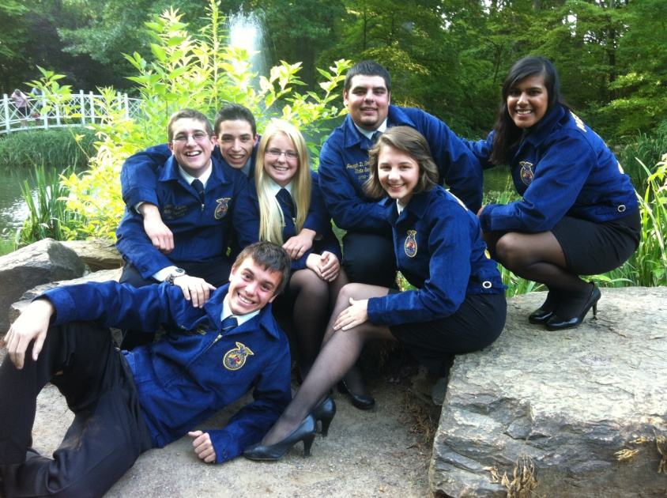

2012-2013 NJ State FFA Officers
Ernest Arians
State President
Anne Poinsett
State Vice President
Delaney Gray
State Secretary
Gaspar Hernandez IV
State Treasurer
Kyle Clement
State Reporter
Joseph Goodenough IV
State Sentinel
Lauren Fillebrown
State Parliamentarian

Slide 4
National FFA Convention
  17 Chapters
  15 American FFA Degree Recipients
  4 Honorary American FFA Degree Recipients
  2 Three-Star National Chapters
  9 National Agriscience Fair Finalists
  4 Official Delegates
  170+ attendees

Slide 5
Chapter Charter Requirements
  Affiliation Contracts: September 30
  Chapter Officer List: October 1
  Program of Activities: December 1
  Membership Rosters: November 1
  Participate in at least 5 state/national level events
  Send 2 delegates to the State FFA Convention

Slide 6
Requirements - POA
  Template on State Activity Guide
  Superior Chapter Recognition = at least 1 activity in each of the 15 quality standards
  National Chapter Recognition (State Level)
    Gold, Silver, Bronze Ranking
  National Chapter Recognition (National Level)
    Model of Excellence
    Model of Innovation
    Outstanding Middle School
    Star Ranking

Slide 7
Requirements - Participation
  Under Utilized Opportunities
  Leadership Continuum
  NEW Leadership Conferences in 2012
    Leadership & Opportunities Conference (LOC)
    212° Conference
  Grant Opportunities from National FFA

Slide 8
Under Utilized Opportunities
  Career Development Events
    State Convention
      Creed Speaking
      3-5 Min. Prepared
      6-8 Min. Prepared
      Ag Issues Forum
      Job Interview
    Winter/Online
      Farm Business Management
      Meat Evaluation
      Forestry
      Agronomy
    Other
      Landscape Design
      Poultry Evaluation
      Horse Evaluation
      Dairy Cattle Evaluation and Management
      Livestock Evaluation
      Dairy Cattle Handlers

Slide 9
Under Utilized Opportunities
  Applications
    September 30th
      Star State Greenhand
      Star State Chapter
    March 15th
      Proficiency Awards
    April 1st
      Advisor of the Year
      Distinguished Service Award
      Honorary State FFA Degree
      Washington Leadership Conference
      Princeton Ag Leadership (Hunterdon, Middlesex, Somerset)
      8,000 Hour Challenge/Outstanding Community Service Award
    At State Convention
      Ag Awareness

Slide 10
Under Utilized Opportunities
  Events
    April 24th
      Agriscience Fair (Materials due April 3rd)
    April 1st
      Essay Event
      Soybean Yield Contest
      Talent
      Video Public Relations
      FFA Week Event
    At State Convention
      Official Ceremonies
      Treasurer of the Year
      Secretary of the Year
      Public Relations Event
      Teach Agriculture (Materials due April 10th)
      Hall of States Exhibit Event (Materials due April 1st)

Slide 11
New Jersey FFA Leadership Continuum
Year 1
~State Greenhand Conference
~212° Conference (Virtues/Growth)
Year 2
~360° Conference (Influence/Vision) - Leadership & Opportunities Conference (LOC)
~212° Conference (Virtues/Growth)
Year 3
~Advocacy & Legislative Leadership Day (President Option if applicable)
~State Convention Leadership Workshops
Year 4
~Washington Leadership Conference
~National FFA Convention & Expo
~360° Conference (Influence/Vision) - Chapter Officer Leadership Training
~State Officer Candidates' School
~National FFA Convention & Expo
~State Convention Leadership Workshops
~Advocacy and Legislative Leadership Day
~State Convention Leadership Workshops
~State Convention Leadership Workshops
~360° Conference (Influence/Vision) - Chapter Officer Leadership Training
~State Officer Candidates' School
~National FFA Convention & Expo
~State Convention Delegate
  Leadership Experience And Development: October 5-6 at Crowne Plaza Hotel Monroe/South Brunswick
  Chapter Officer Leadership Training
  Leadership & Opportunities Conference
  State Greenhand Conference
360°
curriculum

Slide 12
212° Conference
  FREE registration through basic program affiliation
  Saturday, December 1, 2012
  Rutgers: Cook Campus Center, MPR-ABC
  8:30 am registration; 6:00 pm departure
  Theme: Virtues

Slide 13
Grant Opportunities from National FFA
  FFA: Food For All (up to $2,500; due December 10, 2012)
  Living To Serve: Environmental Grants (up to $2,000; due May/June 2013)
  Supervised Agricultural Experience Grants ($1,000; due November 15, 2012)

Slide 14
AgCN: Roster & Career Options
  Roster Renewal
    Don’t forget to print student invitations (or you can send via email)
    Students must log-in and update their profile in order for them to receive the FFA New Horizons magazine
    Program graduates who are interested in maintaining their FFA membership for awards, degrees and scholarships can remain on your roster (you should NOT collect state/national dues from them)
  Career Options will be available soon
    Inspire Agricultural Careers Portal - CareerCruising

Slide 15
AgCN for Alumni Affiliates
  Projected to launch soon; in the process of verifying data transfer
  Chapter advisors will have admin rights (Alumni menu will appear in your personal portal)
  Features
    FFA Alumni Interests/Expertise
    Statistical Data
    FFA Alumni Financial Support

Slide 16
Program Affiliation
  Every student, every classroom, everyday!
  Contracts are due September 30th
  Report of August 30th meeting will be presented at the NJAAE Meeting following the conference
  Basic Offerings: 1 Free registration to COLT; New Horizons magazine subscriptions; 20 Official FFA Manuals; Free registration to 212° Conference; State Officer visits
  Blue Offerings: Basic + Subscription to AET; CDE Registration fees waived (except Floral Design); Two free delegates to State FFA Convention
  Gold Offerings: Basic + Blue + Free Hort Expo and Floral Design CDE; Free 1-day Leadership Conferences (ALLD & SOCS); 1 additional registration to LEAD
  Find the package that works best for your chapter!

Slide 17
Reminders
  Ag Ed Website: Ag Education Bulletin Board; State Activity Guide; Calendar of Events; Directory
  Quality of Applications
  Facebook: www.facebook.com/NJFFA
  CDE Registration: Online via judgingcard.com
  Fruits and Vegetable CDE: Updates to the ID list
  Foundation E-Giving
  FFA Alumni 5K: November 17

