Slide 1
2017 NJ Fall Food Agriculture and Natural Resources Education Conference Connecting Industry To Food, Agriculture, and Natural Resources Education
Panel Discussion

Slide 2
Food Science Industry Food, Agriculture, and Natural Resources Industry Panel Discussion
Lucinda Salinas
Director, Category, Flavors | NOAM

Slide 3
My Career in Food Science
Food science educational foundation set the stage for 30 years in the processed food and beverage industry
Through work in various aspects of the industry, exposure to how foods are created, studied, tested, marketed and sold to consumers – from inception to store shelf or restaurant table.
In my current role doing business development for flavors, provide inspiration, innovative concepts and arms-length food science consulting to major CPG companies to drive new flavor sales through their successful market launches.

Slide 4
What are we going to eat?
Food scientists study, research, create or improve food and food processes to ensure the safety of the public, while also delivering desirable consumer attributes such as convenience, taste, and nutrition.
Multi-disciplinary science provides opportunities to advance in the industry across a wide array of specializations.
Specializations include: product development, sensory research, regulatory, processing, food safety, packaging, quality assurance, consumer and market research, culinary

Slide 5
Educational Requirements for Food Science Degree
Math & Statistics
Biology
Microbiology
Chemistry
Biochemistry
Physics
Nutrition
Food Processing/Engineering
Food Analysis
Additional focus courses: sensory science, fermentation science, culinary/culinology
Median salary for food scientisst is $68,750*
Starting salary is $50,000**
*Salary.com; **IFT survey

Slide 6


Market Forces in Food Industry Driving Innovation
“Alternative” products to address consumer health and wellness desires, centered around plant protein: (gluten-free) flours (quinoa, rice, almonds, bananas), alternative dairy (nuts, banana) and meats

Slide 7
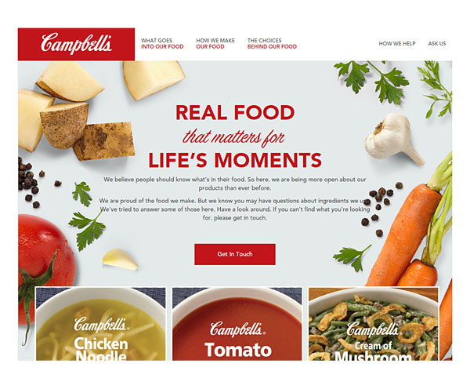


Market Forces ->Innovation
Clean and clear labeling due to drive for transparency – includes aspects: verification symbols (organic, Non-GMO Project), “real food” (what you mind find in your pantry), more information provided on products via the internet

Slide 8

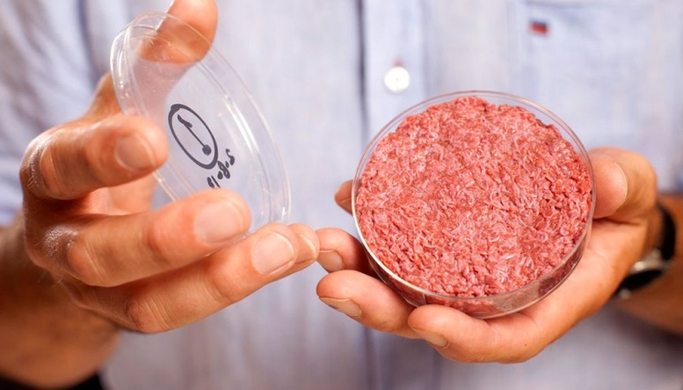

Market Forces -> Innovation
Ethical and conscious eating – Fair Trade, animal welfare (big in foodservice), sustainability (“ugly” vegetables and fruits, “slaughter-free” meat)

Slide 9
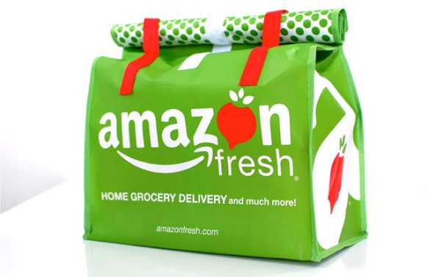



Market Forces -> Innovation
Blurring of distribution channels between grocery, convenience, foodservice, meal kits prepared meals and home delivery
Expansion of E-commerce – Amazon entering the food space
Innovative process technologies to extend shelf life of fresh food – HPP

Slide 10
Future Needs
Future needs in the food industry include:
Sustainability – reducing food waste, extending shelf life, improving energy efficiency
Supply chain – farm to table
Processing of natural materials
Biotech
Marketing for the new world
Culinary
Nutrition
Consumer research
Food safety
Food regulations
Employment of agricultural and food scientists is projected to grow 5 percent from 2014 to 2024, about as fast as the average for all occupations
–Bureau Labor Statistics

