Slide 1
Integrating STEM into your program through CASE
2012 NJ Fall Agricultural Education Conference
Presenters:
Lisa Moschera – Middlesex County Vocational School
Erik Fargo – Somerset County Vocational & Technical High School

Slide 2
Where it began
The Council
NAAE
STEM
Project Lead the Way
Notes:
21st century ag education high demand high skill high wage careers- perkins driven

Slide 3
CASE lesson modalities
All labs are student directed
Responsibility and engaging
Activities
Most guided
Projects
Less guiding, more student directed, problem solving skills
Problems
Least guided, most student directed, strongly focused on problem solving and creativity
Notes:
Show examples 2.1.5, 3.2.3, 6.4.2

Slide 4
How it works
Sequencing
Spiraling
Previous lessons, units, & courses build foundation for more advanced lessons
Difficult to “plug & play”
Pacing
Plant 163 days
Articulation

Slide 5
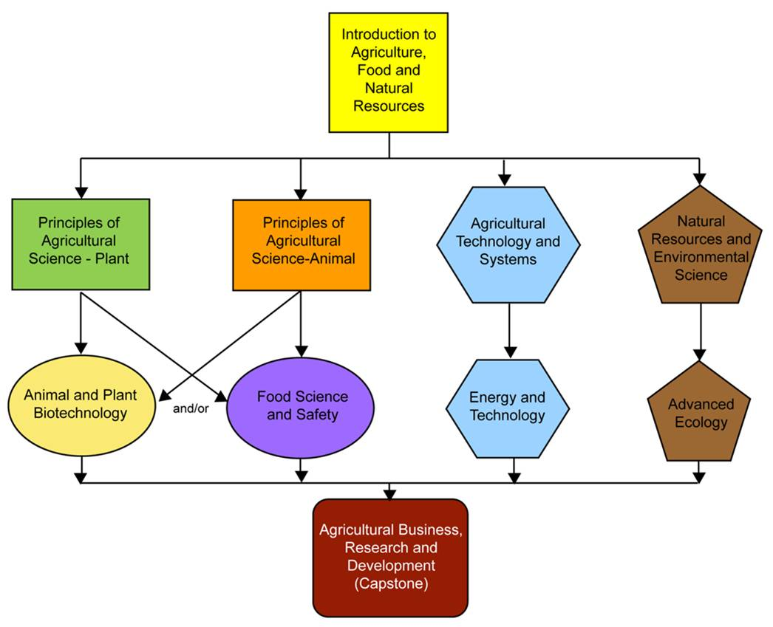
Pathways

Slide 6
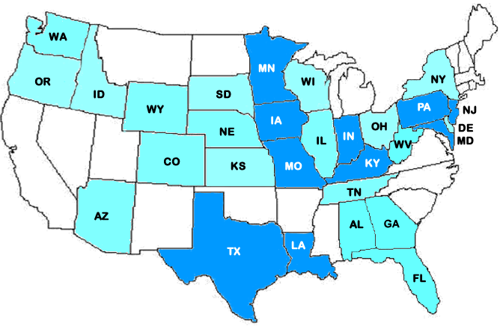
CASE Schools
In 2009, schools began implementing CASE into their programs. In four years, 417 teachers and 338 schools from 29 states are using CASE.
Notes:
Mention lab notebooks for biotech
Pacing for year important
Assessments – national tests will have developed end of program.

Slide 7
NJ DOE & Rutgers support
http://www.youtube.com/watch?v=7H2QnLXMats

Slide 8
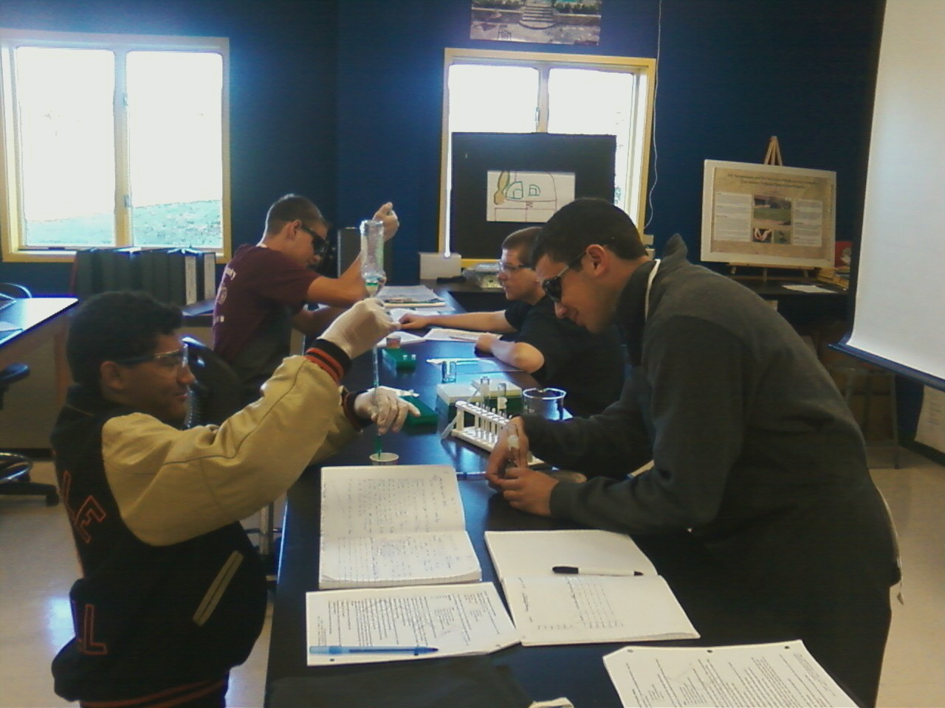
Animal & Plant Biotechnology

Slide 9
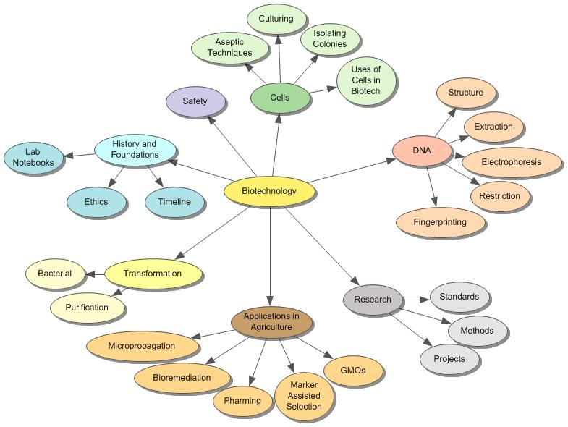
Structure
Five Units
Intro
DNA
Protein
Ag Biotech
Research
Concepts

Slide 10
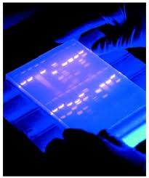
Biotech Skills World problem solvers
Micropipetting
Electrohoresis
PCR
Protein Detection
Disease Diagnosis
Create disease resistant crop
Reduce pesticide use
Determine best Sire & Dam for breeding
Determine best pollen & seed parents
Invent biofuel crop
Increase nutrients in food crops

Slide 11
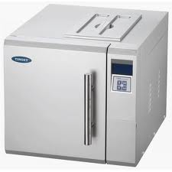
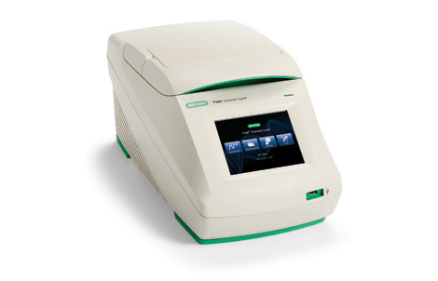
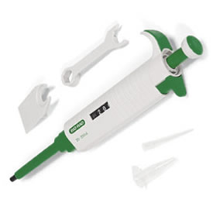
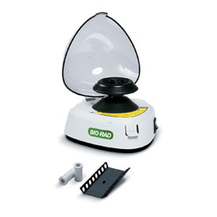
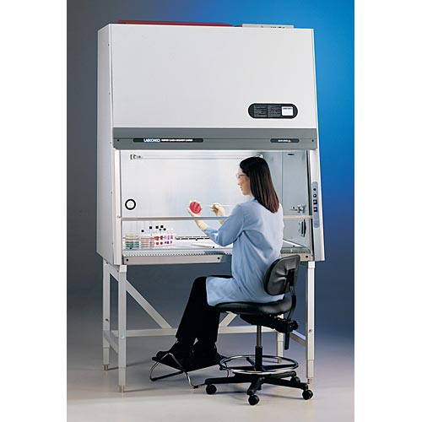
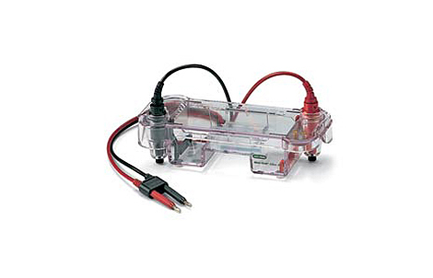
Equipment
Micropipettes
Centrifuge
Hot water bath
Glassware
Kits
Autoclave
Laminar Flow hood
Thermal Cycler
Storage & Safety

Slide 12
Elevated rigor in other areas
Lab notebooks
Industry standards
Proper headings
Purpose
Procedure – what was done, not activity sheet
Observations - visual
Conclusions
Signatures, date, page numbers
ToC
Up to date
Neat, legible, inclusive, able for others to repeat experiment
SAFETY
100% on safety tests on equipment used
Safety contract/agreement
Wear PPE at all times in the lab
No food, drink, gum
Properly label all containers
Spill kits
Broken glass containers
Sharps containers
Bio-materials
Communication with custodial staff

Slide 13
Most memorable
Ethics
Loading Electrophoresis wells
Biofuels – ethanol production
Transforming yeast with Green Fluorescent Protein

Slide 14
Contact info
Erik Fargo efargo@scvts.net
Lisa Moschera

