Slide 1
CDE/LDE, Agriscience Fair & National Chapter Revisions:
2017 - 2021

Slide 2
Career & Leadership Development Events 2017-21
Special Note
Information discussed in this presentation is for the 2017- 2021 National FFA Events.
The events conducted at the 2016 National FFA Convention and Expo will use the 2012-2016 Policies and procedures.
Use of CDE/LDE handbooks and Agriscience Fair & National Chapter procedures will begin on November 1 for New Jersey events

Slide 3
Career and Leadership Development Events:
2017 - 2021

Slide 4
Career & Leadership Development Events 2017-21
Program Purpose
National Career and Leadership Development Events should reflect instruction that currently takes place in the entire agricultural education program, including classroom instruction, laboratory instruction, instruction in leadership and supervised agricultural experience. Events are intended to be an outgrowth of instruction. Also, it is appropriate for the national organization to develop events and awards that stimulate instruction in emerging areas that reflect both current and future community, national and global workforce needs.

Slide 5
Career & Leadership Development Events 2017-21
National Handbooks
Footer description area.

Slide 6
Career & Leadership Development Events 2017-21
National Handbooks
Footer description area.

Slide 7
Career & Leadership Development Events 2017-21
National Handbooks
(right hand side)
Footer description area.

Slide 8
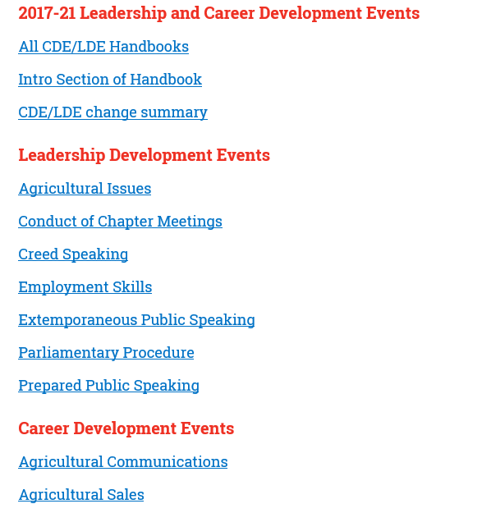
Career & Leadership Development Events 2017-21
National Handbooks
Handbook

Slide 9
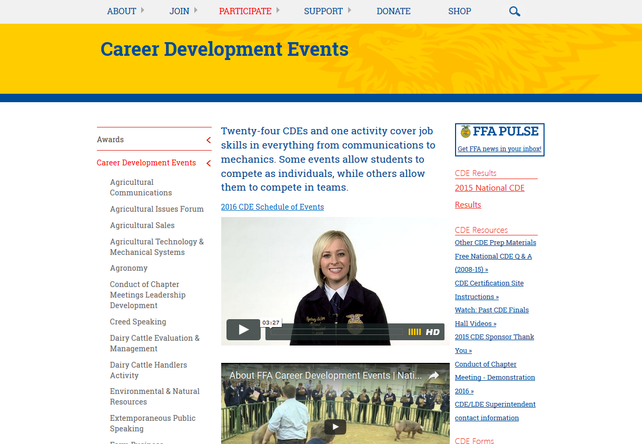
Career & Leadership Development Events 2017-21
National Handbooks

Slide 10
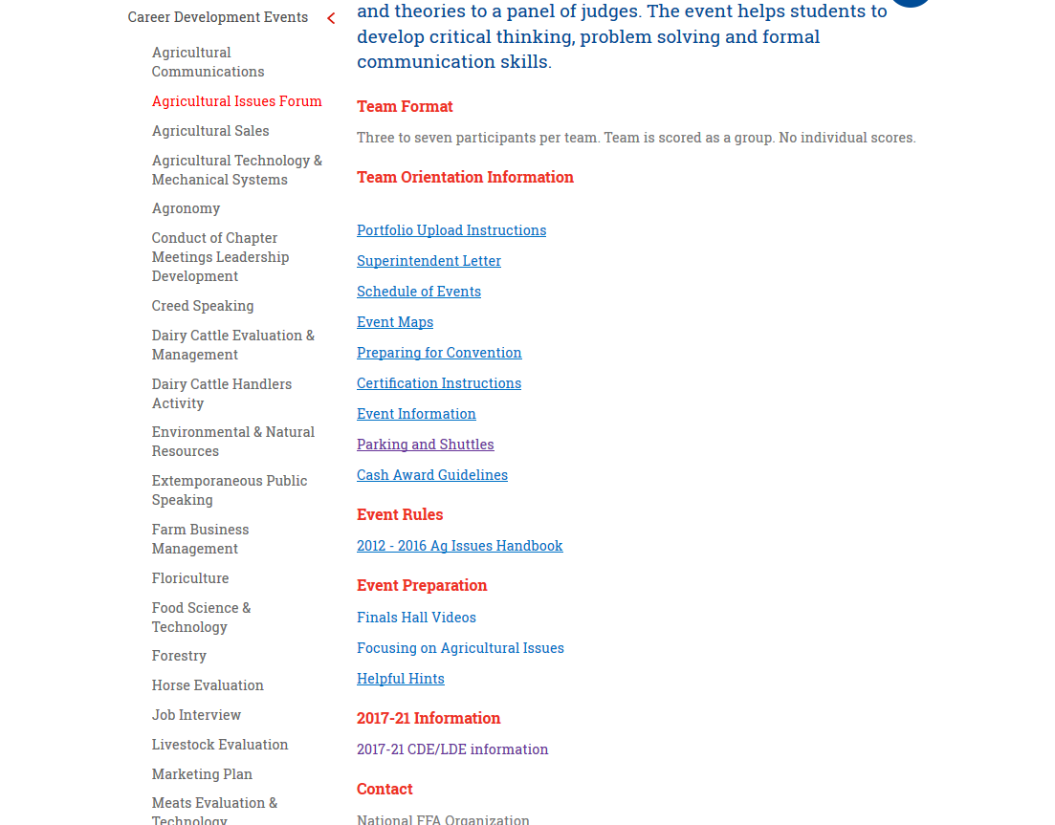
Career & Leadership Development Events 2017-21
National Handbooks

Slide 11
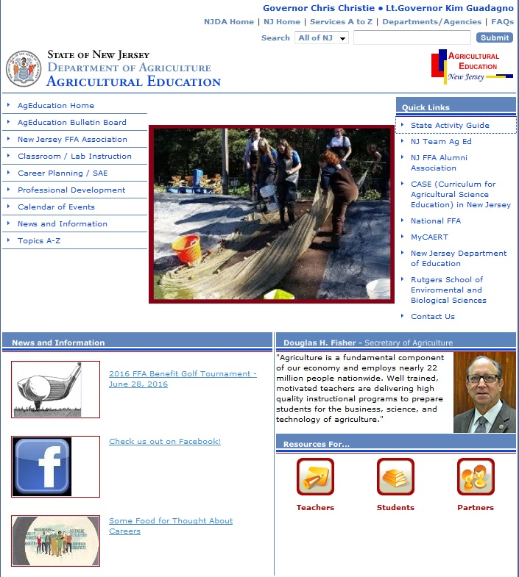
Career & Leadership Development Events 2017-21
State Handbooks

Slide 12
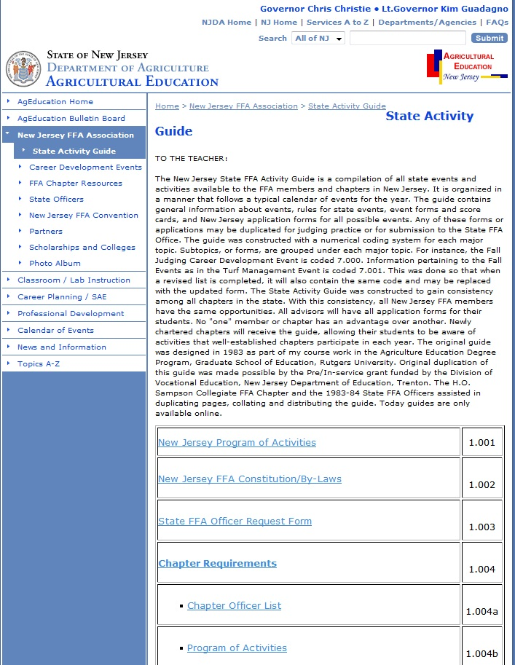
Career & Leadership Development Events 2017-21
State Handbooks

Slide 13
Career & Leadership Development Events 2017-21
Overall changes
Transitioned some Career Development Events to Leadership Development Events
2012-2016 CDE Titles | 2017-2021 LDE Titles
Agricultural Issues Forum CDE | Agricultural Issues LDE
 | Conduct of Chapter Meeting LDE (not currently offered in NJ)
Creed Speaking CDE | Creed Speaking LDE
Extemporaneous Public Speaking CDE | Extemporaneous Public Speaking LDE
Job Interview CDE | Employment Skills LDE
Parliamentary Procedure CDE | Parliamentary Procedure LDE
Prepared Public Speaking CDE | Prepared Public Speaking LDE
Footer description area.

Slide 14
Career & Leadership Development Events 2017-21
Career Development Events
2017-2021 CDE Titles
Agricultural Communications (not currently offered in NJ) | Forestry
Agronomy | Horse Evaluation
Agricultural Sales | Livestock Evaluation
Agricultural Technology and Mechanical Systems | Marketing Plan
Dairy Cattle Management and Evaluation | Meats Evaluation and Technology
Dairy Cattle Handlers (Activity only) | Milk Quality and Products
Environmental and Natural Resources | Nursery/Landscape
Farm and Agribusiness Management | Poultry Evaluation
Floriculture | Veterinary Science
Food Science and Technology
Footer description area.

Slide 15
Career & Leadership Development Events 2017-21
Overall changes
Moved all team CDEs to counting all scores
Meat Evaluation & Technology CDE – 3 member team
Name Changes
Job Interview  Employment Skills
Farm Business Management  Farm & Agribusiness Management
Team activities – Process and product evaluation
Age Participation
With the exception of Conduct of Chapter Meeting (grades 7,8,9 at time of qualification) and Creed (grades 7,8,9 at time of qualification)LDEs, all other CDEs and LDEs will be open to all levels of membership – Grades 7-12 at time of qualification.

Slide 16
Agriscience Fair:
2017 and 2021

Slide 17
Agriscience Fair
Program Purpose
The National FFA Agriscience Fair recognizes student researchers studying the application of agricultural scientific principles and emerging technologies in agricultural enterprises. The agriscience fair is for middle and high school students. Participation begins at the local level and progresses to state and national levels.

Slide 18
Agriscience Fair
Categories

Slide 19
Agriscience Fair
Divisions

Slide 20
Agriscience Fair
What about tricky topics?
Some topics are difficult to determine proper category placement
Tips:
Identify independent variable and dependent variable
This helps clarify
Still a question? Email abstract to agriscience@ffa.org and request a category determination

Slide 21
Agriscience Fair
Rule Transitions
Data cannot be added after state level selection
Maximum of 12 national finalists selected in each category and division
Displays
Board dimensions will not exceed 36’’ high, 48’’ wide, 30’’ deep
Optional: Log book, up to 5 copies of written report
No additional props, handouts or electronics will be permitted
No electricity will be provided
If a project is selected as a national finalist in team divisions (2, 4 or 6) and only one team member is present at the interview, project cannot rank higher than 4th overall
Substitutions are not permitted (no add/deletes)

Slide 22
Agriscience Fair
Rule Transitions
Online application is required, but will NOT be submitted online
Report Templates are required
Different rubrics for middle school participants versus high school participants

Slide 23
National Chapter:
2017 - 2021

Slide 24
National Chapter Award Program
Program Purpose
The national chapter award program is designed to recognize FFA chapters that actively implement the mission and strategies of the organization. These chapters improve chapter operations using the National Quality FFA Chapter Standards and a Program of Activities that emphasizes growing leaders, building communities and strengthening agriculture. Chapters are rewarded for providing educational experiences for the entire membership. This application process assists chapters in assessing their accomplishments.

Slide 25
National Chapter Award Program
Recognition
Form I – Superior Chapter (certificate)
Form II – Gold, Silver Bronze Chapter (multi-year plaque)
Gold Chapters – ranked 1st – 3rd (monetary award & 1st place plaque)
Gold Chapters – move to National Level competition and given 3-star, 2-star or 1-star designation
National Level Competition
3-star Chapters – recognized on stage at the National FFA Convention
Premier Chapter Awards – top ten chapters in each division
Models of Excellence – top ten chapters in all divisions
Middle School Models of Excellence – top five middle school chapters

Slide 26
National Chapter Award Program
Divisions & Quality Standards
Division Structure
Growing Leaders, Building Communities, Strengthening Agriculture
Quality Standard Structure

Slide 27
Career & Leadership Development Events 2017-21
Overall changes
New Divisions and Quality Standards
Online Application, but not submitted online
Form 1
Based on self assessment National Quality FFA Chapter Standards and a summary of one activity in each quality standard area
A minimum of 51 points or higher in addition to the activity summaries must be earned and completed in order for a chapter to fill out Form 2.
If dates don’t coincide with the dates listed on the cover of the application, a 25 point deduction per activity will be assessed.

Slide 28
Career & Leadership Development Events 2017-21
Overall changes
Chapters who collaborate on an activity can use the same activity, but must have different goals, plans of action and results and evaluation.
Form I & Form II - Do not contain multiple activities in one description. Each activity write up should be based on one activity.

Slide 29
Additional Information will be Provided During the “Deep Dive” Break-out Sessions

