Slide 1
The Value of Membership in Professional Organizations
Jenny J. Allen
Newton High School

Slide 2
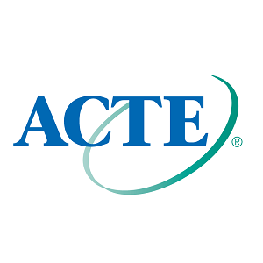

Slide 4
NAAE Member Benefits
Professional Liability Insurance Coverage and other insurance options through the Trust for Insuring Educators (for active, active life, and student members)
Hotel Discounts with Choice Hotels International
Legislative advocacy for the profession
Technical and Pedagogical Education

Slide 5
NAAE Member Benefits continued
Leadership, Personal and Professional Development
Awards and Grants
Communities of Practice Professional Networking Site
News & Views

Slide 7
ACTE Membership Rewards
Professional Development
Knowledge and Information
Career Advancement
Advocacy and Policy
Personal Protection
Recognition - Awards

Slide 8
Personal Experiences

