Slide 1
NJ Fall Ag Ed Teachers Workshop

Slide 2
Workshop Objectives
Setting the Stage
The need for SAE and philosophy
Understanding the “SAE for All” Model
Foundational SAE Component*
Immersion SAE Component
Notes:
Facilitator notes:
Set context around goals for workshop and why we are here.
Explain that up until now we’ve been demonstrating the need for a new model. Now we will dive into the new model.
Assure participants that SAE for All does not mean a bunch more work for teachers – it is a new framework for how we approach what we do.

Slide 3
WHAT IS AN SAE?
Using the notecard provided define SAE as you know it.

Slide 4
WHAT IS AN SAE?

Slide 5
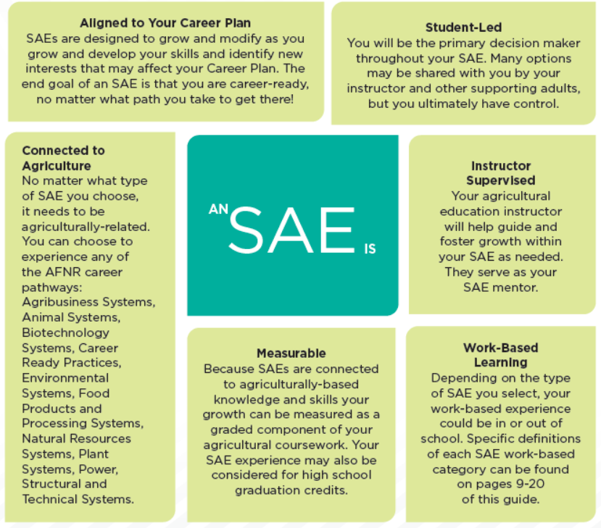

Slide 6
Spring
Fall
2010
2011
2011
Council initiates SAE renewal
National Ag Ed Summit – SAE held in Orlando
NCAE and AERO SAE committees formed
Fall
Spring
2015
2015
SAE resource development starts
Council approves SAE philosophy and guiding principles
Fall
Fall
Summer
Fall
2016
2017
2018
2018
SAE Summit held in Omaha
SAE for All guides released for students and teachers
Independent Learning Guides released
Council approves
Plaid Agency marketing plan
Fall
Spring/Summer
Winter
2019
2019
2019
SAE for All Implementation
Regional Train-the-Trainer events held
Marketing plan initiates
Notes:
Facilitator notes:
Briefly set context that this has been a multi-year process with various stakeholders to develop and test the model and now we are ready to roll it out nationally and ensure it is successful.
Note: Facilitators are not meant to walk through the timeline on screen- it is just meant to be a visual to display how long the project has been going on.
Draw attention that there have been opportunities in the past decade for input and participation of all members of Team Ag Ed

Slide 7
WHAT IS THE GOAL OF AN SAE?
Earn Awards and Recognition
Develop Record Keeping Skills
Application of Skills
Prepare Students for Successful Careers

Slide 8
The Ag Ed Mission
“Agricultural education prepares students for successful careers and a lifetime of informed choices in the global agriculture, food, fiber, and natural resources systems.”

Slide 9
DISCUSSION
What are you currently doing in your Ag Ed program that is career preparation focused?
Notes:
FFA/leadership development
Classroom instruction/knowledge and skills
Experiential/work-based learning

Slide 10
Step 1. THINK
What barriers might inhibit meaningful educational and career-readying experiences through SAE?
Step 2. PAIR
Step 3. SHARE
Notes:
Preparation for this slide:
Create two tear sheets. Label one “Teacher Barriers” and the other “Student Barriers” with ample space beneath each label.
Divide the “Student Barriers” poster into two columns: “No SAE project” and the other “SAE with limited value for student’s career goals” with ample space beneath each label.
Be prepared to save these posters. You’ll refer back to them later in the workshop.
Facilitator notes:
Introduce the two posters. Explain that one represents barriers faced by teachers and the other faced by students.
Explain that student barriers may look different for a student who lacks an SAE versus a student who has an SAE with limited career preparation value (i.e. feeding their dog).
Draw participants’ attention to the question on the screen and ask them to accomplish the following ( click to reveal instructions):
First, ask them to think independently about how they’d answer the question for the two students represented by the posters. Instruct them to capture their thoughts on individual sticky notes (one per idea)
Second, ask them to turn to their immediate neighbors and share their thoughts in pairs or trios.
Finally, have pairs share with the large group. As each pair shares, they should post their stickies on the appropriate poster. If a barrier it already represented - they should stack the sticky on top of the duplicate.
Bring closure to this exercise by emphasizing that these barriers represent the current state of SAE and signify the need for a new approach, they do not necessarily indicate the future state of SAE.
Ask participants to consider the potential a new approach might offer by posing this question: “If we were to rethink our approach to SAE in a way that students maintained high-quality projects, how would their learning experience be richer?”
Ask: “How would agriculture teachers benefit from their students having quality SAEs?”

Slide 11
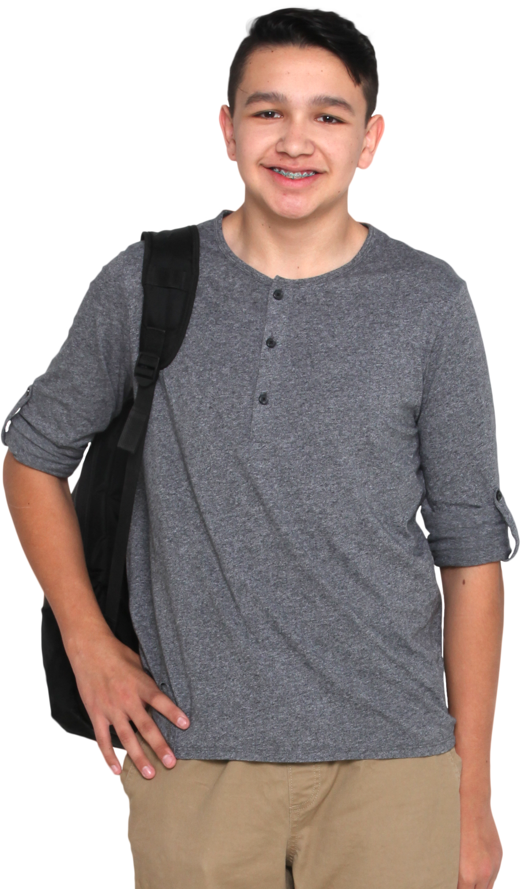
ISAAC:
He took “Introduction to Ag” the first semester of his Freshmen year. Then, he took electives for the next two semesters. He’s enrolled in “Environmental Science” for his Sophomore spring semester.
EMMA:
TORI:
She wasn’t enrolled in your program until the fall of her Senior year when she decided to take “Ag Welding” to earn dual credit.
She’s a graduating Senior who has taken agricultural education classes every semester of her high school career.
Notes:
Preparation for this slide:
Foundational SAEs will be a mindset shift for most experienced teachers. Before diving into the technical content, spend a few minutes demonstrating the need for a new approach.
Facilitator notes:
By a show of hands, identify who in the room is a current or former agriculture teacher.
For those that aren’t, ask them to imagine themselves in the role.
Ask participants to raise their hand if they have taught/met/or heard of students like Tori who take four years of agricultural education courses.
Ask participants to raise their hand if they have taught/met/or heard of students like Isaac who come in and out of the program multiple times throughout their high school career.
Ask participants to raise their hand if they have taught/met/or heard of students like Emma who take only one course in the program.
 Click to focus participants’ attention on Isaac and Emma and away from Tori.
Ask what challenges exist in reinforcing SAE among students such as them. For example:
Students like Isaac may lack continuity in their project and their record keeping. When they re-enter the program, they may be starting at
square one again.
Students like Emma may see one-off ag classes as a means to graduation. While she has a number of other things on her plate (potentially a part-time job) and limited time, she may comfortable doing the bare minimum.
Explain that a new classification of SAE — Foundational SAEs — alleviate some, if not all, of those challenges by enabling students to engage in SAE from the moment they enroll in agricultural education.

Slide 12
Let’s hit
PAUSE.
Setting the Stage – the need and philosophy
Understanding the “SAE for All” Model
Foundational SAE Component
Immersion SAE Component
What questions do you have?
Notes:
Facilitator notes:
Pause and allow the participants to reflect on the facilitation of the previous activities in this session.
Set context of the SAE for All model overview and foundational SAE that will be covered in the next session

Slide 13
View this video in a larger online lesson when you visit thecouncil.ffa.org.
Click on SAE and launch the Learning Guides Online Course.
Notes:
Facilitator notes:
Before playing the video, acknowledge that the term “Foundational SAEs” may be a new term to veteran professionals.
Emphasize that it’s a new term to students as well, so the National Council for Agricultural Education has produced this video to explain the term to students.
Reassure the group that while they may not be the intended audience, the video does a nice job explaining the concept.
Following the video, reassure participants that you’re about to dissect the five elements of a Foundational SAE one-at-a-time.
Other notes:
This video is from the “Learning Guides Online Course” found on the National Council for Agricultural Education website at https://thecouncil.ffa.org/sae/.

Slide 14
SAE Student Roadmap
Awareness
Grades 6-9
Intermediate
Grades 9-11
Advanced
Grades 11-12
Career Exploration and Planning
Employability Skills for College and Career Readiness
Foundational
Personal Financial Management and Planning
Workplace Safety
Agricultural Literacy
The agricultural literacy component of a Foundational SAE may be transitioned to one or more Immersion SAEs. All Foundational SAE components and Level 1 Immersion SAEs are intended to be graded.
Notes:
Facilitator notes:
Click to move the word “Foundational” to the side.
Explain that everything that we will add in the green Foundational arrow is a component of a Foundational SAE.
Emphasize that what we are about to add are not “choices” of different types of Foundational SAEs, but rather all contribute to a complete Foundational SAE. (Nothing on the screen is “optional”.)
Emphasize that everything in the Foundational green arrow is intended to be graded (in every class), which ensures that this is truly an SAE for All students.
Ask teachers if they currently give a class grade for SAE, and if so, what percent?
Ask how much class time they give to SAE and how that is used (usually record books). Based on the percent grade, we should allow ourselves time in class to spend on SAE. For example, a 20% grade is one day each week; a 10% is one day every other week.
What if we were to expand how we use class time for SAEs to includes other artifacts beyond a traditional record book?
Click to bring up the blank bars.
Explain that there are five parts. Re-emphasize that all are necessary for a Foundational SAE.
Click to bring up each component of a Foundational SAE.
Provide a bit of commentary for each part to draw attention to each component individually.
Emphasize the need of each component for every student. “Doesn’t every student deserve to spend time individually planning for their career?” etc.
Click to bring up the small Ag Literacy text.
Explain how Ag Literacy can “fade away” for students who may add an Immersion SAE. Mention that you’ll talk about that later as well.

Slide 15
Awareness
Grades 6-9
Intermediate
Grades 9-11
Advanced
Grades 11-12
Career Exploration and Planning
Complete Career Interest Inventory (ex. AgExplorer.com)
Career Pathway Goals
Start 4-year Career Plan
Academic
Immersion SAE Research/Plan
Career Readiness Skills/Leadership
Revisit Career Goals
Update Career Plan
Pursue Shadowing Opportunities
Develop Immersion SAE Plan
Explore post-secondary options and terminology
Specific post-secondary research and planning based on Career Goals
Financial aid research
Revisit Career Goals
Update Career Plan
Application to post-secondary
Application for financial aid
Identify and contact support at post-secondary level
Foundational
Employability Skills for College and Career Readiness
Personal Financial Management and Planning
Workplace Safety
Agricultural Literacy
The agricultural literacy component of a Foundational SAE may be transitioned to one or more Immersion SAEs. All Foundational SAE components and Level 1 Immersion SAEs are intended to be graded.
Conceptual example of how Foundational SAE components may be delivered.
Notes:
Facilitator notes:
Click to show the Awareness examples.
Describe the value of a student who would experience these types of activities.
Draw particular attention to the Career Plan and the value it gives to the rest of the student experience.
Click to show the Intermediate examples.
Describe how the experiences listed here would help to “level up” students, individualizing and personalizing it for students.
Click to show the Advanced.
Continue the conversation.
Discuss that we “could” expand each of the other Foundational components (workplace safety, etc), but that participants will do that and also find examples in the SAE for All guide materials.
Click to “close” the example.

Slide 16
ISAAC:
He took “Introduction to Ag” the first semester of his Freshmen year. Then, he took electives for the next two semesters. He’s enrolled in “Environmental Science” for his Sophomore spring semester.
AWARENESS
EMMA:
TORI:
She wasn’t enrolled in your program until the fall of her Senior year when she decided to take “Ag Welding” to earn dual credit.
She’s a graduating Senior who has taken agricultural education classes every semester of her high school career.
INTERMEDIATE
ADVANCED
Notes:
Facilitator notes:
Tell participants that even delivering foundational SAE’s can be differentiated. This allows us to meet students where they are. No matter where they are at in their Ag Ed journey, we can tailor foundational SAEs to meet their needs.
Revisit Tori, Isaac, and Emma to introduce the different levels of Foundational SAEs.
Awareness: Grades 6-9
 Click to trigger label by Isaac
Intermediate: Grades 9-11
 Click to trigger label by Emma
Advanced: Grades 11-12
 Click to trigger label by Tori

Slide 17
Awareness
Grades 6-9
Intermediate
Grades 9-11
Advanced
Grades 11-12
Career Exploration and Planning
Employability Skills for College and Career Readiness
Foundational
Personal Financial Management and Planning
Workplace Safety
Agricultural Literacy
The agricultural literacy component of a Foundational SAE may be transitioned to one or more Immersion SAEs. All Foundational SAE components and Level 1 Immersion SAEs are intended to be graded.
Five Immersion SAE categories span three levels of motivation.
Every enrolled agricultural education student shall have a Foundational SAE. As part of this SAE, students will maintain intensive Career Exploration and Planning, Personal Financial Management and Planning and Workplace Safety components throughout their high school career. Students will also start an Agricultural Literacy project that may transform into one or more Immersion SAEs.
Graded
Recognition
Career-Ready
Placement / Internship
Ownership / Entrepreneurship
Research: Experimental, Analysis or Invention
School-Based Enterprise
Service Learning
Notes:
Facilitator notes:
Click to slide up the Foundational SAE.
Click to add the arrows.
Reemphasize that what we are going to add is in addition to students maintaining a Foundational SAE.
Click to add the Immersion box.
Everything added in this box is considered an Immersion SAE.
Click once to add all five Immersion SAE categories.
Provide a brief explanation of each, reminding participants that they will have a “deep dive” of each Immersion SAE at a later time.
Explain that Immersion SAEs are designed to be “RESUME WORTHY” experiences.
Immersion SAEs directly align to Perkins V’s definition of Work-Based Learning Experiences. (Good info for state staff, in particular.)
Click once to add the three levels of Immersion SAEs.
Discuss that teachers should have graded expectations when they have an Immersion SAE.
The reason the Ag Literacy component “fades away” is because we are now also requiring graded artifacts for an Immersion SAE, which replaces the Ag Literacy grade.
Discuss how we hope “stair step” student from extrinsic motivation (graded expectations) to more intrinsic motivation (recognition through FFA and career readiness, or being passionate about their future career).

Slide 18
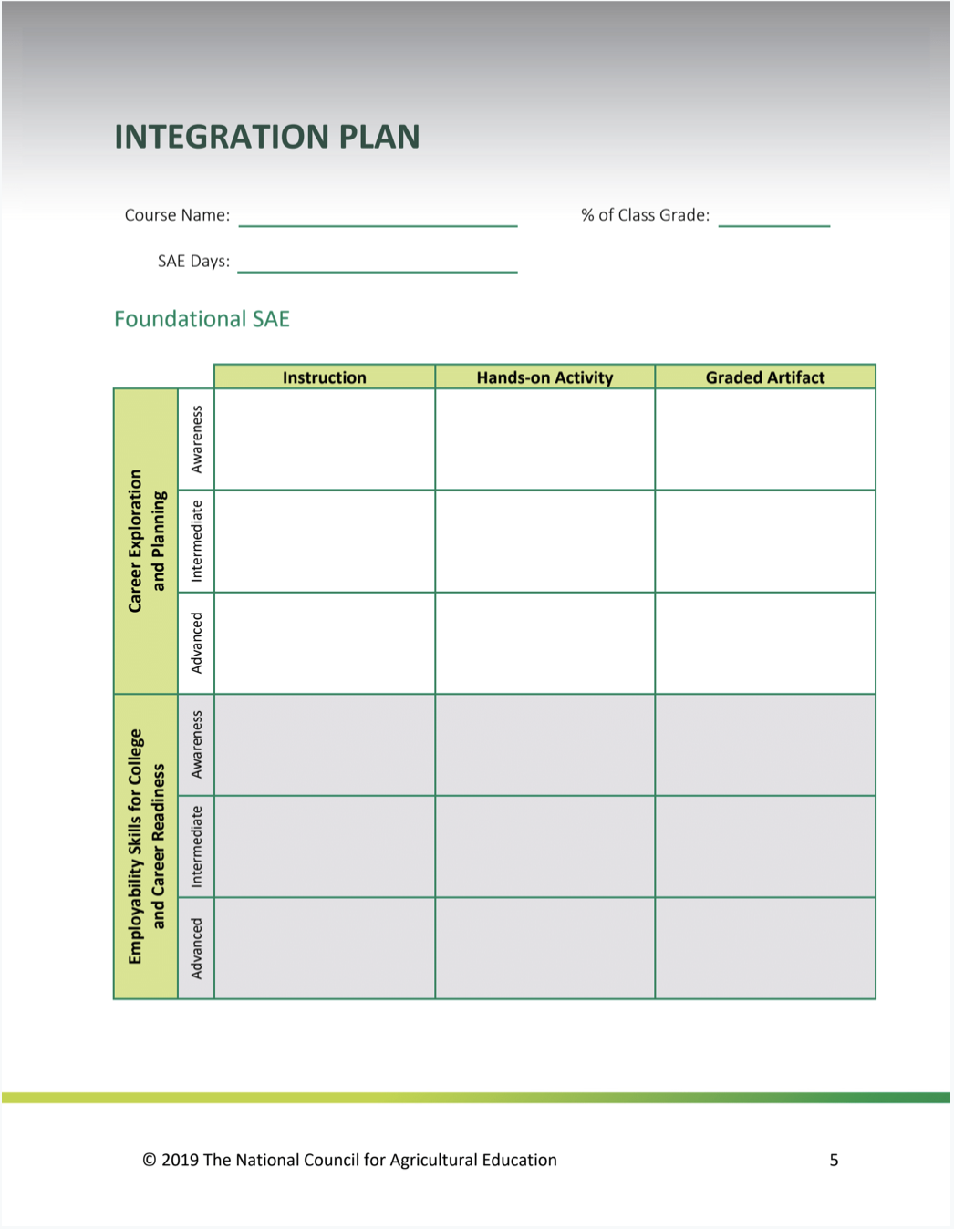
Integration Plan: Foundational SAE
Instruction |  |  | What will you teach?
Hands-on Activity |  |  | How do you plan to teach it?
Graded Artifact |  |  | How will you know students understand it?
Participant Guide, page 5-6.
Notes:
Facilitator notes:
Acknowledge that participants are the key ingredient to a successful roll-out of the “SAE for All” model in their states.
Emphasize that while they may not be local teachers, they will need to help local teachers adopt these principles into their total agricultural education program.
Explain that you’re about to share a plan to integrate the model successfully. Stress the importance of understanding how to use this resource in order to effectively assist teachers at the local level.
Direct learners’ attention to the SAE Integration Plan on page 5-6 in their Participant Guide.
Explain that the Integration Guide will be a take-home tool to guide their implementation of the new SAE model.
Draw attention to the five elements of Foundational SAE in the left-most column.
Remind participants that a Foundational SAE contains all five components, therefore all five components should be infused into each course taught.
Emphasize that for each element, participants will build out the remaining columns:
Instruction: What will you teach students regarding this element?
Hands-on Activity: What will be your instructional method?
Graded Artifact: What will you use to verify that learning occurred?
Highlight that there are different levels for Awareness, Intermediate, and Advanced and they should think of examples for each.
Suggest that state staff can pair up or work in small groups with people who are currently classroom teachers.
Offer clarity and give the group ample time to work, making yourself available for questions.
If time allows, seek one or more volunteers to share their integration plan with the group.

Slide 19
Foundational SAE in Action Foundational SAE Portfolio
Four year menu activities in Foundational SAE
Primarily in Career Exploration & Planning
Students select which activities they complete each year and accumulate points for each.
Minimum requirement of 10 points / semester
Contains worksheets and resources for each activity
Brandon Jacobitz
Adams Central High School
Hastings NE
https://app.box.com/file/502395283703
Video explanation by Brandon
https://www.dropbox.com/s/y8iy0fhmo140wjn/Adams%20Central%20Foundational.mp4?dl=0

Slide 20
Foundational SAE in Action SAE Activity Guide
Example of a Google document created by Kurt VanDeWalle in Nebraska.
Activity designed to guide the student through the activities identified in the integration plan.
Shared Google doc that the student fills out as they progress through the semester.
https://ffa.box.com/s/7d7n21kej9h1p3dmmv70ip0mcjzinjrd

Slide 21
Sponsored as as special project of the National FFA Foundation by

