Slide 1
National Teach Ag Campaign
What you need today:
Writing Object
Something to write on
Positive Attitude
Smile ☺

Slide 2
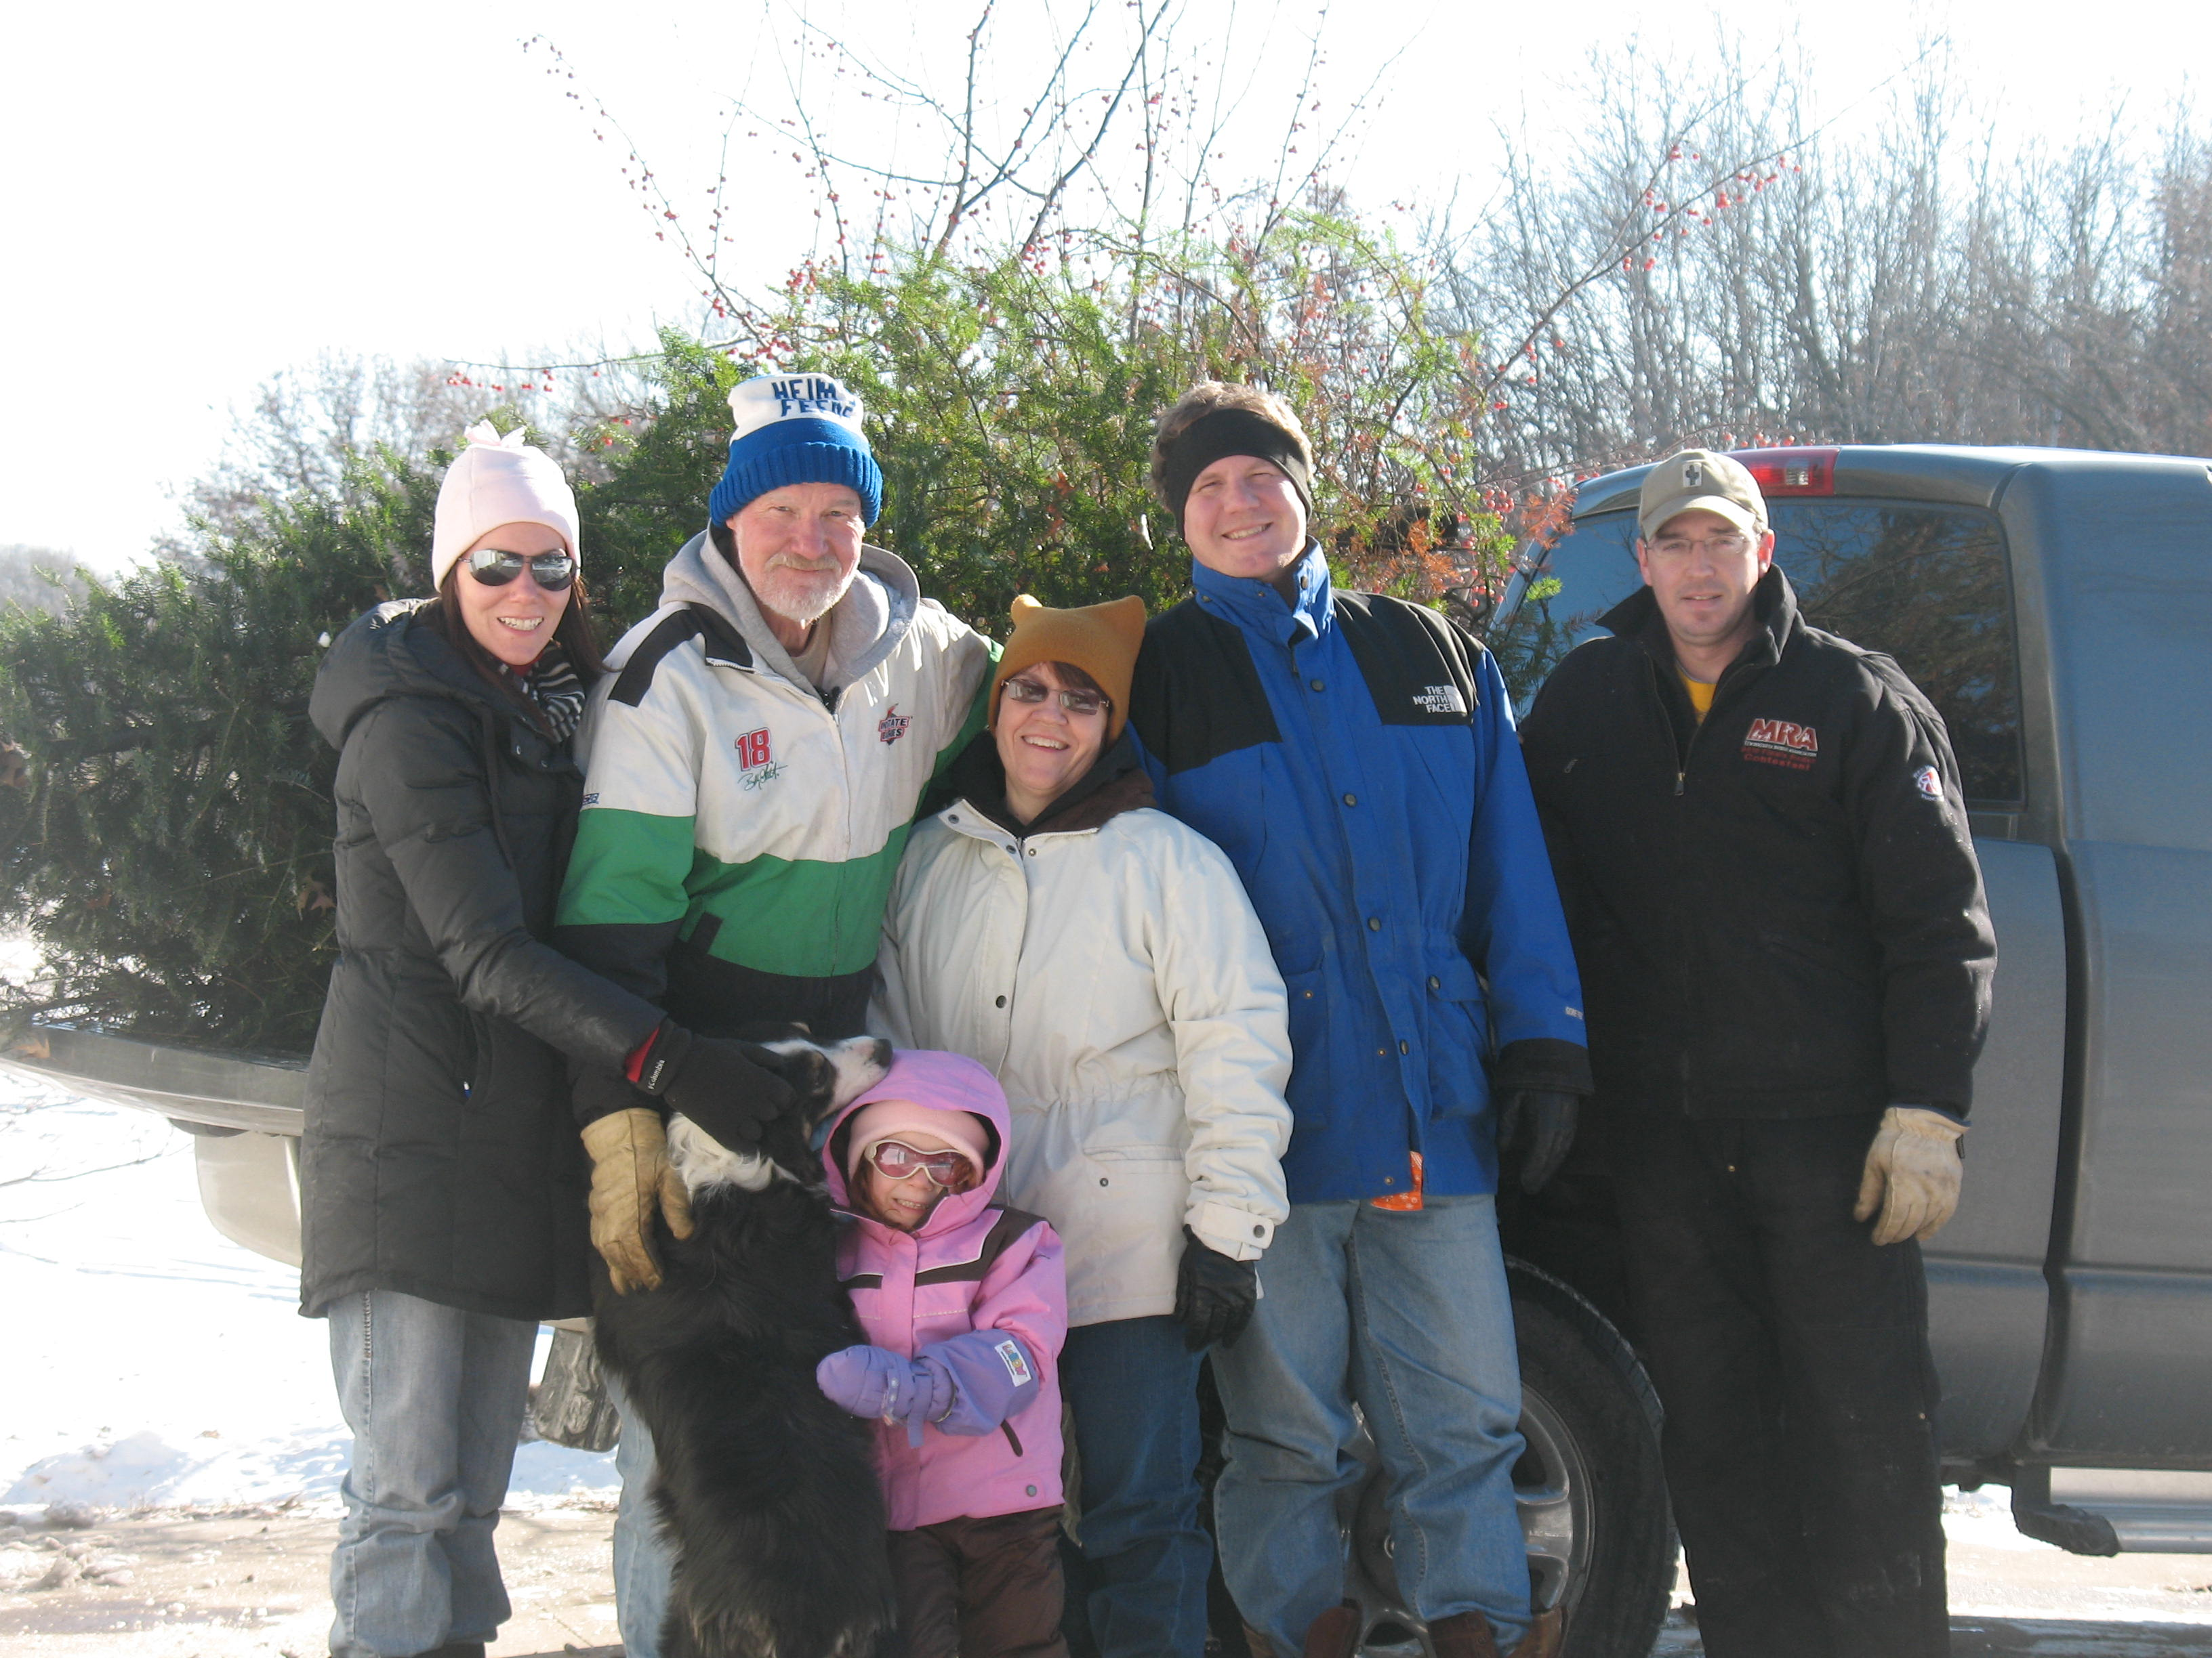
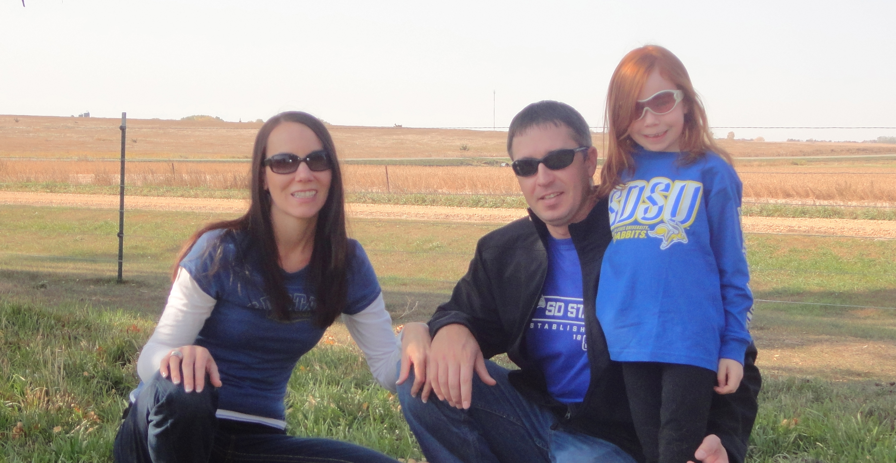
Personal Background
Royalton, MN
Sauk Centre, MN
Brookings, SD

Slide 3
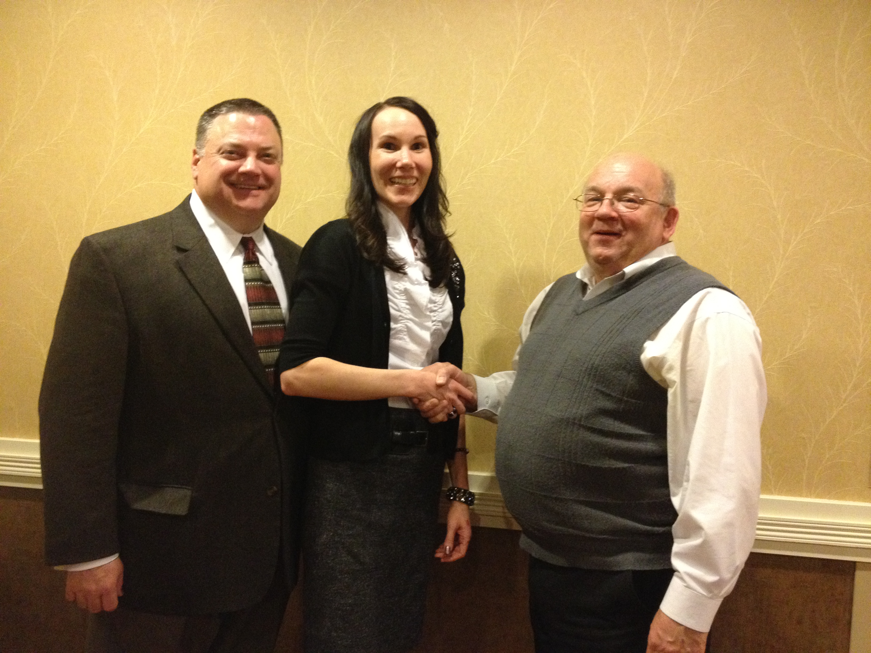
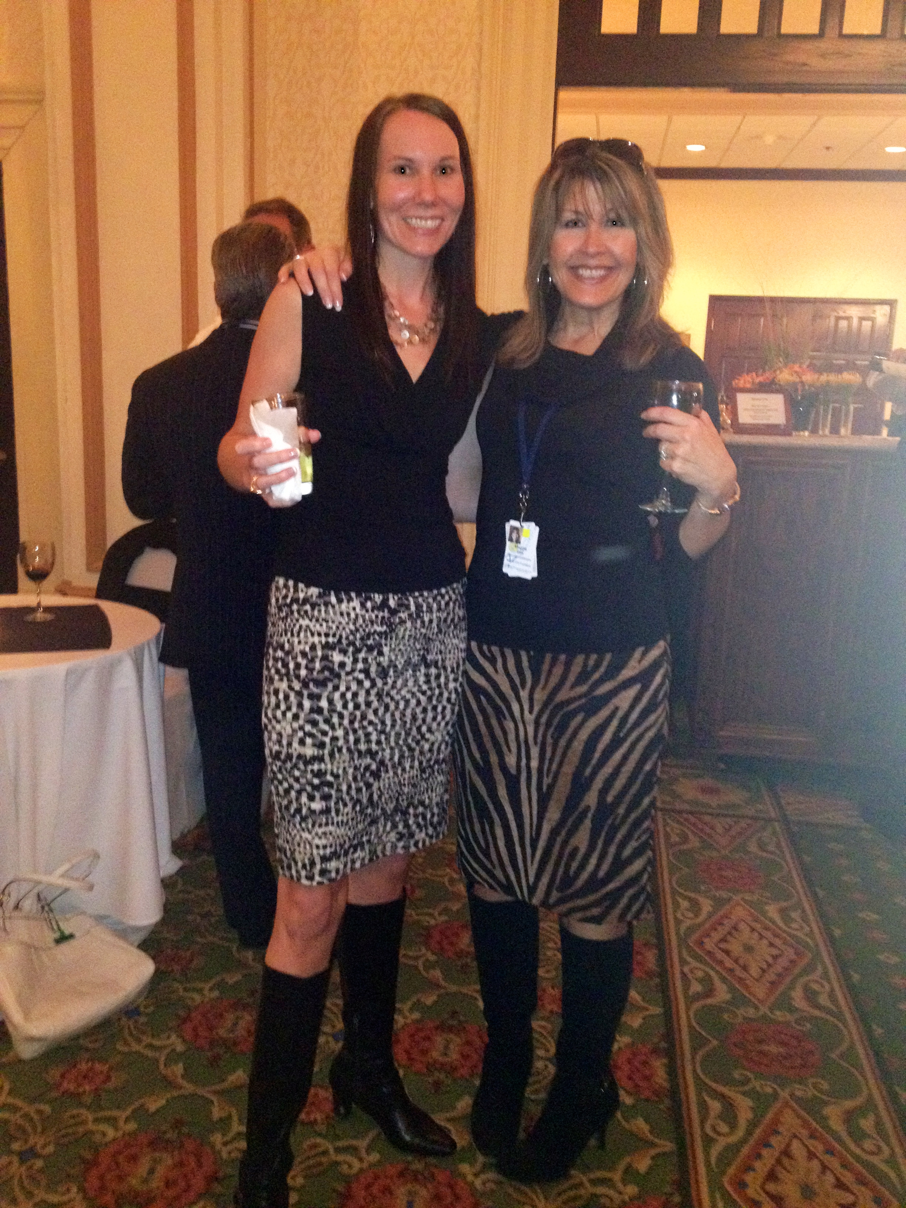
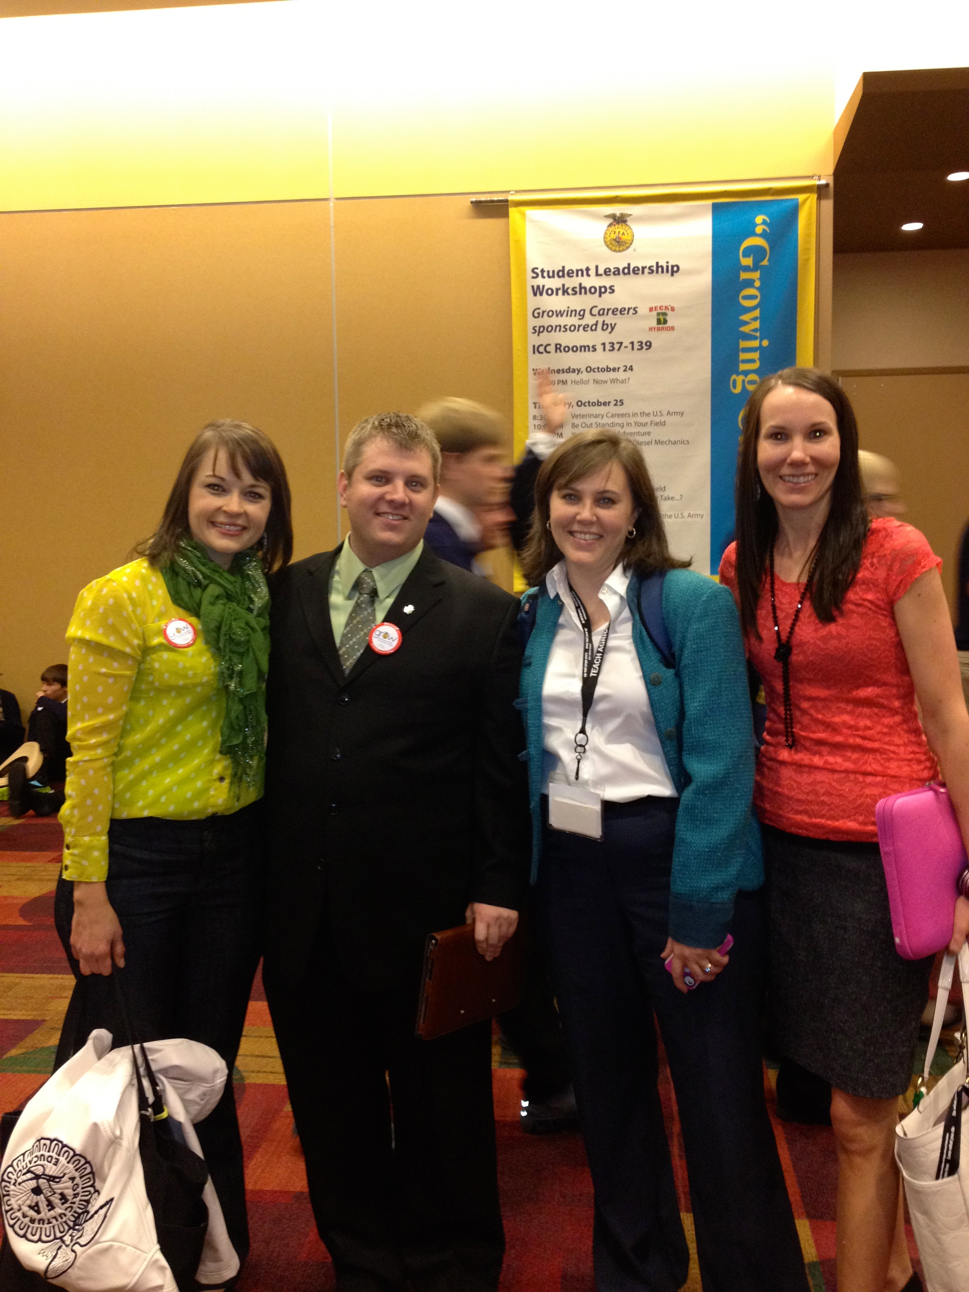
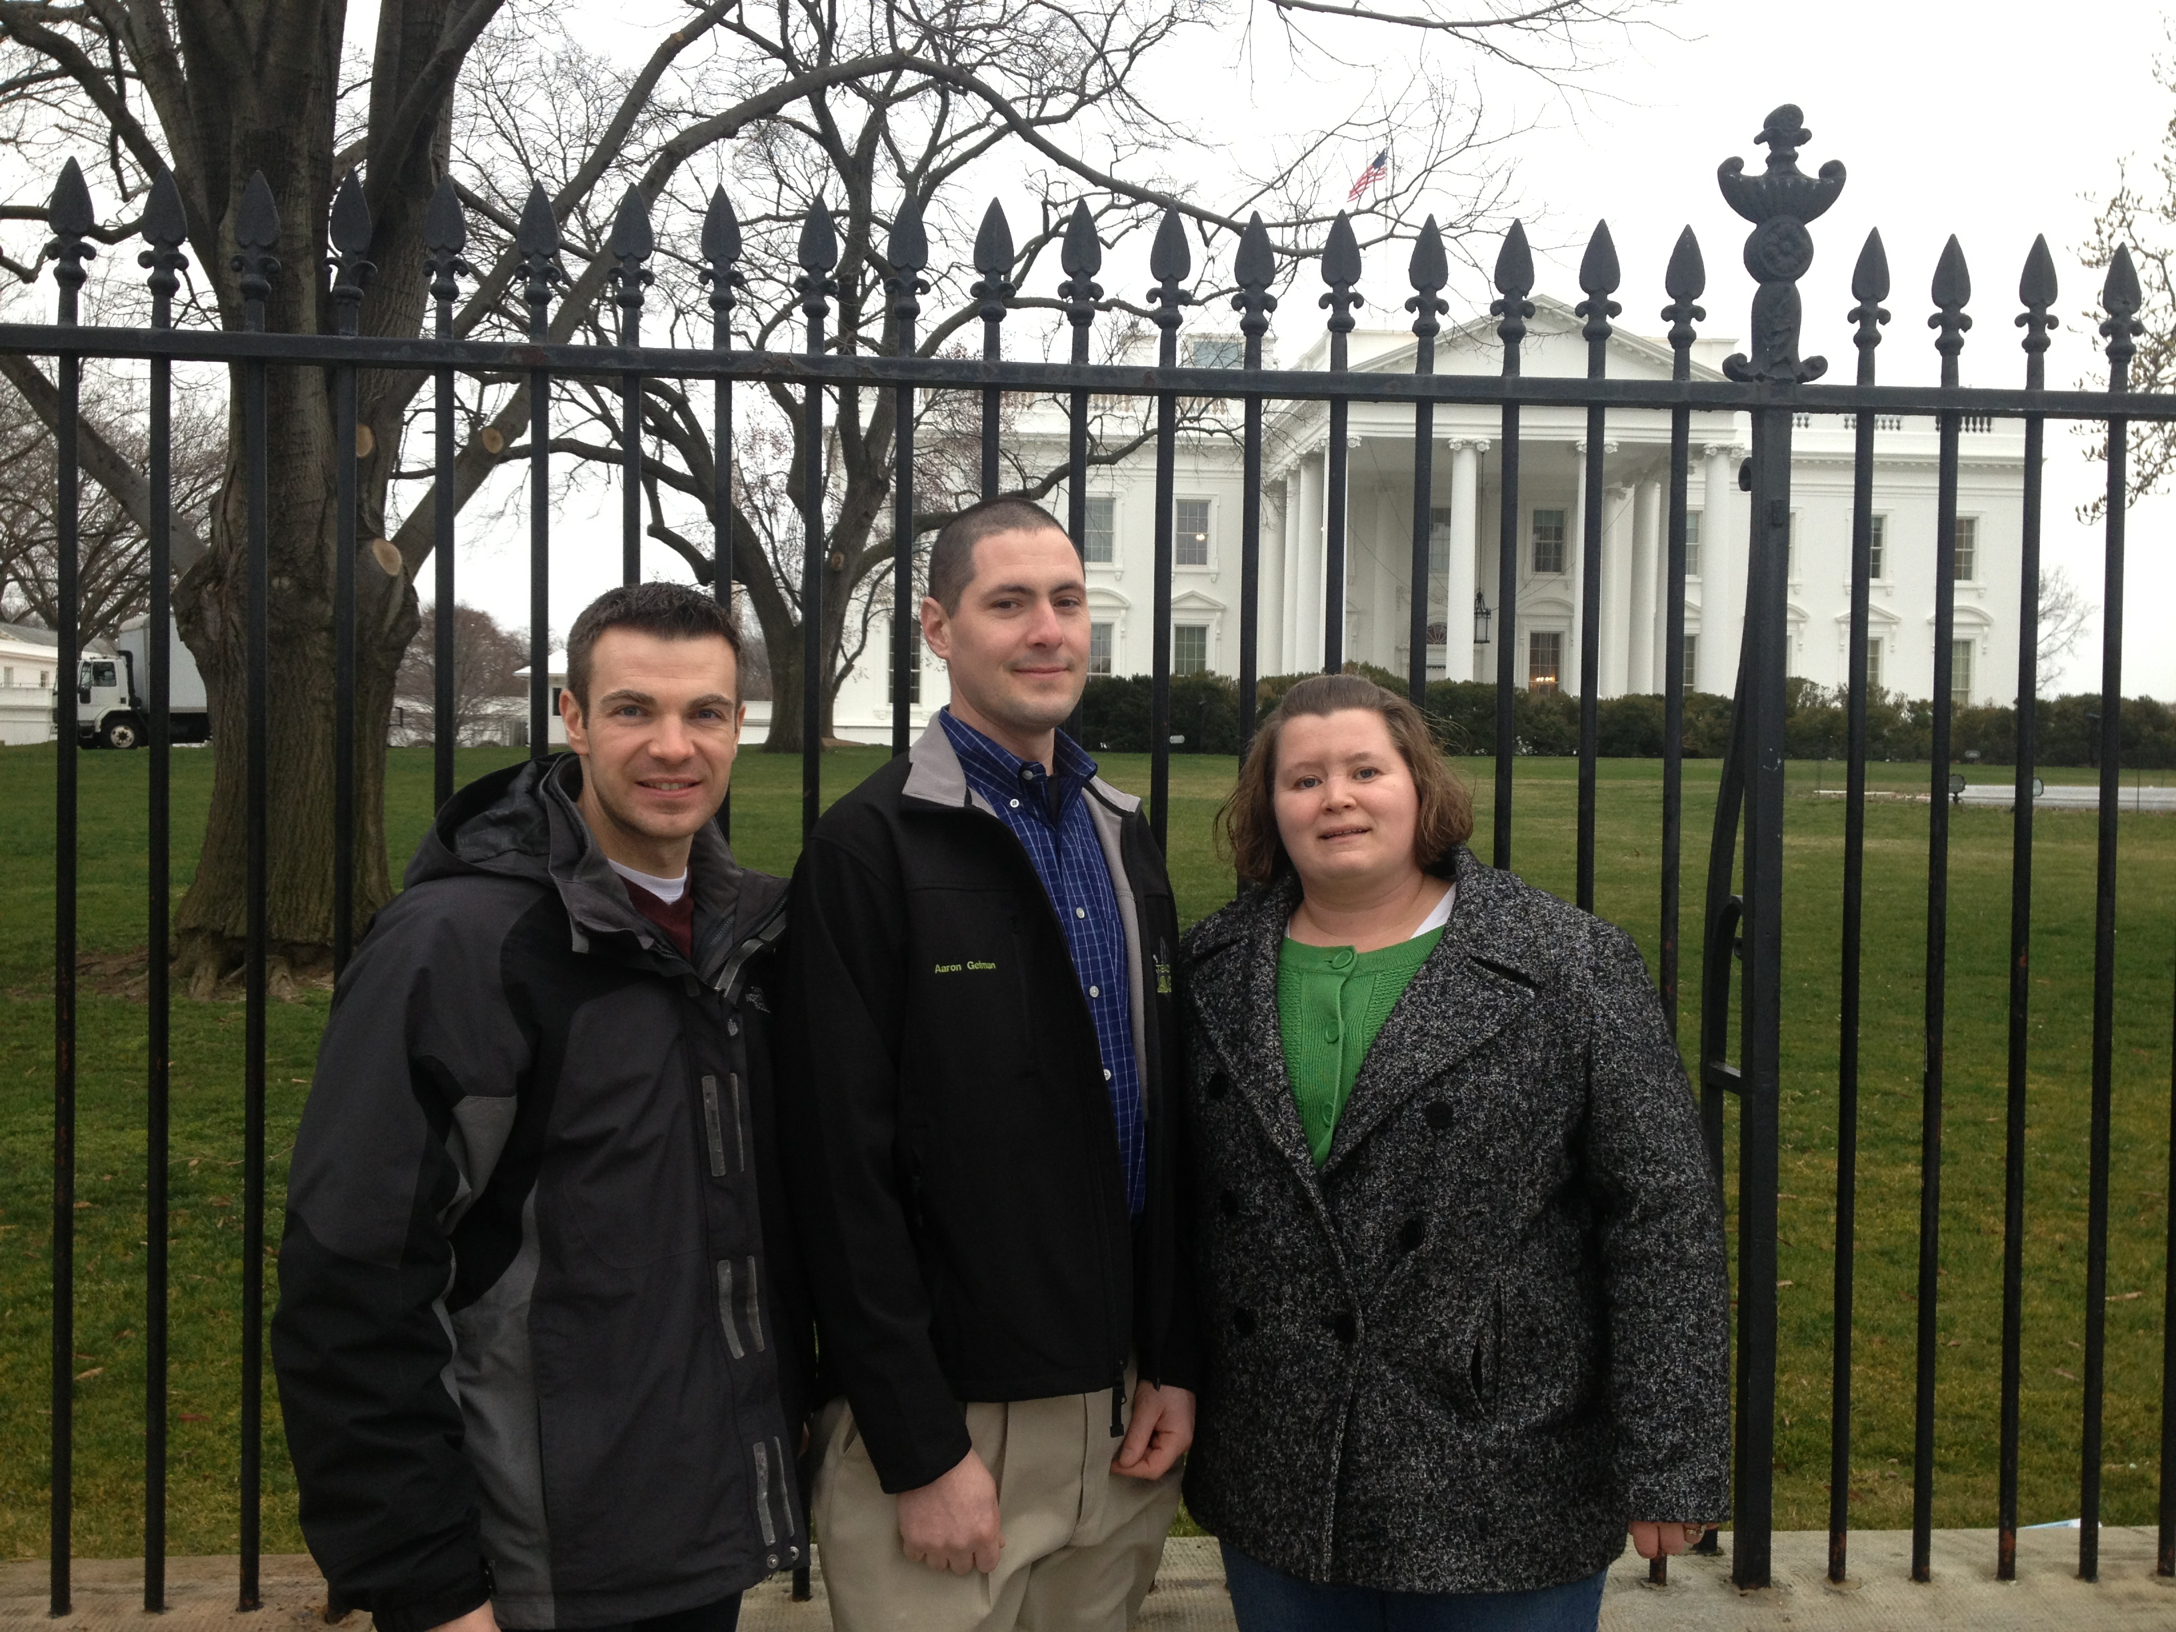
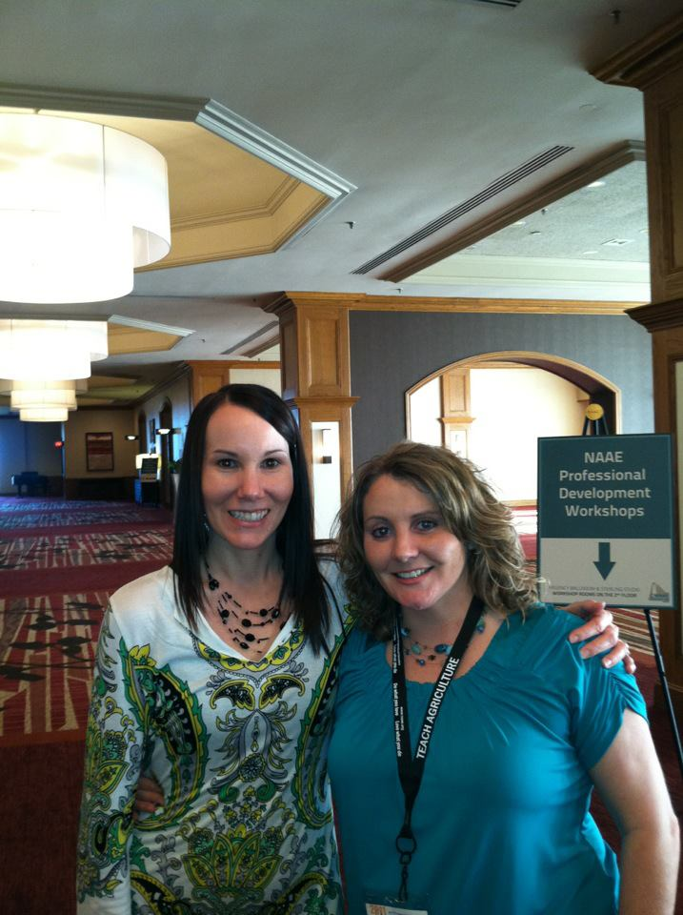
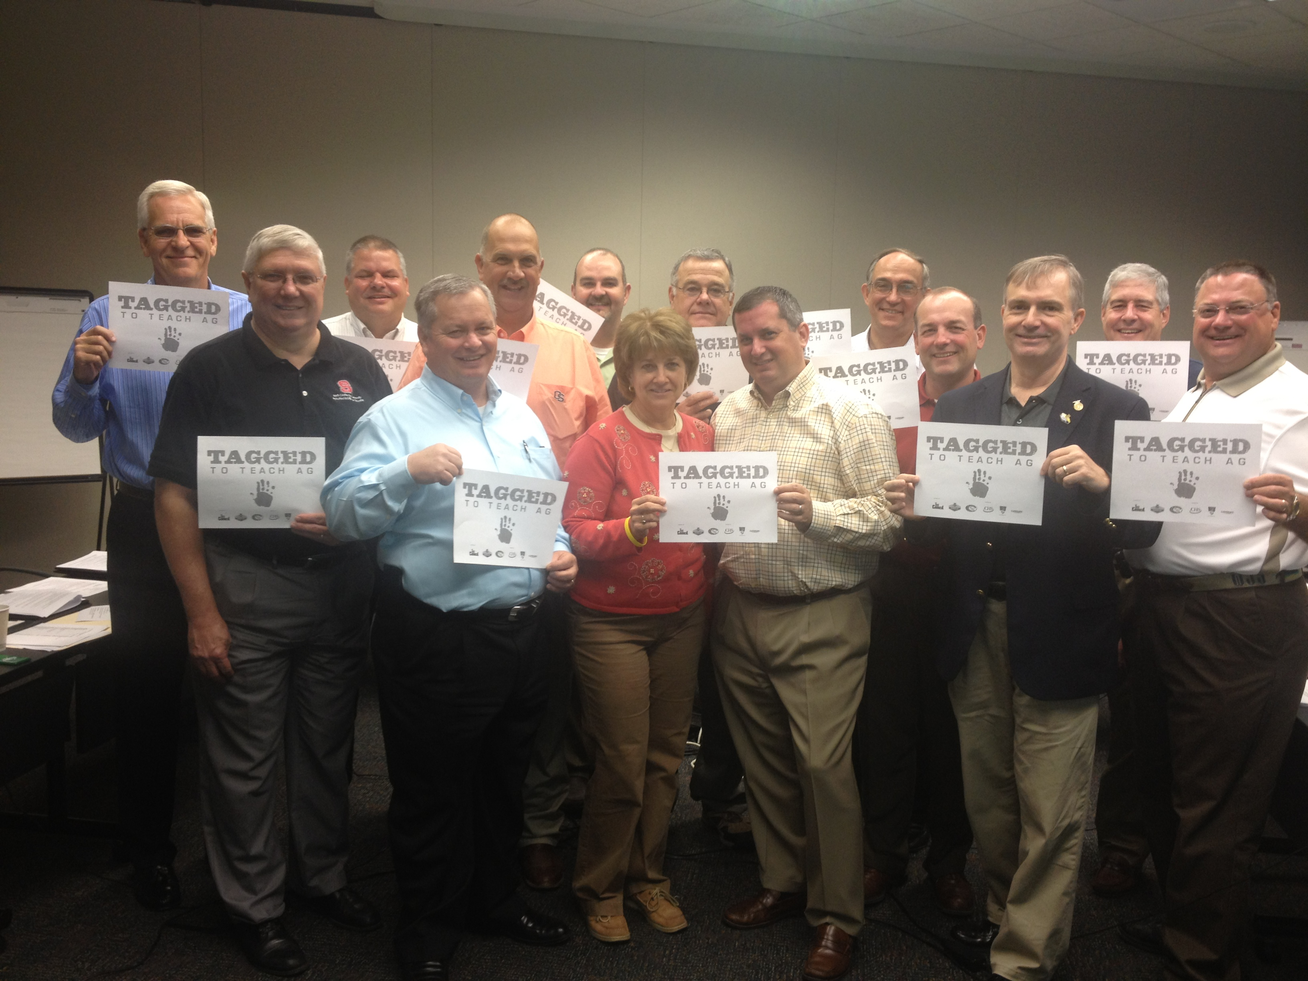
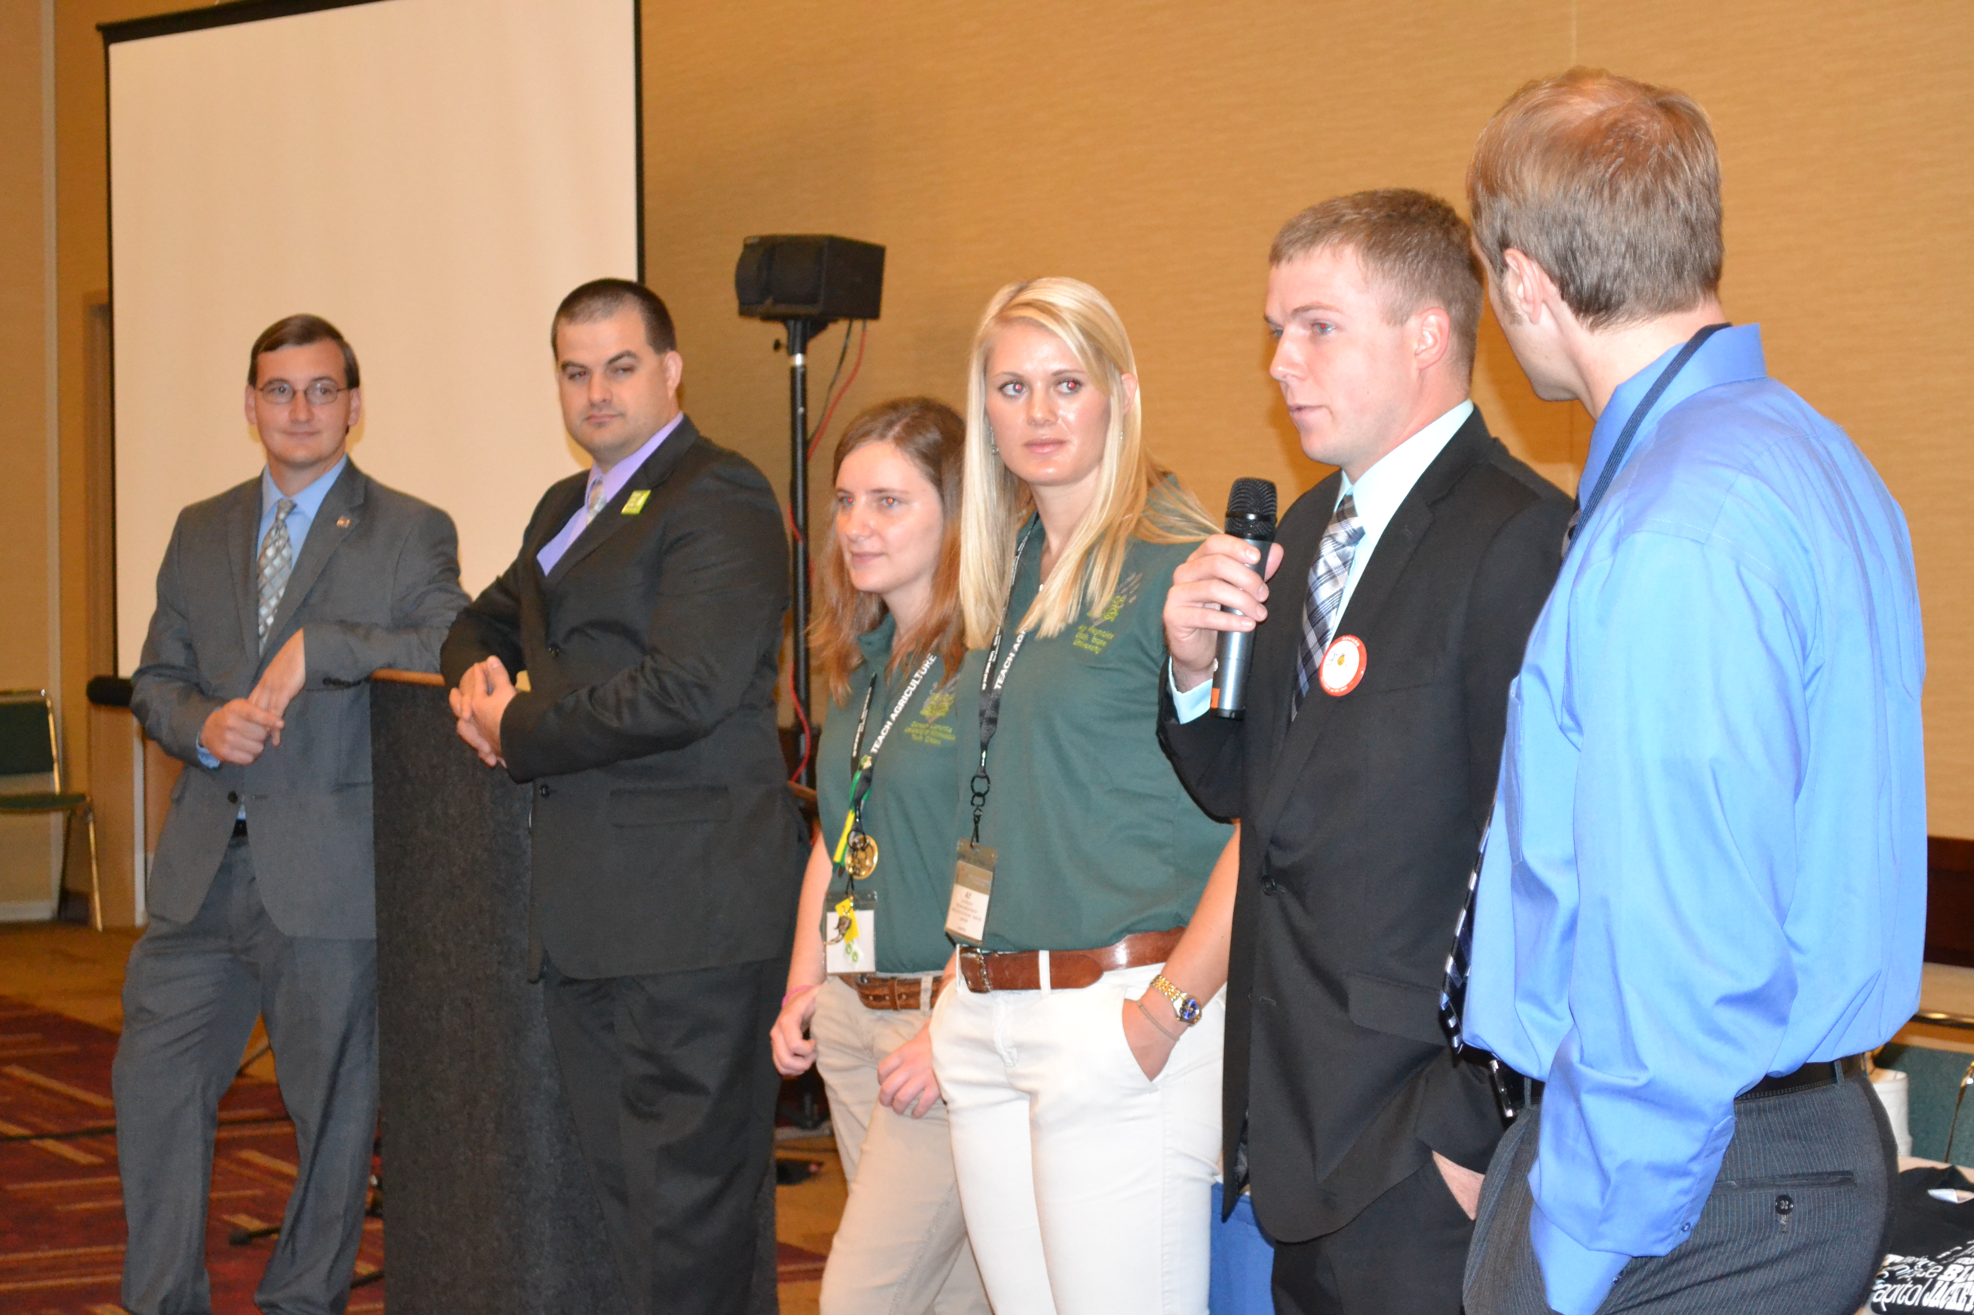
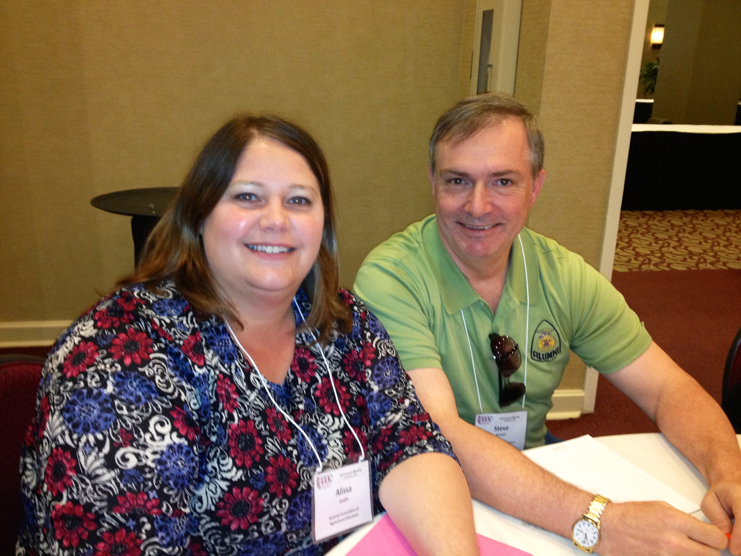
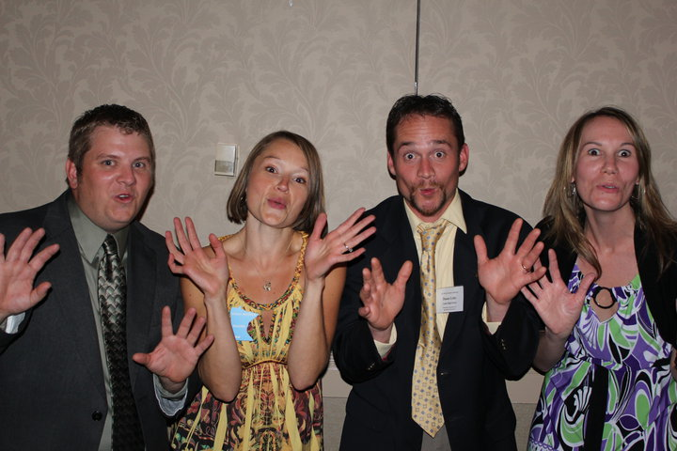
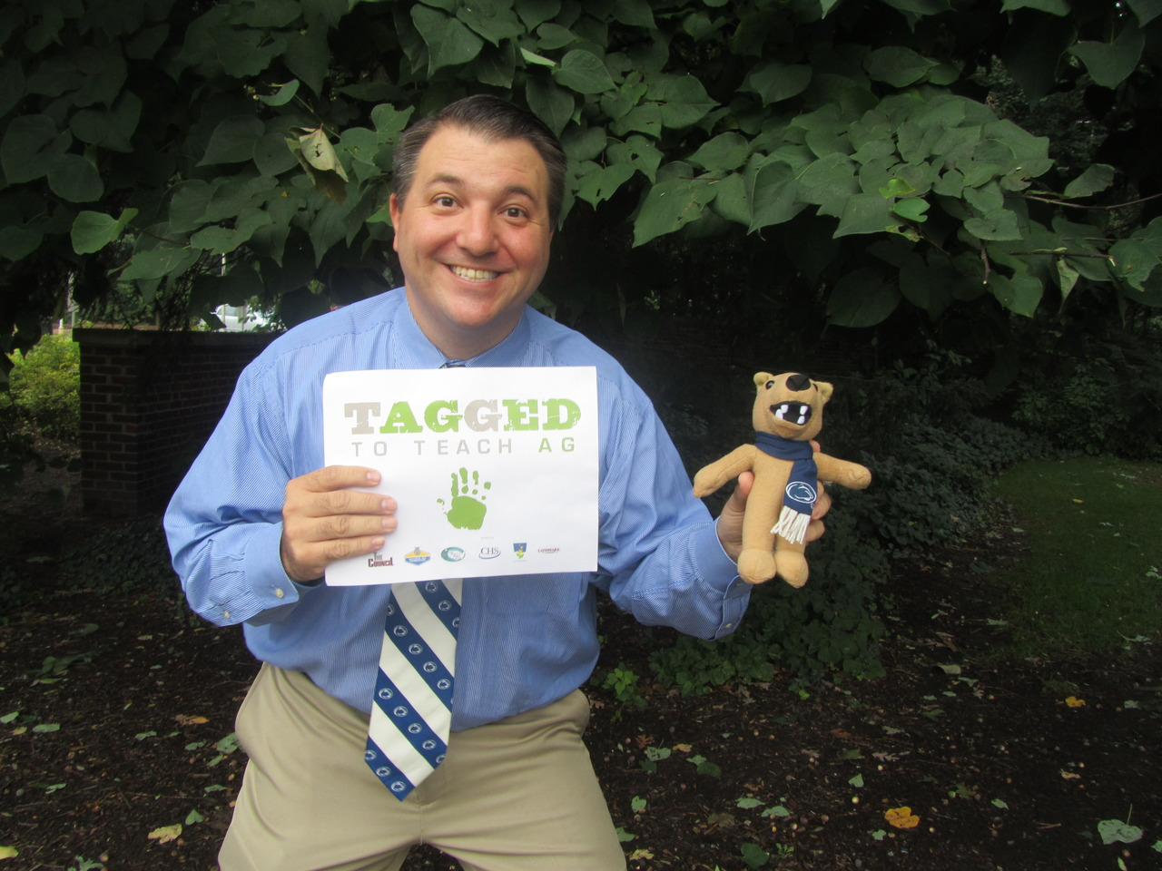

Slide 4
Your turn…
Using previously mentioned writing tools answer:
Future Teachers
What do you admire about your agriculture teacher?
Teachers
What do you love about teaching agriculture?
List all the internal and external benefits of teaching agriculture?

Slide 5
Now answer this
How many times have you shared the items on your list with your students?
How many people have you told “teaching agriculture is a great career choice”?

Slide 6
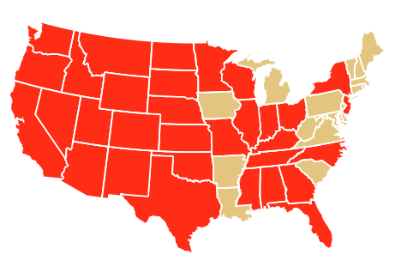
Yes! There really is a shortage:
Alabama
Arizona
California
Colorado
Florida
Georgia
Idaho
Illinois
Indiana
Kansas
Kentucky
Minnesota
Mississippi
Missouri
Montana
Nebraska
Nevada
New Mexico
New York
North Carolina
North Dakota
Ohio
Oklahoma
Oregon
South Dakota
Tennessee
Texas
Utah
Washington
Wisconsin
Wyoming
Notes:
Shortage=having an adequate supply of quality candidates. Degree institutions feel the pressure to graduate students who may not be the best teacher candidates because of the shortage. This compounds the problem further.
26 states out of 35 respondents

Slide 7
What we know…
Nationwide
Region 6
117 new ag programs opened
14 average years of teaching experience
7737 ag ed programs
742 agriculture teachers will retire in the next three years/247 year
22 ag programs closed because they couldn’t find an ag teacher
146 programs are operating with a teacher not licensed to teach agriculture
473 of last years 679 ag ed graduates are teaching* 69%
Approximately 3216 students are currently enrolled in an ag ed degree program across the country (804 each class)
9 new ag programs opened last year
15 average years of teaching experience
737 ag ed programs/43 NJ programs
124 agriculture teachers will retire in the next three years
9 ag programs closed because they couldn’t find an ag teacher
1 programs are operating with a teacher not licensed to teach agriculture
27 of last years 58 ag ed graduates are teaching* 46%
Approximately 268 students are currently enrolled in ag ed
14 new teachers added/1 in NJ

Slide 8
Causes of the shortage
New programs
Programs expanding
Retirements
Current teachers leaving for other positions
Ag Industry attracting Ag Ed graduates into more lucrative careers.
Negative attitudes by the media and policy makers towards education and teachers.
Not promoting our own profession.
Geography
Attitude of current generation towards work/life balance.
Overall shortage of agriculture talent

Slide 9
How does the shortage affect you?
Workload
Validity
Quality of Education
Professional obligation
Job security
Strength and power in numbers
Future funding

Slide 10
You can help!
Love your job and let it show!
Encourage students in your classroom to consider Ag Ed.
Mentor and befriend new agriculture teachers
Work together
Stop the do it all mentality
Build strong relationships with decision makers

Slide 11
Get Involved!
Work with others in your state to develop a recruitment and retention plan.
Share best practices
Tag a future agriculture teacher
Apply for a Teach Ag grant
Sign Up for the National Teach Ag Campaign
Utilize Teach Ag Resources

Slide 12
National Teach Ag Campaign Website www.naae.org/teachag
Sign Up for the National Teach Ag Campaign
Search by state for institutions that offer an Ag Ed degree
State teacher licensure requirements
Ag Ed FAQ Section
Job Openings by State
Teach Ag Lesson Plans, Activities, Games
Teach Ag Merchandise and Promotional Materials
Teach Ag Workshop Materials

Slide 13
Your turn again…
Challenge
Questions?
Comments?
Suggestions?
Ideas?
Needs?
Concerns?

Slide 14
Contact Me Anytime about Anything:
ethompson.naae@uky.edu
605.350.3842
www.naae.org/teachag
@ellencthompson

