Slide 1



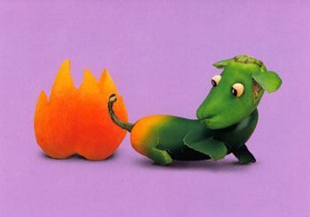
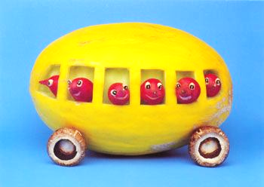

Fresh Fruit & Vegetable Program
State of New Jersey
2019-2020

Slide 2

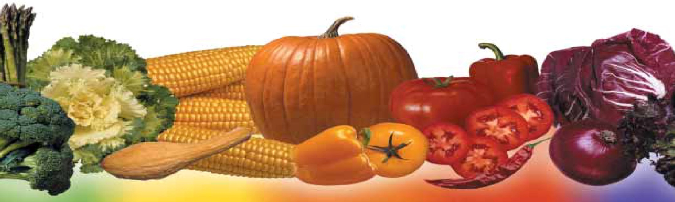
Fruits and Vegetables --- MORE!!!

Slide 3

Congratulations!
Participants in Fresh Fruit & Vegetable Program (FFVP)
School Year 2019-20:
157 Schools Across 50 Districts
Schools extending into 14 counties
79,277 Students

Slide 4



FFVP LOGO!

Slide 5

FFVP BANNER!

Slide 6

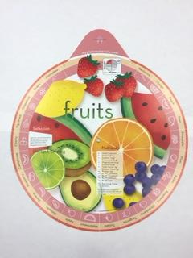
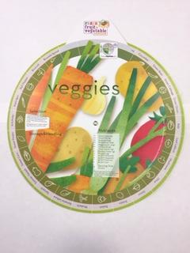
Kids’ Aprons!
Kids’ Aprons
Produce Wheel

Slide 7

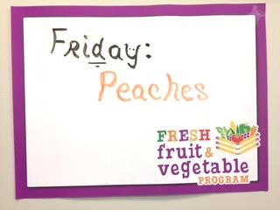
Marketing!
Dry Erase Boards

Slide 8

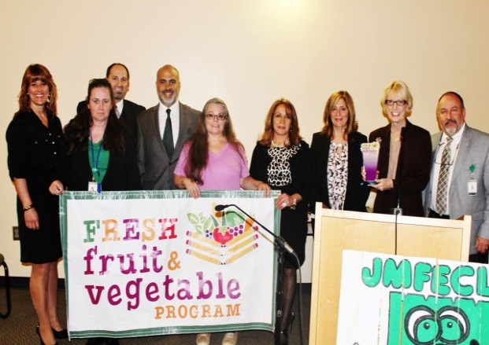
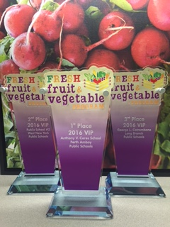
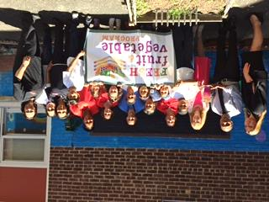
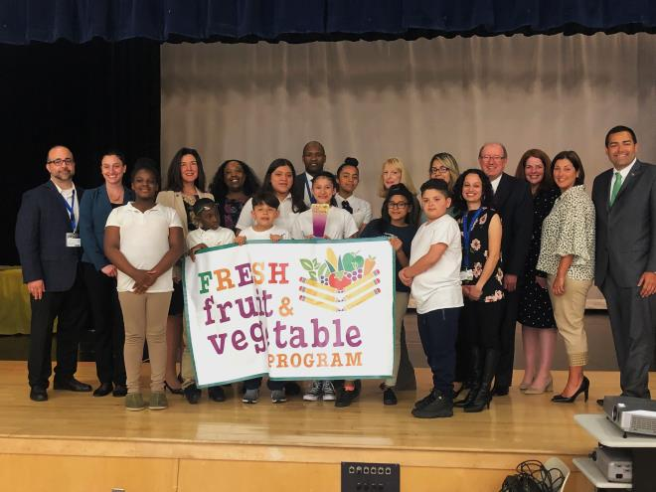
FFVP AWARD!
  “VIP”
  Very Impressive Produce
TROPHY
#1 Elizabeth School #28
#2 Long Branch
Catrambone
#2 Passaic
School 20

Slide 9
History of the FFVP
2002 pilot project authorized by Congress in
4 states
Pilots’ tremendous success led to expansion in 2004 --- 4 additional states
2006 Appropriations Act --- Expanded to 6 more states
2008 Appropriations Act --- Expanded to All states
2008 Farm Bill permanently authorized FFVP

Slide 10

How the FFVP
Works
Select schools with highest percentage of free & reduced eligibility
Submit accurate FFVP application
Reimbursed for fresh fruit & veggie costs
Provide free produce to all students

Slide 11
Level of Funding
New Jersey’s total funding for 2019-20 is over
$4.4 million:
  5% state administrative
  95% to schools
State funds are divided among selected schools, based on school’s enrollment
Regulations require funding to be
$50 - $75 per student, per year

Slide 12

Requirements of Participation
Signed addendum for Fiscal Year 2020 ---
Part of Child Nutrition Program Agreement
Monthly report to claim reimbursement
Mid-year progress report
  Simple questions
  Examples: success/barriers, student/staff reactions
Year-end report
Last, but certainly not least…
SPEND THE MONEY!

Slide 13

Goals of FFVP for Children:
Increase Fruit and Vegetable Consumption
Create Healthier Schools
Promote Wellness
Change Diets to Impact Current & Future Health

Slide 14

Who Receives
Fruits & Veggies ?
For all children who attend the school
  including half or full day pre-K or K
Teachers/Aides may participate with students
NOT for community residents or adults attending after school functions
MAY NOT be withheld to discipline children

Slide 15
Types of
Fruits & Vegetables ?
Allowable:
FRESH fruits or vegetables
A variety is highly encouraged!
Pre-cut; Individual Bags; Ready-Made Trays
Pre-cut Blends --- Eg. “Power Blend”
(Beets, Broccoli, Cauliflower, Brussel Sprouts, Kale, Carrots…)
Pre-made Salads ---- Must be Fresh & Low Fat!!!!
Herbs; Spices; Cooking Spray; Oil
(Enter Fresh Herbs under “Vegetables” & others under “Supplies”)
Purchase Jersey Grown

Slide 16
Variety of
Fruits & Vegetables
Students’ Favorites:
  Oranges, Apples, Bananas, Grapes, Pineapple…
  Carrots, Cucumbers, Celery, Grape Tomatoes

Slide 17
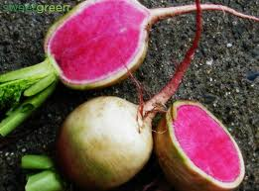
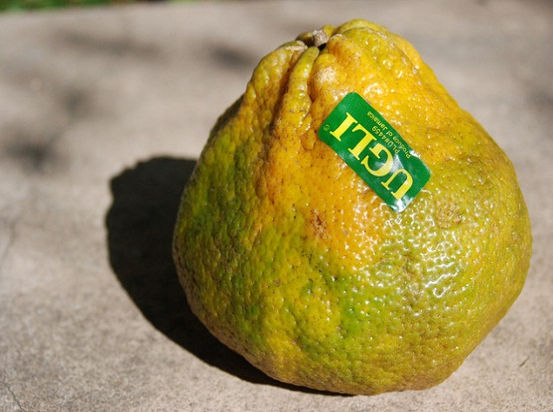

Variety of
Fruits and Vegetables
NEW Items ---- Occasionally:
  Star Fruit, Raspberries, Mangoes, Papaya, Ugli Fruit, Blood Orange…
  Bok Choy, Fennel, Watermelon Radish, Jicama…

Slide 18
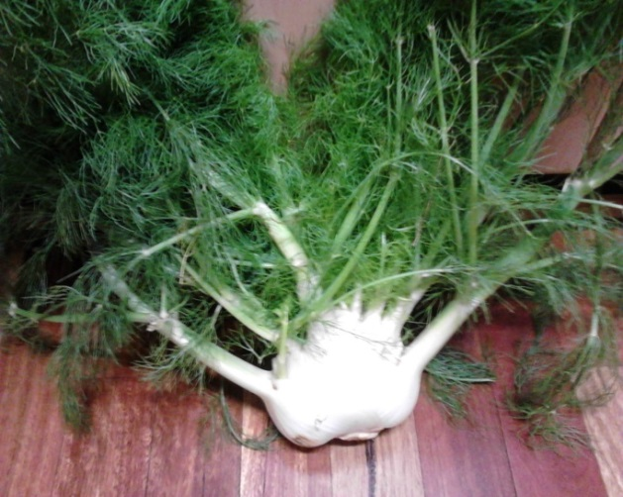
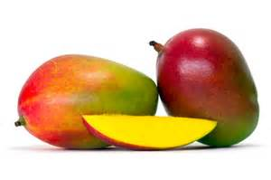
UNUSUAL
Fruits and Vegetables
Research
Taste-Test
Check Price
Check Yield
Once/Month

Slide 19

Taste
&
Tell
FRUIT ?

Slide 20
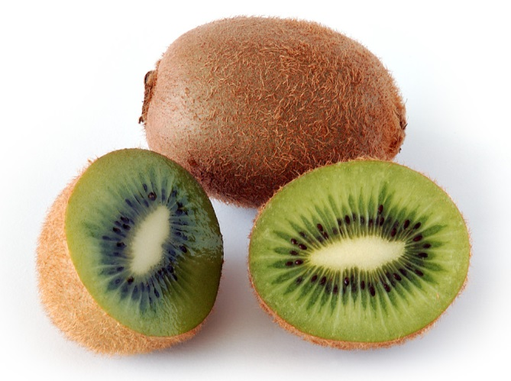


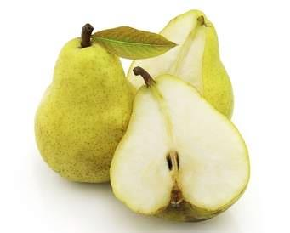
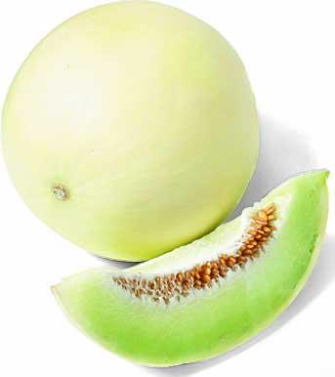
? TASTE & TELL ?
FRUIT ?
#1
#2
Kiwi
Mango
#5
Cherry
Pear
#3
#4
Honeydew

Slide 21

Purchasing
Fruits & Vegetables
“Buy American” Provision
  As required for National School Lunch Program, produce must be produced in America, unless product is generally not available domestically
  (i.e., bananas) Record reasons!
Purchase locally grown as much as possible
“Geographic Preference” --- USDA Allows schools to use for locally grown produce
(See Farm 2 School Toolkit on flash drive)

Slide 22

Procurement of
Fruits & Vegetables
Follow USDA & State Regs
  Training & guidelines provided in SNEARS
Collaborate with district’s food services
Informal --- Quotes
  QPA (Qualified Purchasing Agent) --- $6,001 to $39,999
  No QPA --- $4,351 to $28,999
Formal:
  QPA (Qualified Purchasing Agent) --- $40,000 & higher
  No QPA --- $29,000 & higher

Slide 23

Farm to School Week --- Sept. 23 – 27
October --- Farm to School Month
http://www.farmtoschool.nj.gov/

Slide 24

Jersey Tastes --- Sept. 24!
TOMATOES

Slide 25


Jersey TASTES --- Year Round!

Slide 26
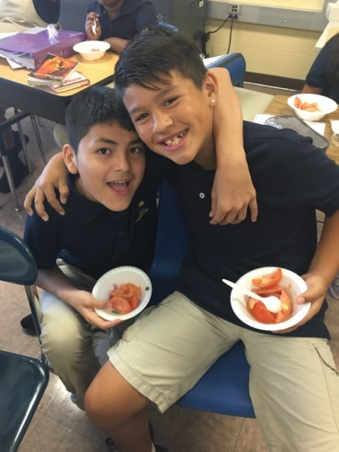
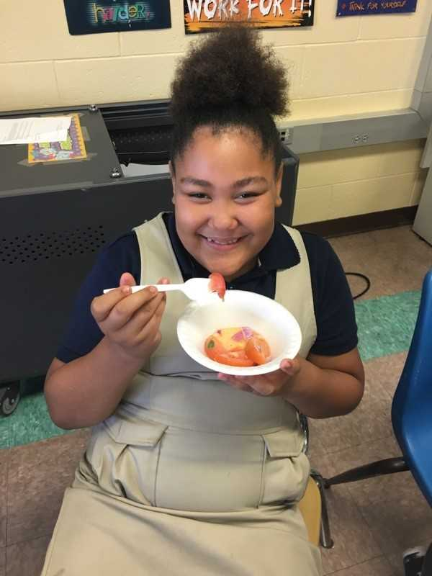
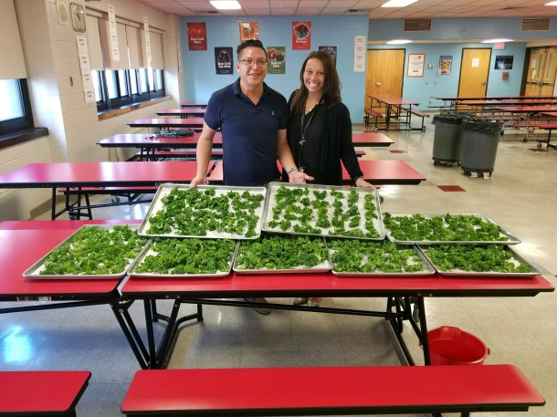
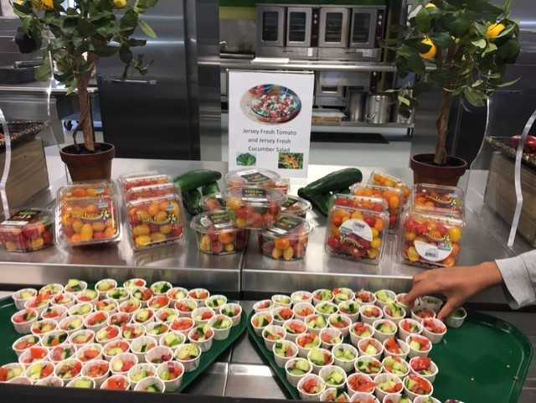
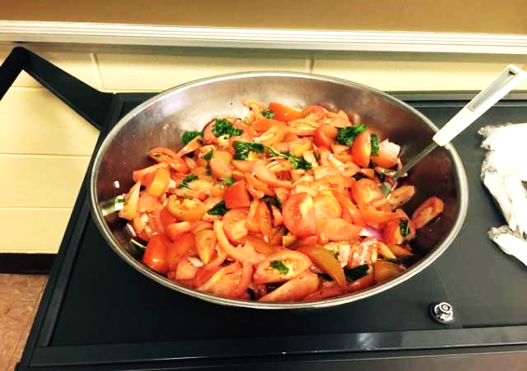
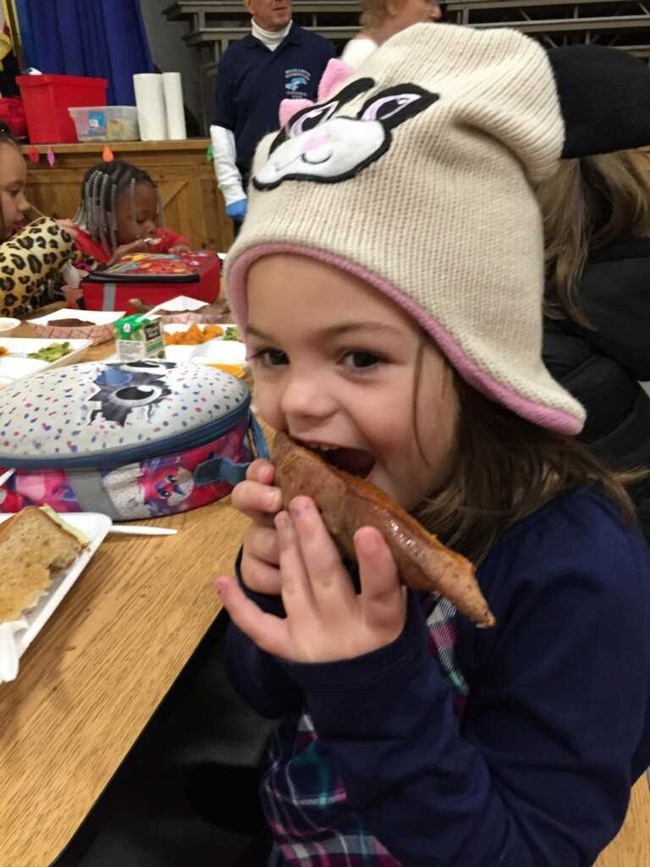
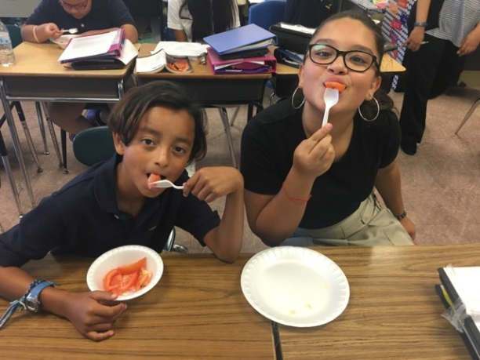
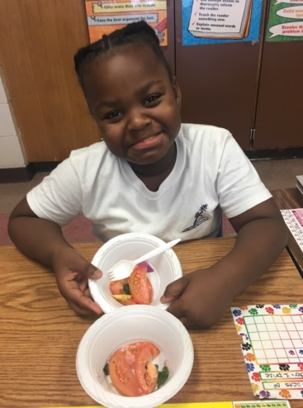
Jersey Tastes

Slide 27
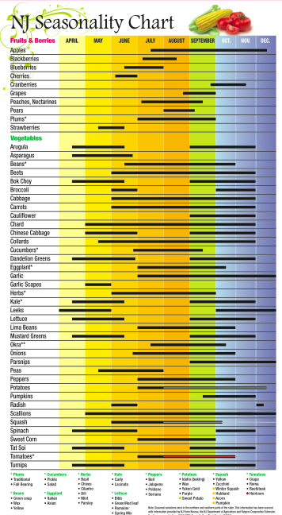

https://www.nj.gov/agriculture/divisions/fn/pdf/njseasonalitychart.pdf

Slide 28

From the Garden State to Your Plate
Questions:
learningthroughgardening@mail.com

Slide 29



How Much Do You Know About
JERSEY
Produce

Slide 30
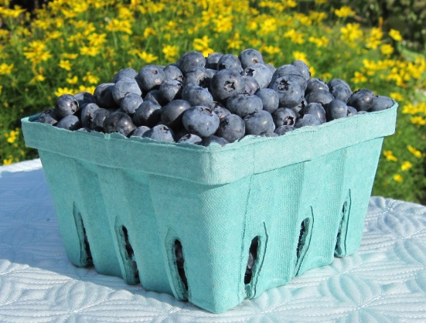

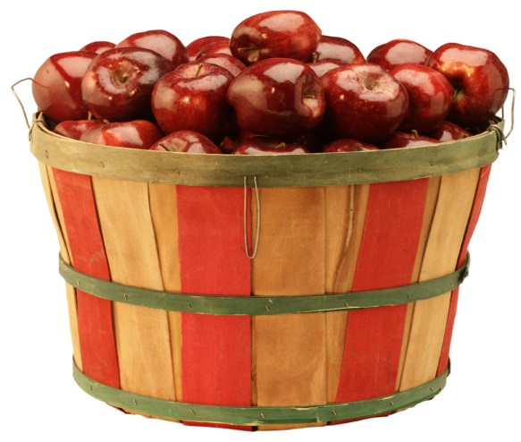
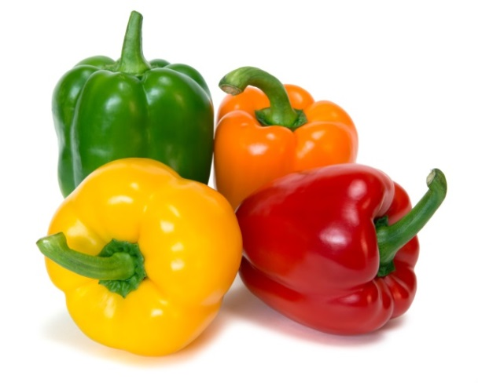
? ?
?
#1 $79.4 M
#2 $38 M
Blueberries
Tomatoes
#3 $29.8 M
#4 $29.5 M
Apples
Bell Peppers

Slide 31

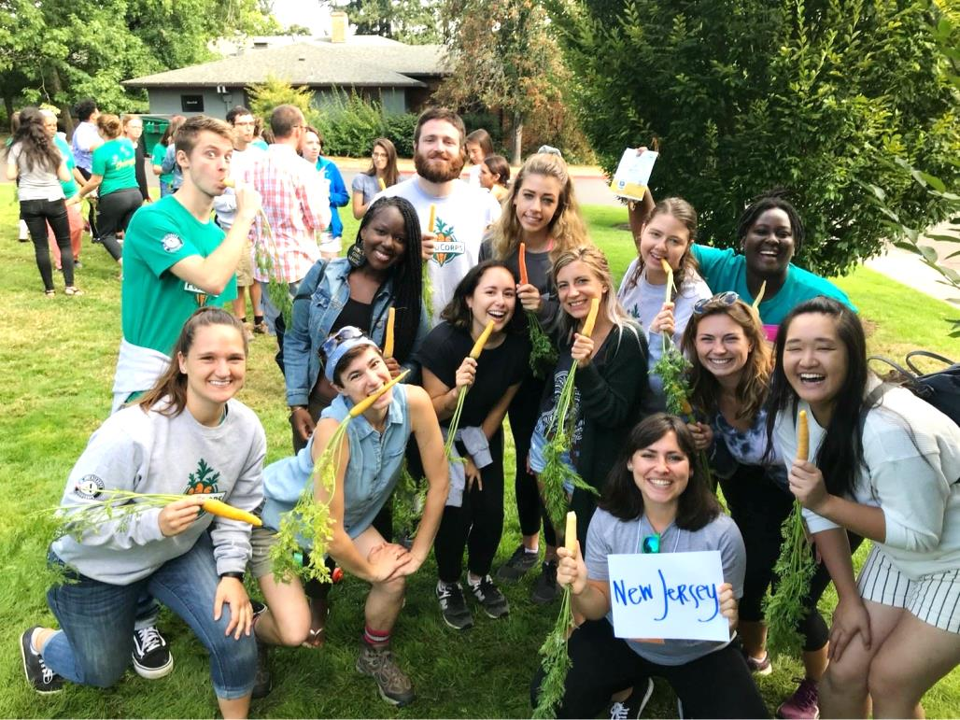
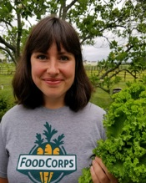
FOOD CORPS
Partners!
hayley.klein@foodcorps.org
Training
Classroom Ed
Gardens
Taste Testing

Slide 32
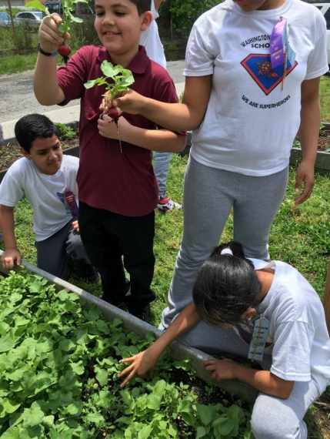
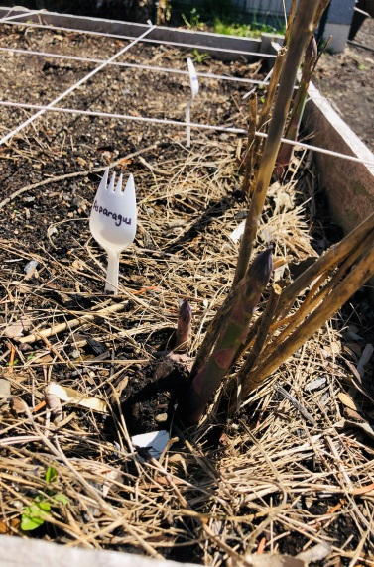
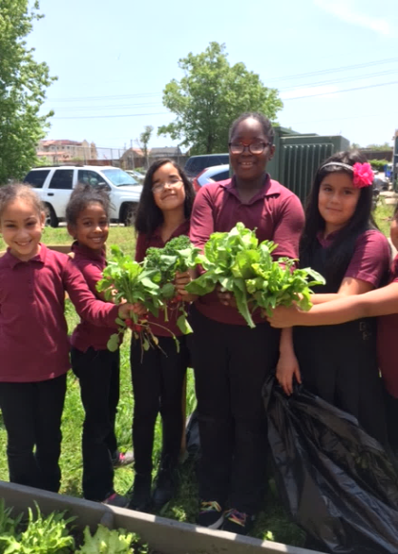
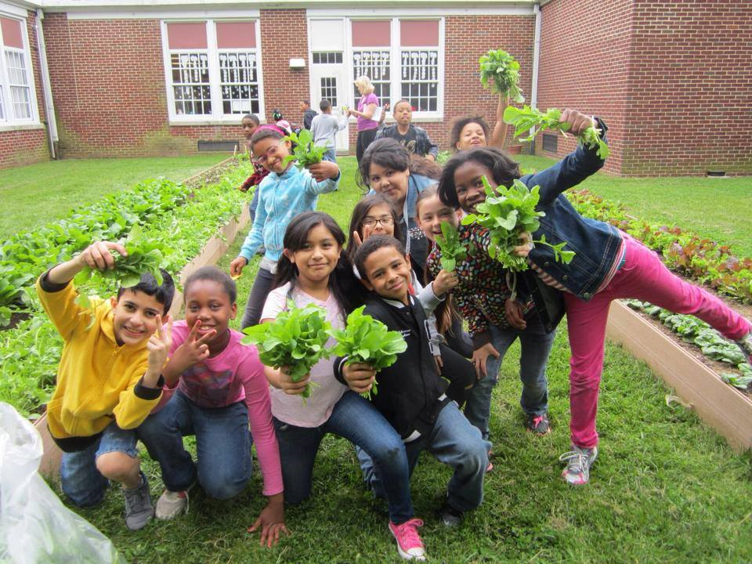
SCHOOL GARDENS

Slide 33
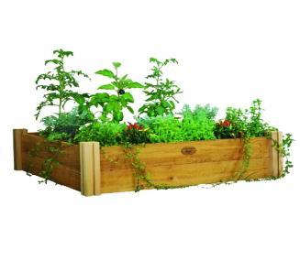

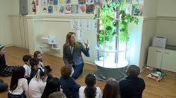
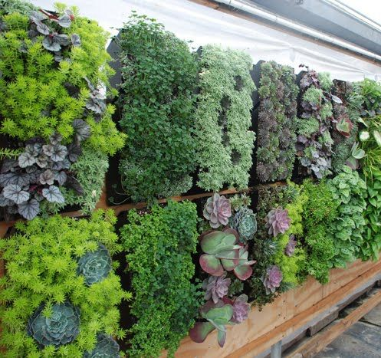
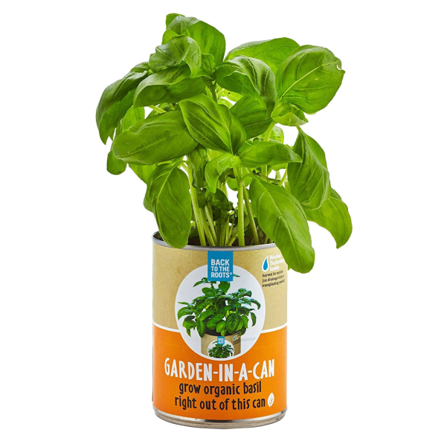
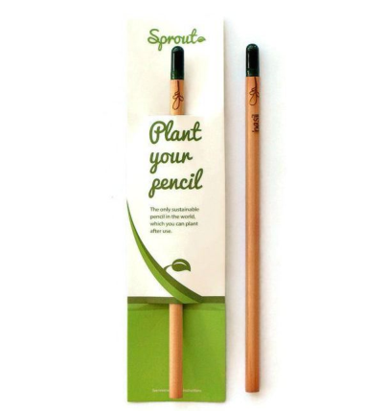
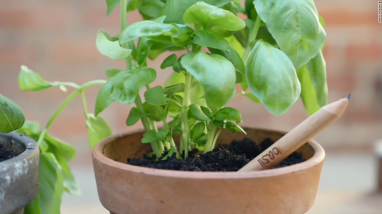
ALTERNATE
GARDEN Ideas
● Garden
Tower/Wall
● Sprout Pencil
● Garden-In-A-Can

Slide 34


GROWN In NEW JERSEY --- Add’l Money!
79% of FFVP Schools!
Does Not Have to have “Jersey Fresh” Label
Sept.- Nov. --- 2 Days per Month
April – June --- 2 Days per Month
Enter Info. In SNEARS --- “Enter total amount of money school spent on JERSEY fruits and vegetables”
Will Monitor!

Slide 35
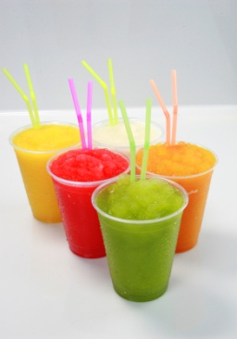
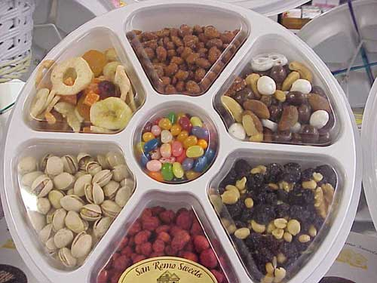
Types of
Fruits & Vegetables ?
NOT ALLOWABLE:
  Processed or preserved fruits and vegetables
  (i.e., canned, frozen, vacuum-packed or dried)
  Dried fruit (i.e., raisins, craisins or dried cherries)
  Canned Chick Peas
  Smoothies
  Fruit Snacks/Roll-Ups/Fruit Leather
  Jellied Fruit; Trail Mix or Nuts
  Cottage Cheese
  Fruit or Vegetable Pizza

Slide 36


Types of
Fruits & Vegetables ?
NOT ALLOWABLE:
  Pickles
  Dip for Fruit
  (i.e., yogurt, sour cream, whipped topping)
  Honey or other Sweeteners
  Fruit or Vegetable Juices
  Sugar Cane
  Coconut Milk
  USDA Commodities

Slide 37
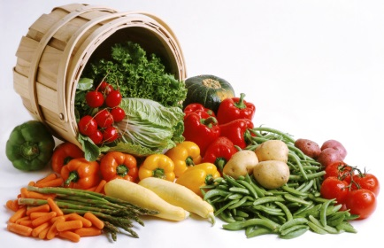

Vegetables Tips
Add’l Points:
  Vegetable Dips Allowed
    Choose low fat or yogurt based dips
    Must be 1 oz. portion or less
  “Prepared” Vegetables
    Fresh (not canned, frozen, or dried) vegetables that are cooked --- limited once a week & must be part of nutrition ed. lesson

Slide 38

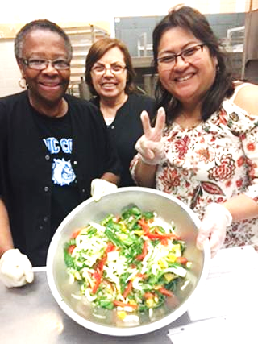
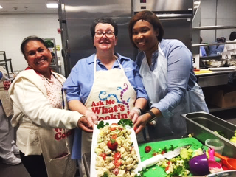
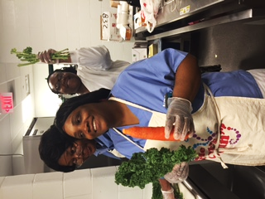
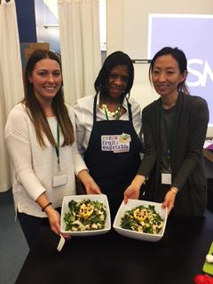
COOKING
Vegetables
Roast Veg.
Serve Cold
Expands Vegetable Variety
Attend Trainings
Allowable ---
Oil/Cooking Spray & Fresh Herbs

Slide 39

WHO AM I ?
VEGETABLE

Slide 40
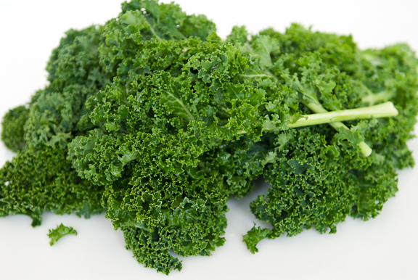
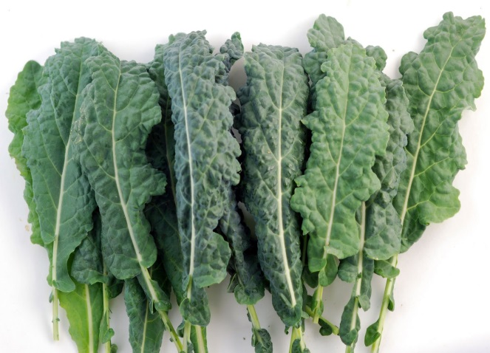
#1
KALE

Slide 41

#2
Kohlrabi

Slide 42



#3
Jicama

Slide 43


#4
Butternut Squash

Slide 44

#5
Fennel

Slide 45


#6
Portobello Mushroom

Slide 46

#7
Bok Choy

Slide 47

#8
Brussel Sprouts

Slide 48



#9
Swiss Chard

Slide 49


#10
Rutabaga

Slide 50


#11
Daikon

Slide 51


When to Serve
Fruits & Veggies ?
At discretion of each school
CANNOT be served during meals or as part of meal
CANNOT be served for after-school programs… must be served during school day
MAY be served to different groups/grades at different times/days
Fruits & Veggies Not Permitted to Go Home!

Slide 52
Where to Serve
Fruits & Veggies ?
At discretion of each school
Classroom
Cafeteria
Salad Bar / Portable Cart / Hallway Kiosk

Slide 53


Where to Serve
Fruits & Veggies

Slide 54






How to Distribute
Fruits & Veggies

Slide 55

How to Distribute
Fruits & Veggies

Slide 56




? Who Can Distribute ?
STUDENTS!
CAFETERIA!
SELF SERVE!
PARENTS!

Slide 57

Frequency of Service ?
Local decision as to how often to serve fruits & vegetables
Per serving costs & amount of funding --- drives decision
Important --- Plan and Budget Funds
(base on estimated costs)

Slide 58
Frequency
&
Starting Date ?
MUST BE Minimum of 2 Days/ Week!
ALL Schools
START in SEPTEMBER ----
Or ELIMINATED!

Slide 59

WASTE!
Have a Plan!
Let Students Eat Extras
Send to Nurse’s Office
Use for Meal Preparation
Send to Soup Kitchen/Food Bank

Slide 60
Nutrition Education
Nutrition Ed & Marketing important for success!
  Partner w/ food service to coordinate FFVP menu
  Refer to resources sheet -- free nutrition material
  Include home links --- keep parents in loop
  Allowable --- Dry Erase Boards & Bulletin Boards
  (Reasonable Cost!)
FFVP funds CANNOT be used for Nutrition Ed.

Slide 61


Activities!
HEADS
UP!

Slide 62
FFVP AWARD!
  “VIP”
  Very Impressive Produce
Plan Now---
To Win!!!
New
Guidelines
Upcoming
Webinar

Slide 63


Weighing & Measuring

Slide 64





EXTRA EFFORTS
Dr. Seuss
Market --- Art Class

Slide 65




CINCO de MAYO
Guacamole

Slide 66




Fall & Spring
Harvest
Fall Harvest
Spring Harvest

Slide 67



Educational Day of Fun!

Slide 68





HeH
Health & Nutrition

Slide 69



SOCIAL STUDIES

Slide 70


SOCIAL STUDIES
&
ART
School #6
Elizabeth

Slide 71




Making Learning
FUN!

Slide 72





MARKETING

Slide 73


Slide 74
SPECIAL
FFVP Events
5% of Budget
    Example: $10,000 X .05 = $500
Label as “SE”
Notify Janet or Jackie!
If Exceed --- Schools Will
NOT be Reimbursed!

Slide 75


FFVP
BUDGET
School Responsibility!!!
Communicate w/ Vendors!

Slide 76

Nutrition Education
PARTNERSHIPS & RESOURCES
  Yellow Handout
PROMOTION & EDUCATION RESOURCES
  Orange Handout
SCHOOL PROMOTION of FFVP
  Parent/Guardian Letter ---English & Spanish
  (flash drive)
  Web-Site/Back to School Night/Newsletters…
VEGETABLE TRAININGS --- Hands-On!

Slide 77


PARENTS
English/Spanish

Slide 78

PRINCIPALS
Dos & Don’ts!

Slide 79
TEACHERS
We need you to be role models by implementing the following:
Join in with your students and eat the fruit or veggie snack.
Highlight the importance of eating healthy fruits and veggies.
Emphasize trying veggies even though your students may think their yucky. Persuade your students to take a small taste.
Encourage your students to eat fruits & veggies at home during meal times and for snacks.

Slide 80

FLIER
* Back To School
* PTA/PTO
* Special Events

Slide 81
Non-Allowable Costs ?
Nutrition Education
Trips
Gardening Items; Seeds
Promotions
Access Free Resources
IF YOU’RE NOT SURE IF AN EXPENSE IS ALLOWABLE --- CHECK BEFORE YOU SPEND!

Slide 82
NEW JERSEY’S
QUICK STEPS
to
FRUITS & VEGETABLES
TOOLKIT
School Food Service Link
Classroom
Home Links

Slide 83

Fruits & Vegetables
Toolkit
HOW It Works…
“Fact Sheet”
“Fun Facts”
“FRUIT & VEGETABLE IDEAS”
“School Food Service Link”
“Classroom Link”
“Home Link”
ü Kid’s Kitchen Recipes
ü Recipes for Home

Slide 84


Activities!
Go
NOODLE !
https://family.gonoodle.com/activities/baby-shark

Slide 85

Financial --- Two Categories:
  #1- OPERATING Costs
  Fruits/Veggies/Labor/Supplies
  #2- ADMINISTRATIVE Costs
  Labor/Large Equipment

Slide 86
Financial --- Two Categories
Operating Costs:
(directly related to serving fruits & vegetables)
  Costs for Fresh Fruits & Vegetables
  Labor for Preparation or Service
    Limited to 25% of Total Budget
    Must be Reasonable
    Can Include Wages & Fringe Benefits

Slide 87


Financial
Operating Costs:
  Small Supplies or Other
    Low Fat Dressings for Veggies
    Paper Supplies
    (utensils, soufflé cups, napkins, plates…)
    Cleaning Supplies
    (trash bags, hand wipes, sanitizer…)

Slide 88
Financial
Operating Costs:
  Small Supplies or Other
    Small Kitchen Supplies
    (paring knives, cutting boards, baskets, bowls, bags…)
    Small Equipment (carts, orange sectionizers…)
    May & June Purchases Must Be Approved By
    FFVP Coordinator!
    Delivery Charges

Slide 89
Financial Responsibilities:
Two Categories
  Administrative Costs:
  FFVP costs not related to preparation & service of fruits/vegetables
    Equipment
    (refrigerators, coolers, portable kiosks, portable food bars)
      “Large Equipment Request Form” ---
      Approval Prior to Ordering! (flash drive)
      Must Be Submitted By January 31

Slide 90
Submit by
January 31

Slide 91
Financial Responsibilities
Administrative Costs:
  Administrative Labor
    Costs for planning, ordering, managing records, submitting reimbursement claims, coordinating nutrition ed. activities
    Salaries/Hourly rates & fringe benefits
  Supplies
      Paper for Administrative
      Paper for copying info. for classrooms

Slide 92
Financial Responsibilities
Administrative Costs:
  IMPORTANT:
  No more than 10% of total funds may be used for administrative costs

Slide 93
Financial Responsibilities
Administrative Costs:
  10% of your Oct. – June Budget
  Large equipment --- Wait till October to submit expense

Slide 94
Financial Responsibilities
FFVP Budget:
$$/Student/Year: $50.00
$55.00 Locally Grown
Example
Enrollment: 500
$50.00 X 500 = $25,000 FFVP Budget
$55.00 X 500 = $27,500 FFVP Budget

Slide 95
Financial Responsibilities
FFVP Budget:
Budget in Excel
(See Flash Drive)
Cost/Serving for Produce:
Approx. 35¢ - 85¢
$1.00 plus --- RED FLAG!
Cost/Serving for Supplies:
Approx. 3¢ - 10¢

Slide 96

Monthly Budget
Remaining
Balance
$25,000
OCT ALLOCATION: |  | ENROLLMT.
MONTH: | Oct. | Nov. | Dec.
OP DAYS:
FRUITS:
VEGGIES:
LABOR:
SUPPLIES:
ADMIN:
TOTAL:
REMAINING BALANCE:
AVG. PORTION COSTS:
500
8
$3,000
$1,800
RED FLAG!!
$4,800
$20,200
$1.20

Slide 97
Spend the Money!
Submit/Certify reimbursement claims by 10th of month (prior month’s expenses)
After approved, funds paid similar to how school lunch money is received, w/ notation of FFVP
Two Budgets: Sept. & Oct-June
  Spend Sept. 2019 funds by Sept 30, 2019
  Spend Oct.-June funds by June 30, 2020
NEW Change

Slide 98
REIMBURSEMENT
CLAIM
Submit/Certify Reimbursement Claims by 10th of Following Month
Schools that submit voucher 60 days
after last day of claim month ---
Will be Eliminated & Not Paid
Monthly “Remaining Budget” Sent to
FFVP Coordinator

Slide 99
PROGRESS
REPORTS
Mid-Year --- Due Feb 15
Year-End --- Due June

Slide 100
PROGRESS
REPORTS
Standardized Form
Short!
Completed by School Representative --- Not FSD
Must Be On Time!

Slide 101

ELLIGIBILITY CRITERIA
For
Future FFVP Grants
Spend All Funds by June 30, 2020 June 30 --- 10% or Less of Budget Remaining!!
Manage Budget Efficiently --- Do Not Overspend or Underspend
Use 50% of Budget by Feb. 29

Slide 102
ELLIGIBILITY CRITERIA
For
Future FFVP Grants
Submit Reports on Time
Submit & Certify Vouchers On Time
Receive Acceptable Reviews for All
Child Nutrition Programs
Obtain Satisfactory FFVP Review

Slide 103



Activities!
FUN!

Slide 104


FEEDBACK!
LESSONS LEARNED

Slide 105
LESSONS
LEARNED
Partner w/ school food service!!
Encourage teachers --- to use fruits & vegetables in lessons
Serve students w/ late lunch A.M. fruit/veg. snack & classes w/early lunch P.M. snack
Designate special students to make morning announcements w/ interesting facts about
fruit/veggie of day

Slide 106
LESSONS
LEARNED
Have students create fruit/veggie announcements
Give teachers snacks ---- Role Models
Plan when ordering --- Produce requires time to ripen
Test & research new produce!
Keep emergency fruit

Slide 107
LESSONS
LEARNED
Use students for distribution
Pay for labor
Balance easy to prepare w/ labor intensive
Use packaged produce!
Order double amount of delivery containers
Preschool --- Supply whole fruit/ knife/ cutting board

Slide 108
LESSONS
LEARNED
Serve fruits/veggies during testing
Serve fruits/veggies as healthy field day energizers
Try not to create add’l work for teachers
Every snack does not need educational lesson
Include info. on FFVP at staff meeting
Make it SIMPLE!!!

Slide 109
??What Do We Do Next??
Plan --- NOW!
TEAMWORK!

Slide 110


Slide 111
What’s on
FLASH DRIVE??
New Logos
PowerPoint & Handouts
Parent Letters, Principal /Teacher Memo & 1 pg. Flier
Farm To School Tools & Apple Promo
Fruit & Veggie Calendar & Dates To Remember
Seasonality Charts
Excel Budgets
Large Equipment Request Form
Cauliflower & Bok Choy Recipes

Slide 112



What’s on
FLASH DRIVE??
Reading Book List
USDA Free Resources
USDA Fruit & Veggie Flash Cards
Peach
Aliases: Tree Fruit and Stone Fruit
Description: Round and about the size of a baseball. Skin color is yellow or cream, sometimes blushed with red. The flesh inside is usually yellow, but may also be white. There is a large pit in the center that is not eaten.
Wanted for: Its sweet fruit, which provides vitamin C and some vitamin A, fiber, and potassium. Eating peaches helps kids eat smart to play hard.
Known Associates: Member of the Fruit Group.
Last Known Location: Hanging out on the branches of a peach tree in California and the Southern States.
Notes: Georgia is known as the “Peach State.”

Slide 113
What’s on
FLASH DRIVE??
Magic Can & Dr. Seuss Directions
Seed Necklace Directions
Coloring Pg. --- Pledge to be Healthy
Fruits & Vegetables A to Z ---
Fun Facts!
Fruit & Vegetable Tool Kit

Slide 114
What’s
in the
Cans??

Slide 115






Liked It!
Loved It!
Not for Me!
SURVEY!

Slide 116


☺ Rambutan ☺

Slide 117


☺ Rambutan ☺

Slide 118


☺ Romanesco Cauliflower ☺

