Slide 1
SIROMS Technical
Environment Overview
12/1/2023

Slide 2
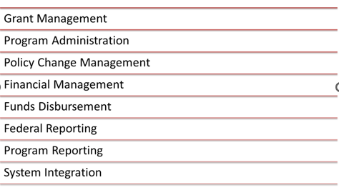
SIROMS Functional Overview
Storm Integrated Recovery & Operations Management System includes the following management functions

Slide 3
Applications supported using OpenText Metastorm
SIROMS utilizes OpenText BPM to create screens and workflows for its multi-stage modules.
Accounts Receivable
American Recovery Program Act Quarterly Progress Reports
ARP Master Program
Atlantic City Resilience Program
Baseline Site Inspection
Blue Acres Buyout Program
Change Request
Contractor Incident Tracking
Contractor Invoicing
Easement Acquisition Module
Email Template Generation
Essential Services Grant Application
Federal Funding Accountability and Transparency Act Reports
Financial Forecasting
Flood Hazard Easement Program
Flood Hazard Risk Reduction
Form Template Generation
Funds Request
Grant Management Reporting
Grant Program Management
Housing Development Projects
Hurricane Ida Housing
Integrated Financial System
Landlord Rental Repair Program
Local Planning Services
Local Planning Services - Zoning
Low to Moderate Income Housing
Minority and Women Owned Business Enterprise Reports
Mitigation Assistance Program
National Disaster Resilience Program
New Jersey Central Financial System Integration
Program Income
Program Status Management
Project Expense Reporting
Quarterly Progress Report Management
Quarterly Progress Reports
Reconstruction, Rehabilitation, Elevation, and Mitigation
Resilient Communities
Return Funds
Section 3 Reports
Site Inspection Module
Strategic Recovery Planning Reports
Supplemental Funds
Technical Assistance and Monitoring
Tenant Based Rental Assistance
Unfunded Assessment Module
Uniform Relocation Act
Unsafe Structure Demolition

Slide 4
Application support using Non BPM Technologies
SIROMS utilizes various technologies (.Net, Angular, bootstrap..) outside of BPM to develop stand alone modules and embedded pages in BPM when a more flexible user interface is required.
American Recovery Program Act Quarterly Progress Report Configuration
AMP Program Details
Applicant Interactions
Applicant Public Portal
ARP Master Program Dashboard
Attachment Document Administration
Attachments
Attachments Review
Award Calculator
Constituent Services
Contractor Incident Tracking
COVID Transparency Portal
Cross Functional Data Management
DRM Vendor Portal
Email Template Builder
Grant Management Reporting Financials
Grant Management Reporting Progress Questions
Grant Management Reports
Grant Program Management Financial Management
Housing Counseling Services
Ida Housing Home Owner Administration
Ida Housing Program Intake
Ida Payment Details
Ida Site Inspections
Inspection Appoints
Integrated Financial System
Mitigation Assistance Program Intake
Mitigation Assistance Program Non-Direct Payments
Mobile Inspection Application
Password Maintenance
Payment Details
Portal Document Administration
Portal Section Administration
Program Details
Project Expense Reporting
Project Expense Reporting Upload
Project Expense Reporting Upload Review
Public Project Expense Report Upload
Resettlement Program
Site Inspection Module Details
Tenant Based Rental Assistance Intake
Unfunded Assessment Module Intake

Slide 5
Integration Technical Environment
SIROMS Components
SIROMS - Integration Layer:
Treasury Integration – NJCFS
EDA Integration – Document Transfers (FTP)
DEP Integration – Document Transfers (S3) RREM, LRRP, LMI, USD, FHRP, FHE, …
Common Functions – Bulk Document Transfers (scanned, auto-generated)
Common Functions – Web Application Intake file Transfers BLU, IDA, MAP, PER……..
Common Functions – Bulk E-mail Notifications BLU, IDA, PER, Portal, CEN, CSD, LMI…
Common Functions – Application Intake process BLU, IDA, MAP,…
Common Functions – Trigger BPM Actions Externally HCS, CS …….
Common Functions – SSRS Report Delivery QPR, Forecasting, PER etc.
Common Functions – Notification Email/PDF template Creation FTG, FTDG etc.

Slide 6
Datawarehouse and Reporting Technical Environment

Slide 7
SIROMS Technical Environment
SIROMS UAT Technical Environment

Slide 8
SIROMS Production Technical Environment
SIROMS Production Technical Environment

Slide 9
SIROMS Infrastructure Overview
  29 servers total across all environments
    8 server VMs in Dev\Test environment
    8 server VMs in UAT environment
    12 server VMs in Production environment
    1 server VMs in Disaster Recovery environment
  22156 GB of disk space being utilized across all environments
    4400 GB in Dev\Test
    6180 GB in UAT
    9416 GB in Production
    2160 GB in Disaster Recovery
  394 GB of RAM being utilized across all environments

Slide 10
Dev\Test Environment Setup
8 Development Application Servers
Total of 8 virtual machines
  1 web server
  5 application servers
  2 database servers
Total of 12 virtual machines
  3 web servers
  7 application servers
  2 database servers
1 Database Server

Slide 11
What is the Version Control Tool?
Subversion – Opensource version control currently maintained by the Apache Software Foundation. SIROMS developers use this tool to store the current and previous version of the software modules developed for the SIROMS project.
  Client access: TortoiseSVN – This is the tool that developers use on their local machines to access the files stored on the SVN server. This tool comes with Windows Explorer integration to allow for easy access to files stored on the server.
  Trunks: Currently there are 3 application trunks configured in the SVN environment:
    BPM – modules that are access through the bpm.siroms.com site.
    Applications - .Net applications deployed on apps.siroms.com
    Integration – Code executed by the Camel integration to transfer data between internal and external applications

Slide 12
Software
Software | Purpose
Microsoft Visual Studio | Development of .Net and SharePoint applications
SQL Server | Relational Database Management System
SQL Server Management Studio | Tool connecting to database
TortoiseSVN | SVN repository browser
IIS | Web Server
Apache Camel | Integration framework
FileZilla Client | Encrypted uploading and downloading of files
Amazon AWS | Downloading/Uploading information/attachments from/to DEP
Amazon S3 Browser | View/download DEP related files for development/troubleshooting purposes
Spring IDE | IDE used for development of Integration jobs
MS SharePoint Designer | Development of SharePoint workflows, masterpage development, custom actions, BCS External content types, etc
PowerShell | Used for WSP deployment, SIROMS Reports deployment, SIROMS Document Library Daily Upload Summary Report Emails, Administration utilities, etc
MS InfoPath | Used in forms development
Central Administration | Used for SharePoint administration, job monitoring, application management , farm and site backups, etc.
SAP Business Objects | Reporting
SQL Server Integration Services | Used for ETL jobs
OpenText MBPM Designer | Development of BPM solutions
LDAP | User Authentication
Mail Server | Bulk Emailing
ArcGIS | Geo-location services
OpenText ECM | Document storage
DFS-Microsoft File replication | Software used to keep files servers, including OpenText ECM, in sync.

Slide 13
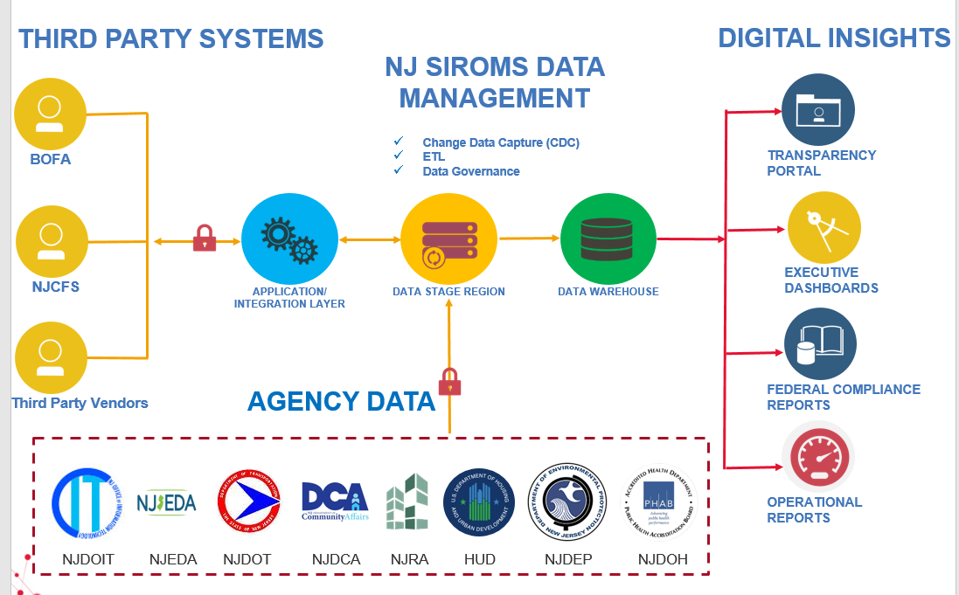
Data Warehouse and Reporting

Slide 14
SIROMS Data Warehouse and Reporting Technical Environment
Purpose | Toolset
Data Warehouse | Microsoft SQL Server
Reporting | SQL Server Reporting Services
ETL | SQL Server Integration Services/Data Quality Services
Visualization and Analytics | Tableau / D3.js
Geo Spatial | ESRI ArcGIS
Integration | Apache Camel

Slide 15
SIROMS Data Warehouse
The Data Warehouse is built using Microsoft Business Intelligence Stack
The Data Warehouse is synchronized with the OLTP using real time replication and ETL
The Data Warehouse data model is optimized to perform queries needed for reporting and analytics
The Data Warehouse keeps track of historical data and integrates data from both internal and external data sources
The Data Warehouse ETL is used to send data outbound to various targets like vendors, End users, OIT and other agencies.

Slide 16
SIROMS Data Warehouse – External Data Imports
  Hud DRGR – The following files are imported from the HUD DRGR system daily:
    A21
    A32
    F32
    P33
    P41
    F66
  Treasury NJCFS – The following files are imported into the SIROMS data warehouse from the NJCFS system daily
    Reporting Category File for SANDY/ ARPA
    FBLT
  Economic Development Authority (EDA) – Disbursement Data from EDA for GORR Report.
  HMFA – Disbursement Data from HMFA for GORR Report
  NJRA – Disbursement Data from NJRA for GORR Report
  Program Expenditure Report (PER) Imports – PER Data is imported via uploads from the Agency and Local government users. This data is stored in the data warehouse and used for reporting.
  NJ Transparency Imports – ARPA Funding Data is imported from local governments as well as other agencies

Slide 17
GORR Report
The GORR report is a Quarterly report that provides transparency of the dollars obligated and disbursed across all Sandy Recovery programs
Data will be pulled from SIROMS Grant Management and SIROMS Funds Request/Return Funds for the programs which are currently managed and tracked within SGM
The Housing and Mortgage Finance Agency (HMFA), Economic Development Authority (EDA), and New Jersey Redevelopment Authority (NJRA) provide data for their respective programs to meet the transparency reporting requirements from the GORR
The GORR report is transmitted to OIT to update the NJ Open Data Site

Slide 18
Reporting from NJCFS
Following Reports from the NJCFS system are used to reconcile financial data between SIROMS and NJCFS
    FBLT Cumulative Report
    Reporting Cat By Activity
Both the reports mentioned above are sourced in daily from NJCFS as excel files. These excel files are then saved in the SIROMS database using import jobs.
SIROMS database also maintains complex mappings which connect the Activities in SIROMS to Reporting Category, Activity Code and FBLT description in NJCFS.
ETL Jobs are used to transform and load data from the CFS reports to the SIROMS data warehouse.
Various reconciliation reports are created from the data that is loaded into the data warehouse.

Slide 19
Historical Imports ETL Process
The historical import process helps in importing transactions that happened outside the SIROMS system. An example for such a transaction is check that is directly issued by the treasury without an approved Funds Request.
The transactions are imported from the Reporting Cat By Activity File from NJCFS.
Using the ETL mappings the transactions from NJCFS are then converted into a Funds Requests in SIROMS.
The Historical Import ETL is a daily job, that helps the SIROMS and CFS systems stay in sync and track every single transaction using Funds Requests.
The Historical import process includes both housing and ARPA data.

Slide 20
Business Intelligence
Business Intelligence Suite consists of Microsoft SQL Server for paginated reports and Tableau and D3.js for Visualization for analytics.
The reports are emailed out as Excel or PDF attachments to the users on a daily, weekly or monthly basis.
The reporting tool is integrated with BPM, allowing users to request reports using a button in BPM.
Types of Reports
  Operational Reports
  System Assurance Reports
  Data Dump Reports
  Audit Support Reports
  Dashboards and Analytics

Slide 21
Reports by Program
Program | Report Count
Finance and Forecasting | 56
Cross Application Reporting | 20
IDA | 19
ARPA | 16
RREM | 10
Other Programs | 10
LRRP | 5
Mitigation Assistance Program | 5
LMI Homeowner Rebuild Program | 4
Blue Acres | 3
Tenant Based Rental Assistance | 2

Slide 22
Tableau Dashboards
Tableau Dashboards are created from the SIROMS Data Warehouse
Tableau is deployed in an Air Gapped Environment separated into Prod, UAT and Staging Sites.
Tableau dashboards are published to the tableau site and reports are scheduled to be sent as a PDF and a clickable image to users.
Tableau dashboard PDFs are integrated and published to BPM folders
There are 8 active Dashboards that are being used.
Tableau dashboards allow the users to slice and analyze data from summary to detail.

Slide 23
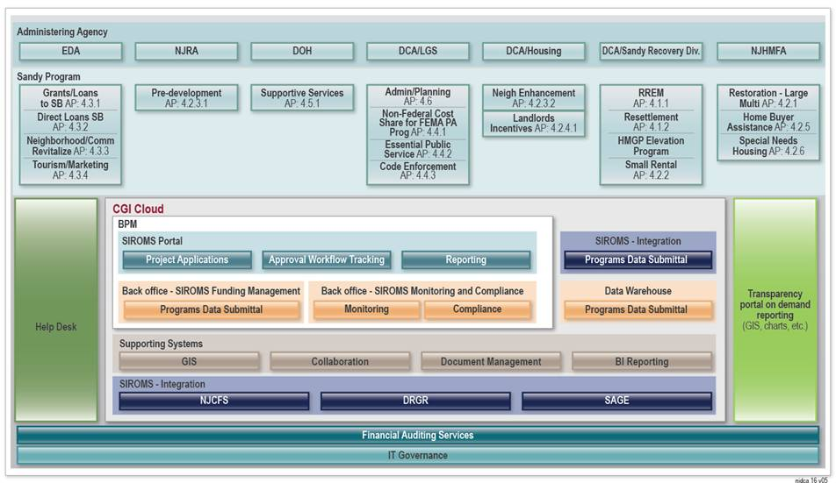
SIROMS Overall Solution Overview

Slide 24
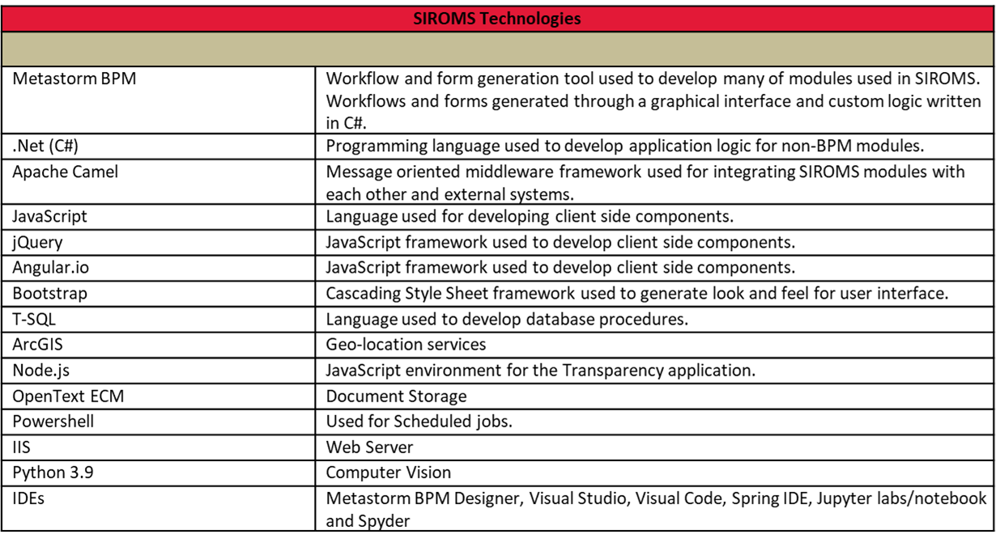
SIROMS Web Development Stack

