Slide 1


NJ Department of Community Affairs
Division of Housing and Community Resources
Affordable Housing Trust Fund
FY26 RFP Webinar
September 11, 2025

Slide 2
Housekeeping
All attendees will be on mute
No questions will be answered as part of this webinar
Please submit questions about the FY26 RFP via email to AHTF@dca.nj.gov
Questions will be answered in the form of FAQs that will be posted to the AHTF website weekly
DCA staff are unable to answer questions talk about a potential project/application while the RFP process is open until after awards are announced
Webinar recording will be posted to the AHTF website

Slide 3
OVERVIEW AND APPLICATION

Slide 4
Overview
Available funding $35,000,000
  Additional $10,000,000 for HFH projects from previous years allocation
FY26 RFP opened September 5, 2025
RFP will close October 3, 2025 at 5:00 pm
Anticipated award announcement will be November 7, 2025
If you applied in FY2025 and did not receive an award prior to the 6/3/2025 pause, you must reapply under FY2026
Make sure you read through and follow all directions in the RFP found on the SAGE grant opportunity page or the AHTF website

Slide 5
Application
Three required parts of the application
  Fully completed SAGE application
  Submission of required application documents
  Proforma submission
If you applied in SAGE in FY2025 you should have the ability to copy your previous application over into FY2026. If you have an application in SAGE for previous funding years (2024 or before) you will not be able to copy it forward
If you are having issues with SAGE you must reach out to the SAGE Helpdesk at helpdesk@dca.nj.gov or (609) 292-8134

Slide 6
Application
You must submit required application documentation electronically through a document portal.
NO DOCUMENTS WI LL BE ACCEPTED VI A EMAI L OR
MAI L!
If you submitted documentation previously as part of FY2025 application (prior to pause) you must resubmit all documents through the portal for the FY2026 application process
You can find the link to the document portal on both the SAGE grant opportunity page and the AHTF website
The portal does not have a SAVE function so you must upload and submit all documentation in one session
Multiple document submissions will not be accepted

Slide 7
Application
As part of the application submission you must complete either RENTAL Proforma or HOMEOWNERSHIP Proforma
Links can be found on both the SAGE grant opportunity page and the AHTF website
The proforma must be submitted through the document portal along with all the required application documentation
You still need to complete budget pages in SAGE and they must align with information provided in the submitted proforma

Slide 8
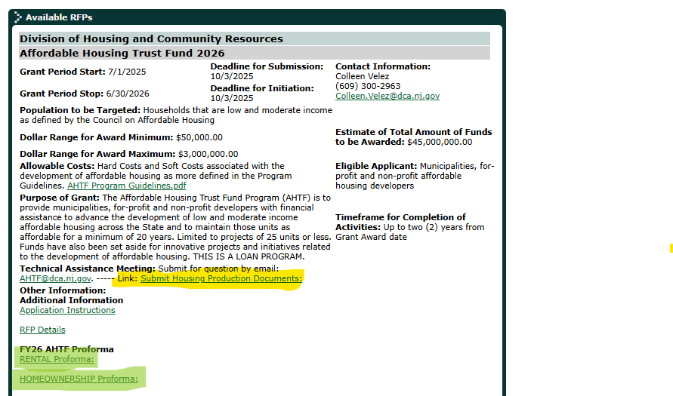
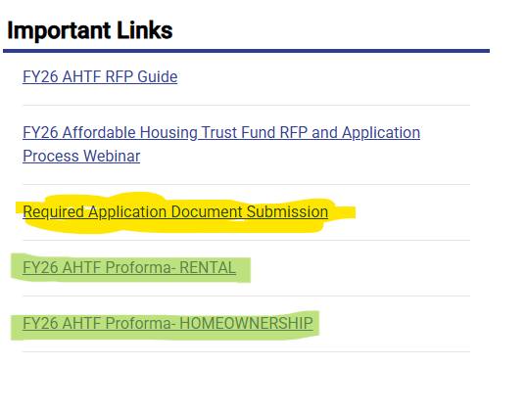
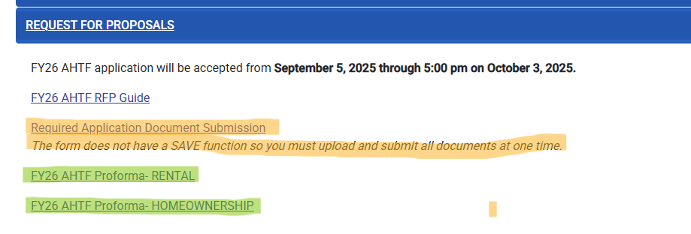
Application Links

Slide 9
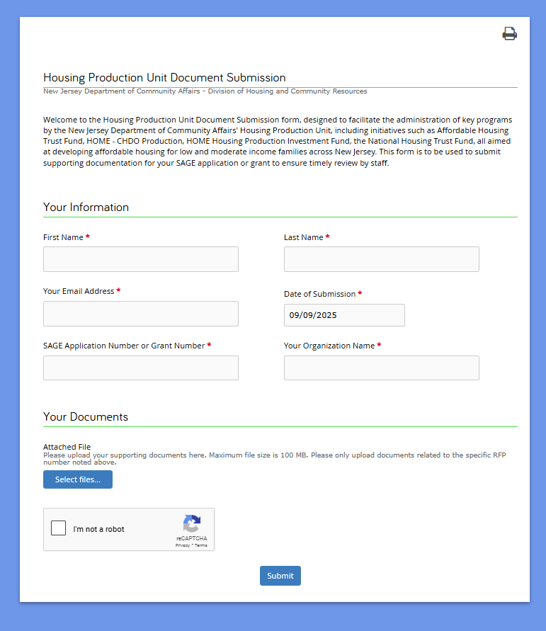
Application Document Portal

Slide 10
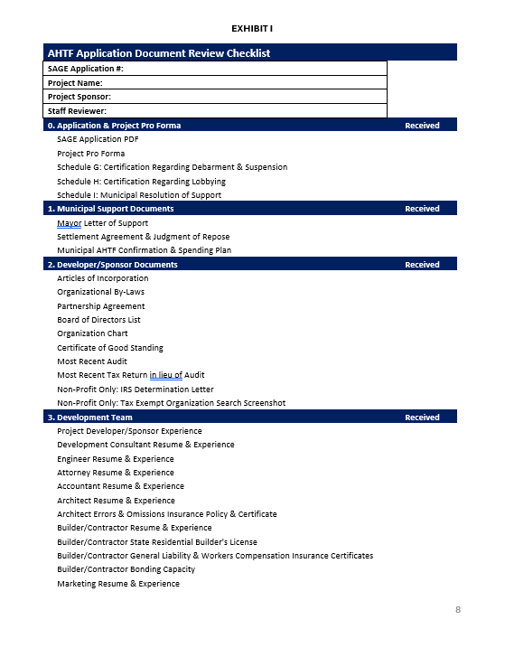
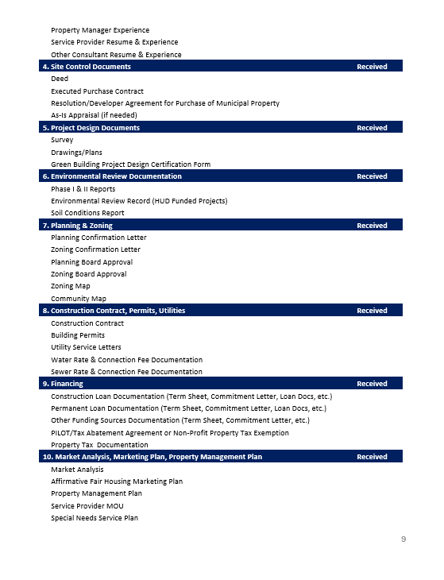
Application Required Documents
You can find the list of required application documents under Exhibit I of the RFP

Slide 11
FY 2026 RFP

Slide 12
RFP Overview
The FY2026 RFP has a two-step process
  Step 1-Threshold Review
  Step 2-Scored Application
Threshold Review
  Reviews for application completeness
  Looks at basic project readiness including:
    Site control
    Funding
    Municipal support
Must receive 8 out of 12 points to move on to scored review

Slide 13
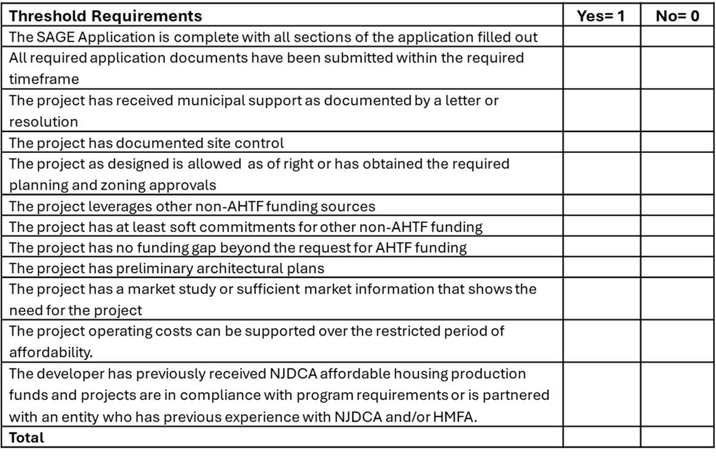
RFP- Step 1 Threshold Review

Slide 14
RFP- Step 2 Scored Review
The scored review will look at the following areas:
  Financial Feasibility & Project Readiness
  Construction & Operating Cost Reasonableness
  Development Team Capacity & Experience
  Site Selection & Design Characteristics
  Market Analysis
  Priority Points

Slide 15
RFP- Step 2 Scored Review
Financial Feasibility & Project Readiness
AHTF Pro Forma
10 points: The AHTF Pro Forma contains a realistic set of funding sources and uses, development budget, and operating budget based on reasonable assumptions with all line items falling within expected parameters
5 points: The AHTF Pro Forma contains a realistic set of funding sources and uses, development budget, and operating budget based on reasonable assumptions with most line items falling within expected parameters
0 points: The AHTF Pro Forma contains an unrealistic set of funding sources and uses, development budget, and operating budget based on reasonable assumptions with most line items falling outside expected parameters

Slide 16
RFP- Step 2 Scored Review
Proforma Expected Parameters:
Line Item | Expected Standard
Construction Contingency | Minimum 2%, Maximum 5%
Professional Services and Carrying & Financing Contingencies | Minimum 2%, Maximum 5% (combined)
Developer Fee | Maximum 8%
Profit, Overhead & General Requirements | Maximum 14% combined
Soft Costs | Maximum 28%
Annual Per Unit Operating Costs | Between 35% and 50% of effective income (rents minus vacancies), 60% if special needs/supportive housing AND project has no mandatory debt service
Percentage Change in Net Income | Minimum 1%, Maximum 3%
Percentage Change in Annual Operating Expenses | Minimum1%, Maximum 3%
Debt Service Coverage Ratio | Minimum 1.20
Vacancy Rate | Maximum 7%
Annual Management Fee | Less than $80 per unit per month OR less than 8% effective income (rents minus vacancies)
Annual Reserve Contribution per Unit | Minimum $250 per unit
***Homeownership applications will not be scored on operating standard items.***

Slide 17
RFP- Step 2 Scored Review
Financial Feasibility & Project Readiness
Financing Commitments
5 points: Firm letters of commitment from all other funding sources have been finalized and lenders are ready to close in conjunction with AHTF funding.
3 points: Firm letters of commitment are finalized by some, but not all other public and private funding sources.
1 point: Financing commitments are substantiated with Letters of Interest that include terms of financing.
0 point: Financing letters of interest are missing from most identified sources of financing.

Slide 18
RFP- Step 2 Scored Review
Financial Feasibility & Project Readiness
Planning & Zoning Approvals
5 points: Project is zoned as of right OR obtained the necessary zoning board approval and received final planning board approval.
3 points: Project has obtained the necessary zoning board approval and received preliminary planning board approval.
1 point: Project has applied for planning board and/or zoning board approvals.
0 points: Project has not applied for planning board and/or zoning board approvals

Slide 19
RFP- Step 2 Scored Review
Financial Feasibility & Project Readiness
Project Timeline
3 points: There is a strong likelihood that the project will proceed into construction within the next 12 months and the project will be completed within 4 years from the date of funding based on the project narrative, estimated timeline, and other supporting documentation.
2 points: There is a strong likelihood that the project will proceed into construction within the next 12 to 18 months and the project will be completed more than 4 years from the date of funding based on the project narrative, estimated timeline, and other supporting documentation.
0 points: The project does not have a complete or realistic timeline.

Slide 20
RFP- Step 2 Scored Review
Financial Feasibility & Project Readiness
Architectural Plans
2 points: Architectural plans are permit-ready and the construction budget is aligned with the plans. The plans reflect all design characteristics represented in the AHTF application.
1 point: Architectural plans are not yet permit-ready but have been developed beyond the schematic design phase. The plans reflect all design characteristics represented in the AHTF application.
0 points: Architectural plans are in the schematic design phase.

Slide 21
RFP- Step 2 Scored Review
Construction and Operating Cost Reasonableness
Construction Cost Guidelines
Housing Type | Studio | 1 Bedroom | 2 Bedroom | 3 Bedroom | 4 Bedroom
Single Family Detached/Semi-Detached | $294.29 | $273.62 | $254.17 | $227.88 | $215.01
Row House (1-4 Family) | $255.01 | $239.12 | $226.38 | $208.82 | $198.59
Walkup (5+ units) | $231.07 | $224.39 | $220.55 | $217.71 | $215.72
Elevator (5+ units) | $259.66 | $259.66 | $259.66 | $259.66 | $259.66
Parking Deck (Per Space) | $25,000.00

Slide 22
RFP- Step 2 Scored Review
Construction and Operating Cost Reasonableness
Construction Cost Guidelines
10 points: Construction costs do not exceed the per square foot maximum cost.
5 points: Construction costs are equal to or less than 5% greater than the per square foot maximum cost and there are reasonable justifications for the higher cost.
3 points: Construction costs are equal to or less than 10% greater than the per square foot maximum cost and there are reasonable justifications for the higher cost.
1 point: Construction costs are equal to or less than 15% greater than the per square foot maximum cost and there are reasonable justifications for the higher cost.
0 points: Construction costs exceed 15% greater than the per square foot maximum cost and there is no reasonable justification for the higher cost.

Slide 23
RFP- Step 2 Scored Review
Construction and Operating Cost Reasonableness
Annual Per Unit Operating Expenses Guidelines
5 points: Annual Per Unit Operating Expenses in the AHTF Pro Forma are between 35% and 50% of Total Effective Income (rents minus vacancies).
3 points: Annual Per Unit Operating Expenses in the AHTF Pro Forma fall 5% or less outside the expected range 35% to 50% of Total Effective Income (rents minus vacancies).
2 points: Annual Per Unit Operating Expenses in the AHTF Pro Forma fall 10% or less outside the expected range 35% to 50% of Total Effective Income (rents minus vacancies).
1 point: Annual Per Unit Operating Expenses in the AHTF Pro Forma fall 15% or less outside the expected range 35% to 50% of Total Effective Income (rents minus vacancies).
0 points: Annual Per Unit Operating Expenses in the AHTF Pro Forma fall greater than 15% outside the expected range 35% to 50% if Total Effective Income (rents minus vacancies).

Slide 24
RFP- Step 2 Scored Review
Development Team Capacity & Experience
Developer/Owner Capacity & Experience (maximum 5 points)
5 points: The Developer/Owner has financial and workload capacity to undertake the project. The Developer/Owner demonstrates a track record in successfully completing multiple projects of similar size, scale, type, and complexity to the proposed project.
2 points: The Developer/Owner has successfully completed at least one project of similar size, scale, type, and complexity to the project.
0 points: The Developer/Owner’s has never completed a project of similar size, scale, type, and complexity to the project OR the Developer/Owner has a documented history of performance issues or non-compliance with projects currently in operation.

Slide 25
RFP- Step 2 Scored Review
Development Team Capacity & Experience
General Contractor Capacity & Experience
5 points: The selected General Contractor demonstrates a track record (four (4) or more) in successfully completing projects of similar size, scale, type, and complexity to the proposed project. The General Contractor resume shows they are able to deliver the proposed project on time and within budget.
2 points: The selected General Contractor demonstrates a successful but has a limited track record (three (3) or less) in successfully completing projects of similar size, scale, type, and complexity to the proposed project. There are some concerns based on the General Contractor’s resume that they are able to deliver the proposed project on time and within budget.
0 points: A General Contractor has not been selected; or the selected General Contractor has minimal experience in successfully completing projects of similar size, scale, type, and complexity to the proposed project.

Slide 26
RFP- Step 2 Scored Review
Development Team Capacity & Experience
Architect Capacity & Experience
5 points: The selected Architect demonstrates a successful track record (four (4) or more) in designing projects of similar size, scale, type, and complexity to the proposed project. Based in their resume, the Architect has the capacity and experience to ensure the proposed design is compliant with all state and local building codes, construction standards, and accessibility requirements. The Architect has the capacity and experience to provide project oversight during the construction phase to ensure the project is delivered on time and within budget.
2 points: The selected Architect demonstrates a successful, but limited track record (3 or less) in designing projects of similar size, scale, type, and complexity to the proposed project. Based in their resume, there are some concerns that the Architect can ensure the proposed design is compliant with all state and local building codes, construction standards, and accessibility requirements and they have the capacity and experience to provide project oversight during the construction phase to ensure the project is delivered on time and within budget.
0 points: The selected Architect has no experience in projects of similar size, scale, type, and complexity to the proposed project. Based in their resume, they cannot show they have previously executed projects that are compliant with all state and local building codes, construction standards, accessibility requirements or that they have provided project oversight during the construction phase that ensured the project is delivered on time and within budget.

Slide 27
RFP- Step 2 Scored Review
Site Selection and Design Characteristics
The proposed project site location is accessible to social, recreational, educational, commercial, and health facilities as well as municipal facilities and services. The project design is consistent with the neighborhood character.
5 points: Site selection is appropriate for use and accessible- walking or public transportation that is walkable- to community resources. The project design is consistent with neighborhood character.
3 points: Site selection is generally appropriate for use however accessibility to community resources is limited- would require public or private transportation. Project design has some differences from the neighborhood character.
0 points: Site selection is inappropriate for use and is not accessible to community resources. Project design does not fit into the neighborhood character.

Slide 28
RFP- Step 2 Scored Review
Market Analysis
Project application contains a narrative market analysis or recent market study that includes information about the number of renters and homeowners, analysis of comparable area rents for both affordable and market rate projects of similar size, and an explanation of how the market analysis supports the need for the proposed project; homeownership projects should include recent sales data.
5 points: The market analysis and/or market study fully supports the need for the proposed project.
3 points: The market analysis and/or market study support the need for the proposed project, but more information is needed.
0 points: The market analysis and/or market study was not included in the project application or does not support the need for the proposed project.

Slide 29
RFP- Step 2 Scored Review
Priority Points
Leveraging: AHTF funding is 50% or less of the total funding sources for the project: 5 points
Family Sized Units: The project has a greater number of units with 3+ bedrooms than the minimum requirement for the bedroom distribution required by Uniform Housing Affordability Controls: 2 points
Affordability Controls: The project has affordability controls longer than the 20-year requirement of AHTF: 2 points
Non-profit Developer: The applicant is a non-profit developer. 1 point

Slide 30
RFP- Step 2 Scored Review
AHTF Score Summary
I. Financial Feasibility & Project Readiness (maximum 25 points) | Maximum Points
1. AHTF Pro Forma | 10
2. Financing Commitments | 5
4. Planning & Zoning Approvals | 5
5. Project Timeline | 3
6. Architectural Plans | 2
II. Construction & Operating Cost Reasonableness (maximum 15 points)
1. Construction Cost Guidelines | 10
2. Annual Per Unit Operating Expenses Guidelines | 5
III. Development Team Capacity & Experience (maximum 15 points)
1. Developer/Owner Capacity & Experience | 5
2. General Contractor Capacity & Experience | 5
3. Architect Capacity & Experience | 5
IV. Site Selection & Design Characteristics (maximum 5 points)
1. Site Selection & Design Characteristics | 5
V. Market Analysis (maximum 5 points) | 5
Total Available Points Section I-V | 65
VI. Priority Points (maximum 10 points)
1. Leveraging | 5
2. Family Sized Units | 2
3. Affordability Controls | 2
4. Non-profit Developer | 1
Total Available Points Section VI | 10
TOTAL AVAILABLE POINTS ALL SECTIONS | 75

Slide 31
Awards
All applications will be scored and ranked by score
The number of awards will be determined by funds available, amount requested per project, and ranked project amounts
The final ranking will be submitted to the Commissioner who will have final determination of which projects will receive AHTF funding
Anticipated award announcement will be on November 7, 2025

Slide 32
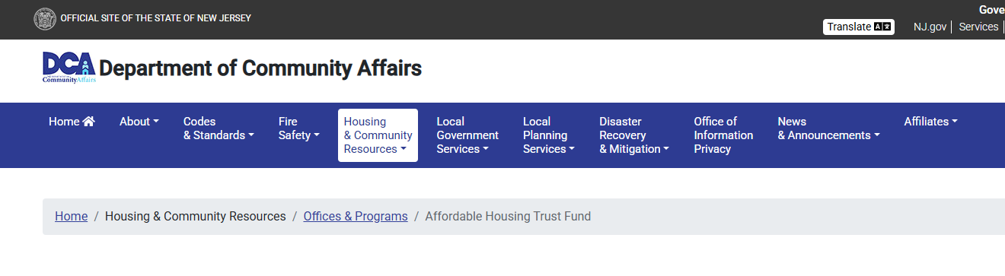
Questions
Submit all FY 2026 RFP question to AHTF@dca.nj.gov
FAQs will be posted weekly to the AHTF Website
Please continue to check the website for updates- recording of this webinar will be posted by 9/18/2025
DCA Home/Housing & Community Resources/Offices & Programs/Housing Production/Affordable Housing Trust Fund

Slide 33
THANK YOU

