Slide 1


Property portal
MITAS TRAINING SERIES
HOW TO LOG-IN AND CREATE NEW USER ACCOUNTS

Slide 2




AGENDA
NEW PROPERTY PORTAL
HOW TO LOG-IN
HOW TO ASSIGN USERS TO PROPERTIES
HOW TO CREATE MORE ACCOUNTS

Slide 3


PROPERTY PORTAL
New Portal Design Objectives
Allow for Management of Multiple Properties with 1 Username
Reduce E-Mails With Property Managers and Agency Staff
Centralize all Property Documents

Slide 4




How Can I Log-In?
NJHMFA will be sending a Secure Document Request with your username after the Owner submits the Portal Access form on the Owner Portal.
Go to Property Portal link found in the Document Request and enter your e-mail and select “Forgot Password”
A temporary password will be emailed to you.
This portal is not open to the public. You must be registered with NJHMFA before you can login.
If you do not receive the Document Request, contact your Owner.

Slide 5
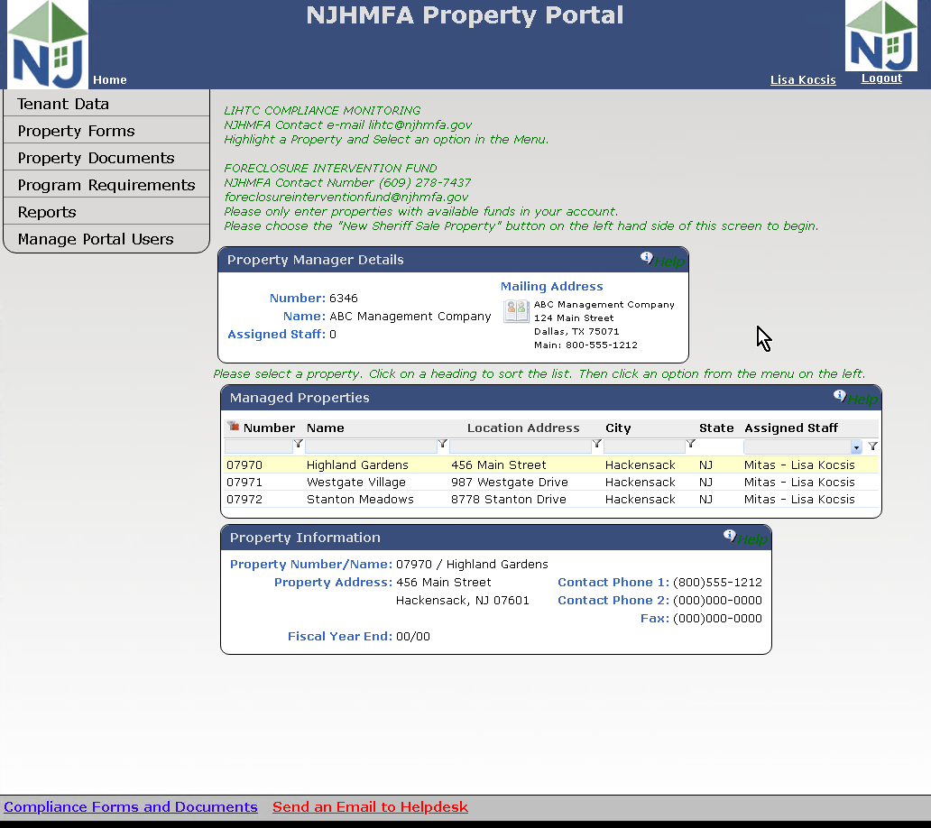
HOME SCREEN
PROPERTY MANAGER DETAILS BUBBLE
MANAGED PROPERTIES BUBBLE
PROPERTY INFORMATION BUBBLE
NJHMFA LINKS and HELP

Slide 6

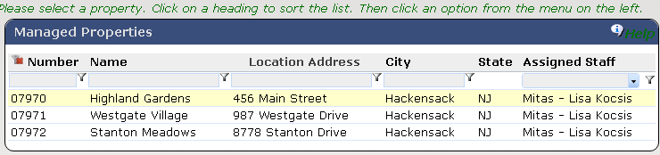
HOME SCREEN
MANAGED PROPERTIES BUBBLE
This displays all Properties. Select a Property by highlighting the property before you choose a menu option on the left.
Each Column is searchable
The Properties that appear on this screen for each user is configurable under Manage Portal Users.

Slide 7
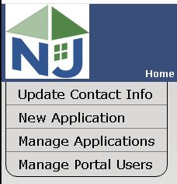
HOME SCREEN
PORTAL MENU OPTIONS
Manage Portal Users
Add additional Users to the Portal
Create Usernames and maintain Passwords
Assign a Security Role for each User
Give each User access to your Properties
Always include the Email for each User

Slide 8

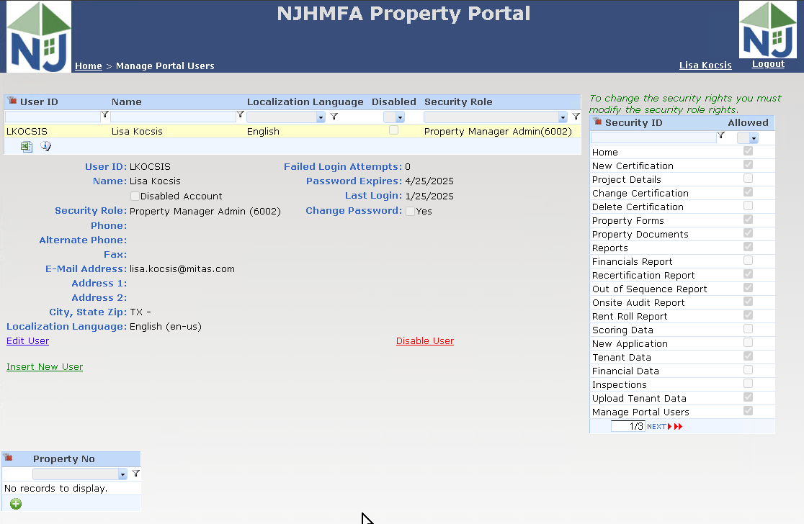
MANAGE PORTAL USERS SCREEN

Slide 9

MANAGE PORTAL USERS
Insert New User
Use this link to insert a new user for the Portal
Edit User
Use this link to change information or reset a password.
Disable User
Use this link to disable the user from accessing the Portal.

Slide 10
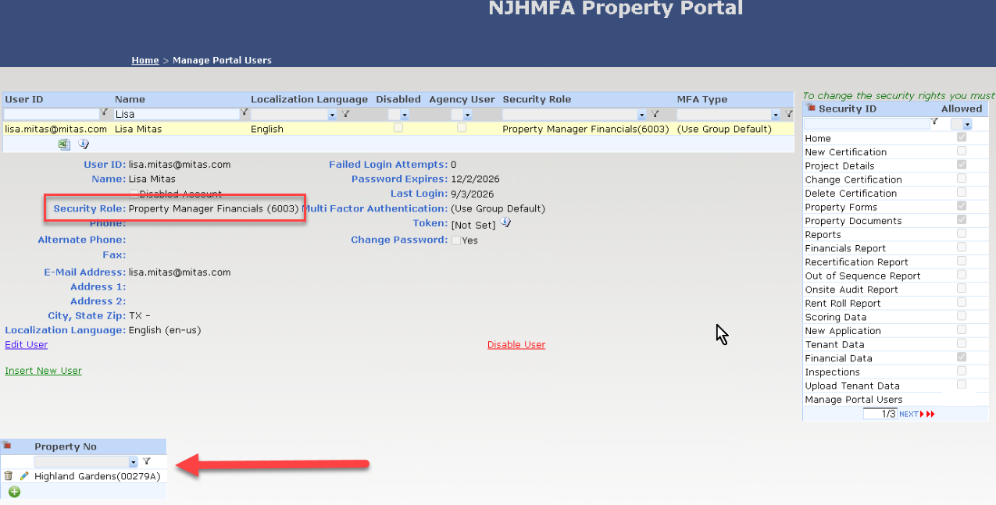
MANAGE PORTAL USERS
Assign a Security Role
Portal Users
Security Roles determine what screens the user will have access to. The Security Role for most users will be “Property Manager Financials”.
For each User, give access to any and all properties the user is allowed to access.
The Financials Role must have assigned Properties.

Slide 11
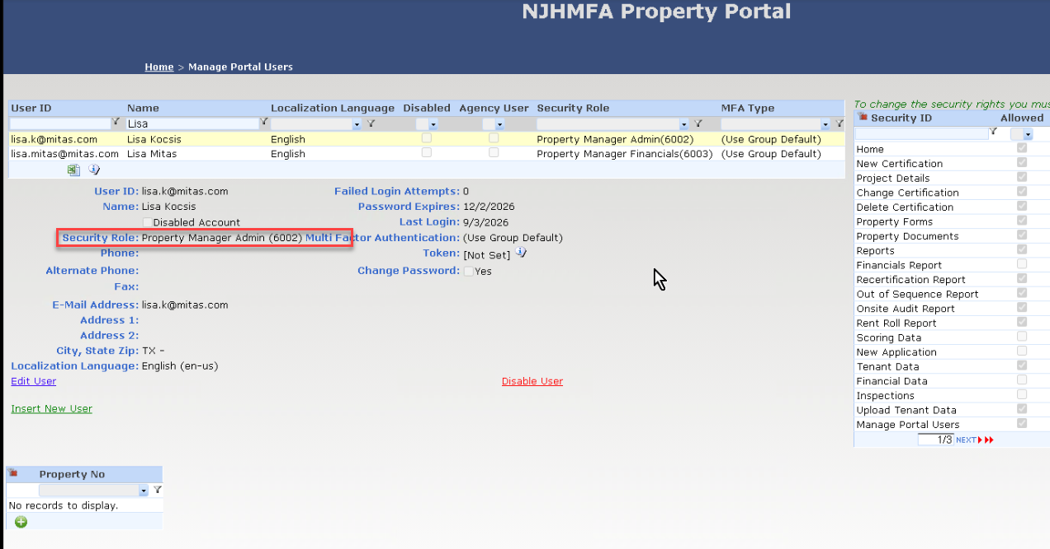
MANAGE PORTAL USERS
Portal Admins
The “Portal Admin” will give access to specific properties to specific Users.
Portal Admins will have access to all properties.
“Portal Admin” Security Role will be only for the user who will be creating other users and controlling access to the Portal for your company.
E-mails have to be unique!!!

Slide 12

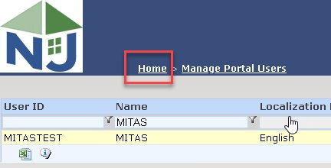
HOME SCREEN
HOME LINK
The “Home” link in the upper left side of the Portal will always bring you back to your Home Page.

Slide 13

MITAS TRAINING SERIES
These are the other videos available for this Portal. Please watch all of them before calling NJHMFA staff with your questions.
HOW TO LOGIN AND CREATE NEW USERS
New User Setup and Giving Access to Property Data
ENTERING FINANIAL DATA
Using Secure Document Request to send the Financial Package

Slide 14

THANK YOU
ANNOUNCEMENTS
WE WILL SEE YOU AT THE WEBINAR COMING SOON!
CONTACT THE ?????????????????? WITH QUESTIONS

