Slide 1


NJHMFA Property porTAL
MITAS TRAINING SERIES
HOW TO SUBMIT PROPERTY FINANCIALS

Slide 2



AGENDA
SECURE DOCUMENT REQUEST
HOW TO LOG-IN TO NJHMFA PROPERTY PORTAL
HOW TO VIEW APPROVED FINANCIALS

Slide 3


SECURE DOCUMENT REQUEST
New Process for sending Property Financials
Each Property will receive an e-mail with a link to a secure portal
If you have multiple properties, you will receive multiple e-mails
E-mails are specific to the Property named in the e-mail
If you do not receive an e-mail, please contact NJHMFA.
Asset Management Documents can be submitted in two ways:
  Secure Document Request
  NJHMFA Property Portal
  Always refer to the latest bulleting for the most current information.

Slide 4

Secure Document Request E-mail
Sample E-mail
The Secure Document Request for “Property Name” (Property Number) has been updated to a new status of Outstanding. The initial request was sent on 9/3/2026 10:18:56 AM. This request has an expiration date of 12/2/2026.
View Your Secure Document Request
Each e-mail will contain the Property Name.
Each e-mail will contain an Expiration Date.
You will not be able to click the link after the Expiration Date.
If you do not access your Secure Document and complete your Secure Document Request before the end of the day on the Expiration Date, you will need to contact NJHMFA.

Slide 5
Secure Document Request E-mail
Sample E-mail
Dear Managing Agent/Owner,
The New Jersey Housing and Mortgage Finance Agency (NJHMFA) has issued a Secure Document Request (SDR) for the submission of your property’s Annual Budget.
Please use the Secure Document Request (SDR) link provided in this email to upload the required documentation. Documents submitted by email will not be accepted and will not satisfy the submission requirement.
Required Documentation
Annual Budget (must include a current rent roll and rent increase notice to tenants if applicable).
Budget will not be processed if the rent roll is missing and will be considered not received.

Slide 6
Secure Document Request E-mail
Sample E-mail
Important Instructions
1. Upload all required documents using the Secure Document Request (SDR) link.
After all documents have been uploaded, you must select “Finish” on the SDR screen to complete your submission.
2. Uploading documents without selecting “Finish” will result in an incomplete submission, and NJHMFA will not receive your documents.
Please complete your submission before the SDR expires to remain in compliance with NJHMFA reporting requirements.
If the SDR expires before your submission is complete, please contact your assigned HMO by email to request that a new SDR be issued. Documents must be submitted through the new SDR link. Always use the link provided in the most recent reminder email, as a link from an earlier email may have expired. Thank you for your prompt attention to this matter.

Slide 7
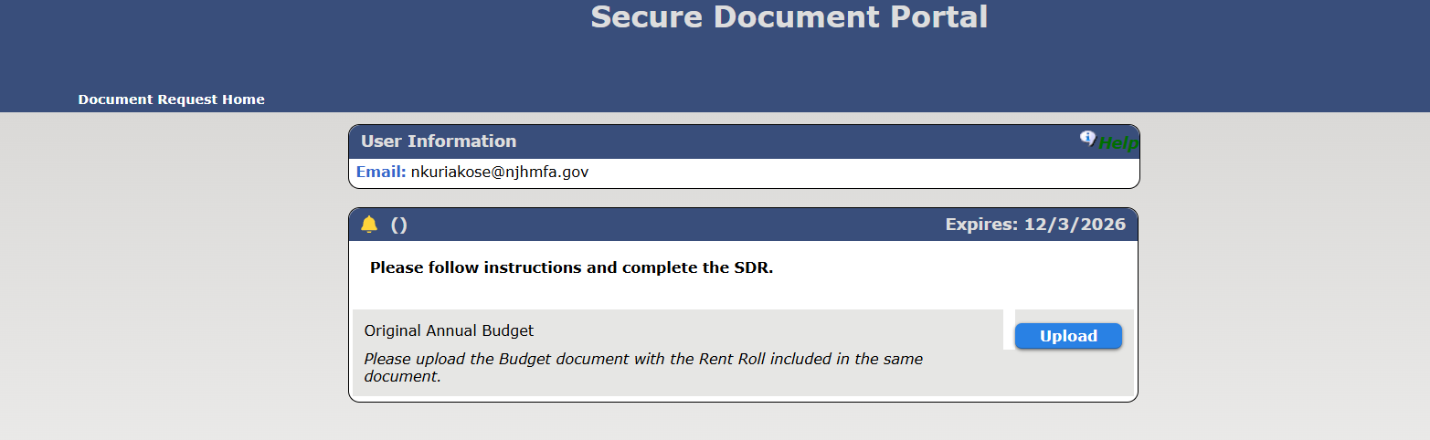
Secure Document Request Portal
Document Upload Screen

Slide 8

Secure Document Request Portal
Document Upload Screen
On your SDR Portal, there will be 2 buttons.
The UPLOAD button will be used to submit the entire Budget Submission Package including a Rent Roll and rent increases.
Once you have Uploaded the package, the FINISH button will appear. Please select the Finish Button.

Slide 9
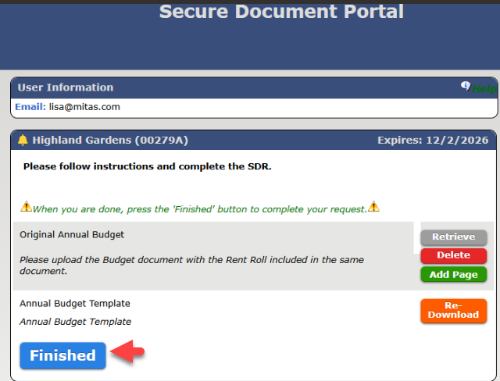
Secure Document Request Portal
FINISH Screen
Once you have pressed both buttons, the FINISH button will appear.
The screen should appear with options to retrieve what you have uploaded or to re-download the template again.
Press FINISH.

Slide 10
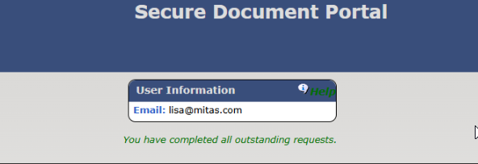
Secure Document Request Portal
SDR Closed Screen
Once you have pressed the FINISH button, you will receive this message.
This browser window can be closed.
Your submission will be date and time stamped. If you have missed the Expiration Date and your link no longer works, please contact NJHMFA.

Slide 11

Secure Document Request Portal
Reviewed Budgets
Check your e-mail!
You will receive another Secure Document Request when NJHMFA has reviewed your budget.
The second request will have a DOWNLOAD button for you to receive the budget spreadsheet.
Once you have downloaded the budget, press the Finish button complete the request.
If your Secure Document Request expires, please contact the NJHMFA Asset Management staff or HMO for assistance.

Slide 12
NJHMFA PROPERTY PORTAL
New Portal Design Objectives
Allow for Management of Multiple Properties with 1 Username
Reduce E-Mails With Property Managers and Agency Staff
Centralize all Property Documents

Slide 13




How Can I Log-In?
NJHMFA will be sending a Secure Document Request with your username after the Owner submits the Portal Access form on the Owner Portal.
Go to NJHMFA Property Portal link found in the Document Request and enter your e-mail and select “Forgot Password”
A temporary password will be emailed to you.
This portal is not open to the public. You must be registered with NJHMFA before you can login.
If you do not receive the Document Request, contact your Owner.

Slide 14
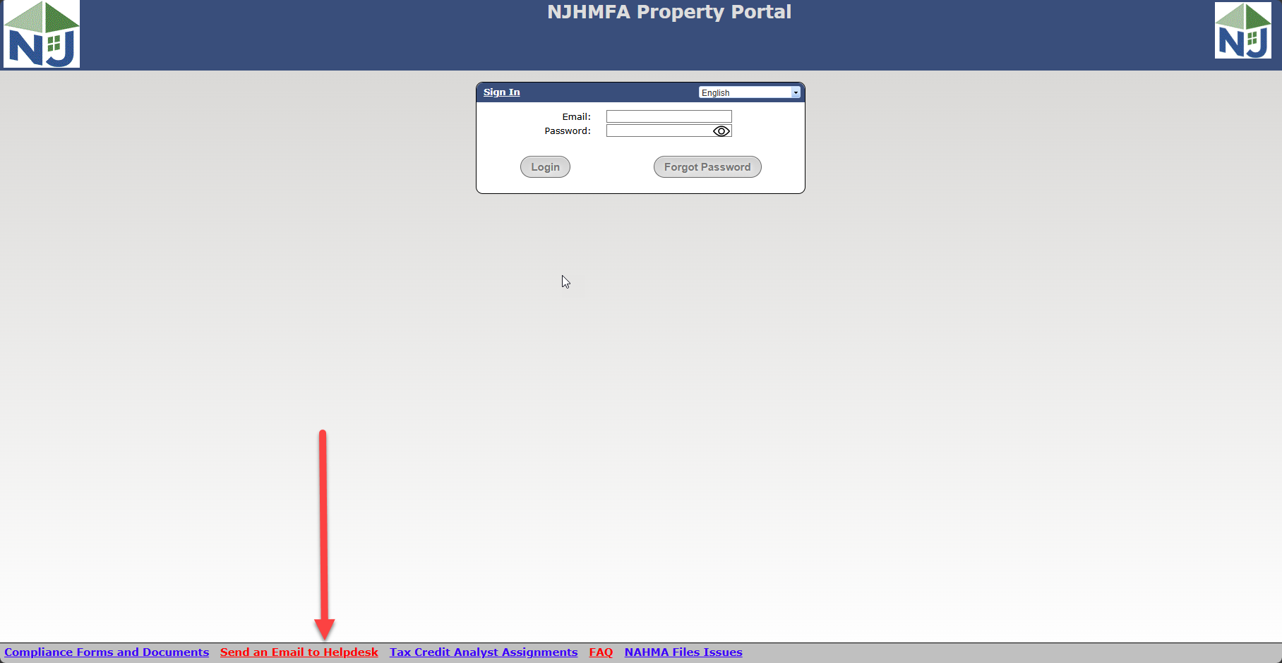
Register for the NJHMFA Property Portal
NJHMFA Property Portal
If you are new to the NJMFA Property Portal, you will need to register to use this portal. If you do not have a login, click on this link and NJHMFA IT will be in contact with you.
https://propertymanagers.njhousing.gov/

Slide 15
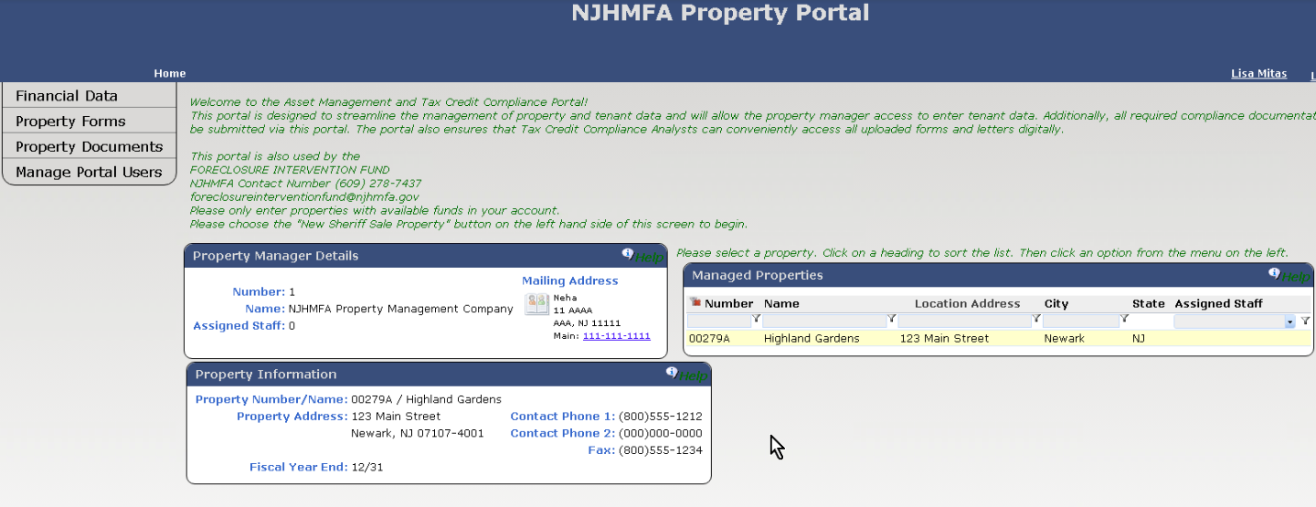
HOME SCREEN
PROPERTY MANAGER DETAILS BUBBLE
MANAGED PROPERTIES BUBBLE
PROPERTY INFORMATION BUBBLE

Slide 16
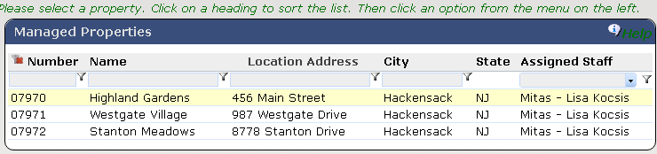
HOME SCREEN
MANAGED PROPERTIES BUBBLE
This displays all Properties. Select a Property by highlighting the property before you choose a menu option on the left.
Each Column is searchable.
The Properties that appear on this screen for each user is configurable under Manage Portal Users.

Slide 17
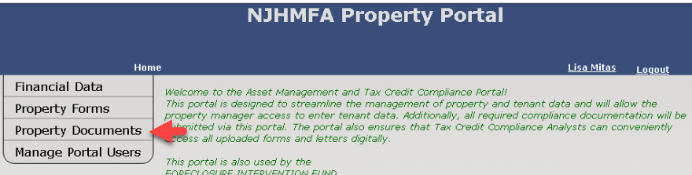
HOME SCREEN
Select Property Documents
Select the Property Documents menu option.

Slide 18
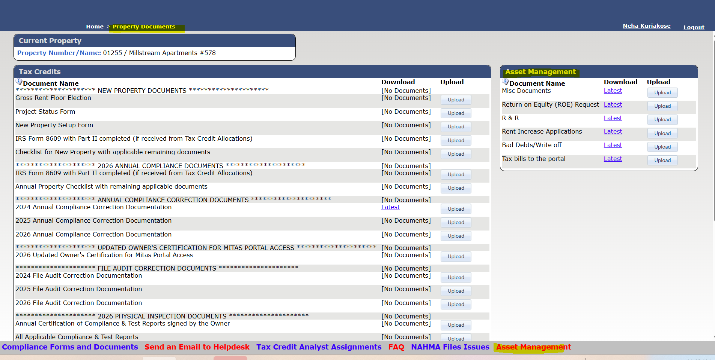
PROPERTY DOCUMENTS SCREEN

Slide 19

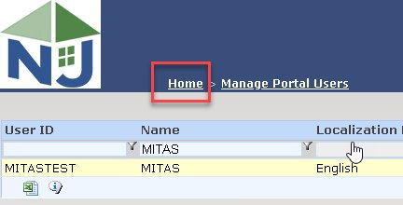
HOME SCREEN
HOME LINK
The “Home” link in the upper left side of the Portal will always bring you back to your Home Page.

Slide 20

MITAS TRAINING SERIES
These are the other videos available for this Portal. Please watch all of them before calling NJHMFA staff with your questions.
HOW TO LOGIN AND CREATE NEW USERS
New User Setup and Giving Access to Property Data
ENTERING FINANIAL DATA
Using Secure Document Request to send the Financial Package

Slide 21

NJHMFA Web Site Resources
New Link on the NJHMFA Property Portal Footer
This Link will appear on every page of the NJHMFA Property Portal.
Choose the Asset Management link to be taken to the NJHMFA Web Site for Property Management Bulletins and other resources.

Slide 22
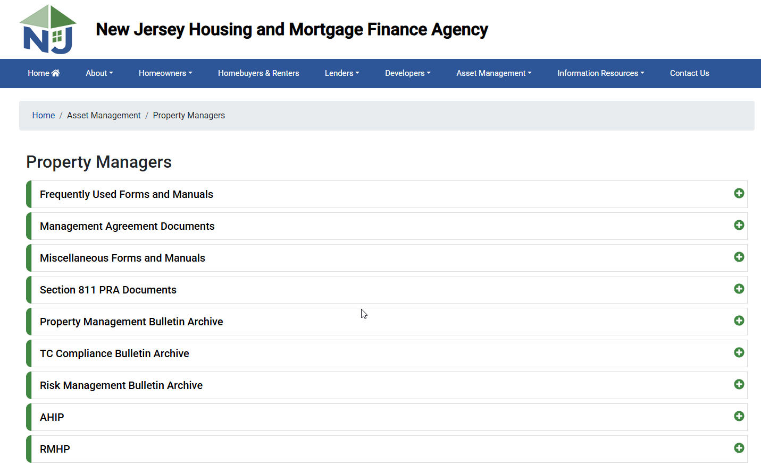
NJHMFA Web Site Resources

Slide 23
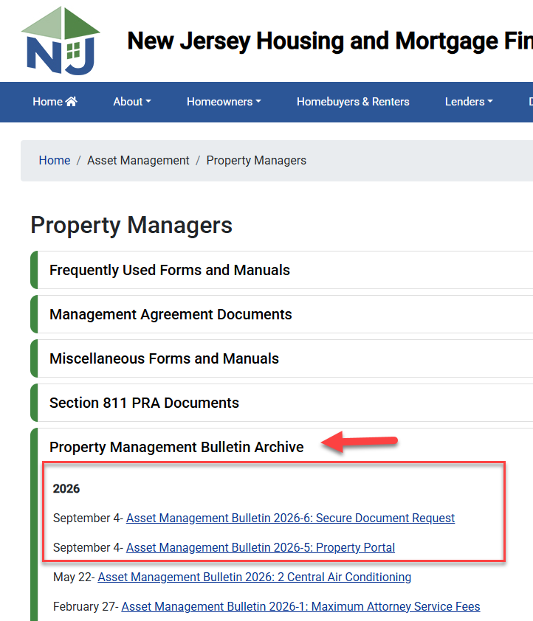
NJHMFA Web Site Resources
New Property Management Bulletins for the New Process for submitting your financials and documentation.

Slide 24

THANK YOU
ANNOUNCEMENTS

