Slide 1
NEW JERSEY DEPARTMENT OF CHILDREN AND FAMILIES
Intensive In-Home Behavioral Supports
INFORMATION SESSION
DCF Children’s System of Care
October 29, 2024
Notes:
Intro Static Page

Slide 2
Agenda & Objectives
Welcome & Introductions
Children’s System of Care (CSOC)
IIH-B Services
RFQ Requirements
Organizing the RFQ Application
Q & A
Notes:
Melissa

Slide 3
Children’s System of Care (CSOC)
Serves youth under 21 with emotional and behavioral health care challenges, intellectual/developmental disabilities including autism, and/or substance use challenges.
Objective is to help youth thrive at home, in school, and in the community; successfully living with their families and becoming independent, productive and law-abiding citizens.
PerformCare, the Contracted Systems Administrator for CSOC, is the single point of access for children, youth, and young adults up to the age of 21
CSOC structure and foundational values ensure that services provided are based on the needs of the youth and family; are family-centered, culturally competent, and community-based.
Notes:
Ben
The NJ Department of Children and Families is devoted exclusively to serving and supporting at-risk children and families. The Children’s System of Care, or CSOC, is the state’s public behavioral health system that serves youth under 21 with emotional and behavioral health care challenges, substance use challenges, and intellectual/developmental disabilities including autism.
The system of care is a coordinated network of services and supports that relies on youth and families being at the center of their own care and aims to support youth and families within the community and with an approach that is mindful of cultural context, the social determinants of health, and how these impact families.
CSOC’s Objective is to Help Youth Succeed:
-At Home-successfully living with their families and reducing the need for OOH treatment settings
-In School-successfully attending the least restrictive and most appropriate school setting close to home
-and In the Community-Successfully participating in the community and becoming independent, productive and law-abiding citizens.
Our contracted system administrator, PerformCare, provides member services, medical necessity determinations, initial and continuing prior authorization of services, quality management functions, as well as development and maintenance of CYBER, which is the electronic behavioral health information record used across CSOC.
PerformCare is also the single point of access to CSOC’s wide array of behavioral health, substance use, and intellectual/developmental disability services for youth and families in New Jersey.
Lastly, CSOC’s values ensure that the supports and services provided are based on the needs of the youth and family, are family centered, culturally competent and community-based.

Slide 4
PerformCare: CSOC’s Contracted System Administrator
Access to Care and Integrated Services
Single point of access for children, youth, and young adults up to age 21
Available 24/7/365
Triage calls to assess immediacy of need
Authorize services based upon level of urgency
Provide information and referral
Notes:
Ben

Slide 5
PerformCare Roles and Responsibilities
Perform Care
CMO
MRSS
FSO
DD Eligibility
FSS/IIH
OOH
Notes:
Ben

Slide 6
The Service Array – DD Eligible Youth
Services can include any CSOC service:
Care Management Organization
Mobile Response Stabilization Services
Family Support Organization
As well as Functional Services:
Family Support Services (FSS)*
Intensive In-Home (IIH) Services*
*DD-Eligibility Required
Notes:
Margie
DCF CSOC offers a wide range of services for children and youth with intellectual and developmental disabilities. These services include community-based services, in-home services, out-of-home residential services and family support services.
DD-eligible youth are able to receive Care Management Organization services, Mobile Response Stabilization Services, and Family Support Organization services as well as Family Support Services and Intensive In-home services.
Youths need to be found DD-eligible through the DD-eligibility application process in order to access Functional Services. We will discuss the DD-eligibility process in more detail a little later in the presentation.
Now we will discuss the service array in more detail.

Slide 7
Intensive In-Home Services (IIH)
Behavioral Health Services (IIH Behavioral)
Clinical and Therapeutic Services (IIH Clinical)
Individual Support Services (ISS)
Notes:
Margie
IIH are intensive interventions: Behavioral (Applied Behavior Analysis- or ABA); clinical and therapeutic services; or Individual Support Services (ISS) utilized to meet the needs of youth with Intellectual and Developmental Disabilities and their families.
SERVICE TYPES
Behavioral Health Services (ABA):
Focus on decreasing challenging/dangerous behaviors and improving the youth's self-regulating skills, communication skills, and adaptive skills. Clinician will also work with the parent to support the Behavior Plan. Ranges from 5 to 17 hours per week, depending on the level of need of the youth.
Clinical and Therapeutic Services:
Focus on youth & family and provide cognitive & behavioral strategies to enable youth to function at his/her optimal level. Serves youth with I/DD and co-occurring mental health issues. Can include indiv/family therapy and can be combined with ISS for addition support. Provided by Masters level clinician. Ranges from 1 to 4 hours per week.
Individual Support Services:
Addresses adaptive behavior and skill development for basic activities of daily living (ADL’s) including self-care tasks and fundamental functioning tasks that enable an indiv to live independently in the community. Teaches skills directly to the youth and trains parents in implementation of the Individual Support Plan. Focuses on positive beh support. Provided for up to 10 hours per week. May not be combined with IIH.
As with all CSOC services, these services are authorized in 90-day increments.
IIH services can only be accessed through the Care Management Organization (CMO) or Mobile Response and Stabilization Services (MRSS) unit by youth who are DD eligible.
Family Participation is vital for success- Families are critical team members in the identification of needs, strengths, strategies and reporting progress. Therefore, each IIH service requires caregiver and/or family commitment and involvement.
**Note: Not all eligible youth receive these services, youth primarily receive services through DOE. Youth enrolled in Medicaid with an Autism diagnosis are not eligible for CSOC IIH behavioral services. ABA services for these youth must be accessed through the youth’s Managed Care Organization (MCO).

Slide 8
IIH Behavioral Clinical Criteria
Habilitation - goals that focus on the amelioration of:
Behaviors that may threaten the health or safety of youth or others;
Behavior disorders that may be a barrier to the youth remaining in least restrictive setting and/or youth’s ability to participate in family and community life;
Absence of developmentally appropriate adaptive, social, or functional skills.

Slide 9
IIH Behavioral Clinical Criteria
IIH Behavioral provides Applied Behavior Analysis (ABA) treatment
IIH Behavioral addresses dangerous and/or maladaptive behaviors (elopement, self injury, aggression)
Board Certified Behavior Analyst (BCBA) is authorized for 3 hours weekly supervision
Supervisor works with behavioral technician (BT) who can be authorized 10-17 hours per week depending on the intensity of need
Parents/caregivers are trained to implement the behavior support plan

Slide 10
Initial Authorizations
Child Family Team (CFT) identifies the need for ABA for a DD Eligible youth
CMO submits the request for Functional Behavioral Assessment and initial Behavior Support Plan; the CFT progress note must also document the need for ABA
Once approved, the FBA should be completed within 21 business days by the BCBA/BCaBA
IIH provider submits the FBA and initial BSP at the same time
PerformCare has 5 business days to review

Slide 11
On-Going Authorizations:
Weekly progress notes submitted by BCBA/BCaBA and Behavioral Technician
BCBA/BCaBA completes BSP update approx. 14 days prior to the end of the authorization.
PerformCare has 5 business days to review
Once approved, CMO is to submit their ISP requesting continued IIH services (90-day request).

Slide 12
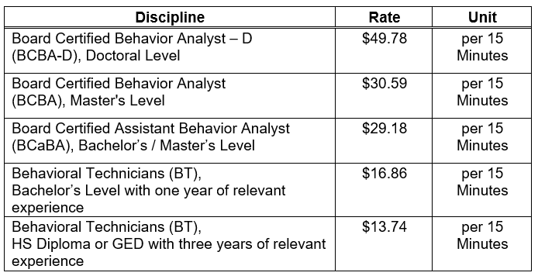
Funding Information
Providers will be reimbursed according to the rates below:
Notes:
Margie

Slide 13
RFQ
DCF will send an official decision letter to all respondents once a final qualification decision is made.
If qualified, post-award documentation will be collected from the provider by the DCF Office of Contract Administration.
Providers will need to complete a Medicaid provider application before their contract can be executed. IIC Providers will need to complete a new application to obtain a new Medicaid ID.
Once the contract is executed, DCF/CSOC will send a welcome email including information on trainings, billing, referrals, and background check requirements to newly contracted providers.
Notes:
GIA
Now, we would like to provide some information about the RFQ process, provider requirements, and deadlines:
After the RFQ Deadline, DCF will conduct a preliminary review of each response to determine where it is eligible for evaluation or immediate rejection based on the criteria stated in the RFQ. Responses meeting the initial screening requirements of the RFQ will be distributed to the Evaluation Committee for its review and recommendations. The voting members of the Evaluation Committee will review responses, deliberate as a group, and recommend final funding decisions.
DCF will send an official decision letter to all respondents once a final qualification decision is made.
If qualified, post-award documentation will be collected from the provider by the DCF Office of Contract Administration. The CSOC respite contract administrator will reach out to the agency via email to begin the process.
CSOC’s Medicaid unit will send qualified respondents a NJ FamilyCare/Medicaid Provider Application via email. Applications must be completed and submitted directly to CSOC’s Medicaid unit.
Once the contract is executed, the CSOC Respite program team will send a welcome email including information on trainings, billing, referrals, and background check requirements to newly contracted providers.

Slide 14
Key Components
Background Checks
Compliance with Reporting:
-NJ Abuse/Adult Protective Services
-Danielle’s Law
-Unusual Incident Reporting (UIR)
Documentation Requirements
Functional Behavior Assessment (FBA)
Behavioral Support Plan (BSP) supported by the FBA
Individual service record for each youth
Claims data
Notes:
GIA
Background Checks:
-Providers will ensure all employees rendering services to youth receiving CSOC funding will receive fingerprint background checks that include state and federal Criminal History Record Information (CHRI) during the hiring process and every two years thereafter.
-Once a provider is qualified, CSOC will provide an information packet via email describing the steps for the fingerprinting background process.
-The cost of the fingerprinting background check will be paid for by DCF. The Provider agency will be responsible for ensuring background check clearance for all staff providing CSOC-funded services to youth. This does not include administrative staff if they have no contact with the youth in the program.
-Fingerprinting/background check results are obtained by accessing the DHS records database as described in the information packet provided by CSOC. The provider must maintain a record of the background check results on file and available upon CSOC’s request.
-In addition, qualified providers must ensure that the names of all agency employees, volunteers, and consultants that provide services to youth with I/DD shall be checked against the names found in the Central Registry of Offenders Against Individuals with Developmental Disabilities. If a qualified provider does not have access to the system, DCF CSOC should be notified so access can be granted.
Additional information about the Central Registry of Offenders can be found on the NJ Department of Human Services website found in the chat.
Another Key Component is Compliance with Reporting as there are different situations that must be reported.
-NJ Abuse- As mandated reporters, providers must comply with the requirement to report suspected abuse and neglect against a child under 18 yo to the NJ Division of Child Protection and Permanency through the State Central Registry hotline. In addition, any suspected abuse and neglect against a vulnerable youth 18 years of age or older must be reported to Adult Protective Services (APS). You can find more information about reporting abuse by visiting the websites found in the chat.
-Danielle’s Law- Providers are required to adhere to Danielle's Law which requires staff working in facilities that provide services to individuals with intellectual/developmental or traumatic brain injury to call 911 when there is a life-threatening emergency.
-UIR (Unusual Incident Reporting)-Pursuant to Administrative Order 2:05, providers are required to report all related accidents, incidents, or unusual occurrences involving staff, youth, and/or families by notifying CSOC’s Family Support Services Program Lead and submitting an Unusual Incident Report (UIR) through the Universal Incident Management Reporting System (UIRMS). You can obtain more information about the UIR reporting process at the NJ Dept of Human Services website found in the chat.
In addition, CSOC offers virtual UIR training at no cost to providers. A copy of the Provider UIR training PowerPoint presentation will be sent to Qualified Providers in a CSOC welcome email.
HIPAA- In addition, Qualified providers are required to adhere to the requirements of HIPAA. As DCF is considered a “covered entity” as defined by HIPAA, any agency contracted with DCF to provide services is responsible for adhering to HIPAA requirements. You can learn more about HIPAA requirements via the link in the chat.
Documentation Requirements
Functional Behavior Assessment (FBA)
Upon service authorization by the CSA, qualified respondents must complete a Functional Behavior Assessment (FBA) to understand the communicative functions of the maladaptive behavior
Only a licensed BCBA-D, BCBA or BCaBA (under the supervision of a BCBA) shall complete the FBA.
The primary outcome of an FBA is:
i. Creating a clear description of the maladaptive behaviors;
ii. Identifying times, contexts, and situations that predict when a maladaptive behavior will or will not occur;
iii. Identifying what is gained or avoided when maladaptive behaviors occur;
iv. Developing functional hypotheses for maladaptive behavior; and
v. Creating a multi-element behavior intervention plan based upon the results of the FBA.
Behavioral Support Plan (BSP)
A BSP must foster independence, integration, individualization, self-determination, and productivity within the community for each youth while honoring the individual’s cultural background
Only a BCBA-D, BCBA or BCaBA (under the supervision of a BCBA) shall develop the BSP and any updates to the plan.
The youth’s treatment is based on targeted needs as identified in the BSP.
Individual Service Record - Maintain an individual service record for each youth, which shall contain, at a minimum, the following information:
i) documentation that family members have been informed of their rights, consents for assessment and plans, and the agency’s policies and obligations;
ii) contact phone numbers for the IIH Behavioral services staff and any supervisor;
iii) the reason for initial referral and involvement;
iv) information on the youth’s behavior from the family, youth’s interests, and any limitation on activities;
v) the initial schedule for allocation of IIH Behavioral services hours;
vi) for each discrete contact with the youth and family, progress notes that address the defined goals stipulated in the youth’s BSP must be completed;
vii) dates of service and number of care hours, per level of service, received;
viii) documentation of any and all crisis or emergency situations that occur during the provision of the services, including a summary of action taken and resolution of the situation.
Claims Data - Maintain data in support of all claims, including: which shall contain, at a minimum, the following information:
i) name and address of the youth being provided services;
ii) the name and credentials of the person(s) providing the service;
iii) the exact date(s), location(s) and time(s) of service;
iv) the type of IIH Behavioral services provided and its service code;
v) authorization number;
vi) length of face-to-face contact, excluding travel time to or from the location of the contact with the youth receiving services;
vii) number of units being claimed;
viii)start and end dates of service;
ix) total charge; and
x) comments (optional).

Slide 15
Qualification Process
All responses must be delivered ONLINE on the due date by 12:00 P.M. Responses received after 12:00 P.M. on December 11, 2024, will not be considered.
To submit online, respondent must complete an Authorized Organization Representative (AOR) form. The completed AOR form must be signed and dated by the Chief Executive Officer or designated alternate and sent to DCF.ASKRFP@dcf.nj.gov
Registered AOR forms must be received no less than five (5) business days prior to the date the response is due.
Upon receipt of the completed AOR, DCF will grant the Respondent permission to proceed and provide instructions for the submission of the response.
Notes:
GIA
All responses must be delivered ONLINE on the due date by 12:00 P.M. Responses received after 12:00 P.M. on December 11, 2024, will not be considered.
To submit the RFQ response online, the respondent must FIRST complete an Authorized Organization Representative (AOR) form. The completed AOR form must be signed and dated by the Chief Executive Officer or designated alternate and sent to the DCF Ask RFP email DCF.ASKRFP@dcf.nj.gov
Registered AOR forms must be received no less than five (5) business days prior to the date the response is due. AOR forms are due on 12/4/24.
Upon receipt of the completed AOR, DCF will grant the Respondent permission to proceed and provide instructions for the submission of the RFQ response. The RFQ submission instructions are provided after the AOR deadline. Once Providers are granted access to the FTP Server to enter their RFQ response, providers can make changes, including uploading and deleting files, in their response folders up until the RFQ submission deadline.

Slide 16
Timeframes
Notice of Request for Qualification posted October 16, 2024
Email Question and Answer Period up until November 8, 2024
Informational Session on October 29, 2024
Authorized Organization Representative (AOR) submitted no later than December 4, 2024
Completed response submitted no later than December 11, 2024
DCF recommends not waiting until the due date to submit your response in case there are technical difficulties during your submission.
Notes:
These are some important time frames to keep in mind.
The Notice of Request for Qualification for Respite Services was posted on October 16, 2024
The RFQ Email Question and Answer Period is open until November 8, 2024.
The Informational Session was held today October 29, 2024
The Authorized Organization Representative (AOR) form must be submitted no later than December 4, 2024
A Completed RFQ response must be submitted no later than December 11, 2024, at 12:00 p.m.
DCF recommends not waiting until the due date to submit your response in case there are technical difficulties during your submission.

Slide 17
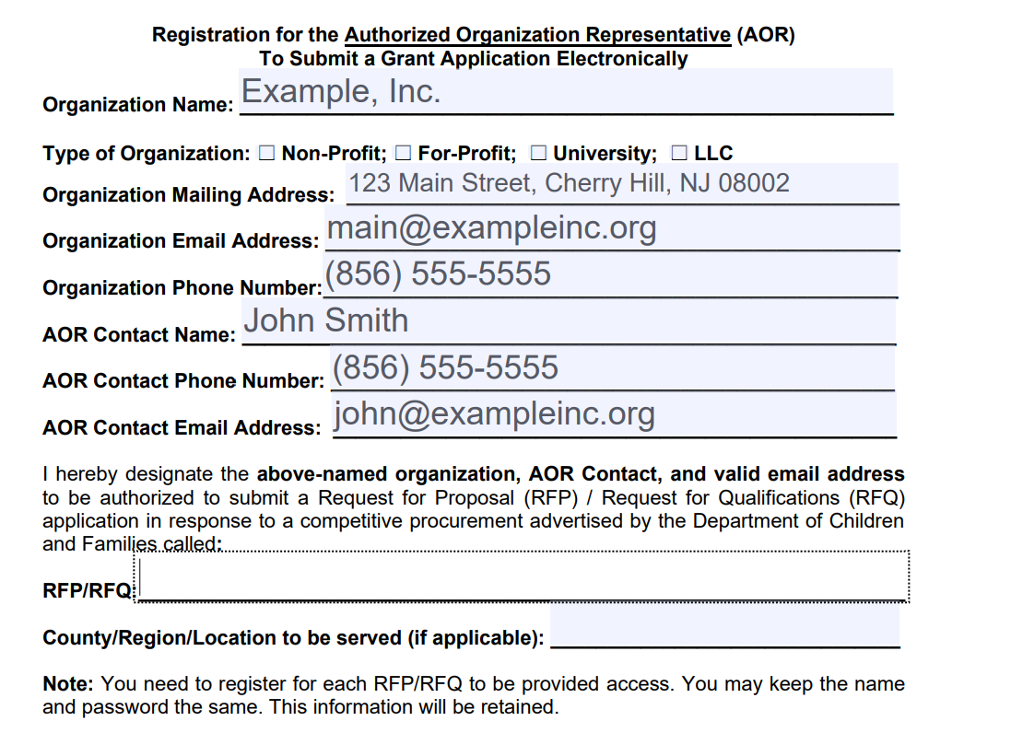
Organizing Your Application
Submit a complete AOR form to DCF.ASKRFP@dcf.nj.gov
Ensure the form is completely filled and signed.
ENTER RFP/RFQ NAME HERE
Notes:
GIA

Slide 18
Organizing Your Application
Applications must be submitted as three separate PDFs.
Providers will be given access and instructions to a secure FTP site to upload.
Refer to RFQ Pages 24-28
Notes:
GIA

Slide 19
Organizing Your Application
PDF 1: Section II – Required Performance and Staffing Deliverables
Complete and sign Signature Statement of Acceptance (Found in RFQ p.23-24)
Only required to submit this signature page (not the whole RFQ)
Your signature certifies that you have read, understood, accepted and, if awarded a contract, will comply with all the deliverables, terms and conditions included in the RFQ.
Notes:
GIA

Slide 20
Organizing Your Application
PDF 2: Section III - Documents Requested to be Submitted with This Response
Subsection A. Organizational Documents Prerequisite to a DCF Contract Award Requested to be Submitted with the Response
There are 25 documents that should be combined into this second PDF. Please complete and, if applicable, sign and date each document.
If any document is not applicable to your agency, please submit a brief statement of non-applicability.

Slide 21
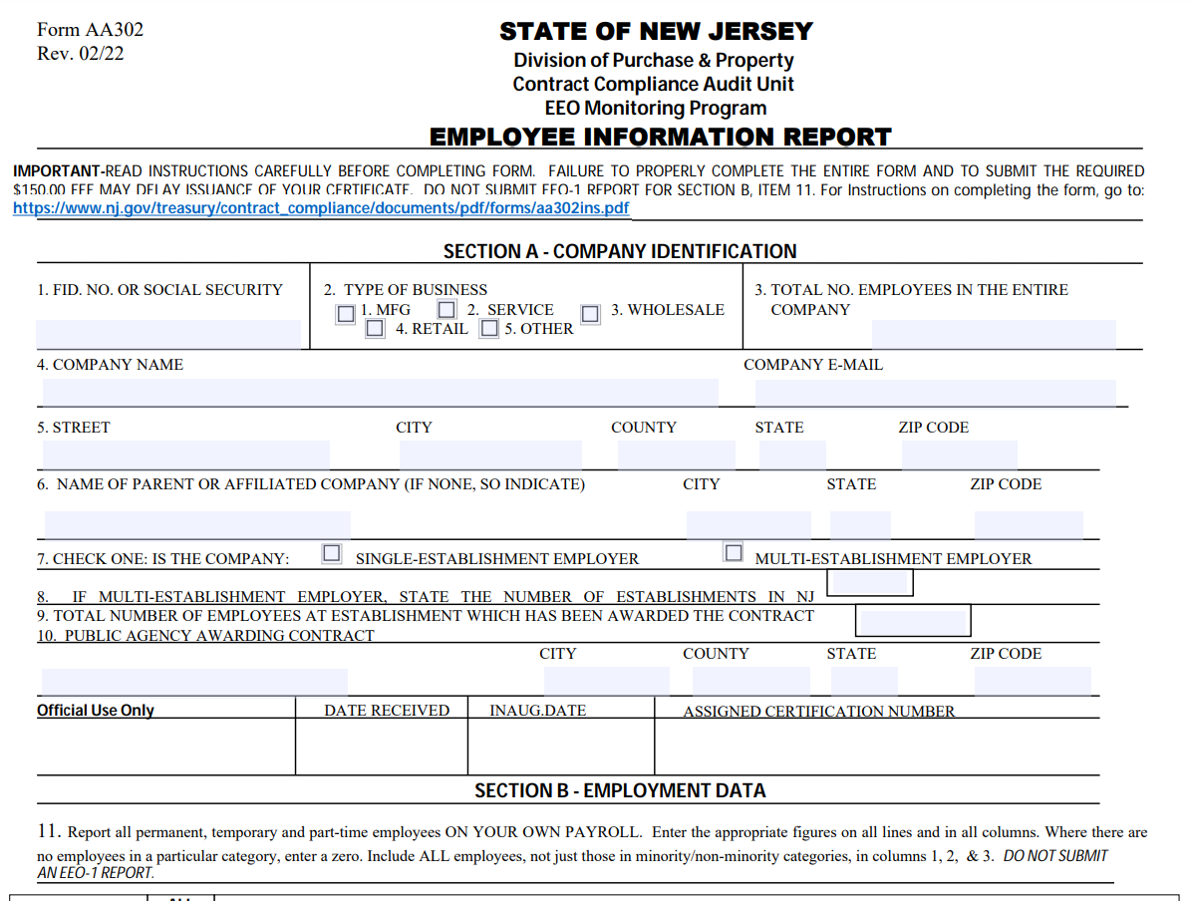
PDF 2 Common Mistakes
2. Affirmative Action Certificate
If you are a startup, you can submit the completed AA302 (left) and the receipt of payment from the Treasury ($150.00).

Slide 22
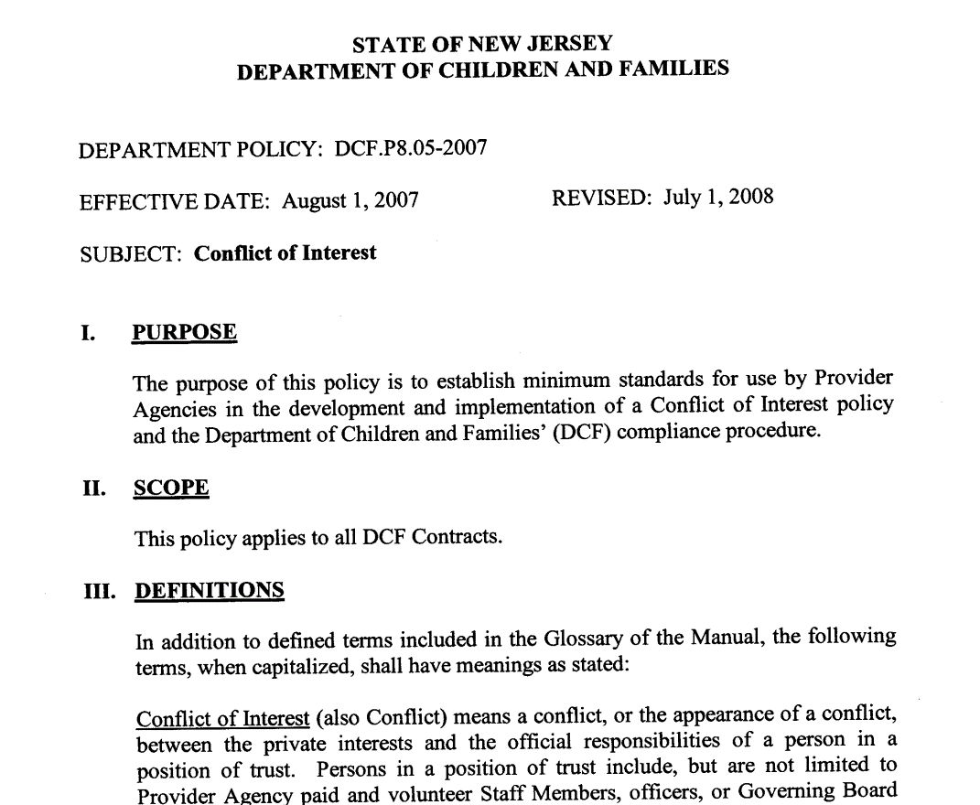
PDF 2 Common Mistakes
8. Your Organization’s Conflict of Interest Policy
Do not submit the DCF Conflict of Interest Policy.

Slide 23
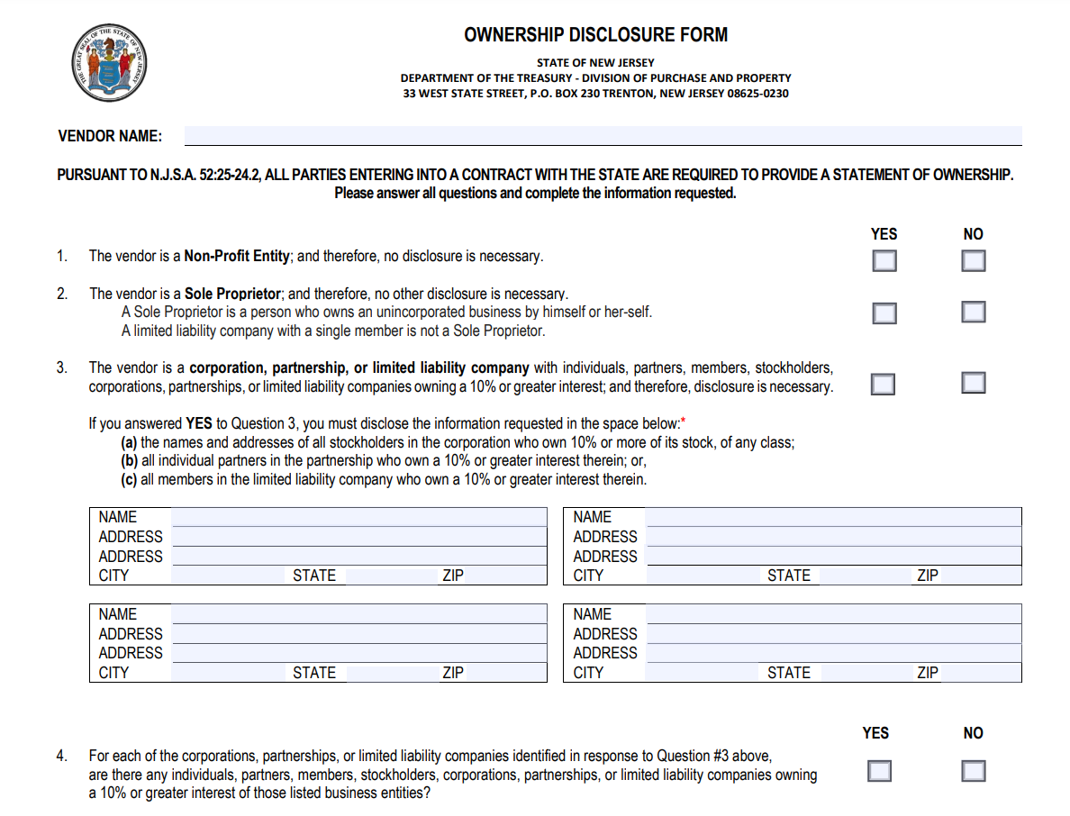
PDF 2 Common Mistakes
13. Ownership Disclosure Form
You must submit this with your response, or it will not be considered.
Read each statement carefully.
YOUR AGENCY NAME HERE

Slide 24
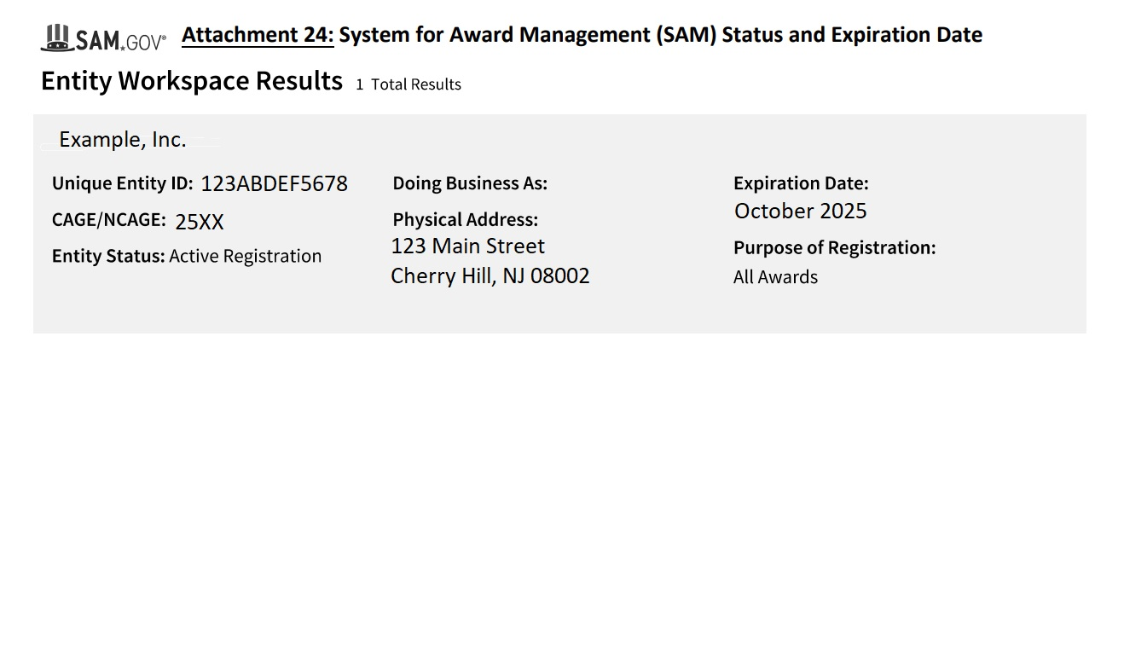
PDF 2 Common Mistakes
16. System of Award Management (SAM)
Submit a printout showing your UEID, Active Status, and Expiration Date.

Slide 25
Organizing Your Application
PDF 3: Section III – Documents Requested to Submitted with This Response
Subsection B. Additional Documents Requested to be Submitted in Support of This Response
There are 2 documents that should be combined into this third PDF:
An Implementation Plan
1 to 3 Letter(s) of Support
Notes:
1) An Implementation Plan for the program that includes a detailed timeline for implementing the proposed services, or some other detailed weekly description of your action steps in preparing to provide the services and to become fully operational.
2) 1 to 3 letters of support from community organizations with which you already partner. Letters from any New Jersey State employees are prohibited. Template/duplicate letters of support are not acceptable. Please include telephone numbers and e-mail for all references so they may be contacted directly.

Slide 26
Questions & Answers
Respondents may not contact the Department directly, in person, or by telephone, concerning this RFP. Questions may be sent in advance of the response deadline via email to DCF.ASKRFP@dcf.nj.gov
Technical inquiries about forms, documents, and format may be requested at any time prior to the response deadline, but questions about the content of the response must be submitted by 12 PM on November 8, 2024.
Responses to content questions will be posted to the Department website at DCF | Requests for Proposals, Qualifications/or Information and Funding Opportunities (nj.gov)
Notes:
Example of a Technical Inquiry:
Do I have to submit the SLD, Individual Provider Agreement, and the State Entity agreement all together? (No. Only one.)
What if I don’t have a SAM? (Please apply for one at the Sam.gov website. It’s free)

Slide 27
Questions
Notes:
This concludes our presentation. At this time, we will answer some previously submitted question and take any questions you may have.
Q. Within this RFQ there is a section on Policy & Procedures that references "Crisis Management: Prevention, Recognition, and Intervention". I am inquiring to whether Ukeru is an acceptable form of Crisis Management that can be utilized for Prevention, Recognition, and Intervention.
Ukeru®, the first national crisis intervention program to offer an alternative to restraint and seclusion as accepted behavioral management tools. https://www.ukerusystems.com/ We are exploring Ukeru and other Crisis Management methodologies to train agency staff in, so I wanted to confirm that this was an acceptable form of behavior management for IIH Behavior services.
A.
Q. Is this new contract for existing Providers who have already obtained an IIH-B contract with DCF/CSOC? Is this new contract different from the existing IIH-B contract?
A. This is an RFQ for new IIH-B providers. Existing IIH-B providers contracted with DCF-Children’s System of Care do not need to apply.
Q. Would we have to apply for another Medicaid provider ID number on the NJMMIS website and use a different NPI for the IIH-ABA services since we already use a different NPI and Medicaid ID for the IIC/BA services we already provide. If so, should we be selecting the DDD or ABA Treatment Providers or ABA Treatment Providers Addendum.
A.
The previously submitted Q&A will be posted on the DCF RFQ webpage after this presentation.
If you have any additional questions after the presentation, please email DCF.ASKRFP@dcf.nj.gov.
Thank you!

