Slide 1
Green Purchasing and Waste Impacts and Innovations
Kevin Lyons, Ph.D.
Associate Professor
Rutgers Business School
Supply Chain Management Department

Slide 2
Kevin Lyons, Ph.D.
Rutgers – 31 Years (Faculty-CPO)
St. Peter’s Medical Center – 2 Years
U.S. Air Force – 6 years
Ph.D. Supply Chain Management and Environmental Management
Areas of Research/Work:
Procurement – Supply Chain Management
Supplier Diversity
Economic Development – Social Impact – Social Determinants of Health (Newark 2020)
Complex Decision Analysis
Manufacturing
Supply Chain Workforce Development
Environmental Sustainability
Mandela Washington Fellowship
Sub-Saharan Africa Agriculture and Entrepreneurship
Current Board Membership:
Newark Equitable Growth Advisory Commission
Rutgers Climate Neutrality and Resilience Task Force
Rutgers Institute for Corporate Social Innovation
Rutgers Global Health Institute (Core Faculty Member)
Rutgers Center for African Studies
Rutgers Office for the Promotion of Women in Science, Engineering & Mathematics (WiSEM)
Rutgers Earth, Ocean and Atmospheric Science Institute
Rutgers EOHSI Division of Global Environmental Health
Member:
Institute for Supply Management (ISM)
Chartered Institute of Procurement and Supply (CIPS)
Current Significant Research Project:
Newark 2020-Buy Local (Researcher, Board Member)
Newark Anchor Collaborative (Steering Committee Member, Researcher)
NJEDA (NJMEP Grant) NJ Manufacturing Research (NJMEP Board of Trustees)
Center of Accelerated Real Time Analytics an NSF Industry/University Cooperative
Research Center (Researcher)
Rutgers Energy Institute (Associate Director and Researcher)
Rutgers EcoComplex (Associate Director and Researcher)
Rutgers Edison Papers (Board Member and Researcher)
Rutgers CAIT (Researcher)
Rutgers SEBS (Researcher)

Slide 3
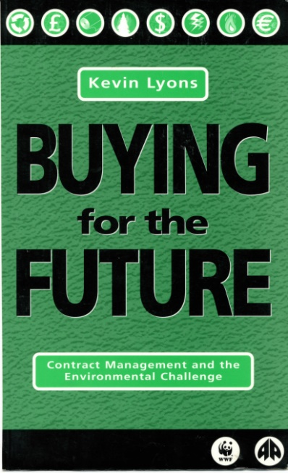
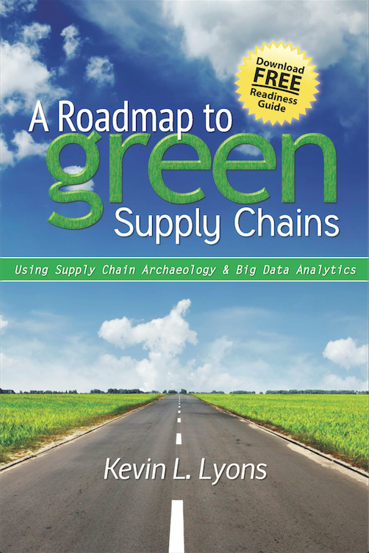
Overview
Background
Business Case for GP
Green Purchasing Defined
Research – Supply Chain Sustainability
Rutgers GP
Project Work

Slide 4
What is a “Green” Supply Chain?
Integrating environment thinking into supply chain management, including
Product design
Material sourcing and selection
Manufacturing processes
Delivery of the final product to the consumers
End-of-life management of the product after its useful life.
- Executive Order 13101, Greening the Government Through Waste Prevention, Recycling, and Federal Acquisition, September 16, 1998

Slide 5
Why consider the environment?
Supply Chain Management with a ‘DfE’ mindset can:
Reduce energy and water consumption (which can reduce costs)
Improve resource use efficiency
Reduce waste (which can reduce waste disposal costs)
Reduce environmental health impacts of goods and services.
Potential post-consumer feedstock
Potential Benefits:
Improves Agility
Increases Adaptability
Promotes Alignment
Bring Value

Slide 6
Rutgers University Product Climate/Waste Impact Research
Measuring carbon emissions at every step of the supply
chain could lead to valuable energy and cost saving
opportunities (for the General Public, Rutgers, and our
Manufacturers). “Carbon Footprinting” is a way to
measure the impact human activities have on the
environment, in terms of the amount of greenhouse
gases produced, measured in units of carbon dioxide.
Rutgers Carbon/Waste Reduction Label Concept:
The Rutgers Carbon Reduction Label would show the total
Greenhouse gas emissions/waste from every stage of the
product's lifecycle, including production, transportation,
preparation, use and disposal.

Slide 7
Product Climate/Waste Life Cycle
Research and Product Development (Including Market Analysis Research)
Raw Material
Manufacturing
Packaging
Sales, Distribution and Transportation
Consumer Use
Final Disposition (or ReUse)

Slide 8
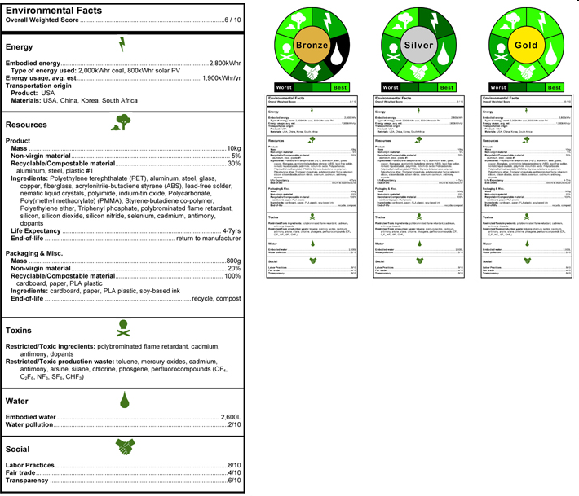
Green Product Labeling: News Flash!
Wal-Mart: Will Be Requiring Life-Cycle Analysis Eco-labeling on ALL Products (~2015)
Notes:
8
WalMart recently announced that it is creating its own sustainability label. Now that’s what I call mainstream…here is an example of what an environmental life cycle label might look like.
Life Cycle analysis labels are (LCA’s) are currently a developing science that could one day look like food nutrition labels with all kinds of useful information.

Slide 9
Pollution (@ All Phases)
Vendor/Supplier Management Research:
Vendor Selection (3PL Logistics Providers)
Vendor Competition (Game Theory)
Selection Criteria Development
Sustainable Supply Chain Performance and Benchmarking
Scale Research on GSCM (What makes up GSCM)
Cleaner Production Research:
Environmental Management Systems (ISO 14000) and Source Reduction
Selection of Environmentally Conscious Business Practices/Technology
Substitution Policies
Environmental Performance Measurement Systems/Benchmarking
Performance of Environmental/Risk Management Policies
Environmental Process and Technology Selection and Performance (Re's/Energy Technology)
Barriers to Environmentally Conscious Manufacturing
Activity Based Environmental and Cost Management Systems
Energy
Energy
Energy
Energy Related Research:
Real Options for Project Selection in GHG Trading Scheme
Energy Production Efficiencies
Selection of Renewable Energy Products
Pollution
Pollution
Distribution and Logistics Research:
Organizational Learning and Environmental Logistics Planning
E-Logistics and the Natural Environment
Closed-Loop Manufacturing,
Demanufacturing,
Source Reduction
Design/Marketing Research:
Green Consumers
Process Selection
Design Selection (LEED)
Disposal
External
Transportation
Internal Transportation, Materials Movement
Location Analysis,
Inventory Management,
Warehousing
Transportation
Packaging
Raw and Virgin Material
Selection
Inventory Management
Vendors
Fabrication
New Components and Parts
Storage
Storage
Distribution, Forward Logistics
USE
Waste Management Research:
Management of Waste and Efficiency - (industry differences and program relationships)
Selection of Waste Management Approaches
Assembly
Reverse Logistics Research:
Demanufacturing Electronics
Reverse Logistics and Sustainability
Reverse Logistics Project Selection
Drivers for Reverse Logistics Adoption
Recycled, Reused Material and Parts
Purchasing, Materials Management, Inbound Logistics
Outbound Logistics
Production
Energy
Product/Process Design
Waste
Waste
Waste
Reusable,
Remanufacturable,
Recyclable Materials and Components
Engineering
Marketing
Reverse Logistics
3rd Party Logistics!
Pollution
Waste

Slide 10
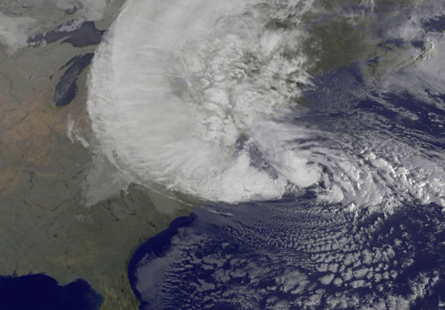
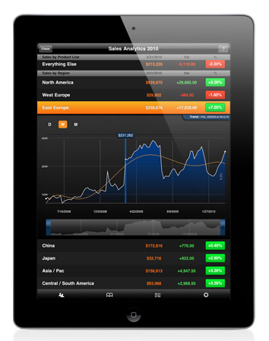
Climate Change…Analyzing Supply Chain Risks and Responses Utilizing Big Data Analytics Impact of “Any” Storm on the Supply Chain
Big Data Analytics Climate Change and Supply Chain/Procurement Impacts
Marine Traffic!
Big Data Enhancements
RiskPulse Link 1
RiskPulse Link 2

Slide 11
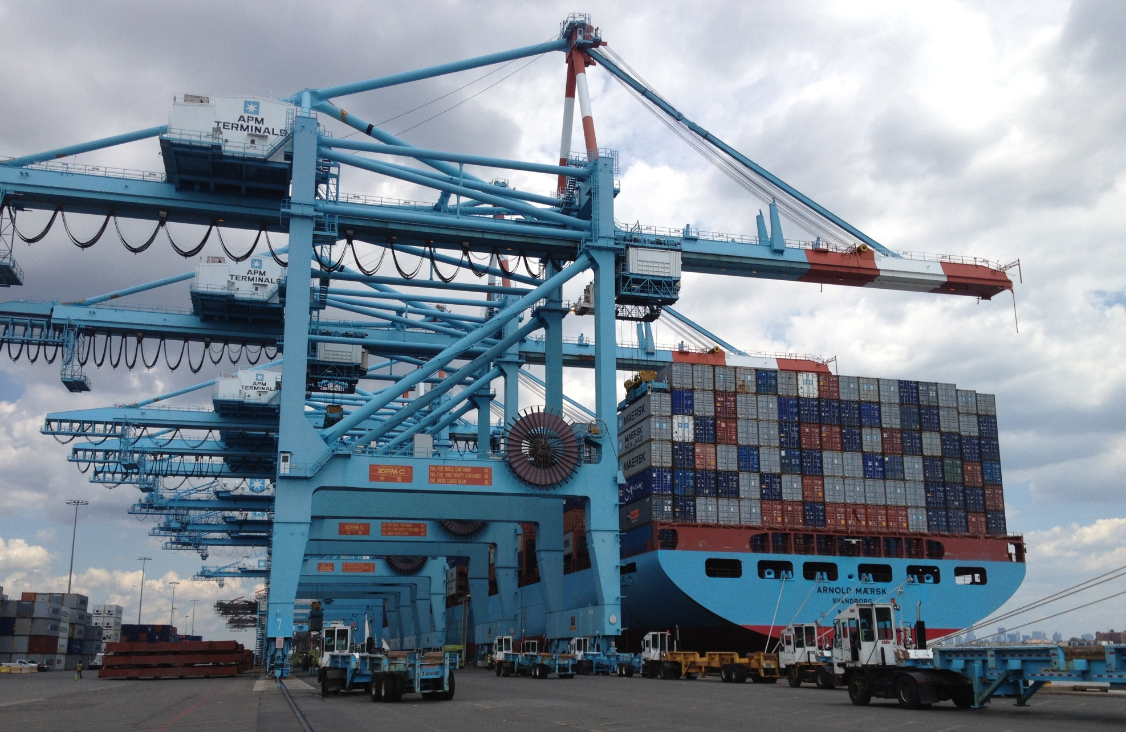
Maersk Line: Environmental, Waste and Operations Perspectives
Rutgers Business School
Supply Chain Environmental Management
Doug Morgante – National Director, State Government Relations
Notes:
Arnold Maersk ( I believe at NWK)

Slide 12
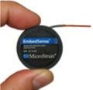
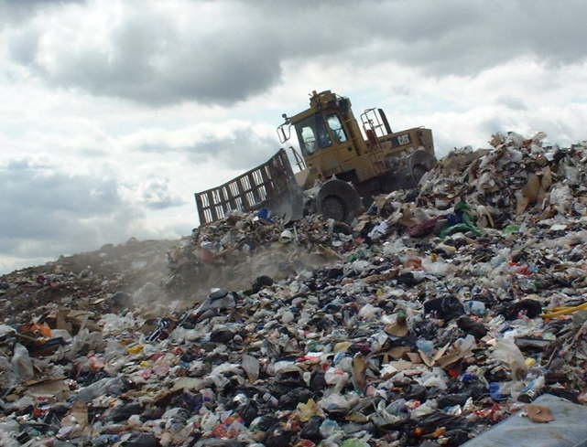
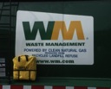
Green Purchasing and Waste Research
Supply Chain Archeology
A Supply Chain Manager’s and Purchaser’s Perspective On:
Understanding the History, Behavior, Movement and Business of Waste;
http://www.sustainabledevelopment.loreal.com/
Methane!
http://www.garnierusa.com/_en/_us/pure_clean/index.aspx#/home
Consumerism, Consumption and the Linking and Integrating of Solid Waste into the Supply Chain Management Process
Kevin Lyons, Ph.D. http://greenpurchasing.rutgers.edu/

Slide 13
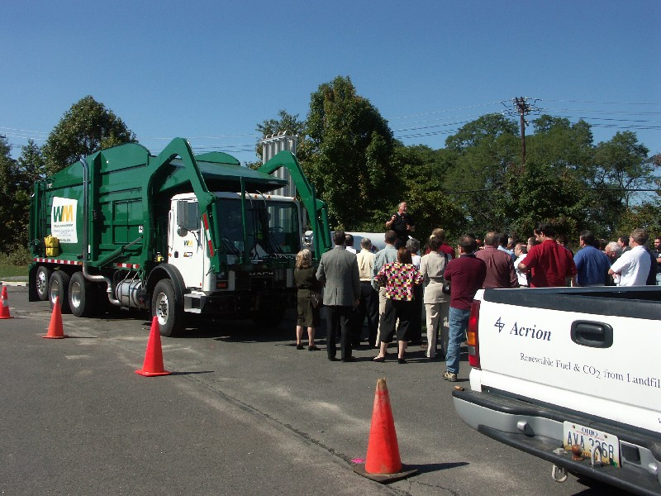
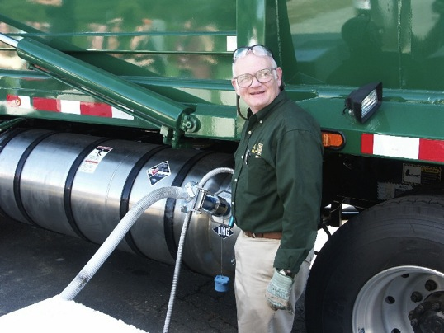
Waste as a Commodity!
Mack Truck/Volvo
Rutgers
Burlco
B2B!
Kevin Lyons, Ph.D. http://purchasing.rutgers.edu/green

Slide 14
UPS-Rutgers BioDiesel Project!

Slide 15
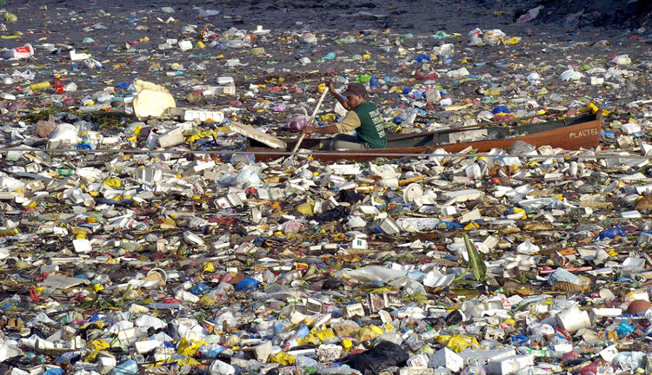
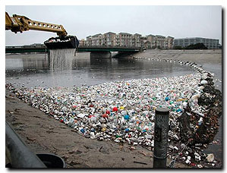
Green Purchasing and Waste Research
Supply Chain Archeology (Water Body)
Designing a Ocean Vessel equipped with plastic polymer extruder to capture, process and extrude lumber … return to port!
Ocean Plastic Reclaim and Processing Vessel
Melt-a-Way Packaging
Linking and Integrating of Plastic Waste into the Supply Chain Management Process

Slide 16
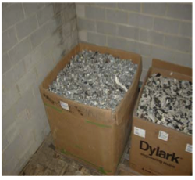
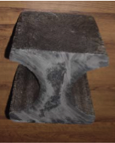
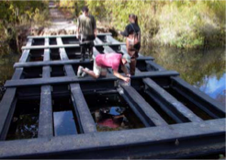
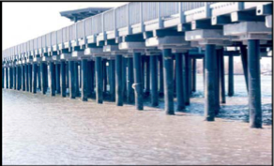
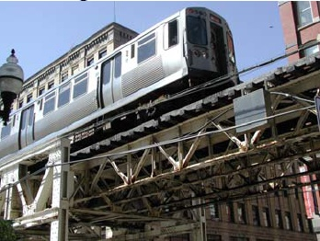
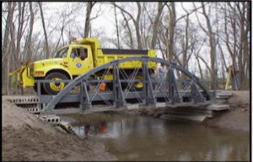
Projects From Recycled Plastic Polymers http://www.youtube.com/watch?v=0hE-ymdio44 http://www.youtube.com/watch?v=3dD3ml_t77Y&feature=related
Corporate Logistics and Packaging
http://vodpod.com/watch/1866241-eco-tech-zero-waste-plastic-bottles
Kevin Lyons, Ph.D. http://purchasing.rutgers.edu/green

Slide 17
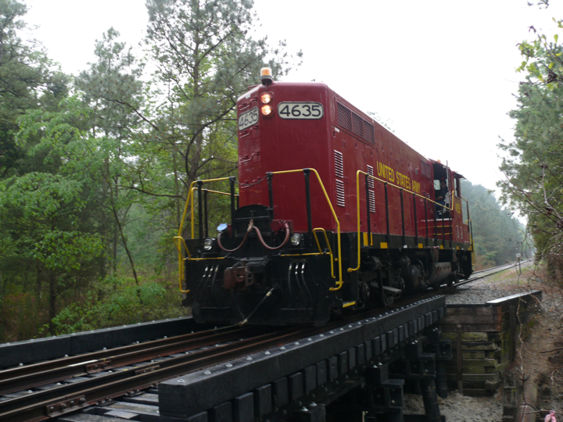
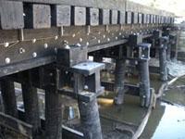
A 120-ton diesel locomotive crosses newly built plastic lumber bridge at the Army's Fort Eustis installation in Newport News, Virginia.

Slide 18
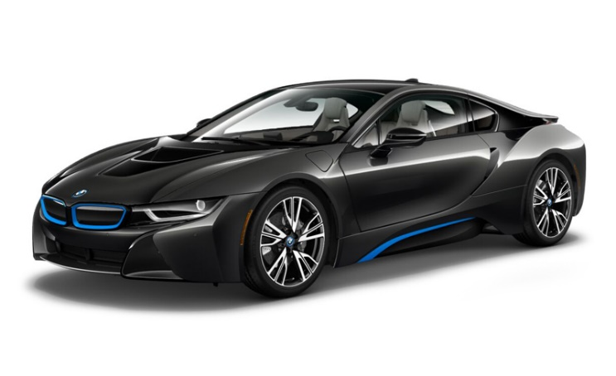
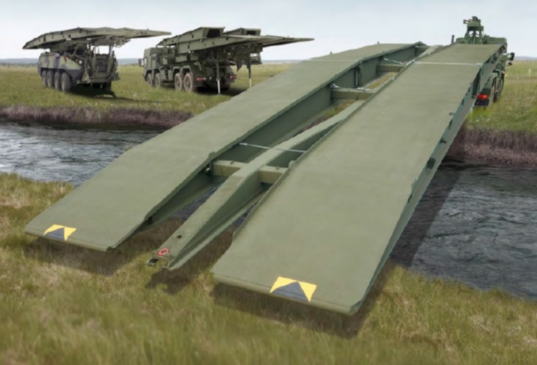
Newark 2020 New Business Opportunity
Graphene-Reinforced Polymer Matrix Composites G-PMCs
Stiffness (GPa)
Graphene | 1000
Steel | 200
Aluminum | 69
Wood | 8-11
PEEK | 3
HDPE | 1
Thomas Nosker
Rutgers University, Materials Science and Engineering Department
Kevin Lyons
Rutgers Business School (SCM/PPCP)

Slide 19
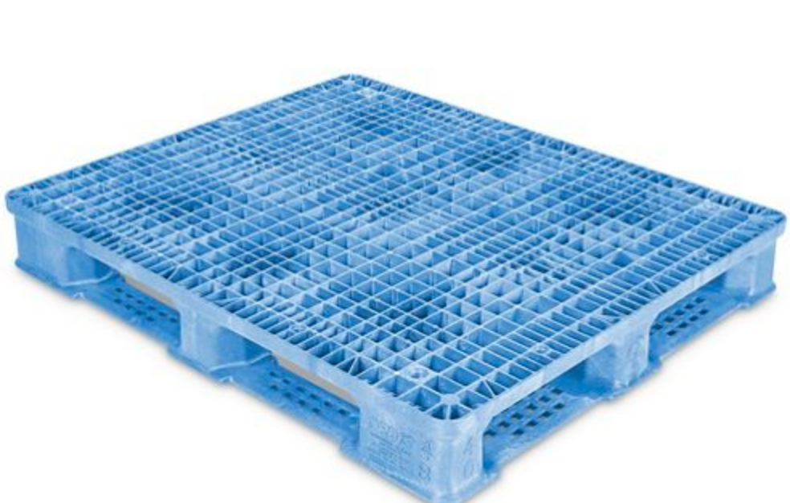
Newark 2020 New Business Opportunity
Graphene-Reinforced Polymer Matrix Composites G-PMCs
Lighter, Stronger, Cheaper

Slide 20
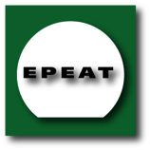
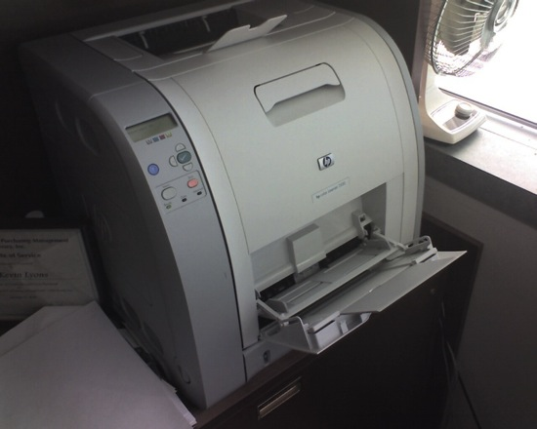
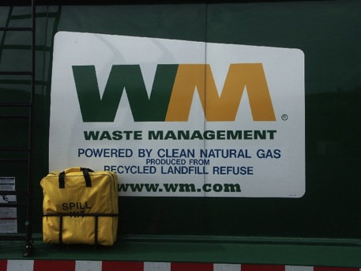
30% Cost 25% Energy 35% Waste Reduction Rutgers PC-Laptop Purchasing Program
Greening RU RFPs & Contracts
EPEAT/ISO 14001
Energy Star
Environmental Mgt Plan (Take-Back and Mfg RU Products)
Corporate Social and Environmental Reporting Criteria
Extended Product Responsibility (Recycling On-Site)
Kevin Lyons, Ph.D. http://purchasing.rutgers.edu/green

Slide 21
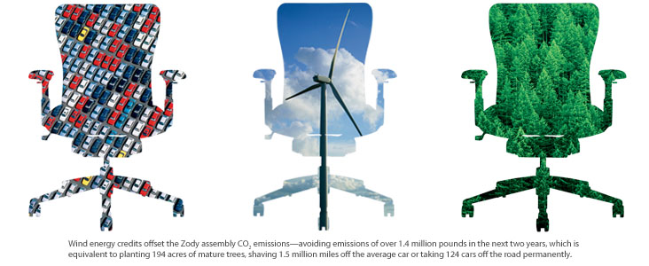
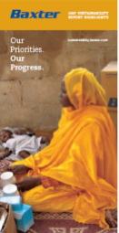
Supplier Responses
Kevin Lyons, Ph.D. http://purchasing.rutgers.edu/green

Slide 22
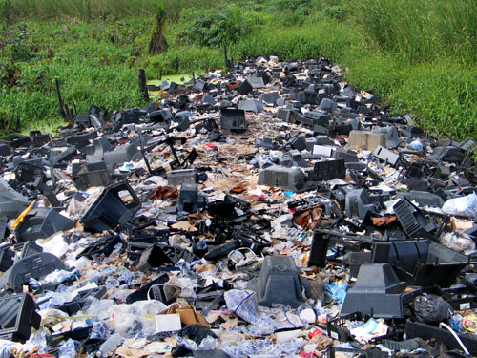
35% Cost and Waste Reduction Rutgers Waste Management Contract
RU RFPs & Contracts
Competitive RFP
Innovative Environmental Mgt Plan
Corporate Social and Environmental Reporting Criteria
Supply Chain Archaeology Research
Optimization Research
Innovation and Collaboration
Kevin Lyons, Ph.D. http://purchasing.rutgers.edu/green

Slide 23
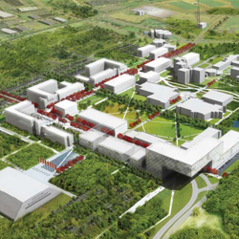
New Sustainable Vision for Livingston Campus
Multiple RFPs
seven-acre solar energy facility that provides about 10 percent of the power needs of the Livingston Campus;
32-acre solar canopy energy system to be completed in summer 2012 that will generate approximately $1.2 million in electricity;
expanded use of geothermal systems for heating and cooling of new academic buildings;
the creation of artificial wetlands and planted areas and installation of a biofiltration system to capture storm-water runoff that would otherwise wash into sewers and the river;
creation of naturalized meadows around campus that save energy, reduce pollution, and cut down on the use of fertilizers;
an improved pedestrian- and bicycle-friendly circulation network;
reduced reliance on automobiles and increased emphasis on mass transportation; and
accessible recreational amenities and green spaces, including integration of the Rutgers Ecological Preserve into the campus design.

Slide 24
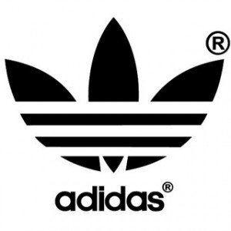
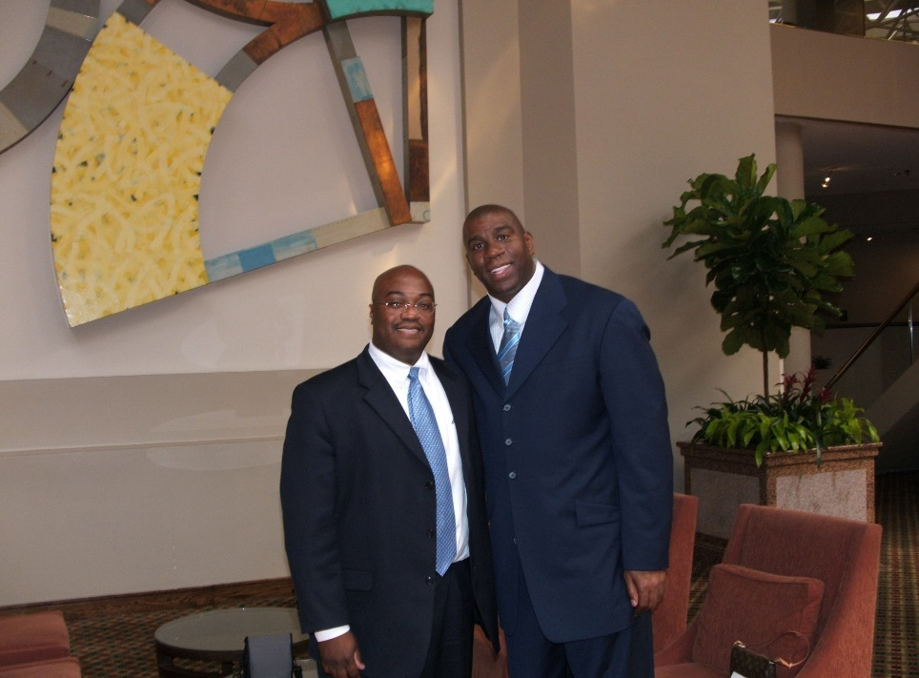
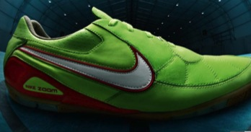
Global Corporate Social and Environmental Reporting = Performance=Customers
Russell Athletics
Nike
Adidas
Puma
Starbucks
Community
Diversity
Environment
Ethics
Financial Responsibility
Human Rights
Safety
Quality
Kevin Lyons, Ph.D. http://greenpurchasing.rutgers.edu/

Slide 25
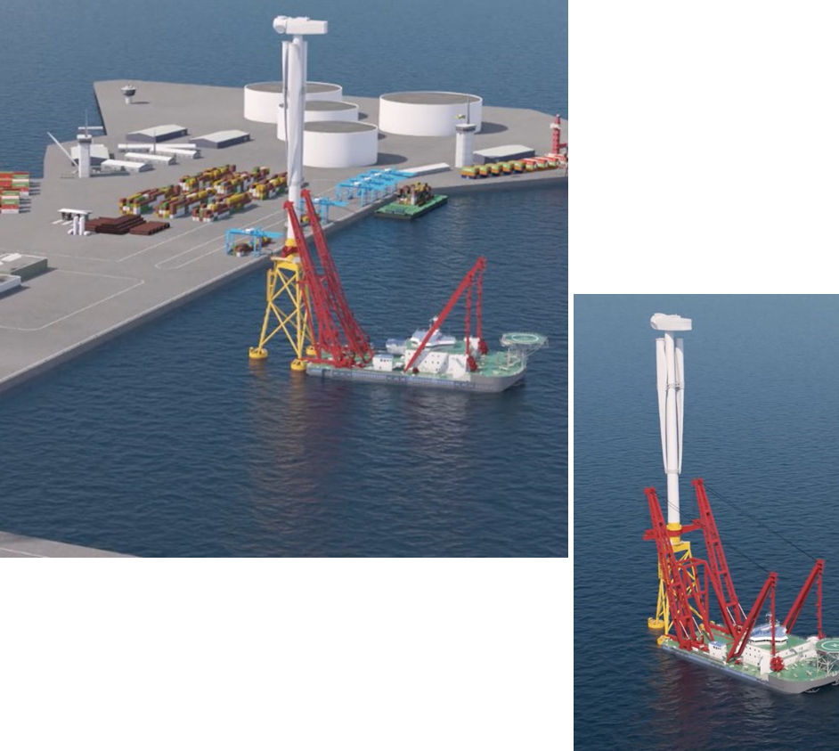
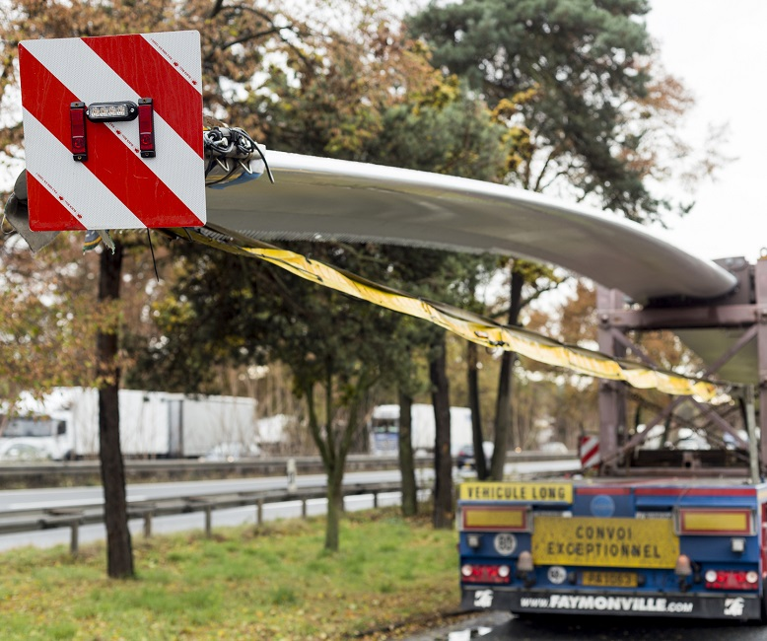
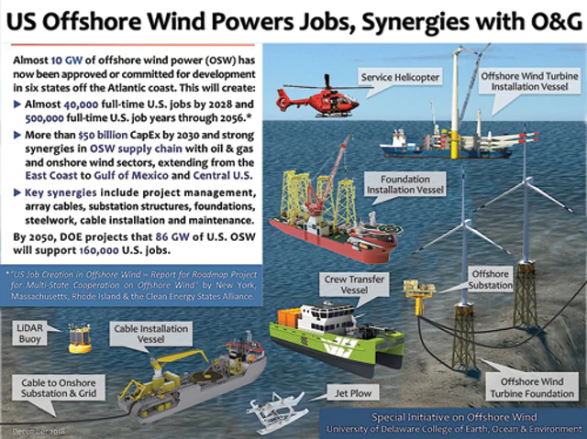
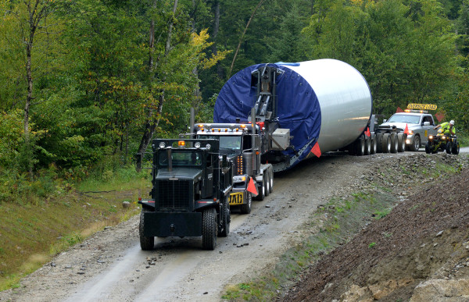
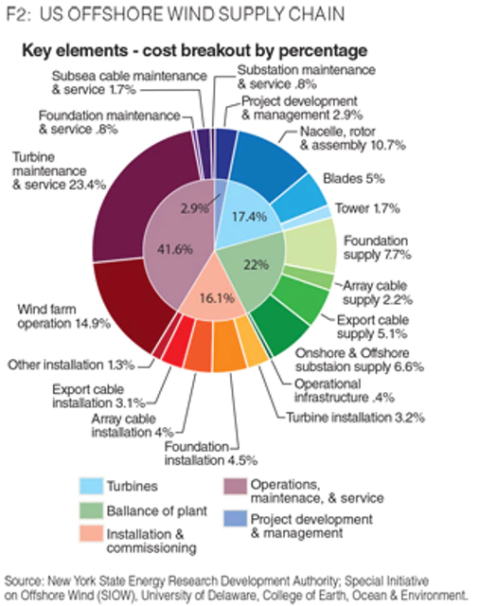
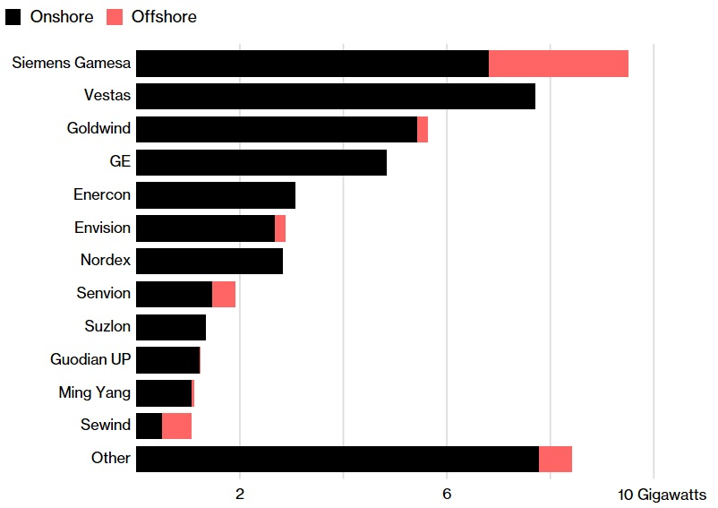
Design and Develop the OSW Supply Chain
Offshore Drilling / Rigs
Subsea
Marine Construction (Ports)
Marine (Boats, Platforms)
Facilities/Warehouse
Shipyards / Fabrication
Blades
Advanced Drivetrains
Infrastructure and Logistics

Slide 26
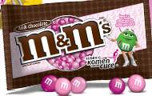
Student Research Projects
UBS
KPMG
Kevin Lyons, Ph.D. http://purchasing.rutgers.edu/green

Slide 27
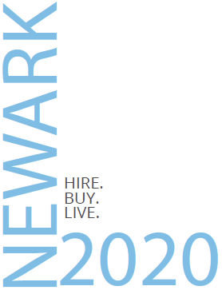
Corporate Social Responsibility Certificate Program Partnering for Greater Impact: Managing Stakeholder & Supply Chain Relationships
Newark 2020 2019/2020
Kevin Lyons, Ph.D.
RBS – Supply Chain Management Department
Public Private Community Partnership Program (Newark Buy Local Researcher)
Buy Local (Economic Development - Social Determinants of Health Nexus)

Slide 28
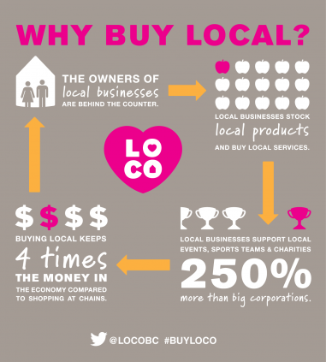
Business and Manufacturing in Newark/Essex (greater Newark region) is highly diversified.
Biotechnology
Fabricated metal products
Apparel & Accessories
Textiles
Food & Beverage
Chemicals
Logistics
Renewable energy
Building materials
Printing & Packaging
Resin & PLASTICS (Recycling)
*Anchor:
30% supply
-----------
70% demand

Slide 29
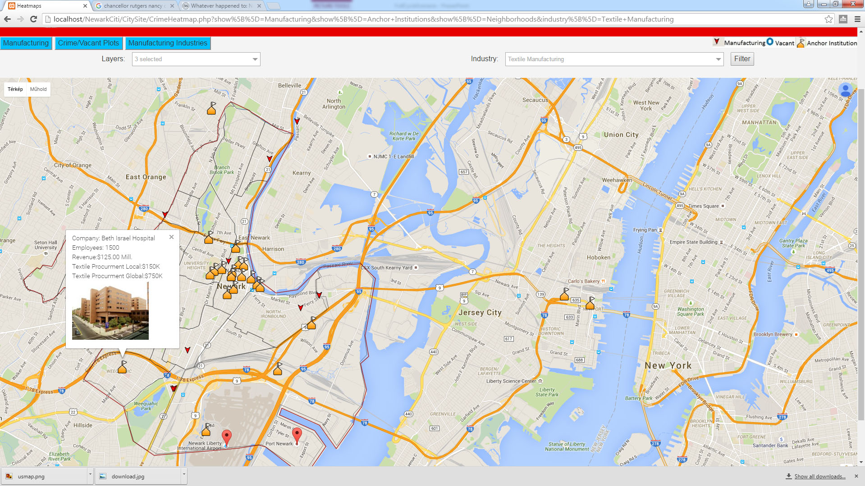
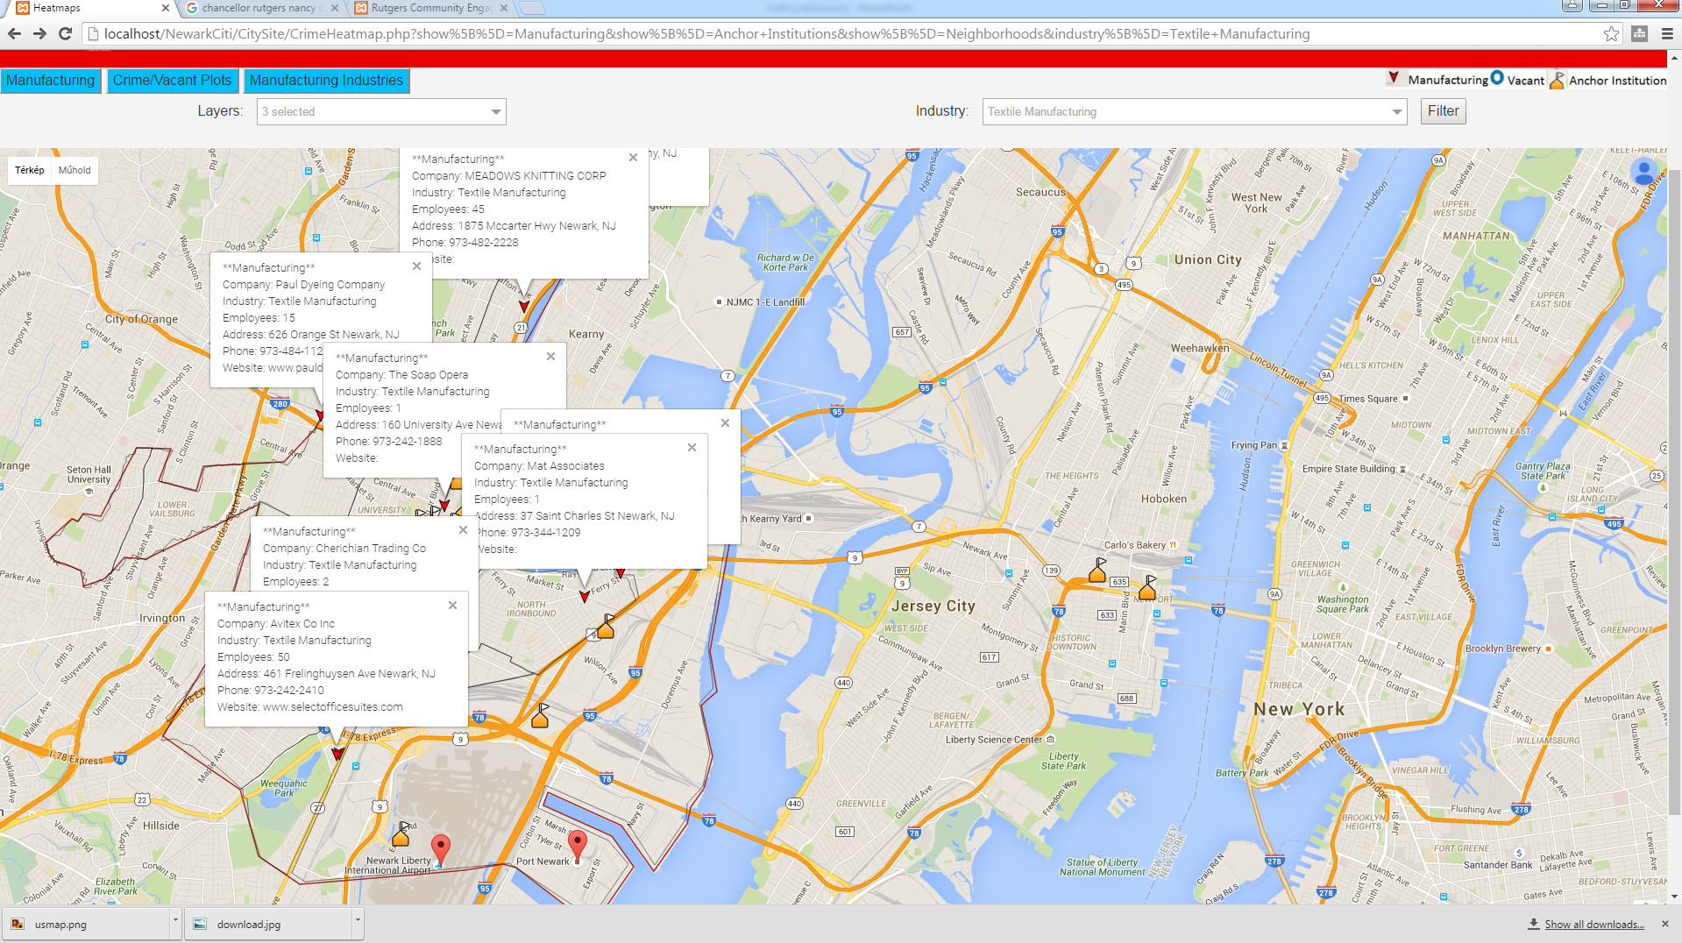
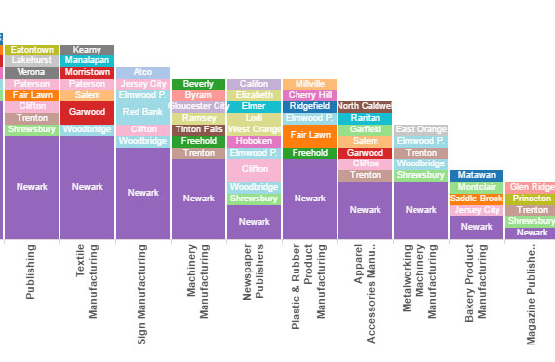
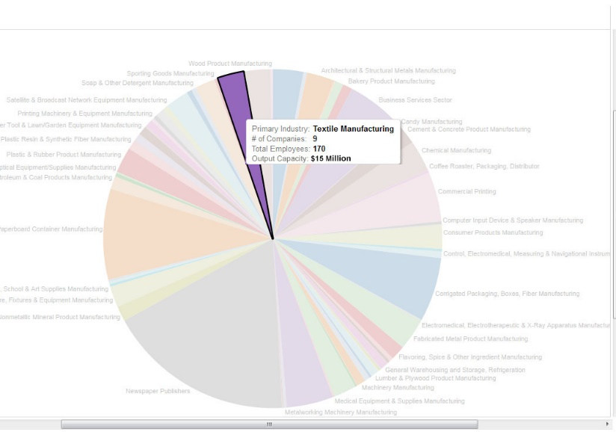
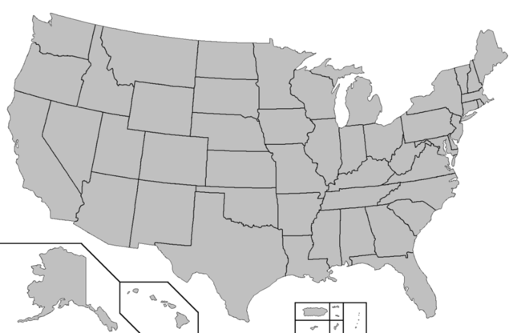
Newark Anchor Procurement Buy Local Program
Our system can show a simulation of a Beth Israel's textile procurement
There are 9 companies in textile manufacturing in Newark employing 170 people with potential capacity of $15 Million
At the same time the Anchor procures $5 Million worth of textile products from outside of the Newark area
Using the industry filter all companies in textile industry can be visualized on the map
Our analytics shows that Newark’s Textile industry is very significant compared to the neighboring cities
Textile Procurement Local: $150K
TAnchorTotal Procurement: $5Mill.
If Beth Israel procured $150K worth of textile products from 2 local manufacturers
Data & Analytics Infrastructure Newark Industrial Solution Center

Slide 30
Identify Product, Follow Product Through Supply Chain; Making Value Chains Sustainable
Main Challenge: To increase efficiencies throughout the supply chain while building better B2B relationships.
Competencies Needed: Expertise in techniques such as carbon management and life cycle assessment. The ability to redesign operations to use less energy and water, produce fewer emissions, and generate less waste. The capacity to ensure that suppliers and retailers make their operations eco-friendly.
Innovation Opportunities: Developing sustainable sources of raw materials and components. Increasing the use of clean energy sources such as wind and solar power. Finding innovative uses for returned products.
Kevin Lyons, Ph.D. http://greenpurchasing.rutgers.edu/

