Slide 1
Workshop for NJ DEP on the Hazardous Waste Generator Improvements Rule
US EPA
Office of Resource Conservation and Recovery
May 18, 2017

Slide 2
Module 1: Goals and Background of the Generator Improvements Rule
Contents of Module 1
Purpose of this Training
Background
History of the Rule
Generator Universe
Goals of the Final Rule
Reorganization of the Generator Regulations

Slide 3
Purpose of this Training
Spread awareness of this new rule to the states and regulated community
Describe and explain in more detail the rule’s provisions and how this rule may potentially affect generators and states implementing the rule
Obtain feedback and answer questions from participants about the rule and how it might work
Discuss what types of training and outreach materials would be most useful for EPA to develop to assist in implementing this rule

Slide 4
Background
What is the Resource Conservation and Recovery Act (RCRA)?
RCRA was enacted by Congress in 1976 and regulates the management of solid waste (e.g., garbage), hazardous waste, and underground storage tanks holding petroleum or certain other chemicals.
RCRA Program Goals
To protect human health and the environment from the potential hazards of waste disposal.
To conserve energy and natural resources.
To reduce the amount of waste generated.
  Statutory Authority for Generator Improvements Rule: Sections 2002, 3001, 3002, 3003, 3004, 3007, 3010 of the Solid Waste Disposal Act of 1965, as amended by the Resource Conservation and Recovery Act of 1976, as amended by the Hazardous and Solid Waste Amendments of 1984, 42 U.S.C. 6921, 6922, 6923, 6924.

Slide 5
Background
Waste Programs
WASTES
Municipal Solid Wastes
Industrial
Solid Wastes
Hazardous Wastes

Slide 6
Background
Hazardous Waste Regulatory Program
Definition of Solid
Waste
Definition of
Hazardous Waste
Waste
Generation
Waste
Management
Implementation

Slide 7
Background
Waste Generation
Different levels of regulation for facilities that generate different volumes of hazardous waste on a monthly basis
  Three categories of Generators:
    Very small quantity generators (VSQGs) – renamed in this rule (previously called “conditionally exempt small quantity generators (CESQGs)”)
    Small quantity generators (SQGs)
    Large quantity generators (LQGs)

Slide 8
Background
To determine your generator category, count all waste generated in a calendar month:
Key: 55 Gallon Drum = 440 lbs. = 200 Kg.
Conditionally Exempt
Small Quantity Generator
(CESQG)
Small Quantity
Generator (SQG)
Large Quantity
Generator (LQG)
Very Small Quantity Generator (VSQG)
½ Drum or
27 Gal. Or
220 lbs. Or
100 Kg
½ to 5 Drums or
27-275 Gal. Or
220-2200 lbs. Or
100-1000 Kg.
>5 Drums or
>275 Gal. or
>2200 lbs. or
>1000 Kg.

Slide 9
History of the Rule
Most of the generator rules were promulgated in the 1980s and are over thirty years old
In 2004, ORCR conducted an evaluation of the generator program to improve program effectiveness, reduce compliance costs, and foster an improved relationship with states and the regulated community, published an ANPRM (April 22, 2004, 69 FR 21800) and held four public meetings soliciting comment on the effectiveness of the generator program
  Comments included: simplify the regulations, eliminate cross-referencing, codify guidance, provide flexibility for episodic generators, require re-notification for SQGs, provide one-pager basic information for contingency planning, clarify ambiguities, clarify concepts in satellite accumulation among others

Slide 10
History of the Rule
After 2004, ORCR took a number of non-regulatory actions to respond to public comments and to improve the generator program:
  Improved user-friendliness of generator website
  Developed online guide to the “Hazardous Waste Generator Regulations”
  Released “Closed Container” guidance
  Issued memo for turnover of hazardous waste in tanks
  Issued a Technical Corrections (direct final) rule
We also engaged in further program evaluation
  2012 Hazardous Waste Determination Program Evaluation
  2014 Retail NODA OMB Retrospective Review
However, EPA determined that many of the existing issues with the generator regulations could only be resolved through rulemaking.
The September 25, 2015, proposed rule grew out of all of these evaluations and presented more than 60 proposed changes to the generator regulations, plus technical corrections, for public comment.

Slide 11
History of the Rule
Over 230 public comments were received on the Generator Improvements Proposed Rule
The commenters included:
  25 states
  10 local governments
  More than 50 from academic institutions
  About a dozen from the energy sector/utilities
  More than 25 from industry and related trade associations
  10 from the waste management industry
Comments covered all aspects of the rule, particularly waste determinations and marking and labeling; independent requirements and conditions for exclusion; VSQG consolidation; and episodic generation

Slide 12
Generator Universe
Generator Category | Number of Facilities | Total Hazardous Waste Generated (tons) | Percent of Total Hazardous Waste Generated
VSQGs | 353,400–591,800 | 46,000–148,000 | <1%
SQGs | 49,900–64,300 | 66,000–141,000 | <1%
LQGs | 20,800 | 35.2 million | 99%
Total | 424,100–676,900 | 35.3–35.4 million | 100%
* Numbers of VSQGs and SQGs are estimates based on Biennial Report (BR) and limited state data. LQG number is derived from 2013 BR.

Slide 13
Goals of the Final Rule
The 2016 HW Generator Improvements Final Rule —
Over 60 changes to Hazardous Waste Generator Program that:
  Reorganizes the regulations to make them more user-friendly and thus enables improved compliance by the regulated community
  Provides greater flexibility for hazardous waste generators to manage waste in a cost-effective manner through episodic generation and VSQG-LQG consolidation provisions
  Strengthens environmental protection by addressing identified gaps in the regulations
  Clarifies certain components of the hazardous waste generator program to address ambiguities and foster improved compliance

Slide 14
Reorganization of Generator Regulations
Provision | Existing Citation | Proposed Citation
Generator Category Determination | § 261.5(c)−(e) | § 262.13
VSQG Provisions | § 261.5(a), (b), (f)−(g) | § 262.14
Satellite Accumulation Area Provisions | § 262.34(c) | § 262.15
SQG Provisions | § 262.34(d)−(f) | § 262.16
LQG Provisions | § 262.34(a), (b), (g)−(i), (m) | § 262.17
As part of this reorganization, the Agency made conforming changes to citations that reference § 261.5 and § 262.34
Note: See Crosswalk Handout for more details about reorganization.

Slide 15
Definitions of Terms
§ 260.10
Acute hazardous waste/ Non-acute hazardous waste
Central accumulation area
Large quantity Generator/ Small quantity generator/ Very small quantity generator
§ 262.1
Conditions for exemption/ Independent requirement

Slide 16
Module 2: Independent Requirements for All Generators
Contents of Module 2
Hazardous Waste Determinations
Counting and HW Generator Categories
Mixtures
Marking and Labeling

Slide 17
Hazardous Waste Determinations

Slide 18
Hazardous Waste Determinations: What Changes and Why?
What changes?
Clarifies and emphasizes that waste determinations must be accurate!
Confirms when a generator’s hazardous waste determination must be made
Elaborates on how to determine if a solid waste is either a listed and/or characteristic hazardous waste
Reiterates what waste determination records must be kept
Requires SQGs and LQGs to identify and mark RCRA waste codes on containers prior to sending hazardous waste off-site per § 262.32

Slide 19
Why did we make these changes?
To improve generator compliance and therefore program success
From different Agency analyses, generators consistently fail to make an accurate hazardous waste determination, leading to the mismanagement of hazardous waste
  Non-compliance rates range from 10 to 30 percent
  Reasons vary from not understanding RCRA to not even being aware of RCRA
Making an accurate hazardous waste determination reduces Domino Effect
  Hazardous waste most likely will be managed safely from “cradle to grave”

Slide 20
Where It All Begins
Statutory Definition of Solid Waste - 42 U.S.C. § 6903(27)
“The term “solid waste” means any garbage, refuse, sludge from a waste treatment plant, water supply treatment plant, or air pollution control facility and other discarded material, including solid, liquid, semisolid, or contained gaseous material resulting from industrial, commercial, mining, and agricultural operations, and from community activities, but does not include…”

Slide 21
Putting Things in Context
Chemicals
used to produce product
Production
Process
Product
Inputs to
Production
Yes
In-House?
Recycle?
Residuals
derived-from
Production Process
Yes
No
No
Transferred
Off-site
Solid and Potentially Hazardous Waste
Notes:
While the operations/processes at some facilities can be very complex, there still has to be a step-by-step process that involves: inputs to the production process, the steps in a production process, and the outputs of that production process, and whether a secondary material that is either recycled or discarded.
Understanding these relationships is the challenge of the HW identification process. Review the slide.
You’ll notice that we pose the questions of whether the secondary material is recycled or not, and if so, how. We’ve briefly discussed recycling of a secondary material to help you better understand whether or not the material being recycled would be subject to RCRA regulation.
A separate training module will deal with the Definition of Solid Waste regulatory program in more detail.

Slide 22
Making a Hazardous Waste Determination
§ 262.11(a) The hazardous waste determination for each solid waste must be made
  at the point of waste generation,
  before any dilution, mixing, or other alteration of the waste occurs,
  and at any time in the course of its management that it has, or may have, changed its properties as a result of exposure to the environment or other factors that may change the properties of the waste such that the RCRA classification of the waste may change.

Slide 23
§ 262.11(a) Hazardous Waste Determination
The hazardous waste determination for each solid waste must be made at the point of waste generation,…
RCRA Statute is clear:
The term ‘‘hazardous waste generation’’ means the act or process of producing hazardous waste. See Solid Waste Disposal Act, Section 1004.
Why at the point of waste generation?
  To Ensure:
    Proper waste identification
    Proper handling and management from “cradle to grave”
    Compliance with LDRs

Slide 24
§ 262.11(a) Hazardous Waste Determination
The hazardous waste determination for each solid waste must be made at the point of waste generation, before any dilution, mixing, or other alteration of the waste occurs, …
  We added this language to make it clear that you need to characterize your waste before dilution, mixing or alteration
  Alteration of waste: May change waste properties and subsequent handling
    Example: Letting volatile organic solvents volatilize from an uncovered container

Slide 25
§ 262.11(a) Hazardous Waste Determination
The hazardous waste determination for each solid waste must be made at the point of waste generation, before any dilution, mixing, or other alteration of the waste occurs, and at any time in the course of its management that it has, or may have, changed its properties as a result of exposure to the environment or other factors that may change the properties of the waste such that the RCRA classification of the waste may change.
Why inclusion of this statement?

Slide 26
At any time in the course of its management…
Generators need to understand the chemistry and chemical properties of their waste.
A SW determined to be non-hazardous at the point of generation can in some cases become hazardous over time while being managed on-site through exposure to the environment (reactive wastes), settling (bi-phasic solvent waste), etc.
Note: Opposite also true; hazardous wastes can become non-hazardous so long as not diluted or non-LDR compliance treatment
Does this mean you need to monitor your waste 24/7?

Slide 27
Point of generation (continued)
In rare cases, identifying the point of generation may not always be straightforward
  Example: Utility boiler cleanouts
Generators may also take conservative approach and manage non-HW as HW if they so choose
  Wait until test results come back
  Play it safe

Slide 28
§262.11(b) A person must determine whether the solid waste is excluded from regulation under 40 CFR 261.4
40 CFR 261.4 has three sections that exclude or exempt certain secondary materials from being either a SW or HW*
  40 CFR 261.4(a) identifies secondary materials that are not SW
  40 CFR 261.4(b) identifies SW but are not HW
  40 CFR 261.4(c) identifies HW which are exempted from certain regulations until the HW exits the unit(s) in which it was generated
  *This language has not changed

Slide 29
§262.11(c) Have You Generated a Listed Hazardous Waste?
If the waste is not excluded under 40 CFR 261.4, the person must then use knowledge of the waste to determine if the waste meets any of the listing descriptions under subpart D of 40 CFR part 261.
Acceptable generator knowledge that may be used in making an accurate determination as to whether the waste is listed may include:
- waste origin
- composition
- the process producing the waste
- feedstock, and
- other reliable and relevant information; e.g., the regulatory language of the listing, the regulatory intent of the original listing (as evidenced by Federal Register notices, background documents, etc.)
If the waste is listed, the person may file a delisting petition under 40 CFR 260.20 and 260.22 to demonstrate to the Administrator that the waste from this particular site or operation is not a hazardous waste.

Slide 30
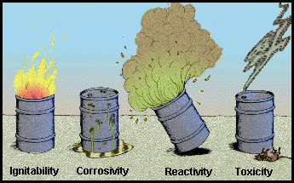
§262.11(d): Have you generated a characteristically hazardous waste?
There are four hazardous waste characteristics

Slide 31
§262.11(d): Have you generated a characteristically hazardous waste?
The person then must also determine whether the waste exhibits one or more hazardous characteristics as identified in subpart C of 40 CFR part 261 by following the procedures in paragraph (d)(1) or (2) of this section or a combination of both.
(1) The person must apply knowledge of the hazard characteristic of the waste in light of the materials or the processes used to generate the waste.

Slide 32
Have you generated a characteristically hazardous waste (cont.)?
Acceptable knowledge may include:
  process knowledge (e.g., information about chemical feedstocks and other inputs to the production process);
  knowledge of products, by-products, and intermediates produced by the manufacturing process;
  chemical or physical characterization of wastes;
  information on the chemical and physical properties of the chemicals used or produced by the process or otherwise contained in the waste;
  testing that illustrates the properties of the waste; or other reliable and relevant information about the properties of the waste or its constituents.
  A test other than a test method set forth in subpart C of 40 CFR part 261, or an equivalent test method approved by the Administrator under 40 CFR 260.21, may be used as part of a person’s knowledge to determine whether a solid waste exhibits a characteristic of hazardous waste.

Slide 33
Have you generated a characteristically hazardous waste (cont.)?
(2) When available knowledge is inadequate to make an accurate determination, the person must test the waste according to the applicable methods set forth in subpart C of 40 CFR part 261 or according to an equivalent method approved by the Administrator under 40 CFR 260.21 and in accordance with the following:
(i) Persons testing their waste must obtain a representative sample of the waste for the testing, as defined at 40 CFR 260.10.
(ii) Where a test method is specified in subpart C of 40 CFR part 261, the results of the regulatory test, when properly performed, are definitive for determining the regulatory status of the waste.

Slide 34
What Counts as “Knowledge” for Making a Determination?
The results of non-regulatory tests may also provide relevant information:
  Total concentration in the waste may show the waste is not TC hazardous
  Tests that evaluate properties similar to the characteristic may be relevant, even if they do not define the waste as hazardous by themselves.
  SW-846 includes several guidance tests, including method 1040 for oxidizers, and others.

Slide 35
Remember: A Hazardous Characteristic Determination Must be Made Regardless of Listing Status
Even if the waste is listed, the generator must still determine if the waste exhibits a characteristic in order to comply with land disposal restrictions (LDR) in 40 CFR Part 268
  Need the full list of applicable waste codes to identify all necessary treatment
Note: Under 268.9(b), the treatment standard for the listed code will operate in lieu of the standard for the characteristic (if the constituent causing the characteristic has a treatment standard via the listed code).

Slide 36
§262.11(e): You’ve determined you have generated a hazardous waste
(e) If the waste is determined to be hazardous, the generator must refer to parts 261, 264, 265, 266, 267, 268, and 273 of this chapter for other possible exclusions or restrictions pertaining to management of the specific waste.*
*This language has not changed

Slide 37
§262.11(f): Recordkeeping*
A small or large quantity generator must maintain records supporting its hazardous waste determinations, including records that identify whether a solid waste is a hazardous waste, as defined by 40 CFR 261.3.
Records must be maintained for at least three years from the date that the waste was last sent to on-site or off-site treatment, storage, or disposal.
The records must include, but are not limited to, the following types of information:
  the results of any tests, sampling, waste analyses, or other determinations made in accordance with this section;
  records documenting the tests, sampling, and analytical methods used to demonstrate the validity and relevance of such tests;
  records consulted in order to determine the process by which the waste was generated, the composition of the waste, and the properties of the waste; and
  records which explain the knowledge basis for the generator’s determination, as described at 40 CFR 262.11(d)(1).
  *Basic recordkeeping requirement copied from existing 262.40

Slide 38
§262.11(g): RCRA Waste Codes
If the waste is determined to be hazardous, small quantity generators and large quantity generators must identify all applicable EPA hazardous waste numbers (EPA hazardous waste codes) in subparts C and D of part 261. Prior to shipping the waste off site, the generator also must mark its containers with all applicable EPA hazardous waste numbers (EPA hazardous waste codes) according to § 262.32.

Slide 39
Comparison of New vs. Old §262.11
New | Old
A person who generates a solid waste, as defined in 40 CFR 261.2, must make an accurate determination as to whether that waste is a hazardous waste | A person who generates a solid waste, as defined in 40 CFR 261.2, must determine if that waste is a hazardous waste using the following method:
(a) The hazardous waste determination for each solid waste must be made at the point of waste generation, before any dilution, mixing, or other alteration of the waste occurs, and at any time in the course of its management…that may change the properties of the waste such that the RCRA classification of the waste may change.
(b) A person must determine whether the solid waste is excluded from regulation under 40 CFR 261.4. | (a) He should first determine if the waste is excluded from regulation under 40 CFR 261.4.
(c) If the waste is not excluded under 40 CFR 261.4, the person must then use knowledge of the waste to determine if the waste meets any of the listing descriptions under subpart D of 40 CFR part 261. | (b) He must then determine if the waste is listed as a hazardous waste in subpart D of 40 CFR part 261.

Slide 40
Comparison of New vs. Old §262.11
NEW | OLD
(c) Continued Acceptable knowledge that may be used in making an accurate determination as to whether the waste is listed may include waste origin, composition, the process producing the waste, feedstock, and other reliable and relevant information. If the waste is listed, the person may file a delisting petition under 40 CFR 260.20 and 260.22 to demonstrate to the Administrator that the waste from this particular site or operation is not a hazardous waste.

Slide 41
Comparison of New vs. Old §262.11 (cont.)
New | Old
(d) The person then must also determine whether the waste exhibits one or more hazardous characteristics as identified in subpart C of 40 CFR part 261 by following the procedures in paragraph (d)(1) or (2) of this section, or a combination of both. (1) The person must apply knowledge of the hazard characteristic of the waste in light of the materials or the processes used to generate the waste. Acceptable knowledge may include………………………………………..; testing that illustrates the properties of the waste; or other reliable and relevant information about the properties of the waste or its constituents. A test other than a test method set forth in subpart C of 40 CFR part 261, or an equivalent test method approved by the Administrator under 40 CFR 260.21, may be used as part of a person’s knowledge to determine whether a solid waste exhibits a characteristic of hazardous waste. However, such tests do not, by themselves, provide definitive results. Persons testing their waste must obtain a representative sample of the waste for the testing, as defined at 40 CFR 260.10. (2) When available knowledge is inadequate to make an accurate determination, the person must test the waste according to the applicable methods set forth in subpart C of 40 CFR part 261 or according to an equivalent method approved by the Administrator under 40 CFR 260.21 | (c) For purposes of compliance with 40 CFR part 268, or if the waste is not listed in subpart D of 40 CFR part 261, the generator must then determine whether the waste is identified in subpart C of 40 CFR part 261 by either: (1) Testing the waste according to the methods set forth in subpart C of 40 CFR part 261, or according to an equivalent method approved by the Administrator under 40 CFR 260.21; or (2) Applying knowledge of the hazard characteristic of the waste in light of the materials or the processes used.

Slide 42
Comparison of New vs. Old §262.11 (cont.)
NEW | OLD
(e) If the waste is determined to be hazardous, the generator must refer to parts 261, 264, 265, 266, 267, 268, and 273 of this chapter for other possible exclusions or restrictions pertaining to management of the specific waste. | (d) If the waste is determined to be hazardous, the generator must refer to parts 261, 264, 265, 266, 267, 268, and 273 of this chapter for possible exclusions or restrictions pertaining to management of the specific waste.
(f) Recordkeeping for small and large quantity generators.
(g) Identifying hazardous waste numbers for small and large quantity generators.

Slide 43
Counting and Hazardous Waste Generator Categories

Slide 44
Determining Generator Category and Hazardous Waste Counting (§ 262.13)
A hazardous waste generator has always had to know what category of generator it is (VSQG, SQG, or LQG).
The regulations did not previously present requirements about determining generator categories in a clear and succinct way.
New § 262.13 clarifies the process for a generator to determine its generator category each calendar month for generators of acute hazardous waste, generators of non-acute hazardous waste, and generators that mix acute and non-acute hazardous wastes.
  "Acute" hazardous waste and "non-acute" hazardous waste
This provision also discusses how mixing of hazardous waste with non-hazardous waste impacts generator category.

Slide 45
Hazardous Waste Counting
Introductory language of § 262.13
  A generator must determine its generator category
  The category is based on the amount of hazardous waste that is generated in a calendar month.
  A generator's category can change from month to month.
  The counting requirements are based on the RCRA statute & are critical to the framework of the generator regs

Slide 46
Hazardous Waste Counting
262.13 (a): Basic procedures for determining generator category if generating only non-acute hazardous waste or only acute hazardous waste
262.13(b): Procedures for determining generator category if generating a combination of acute and non-acute hazardous waste
262.13 (c) & (d): Those materials that do not need to be included when counting hazardous waste
  Existing provisions being moved from 261.5 (c) & (d) + hazardous waste from an episodic event
262.13 (e): Statement that a generator uses its determined category to identify which regulations apply

Slide 47
Generating Acute and Non-Acute Hazardous Waste in the Same Month
Before the final generator rule, EPA had issued contradictory guidance documents on whether a generator could be one category of generator for acute waste and another for non-acute waste in the same month.
The Generator final rule provisions make it clear that acute hazardous waste, non-acute hazardous waste, and residues of clean ups of hazardous waste are all considered in making a generator's monthly category determination.

Slide 48
Hazardous Waste Counting
TABLE 1 to § 262.13—Generator Categories Based on Quantity of Waste Generated In A Calendar Month
Quantity of acute hazardous waste generated in a calendar month | Quantity of non-acute hazardous waste generated in a calendar month | Quantity of residues from a cleanup of acute hazardous waste generated in a calendar month | Generator Category
> 1 kg | Any amount | Any amount | Large quantity generator
Any amount | ≥ 1,000 kg | Any amount | Large quantity generator
Any amount | Any amount | > 100 kg | Large quantity generator
≤ 1 kg | > 100 kg and < 1,000 kg | ≤ 100 kg | Small quantity generator
≤ 1 kg | ≤ 100 kg | ≤ 100 kg | Very small quantity generator

Slide 49
Comparison of Old § 261.5 vs. New § 262.13
New | Old
262.13 Introductory Text A generator must determine its generator category. A generator's category is based on the amount of hazardous waste generated each month and may change from month to month. This section sets forth procedures to determine whether a generator is a very small quantity generator, a small quantity generator, or a large quantity generator for a particular month, as defined in § 260.10 of this chapter.
262.13 (a) & (b) (a) Generators of either acute hazardous waste or non-acute hazardous waste. A generator who either generates acute hazardous waste or non-acute hazardous waste in a calendar month shall determine its generator category for that month by doing the following: (1) Counting the total amount of hazardous waste generated in the calendar month; (2) Subtracting from the total any amounts of waste exempt from counting as described in paragraphs (c) and (d) of this section; and (3) Determining the resulting generator category for the hazardous waste generated using Table 1 of this section. (b) Generators of both acute and non-acute hazardous wastes. A generator who generates both acute hazardous waste and non-acute hazardous waste in the same calendar month shall determine its generator category for that month by doing the following: (1) Counting separately the total amount of acute hazardous waste and the total amount of non-acute hazardous waste generated in the calendar month; (2) Subtracting from each total any amounts of waste exempt from counting as described in paragraphs (c) and (d) of this section; (3) Determining separately the resulting generator categories for the quantities of acute and non-acute hazardous waste generated using Table 1 of this section; and (4) Comparing the resulting generator categories from paragraph (b)(3) of this section and applying the more stringent generator category to the accumulation and management of both non-acute hazardous waste and acute hazardous waste generated for that month.

Slide 50
Comparison of Old § 261.5 vs. New § 262.13
New | Old
262.13 (c) (c) When making the monthly quantity-based determinations required by this part, the generator must include all hazardous waste that it generates, except hazardous waste that: (1) Is exempt from regulation under 40 CFR 261.4(c) through (f), 261.6( a)(3), 261.7( a)(1), or 261.8; (2) Is managed immediately upon generation only in on-site elementary neutralization units, wastewater treatment units, or totally enclosed treatment facilities as defined in 40 CFR 260.10; (3) Is recycled, without prior storage or accumulation, only in an on-site process subject to regulation under 40 CFR 261.6(c)(2); (4) Is used oil managed under the requirements of 40 CFR 261.6(a)(4) and 40 CFR part 279; (5) Is spent lead-acid batteries managed under the requirements of 40 CFR part 266 subpart G; (6) Is universal waste managed under 40 CFR 261.9 and 40 CFR part 273; (7) Is a hazardous waste that is an unused commercial chemical product (listed in 40 CFR part 261 subpart D or exhibiting one or more characteristics in 40 CFR part 261 subpart C) that is generated solely as a result of a laboratory clean-out conducted at an eligible academic entity pursuant to § 262.213. For purposes of this provision, the term eligible academic entity shall have the meaning as defined in § 262.200; or (8) Is managed as part of an episodic event in compliance with the conditions of subpart L of this part. | 261.5(c) (c) When making the quantity determinations of this part and 40 CFR part 262, the generator must include all hazardous waste that it generates, except hazardous waste that: (1) Is exempt from regulation under 40 CFR 261.4(c) through (f), 261.6(a)(3), 261.7(a)(1), or 261.8; or (2) Is managed immediately upon generation only in on-site elementary neutralization units, wastewater treatment units, or totally enclosed treatment facilities as defined in 40 CFR 260.10; or (3) Is recycled, without prior storage or accumulation, only in an on-site process subject to regulation under 40 CFR 261.6(c)(2); or (4) Is used oil managed under the requirements of 40 CFR 261.6(a)(4) and 40 CFR part 279; or (5) Is spent lead-acid batteries managed under the requirements of 40 CFR part 266, subpart G; or (6) Is universal waste managed under 40 CFR 261.9 and 40 CFR part 273; (7) Is a hazardous waste that is an unused commercial chemical product (listed in 40 CFR part 261, subpart D or exhibiting one or more characteristics in 40 CFR part 261, subpart C) that is generated solely as a result of a laboratory clean-out conducted at an eligible academic entity pursuant to §262.213. For purposes of this provision, the term eligible academic entity shall have the meaning as defined in §262.200 of Part 262.

Slide 51
Comparison of Old § 261.5 vs. New § 262.13
New | Old
262.13(d) (d) In determining the quantity of hazardous waste generated in a calendar month, a generator need not include: (1) Hazardous waste when it is removed from on-site accumulation, so long as the hazardous waste was previously counted once; (2) Hazardous waste generated by on-site treatment (including reclamation) of the generator's hazardous waste, so long as the hazardous waste that is treated was previously counted once; and (3) Hazardous waste spent materials that are generated, reclaimed, and subsequently reused on site, so long as such spent materials have been previously counted once. | 261.5(d) (d) In determining the quantity of hazardous waste generated, a generator need not include: (1) Hazardous waste when it is removed from on-site storage; or (2) Hazardous waste produced by on-site treatment (including reclamation) of his hazardous waste, so long as the hazardous waste that is treated was counted once; or (3) Spent materials that are generated, reclaimed, and subsequently reused on-site, so long as such spent materials have been counted once.
262.13 (e) (e) Based on the generator category as determined under this section, the generator must meet the applicable independent requirements listed in § 262.10. A generator's category also determines which of the provisions of §§ 262.14, 262.15, 262.16 or 262.17 must be met to obtain an exemption from the storage facility permit, interim status, and operating requirements when accumulating hazardous waste.

Slide 52
Mixing

Slide 53
Mixing Solid Waste with Hazardous Waste – What changed?
Reorganization distinguished VSQGs mixing requirements from those for SQGs and LQGs
Clarified VSQGs mixing solid waste with hazardous wastes and generating characteristic waste must count that waste towards their generator category for that month
Made clear that SQGs and LQGs mixing solid wastes with hazardous wastes are subject to certain restrictions and requirements.

Slide 54
VSQGs Mixing Solid Waste with Hazardous Waste
Clarifies that a VSQG mixing hazardous waste with solid waste can remain subject to VSQG requirements (i.e., § 262.14), even though the mixture may exceed the VSQG quantity limits (either 100 kg per month generated or 1,000 kg accumulated on site at any one time) as long as the mixture does not exhibits one or more of the characteristics of a hazardous waste.
If the resultant mixture does exhibit a hazardous waste characteristic, the mixture is a newly generated hazardous waste.
    The VSQG must add the quantity from the resulting mixture with any other regulated hazardous waste generated in the calendar month and determine whether the total quantity generated exceeds the generator calendar month quantity identified in the definition of generator categories found in 40 CFR 260.10.
(262.13(f)(1))

Slide 55
SQGs and LQGs Mixing Solid Waste with Hazardous Waste
Mixtures of hazardous waste and solid waste at SQGs and LQGs are subject to:
    The mixture rule in §§ 261.3(a)(2)(iv), (b)(2) and (3), and (g)(2)(i);
    The prohibition of dilution rule at § 268.3(a);
    The land disposal restriction requirements of § 268.40 if a characteristic hazardous waste is mixed with a solid waste so that it no longer exhibits the hazardous characteristic; and
    The hazardous waste determination requirement at § 262.11.

Slide 56
Mixing vs Dilution
Generators can’t dilute their hazardous wastes unless it provides a useful and effective contribution (i.e., possess a unique property to remove the hazardous characteristic from the hazardous waste instead of merely diluting it).
The prohibition of dilution rule at § 268.3(a) reads:
  Except as provided in paragraph (b) of this section, no generator, transporter, handler, or owner or operator of a treatment, storage, or disposal facility shall in any way dilute a restricted waste or the residual from treatment of a restricted waste as a substitute for adequate treatment to achieve compliance with subpart D of this part, to circumvent the effective date of a prohibition in subpart C of this part, to otherwise avoid a prohibition in subpart C of this part, or to circumvent a land disposal prohibition imposed by RCRA section 3004.

Slide 57
Mixing: Why the Changes?
Changes are designed to clarify the language that was found at §§ 261.5(h) and (i) which addressed the mixing of hazardous waste and nonhazardous waste by a VSQG and the implications to its generator category if the mixture is determined to be a hazardous waste.
The language specifically addressed how the regulations apply when VSQG hazardous waste is mixed with nonhazardous solid waste and the resulting combination exceeds the VSQG quantity limits.
The previous §§ 261.5(h) and (i) had not evolved with the changes to the SQG and CESQG regulations through the years, leaving ambiguities.
The previous regulations also did not specifically discuss SQGs and LQGs mixing solid wastes with hazardous wastes in the generator provisions.

Slide 58
Marking and Labeling

Slide 59
Marking and Labeling
Marking and labeling requirements apply throughout the hazardous waste management regulations.
Final Rule: What changed?
Container and tank labels must have the words “Hazardous Waste” and also indicate the hazards of the contents of the containers
Flexibility in how to comply with this new provision; can indicate the hazards of the contents of the container using any of several established methods (e.g., DOT hazard communication, OSHA hazard statement or pictogram, NFPA chemical hazard label, or RCRA characteristic)
For containment buildings, the generator can keep this information in logs or records near the accumulation unit (waste piles, etc.)
Note, the labels are not required to include the identity of the contents of the container (as proposed)

Slide 60
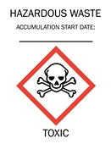
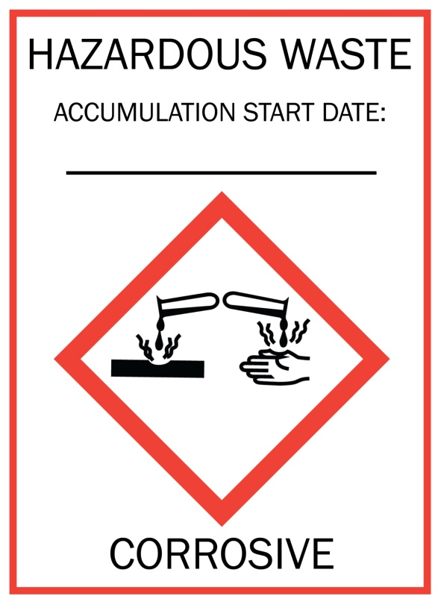
Examples of Labels that indicate the “Hazards”
The applicable hazardous waste characteristic (i.e., ignitable, corrosive, reactive, toxic)

Slide 61
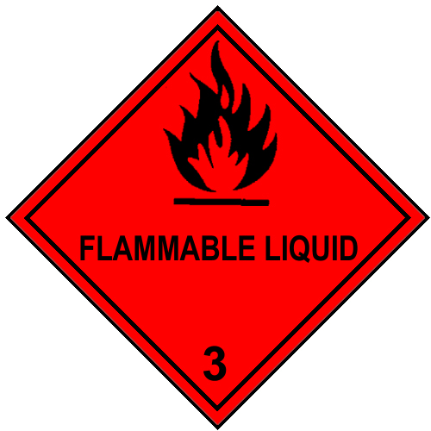
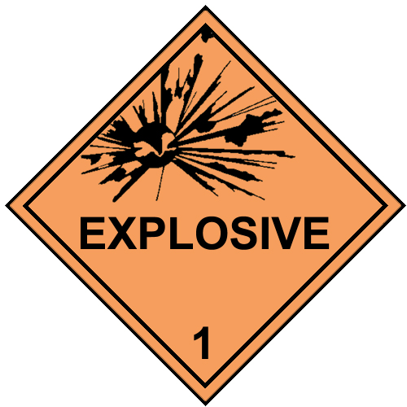
Examples of Labels that indicate the “Hazards”
Hazard communication consistent with DOT (49 CFR part 172 subpart E – labeling or subpart F – placarding)

Slide 62


Examples of Labels that indicate the “Hazards”
Hazard statement or pictogram consistent with OSHA (29 CFR 1910.1200)

Slide 63
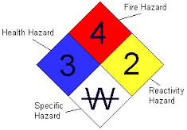
Examples of Labels that indicate the “Hazards”
Chemical hazard label consistent with the National Fire Protection Association code 704

Slide 64
Marking and Labeling
EPA is providing flexibility on how to indicate the hazards of the contents of the containers
Some clarifications:
  Labeling should occur at the initial point of generation
  For containers that have small containers inside (e.g., tubes, vials, etc.), generators can mark the outer/secondary container or attach a tag with the required information
  For containers that are in a container that already has appropriate marking and labeling (e.g., a CCP in its original container with an intact label), the existing marking and labeling is sufficient, provided it indicates the hazards of the chemical

Slide 65
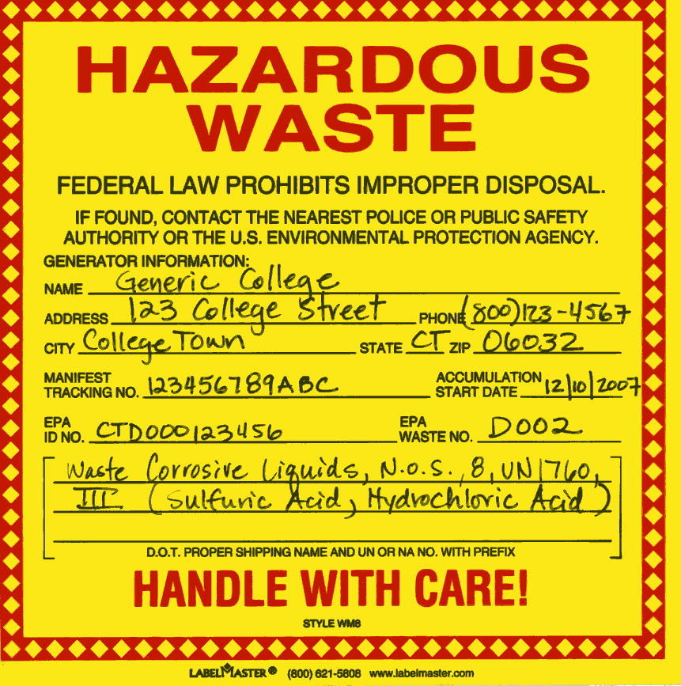
Marking and Labeling
Per §262.32, Generators must add the RCRA waste codes before shipping waste off-site
  This allows receiving TSDFs to know how to treat the wastes to meet land disposal restriction requirements
  Generators must mark their containers with the applicable RCRA waste codes or use a bar-coding system that performs the same function

Slide 66
Marking and Labeling – Why the Changes?
Previous RCRA labeling regulations did not require generators to identify and indicate the hazards of hazardous wastes accumulated in containers, tanks, and containment buildings
  Resulted in a failure to communicate risks associated with wastes being accumulated/stored in different locations
  Can impact workers, waste handlers, emergency responders and visitors
Areas affected include:
  Generator satellite accumulation areas and central accumulation areas
  Transfer facilities consolidating hazardous wastes from different generators
  Generator container and tank storage areas at TSDF

Slide 67
Module 3: Revisions that Apply to Very Small Quantity Generators
Contents of Module 3
VSQGs
Episodic Generation
VSQG Consolidation

Slide 68
Very Small Quantity Generators (VSQG)
Limited Requirements under both the previous regulations and the new final rule
  Same basic requirements but they are now located in § 262.14
The new final rule provides new options for flexibility for VSQGs
  Episodic Generation
  Consolidation at an LQG under the same company

Slide 69

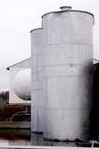
Episodic Generation

Slide 70
Episodic Generation
Current RCRA rules lack flexibility to address an “episodic” change in a generator’s regulatory category:
  Planned event (i.e., periodic maintenance such as tank cleanouts)
  Unplanned event (i.e., production upset conditions, spill, acts of nature)
Generators must comply with more comprehensive set of regulations for short period of time when they are not regular generators of higher levels of hazardous waste.

Slide 71
Episodic Generation
Applicable to VSQGs and SQGs.
New part 262 subpart L allows generators that temporarily change their generator category as a result of an episodic event to operate under streamlined requirements.
All hazardous waste from episodic events must be shipped by hazardous waste transporter with a hazardous waste manifest to a RCRA-designated facility (TSDF or recycler).

Slide 72
Episodic Generation
Where do I find the Episodic Generation Regulations?
§ 262.13(c)(8) states that hazardous waste managed as part of an episodic event does not have to be counted toward a generator's category
Part 262 subpart L (§§ 262.230-262.233) contains the conditions for the episodic generation provision.

Slide 73
Episodic Generation
What is an Episodic Event?
Episodic event means an activity or activities, either planned or unplanned, that does not normally occur during generator operations, resulting in an increase in the generation of hazardous wastes that exceeds the calendar month quantity limits for the generator's usual category.
Planned episodic event means an episodic event that the generator planned and prepared for, including regular maintenance, tank cleanouts, short-term projects, and removal of excess chemical inventory
Unplanned episodic event means an episodic event that the generator did not plan or reasonably did not expect to occur, including production process upsets, product recalls, accidental spills, or “acts of nature,” such as tornado, hurricane, or flood.
(§ 262.231)

Slide 74
Episodic Generation
Events Per Year
One episodic event per year + one opportunity to petition EPA/ authorized state for a second event
A generator can complete multiple projects during the time limit for the episodic event
Petition process allows a total of 1 unplanned and 1 planned event per year
  For example:
    A generator conducts a clean out in the spring and then has an unexpected recall in October
    A generator plans a small episodic project for the fall but a hurricane causes facility damage in July

Slide 75
Episodic Generation
Duration of an Episodic Event
The first day of an episodic event is the first day of generation of waste for the event—for an unplanned event, this is the first day of the storm, spill, other unexpected event
An episodic event can last 60 days
All hazardous waste must be shipped off site by the end of 60 days or that waste counts toward the generator's category and must be managed under the regulations for that category of generator
Time frame should allow waste from unplanned events to be characterized and allow arrangements for disposal to be made
If a generator doesn’t know if the event is going to be episodic, we recommend notification

Slide 76
Episodic Generation
Notification
Both VSQGs and SQGs must notify about episodic events using Site ID from (EPA form 8700-12)
Planned event: notify 30 or more days prior to the episodic event on Site ID form
Unplanned event: notify within 72 hours of the event by phone or email and follow up with Site Id form
Notification elements
A VSQG must get an EPA ID number (automatic upon submitting the Site ID form)
Start and end dates of the episodic event (no more than 60 calendar days)
Reason for the event
Types of hazardous waste
Estimated quantities of hazardous waste
Emergency coordinator contact information

Slide 77
Episodic Generation
Hazardous Waste Accumulation Standards
Necessary to ensure protective management of larger quantities of hazardous waste
  VSQGs
  Marking and labeling:
  "Episodic hazardous waste;"
  An indication of the hazards of the contents; and the date the episodic event began
    For tanks, inventory logs or other records are appropriate, but must be accessible
  Manage the hazardous waste in a manner that minimizes the possibility of an accident or release
    Containers should be in good condition, chemically compatible with contents, and kept closed
      Part 265 subpart I would satisfy this condition
    Tanks must have procedures in place to prevent overflow (e.g., a means to stop inflow such as a waste feed cutoff system or bypass system to a standby tank when hazardous waste is continuously fed into the tank). Tanks must be inspected at least once each operating day.
  Treatment is not allowed by VSQGs (except in an on-site elementary neutralization unit).

Slide 78
Episodic Generation
Hazardous Waste Accumulation Standards
SQGs
  Marking and labeling:
  "Episodic Hazardous Waste;"
  An indication of the hazards of the contents and the date the episodic event began
    For tanks, inventory logs or other records are appropriate, but must be accessible
  All conditions of 262.16 (e.g., container and tank standards, employee training, emergency preparedness and prevention)
  Hazardous wastes on drip pads and in containment buildings cannot be managed under subpart L

Slide 79
Episodic Generation
Recordkeeping
Cradle to grave management of hazardous waste is required
Records must be maintained for 3 years from the completion of each event
Elements
  Beginning and end date of the episodic event
  A description of the episodic event
  Types of hazardous wastes generated
  Quantities of hazardous wastes generated
  How the hazardous waste was ultimately managed and the name of the RCRA-designated facility or facilities that received the hazardous waste
  Name of the hazardous waste transporter(s)
  Approval letter from EPA if a petition was submitted and approved for a second event
Copies of the notification form and the hazardous waste manifest cover most of the elements.

Slide 80
Episodic Generation
Petition for a Second Event
If petition is approved, total of one planned and one unplanned event per calendar year
Petition requirements
  Made in writing
  Include reason for the event; nature of the event; estimated amount of hazardous waste to be managed; how the waste will be managed; estimated length of the episodic event; and information about the previous event in the calendar year
Planned event
  Petition submitted to EPA/authorized state 30 or more days prior to the event
  Generator may not manage hazardous waste from a planned second episodic event under subpart L until approval is received on its petition
Unplanned event
  EPA/authorized state must be notified within 72 hours by phone or email, followed by submittal of 8700-12 and an indication that this is a petition for a second event
  Generators can manage hazardous waste from an unplanned second episodic event under subpart L while waiting for approval of its petition
  If a petition is denied, generator must start managing hazardous waste under the conditions for the applicable generator category.

Slide 81
Episodic Generation – Example 1
Planned event: In early 2018, an SQG plans a maintenance project in the fall and anticipates they are likely to exceed the SQG limit of 1000 kg in October 2018.
The event starts September 17, 2018, and is scheduled to be completed by November 5, 2018. Sixty days are over on November 16, 2018.
  This CAN be an EPISODIC EVENT!
Preparation:
  SQG identifies waste codes for waste to be generated and estimates waste amounts
  SQG notifies state before August 18, 2018, using the Site ID form (30 days before the event begins)
  SQG sets up contracts and plans for waste transport and management. All waste must be off site by November 16th.

Slide 82
Episodic Generation – Example 1 (continued)
Planned event: In early 2018, an SQG plans a maintenance project in the fall and anticipates they are likely to exceed the SQG limit of 1000 kg in October 2018.
Event:
  SQG completes maintenance project, manages the hazardous waste under 262.16 standards and sends all waste for hazardous waste management.
  (If the event or waste management runs past November 16th, the SQG must begin operating as an LQG)
After Event:
  SQG maintains records for the event for 3 years (a description of the event and notifications & manifests).
  If SQG has ANOTHER unplanned episodic event in 2018 after the maintenance project is over, it has to petition the state for a second event.

Slide 83
Episodic Generation – Example 2
Unplanned event: In March 2018, a VSQG experiences a storm that causes a spill of product, and they expect the clean up will cause them to exceed the 100 kg limit for March and April, 2018.
The storm occurs on March 8. This is the first day of the event. The VSQG isn’t sure if spilled chemicals are hazardous waste but they suspect they may be. Sixty days are over on May 7, 2018.
  This CAN be an EPISODIC EVENT!

Slide 84
Episodic Generation – Example 2 (continued)
Unplanned event: In March 2018, a VSQG experiences a storm that causes a spill of product, and they expect the clean up will cause them to exceed the 100 kg limit for March and April, 2018.
Event:
  VSQG notifies state within 72 hours by call or email & follows up with a Site ID form; if the VSQG already had a planned event in 2018, it must submit a petition and can operate under the episodic standards while waiting for approval from the state
  VSQG samples hazardous waste and sets up hazardous waste transportation and disposal
      If the clean up material is not hazardous waste or does not exceed the VSQG threshold, the generator can work with the state to cancel the event
  VSQG completes cleanup, manages the hazardous waste under VSQG episodic generator standards and sends all waste for hw management by May 7th.
  (If the event or waste management runs past May 7th, the VSQG must begin operating as an SQG or LQG, as appropriate)
After Event:
  VSQG maintains records for the event for 3 years (notifications and manifests)
  If VSQG has ANOTHER episodic event (planned) in 2018 after the clean up is over, it has to petition the state for a second event.

Slide 85
VSQG Waste Consolidation
Issue that the New Consolidation Provision Addresses
Some companies would like to be able to consolidate wastes from their own VSQG sites for more efficient shipping and hazardous waste management
  Reduces liability for company as a whole by ensuring proper management of hazardous waste
  Sending to a RCRA-designated facility is the most environmentally sound option
  Previously, an LQG needed a RCRA permit to receive VSQG wastes

Slide 86
VSQG Waste Consolidation
Final Consolidation Provision
Consolidate waste at an LQG under the control of the same person:
  Person – as defined under RCRA in § 260.10 - means an individual, trust, firm, joint stock company, Federal Agency, corporation (including a government corporation), partnership, association, State, municipality, commission, political subdivision of a State, or any interstate body
  Control – means the power to direct policies at the facility
VSQG requirements
  Marks and labels waste containers with “Hazardous Waste” and the hazards (as discussed in Module 2)
No hazardous waste manifest is required and hazardous waste transporters do not have to be used

Slide 87
VSQG Waste Consolidation
LQG requirements
  Notifies state on Site ID Form that it is participating in this activity and identifies which VSQGs are participating
  Recordkeeping for each shipment – normal business records
  Manages consolidated waste as LQG hazardous waste including ensuring final treatment or disposal is at a RCRA-designated facility (TSDF or recycler)
  Reports in Biennial Report – there will be a different source code for the VSQG consolidated waste to distinguish from the LQG’s own generated waste
We did not extend this provision to SQGs due to more complicated implementation issues but an SQG can participate if they notify and act as an LQG (meeting all LQG requirements including getting the VSQG HW off-site in 90 days)

Slide 88
VSQG Waste Consolidation
FAQs about new Consolidation Provision
  When does the 90-day clock start for VSQG consolidated waste?
    When the VSQG waste gets to the LQG, the 90-day clock to accumulate the waste starts
  Is there any accumulation limit for how much waste can be consolidated at an LQG?
    No, there is no overall accumulation limit but the waste must be sent off-site to a RCRA TSDF or recycler within 90 days
  Does the LQG add the VSQG waste to its annual generation amount?
    The LQG would report both its own generated waste and the waste consolidated from its VSQGs on the Biennial Report. However, there will be a different source code for the VSQG waste so they can distinguish between their own HW and the consolidated waste

Slide 89
VSQG Waste Consolidation
FAQs about new Consolidation Provision
  When transporting the waste from the VSQG to the LQG, what requirements must be met?
    There are no specific RCRA requirements for the transport but any applicable DOT requirements would continue to apply
  Is there a quantity limit for shipments from the VSQG?
    No, but the VSQG has to stay within its own accumulation limit
  Can the VSQG and the LQG be in different states?
    Yes, if both states have adopted the consolidation provision. If the HW is transported through other states, the generator should check with the transit state to see if they can pass through
  What marking and labeling should be on the containers?
    At the VSQG, the words “Hazardous Waste” and the hazards
    At the LQG, the words “Hazardous Waste,” the hazards, and the accumulation start date

Slide 90
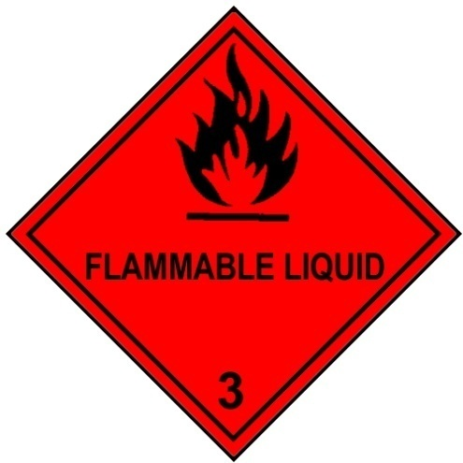
VSQG Waste Consolidation - Example
Army reserve facilities that are VSQGs could consolidate their HW at an Army base that is an LQG (assuming they are in states that have adopted the consolidation provision)
  They could transport the waste themselves and would not need to manifest it as long as the LQG has notified, including listing the participating VSQGs on the Site ID form
  The Army reserve sites (the VSQGs) would need to mark the containers with the words “Hazardous Waste” and the hazards of the waste in the containers. For example, if they generate spent solvents that are ignitable, the containers could be marked:

Slide 91
VSQG Waste Consolidation - Example
Once the VSQG waste arrives at the Army base, the LQG would add the accumulation start date and manage the waste as LQG waste, including getting it off-site to a TSDF in 90 days
The LQG would also keep the shipping records of the waste received from the VSQG for 3 years
  These records would include:
    the name, address, and contact info for the VSQG, and
    a description of the waste received, including the quantity and date the VSQG waste was received
The LQG would report the VSQG waste consolidated at their site on their BR using the new source code

Slide 92
Module 4: Changes to SQG and LQG Requirements
Contents of Module 4
Satellite Accumulation Areas
Waiver to 50-Ft Requirement
Waste Accumulation in Drip Pads and Containment Buildings
Personnel Training for LQGs
Emergency Preparedness and Planning
Closure

Slide 93
Satellite Accumulation Areas
Reorganization and Clarifications
SAA requirements are now found in their own part of the generator regulations - §262.15
Clarifications include:
  Explicitly state that hazardous wastes not be mixed or placed in a container with other hazardous wastes that are incompatible – applying the same storage standard for SAAs as CAAs in regard to incompatible wastes
  Allow containers to remain open temporarily under limited circumstances, when necessary for safe operations
  Provides maximum weight (1 kg) in addition to volume (1 quart) for acute hazardous waste limit

Slide 94
Clarifications to SAA requirements (continued)
Clarifies that “three days” means three consecutive calendar days for when waste must be moved to CAA or permitted TSDF
Rescinds memo allowing reactive hazardous waste to be stored away from the point of generation
  If waste is so dangerous it needs to be stored separately, then it needs to go directly to the CAA
Makes marking and labeling requirements consistent with central accumulation areas
  Labeled with the words “Hazardous Waste” and the hazards
  Do not need an accumulation start date but do need to move in 3 calendar days when accumulation limit is reached – either to the CAA or TSDF

Slide 95
Preamble Clarification re: SAAs
“Under the Control of the Operator” means:
The operator is someone familiar with the operations generating the HW
Is aware of and able to attend to these operations, if needed
Provides some measure of controlled access
Some examples of demonstrating the SAA is under the control of an operator:
The operator controls access to SAA by access card, key, or lock box
The operator accumulates waste in a locked cabinet and controls access to the key (even if access to the room is not controlled)
The operator is regularly in view of the SAA during the course of their job
The operator is able to see if anyone enters or exits the SAA
* There can be more than one operator having control of the SAA

Slide 96
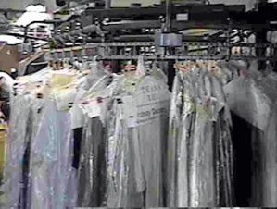
Waiver to 50-Foot Requirement
What changed?
Final rule allows LQGs to approach the authority having jurisdiction (AHJ) over the fire code (e.g., fire marshal or fire department) to apply for a site-specific waiver from this requirement if the AHJ believes that the precautions taken by the facility make the waiver appropriate and safe (§262.17(a)(1)(vi)). The AHJ will help the LQG determine a safe and practical location. The LQG is then required to keep the written approved waiver in their records.
Why the change?
The generator regulations previously required that containers holding ignitable or reactive waste be located at least 15 m (50 feet) from the facility’s property line, with no exceptions. Meeting this requirement could be impossible, especially in urban areas where properties are sometimes less than 100 feet wide

Slide 97
Drip Pads and Containment Buildings
What changed?
Clarifies that SQGs may accumulate hazardous waste on drip pads and in containment buildings, provided they:
  Meet the standards found in Part 265, subparts W and DD, for drip pads and containment buildings, respectively
  Meet all of the conditions specified in § 262.16 for SQGs accumulating hazardous wastes in these units (§ 262.16(b)(4))
Restated Agency technical guidance and clarified in preamble that VSQGs may accumulate hazardous wastes on drip pads provided they comply with 40 CFR part 265 subpart W requirements.
Note: SQGs only have 90 days to accumulate hazardous wastes in containment buildings
Why the change?
Drip pads and containment building regulations only addressed LQGs and TSDFs – not SQGs accumulating hazardous wastes
Therefore, it appeared that SQGs must comply with LQG regulations when generating SQG quantities of hazardous wastes monthly

Slide 98
Personnel Training for LQGs
Maintains existing regulatory framework/requirements, but explicitly allows the use of computer-based tools:
  “Facility personnel must successfully complete a program of classroom instruction, online training (e.g., computer-based or electronic), or on-the-job training that teaches them to perform their duties in a way that ensures compliance with this part.”
  (§ 262.17(a)(7)(i)(A))

Slide 99
Emergency Preparedness and Planning
Generator Rule made a wide variety of revisions to the emergency planning and preparedness requirements.
  SQG regulations—§§262.16(b)(8) & (9)
  LQG regulations—§ 262.17(a)(6) refers generators to part 262 subpart M
Revisions are designed to improve emergency responders’ ability to respond to events, improving compliance with existing requirements, and clarifying ambiguous regulations.
  Scope of regulations
  Contingency Plan Quick Reference Guide
  Documentation of Arrangements
  Technical Changes

Slide 100
Emergency Preparedness and Planning
Scope of the Emergency Preparedness and Planning Regulations
Previous emergency preparedness regulations in part 262.34 stated that generators must comply “with the requirements for owners and operators in subparts C and D in 40 CFR part 265” for LQGs and “the requirements of subpart C of part 265” for SQGs
Subparts C and D of part 265 do not include applicability statements relevant to generators of hazardous waste, making it unclear where these requirements apply at a generator’s site
Revised regulations clearly specify that the emergency planning and preparedness requirements apply where hazardous waste is being generated or accumulated at the generator’s site—includes points of generation, satellite accumulation areas, and central accumulation areas (90-day areas)
One-Plan is still applicable for generators under multiple statutes

Slide 101
Emergency Preparedness and Planning
Contingency Plan Quick Reference Guide
The Quick Reference Guide is a new part of an LQG’s contingency plan designed to provide easy access for emergency responders to the most critical information for an immediate response to an event
New LQGs submitting contingency plans to also include a Quick Reference Guide (described as an Executive Summary in proposed rule)
Existing LQGs to include a Quick Reference Guide when they otherwise update and submit their contingency plan
(§ 262.262)

Slide 102
Emergency Preparedness and Planning
Contingency Plan Quick Reference Guide
Contents of the Quick Reference Guide (eight elements)
  Types/names of hazardous waste and associated hazards
  Estimated maximum amounts of hazardous wastes
  Hazardous wastes requiring unique/special treatment
  Map showing where hazardous wastes are generated, accumulated or treated at the facility
  Map of facility and surroundings to identify routes of access and evacuation
  Location of water supply
  Identification of on-site notification systems
  Name of emergency coordinator(s) or listed staffed position(s) and 7/24-hour emergency telephone number(s)
EPA encourages generators to work with local emergency authorities and others to identify additional information that could be included

Slide 103
Emergency Preparedness and Planning
Making and Documenting Arrangements with Local Emergency Responders
The requirement for generators to make arrangements with local emergency responders is found in the previous regulations in part 265 subpart C (§ 265.37), applicable to both SQGs and LQGs.
§ 262.37(b) stated that when the state or local authorities refused to enter into agreements, it must be documented.
Under the revisions, generators must document that they have attempted to make arrangements with local emergency responders (or that arrangements were sought but not obtained) and keep the documentation in the facility’s operating record
No specific form or type of documentation is required and additional flexibility is provided regarding where documentation can be retained
(§ 262.16(b)(8)(vi) & § 262.256)

Slide 104
Emergency Preparedness and Planning
LQGs can eliminate unnecessary employee personal information in the contingency plan (§ 262.261(d))
  Replacing addresses and phone numbers of employees with an emergency telephone number and, where applicable, a position title, as long as the number is staffed at all times
SQGs and LQGs may determine the most appropriate locations for emergency equipment, when it is not possible or unsafe to have the equipment located immediately next to the generating equipment (§ 262.16(b)(8)(ii)/ § 262.252)
Add “direct or unimpeded access” as a meaning for the term “immediate access” in SQG and LQG regulations (§ 262.16(b)(8)(iv)/§ 262.254)
Stating that SQGs the location relevant emergency response information should be posted is “next to the telephone” (§ 262.16(b)(9)(ii))
Clarify that SQGs have the option to use contractors to address releases (containment/cleanup) (§ 262.16(b)(9)(iv)(B))
Large facilities with internal response capabilities may seek a waiver from entering into arrangements with local authorities (§ 262.16(b)(8)(vi)(C)/ § 262.256(c)

Slide 105
Closure: What Changed?
Consolidates closure requirements in one place
Requires LQGs to notify EPA when closing a facility and/or accumulation unit
Requires LQGs accumulating hazardous wastes in containers to close as a landfill if unable to meet closure performance standards; i.e., they can’t clean close
Clarifies that closure does not apply to SAAs

Slide 106
Why did we make changes?
Previous regulations confusing and contradictory
Consolidates and streamlines regulations to improve user-friendliness
Closes important gaps:
  Prior to this rule, EPA and most states had no idea when an LQG closed its facility or waste accumulation unit
  LQGs accumulating hazardous wastes in tanks, containment buildings and drip pads must close as landfill (or equivalent) if unable to meet closure performance standards
  LQGs accumulating hazardous wastes in containers had no such requirements
  Yet, numerous damage cases found where LQGs accumulating hazardous wastes in containers abandoned their facility leaving EPA and/or states to clean up as Superfund removal action – often costing millions

Slide 107
Closure Notification
Requires LQGs to notify EPA when closing a facility via Site ID form
  30 days prior to closing facility and
  90 days after closing facility and complied with closure performance standards
  Extension requests must be submitted within 75 days after closing
Provides option of LQG closing waste accumulation unit to:
  Place a notice in operating record within 30 days after closing waste accumulation unit and addressing closure when facility closes, OR
    (Notice can be removed from the operating record if unit going back into service)
  Notify EPA or state they have met closure performance standards for containers, tanks, and containment buildings (§262.17(a)(8)(iii)) or closure performance standards for drip pads (§262.17(a)(8)(iv))
    90 days after closure via Site ID form 8700-12
    (§ 262.17(a)(8))

Slide 108
Closure Requirements
Consolidates performance standards found in § 265.111 and §265.114 into LQG section (§262.17(a)(8)(iii)&(iv)) and clarifies that these units are subject to clean closure standards
LQGs for containers, tanks, and containment buildings must:
  Minimize and control post-closure care releases of hazardous waste and constituents to the environment
  Remove or decontaminate all contaminated structures, equipment, and soils
  Manage any hazardous waste generated in the process of performing closure according to Subtitle C
  If the LQG cannot clean close then they must close as a landfill and meet the requirements of Subparts G and H of 40 CFR 265
Note: LQG drip pad operators are subject to 1 and 3 above and 265 Subpart W in lieu of 40 CFR 265 Subparts G and H

Slide 109
Closure: Comparison of New vs. Old Requirements
NEW | OLD
§ 262.17 (a) (8) (i) Notification for closure of a waste accumulation unit. (ii) Notification for closure of the facility.
(iii) Closure performance standards for containers, tank systems, and containment building waste accumulation units.
(A) At closure, the generator must close the waste accumulation unit or facility in a manner that: | § 265.111 The owner or operator must close the facility in a manner that:
(1) Minimizes the need for further maintenance by controlling, minimizing, or eliminating, to the extent necessary to protect human health and the environment, the post-closure escape of hazardous waste, hazardous constituents, leachate, contaminated run-off, or hazardous waste decomposition products to the ground or surface waters or to the atmosphere, | (a) Minimizes the need for further maintenance, and (b) Controls, minimizes or eliminates, to the extent necessary to protect human health and the environment, post-closure escape of hazardous waste, hazardous constituents, leachate, contaminated run-off, or hazardous waste decomposition products to the ground or surface waters or to the atmosphere, and (c) Complies with the closure requirements of this subpart, including, but not limited to, the requirements of §§265.197, 265.228, 265.258, 265.280, 265.310, 265.351, 265.381, 265.404, and 265.1102.

Slide 110
Closure: Comparison of New vs. Old Requirements
NEW | OLD
(2) Removes or decontaminates all contaminated equipment, structures and soil and any remaining hazardous waste residues from waste accumulation units including containment system components (pads, liners, etc.), contaminated soils and subsoils, bases, and structures and equipment contaminated with waste, unless § 261.3(d) of this chapter applies. (3) Any hazardous waste generated in the process of closing either the generator’s facility or unit(s) accumulating hazardous waste must be managed in accordance with all applicable standards of parts 262, 263, 265 and 268 of this chapter, including removing any hazardous waste contained in these units within 90 days of generating it and managing these wastes in a RCRA Subtitle C hazardous waste permitted treatment, storage and disposal facility or interim status facility. | §265.114 Disposal or decontamination of equipment, structures and soils. During the partial and final closure periods, all contaminated equipment, structures and soil must be properly disposed of, or decontaminated unless specified otherwise in §§265.197, 265.228, 265.258, 265.280, or 265.310. By removing all hazardous wastes or hazardous constituents during partial and final closure, the owner or operator may become a generator of hazardous waste and must handle that hazardous waste in accordance with all applicable requirements of part 262 of this chapter.

Slide 111
Closure: Comparison of New vs. Old Requirements
NEW | OLD
(4) If the generator demonstrates that any contaminated soils and wastes cannot be practicably removed or decontaminated as required in paragraph (a)(8)(ii)(A)(2) of this section, then the waste accumulation unit is considered to be a landfill and the generator must close the waste accumulation unit and perform post-closure care in accordance with the closure and post-closure care requirements that apply to landfills (§ 265.310 of this chapter). In addition, for the purposes of closure, post-closure, and financial responsibility, such a waste accumulation unit is then considered to be a landfill, and the generator must meet all of the requirements for landfills specified in subparts G and H of part 265 of this chapter. (iv) Closure performance standards for drip pad waste accumulation units. At closure, the generator must comply with the closure requirements of paragraphs (a)(8)(ii) and (a)(8)(iii)(A)(1) and (3) of this section, and § 265.445(a) and (b) of this chapter. (v) The closure requirements of paragraph (a)(8) of this section do not apply to satellite accumulation areas. | § 265.197 (b) If the owner or operator demonstrates that not all contaminated soils can be practicably removed or decontaminated as required in paragraph (a) of this section, then the owner or operator must close the tank system and perform post-closure care in accordance with the closure and post-closure care requirements that apply to landfills (§265.310). In addition, for the purposes of closure, post-closure, and financial responsibility, such a tank system is then considered to be a landfill, and the owner or operator must meet all of the requirements for landfills specified in subparts G and H of this part. Comparable text found for containment buildings.

Slide 112
Module 5 – Recordkeeping and Reporting
Contents of Module 5
Recordkeeping
Reporting
Site ID Walk Through

Slide 113
Summary of New Recordkeeping Requirements
New Recordkeeping Requirements
  Episodic generation
  VSQG consolidation
  Tanks
  Closure – waste accumulation unit(s)
  50-foot waiver
  Arrangements with local authorities

Slide 114
New Recordkeeping Requirements: What Changes?
Episodic generation
  Maintain records of episodic event and any approved petitions in operating record for 3 years
VSQG consolidation at same-company LQG
  LQG is required to keep records of shipments from the VSQG for 3 years
    These can be normal business records
    Must identify the name, site address, and contact information for the VSQG
    Must include a description of the hazardous waste received, including the quantity and the date the waste was received

Slide 115
New Recordkeeping Requirements: What Changes? (cont)
SQGs and LQGs may use logs, monitoring equipment or other records to demonstrate that hazardous waste is either emptied or removed from the tank within 180 or 90 days
Regulations address both batch and continuous flow processes.
Records must be kept on site and readily available for inspections.
  Ideally these records will be in close proximity to where hazardous waste is being accumulated in the tank, or if not practical (i.e., exposure to weather, physically infeasible, etc.) in a control room, or other central location at the facility.
Bottom Line: Methods used to demonstrate that a tank has been emptied must be reasonable and easily discernible.

Slide 116
New Recordkeeping Requirements: What Changes? (cont)
Closure of waste accumulation unit
  Maintain information of closed units as part of operating record
50-Foot Waiver
  Maintain approval of waiver as part of operating record
Arrangements with local authorities
  Maintain record of arrangements as part of operating record

Slide 117
Summary of New Reporting Requirements
New Reporting Requirements
  SQG Re-notification (Site ID form)
  LQGs receiving wastes from VSQGs under control of same company (Site ID form & GM form of BR)
  Episodic generation (Site ID form)
  Biennial Reporting for Facilities Not Storing (WR form of BR)
  Closure – facility and/or waste accumulation units (Site ID form)
  Quick response guide (Summary of contingency plan)

Slide 118
New Reporting Requirements: What Changes?
SQG Re-notification
§ 262.18(d) Re-notification.
(1) A small quantity generator must re-notify EPA starting in 2021 and every four years thereafter using EPA Form 8700–12. This re-notification must be submitted by September 1st of each year in which re-notifications are required.
We expect many states to allow electronic reporting. EPA made the timeframe off-cycle with the Biennial Report to reduce the impact on state programs.
Note: SQGs located in states with more frequent re-notification should comply with the state’s timeframe.

Slide 119
SQG Re-Notification – Why the Change?
Previously, SQGs were only required to notify once – when obtaining a RCRA Identification number.
EPA and many states have outdated information since SQGs may have gone out of business, changed regulatory category, etc.
  Many notifications occurred over 30 years ago
Without accurate and up-to-date generator universe information, both EPA and states cannot conduct necessary oversight and program management activities.

Slide 120
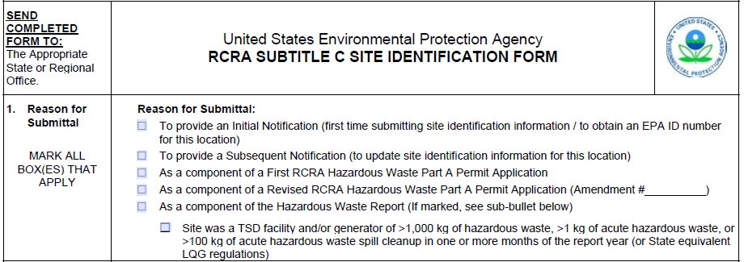
✓
SQG must check this box to re-notify

Slide 121
New Reporting Requirements: What Changes?
LQGs Receiving Wastes from VSQGs
LQGs must submit Site ID form:
  Notifying EPA/state that they are receiving hazardous waste from VSQGs under the control of same company, and
  Identifying in addendum each VSQG they are receiving waste from, including name and address of facility and contact name and telephone number.
See next slides for mock up of Site ID form changes

Slide 122
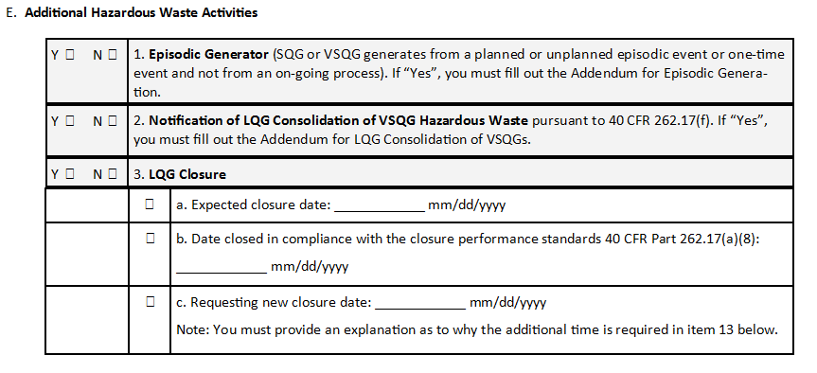

Check Y if LQG consolidating VSQG waste

Slide 123
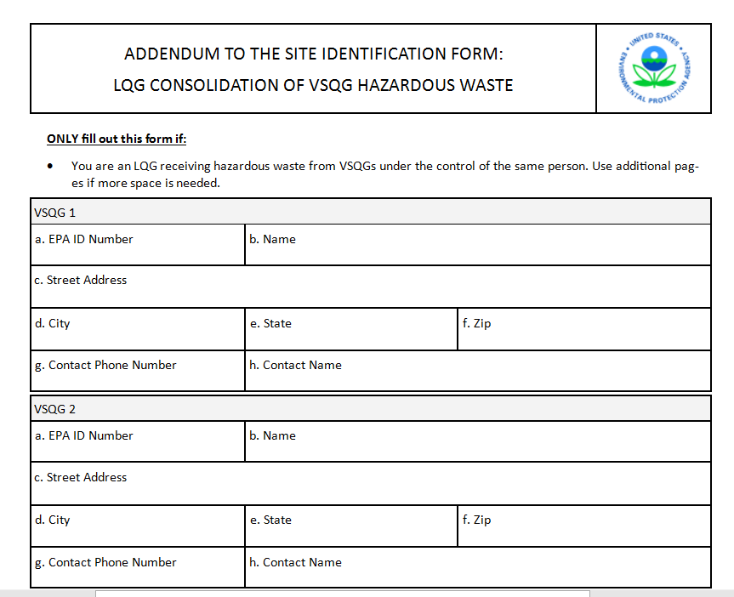
123456
Facility X
123 Main St.
Generator City
Someplace
11111
555-555-5555
Mr. Know it All

Slide 124
New Reporting Requirements: Why the Change?
LQGs Receiving Wastes from VSQGs
Reporting requirements provide oversight capability on part of EPA/states
  Allows EPA/States to determine if LQG complying with rule’s provisions and capable of managing additional amounts of hazardous waste

Slide 125
New Reporting Requirements: What Changes?
Episodic Generation
When holding an episodic event, a generator must notify EPA/authorized state that they are doing so at least 30 days before the event (if planned) or within 72 hours (if unplanned)
  Start and end date of episodic event
  Reason for the event
  Types of hazardous waste generated (federal and state waste codes)
  Estimated amounts of hazardous waste to be generated
  Emergency contact
  Emergency phone number

Slide 126
Check Y if VSQG or SQG holding an episodic event

Slide 127
ADDENDUM TO THE SITE IDENTIFICATION FORM: EPISODIC GENERATOR
Episodic Event
Type of Event  Planned  Unplanned
Emergency Contact Phone |  |  | Emergency Contact Name
Beginning Date _07/15/2017__ mm/dd/yyyy |  |  | End Date __09/01/2017____ mm/dd/yyyy
Event Description
Federal Hazardous Waste Codes
State Hazardous Waste Codes
Check type of event being held
(202) 555-5555
Jane Smith
Biennial tank cleanout
Insert relevant waste codes

Slide 128
New Reporting Requirements: What Changes?
Biennial Reporting
Clarifies in regulation that LQGs must complete and submit BR
Requires LQGs to provide specific information found in EPA Form 8700–13 A/B rather than citing outdated information previously found at § 262.41 (a)(1)-(8)
  Agency will issue FR notice, inform key stakeholders and place notice on EPA website if and when it modifies EPA Form 8700–13 A/B.
Requires in regulation that LQGs identify all of the hazardous wastes they generated throughout the year, not just for months generator was LQG
Note: The Agency did not finalize proposal to change reporting periods.
Requires LQGs consolidating VSQG waste to identify volumes and types of wastes but with new source code
Requires facilities not storing hazardous wastes prior to recycling to complete BR

Slide 129
New Reporting Requirements: Why the Changes?
Biennial Reporting
Previous regulation was not clear as to who should complete and submit a BR; (i.e., A generator …. must)
EPA had modified information required to be reported in BR instructions over the years but not regulatory text – which is much more time consuming
EPA was previously contradictory in what had to be reported; i.e., FR preamble (only months LQG) vs. BR instructions (all months of the year)
Previously, EPA did not require BR reports from facilities not storing prior to recycling

Slide 130
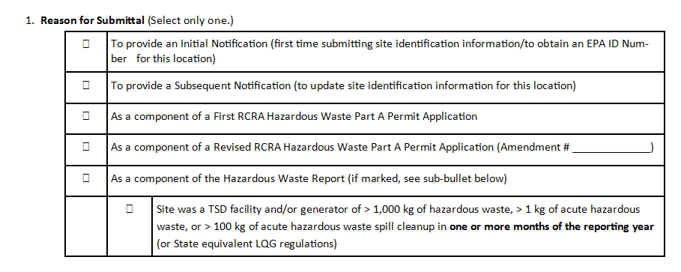
Recycler Who Needs to Notify (because they don’t store prior to recycling)
Assuming facility has ID #, check this box

Slide 131
New Reporting Requirements: What Changes?
Facilities Not Storing Hazardous Wastes Prior to Recycling:
Changes to Site ID Form as part of BR submission
Check both boxes if a you are a recycler who doesn’t store
Y  N  | 6. Recycler of Hazardous Waste
 |  | a. Recycler who stores prior to recycling
 |  | b. Recycler who does not store prior to recycling

Slide 132
New Reporting Requirements: What Changes?
Closure
Closure of waste accumulation area – Require LQGs to place notice in their operating record within 30 days after closure identifying location of unit within facility; or meet closure performance standards and notify EPA.
Closure of facility –
  Notify EPA or authorized state no later than 30 days prior to closing facility, and
  Notify EPA or authorized state within 90 days after closing facility that it has complied with closure performance standards or notify if it can’t clean close
  LQG can request extension but must notify EPA or authorized state within 75 days after closing facility

Slide 133
If check yes, only fill out a, b, or c depending on your closure stage
06/26/2017

Slide 134
New Reporting Requirements: What Changes?
Emergency Response
As part of regulations, requires LQGs to submit Contingency Plan Quick Reference Guide to local emergency responders
Contents of the Quick Reference Guide (eight elements)
  Types/names of hazardous waste and associated hazards
  Estimated maximum amounts of hazardous wastes
  Hazardous wastes requiring unique/special treatment
  Map showing where hazardous wastes are generated, accumulated or treated at the facility
  Map of facility and surroundings to identify routes of access and evacuation
  Location of water supply
  Identification of on-site notification systems
  Name of emergency coordinator(s) or listed staffed position(s) and 7/24-hour emergency telephone number(s)

Slide 135
Module 6 - Implementation and State Adoption
Contents of Module 6
Revisions to § 262.10
State Adoption
Stringency of the Final Rule
EPA Resources
Contacts

Slide 136
Revisions to § 262.10
§ 262.10(a)-(l) has been revised in a variety of ways to clarify the structure of the regulations and remove obsolete provisions.
Obsolete provisions being removed are—
  § 262.10(c)—outdated provision from the early days of RCRA when the regulations distinguished between generators that shipped off-site for management and those that were also RCRA-designated facilities
  § 262.10(j)—Laboratory XL regulations
§§ 262.10(b), (d), and (l) are updated to reflect the new structure of the regulations, but still point generators to counting requirements, import and export requirements, and regulations for academic laboratories
§§ 262.10(e), (f), (h), & (i) are unchanged

Slide 137
Revisions to § 262.10
§§ 262.1, 262.10(a) and 262.10(g)
In this final rule, EPA outlines in regulatory language the distinction between independent requirements for all generators and conditions for exemption from the storage facility regulations for generators who are accumulating hazardous waste on site​
  This distinction has always existed in RCRA and it has been the Agency’s position that generators not complying with a condition of a generator exemption would be considered an operator of a non-exempt storage facility​
  State regulatory agencies will continue to retain discretion and authority regarding bringing enforcement actions when non-compliance with conditions for exemptions have been detected​
  EPA and states have always had, and continue to have, enforcement discretion to bring charges and seek penalties that accurately reflect the seriousness of the violations and their potential for harm​
(§§ 262.1 & 262.10)​

Slide 138
Revisions to § 262.10
§ 262.1 contains definitions of conditions for exemption and independent requirement, used in § 262.10
§ 262.10(a)(1) lists the independent requirements for each generator category
§ 262.10(a)(2) points generators to the conditions for exemption for each generator category
§ 262.10(a)(3) states that hazardous waste must be sent to a designated facility (permitted TSDF or recycler)

Slide 139
Rule Process & Schedule
Rule signed on October 28, 2016
Publication in Federal Register—November 28, 2016 (81 FR 85732)
Effective Date – 6 months from publication—May 30, 2017
Rule goes into effect in Iowa, Alaska, most territories, and tribal lands on the effective date
  EPA runs the RCRA program in those states, most territories, and tribal lands

Slide 140
State Adoption
Authorized states run the RCRA program in their state and thus, will go through the state adoption & authorization process for this new RCRA rule
  Authorized states will have to pick up the more stringent provisions, typically by July 1, 2018 (or July 1, 2019 if state law change is needed)*
  Authorized states can choose to pick up the less stringent provisions and those provisions that are considered equally stringent
  *Some states, including PA and NJ, adopt by reference and the rule will be effective on May 30, 2017 in PA and NJ

Slide 141
Stringency of Final Rule
More stringent provisions:
  SQG re-notification
  SAAs subject to incompatibility and emergency preparedness & prevention requirements
  Identifying hazards of wastes being accumulated on labels and RCRA waste codes added prior to shipment
  Notification of closure
  Closure as a landfill for LQGs accumulating hazardous wastes in containers that cannot meet closure performance standards
  Biennial reporting for whole year, not just months the generator is an LQG
  Biennial reporting for recyclers who don’t store prior to recycling
  Quick Reference guide for contingency plans
Less stringent provisions:
  VSQG consolidation
  Episodic generation
  Waiver from 50-foot rule

Slide 142
EPA resources
Main generator website: https://www.epa.gov/hwgenerators
Generator Improvements Rule website: https://www.epa.gov/hwgenerators/final-rule-hazardous-waste-generator-improvements
We plan to add FAQs, a map showing when states adopt the new rule, and other implementation materials as needed.
We also plan to update existing guidance and resources as much as possible with new terms and citations, starting with the Hazardous Waste Generator Regulations: A User Friendly Reference Document

Slide 143
What resources would be helpful
What new resources would you like to see?
What materials on our website do you use the most and want us to update with new terms and citations?
Email us your suggestions!

Slide 144
Points of Contact
Kathy Lett
  703-605-0761
  Lett.Kathy@epa.gov
Mary Beth Sheridan
  703-308-4941
  Sheridan.MaryBeth@epa.gov
Brian Knieser
  703-347-8769
  Knieser.Brian@epa.gov

