Slide 1
NJDEP C&E’s Environmental Stewardship
Program
Ray Bukowski, Assistant Commissioner
Compliance & Enforcement
January 2018

Slide 2

What is Stewardship?
Stewardship is the careful and responsible management of something entrusted to one’s care.
Environmental Stewardship is a cornerstone of Sustainability. Stewardship includes the concepts, strategies, tools, practices and approaches that lead to environmental improvement in a manner that is sustainable over time. Stewardship is meeting the needs of today without compromising the ability of future generations to meet their own needs.

Slide 3
Environmental Stewardship
Why?
C& E’s Strategic Plan:
PURPOSE:
We are dedicated to ensure that New Jersey’s environment is clean, safe, enjoyable, preserved and enhanced for future generations.
VISION:
We are building a nationally recognized organization that empowers our trained and dedicated professionals to ensure New Jersey’s businesses, communities and individuals are models of environmental stewardship and compliance.
Goal:
“Effectively balance compliance assistance, enforcement and education to achieve compliance and move the regulated community and the public towards environmental stewardship.”

Slide 4
Environmental Stewardship
Why?
Compliance today represents a minimum in responsibility
Government is recognizing the limits to “command and control” approaches to protection
Wise businesses are recognizing that stewardship ensures their own future along with the planet
Stewardship will drive innovations and represents opportunities

Slide 5
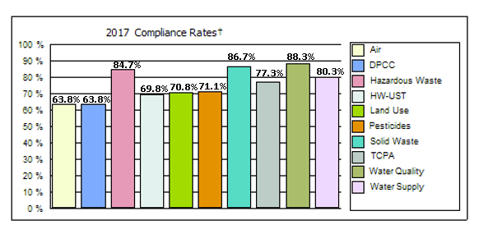
Environmental Stewardship
2017 Compliance & New Stewardship Rates
Compliance Rates
In 2017, there was a 79.8% compliance rate among the 4,824 sites inspected.
New Stewardship
In 2017, 87 new sites began participating in the NJDEP Stewardship Program.
Notes:
In 2017 3,849 sites out of 4,824 inspected had NO violations
(79.8% compliance rate)
Would even 100% compliance solve our remaining environmental problems?
Can the 7,757 sites do any better?

Slide 6
New Jersey Stewardship Program
New Jersey program promotes:
  Reduced burden to participate
  Reduced burden to administer
  Wide acknowledgement with minimal verification
  Accommodates both small and large business/entities
  Voluntary, but active engagement with all entities; Thousands, not hundreds
  Involvement and education of the entire organization, not a limited team of dedicated ‘reviewers’

Slide 7
New Jersey Stewardship Program
Initiated as an add-on to Compliance Assurance activities
Set basic standards in predetermined categories
Record stewardship efforts through standard survey/checklists at all (or most) inspections or field visits
Initially limited to sites NJ inspects for compliance (retailers, offices, etc. excluded)

Slide 8
Survey-checklist hybrid approach
Process
Site representative provides narrative
Inspector helps find any relevant topics
Collaborative effort to clarify details
Significant inspector discretion on credibility and need for proof
Possibly some hard verification
Inspector records basics
1, 2 and 3 reduced as program becomes known and sites are prepared ahead of time.

Slide 9
Survey-checklist hybrid approach
Verification – NOT Certification
Inspector lends some credibility to stewardship claims but is not certifying them.
Inspector must understand the claims, fit them into the list and have good reason to believe them.
Inspector applies logic, previous observation and history with the site in recording claims absent complete proof.
Notes:
Survey- you take their word for it
Checklist is affirmative – we assert compliance or cite a violation
We are blending these two

Slide 10
General Rules
Compliance distinct from Stewardship
Violations don’t automatically disqualify stewardship
  whether newly found or outstanding
  whether penalties are outstanding
  whether awaiting hearing or negotiating ACO or settlement
Record good and bad; reports will reflect and publicize both
  public can make judgments on full history
Skip Stewardship for egregious situations only
  history of flaunting regulation
  major court cases
  seeking shutdown
  usually not acting as stewards anyway
    Ex: Berkowitz, S&W Rail, Eastern Organic, etc.

Slide 11
General Rules
Voluntary actions only
  Actions that are REQUIRED cannot be counted towards Stewardship
    NOT Allowed:
      orders, settlements, SEPs, etc.
      requirements from other programs of DEP
        SRP, Water Allocation, etc.
      requirements from other Agencies
        EPA, Agriculture, Soil Conservation
      a requirement imposed as a condition of approval
    Generally Allowed
      An innovative action “beyond compliance” may require a permit and still be worthy of recognition
      better than “state of the art”
      clean-up well beyond minimum standards
      actions ahead of regulatory compliance deadlines

Slide 12
Checklist Categories
Environmental Policy | Environmental Management System
Annual Environmental Report | Greenhouse Gas Emissions Calculations
Environmental Purchase Policy | Vendor Supply Chain Requirements
Mentoring to Other Businesses | Community Outreach Program
Green Building Certification | Life Cycle Assessments
Hazardous Materials reductions | Water Use Reduction
Waste Exchange Program | Employee Trip Reduction
Process/Operations Energy Use Reduction | Transportation Energy Use Reduction
Renewable Energy Use | Environmental Enhancement Projects
Innovative Program | EPA Voluntary Programs
Click Here for printable checklist

Slide 13
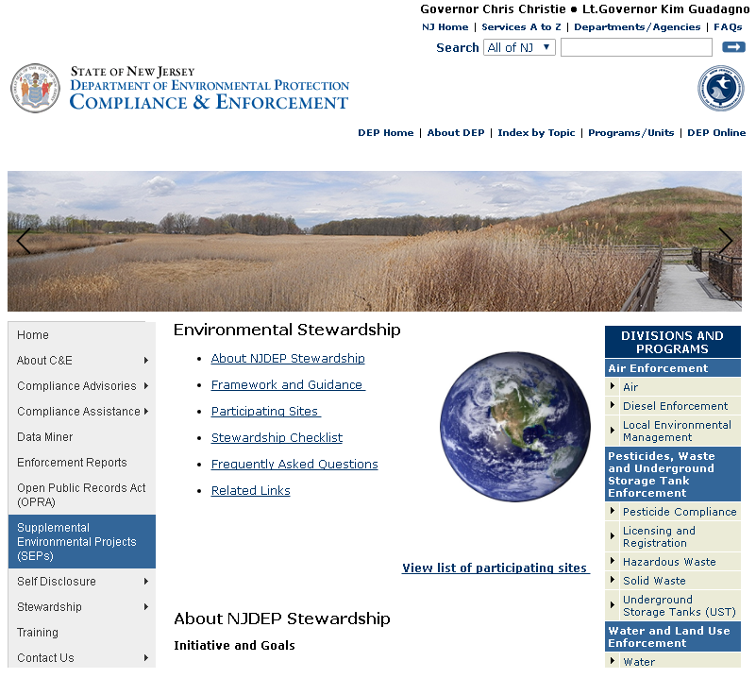
Program Information on Webpage
Click here to view the Stewardship webpage
Use these quick links to navigate the Stewardship page and find all information related to the program
Additional questions can be referred to the Stewardship Coordinator, Devin Walker at stewardship@dep.nj.gov

Slide 14
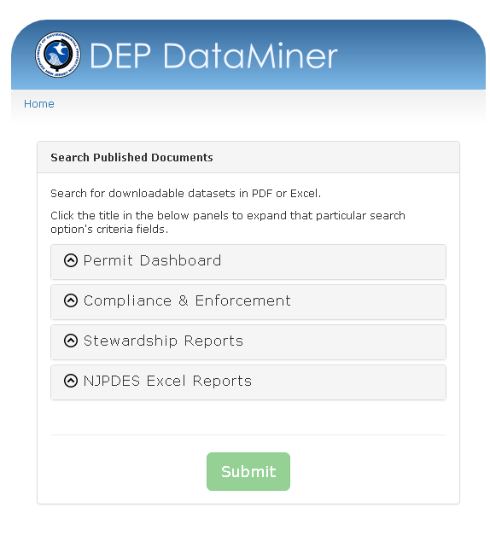
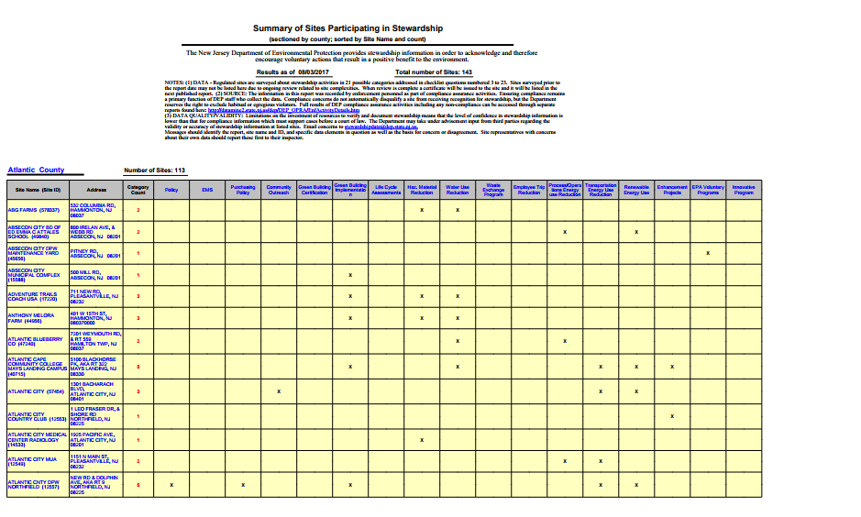
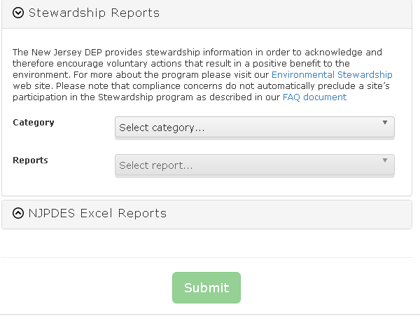
C&E Published Results
Published results from all participating sites can be found on the webpage.
1
2
4
3

Slide 15
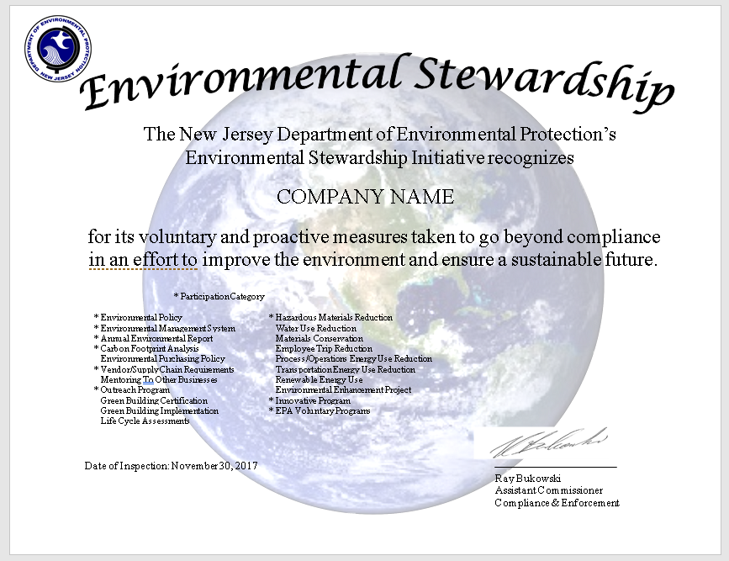
Certificates Issued
After a stewardship inspection is performed:
Inspector documents stewardship checklist in NJEMS system
Supervisor approves stewardship checklist
Stewardship Coordinate generates and sends environmental stewardship certificate

Slide 16
Questions?
Please direct any stewardship related questions to the Stewardship Coordinator, Devin Walker.
609-984-0799
stewardship@dep.nj.gov

