Slide 1


New Jersey Department of Education
Provisional Educator Programs Virtual Training
Office of Recruitment, Preparation and Certification
Division of Teaching and Learning Services
2025-2026
nj.gov/education

Slide 2
General Information
The virtual training sessions will occur on November 12, 2025, and January 14, 2026. The slides will be posted online after all training sessions have occurred.
All questions must be posted into the Q&A panel on the right side of your screen.
The Provisional Team will address questions at the end of the presentation.
The Provisional Team is unable to answer any questions that are specific to a district or educator. Please use the web to case for specific questions on candidates.

Slide 3
Provisional Team Introductions
Vickie Sikorski, Coordinator
Mike O’Neill, Planning Associate
Jennifer Kern, Technical Assistant
Taya Womack, Examiner 3

Slide 4
Agenda
Introductions
Provisional Teacher Process Overview
Provisional Educational Services and Administrative Endorsements Overview
Process for Submitting a Provisional Registration Case
Process for Submitting a Renewal Case
Process for Submitting a Termination Date
Process for Submitting a Conversion to Standard Case
New Jersey Department of Education (NJDOE) Contact Information

Slide 5
Provisional Process:
Teachers

Slide 6
Overview of Certification for Teachers (Three-Tiered System)
Certificate | Type | Description
Certificate of Eligibility with Advanced Standing (CEAS) or Certificate of Eligibility (CE) | A license to seek employment as a teacher | Is issued before a candidate seeks employment as a teacher.
Provisional Certification | A temporary license to teach | Is issued once a candidate is hired as a teacher and registered in the provisional process.
Standard Certification | A permanent license to teach | Is issued once a teacher meets all the requirements.

Slide 7
Provisional Process for Teachers (1 of 3)
Once employment is secured, it is the responsibility of the hiring school district to register the teacher into the Provisional Teacher Process via NJEdCert. A provisional certificate is then issued and is valid for a period of up to two school years. The teacher cannot apply for the provisional certificate. This certificate must be requested by the school district.
If the candidate has a CE, the district must verify completion of the required 50 hours of pre-professional experience and must choose in the CE Educator Preparation Program (CE-EPP) where formal instruction is being completed in drop down menu under “program enrollment.”
N.J.A.C. 6A:9B-8.4 (b), "the employing school district shall register the provisional teacher within 60 days of the date the CE or CEAS holder begins employment.” A provisional registration submitted after the 60th day will be marked as out of regulation and denied.

Slide 8
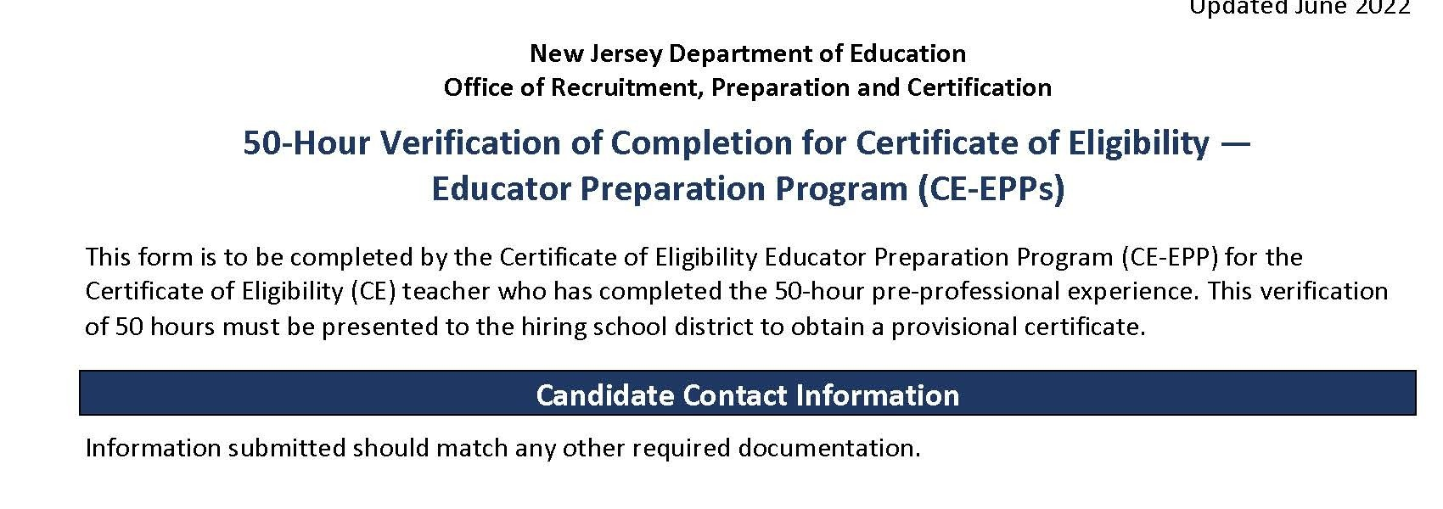
50-Hour CE-EPP Verification of Program Completion (VOPC)
Form

Slide 9
Provisional Process for Teachers (2 of 3)
The following must be completed while employed under a provisional certification to obtain a standard license:
Mentoring and Induction
Provisional teachers must complete a school mentoring program.
The mentoring fee charged by the district is $550 for CEAS teachers and $1000 for CE teachers.
The Office of Professional Development has information about developing a mentoring plan. Please contact TeachPD@doe.nj.gov for any questions you may have about developing a mentoring plan.

Slide 10
Provisional Process for Teachers (3 of 3)
Supervision and Evaluation
Provisional teachers must obtain at least two years of effective or highly effective final summative evaluations.
The Office of Educator Evaluation has information regarding AchieveNJ. Please contact edueval@doe.nj.gov for any questions regarding AchieveNJ/summative ratings.
Alternate Route Formal Instruction for CE teachers
At least 400 hours, or the credit equivalent of instruction, through an approved CE-EPP.

Slide 11
Instruction for CE Holders (1 of 2)
Categories of CE programs:
Department-approved CE EPP for P-12 Subject Area and K-6 Elementary Teachers;
Career and Technical Educators (CTE);
Preschool through Grade 3 (P-3 );
Teacher of Students with Disabilities (TOSD);
English as a Second Language (ESL); and,
Bilingual/Bicultural.
To see a list of all approved CE programs , please visit the NJDOE website

Slide 12
Instruction for CE Holders (2 of 2)
“Program Enrollment” requirements for each of the following:
English as a Second Language (ESL) candidates:
400-hours or the credit equivalent through an approved CE-EPP; and,
15–21 credits in an ESL program.
Bilingual candidates with a content area CE:
400-hours or the credit equivalent through an approved CE-EPP; and
12 credits in a Bilingual program.
TOSD candidates with a content area CE:
400-hours or the credit equivalent through an approved CE-EPP program; and
21–27 credits in a TOSD program.

Slide 13
Provisional Process:
Educational Services and Administrative Endorsements

Slide 14
School Library Media Specialists (SLMS) 1 of 2
The school district will register the candidate through NJEdCert. If the candidate has a CE, the school district must select the EPP where the School Library Media Specialists (SLMS)courses will be taken in the NJEdCert drop-down menu under "program enrollment".
A one-year residency and mentoring is required under the provisional certificate. Mentoring must be completed by an experienced school library media specialist. If there is not an experienced SLMS available within the school district to mentor the candidate, an experienced SLMS mentor can be provided through the New Jersey Association of School Librarians (NJASL). NJASL can be reached at mentoring@njasl.org.

Slide 15
School Library Media Specialists (SLMS) 2 of 2
A candidate’s standard certificate determination will be based on completion of the residency and the final summative rating.
The final summative rating is entered by the district in NJEdCert.
A CE candidate must have the VOPC submitted by the EPP provider.
Note: The same requirements apply for candidates seeking an Associate Library Media Specialist (ASLMS) endorsement.

Slide 16
Student Assistance Coordinators (SAC)
The school district registers the candidate through NJEdCert.
If the candidate has a CE, they must choose the EPP where the courses will be taken in the drop-down menu under "program enrollment”.
A six-month residency is required under the provisional certificate.
A candidate’s standard certificate determination will be based on completion of the residency and the final summative rating.
The final summative rating is entered by the school district in NJEdCert.
A CE candidate must have the VOPC submitted by the EPP provider.

Slide 17
Provisional Process for Administrators
The school district registers the administrator through NJEdCert.
Administrators must be registered in the appropriate program:
Principals will register with Leader to Leader/ NJPSA for the two-year residency.
School Administrators will register with NJASA for the one-year residency.
School Business Administrators will register with NJASBO for the one-year residency.
A one-to-two-year residency is required under the provisional certificate.
A candidate’s standard certificate determination will be based on successful completion of the residency.

Slide 18
New Provisional Registration

Slide 19
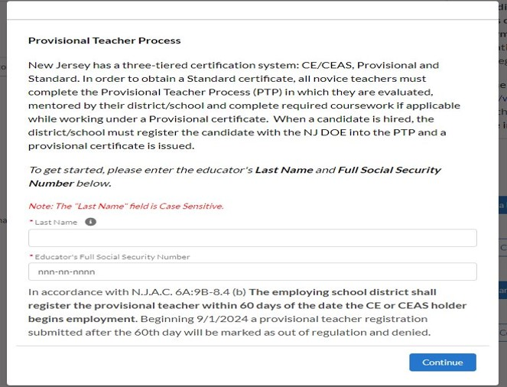
Register Educator for New Provisional License

Slide 20
New Provisional: Educator Information
Steps to register an educator for the provisional teacher process:
Complete the fields for last name and social security number.
Verify email address on file. If email is incorrect, the applicant will need to login to their NJEdCert account and update their email address.
Complete fields for job type, employment status, and start date.
Select the license that matches the position for which the district hired the educator.
Select the CE EPP information, if applicable, and provide the mentor information.

Slide 21
New Provisional License
After completing the registration, the following will occur:
A case is created and assigned to the provisional program.
An application record is created within the case.
A new provisional teacher process (PTP) record is created for that educator.
Note: This record is created for all educators (i.e. teachers, administrators, and educational service specialists).

Slide 22
Provisional Renewal Process

Slide 23
Renewal of Provisional (1 of 2)
Candidates who have not met the requirements for a standard certificate while working under a provisional certificate set to expire on July 31, will need to be issued a provisional renewal to continue employment in their current district. The school district can initiate the renewal process in NJEdCert in June of the expiring year.
Candidates may be eligible for one provisional renewal. CE teachers must provide the school district with documentation of progress made towards alternate route program completion.

Slide 24
Renewal of Provisional (2 of 2)
CE teachers in the following endorsement areas may be eligible for a second renewal of their provisional if they have not completed coursework:
Teacher of Students with Disabilities CE, and a CE with an endorsement appropriate to the subject to be taught;
Student with Disabilities CE holders must demonstrate successful completion of at least two courses per provisional period to the school district.
Bilingual/Bicultural CE, and a CE with an endorsement appropriate to the subject or grade level to be taught; or
Teachers who hold a CE in English as a Second Language
CE teachers must provide documentation to the school district of progress made towards program completion.

Slide 25
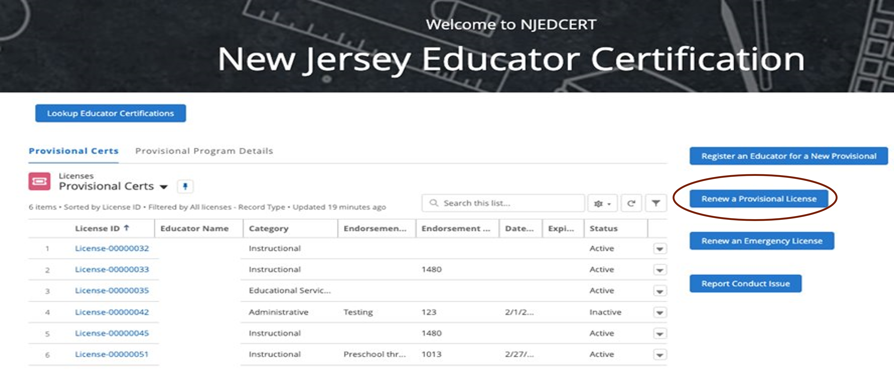
Initiating Provisional License Renewal (1 of 3)
To initiate a provisional renewal, the school district must complete the following:
Step 1: From the homepage, click “Renew a Provisional License.”

Slide 26
Initiating Provisional License Renewal (2 of 3)
Step 2: Once the school district has selected the provisional licenses that are eligible to be renewed, the district will choose the appropriate educator.
Step 3: Follow the screen prompts

Slide 27
Initiating Provisional License Renewal (3 of 3)
After creating the renewal case, the following will occur:
A case is created with the status “pending payment.”
An application is created and associated to the case.
A new PTP record is created and associated to the educator and the application.
The educator will receive an email with the subject line, “Your Provisional Renewal Application.” This will allow the educator to complete the application and payment.
Once the payment and Oath of Allegiance are completed, the status will change to “pending review.”

Slide 28
Entering a Termination Date
When an educator leaves a school district, the last date of employment, known as the termination date, must be entered in NJEdCert.
A PTP record is created for each endorsement the educator is registered for in NJEdCert.
To enter a termination date, visit the "district educator" list in your district NJEdCert account and select click educators hyperlinked name to pull up the account records. Locate the educator’s PTP ID records for your school district and enter a termination date for each. If the educator has multiple PTP ID records for your district, a termination date must be entered for each PTP ID record.

Slide 29
Conversion to Standard Process

Slide 30
Conversion to Standard
School districts must initiate a conversion to standard for all educators through NJEdCert. Before initiating a conversion to standard, the school district must confirm the following has been completed:
Teachers have completed 30 weeks of mentoring, received two years of effective or highly effective final summative ratings and completed required coursework, if applicable.
Administrators have completed one-to-two-year residency.
SAC have completed a 6-month residency, received an effective or highly effective rating, and completed coursework, if applicable.
SLMS/ALMS have completed a one-year residency, mentoring, received an effective or highly effective rating, and completed coursework, if applicable

Slide 31
Conversion to Standard Checklist
Activity | Teachers | SLMS/ASLMS | SAC | Administrator
Mentoring | Completed 30 weeks of mentoring | Completed one year of mentoring | N/A | N/A
Residency | N/A | Completed one year residency | Completed six-month residency | Completed one-to-two-year residency
Evaluation | Two years of effective or highly effective final summative ratings | An effective or highly effective final summative rating | An effective or highly effective final summative rating | N/A
Coursework | CE teachers completed 400 hours or semester-hour credits. | CE SLMS/ASLMS completed required coursework | CE SACS completed required coursework | N/A

Slide 32
Final Summative Evaluation Ratings and Mentorship
The final summative evaluation rating and mentoring weeks completed are entered by the school district into NJEdCert.
To enter a final summative rating and mentoring weeks visit the "district’s educator" list in your district NJEdCert account and select the educator's hyperlinked name to pull up the account records. This will open a page that has the option to choose “Enter Final Summative Ratings and Mentorship.”
Mentoring time must be tracked by each employer. If a provisional teacher leaves a school district and is employed in a new school district, the initial district will need to complete the Mentoring Transfer Template to document the amount of mentoring time the educator completed.

Slide 33
NJEdCert Instructional Videos
Video 1: NJEdCert video on provisional registration, final summative rating, and termination.
Video 2 :How to submit provisional renewal case in NJEdCert YouTube video
Video 3: How to submit a CEAS conversion to standard case in NJEdCert YouTube video
Video 4: How to submit a CE conversion to standard case in NJEdCert YouTube video
Video 5: How to submit a Customer Service Web to Case in NJEdCert YouTube video

Slide 34
Contact Information

Slide 35
Contact Customer Service (1 of 2 )
Call the Customer Service Center at (609) 292-2070, Monday through Friday, from 8:00 a.m. to 7:00 p.m.
Educators can create an NJEdCert account to submit questions and communicate directly with customer service staff. Case inquiries include:
Name update;
DOB update;
Social Security Number update;
Citizenship Status update;
Test Score Records;
Application Questions; and
Customer Service Questions

Slide 36
Contact Customer Service (2 of 2 )
School districts can create a case through their NJEdCert school district account to submit questions. For guidance, please visit How to submit a customer service web to case in NJEdCert.

Slide 37
Additional Contact Information/Resources
Office of Educator Evaluation: edueval@doe.nj.gov
Educator Evaluation: nj.gov/education/edueval/
Educator Mentoring and Inductor Support: nj.gov/education/profdev/mentor/
Office of Professional Development: teachpd@doe.nj.gov
NJDOE County and District Information: nj.gov/education/certification/ctydistinfo/
NJDOE NJEdCert: nj.gov/education/certification/apply/

Slide 38
Guidance on Submitting a Question
Please submit your question in the Q&A section.
The Provisional Team will answer all relevant questions verbally.
Questions about a specific educator will not be addressed.

Slide 39

Follow Us
Facebook @njdeptofed
X @newjerseydoe
Instagram @newjerseydoe
LinkedIn New Jersey Department of Education
nj.gov/education
Threads @newjerseydoe
YouTube @newjerseydepartmentofeduca6565

Slide 40
Thank You
Office of Certification, Recruitment and Preparation

