Slide 1
New Jersey Educator Certification System Training
Office of Recruitment, Preparation and Certification
Division of Field Support and Services
July 2022

Slide 2
Agenda
Introductions
NJEdCert overview
Process updates
Provisional process
Supporting educators
Limited CE/CEAS Pilot Program

Slide 3
NJEdCert

Slide 4
NJEdCert Overview
The New Jersey Department of Education (NJDOE) launched the New Jersey Educator Certification System (NJEdCert) on May 31, 2022, which replaced the Teacher Certification Information System (TCIS). NJEdCert leads to a more efficient process for timely issuance of certificates.
4

Slide 5
Timelines
May 31, 2022: Official launch of NJEdCert
May 31, 2022: Educator preparation programs (EPP) and school districts received log-in information
July 31, 2022: Last day for applicants to complete applications in TCIS
August 1 through 31, 2022: Office of Recruitment, Preparation and Certification/County Office of Education Staff will close out open applications in TCIS
August 31, 2022: TCIS will close
Early September: Last data migration from TCIS to NJEdCert

Slide 6
Benefits of NJEdCert
The new NJEdCert system:
Eliminates manual processes and physical paper submissions;
Provides applicants with real-time updates on certification status, a checklist to clearly identify requirements and deficiencies, and other automated notifications;
Streamlines and automates the approved educator preparation program provider (batch) submission process;
Integrates the current provisional program database;
Enhances reporting capabilities; and,
Enhances access and integration capabilities for candidates, colleges, county offices, and school districts.

Slide 7
New Terminology
Educator: the applicant seeking certification
Educator Preparation Program (EPP) Nomination: EPP recommendation to the NJDOE for a program completer to receive certification
Portal: NJEdCert system’s outward facing interface
Case: equivalent to “application” in TCIS
Application: equivalent to “transaction” in TCIS

Slide 8
Process Updates

Slide 9
Emergency Applications
Emergency Application Process:
School districts must instruct the applicant to apply online for the emergency endorsement.
Candidates apply in NJEdCert.
A question will emerge asking if applying for emergency certification.
Once the applicant has completed an emergency application and submitted all required documentation, the school district will login to NJEdCert and approve the emergency request.
County Office of Education then approves emergency request.
Once the approval is granted, the application will be designated as high priority and assigned to an examiner for review.

Slide 10
Expedites
Expedite Request Process:
School district sends expedite request for the candidate with supporting documentation to the County Office of Education.
County Office of Education reviews the expedite request and supporting documents.
Upon approval, the County Office of Education will view the candidate’s application in NJEdCert (must be marked as “Pending Review”), click on the “Expedite Request” tab and complete the ECS approval and reason for request fields.
County Office of Education will upload documents such as need for hire and board minutes to justify the expeditious review of an application in the “Upload Supporting Documents” tab in NJEdCert.
Expedite request and supporting documentation is reviewed by lead examiner and then assigned to an examiner for review.

Slide 11
Examiner Process: Case Status
Deficient vs. Denied:
Deficient in NJEdCert is equivalent to “Examiner Seeks Info” from TCIS. The applicant needs to submit a required item on the checklist in order to move forward with the application process.
Denied means the applicant has not met requirements in order to receive the endorsement.

Slide 12
Provisional Teacher Process: General Overview

Slide 13
Four Categories of Certificates
Teacher certificates: classroom teachers
Educational Services Personnel certificates: includes school social worker, school psychologist, learning disabilities teacher-consultant, student assistance coordinator, school librarians, etc.
School Leaders certificates: includes school administrator, principal, and school business administrator
Career and Technical Education certificates: includes automotive technology, carpentry, graphics

Slide 14
Three-Tiered Certification System
Certification Type | What is it? | When is it issued?
Initial (CE or CEAS) Certificate | A license to seek employment as an educator | issued before candidate seeks employment as an educator
Provisional Certification | A temporary license | issued once a candidate is hired as a educator and registered in Provisional Process
Standard Certification* | A lifetime valid license | issued once a candidate meets all requirements
*The standard certificate is a permanent certificate issued to educators who have met all requirements for State certification.

Slide 15
Pathways to Certification
Certificate of Eligibility (CE)
Offers a path to become an educator for those who did not attend school to become a teacher.
Certificate of Eligibility with Advanced Standing (CEAS)
Offers certification for those who attended an approved teacher preparation program that culminated in student teaching.
Certificate of Eligibility through Reciprocity (CE-R)
Offers certification for those who attended an approved teacher preparation program that culminated in student teaching but have not yet completed a state-approved performance assessment.

Slide 16
Provisional Teacher Process

Slide 17
Provisional Process for School Library Media Specialists (SLMS) and Associate School Library Media Specialists (ASLMS)
The school district will register the candidate through NJEdCert.
If the educator has a CE, they must choose the college where courses will be taken in the drop-down menu under program enrollment.
A one-year residency is required under the provisional certificate.
A candidate’s standard certificate determination will be based on completion of the residency and the final evaluation rating.
The final evaluation rating is entered by the school district in NJEdCert.

Slide 18
Provisional Process for Student Assistance Coordinators (SAC)
The school district registers the candidate through NJEdCert.
If the candidate has a CE, they must choose the college where courses will be taken in the drop-down menu under program enrollment.
A six-month residency is required under the provisional certificate.
A candidate’s standard certificate determination will be based on completion of the residency and the final evaluation rating.
The final evaluation rating is entered by the district in NJEdCert.
A CE candidate must also submit transcripts and a Verification of Program Completion.

Slide 19
Provisional Process for Administrators
The school district registers the administrator through NJEdCert.
Administrators must also be registered in the appropriate program:
For Principals: Register with Leader to Leader NJPSA/FEA for the two-year residency.
For School Administrators: Register with NJASA for the one-year residency.
For School Business Administrators: Register for the one-year residency with NJASBO.
A one-to-two-year residency is required under the provisional certificate.
A candidate’s standard certificate determination will be based on successful completion of the residency

Slide 20
Provisional Process for Teachers
Mentoring and Induction
Provisional teachers (CE and CEAS) must be mentored for a minimum of 30 weeks.
Supervision and Evaluation
At least two years of effective or highly effective evaluations under the AchieveNJ system.
Alternate Route Formal Instruction for CE teachers
At least 400 hours of instruction through a CE-EPP.

Slide 21
Formal Instruction for CE Holders (1 of 2)
There are six possibilities:
Department-approved CE educator preparation program (CE EPP) for N-12 Subject Area and K-6 Elementary Teachers;
Career and Technical Educators (CTE);
Preschool – Grade 3 (P-3 );
Teacher of Students with Disabilities (TOSD);
English as a Second Language (ESL); and,
Bilingual/Bicultural.
The list of all approved CE programs is available online.
When registering, choose the program the candidate is attending under “Program Enrollment” in NJEdCert.

Slide 22
Formal Instruction for CE Holders (2 of 2)
“Program Enrollment” requirements for each of the following:
ESL candidates:
400-hour CE-EPP program; and
15-21 credit ESL program.
Bilingual candidates with content area CE:
400-hour CE-EPP program; and
15 credit Bilingual program.
Teacher of Students with Disabilities (TOSD) candidates with content area CE:
400-hour CE-EPP program; and
21-27 credit TOSD program.

Slide 23
50-Hour CE-EPP Verification of Program Completion (VOPC) Form

Slide 24
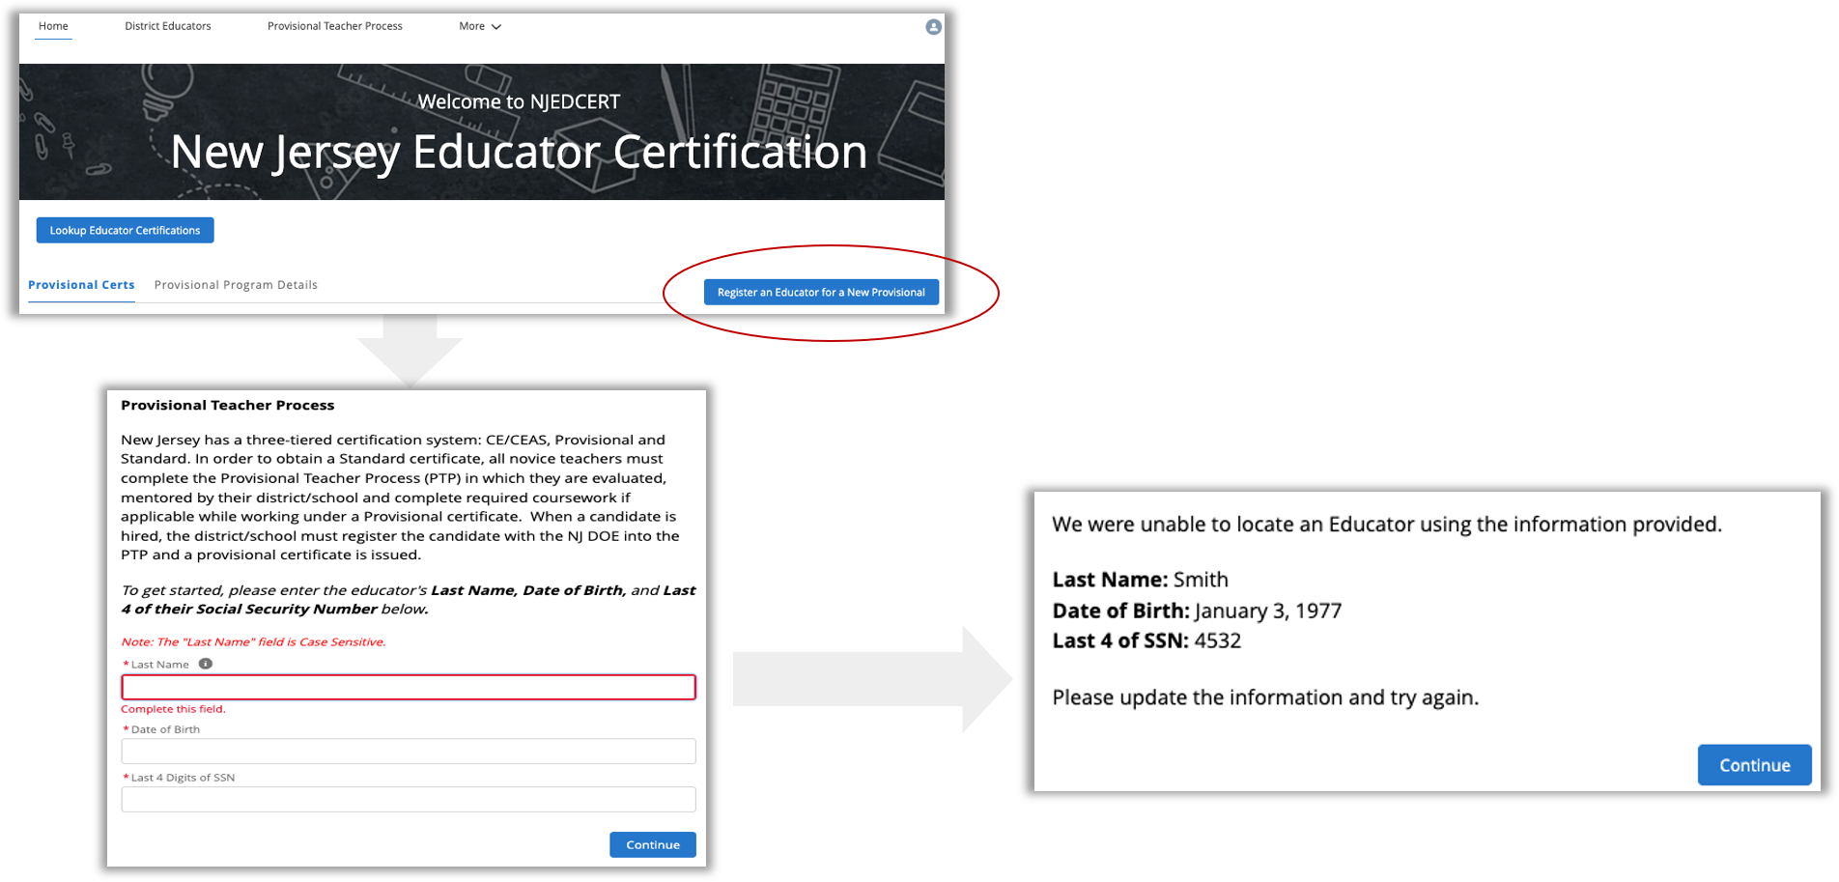
Register Educator for New Provisional License

Slide 25
New Provisional: Educator Information (1 of 2)
Steps to register an educator for the provisional teacher process:
Complete fields for last name, date of birth, and last four digits of social security number.
Verify email address on file.
Complete fields for job type, employment status, start date, and additional job details.
Select the license that matches the position for which you hired the educator.

Slide 26
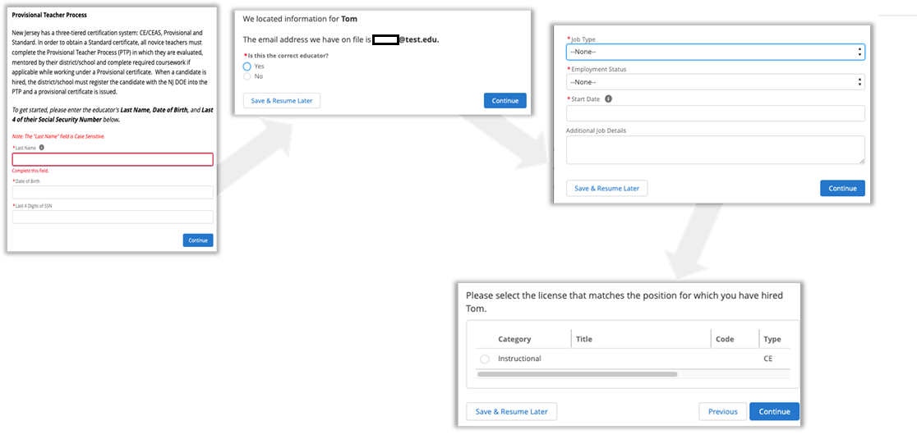
New Provisional: Educator Information (2 of 2)

Slide 27
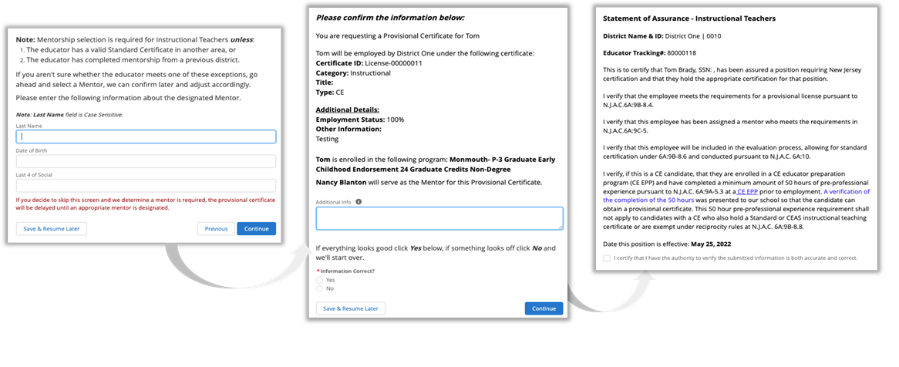
New Provisional: Mentorship & Confirmation
Mentorship and alternate route information will be requested.
After mentorship, a confirmation of the Provisional License to be created.

Slide 28
New Provisional License
After completing the registration:
A Case is created and assigned to the provisional program.
An application record is created within the Case.
A new provisional teacher process record is created for that Educator.

Slide 29
Viewing Provisional Licenses
You can view Provisional Licenses when you login to the Portal
The first column provides the “License ID” associated with each license in the system for the educator; To sort the list, click on the column header by which you want to sort.
To view an individual License, click on the “License ID” value.
To view an Educator’s record, click on the “Educator Name.”
Use the search box to filter your Provisional Certification list.

Slide 30
Entering Final Summative Ratings and Mentorship
Ratings and mentoring weeks are entered by the school district into NJEdCert.
Click on the teacher's name that is hyperlinked which will transition to a page that has the option to choose “Enter Final Summative Ratings and Mentorship”.
Mentoring time must be tracked by each employer. If a provisional teacher leaves employment from the school district and begins to work in another New Jersey school district, the initial district will need to complete the Mentoring Transfer Template to document the amount of mentoring time completed.

Slide 31
Renewal of Provisional Certificates
Candidates who are working under a provisional certificate that, will expire on July 31, and who have not yet met the requirements for a standard certificate will need to be issued a provisional renewal to continue employment in current role while working towards a Standard certificate. The school district must initiate the renewal process in NJEdCert.
Candidates may be eligible for one provisional renewal. CE teachers must provide the district with documentation of progress made towards alternate route program completion.
Candidates completing a TOSD, Bilingual, or ESL program must also provide documentation to the district of progress made towards program completion to be eligible for a second renewal of the provisional.

Slide 32
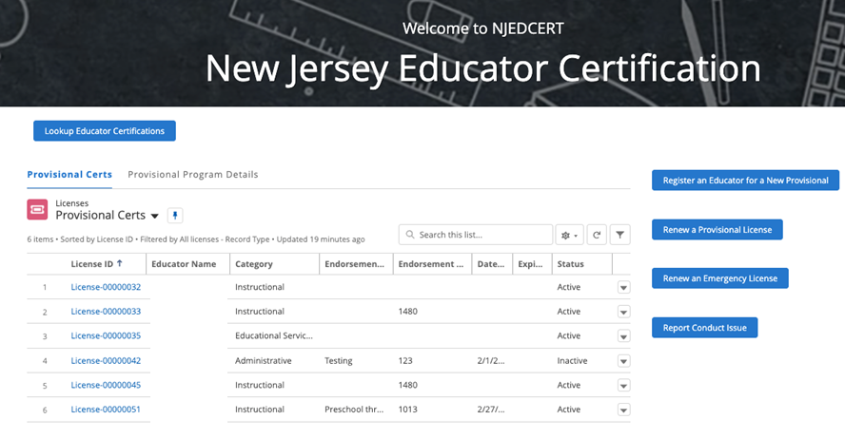
Initiating Provisional License Renewal (1 of 4)
From homepage, click “Renew a Provisional License.”

Slide 33
Initiating Provisional License Renewal (2 of 4)
There will be a list of provisional licenses that are eligible to be renewed.
Select the appropriate educator.
Follow the screen prompts.

Slide 34
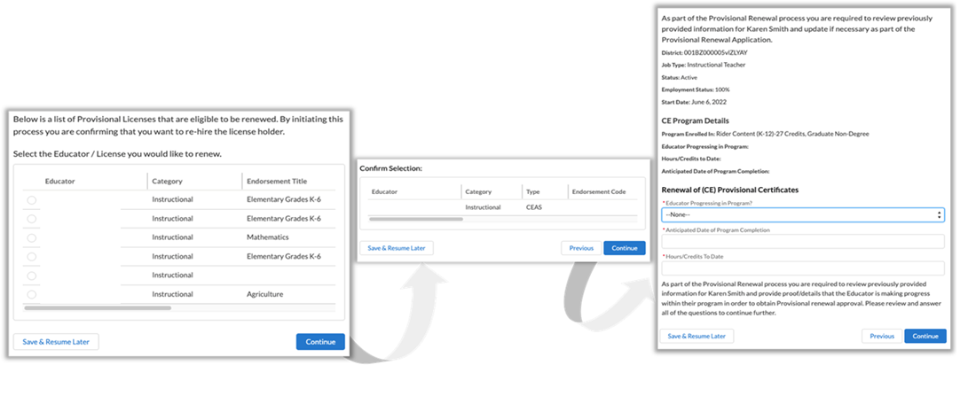
Initiating Provisional License Renewal (3 of 4)

Slide 35
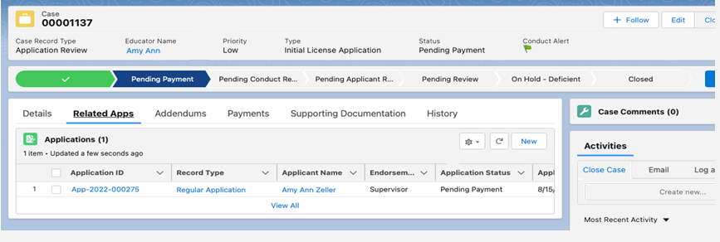
Initiating Provisional License Renewal (4 of 4)
Following the conclusion of processes:
A Case is created with status “Pending Payment.”
An application is created and associated to the Case.
A new PTP record is created and associated to the educator and application.
The educator will receive an email with subject “Your Provisional Renewal Application” to allow for educator to complete application and payment.

Slide 36
Entering a Termination Date
When an educator leaves a school district, a termination date, which is the last date of employment, must be entered in NJEdCert.
A PTP record is created for each endorsement the educator is registered.
The termination date must be entered for each PTP ID record associated with a district.

Slide 37
Conversion to Standard
School districts must initiate conversion to a standard for all educators through NJEdCert. Before initiating conversion to standard, the school district must confirm the following has been completed:
Teachers: Completed 30 weeks of mentoring; received two years of effective or highly effective evaluations, CE candidates must complete all required coursework and pass the teacher performance assessment.
Administrators: Completed one-to-two-year residency.
SAC: Completed a 6-month residency and received an effective or highly effective rating, completed coursework, if applicable.
SLMS/ALMS: Completed a one-year residency and received an effective or highly effective rating, completed coursework, if applicable.

Slide 38
Initiating Conversion to Standard
The school district recommends the educator by choosing the educator in the “list of conversions to standards” tab in NJEdCert.
Educators who have not previously applied online through NJEdCert must register before the district submits for a standard. The educator should not apply for a standard after creating an account. The educator needs to wait for the email with further instructions per step 3.
CE educators must update biographical information to include altroute route program information.
Once submitted, a case is created and is routed to the Provisional Office for review.
Upon review, the Provisional Office sends the educator an email with instructions to finalize the application in order to complete the oath and make payment.
Note: Everyone needs to click into the Payment tab, but only CE holders will be charged.
After completing the online application, the case will be routed back to the Provisional Office for final review/issuance.

Slide 39
NJEdCert: Supporting Educators

Slide 40
Servicing Cases
NJEdCert’s Educator Portal allows educators to submit inquiries and make other customer service requests.

Slide 41
Checking Application Status
Candidates are able to log into the portal and check application status.

Slide 42
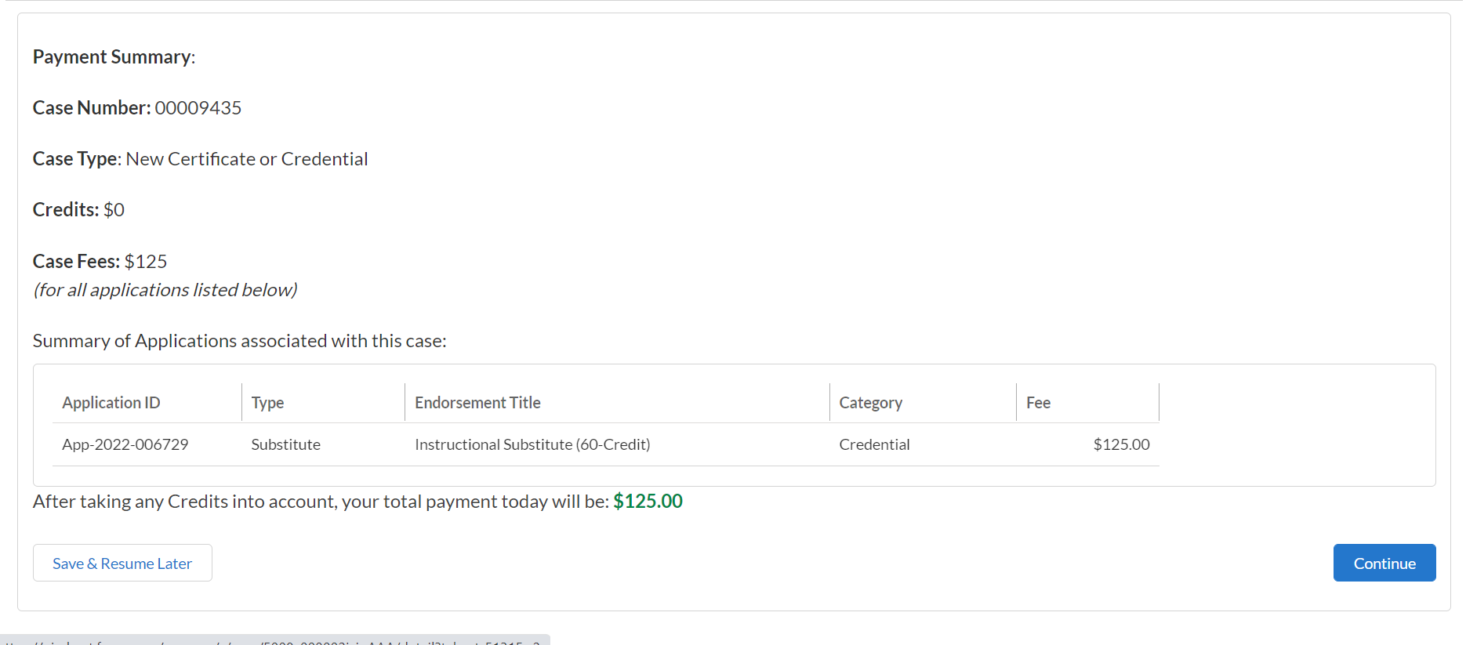
Making Payments
Candidates must be in the case and click the payment tab to make a payment.

Slide 43
Document Collection
Documents may be uploaded from various providers;
Official transcripts are submitted by the college or clearinghouse to certapplication@doe.nj.gov and then uploaded into the system by NJDOE’s intake staff;
Record of Professional Experience (ROPE) and VOPC forms are now embedded in the system. Institutions and employers will receive electronic forms which they complete and will automatically be sent back and matched to the candidate’s application (check school district security settings to ensure you receive the emails from the system). Candidates are advised of document status here:

Slide 44
Degree vs. Non-Degree Path (1 of 2)
Degree Path: Allows candidates to apply for all certificate types

Slide 45
Degree vs. Non-Degree Path (2 of 2)
Non-Degree Path limits candidates to applications for specific certificate types.
Do you plan on applying for a Credential or Career and Technical Education (CTE) Certification that does not require a degree?
Examples of certification areas and credentials that do not require a degree, include but are not limited to:
Carpentry
Electrical
Automotive
Culinary
Cosmetology/Hairstyling
You may need to show proof of a high school diploma.
*I understand and would like to continue.
Yes
No

Slide 46
Educator Preparation Program Nominations
Educators who have completed a New Jersey EPP and are being nominated for certification by the EPP must:
Wait until the EPP nominates them and then accept the nomination; the educator should not apply using the regular application process.
Educators will receive a link sent via email through the system and follow the instructions on the following slides for creating an account.

Slide 47
Required Data For Creating Educator Accounts
Data for creating and/or updating an account:
Email address (see notes on the following slides);
Date of Birth;
SSN;
Previous Tracking Number (TCIS Tracking number);
Language Testing International (LTI) Email (only certain candidates);
PRAXIS ID (eight digits);
United States Citizen (Yes/No);
Military Veteran Status;
First Name;
Last Name; and,
Gender

Slide 48
Creating an Account (1 of 2)
Educators who already held a certification in TCIS must use the same email address that was used in TCIS.
Educators who have been nominated by an EPP and have never logged into the new system (NJEdCert) must use the email address that was used when nominated by an EPP.
Educators must provide accurate personally identifiable information including tracking number (if the educator has one), social security number, and date of birth.

Slide 49
Creating an Account (2 of 2)
Educators who do not hold certification in TCIS and are applying for certification for the first time in NJEdCert must create an account in the new system using a permanent email address.
All personally identifiable information must be accurate - be mindful of autofill features in browsers.

Slide 50
Limited CE/CEAS Pilot Program

Slide 51
P.L. 2021, c. 224 Overview
P.L. 2021, c. 224 requires the NJDOE to establish a five-year pilot program for individuals to obtain a limited certificate of eligibility (CE) and limited certificate of eligibility with advanced standing (CEAS) in an instructional area, provided they meet the criteria established in the law.
These limited certificates may only be utilized in certain districts approved by the Commissioner to participate.
Notes:
Just a reminder that this pilot program is required under P.L. 2021, c.224 in response to the need for teachers in the state.

Slide 52
N.J.A.C. 6A:9B-8A.3(a) Limited CEAS Requirements
To be eligible for a limited CEAS in an instructional area, the candidate shall successfully complete a State-approved educator preparation program and meet all requirements for a CEAS, except one of the following:
The minimum GPA requirement; or
The minimum passing score on an appropriate State test(s) of subject matter knowledge.
Fees - $170.00, which includes the issuance of the provisional certificate and standard certificate.

Slide 53
N.J.A.C. 6A:9B-8A.3(b) Limited CE Requirements
To be eligible for the limited CE in an instructional area, the candidate shall hold a minimum of a bachelor’s degree and shall meet all other requirements for a CE, except one of the following:
The minimum number of subject area course credits;
The minimum GPA;
The minimum score on a Commissioner-approved test of basic reading, writing, and mathematical skills; or
The minimum passing score on an appropriate State test(s) of subject matter knowledge.
Fees - $170.00, which includes the issuance of the provisional certificate and standard certificate.

Slide 54
N.J.A.C. 6A:9B-8A.4(a) and (b) Provisional Requirements
The limited CE or CEAS in an instructional area shall satisfy the CE or CEAS requirement at N.J.A.C. 6A:9B-8.1(a) for purposes of obtaining a provisional certificate until November 1, 2027.
To be eligible for a provisional certificate, a certificate holder with a limited CE or CEAS shall meet all existing provisional certification requirements at N.J.A.C. 6A:9B-8.4.

Slide 55
N.J.A.C. 6A:9B-8A.4(c) Standard Requirements
To be eligible for a standard certificate, a provisional certificate holder hired under this pilot program shall meet all existing requirements for a standard instructional certificate at N.J.A.C. 6A:9B-8.7.

Slide 56
N.J.A.C. 6A:9B-8A.4(d) Expiration of Limited CE/CEAS
Holders of the limited CE or CEAS shall meet all requirements for a provisional certificate at N.J.A.C. 6A:9B-8.4 no later than September 1, 2027.

Slide 57
Guidance for LEAs
LEAs approved to participate in the pilot program must submit candidates for a limited CE or limited CEAS to the County Office of Education via email and confirm that recommended candidates have satisfied requirements of the limited CE or CEAS as applicable.
The LEA will be expected to hire the recommended candidates upon NJDOE’s granting of the certification. In submitting candidates recommended for certification, the LEA will be expected to provide the following information in order to ensure that recommended candidates are placed in expedite status:
The candidate’s name, date of birth, and certification application tracking # (if available);
An attestation of the LEA’s intent to hire the candidates; and,
The requirement from which the limited CE candidate is being waived.
Candidates recommended for a limited CE by an LEA must submit an application through the NJDOE’s online certification system, NJEdCert. Upon submission of all required documentation, the certification application that is recommended by the LEA and approved by the County Office of Education will be placed in expedite status.

Slide 58
Guidance for Educators
Candidates may apply directly for a limited CE in the educator certification system by going online at NJEdCert, registering and applying for the certificate. Candidates must submit all required documentation for review for eligibility.
Candidates for limited CEAS must be recommended for certification by the New Jersey Educator Preparation Program (EPP) they completed, just as EPPs must recommend other CEAS candidates.
CEAS EPP programs must receive an approval letter from the Department prior to adjusting policies and recommending candidates for limited CEAS certification.
For limited CEAS candidates, the candidate’s EPP will first recommend the candidate, then they will be prompted to complete the educator portion of the process, as is the case for other CEAS applications.
Additional Limited CE or CEAS Guidance available on the NJDOE website.

Slide 59
Contact Customer Service
Call Center: (609) 292-2070 Hours: Monday through Friday from 8 a.m. to 7 p.m.
Create an NJEdCert account to submit questions and communicate directly with customer service staff. Case inquiries include:
Name update
DOB update
Social Security Number update
Citizenship Status update
Test Score Records
Application Questions
Customer Service Questions
For Technical Assistance and Support only, contact GeneralCertQuestionsNJEdCert@doe.nj.gov

Slide 60
Additional Contact Information
Provisional Teacher Process: provisional.teacher@doe.nj.gov
Alternate Route Certification: altroute@doe.nj.gov
Office of Educator Evaluation: edueval@doe.nj.gov.
Achieve NJ: webpage

Slide 61
Additional Resources
NJDOE NJEdCert Page
EPP Training
District Training
Educator Training

Slide 62
Thank You!
New Jersey Department of Education
Follow Us!
Facebook: @njdeptofed
Twitter: @NewJerseyDOE
Instagram: @NewJerseyDoe

