Slide 1

District Certification Training Summer 2023
Office of Recruitment, Preparation and Certification
Division of Field Support and Services July 2023

Slide 2
Agenda
Introductions
NJEdCert Updates
Certification Fee Holiday
Educator Conduct
Chapter 9 Amendments
Provisional Process

Slide 3
NJEdCert Updates

Slide 4
NJEdCert Enhancements and Updates
Application and process flow updates:
  Language and flow updates for substitute credential and certificate applications.
  Account creation processes.
  Provisional process.
  Auto-emails to educators and school districts.
System improvements for enhanced user experience:
  Educator lookup function:
    Certification status is available for employers to confirm certificates and status.
  School district view enhanced to allow hiring school districts to view application status of potential hires.
  Web to Case has an embedded communication system.

Slide 5
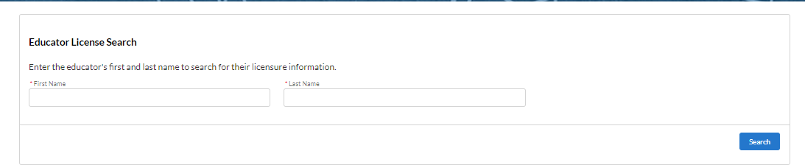
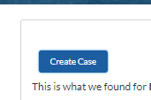
Web to Case – District Process (1 of 2)
District Process To Submit a Customer Service Question / Case
Step 1: Look up an educator using the Educator License Search.
Step 2: Click on the “Create Case” button.

Slide 6
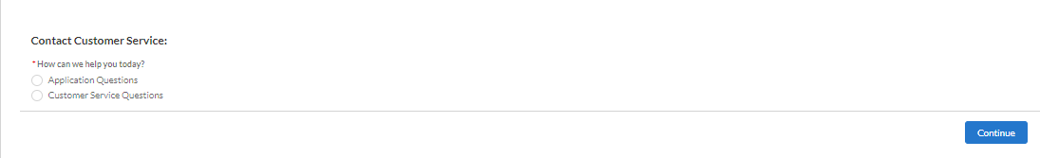
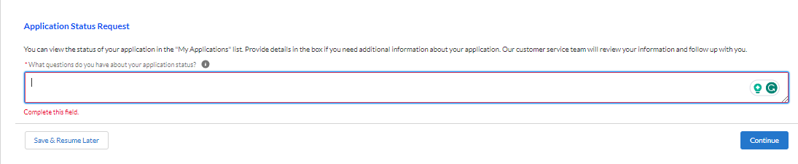
Web to Case – District Process (2 of 2)
Step 3: Select the type of question.
Step 4: Type the question and click “Continue.”

Slide 7
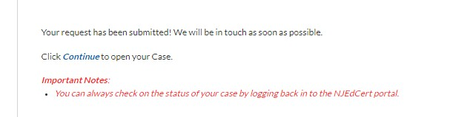
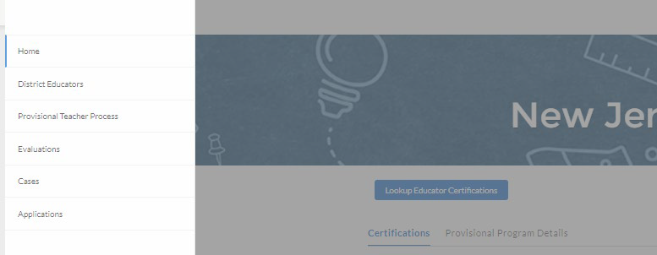
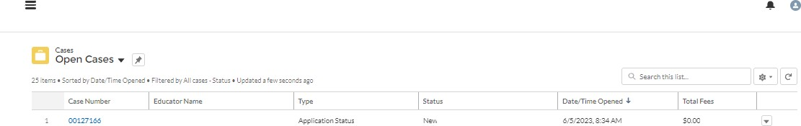
Web to Case – Check Case Status
Option 1: Click “Continue” after the question is submitted.
Option 2: Click “Cases”, then “All Cases,” then “Open Cases.” Open the case by clicking on the Case number.

Slide 8
Certification Fee Holiday

Slide 9
Certification Fee Holiday (1 of 3)
The New Jersey Department of Education is excited to announce the implementation of the Certification Fee Holiday initiative!
Starting July 1, 2023, all prospective and current educators will enjoy a temporary waiver of certification fees.
This initiative aims to increase the educator pool by reducing a financial burden and promotes career advancement for our dedicated educators seeking additional endorsements.
By waiving certification fees temporarily, we are promoting equal access to certification, irrespective of their financial situations.
This initiative aligns with our mission to provide educational equity to all students by expanding the educator pool to ensure all students have access to high-quality educators.

Slide 10
Certification Fee Holiday (2 of 3)
NJEdCert Application Language Updates:
Important Notice of Fee Holiday
When prompted to complete payment information for the purposes of utilizing the Fee Holiday, the payment process requires entering a distinct credit card code, security code, and additional information. There is no charge or transaction applied toward any individual for the purposes of obtaining a certification or credential. Please utilize the code below for the purposes of complying with application procedures.
To complete the transaction, enter your personal identification information and enter the following information on the final payment page:
  Credit Card Code: 4242424242424242
  Security Code: 724
  Expiration Month: 07 - July
  Expiration Year: 2024
Please be advised there will be no personal charges for any transactions.

Slide 11

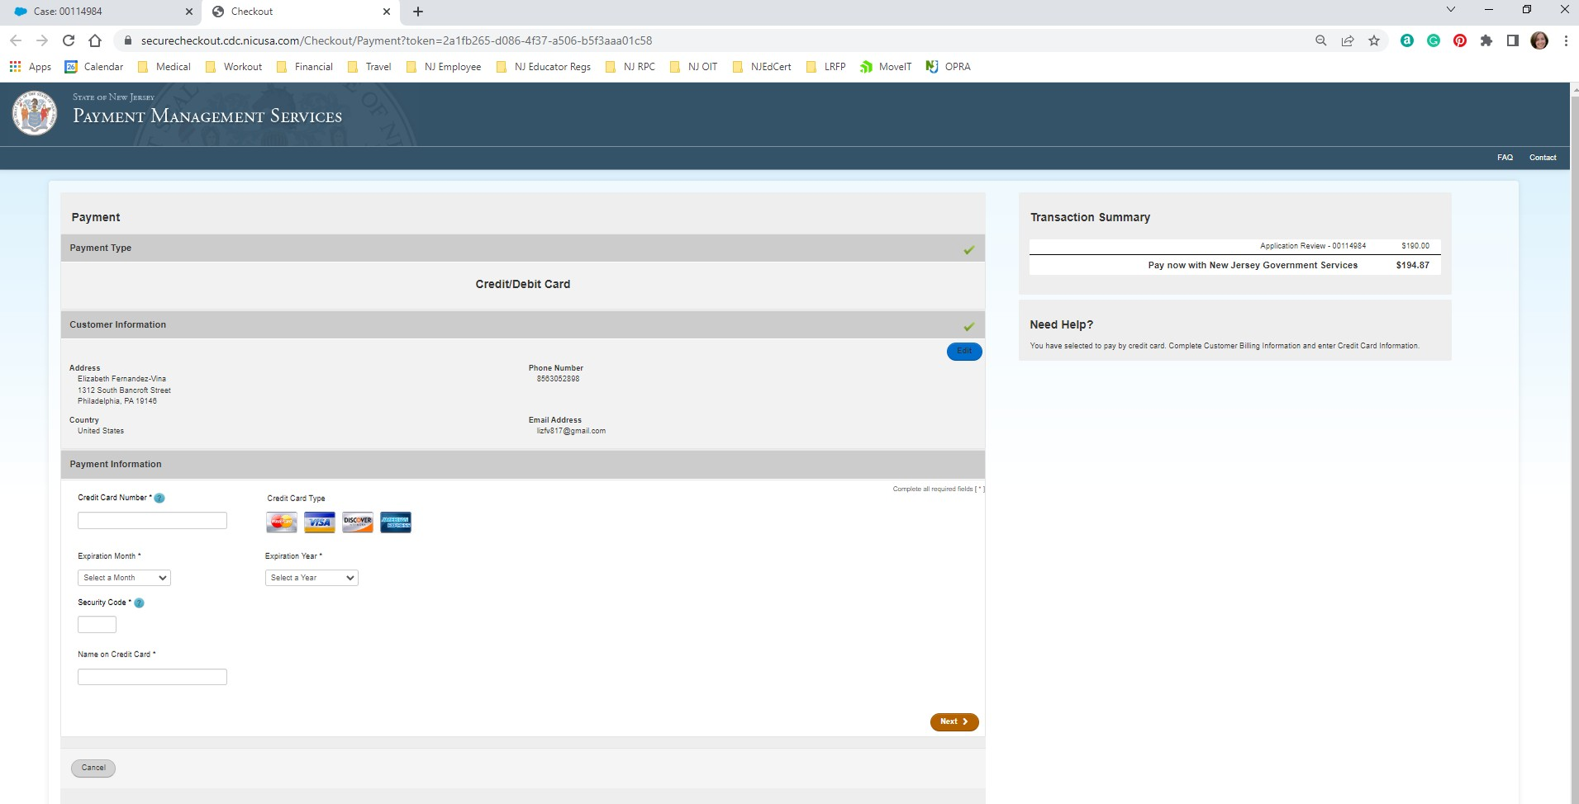
Certification Fee Holiday (3 of 3)
The Payment Management Service Personal Information Page - On this screen the educators will complete a “payment” using the provided credit card code.

Slide 12
Educator Conduct

Slide 13
Reporting Educator Conduct
District Superintendents are required, pursuant to N.J.A.C. 6A:9B-4.3(a), to report allegations of unbecoming conduct that result in an educator’s termination, resignation, retirement or suspension of an educator. Educators include:
Certified staff, i.e. “teaching staff members,” substitute teachers, and employees of 3rd party vendors.
Unbecoming conduct is a broad term that encompasses a variety of conduct, not limited to inappropriate communications with students and outside of school grounds criminal or other improper conduct.
The report must be made to the State Board of Examiners (Board) and can be done via email to stateboardofexaminers@doe.nj.gov. The Board’s secretary is Rani Singh.
The email should include the educator’s name and tracking number, as well as a brief explanation of the conduct. The Board’s Coordinator will reach out to seek additional information, if same is necessary. N.J.A.C. 6A:9B-4.3b requires districts to cooperate by providing requested documentation.

Slide 14
Revocation/Suspension
Educator revocation/suspension information is released through the county offices approximately once per month. School districts are responsible for using the educator lookup to confirm licenses.
All decisions are publicly available at: https://www.nj.gov/education/legal/examiners/
Educators who are revoked/suspended are required to report same to an employing district.

Slide 15
Chapter 9 Amendments

Slide 16
N.J.A.C. 6A:9B Amendments (1 of 13)
N.J.A.C. 6A:9B-5.7 Non-citizen standard certificates can now be renewed three times for a total of up to 20 years.
N.J.A.C. 6A:9B-5.14 Limited certificate for foreign teachers' endorsement renamed to Limited certificate for noncitizen teachers.
N.J.A.C. 6A:9B-6.1 Removes the six-credit limit on professional education to transfer into four-year educator preparation programs from two-year institutions.

Slide 17
N.J.A.C. 6A:9B Amendments (2 of 13)
N.J.A.C. 6A:9B-7.2 - Instructional substitute credential
o 30-credit substitute credential pilot program ended June 30, 2023.
60-credit substitute credential has been permanently lowered to 30 semester-hour credits.
Enrollment in a college is not required.
Must be at least 18 years old.
N.J.A.C. 6A:9B-7.4 Career and technical education substitute credential
Teaching experience now acceptable along with work experience.
Five-year employment experience time limit has been removed.
Out-of-state occupational licenses are now acceptable.

Slide 18
N.J.A.C. 6A:9B Amendments (3 of 13)
N.J.A.C. 6A:9B-8.3 Core Competencies/Basic Skills
Qualifying minimum scores on the SAT, ACT or GRE shall be the top-half percentile score for all test takers in the respective year.
Candidates may hold a master's or terminal degree with a minimum GPA of 3.00 from an accredited institution of higher education.
N.J.A.C. 6A:9B-8.8 Reciprocity
Candidates applying for reciprocity are exempt from repeating a clinical practice for additional instructional certificates. The regulation eliminates the requirement for candidates who satisfied it as part of their initial certification.
Standard Certification – Removes language relating to the experience being within the last four calendar years.
*If experience has not been met, candidate will be issued a CEAS, not CE/CE-R.

Slide 19
N.J.A.C. 6A:9B Amendments (4 of 13)
N.J.A.C. 6A:9B-10.3 Health and Physical Education and Physical Education
o Coursework in a dual sport has been removed and replaced with study in adaptive physical education.
N.J.A.C. 6A:9B-10.4 Science
Candidates holding a science CEAS or standard certificate and seeking an additional science CEAS or standard certificate shall:
Complete 15 credits in the corresponding content area with six credits at the advanced level.
Pass the State test of subject matter knowledge. GPA flexibilities pursuant to
N.J.A.C. 6A:9B-8.2(c) and 8.3(b) shall not apply.

Slide 20
N.J.A.C. 6A:9B Amendments (5 of 13)
N.J.A.C. 6A:9B-10.8 Speech arts and dramatics
This endorsement has been deleted from code.
N.J.A.C. 6A:9B-10.10 Comprehensive business
6 semester-hour credits in accounting are required, instead of 12 semester- hour credits.
N.J.A.C. 6A:9B-11.3 Career and technical education
Amends language to include out-of-state and national occupational credentials for experience-based career and technical education endorsements.

Slide 21
N.J.A.C. 6A:9B Amendments (6 of 13)
N.J.A.C. 6A:9B-10.15 Computer Science
Authorization: This endorsement authorizes the holder to teach computer science, as described in Standard 8.1 of the NJSLS, in all New Jersey public schools
Holders of other endorsements may teach computer science, as defined in Standard 8.1 of the NJSLS, until July 1, 2027. After July 1, 2027, a teacher of computer science in preschool through grade 12 must hold a computer science endorsement issued pursuant to N.J.A.C. 6A:9B-10.15.

Slide 22
N.J.A.C. 6A:9B Amendments (7 of 13)
Computer Science Endorsement Pathways
Meet all regular requirements for the CE, CEAS or standard and complete a minimum of three semester-hour credits, or equivalent, in a methods of teaching computer science course offered by an accredited college or university. CE holders must complete the course within 12 months of the initial computer science teaching assignment.
Candidates holding a standard instructional certificate in another endorsement area shall:
  Complete 15 semester hour credits of computer science coursework;
  Pass the appropriate State test of computer science content knowledge; and
  Complete a minimum of three semester-hour credits, or equivalent, in a methods of teaching computer science course offered by an accredited college or university within 12 months of the initial computer science teaching assignment.

Slide 23
N.J.A.C. 6A:9B Amendments (8 of 13)
Computer Science Endorsement Pathways (continued)
Candidates who hold standard certificates and teach computer science as of September 1, 2024, shall be eligible for the computer science endorsement if they:
  Have received two effective or highly effective ratings in teaching computer science within the last four years; and
  Pass the appropriate State test of computer science content knowledge.

Slide 24
N.J.A.C. 6A:9B Amendments (9 of 13)
N.J.A.C. 6A:9B-11.9(d) and (e) Middle School with subject-matter specialization
New middle school with subject-matter specialization endorsement in science, technology, engineering, and mathematics (STEM). Holders of this new endorsement will be authorized to teach science and mathematics in grades five through eight in all public schools.
  Requirements:
    Hold a middle school with subject-matter specialization endorsement in mathematics or science.
    Pass the necessary State subject-matter test in the additional content area.
New middle school with subject-matter specialization endorsement in humanities. Holders of this new endorsement shall be authorized to teach English language arts, social studies and related literature, and social and civic engagement courses in grades five through eight in all public schools.
  Requirements:
    Hold the middle school with subject-matter specialization endorsement in English language arts or social studies.
    Pass the necessary State subject-matter test in the additional content area.

Slide 25
N.J.A.C. 6A:9B Amendments (10 of 13)
N.J.A.C. 6A:9B-12.6 Supervisor
Eliminated the requirement of three elective credits in curriculum design and development. The six electives may now include instructional staff supervision and/or curriculum design and development.
N.J.A.C. 6A:9B-13– Acting Administrators
Language added that an individual who holds a CE applicable to an administrator position would be eligible to serve as an acting administrator without Commissioner approval.
Language amended that the Commissioner’s approval, pursuant to this section, will be for three months’ duration and may be renewed for a period of three months at a time on a case-by-case basis upon application.
The district board of education shall apply, in writing, to the Commissioner, through the executive county superintendent, for permission to employ the person in an acting capacity and state the reason(s) why the action is necessary to fill the position of superintendent, assistant superintendent, school business administrator, principal, or vice principal with a person who is designated as the acting administrator in a respective situation and who does not hold the CE or the standard New Jersey certificate required for the position.

Slide 26
N.J.A.C. 6A:9B Amendments (11 of 13)
N.J.A.C. 6A:9B-14.2 Student Assistance Coordinator (SAC)
o Adds the completion of a Department approved graduate program with a minimum of 21 semester-hour credits.
Practicum has been moved as a separate requirement. SAC CE candidates will not be required to complete the practicum in order to be eligible for the SAC Standard certificate.
N.J.A.C. 6A:9B-14.3 and 14.4 School Nurse and School Nurse/non-instructional
Adds course requirements for study in substance abuse in accordance with (L.2017, c.70)

Slide 27
N.J.A.C. 6A:9B Amendments (12 of 13)
N.J.A.C. 6A:9B-14.8 School Counselor
o Codifies that the practicum must be completed as a school counselor and supervised by a person holding a standard New Jersey or out-of-State school counselor endorsement.
N.J.A.C. 6A:9B-14.13 Reading Specialist
Additional coursework emphasizing foundational reading skills has been added to the requirements, effective September 1, 2025.
N.J.A.C. 6A:9B-14.14 School library media specialist
Amends language for a candidate to hold only a master’s degree in library media studies from an accredited college or university in order to be eligible for a CE.

Slide 28
N.J.A.C. 6A:9B Amendments (13 of 13)
N.J.A.C. 6A:9B-14.15 Associate school library media specialist
Phases out the associate school library media specialist endorsement by September 1, 2027.
N.J.A.C. 6A:9B-14.22 Bilingual language paraprofessional credential
Develops a new bilingual paraprofessional credential that authorizes the holder to provide bilingual instructional support services in a P-12 setting.
N.J.A.C. 6A:9B-14.23 Early literacy specialist
Authorizes the holder to serve as a reading specialist in grades Preschool through 3. The endorsement will be required as of the 2026-2027 school year.

Slide 29
Provisional Teacher Process: Teachers

Slide 30
Provisional Process for Teachers
Once employment is secured, it is the responsibility of the hiring school district to register the teacher into the Provisional Teacher Process via NJEdCert. A provisional certificate is then issued which is valid for a period of up to two school years. (The educator cannot apply for the provisional certificate; this certificate is requested by the school district.)
If the candidate has a Certificate of Eligibility (CE), the district must verify completion of the required 50 hours of preservice and must choose the CE Educator Preparation Program (EPP) where formal instruction is being completed in the drop-down menu under program enrollment.
School districts must register the teacher within 60 days of hire.

Slide 31
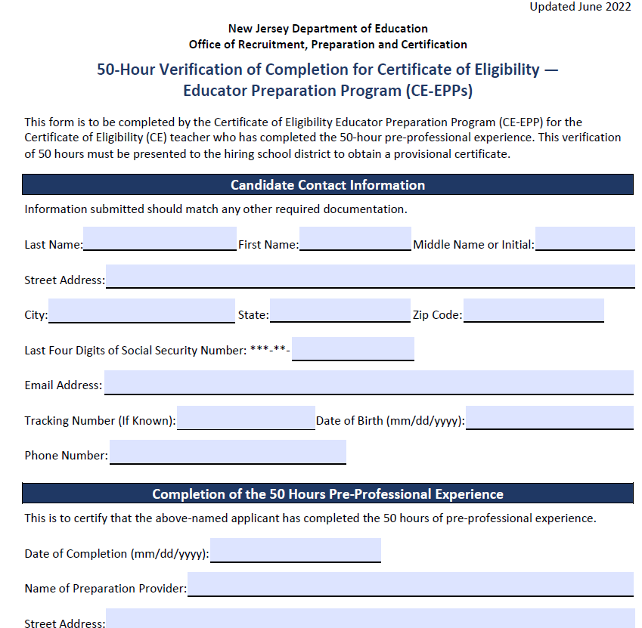
50-Hour CE-EPP Verification of Program Completion (VOPC) Form

Slide 32
Provisional Process for Teachers
The following must be completed while employed under provisional certification to obtain standard license:
Mentoring and Induction
Provisional teachers, CE and Certificate of Eligibility with Advanced Standing (CEAS), must complete a school mentoring program.
  Mentoring fee charged by the district is $550 for CEAS teachers and $1,000 for CE teachers.
  The New Jersey Department of Education Professional Development website has information about developing a mentoring plan. Please contact TeachPD@doe.nj.gov for any questions you may have about developing a mentoring plan.
Supervision and Evaluation
At least two years of effective or highly effective evaluations under the AchieveNJ system.
Alternate Route Formal Instruction for CE teachers
At least 400 hours or credit equivalent of instruction through an approved CE-EPP.

Slide 33
Formal Instruction for CE Holders (1 of 2)
There are six categories of CE programs:
o Department-approved CE educator preparation program (CE EPP) for P-12 Subject Area and K-6 Elementary Teachers;
  Career and Technical Educators (CTE);
  Preschool – Grade 3 (P-3 );
  Teacher of Students with Disabilities (TOSD);
  English as a Second Language (ESL); and,
  Bilingual/Bicultural.
The list of all approved CE programs is available online.

Slide 34
Formal Instruction for CE Holders (2 of 2)
“Program Enrollment” requirements for each of the following:
ESL candidates:
  400-hour CE-EPP program; and
  15-21 credit ESL program.
Bilingual candidates with content area CE:
  400-hour CE-EPP program; and
  15 credit Bilingual program.
Teacher of Students with Disabilities (TOSD) candidates with content area CE:
  400-hour CE-EPP program; and
  21-27 credit TOSD program.

Slide 35
Provisional Teacher Process: Educational Services and Administrative Endorsements

Slide 36
Provisional Process for School Library Media Specialists (SLMS) and Associate School Library Media Specialists (ASLMS)
The school district will register the candidate through NJEdCert.
o If the educator has a CE, they must choose the college where courses will be taken in the drop-down menu under program enrollment.
A one-year residency and mentoring is required under the provisional certificate.
  Mentoring must be completed by an experienced school library media specialist. If no experienced SLMS is available within the school district to mentor the candidate, an experienced SLMS mentor can be provided through the New Jersey Association of School Librarians (NJASL). New Jersey Association of School Librarians (NJASL) can be reached at mentoring@njasl.org.
A candidate’s standard certificate determination will be based on completion of the residency. The final evaluation rating is entered by the school district in NJEdCert.

Slide 37
Provisional Process for Student Assistance Coordinators (SAC)
The school district registers the candidate through NJEdCert.
o If the candidate has a CE, they must choose the college where courses will be taken in the drop-down menu under program enrollment.
A six-month residency is required under the provisional certificate.
A candidate’s standard certificate determination will be based on completion of the residency and the final evaluation rating.
The final evaluation rating is entered by the district in NJEdCert.
A CE candidate must also submit transcripts and request the Verification of Program Completion be completed and submitted by the EPP.

Slide 38
Provisional Process for Administrators
The school district registers the administrator through NJEdCert.
Administrators must also be registered in the appropriate program:
  For Principals: Register with Leader to Leader/ NJPSA for the two-year residency.
  For School Administrators: Register with NJASA for the one-year residency.
  For School Business Administrators: Register with NJASBO for the one-year residency.
A one-to-two-year residency is required under the provisional certificate.
A candidate’s standard certificate determination will be based on successful completion of the residency.

Slide 39
New Provisional Registration

Slide 40
New Provisional: Educator Information
Steps to register an educator for the provisional teacher process
Complete fields for last name, date of birth, and social security number.
Verify email address on file.
Complete fields for job type, employment status, start date, and additional job details.
Select the license that matches the position for which you hired the educator.
Mentorship and alternate route information will be requested.

Slide 41
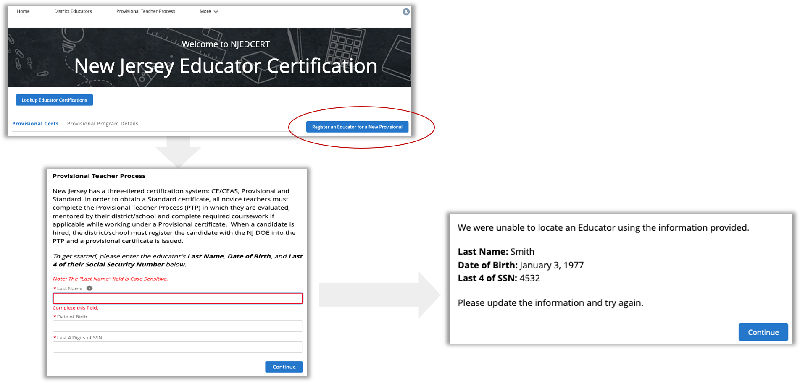
Register Educator for New Provisional License

Slide 42
New Provisional License
After completing the registration
A case is created and assigned to the provisional program.
An application record is created within the case.
A new provisional teacher process record is created for that educator.

Slide 43
Provisional Renewal Process

Slide 44
Renewal of Provisional Certificates
Candidates who are working under a provisional certificate that will expire on July 31, and who have not yet met the requirements for a standard certificate, will need to be issued a provisional renewal to continue employment in current role while working towards a standard certificate. The school district can initiate the renewal process in NJEdCert in June of the expiring year.
Candidates may be eligible for one provisional renewal. CE teachers must provide the school district with documentation of progress made towards alternate route program completion.
Candidates completing a TOSD, Bilingual, or ESL program must also provide documentation to the school district of progress made towards program completion to be eligible for a second renewal of the provisional.

Slide 45
Initiating Provisional License Renewal (1 of 3)
From homepage, click “Renew a Provisional License.”

Slide 46
Initiating Provisional License Renewal (2 of 3)
There will be a list of provisional licenses that are eligible to be renewed.
Select the appropriate educator.
Follow the screen prompts.

Slide 47
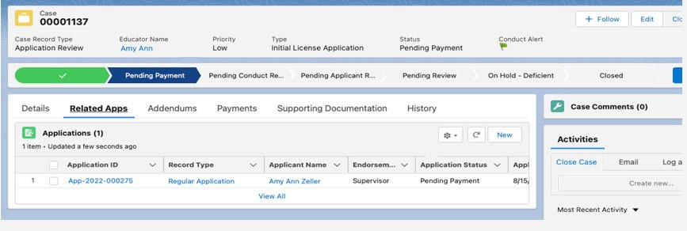
Initiating Provisional License Renewal (3 of 3)
Following the conclusion of processes:
A case is created with status “Pending Payment.”
An application is created and associated to the case.
A new PTP record is created and associated to the educator and application.
The educator will receive an email with subject “Your Provisional Renewal Application” to allow for educator to complete application and payment.

Slide 48
Entering a Termination Date
When an educator leaves a school district, a termination date, which is the last date of employment, must be entered in NJEdCert.
A PTP record is created for each endorsement the educator is registered for in NJEdCert.
  To enter a termination date, you will need to go to your district educator list and click educators hyperlinked name to pull up account records. You must locate the educator’s PTP ID records for your district and enter a termination date for each.

Slide 49
Conversion to Standard Process

Slide 50
Conversion to Standard
School districts must initiate conversion to a standard for all educators through NJEdCert. Before initiating conversion to standard, the school district must confirm the following has been completed:
Teachers: Completed 30 weeks of mentoring, received two years of effective or highly effective final summative ratings and completed required coursework, if applicable.
Administrators: Completed one-to-two-year residency.
SAC: Completed a 6-month residency, received an effective or highly effective rating and completed coursework, if applicable.
SLMS/ALMS: Completed a one-year residency, mentoring, received an effective or highly effective rating and completed coursework, if applicable.

Slide 51
Entering Final Summative Ratings and Mentorship
Ratings and mentoring weeks are entered by the school district into NJEdCert.
  Access by going to your district’s educator list and clicking on the teacher's hyperlinked name which will transition to a page that has the option to choose “Enter Final Summative Ratings and Mentorship.”
Mentoring time must be tracked by each employer. If a provisional teacher leaves employment from the school district and begins to work in a new school district, the initial district will need to complete the Mentoring Transfer Template to document the amount of mentoring time completed.

Slide 52
Contact Information

Slide 53
Contact Customer Service
Call Center: (609) 292-2070 Hours: Monday through Friday from 8 a.m. to 7 p.m.
Educators can create an NJEdCert account to submit questions and communicate directly with customer service staff. Case inquiries include:
  Name update
  DOB update
  Social Security Number update
  Citizenship Status update
  Test Score Records
  Application Questions
  Customer Service Questions
School Districts can create a case through their school district account to submit questions.

Slide 54
Additional Contact Information/Resources
Office of Educator Evaluation: edueval@doe.nj.gov.
Achieve NJ: webpage
EPP Training: https://www.youtube.com/watch?v=m_bzyrzjs-w
NJDOE NJEdCert Page: https://www.nj.gov/education/certification/apply/index.shtml
District Training: https://youtu.be/4PUb1oSaTHk

Slide 55



Thank You!
New Jersey Department of Education: nj.gov/education
Follow Us!
Facebook: @njdeptofed
Twitter: @NewJerseyDOE
Instagram: @NewJerseyDoe

