Slide 1
District Rep Training

Slide 2
Agenda
Navigating the Portal
Register a New Provisional License
Renew a Provisional License
Renew an Emergency License
Create an Evaluation

Slide 3
Overview: Portal Navigation

Slide 4
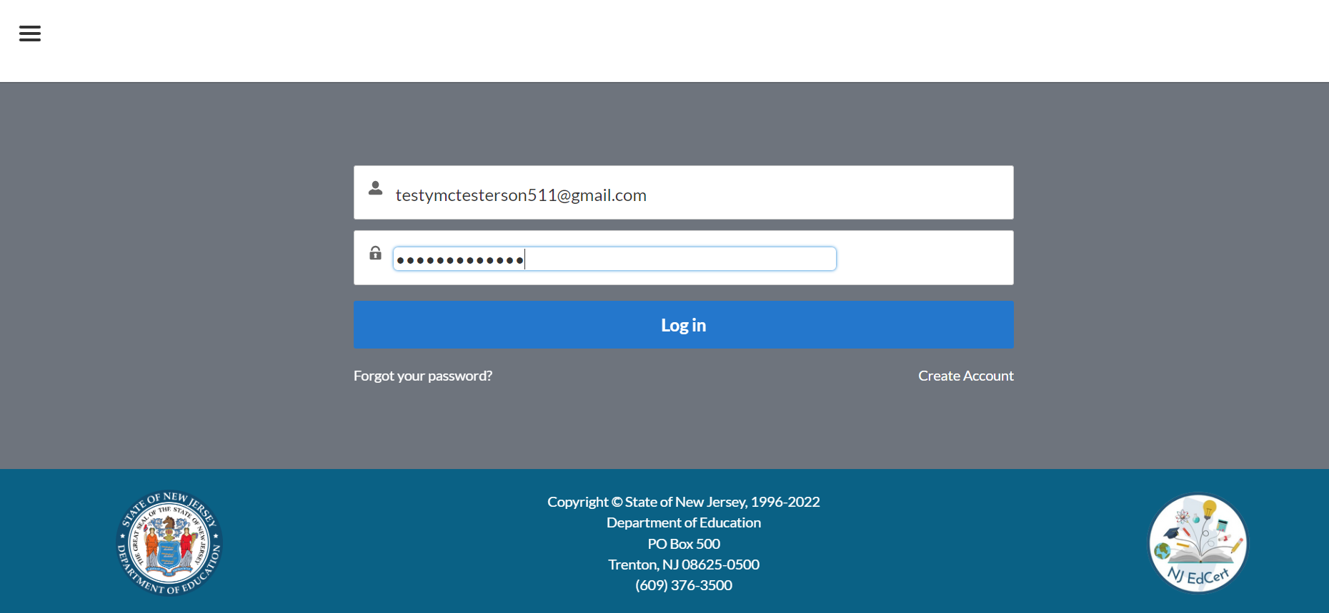
Login to the Portal
1. Enter your email address and password

Slide 5
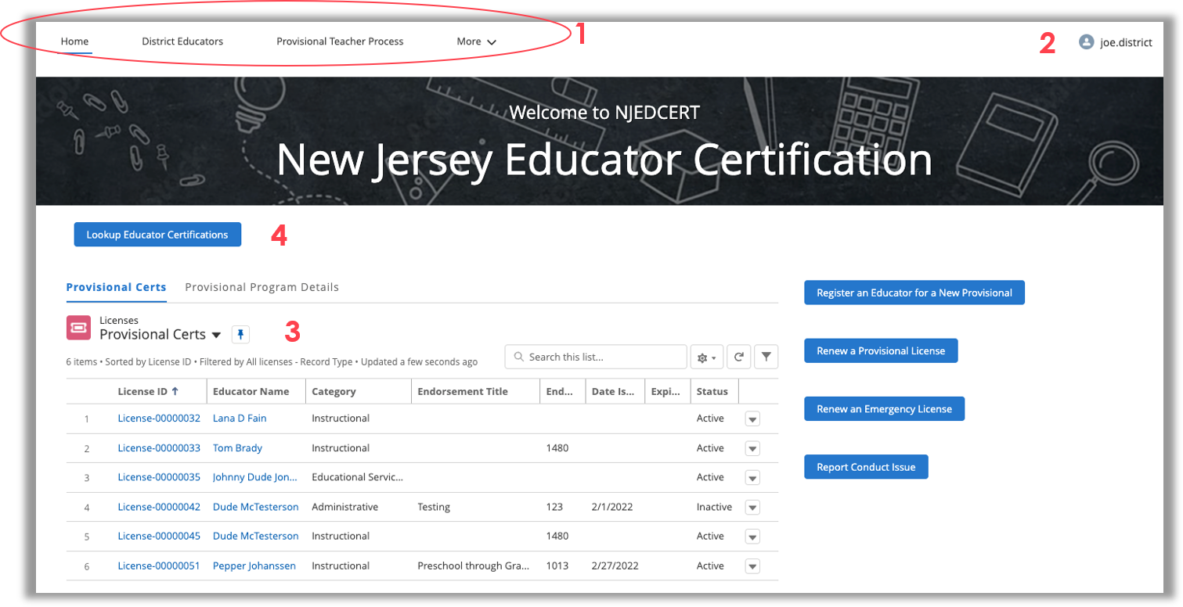
Welcome to the Portal
Tabs across the top will take you to different pages.
Click on your name to access account settings, logout, and more.
Provisional Licenses for your District.
Find all licenses for an Educator.

Slide 6
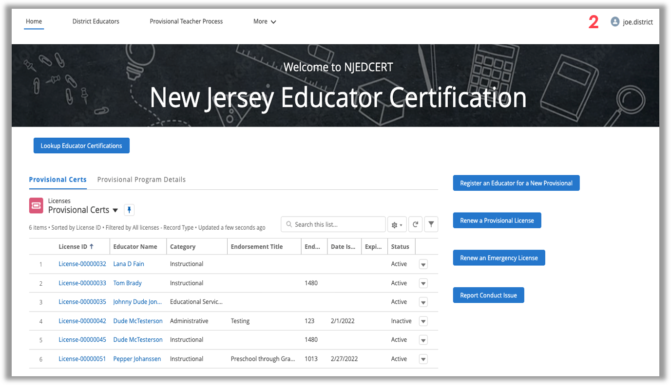
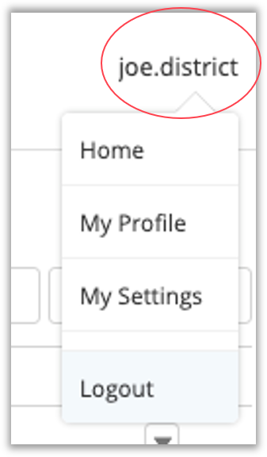
Accessing Your Account Information
Click your name (2 -upper-right corner) to access different Account setting.

Slide 7
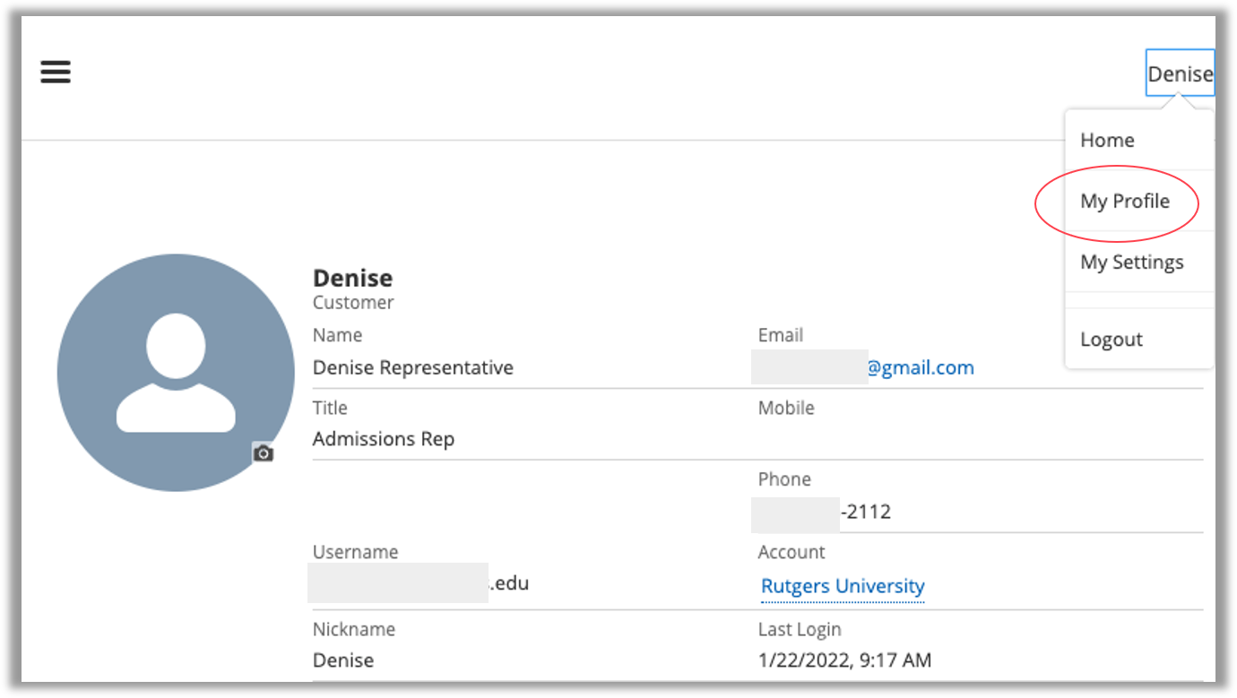
Account Info: My Profile
In “My Profile” you can edit your personal information.

Slide 8
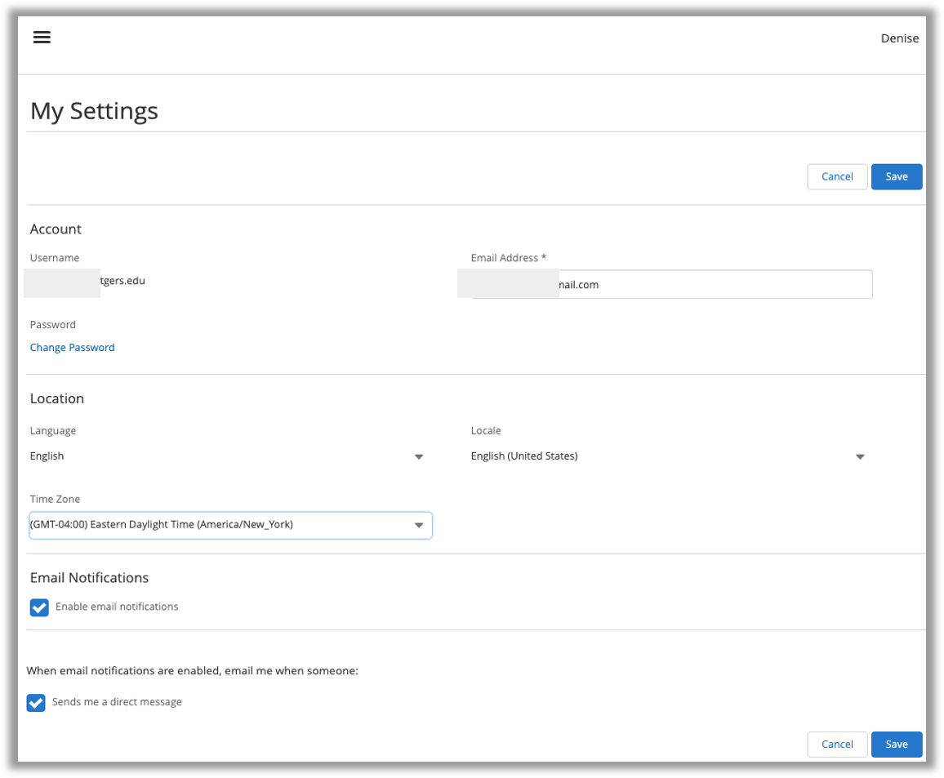
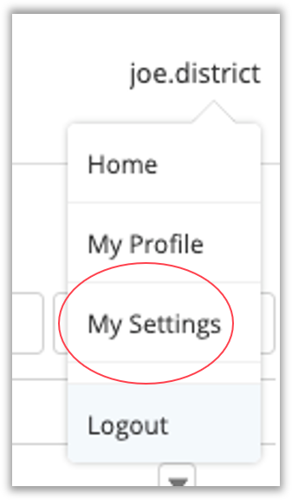
Account Info: My Settings
In “My Settings” you can edit your communication preferences and change your password.

Slide 9
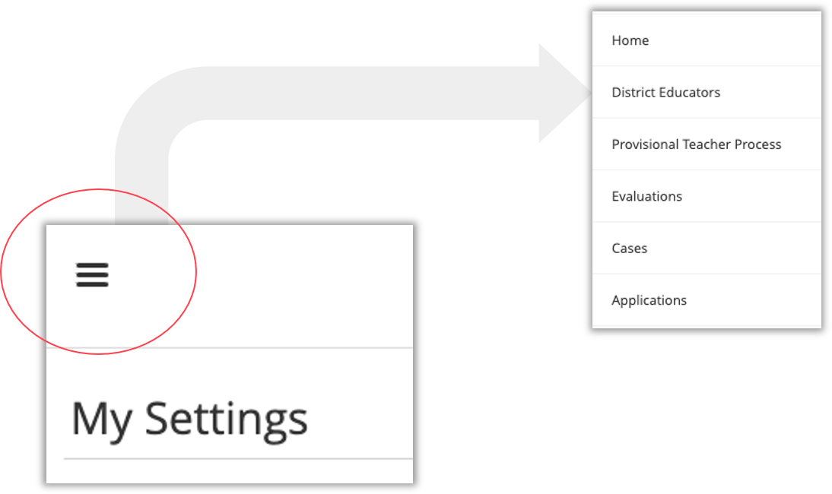
Navigation Tool
Navigate through the 3-bar icon in the upper-left corner.
This navigation allows you to see Educators, Provisional Teacher Process, Evaluations, Cases, and Applications for your district.

Slide 10
Find Licenses for an Educator
You can access a list of all Licenses for an Educator.
Click “Lookup Educator Certification” button from the homepage.
Search for Educator using First and Last name.
Search results should list all License records found for the Educator.

Slide 11
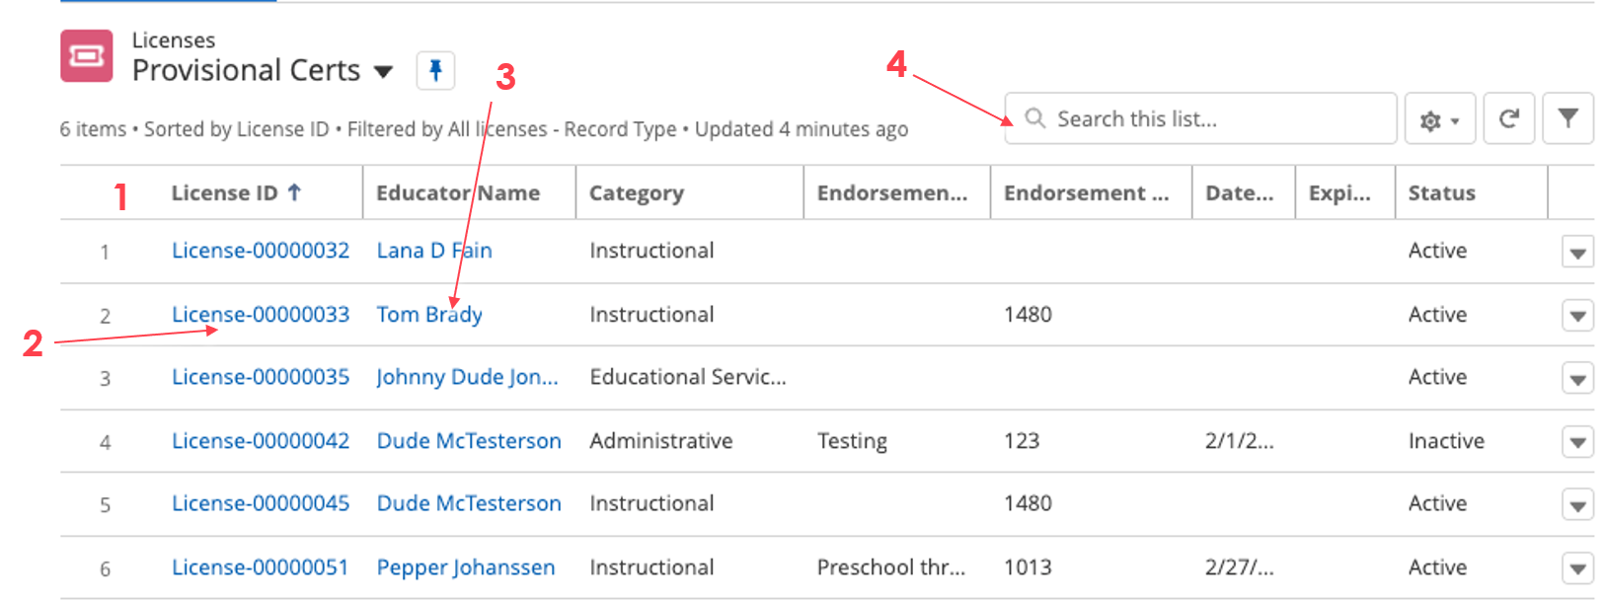
Viewing Provisional Licenses
You can view Provisional Licenses when you login to the Portal.
To sort the list, click on the column header by which you want to sort.
To view an individual License, click on the “License ID” value.
To view an Educator’s record, click on the “Educator Name”.
Use the search box to filter your Provisional Certification list.

Slide 12
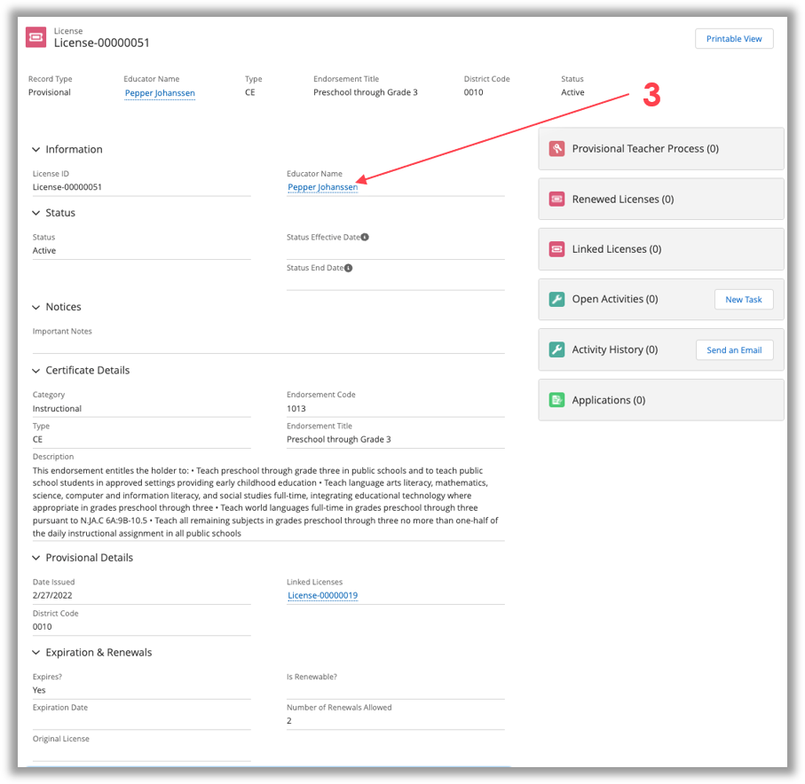
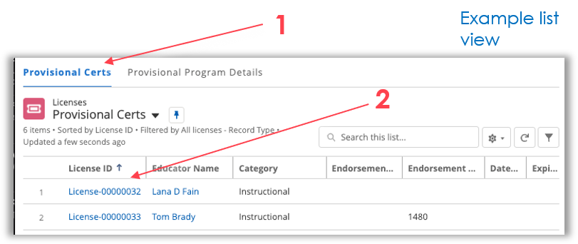
Provisional License Record
Example of a Provisional Cert record viewed in the Portal.
To get here, click the “Provisional Certs” tab (1) on the list view, then “License ID” value (2) in the list view.
To get back to the homepage from here, click the 3 bars in the upper-left corner and select “Home”.
To view the Educator record, click “Educator Name” (3).

Slide 13
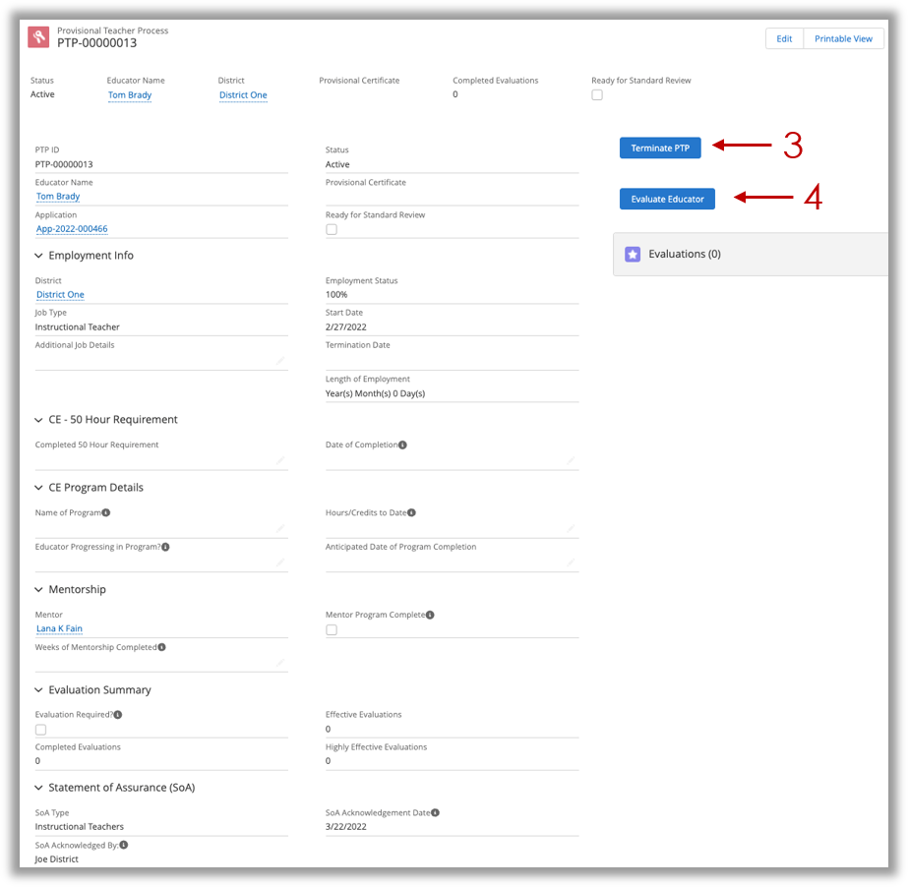
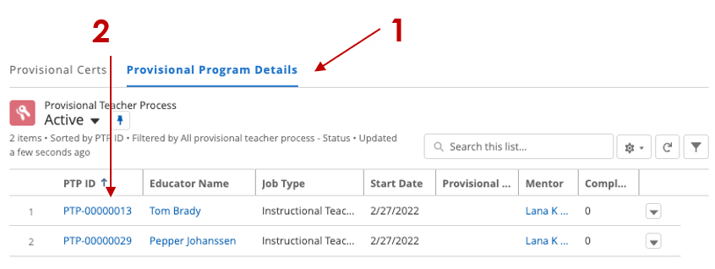
Provisional Teacher Process Record
Example of a Provisional Teacher Process record viewed in the Portal.
To get here, click the “Provisional Program Details” tab (1) on the list view, then “PTP ID” value (2) in the list view.
To get back to the homepage from here, click the 3 bars in the upper-left corner and select “Home”.
You can ”Terminate PTP” (3) or “Evaluate Educator” (4) from this record.

Slide 14
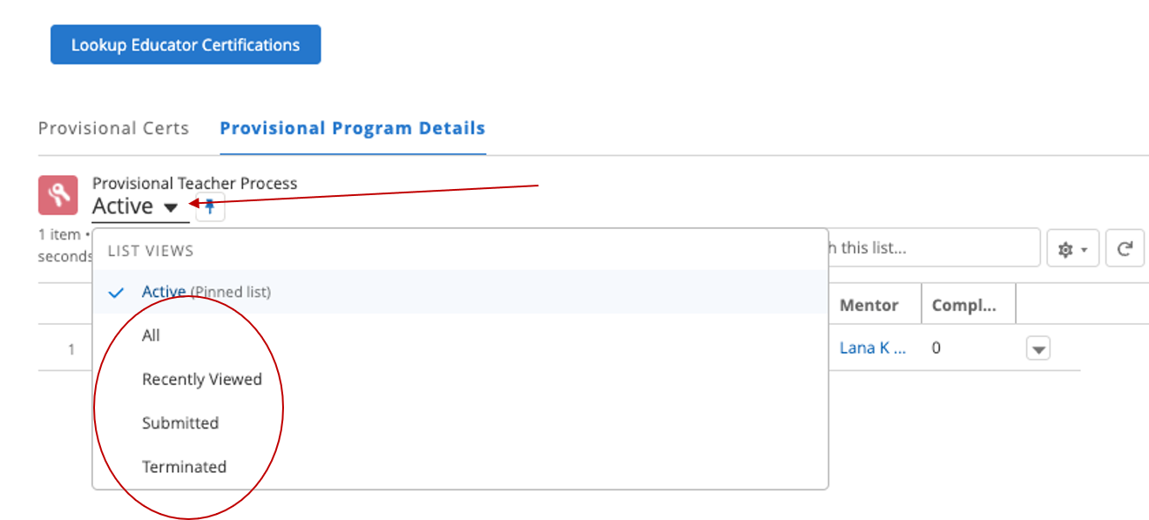
Provisional Teacher Process (PTP) List View
There are several different list views on the PTP tab. Click the down-arrow to switch list views.

Slide 15
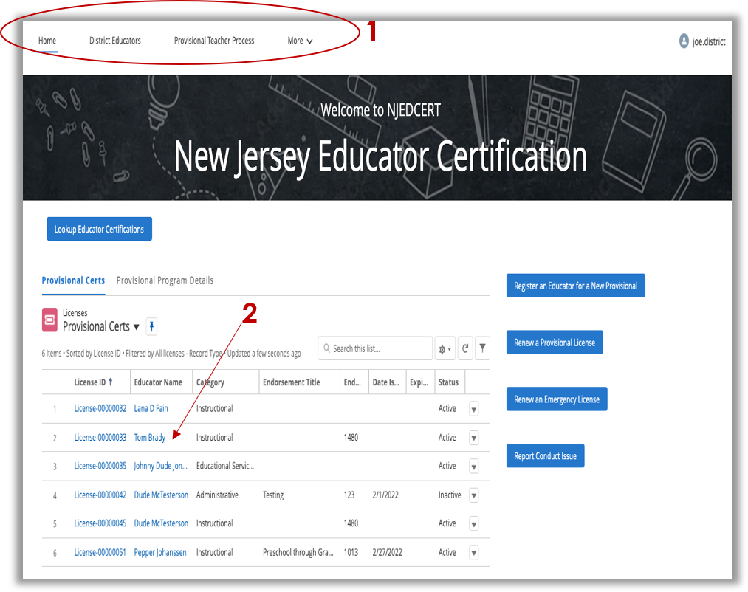
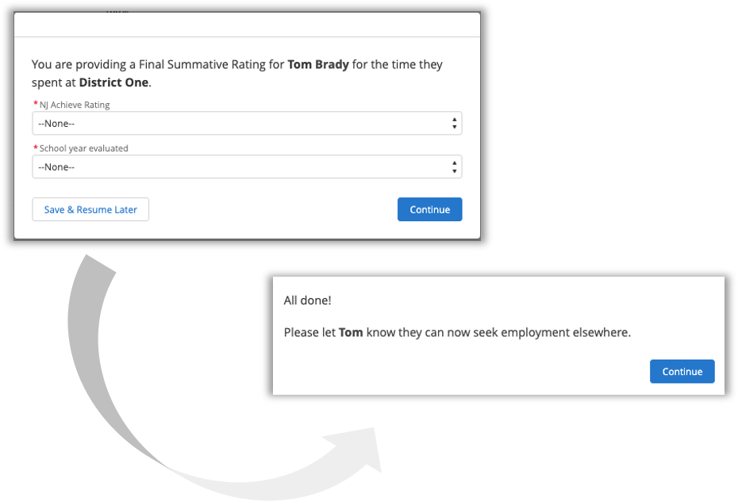
Terminate PTP
From the Provisional Teacher Process record, you can terminate the PTP.

Slide 16
Overview: New Provisional License

Slide 17
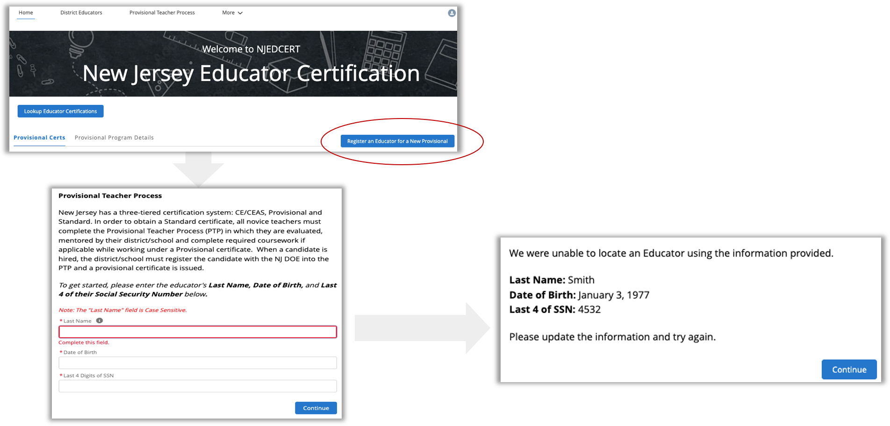
Register Educator for New Provisional License
From the homepage, click “Register an Educator for a New Provisional” button.
Enter information into the first screen.
The system will search for a matching Educator record.
An Educator must be in the system to move forward.

Slide 18
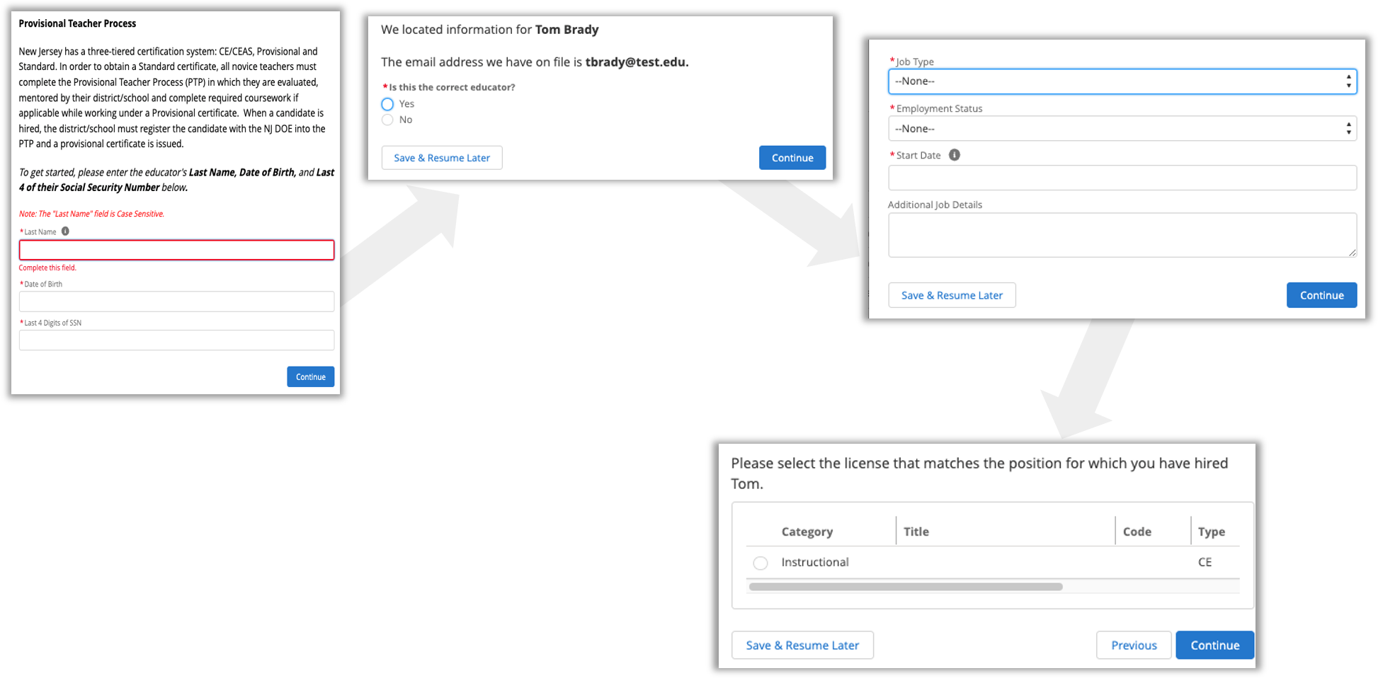
New Provisional: Educator Information
The system will show you the matching Educator information based on search results.
Follow the prompts for the screens.

Slide 19
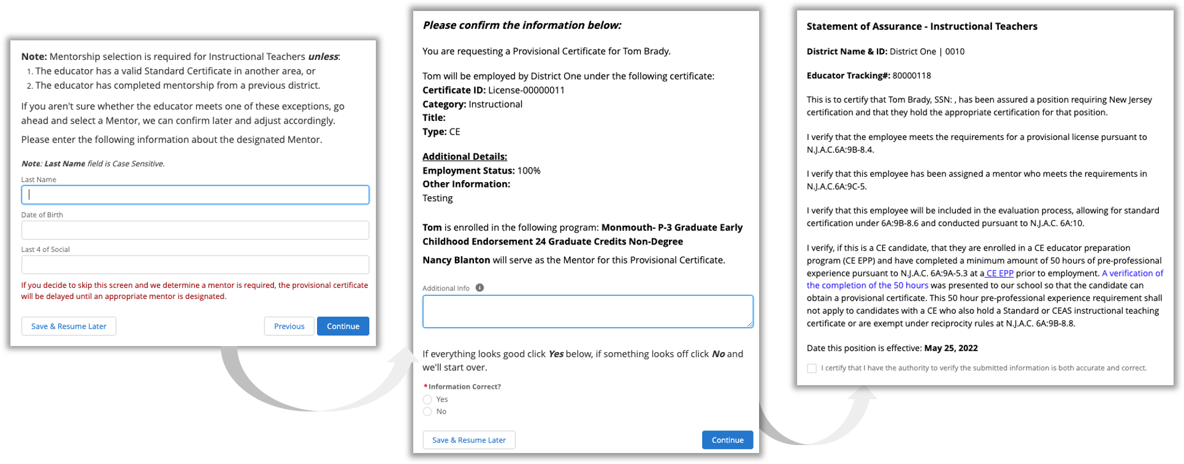
New Provisional: Mentorship & Confirmation
You have the opportunity to add Mentorship information.
After Mentorship, you will get confirmation of the Provisional License to be created.

Slide 20
New Provisional License
After the process finishes, the following happens in the system:
A Case is created and assigned to the Provisional Review Queue.
An Application record is created and attached to the Case.
A PTP record is created for that Educator.
The Educator’s record will be associated to your District’s Account.

Slide 21
Overview: Initiating Renewals

Slide 22
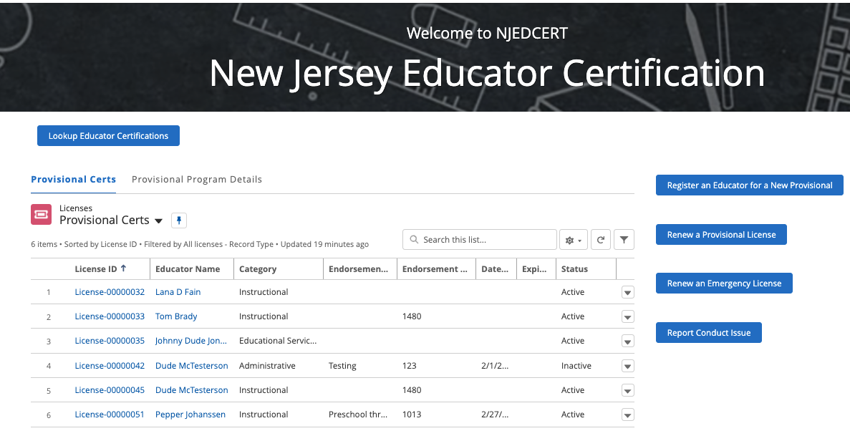
Initiating Provisional License Renewal, 1 of 3
From homepage, click the “Renew a Provisional License” button.

Slide 23
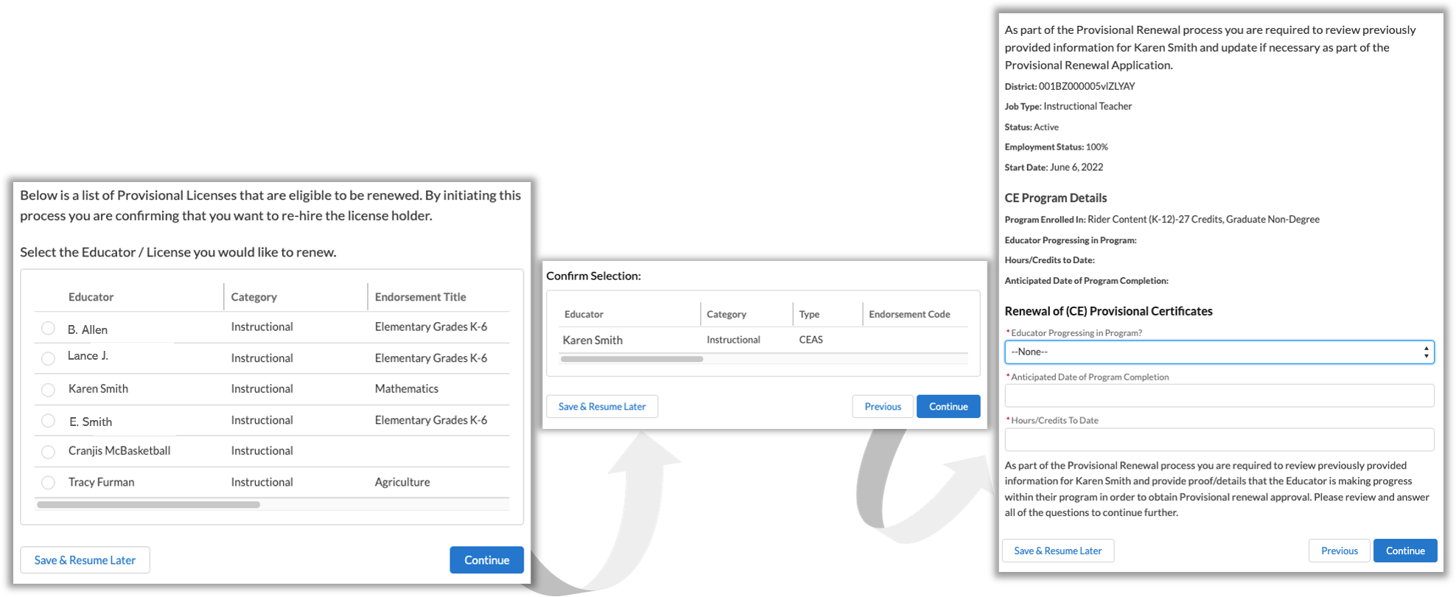
Initiating Provisional License Renewal, 2 of 3
You will see a list of Provisional Licenses that are eligible to be renewed.
Select the appropriate Educator.
Follow the screen prompts.

Slide 24
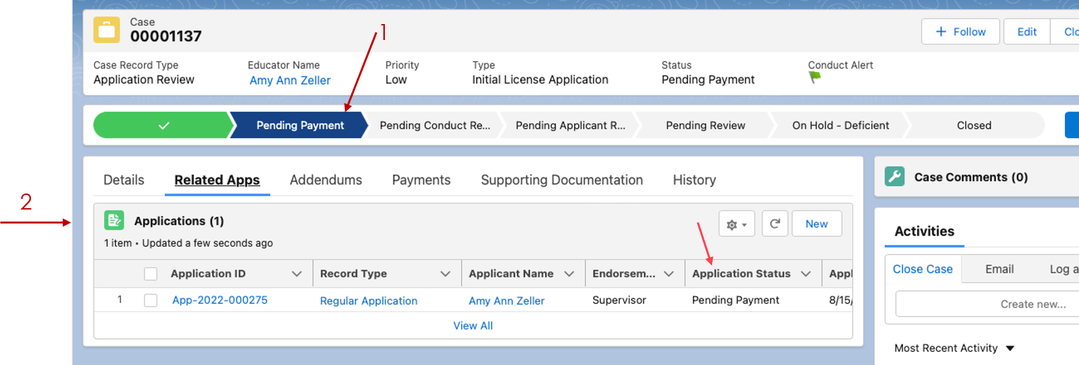
Initiating Provisional License Renewal, 3 of 3
After the process finishes, the following happens in the system:
A Case is created with status “Pending Payment”.
An Application is created and associated to the Case.
A new PTP record is created and associated to the Educator and Application.
An email is sent to the Educator with subject “Your Provisional Renewal Application”.

Slide 25
Provisional License to Standard License
Based on information about the Educator and your answers to questions, the process will notify you if you should consider applying for a Standard Certification.

Slide 26
Overview: Emergency License Renewal

Slide 27
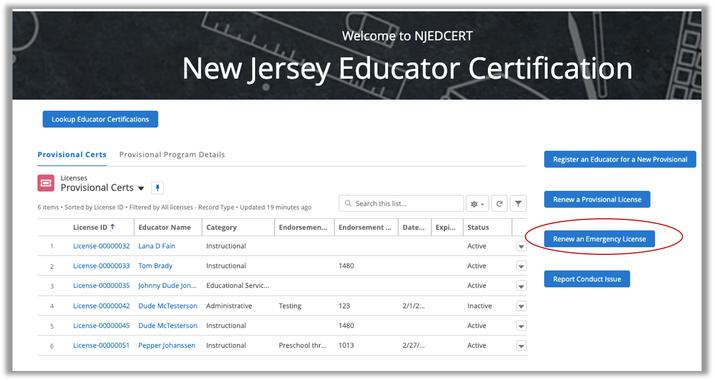
Emergency License Renewal, 1 of 2
From homepage, click the “Renew an Emergency License” button.

Slide 28
Emergency License Renewal, 2 of 2
The Emergency License Renewal process is very similar to regular renewal process. When the process finishes, the following happens in the system:
A new ”Emergency Renewal” Case is created.
An Application is created and associated to the Case.
An email is sent to the Educator with subject “Your Emergency Renewal Application Next Steps”.

Slide 29
Overview: Evaluations

Slide 30
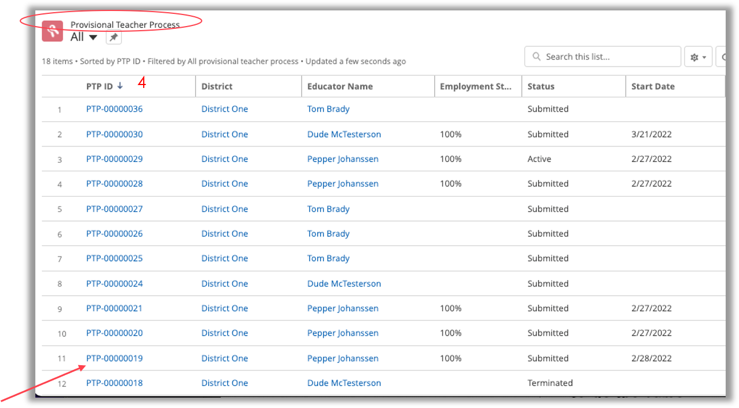
Creating an Evaluation, 1 of 2
Evaluations are done from the PTP record for an Educator.
Either use the PTP tab on the homepage to find the one you want or use the Provisional Teacher Process tab along the top to do the same.
Use the search box to find the correct record
You can also sort by a column. To do so, click on the column name.
Once you found the correct record, click on the “PTP ID” value to go to that record.

Slide 31
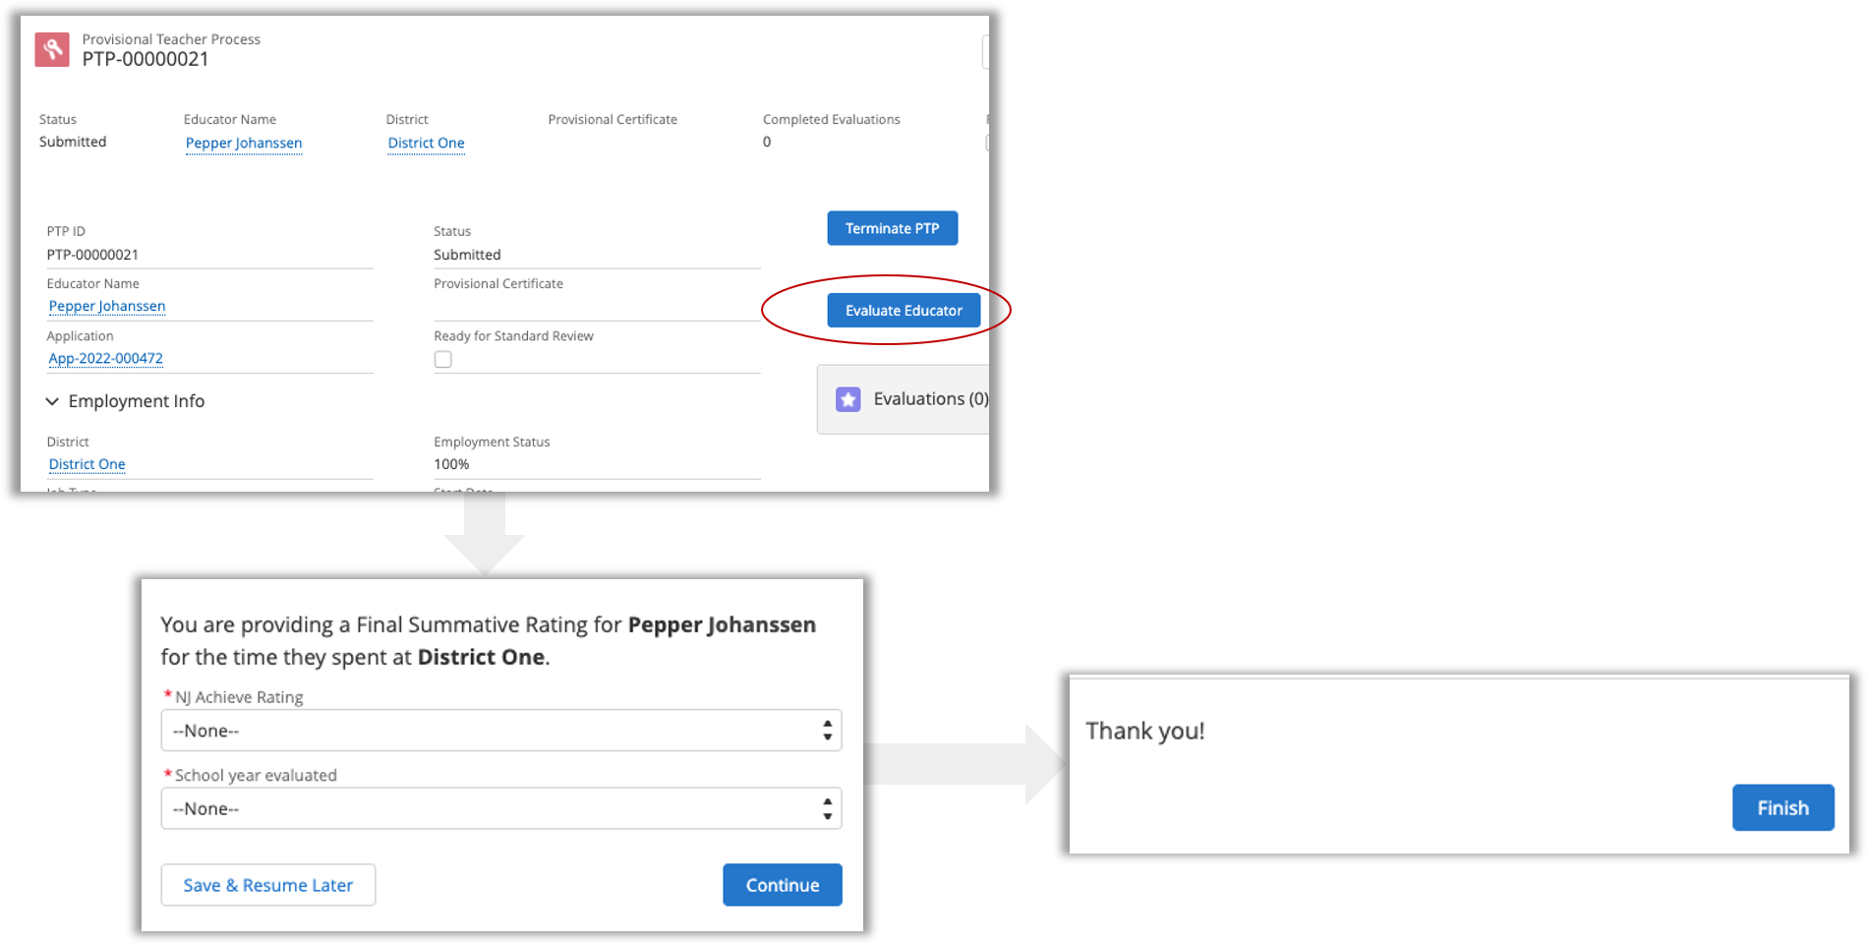
Creating an Evaluation, 2 of 2
From the PTP record, click the “Evaluate Educator” button.
Enter the Rating and School Year information.
Click ”Finish” and the Evaluation record is created.

Slide 32
thank you
copyright publicis sapient | confidential

