Slide 1
District Certification Training Summer 2024
Office of Recruitment, Preparation and Certification
Division of Field Support and Services
July 2024

Slide 2
Agenda
Introductions
NJEdCert Updates
Certification Fee Holiday
Educator Conduct
Educator Preparation Programs ​
Certification
Provisional Process
Contact Information

Slide 3
NJEdCert Updates

Slide 4
NJEdCert Enhancements and Updates (1 of 3)
New endorsements in NJEdCert:
Computer Science
Middle School STEM
Middle School Humanities
Non-Citizen Limited Certificate (all instructional endorsements)
Alternate Route Interstate Reciprocity (all instructional endorsements via nomination)
Mathematics and Science add-on endorsements (via nomination)
Application and process flow updates:
Language and flow updates for substitute credential and certificate applications
Account creation processes
Provisional process
Emergency and emergency renewal process
Auto-emails to educators and school districts
Chapter 9 amendment implementation

Slide 5
NJEdCert Enhancements and Updates (2 of 3)
Certificate / Endorsement Data
Endorsement Title, Code, Description, Expiration Date, Requirement/Checklist Updates (in process)
Substitute Data Migration (in process)
Language Updates
Email Templates
User Experience / Clarity
References to Code
System Maintenance
Back-up, Development Processes, Account Access Renewals, Image Access, ETS/edTPA/NASDEQ APIs, and SF Quarterly Updates

Slide 6
NJEdCert Enhancements and Updates (3 of 3)
Data Protection
Multifactor Authentication, Data Masking, Permission Setting Updates and New Profiles
Permission Settings / Profile Views
Updates made to Examiner, Customer Service, County Office, District, and EPP Representative Accounts
Created Examiner Supervisor and Customer Service Supervisor Profiles
Process Updates:
Account Creation Validation
Conversion to Standard Flow
EPP Nomination Flow
Initial and Renewal Emergency Flow
Initial and Renewal School Safety Specialist Credential Flow
Regular Application Process Flow
Standard Non-Citizen Flow
Board of Examiners Process (in process)
Deficient Application Process (in process)
VOPC, SOPE, ROPE Process (in process)

Slide 7
Certification Fee Holiday

Slide 8
Certification Fee Holiday (1 of 2)
On July 1, 2023, all educators received a temporary waiver of certification fees via the Certification Fee Holiday.
This initiative ended on June 30, 2024, and all fees were reinstated in NJEdCert as of July 1, 2024.
For educators who have credits to use in their account prior to the fee holiday (June 30, 2023, and before), system updates are being made and credits will be available on July 15, 2024. Credits will not be available for educators who applied during the Certification Fee Holiday period, July 1, 2023 – June 30, 2024.

Slide 9
Certification Fee Holiday (2 of 2)
Waived $12,000,000 in payment
Received over 125,000 applications
Issued over 56,000 certificates or credentials
Issued approximately 9,600 initial instructional licenses
Certificates Issued
Certificate | Number Issued
Instructional | 16,755
Administrative | 2,998
Educational Services | 2,719
Emergency | 380
CTE | 601
Provisional | 11,268
Substitutes | 21,277
Other | 22

Slide 10
Educator Conduct

Slide 11
Reporting Educator Conduct
District superintendents are required, pursuant to N.J.A.C. 6A:9B-4.3(a), to report allegations
of unbecoming conduct that result in an educator’s termination, resignation, retirement or suspension of an educator. Educators include certified staff, i.e. “teaching staff members,” substitute teachers, and employees of 3rd party vendors.
Unbecoming conduct is a broad term that encompasses a variety of conduct, not limited to inappropriate actions and/or communications with students and outside of school grounds criminal or other improper conduct.
The report must be made to the State Board of Examiners (Board) and can be done via email to stateboardofexaminers@doe.nj.gov.
  The Board’s secretary is Rani Singh.
The email should include the educator’s name and tracking number, as well as a brief explanation of the conduct. The Board’s coordinator will reach out to seek additional information, if same is necessary. N.J.A.C. 6A:9B-4.3(b) requires districts to cooperate by providing requested documentation, videos, emails, and investigative notes.

Slide 12
Revocation/Suspension
Educator revocation/suspension information is released through the county offices of education approximately once per month. School districts are responsible for using the educator lookup to confirm licenses.
All decisions are publicly available on the State Board of Examiners Legal Decisions webpage (nj.gov/education/legal/examiners/).
Educators who are revoked/suspended are required to report same to an employing school district, pursuant to N.J.A.C. 6A:9B-4.3(c)(3).

Slide 13
Educator Preparation Programs
(EPPs)​

Slide 14
EPP Approved Program Providers
Brookdale Community College
Caldwell University
Centenary University
Drew University
Idioma
Essex County College
Essex County Provisional Teacher Training Program
Farleigh Dickinson University
Felician University
Georgian Court University
Kean University
Monmouth University
Montclair State University (including Bloomfield College of Montclair State University)
New Jersey Center for Teaching and Learning
New Jersey City University
NJEA
NJPSA/FEA
NJASA
NJASBO
Pillar College
Princeton University
Ramapo College of New Jersey
Reimagine
Relay Graduate School of Education
Rider University
Rowan University
Rutgers University- Camden
Rutgers University Graduate School of Education
Rutgers University- Newark
Saint Elizabeth University
Saint Peter’s University
Seton Hall University
Stockton University
Thomas Edison State University
The College of New Jersey
William Paterson University

Slide 15
EPP Approval Process
Credit-based programs will gain authorization to operate from NJ Secretary of Higher Education.
Submit program approval application to the NJDOE.
Undergo review by NJDOE and State Program Approval Council.
Gain initial approval from the NJDOE.
Gain accreditation from an approved Council for the Accreditation of Educator Preparation (CHEA) accrediting agency.
Undergo review by the Department and gain continued approval from the NJDOE.

Slide 16
Pathways to Teaching
Type | Commonly Known As | Description
Certificate of Eligibility with Advanced Standing (CEAS) | Traditional Route | A formal teacher preparation program at an accredited college or university.
Certificate of Eligibility (CE) | Alternate Route | A non-traditional teacher preparation program designed for those individuals who have not completed a formal teacher preparation program at an accredited college or university
Standard Certificate | N/A | A permanent certificate issued to a teacher who has met all requirements for state certification. The district will request the issuance of a standard teaching certificate upon completion of the Provisional Teacher Process (PTP).

Slide 17
Endorsements
Under each type of certificate, there are endorsements.
An endorsement authorizes the specific type of service that the certificate holder is allowed to provide.

Slide 18
Types of Endorsements
Requirements | Endorsement | Add-On Endorsement
Entry Requirements | Currently pursue an initial instructional certificate at a Department approved EPP | N.J.A.C. 6A:11.13(b)1-4: Hold a valid CEAS or Standard; complete at least 6 of 30 credits; at least two years of teaching, be enrolled in an EPP
Program Requirements | N.J.A.C. 6A:9B-8(ii-iii) Hold a graduate degree in the subject area or complete at least 30 credits of courses appropriate to the subject area (different requirement for TOSD, Bilingual/Bicultural, and ESL). | Complete all the requirements for a standard certificate with a mathematics or science area endorsement, pursuant to N.J.A.C. 6A:9B-9.1(a), 10, or 11, as applicable.
Exit Requirements | Praxis II | N.J.A.C. 6A:11.13(e)1-3: Complete EPP Praxis II Be recommended for a standard

Slide 19
Math and Science Add-On Endorsements (1 of 3)
Per N.J.A.C. 6A:9B-11.13(b), to be eligible for a CE with a mathematics or science endorsement as an add-on, the candidate shall be exempt from the requirements at N.J.A.C. 6A:9B-9.1 and instead shall:
  Hold a valid New Jersey CEAS or standard instructional certificate;
  Complete at least six of the 30 credits of appropriate coursework in the subject area as required at N.J.A.C. 6A:9B-9.1(a), 10, or 11;
  Demonstrate at least two years of successful teaching pursuant to a valid New Jersey or out-of-State equivalent instructional teaching certificate; and
  Be enrolled in, and recommended for a CE by an educator preparation program, pursuant to N.J.A.C. 6A:9A-5.6.

Slide 20
Add-On Eligibility for Standard (2 of 3)
To be eligible for a standard certificate with a mathematics or science endorsement, candidates holding a CE issued pursuant to the above shall:
  Meet the coursework and subject matter knowledge assessment requirements for the endorsement area at N.J.A.C. 6A:9B-9.1(a);
  Successfully complete the educator preparation program approved pursuant to N.J.A.C. 6A:9A-5.6; and,
  Be recommended for a standard certificate by the educator preparation program.

Slide 21
Add-On Endorsement Codes (3 of 3)
Endorsement Title | Code
Mathematics Add-On | 1902
Biology Add-On | 2212
Chemistry Add-On | 2272
Physics Add-On | 2262
Earth Science Add-On | 2222
Physical Science Add-On | 2242
Types Available:
CE
Standard
3. Non-Citizen Standard

Slide 22
Addressing the Teacher Shortage (1 of 3)
Pilot Programs
  Alternate Route Interstate Reciprocity Pilot Program
    Will accept out-of-state candidates who meet all CE requirements.
    Participating EPPs: Rowan University (Glassboro) and Rutgers University-Newark
  Limited CE/CEAS Pilot Program
    School districts and EPPs must be approved to participate.
    Certificate holders of limited CEs or CEASs in an instructional area shall not exceed 10% of school district’s total teacher population.
    Pilot program ends on September 1, 2027. All limited CEs and CEASs shall expire on November 1, 2027.

Slide 23
Addressing the Teacher Shortage (2 of 3)
Partnerships
  Reading Accelerated Professional Integrated Development (RAPID) initiative with EPPs to revise K–6 and P–3 programming.
    EPPs will revise their Elementary School (K–6) and P–3 programming to meet the new training requirements.
    All CEAS and CE candidates entering a Department approved EPP on or after September 1, 2025, shall complete all of the certification requirements.

Slide 24
Addressing the Teacher Shortage (3 of 3)
State Grants
Paraprofessional: Provide funding to LEAS to offer tuition reimbursement/assistance to paraprofessionals seeking a teacher certificate in one of the teacher shortage areas.
Grant closed on April 30, 2024.

Slide 25
Certification

Slide 26
Basic Skills Test (CORE)
The Governor signed A1669/P.L.2024, c.26, into law on June 29, 2024, which eliminates the requirement to complete a Commissioner of Education-approved test of basic reading, writing, and mathematics skills (Basic Skills) for all instructional certificates except for the limited certificate of eligibility (CE) and the limited certificate of eligibility with advanced standing (CEAS). This law shall take effect on the first day of the seventh month following the date of enactment. The law also immediately eliminates the Alternate Certificate of Eligibility.
Notes:
The State Board adopted amendments to N.J.A.C. 6A:9B-7.4 to accept in-State and out-of-state work and teaching experience to meet requirements for the career and technical education substitute credential. This amendment broadens the pool of individuals eligible to serve as career and technical education substitute teachers.
New rules at 9B-8.3 reiterate the core competency flexibilities described in chapter 9A expanding the options for potential teachers to demonstrate core competencies.
At 9B-8.8, the Board adopted rules that eliminate the redundant clinical practice requirements for reciprocity candidates. As a reminder, streamlining reciprocity requirements will lessen the burden for educators seeking employment in high-need subject areas from other states.

Slide 27
Emergency Certificate Renewal
Emergency renewal is for candidates who are renewing their emergency certificate and remaining with the same employer.
School district notifies candidate of emergency certificate renewal.
School district initiates the renewal process via district portal access.
Candidate receives an email from NJEdCert with a link and authorization code to claim and pay for the emergency certificate renewal application.
Once claimed, the case is assigned to the county office of education.
County office of education reviews transcripts and/or documentation and notes whether there has been progress towards standard certification such that renewal is appropriate pursuant to regulations.
If progress towards standard certification is noted, the case will be reviewed and if eligible, emergency certificate renewed and viewable in NJEdCert.

Slide 28
New NJEdCert Endorsements
Middle school with subject-matter specialization endorsement in science, technology, engineering, and mathematics (STEM) #1107. Holders of this new endorsement shall be authorized to teach science and mathematics in grades five through eight in all public schools.
  Hold a middle school with subject-matter specialization endorsement in mathematics or science
  Pass the necessary State subject-matter test in the additional content area.
Middle school with subject-matter specialization endorsement in humanities #1108. Holders of this new endorsement shall be authorized to teach English language arts, social studies and related literature, and social and civic engagement courses in grades five through eight in all public schools.
  Hold the middle school with subject-matter specialization endorsement in English language arts or social studies
  Pass the necessary State subject-matter test in the additional content area.

Slide 29
Additional Science Option
Candidates already holding a science CEAS or standard certificate and seeking an additional science CEAS or standard certificate shall:
  Complete 15 credits in the corresponding content area with six credits at the advanced level.
  Pass the State test of subject matter knowledge. GPA flexibilities pursuant to N.J.A.C. 6A:9B-8.2(c) and 8.3(b) shall not apply.
  Website updated as “Option Two.”

Slide 30
Computer Science (1 of 3)
Computer Science #1820
This endorsement authorizes the holder to teach computer science in all New Jersey public schools.
Holders of other endorsements may teach computer science until July 1, 2027. After July 1, 2027, a teacher of computer science in preschool through grade 12 must hold a computer science endorsement.
Holders of the K–6 endorsement may teach computer science up to half-time with no computer science endorsement. Holders of the K–6 endorsement can continue teaching these courses up to half time after July 1, 2027, and do not need a computer science endorsement. If they teach more than that they must obtain the computer science endorsement.

Slide 31
Computer Science (2 of 3)
Computer Science Endorsement Pathways
Meet all regular requirements for the CE, CEAS or standard and complete a minimum of three semester-hour credits, or equivalent, in a methods of teaching computer science course offered by an accredited college or university. CE holders must complete the course within 12 months of the initial computer science teaching assignment.
Candidates holding a standard instructional certificate in another endorsement area shall:
  Complete 15 semester hour credits of computer science coursework;
  Pass the appropriate State test of computer science content knowledge; and
  Complete a minimum of three semester-hour credits, or equivalent, in a methods of teaching computer science course offered by an accredited college or university within 12 months of the initial computer science teaching assignment.

Slide 32
Computer Science (3 of 3)
Computer Science Endorsement Pathways (continued)
3. Candidates who hold standard certificates and teach computer science as of September 1, 2024, shall be eligible for the computer science endorsement if they:
    Have received two effective or highly effective ratings in teaching computer science within the last four years; and
    Pass the appropriate State test of computer science content knowledge.

Slide 33
Provisional Teacher Process: Teachers

Slide 34
Provisional Process for Teachers (1 of 2)
Once employment is secured, it is the responsibility of the hiring school district to register the teacher into the Provisional Teacher Process via NJEdCert. A provisional certificate is then issued which is valid for a period of up to two school years. (The educator cannot apply for the provisional certificate; this certificate is requested by the school district.)
If the candidate has a Certificate of Eligibility (CE), the district must verify completion of the required 50 hours of preservice and must choose the CE Educator Preparation Program (EPP) where formal instruction is being completed in the drop-down menu under program enrollment.
In accordance with N.J.A.C. 6A:9B-8.4 (b) The employing school district shall register the provisional teacher within 60 days of the date the CE or CEAS holder begins employment. Beginning 9/1/2024 a provisional teacher registration submitted after the 60th day will be marked as out of regulation and denied.

Slide 35
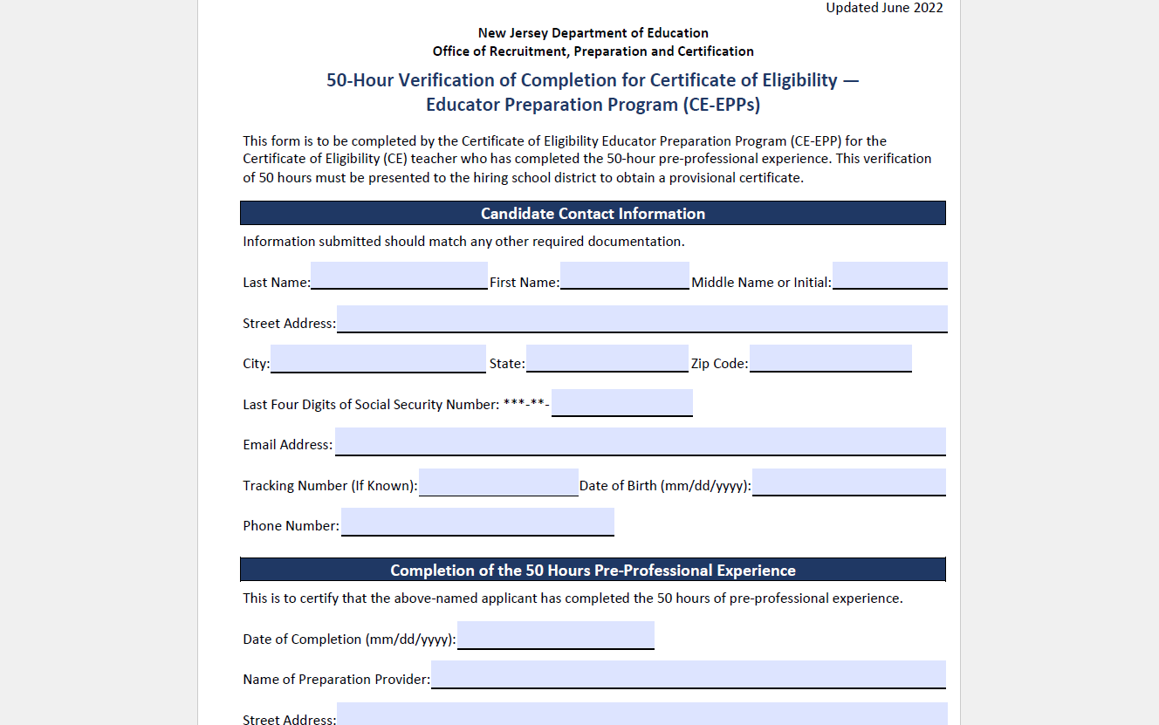
50-Hour CE-EPP Verification of Program Completion (VOPC) Form

Slide 36
Provisional Process for Teachers (2 of 2)
The following must be completed while employed under provisional certification to obtain standard license:
Mentoring and Induction
Provisional teachers must complete a school mentoring program.
  Mentoring fee charged by the district is $550 for CEAS teachers and $1000 for CE teachers.
  The Office of Professional Development has information about developing a mentoring plan. Please contact TeachPD@doe.nj.gov for any questions you may have about developing a mentoring plan.
Supervision and Evaluation
Provisional teachers must obtain at least two years of effective or highly effective final summative evaluations.
  The Office of Educator Evaluation has information regarding AchieveNJ. Please contact edueval@doe.nj.gov for any questions regarding AchieveNJ/summative ratings.
Alternate Route Formal Instruction for CE teachers
At least 400 hours or credit equivalent of instruction through an approved CE-EPP.

Slide 37
Formal Instruction for CE Holders (1 of 2)
There are six categories of CE programs:
  Department-approved CE educator preparation program (CE EPP) for P–12 Subject Area and K–6 Elementary Teachers;
  Career and Technical Educators (CTE);
  Preschool–Grade 3 (P – 3 );
  Teacher of Students with Disabilities (TOSD);
  English as a Second Language (ESL); and,
  Bilingual/Bicultural.
The list of all approved CE programs is available online.

Slide 38
Formal Instruction for CE Holders (2 of 2)
“Program Enrollment” requirements for each of the following:
  English as a Second Language (ESL) candidates:
    400-hour CE-EPP program; and
    15–21 credit ESL program.
  Bilingual candidates with content area CE:
    400-hour CE-EPP program; and
    12 credit Bilingual program.
  Teacher of Students with Disabilities (TOSD) candidates with content area CE:
    400-hour CE-EPP program; and
    21–27 credit TOSD program.

Slide 39
Provisional Teacher Process: Educational Services and Administrative Endorsements

Slide 40
Provisional Process for School Library Media Specialists (SLMS) and Associate School Library Media Specialists (ASLMS)
The school district will register the candidate through NJEdCert.
  If the educator has a CE, they must choose the college where courses will be taken in the drop-down menu under program enrollment.
A one-year residency and mentoring is required under the provisional certificate.
  Mentoring must be completed by an experienced school library media specialist. If no experienced SLMS is available within the school district to mentor the candidate, an experienced SLMS mentor can be provided through the New Jersey Association of School Librarians (NJASL). New Jersey Association of School Librarians (NJASL) can be reached at mentoring@njasl.org.
A candidate’s standard certificate determination will be based on completion of the residency.
The final summative rating is entered by the district in NJEdCert.
A CE candidate must also have the Verification of Program Completion submitted by the college.

Slide 41
Provisional Process for Student Assistance Coordinators (SAC)
The school district registers the candidate through NJEdCert.
o If the candidate has a CE, they must choose the college where courses will be taken in the drop-down menu under program enrollment.
A six-month residency is required under the provisional certificate.
A candidate’s standard certificate determination will be based on completion of the residency and the final summative rating.
The final summative rating is entered by the district in NJEdCert.
A CE candidate must also have the Verification of Program Completion submitted by the college.

Slide 42
Provisional Process for Administrators
The school district registers the administrator through NJEdCert.
Administrators must also be registered in the appropriate program:
  For Principals: Register with Leader to Leader/ NJPSA for the two-year residency.
  For School Administrators: Register with NJASA for the one-year residency.
  For School Business Administrators: Register with NJASBO for the one-year residency.
A one-to-two-year residency is required under the provisional certificate.
A candidate’s standard certificate determination will be based on successful completion of the residency.

Slide 43
New Provisional Registration

Slide 44
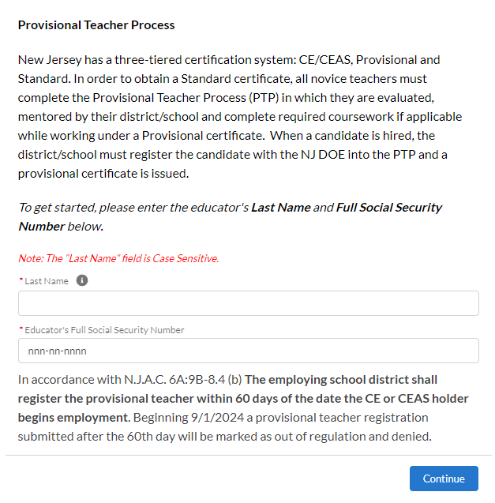
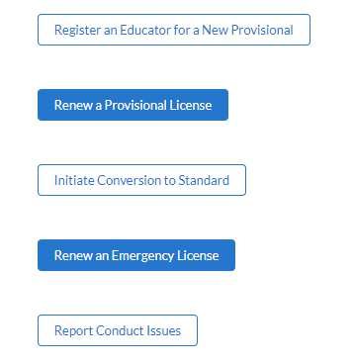
Register Educator for New Provisional License

Slide 45
New Provisional: Educator Information
Steps to register an educator for the provisional teacher process:
Complete fields for last name and social security number.
Verify email address on file. If email is incorrect applicant will need to login to their NJEdCert account and update their email address.
Complete fields for job type, employment status and start date.
Select the license that matches the position for which you hired the educator.
Select the CE EPP information if applicable and provide mentor information.

Slide 46
New Provisional License
After completing the registration
A case is created and assigned to the provisional program.
An application record is created within the case.
A new provisional teacher process record is created for that educator.

Slide 47
Provisional Renewal Process

Slide 48
Renewal of Provisional Certificates
Candidates who are working under a provisional certificate that will expire on July 31, and who have not yet met the requirements for a standard certificate, will need to be issued a provisional renewal to continue employment in current role while working towards a standard certificate. The school district can initiate the renewal process in NJEdCert in June of the expiring year.
Candidates may be eligible for one provisional renewal. CE teachers must provide the school district with documentation of progress made towards alternate route program completion.
Candidates completing a TOSD, Bilingual, or ESL program must also provide documentation to the school district of progress made towards program completion to be eligible for a second renewal of the provisional.

Slide 49
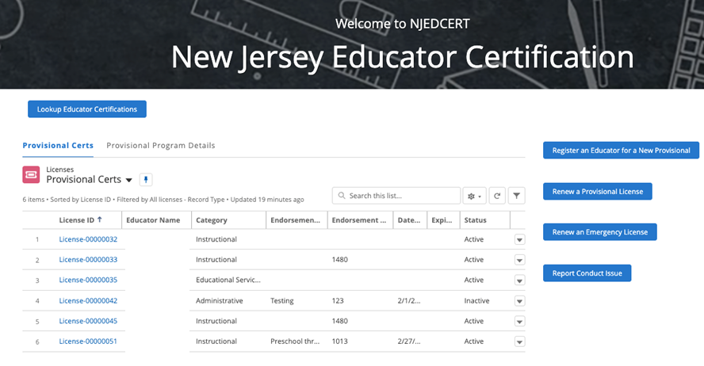
Initiating Provisional License Renewal (1 of 3)
From homepage, click “Renew a Provisional License.”

Slide 50
Initiating Provisional License Renewal (2 of 3)
There will be a list of provisional licenses that are eligible to be renewed.
Select the appropriate educator.
Follow the screen prompts.

Slide 51
Initiating Provisional License Renewal (3 of 3)
Following the conclusion of processes:
A case is created with the status “Pending Payment.”
An application is created and associated to the case.
A new PTP record is created and associated to the educator and application.
The educator will receive an email with subject “Your Provisional Renewal Application” to allow the educator to complete application and payment. Once payment and Oath are completed, the status will change to “Pending Review.”

Slide 52
Entering a Termination Date
When an educator leaves a school district, a termination date, which is the last date of employment, must be entered in NJEdCert.
A PTP record is created for each endorsement the educator is registered for in NJEdCert.
  To enter a termination date, you will need to go to your district educator list and click educators hyperlinked name to pull up the account records. You must locate the educator’s PTP ID records for your district and enter a termination date for each.

Slide 53
Conversion to Standard Process

Slide 54
Conversion to Standard
School districts must initiate conversion to a standard for all educators through NJEdCert. Before initiating conversion to standard, the school district must confirm the following has been completed:
  Teachers: Completed 30 weeks of mentoring, received two years of effective or highly effective final summative ratings and completed required coursework, if applicable.
  Administrators: Completed one-to-two-year residency.
  SAC: Completed a 6-month residency, received an effective or highly effective rating and completed coursework, if applicable.
  SLMS/ALMS: Completed a one-year residency, mentoring, received an effective or highly effective rating and completed coursework, if applicable.

Slide 55
Entering Final Summative Ratings and Mentorship
Ratings and mentoring weeks are entered by the school district into NJEdCert.
  Access by going to your district’s educator list and clicking on the teacher's hyperlinked name which will transition to a page that has the option to choose “Enter Final Summative Ratings and Mentorship.”
Mentoring time must be tracked by each employer. If a provisional teacher leaves employment from the school district and begins to work in a new school district, the initial district will need to complete the Mentoring Transfer Template to document the amount of mentoring time completed.

Slide 56
Contact Information

Slide 57
Contact Customer Service
Call Center: (609) 292-2070
Hours: Monday through Friday from 8 a.m. to 7 p.m.
Educators can create an NJEdCert account to submit questions and communicate directly with customer service staff. Case inquiries include:
    Name update
    DOB update
    Social Security Number update
    Citizenship Status update
    Test Score Records
    Application Questions
    Customer Service Questions
School Districts can create a case through their NJEdCert school district account to submit questions.

Slide 58
Additional Contact Information/Resources
Office of Educator Evaluation email address: edueval@doe.nj.gov
Achieve NJ website: state.nj.us/education/AchieveNJ/
Office of Professional Development website: nj.gov/education/profdev/
Office of Professional Development email address: TeachPD@doe.nj.gov
NJDOE County and District Information: nj.gov/education/certification/ctydistinfo/
EPP Training: youtube.com/watch?v=m_bzyrzjs-w
NJDOE NJEdCert: nj.gov/education/certification/apply/index.shtml
New Jersey Department of Education: nj.gov/education

Slide 59
Follow Us on Social Media
Facebook:
@njdeptofed
Instagram:
@newjerseydoe
LinkedIn:
New Jersey Department of Education
Threads:
@NewJerseyDOE
X: @NewJerseyDOE
YouTube: @newjerseydepartmentofeduca6565

