Slide 1


New Jersey Department of Education
District Certification Training Summer 2025
Office of Recruitment, Preparation and Certification
Division of Teaching and Learning Services
July 2025
nj.gov/education

Slide 2
General Information
The PowerPoint Slides will be posted online after all training sessions have occurred.
All questions must be posted into the Q&A panel on the right side of your screen.
All responses to Q&A will be made during the presentation. Accordingly, we ask that topic relevant questions be submitted into the Q&A while the related content is being discussed.
We are unable to answer any questions that are specific to a district or educator. Please use the web to case for specific questions on candidates.

Slide 3
Agenda
Introductions
NJEdCert Updates
Certification Fee Holiday
Educator Conduct
Educator Preparation Programs ​
Certification
Provisional Process
Contact Information

Slide 4
NJEdCert Updates

Slide 5
NJEdCert Enhancements and Updates
New endorsements in NJEdCert (also discussed later):
Speech Arts #1452
Early Literacy Specialist #3320
Educational Interpreter Substitute credential #9045
Bilingual Language Paraprofessional credential #9050
Various new Career and Technical Education (CTE)
Application and process flow updates:
Language and flow updates for substitute credential and certificate applications
Account creation processes – there is now a pop-up window to prevent duplicate account creation
Provisional process – district login screen includes the links for the guide videos as quick reference
Auto-emails to educators and school districts on application status – revisions to language
Chapter 9 amendment implementation
ROPE form updates to permit second evaluation information
Approved program lists for CE program conditional dropdown

Slide 6
NJEdCert Enhancements and Updates (1)
Certificate / Endorsement Data
Endorsement Title, Code, Description, Expiration Date, Requirement/Checklist Updates (completed)
Substitute Data Migration (in process)
Search by SSN
Search and Print certificate functionality
Language Updates
Email Templates for conduct review, denied applications
User Experience / Clarity
References to Code
Subject Matter Preparation descriptions
System Maintenance
Back-up, Development Processes, Account Access Renewals, Image Access, ETS/edTPA/NASDEQ APIs, and SF Quarterly Updates

Slide 7
NJEdCert Enhancements and Updates (2)
Data Protection
Multifactor Authentication, Data Masking, Permission Setting Updates and New Profiles
Permission Settings / Profile Views
Updates made to Examiner, Customer Service, County Office, District, and EPP Representative Accounts
Process Updates:
Account Creation Validation
Conversion to Standard Flow
EPP Nomination Process
Initial and Renewal Emergency Flow
Initial and Renewal School Safety Specialist Credential Flow
Integrations:
New soft phone system for customer service that integrates into NJEdCert.
Regular Application Process Flow
Standard Non-Citizen Flow
Board of Examiners Process (in process)
Deficient Application Process (completed)
VOPC, SOPE, ROPE Process (completed)

Slide 8
Certification Fee Holiday

Slide 9
Certification Fee Holiday (1 of 2)
On July 1, 2023, all educators received a temporary waiver of certification fees via the Certification Fee Holiday.
This initiative ended on June 30, 2024, and all fees were reinstated in NJEdCert as of July 1, 2024.
Credits for denied, expired or deficient applications are not available to educators who applied during the Certification Fee Holiday period, July 1, 2023 – June 30, 2024.

Slide 10
Certification Fee Holiday (2 of 2)
Waived $12,000,000 in payment
Received over 125,000 applications
Issued over 56,000 certificates or credentials
Issued approximately 9,600 initial instructional licenses
Type | Certificates Issued
Instructional | 16,755
Administrative | 2,998
Educational Services | 2,719
Emergency | 380
CTE | 601
Provisional | 11,268
Substitutes | 21,277
Other | 22

Slide 11
Educator Conduct

Slide 12
Reporting Educator Conduct
District superintendents are required, pursuant to N.J.A.C. 6A:9B-4.3(a), to report allegations of unbecoming conduct that result in an educator’s termination, resignation, retirement or suspension. Educators include certified staff, i.e. “teaching staff members,” substitute teachers, and employees of 3rd party vendors.
Unbecoming conduct is a broad term that encompasses a variety of conduct, not limited to inappropriate actions and/or communications with students, outside of school grounds, criminal or other improper conduct.
The report must be made to the State Board of Examiners (Board) and can be done via email to stateboardofexaminers@doe.nj.gov. The Board’s secretary is Rani Singh.
The email should include the educator’s name and tracking number, as well as a brief explanation of the conduct. The Board’s coordinator will reach out to seek additional information, if same is necessary. N.J.A.C. 6A:9B-4.3(b) requires districts to cooperate by providing requested documentation, such as videos, emails, and investigative notes.

Slide 13
Revocation/Suspension
Educator revocation/suspension information is released through the county offices of education approximately once per month. School districts are responsible for using the educator lookup to confirm licenses.
Educators who are revoked/suspended are required to report same to an employing school district, pursuant to N.J.A.C. 6A:9B-4.3(c)(3).
All decisions are publicly available at: https://www.nj.gov/education/legal/examiners/

Slide 14
Educator Preparation Programs (EPPs)

Slide 15
EPP Approved Program Providers
Brookdale Community College
Caldwell University
Centenary University
Drew University
Idioma Education & Consulting, LLC
Essex County College
Essex County Provisional Teacher Training Program
Farleigh Dickinson University
Felician University
Georgian Court University
Kean University
Monmouth University
Montclair State University (including Bloomfield College of Montclair State University)
New Jersey Center for Teaching and Learning
New Jersey City University
NJEA
NJPSA/FEA
NJASA
NJASBO
Pillar College
Princeton University
Ramapo College of New Jersey
Reimagine Education Group
Relay Graduate School of Education
Rider University
Rowan University
Rutgers University- Camden
Rutgers University Graduate School of Education
Rutgers University- Newark
Rutgers School of Nursing
Saint Elizabeth University
Saint Peter’s University
Seton Hall University
Stockton University
Thomas Edison State University
The College of New Jersey
William Paterson University

Slide 16
EPP Approval Process
Prior to gaining approval to operate as an EPP, institutions that will offer credit-bearing programs need authorization from the Office of the Secretary of Higher Education.
EPP providers will submit program applications to the Department for approval.
Applications will undergo review by the Department and State Program Approval Council.
Upon satisfactory completion of program application review, providers will receive Department approval to operate as an EPP.
All EPPs must gain and/or maintain accreditation from an approved Council for the Accreditation of Educator Preparation accrediting agency.
Every seven years, all programs must gain continued approval from the Department.

Slide 17
Pathways to Teaching
Type | Commonly Known As | Description
Certificate of Eligibility with Advanced Standing (CEAS) | Traditional Route | A formal teacher preparation program at an accredited college or university.
Certificate of Eligibility (CE) | Alternate Route | A non-traditional teacher preparation program designed for those individuals who have not completed a formal teacher preparation program at an accredited college or university
Standard Certificate | N/A | A permanent certificate issued to a teacher who has met all requirements for state certification. The district will request the issuance of a standard teaching certificate upon completion of the Provisional Teacher Process (PTP).

Slide 18
Endorsements (1 of 2)
Under each type of certificate, there are endorsements.
An endorsement authorizes the specific type of service that the certificate holder is allowed to provide.

Slide 19
Types of Endorsements (2 of 2)
Category | Endorsement | Add-On Endorsement (Math and Science)
Entry Requirements | Currently pursue an initial instructional certificate at a Department approved EPP | Hold a valid CEAS or Standard Complete at least 6 of 30 credits of coursework in the subject area Demonstrate at least two years of teaching Be enrolled in, and recommended for a CE by the EPP
Program Requirements | Complete one or more of the following: Undergraduate major in the subject area; Hold a graduate degree in the subject area; or Complete at least 30 credits appropriate to the subject area, of which 12 semester-hour credits must be at the advanced level of study | Complete all the requirements for a standard certificate with a mathematics or science area endorsement, pursuant to N.J.A.C. 6A:9B-9.1(a), 10, or 11, as applicable
Assessments | Pass the appropriate State test of subject matter knowledge | Pass the appropriate State test of subject matter knowledge

Slide 20
Add-On Endorsements (1 of 3)
Pursuant to N.J.A.C. 6A:9B-11.13(b), to be eligible for a CE with a mathematics or science endorsement as an add-on, the candidate shall be exempt from the requirements at N.J.A.C. 6A:9B-9.1 and instead shall:
    Hold a valid New Jersey CEAS or standard instructional certificate;
    Complete at least six of the 30 credits of appropriate coursework in the subject area as required at N.J.A.C. 6A:9B-9.1(a), 10, or 11;
    Demonstrate at least two years of successful teaching pursuant to a valid New Jersey or out-of-State equivalent instructional teaching certificate; and
    Must be recommended for a CE by an educator preparation program, pursuant to N.J.A.C. 6A:9A-5.6.

Slide 21
Add-On Eligibility for Standard Certificate (2 of 3)
To be eligible for a standard certificate with a mathematics or science endorsement, candidates holding a CE issued pursuant to the above shall:
    Meet the coursework and subject matter knowledge assessment requirements for the endorsement area at N.J.A.C. 6A:9B-9.1(a);
    Successfully complete the EPP, pursuant to N.J.A.C. 6A:9A-5.6; and
    Be recommended for a standard certificate by the EPP.

Slide 22
Add-On Endorsement Codes (3 of 3)
Endorsement Title | Types Available | Code
Mathematics Add-On | CE Standard 3. Non-Citizen Standard | 1902
Biology Add-On |  | 2212
Chemistry Add-On |  | 2272
Physics Add-On |  | 2262
Earth Science Add-On |  | 2222
Physical Science Add-On |  | 2242

Slide 23
Addressing the Teacher Shortage (1 of 7)
Pilot Programs
  Alternate Route Interstate Reciprocity Pilot Program
    Will accept out-of-state candidates who meet the CE requirements.
    Participating EPPs: Rowan University and Rutgers University, Newark
  Limited CE/CEAS Pilot Program
    School districts and EPPs must be approved to participate.
    Certificate holders of limited CEs or CEASs in an instructional area shall not exceed 10% of school district’s total teacher population.
    Pilot program ends on September 1, 2027. All limited CEs and CEASs shall expire on November 1, 2027.

Slide 24
Addressing the Teacher Shortage (2 of 7)
Pilot Programs (continued)
  VETeach: A four-year pilot program that aims to facilitate the teacher certification of veterans in a 36-month teacher preparation program to address the high rate of unemployment amongst veterans while ensuring a high-quality teacher workforce.
    Eligibility: Veterans of the United States Armed Forces who served on or after September 11, 2001.
    Participating EPP Providers: Ramapo College and Rowan University

Slide 25
Addressing the Teacher Shortage (3 of 7)
Paraprofessional Expedited Pathway
Expedites the teacher certification of persons who are currently employed to work in a school district as a paraprofessional or an instructional assistant pursuing a CEAS in a specific endorsement area.
Authorizes a candidate's direct classroom service can count towards clinical practice requirements, provided that the candidate is currently employed by a school district and is providing direct classroom service, including tutoring.

Slide 26
Addressing the Teacher Shortage (4 of 7)
Grants
Paraprofessional: Program to support eligible Institutions of Higher Education (IHEs) to recruit paraprofessionals with a bachelor’s degree pursuing teacher certification through the alternate route pathway.
  Grant Recipients: Drew University, Fairleigh Dickinson University, Rowan University, and William Patterson University
  Grant Period: June 1, 2025 – May 31, 2026

Slide 27
Addressing the Teacher Shortage (5 of 7)
Grants (continued)
Teacher Development: Program intended to support eligible IHEs that recruit and support new teachers in high poverty school districts.
  Grant Recipients: Kean University and Montclair State University
  Grant Period: June 1, 2025 – May 31, 2026

Slide 28
Addressing the Teacher Shortage (6 of 7)
Grants (continued)
Teacher Quality and Retention: Program to establish a sustainable program of instructional coaching for teachers in high poverty school districts.
  Grant Recipient: Rowan University
  Grant Period: June 1, 2025 – May 31, 2026

Slide 29
Addressing the Teacher Shortage (7 of 7)
Grants (continued)
Minority Teacher Development - Continuation: Provides funding to recruit, train, and place new teachers in high poverty school districts.
  Grant Recipients: Kean University and Rutgers University, Graduate School of Education
  Grant Period: June 1, 2025 – May 31, 2026

Slide 30
Certification

Slide 31
Basic Skills Test (CORE)
The Governor signed A1669/P.L.2024, c.26, into law on June 29, 2024, which eliminated the requirement to complete a Commissioner of Education-approved test of basic reading, writing, and mathematics skills (Basic Skills) for all instructional certificates except for the limited certificate of eligibility (CE) and the limited certificate of eligibility with advanced standing (CEAS).
This law took effect on January 1, 2025.

Slide 32
Emergency Certificate Renewal
All emergency certificates expire July 31st of each year. Emergency renewals are for candidates who are renewing their emergency certificate and remaining with the same employer.
School district notifies candidate of emergency certificate renewal.
School district initiates the renewal process via district portal access.
Candidate receives an email from NJEdCert with a link and authorization code to claim and pay for the emergency certificate renewal application.
Once claimed, the case is assigned to the county office of education.
County office of education reviews transcripts and/or documentation and notes whether there has been progress towards standard certification such that renewal is appropriate pursuant to regulations.
If progress towards standard certification is noted, then the case will be reviewed and if eligible, emergency certificate is renewed and viewable in NJEdCert.

Slide 33
New NJEdCert Endorsements
Educational Interpreter substitute credential #9045
Teacher of Speech Arts #1452
Early Literacy Specialist #3320
Bilingual Language Paraprofessional credential #9050
New Career and Technical Education (CTE):
    Bioengineering #4191
    Merchandising and Buying #4192
    Healthcare Administration Management #4193
    Design and Applied Arts #4194
    Fashion Design #4195

Slide 34
New Praxis Subject Matter Tests
Code | Regenerated and New Test Name | Proposed Cut Score | Effective | Existing Test Name | Current Cut Score | Expires
5053 | Technology and Engineering Education: Content Knowledge | 157 | 9/1/2025 | Technology Education: Content Knowledge (5051) | 159 | 8/31/2025
5123 | Family and Consumer Sciences: Content Knowledge | 151 | 9/1/2025 | Family and Consumer Sciences: Content Knowledge (5122) | 153 | 8/31/2025
5581 | Social Studies: Content Knowledge | 153 | 9/1/2025 | Social Studies: Content Knowledge (5081) | 157 | 8/31/2025

Slide 35
Reading Specialist
The new reading specialist requirements become effective on September 1, 2025. Anyone with a "denied" evaluation on file or holding a Reading Specialist emergency endorsement are subject to regulations in effect at the time of application. Therefore, these candidates must meet the new requirements if they are reapplying for the standard certificate on or after September 1, 2025.
This endorsement authorizes the holder to serve as a reading specialist in preschool through grade 12. They conduct in-service training of teachers and administrators; coordinate instruction for students or groups of students having difficulty learning to read; diagnose the nature and cause of a student’s difficulty in learning to read; plan developmental programs in reading for all students; recommend methods and materials to be used in the school district reading program; and contributes to the collection of standardized data as a means of determining and monitoring the reading achievement of students.

Slide 36
Early Literacy Specialist
The new early literacy specialist endorsement will be required beginning at the start of the 2026-2027 school year.
The early literacy specialist endorsement authorizes the holder to serve as a reading specialist in preschool through grade three. They conduct in-service training of teachers and administrators; coordinate instruction for students or groups of students having difficulty learning to read; diagnose the nature and cause of a student’s difficulty in learning to read; plan developmental programs in reading for all students; recommend methods and materials to be used in the school district reading program; and contributes to the collection of standardized data as a means of determining and monitoring the reading achievement of students. Additionally, the early literacy specialist may serve as the primary general education interventionist for any student in preschool through grade three with a reading or literacy difficulty that is the result of dyslexia or dysgraphia.

Slide 37
Teacher Certification Websites
Career and Technical Education (CTE) Teachers
  New endorsements
  Eliminated endorsements (Crosswalk)
  Establishing eligibility for CTE certification
Instructional Teachers
  Endorsement specifications website under construction: Teachers

Slide 38
Provisional Teacher Process: Teachers

Slide 39
Overview of Certification for Teachers (Three-Tiered System)
Certificate | Type | Description
Certificate of Eligibility with Advanced Standing (CEAS) or Certificate of Eligibility (CE) | A license to seek employment as a teacher | Is issued before a candidate seeks employment as a teacher.
Provisional Certification | A temporary license to teach | Is issued once a candidate is hired as a teacher and registered in the provisional process.
Standard Certification | A permanent license to teach | Is issued once a teacher meets all the requirements.

Slide 40
Provisional Process for Teachers (1 of 2)
Once employment is secured, it is the responsibility of the hiring school district to register the teacher into the Provisional Teacher Process via NJEdCert. A provisional certificate is then issued, which is valid for a period of up to two school years. The teacher cannot apply for the provisional certificate. This certificate must be requested by the school district.
If the candidate has a CE, the district must verify completion of the required 50 hours of preservice and must choose the CE Educator Preparation Program (CE-EPP) where formal instruction is being completed in the drop-down menu under "program enrollment."
In accordance with N.J.A.C. 6A:9B-8.4 (b), "the employing school district shall register the provisional teacher within 60 days of the date the CE or CEAS holder begins employment. A provisional teacher registration submitted after the 60th day will be marked as out of regulation and denied.

Slide 41
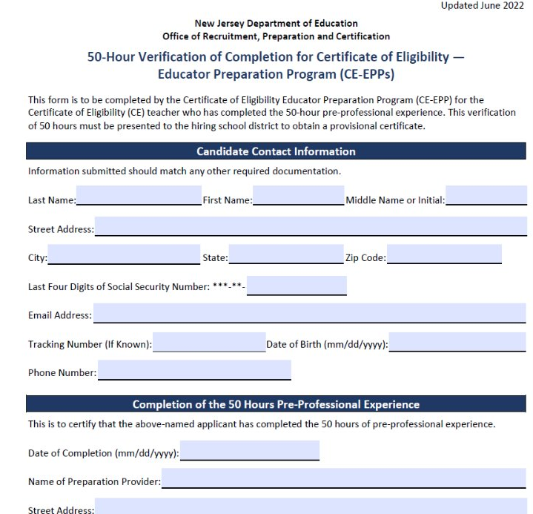
50-Hour CE-EPP Verification of Program Completion (VOPC) Form

Slide 42
Provisional Process for Teachers (2 of 2)
The following must be completed while employed under provisional certification to obtain standard license:
Mentoring and Induction
Provisional teachers must complete a school mentoring program.
  The mentoring fee charged by the district is $550 for CEAS teachers and $1000 for CE teachers.
  The Office of Professional Development has information about developing a mentoring plan. Please contact TeachPD@doe.nj.gov for any questions you may have about developing a mentoring plan.
  Supervision and Evaluation
Provisional teachers must obtain at least two years of effective or highly effective final summative evaluations.
  The Office of Educator Evaluation has information regarding AchieveNJ. Please contact edueval@doe.nj.gov for any questions regarding AchieveNJ/summative ratings.
Alternate Route Formal Instruction for CE teachers
At least 400 hours or the credit equivalent of instruction through an approved CE-EPP.

Slide 43
Instruction for CE Holders (1 of 2)
There are six categories of CE programs:
  Department-approved CE EPP for P-12 Subject Area and K-6 Elementary Teachers;
  Career and Technical Educators (CTE);
  Preschool through Grade 3 (P-3 );
  Teacher of Students with Disabilities (TOSD);
  English as a Second Language (ESL); and,
  Bilingual/Bicultural.
To see a list of all approved CE programs , please visit the NJDOE website.

Slide 44
Instruction for CE Holders (2 of 2)
“Program Enrollment” requirements for each of the following:
  English as a Second Language (ESL) candidates:
    400-hours or the credit equivalent through an approved CE-EPP; and,
    15-21 credits in an ESL program.
  Bilingual candidates with content area CE:
    400-hours or the credit equivalent through an approved CE-EPP; and
    12 credits in a Bilingual program.
  TOSD candidates with content area CE:
    400-hours or the credit equivalent through an approved CE-EPP program; and
    21-27 credits in a TOSD program.

Slide 45
Provisional Process: Educational Services and Administrative Endorsements

Slide 46
School Library Media Specialists (SLMS)
The school district will register the candidate through NJEdCert.
If the candidate has a CE, the school district must select the college where the School Library Media Specialists (SLMS)courses will be taken in the NJEdCert drop-down menu under "program enrollment".
A one-year residency and mentoring is required under the provisional certificate.
Mentoring must be completed by an experienced school library media specialist. If there is not an experienced SLMS available within the school district to mentor the candidate, an experienced SLMS mentor can be provided through the New Jersey Association of School Librarians (NJASL). NJASL can be reached at mentoring@njasl.org.
A candidate’s standard certificate determination will be based on completion of the residency and the final summative rating.
The final summative rating is entered by the district in NJEdCert.
A CE candidate must also have the VOPC submitted by the EPP provider.
Please note: the same requirements apply for candidates seeking an Assoicate Library Media Specialist (ASLMS) endorsement

Slide 47
Student Assistance Coordinators (SAC)
The school district registers the candidate through NJEdCert.
    If the candidate has a CE, they must choose the college where the courses will be taken in the drop-down menu under "program enrollment.
A six-month residency is required under the provisional certificate.
A candidate’s standard certificate determination will be based on completion of the residency and the final summative rating.
The final summative rating is entered by the district in NJEdCert.
A CE candidate must also have the VOPC submitted by the EPP provider.

Slide 48
Provisional Process for Administrators
The school district registers the administrator through NJEdCert.
Administrators must also be registered in the appropriate program:
  Principals will register with Leader to Leader/ NJPSA for the two-year residency.
  School Administrators will register with NJASA for the one-year residency.
  School Business Administrators will register with NJASBO for the one-year residency.
A one-to-two-year residency is required under the provisional certificate.
A candidate’s standard certificate determination will be based on successful completion of the residency.

Slide 49
New Provisional Registration

Slide 50
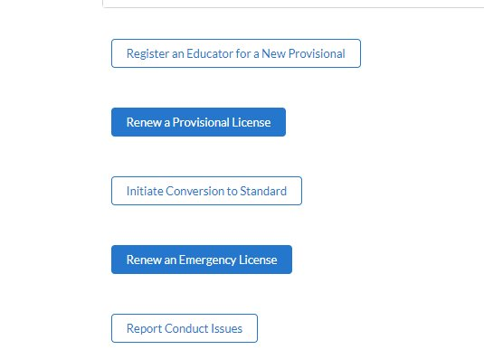
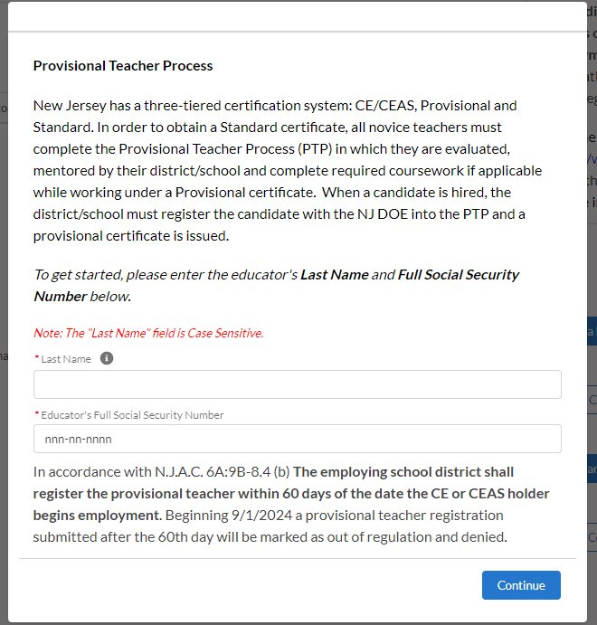
Register Educator for New Provisional License

Slide 51
New Provisional: Educator Information
Steps to register an educator for the provisional teacher process:
Complete fields for last name and social security number.
Verify email address on file. If email is incorrect, the applicant will need to login to their NJEdCert account and update their email address.
Complete fields for job type, employment status, and start date.
Select the license that matches the position for which you hired the educator.
Select the CE EPP information, if applicable, and provide mentor information.

Slide 52
New Provisional License
After completing the registration, the following will occur:
A case is created and assigned to the provisional program.
An application record is created within the case.
A new provisional teacher process (PTP) record is created for that educator. Please note: This record is created for all educators(i.e., teachers, administrators and educational service specialists).

Slide 53
Provisional Renewal Process

Slide 54
Renewal of Provisional (1 of 2)
Candidates who are working under a provisional certificate set to expire on July 31, and who have not yet met the requirements for a standard certificate, will need to be issued a provisional renewal to continue employment in their current role while working towards a standard certificate. The school district can initiate the renewal process in NJEdCert in June of the expiring year.
Candidates may be eligible for one provisional renewal. CE teachers must provide the school district with documentation of progress made towards alternate route program completion.

Slide 55
Renewal of Provisional (2 of 2)
CE teachers in the following endorsement areas may be eligible for a second renewal of their provisional if they have not completed coursework:
  Student with Disabilities CE and a CE with an endorsement appropriate to the subject to be taught;
  Bilingual/Bicultural CE, and CE with an endorsement appropriate to the subject or grade level to be taught; or
  Teachers who hold a CE in English as a Second Language
CE teachers must provide documentation to the school district of progress made toward program completion.
Student with Disabilities CE holders must demonstrate successful completion of at least two courses per provisional period to the school district.

Slide 56
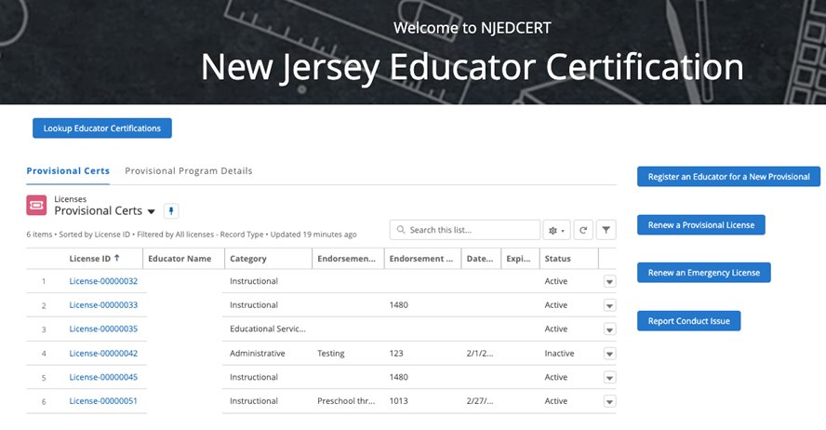
Initiating Provisional License Renewal (1 of 3)
To initiate a provisional renewal, the school district will complete the following:
Step 1: From the homepage, click “Renew a Provisional License.”
An Educator

Slide 57
Initiating Provisional License Renewal (2 of 3)
Step 2: There will be a list of provisional licenses that are eligible to be renewed. The school district will select the appropriate educator.
Step 3: Follow the screen prompts.

Slide 58
Initiating Provisional License Renewal (3 of 3)
After creating the renewal case, the following will occur:
A case is created with the status “pending payment.”
An application is created and associated to the case.
A new PTP record is created and associated to the educator and application.
The educator will receive an email with subject “Your Provisional Renewal Application.” This will allow the educator to complete the application and payment.
Once the payment and Oath of Allegiance are completed, the status will change to “pending review.”

Slide 59
Entering a Termination Date
When an educator leaves a school district, the last date of employment, known as the termination date, must be entered in NJEdCert.
A PTP record is created for each endorsement the educator is registered for in NJEdCert.
  To enter a termination date, visit the "district educator" list in your district NJEdCert account and select click educators hyperlinked name to pull up the account records. Locate the educator’s PTP ID records for your school district and enter a termination date for each. If the educator has multiple PTP ID records for your district, a termination date must be entered for each PTP ID record.

Slide 60
Conversion to Standard Process

Slide 61
Conversion to Standard
School districts must initiate conversion to a standard for all educators through NJEdCert. Before initiating a conversion to standard, the school district must confirm the following has been completed:
  Teachers have completed 30 weeks of mentoring, received two years of effective or highly effective final summative ratings and completed required coursework, if applicable.
  Administrators have completed one-to-two-year residency.
  SAC have completed a 6-month residency, received an effective or highly effective rating, and completed coursework, if applicable.
  SLMS/ALMS have completed a one-year residency, mentoring, received an effective or highly effective rating, and completed coursework, if applicable.

Slide 62
Conversion to Standard Checklist
Activity | Teachers | SLMS/ASLMS | SAC | Administrator
Mentoring | Completed 30 weeks of mentoring | Completed one year of mentoring | N/A | N/A
Residency | N/A | Completed one year residency | Completed six-month residency | Completed one-to-two-year residency
Evaluation | Two years of effective or highly effective final summative ratings | An effective or highly effective final summative rating | An effective or highly effective final summative rating | N/A
Coursework | CE teachers completed 400 hours/ credit coursework | CE SLMS/ASLMS completed required coursework | CE SACS completed required coursework | N/A

Slide 63
Final Summative Evaluation Ratings and Mentorship
The final summative evaluation rating and mentoring weeks completed are entered by the school district into NJEdCert.
To enter a final summative rating and mentoring weeks visit the "district’s educator" list in your district NJEdCert account and select the educator's hyperlinked name to pull up the account records. This will open a page that has the option to choose “Enter Final Summative Ratings and Mentorship.”
Mentoring time must be tracked by each employer. If a provisional teacher leaves employment from the school district and begins to work in a new school district, the initial district will need to complete the Mentoring Transfer Template to document the amount of mentoring time completed.

Slide 64
NJEdCert Instructional Videos
Video 1: NJEdCert video on provisional registration, final summative rating, and termination.
Video 2 :How to submit provisional renewal case in NJEdCert YouTube video
Video 3: How to submit a CEAS conversion to standard case in NJEdCert YouTube video
Video 4: How to submit a CE conversion to standard case in NJEdCert YouTube video
Video 5: How to submit a Customer Service Web to Case in NJEdCert YouTube video

Slide 65
Contact Information

Slide 66
Contact Customer Service
Call Center (Monday-Friday 8 am to 7 pm): (609) 292-2070
Educators can create an NJEdCert account to submit questions and communicate directly with customer service staff. Case inquiries include:
    Name update
    DOB update
    Social Security Number update
    Citizenship Status update
    Test Score Records
    Application Questions
    Customer Service Questions
School districts can create a case through their NJEdCert school district account to submit questions. Information on how to do this can be found here: How to submit a customer service web to case in NJEdCert.

Slide 67
Additional Contact Information/Resources
Office of Educator Evaluation email address: edueval@doe.nj.gov
Educator Evaluation: nj.gov/education/edueval/
Educator Mentoring and Inductor Support: nj.gov/education/profdev/mentor/
Office of Professional Development email address: TeachPD@doe.nj.gov
NJDOE County and District Information: nj.gov/education/certification/ctydistinfo/
EPP Training: https://www.youtube.com/watch?v=m_bzyrzjs-w
NJDOE NJEdCert: nj.gov/education/certification/apply/
New Jersey Department of Education: nj.gov/education

Slide 68
Q&A
We are working to respond to your remaining Q&A questions. Please remain with us as we work to ensure your questions are answered.

Slide 69
Follow Us
Facebook
@njdeptofed
X
@newjerseydoe
Instagram
@newjerseydoe
LinkedIn
New Jersey Department of Education
nj.gov/education
Threads
@newjerseydoe
YouTube
@newjerseydepartmentofeduca6565

Slide 70
Thank You
Office of Certification, Recruitment and Preparation

