Slide 1
Early Mathematics Assessment Practices for Teachers across the P-3 Continuum
Office of K–3
Division of Early Childhood Services

Slide 2
Agenda
Assessment
Types
Formative Assessment
Summative Assessments
Considerations
Resources
(Please be advised that neither the New Jersey Department of Education, nor its employees, specifically promotes, endorses, recommends, or favors any of the entities or resources listed herein Instead, this list of entities and resources is provided for informational purposes only. School districts must always evaluate and determine, based on the individualized needs of its student population, whether to utilize and/or expend its resources on the entities or resources herein.)​

Slide 3
Introduction (1 of 2)
As you reflect on assessment in your classroom, consider these questions:
How do you currently observe, collect and document data?
How do you assess children in a way that matches the goals of the assessment process and the context of the children you teach?
What resources and supports would help you incorporate appropriate assessment practices in your daily work with children?
How do you use assessment tools in your setting?

Slide 4
Introduction (2 of 2)
Gathering, understanding, and using information about children’s learning and development is a complex and challenging process.
Educators make critical decisions based on assessments. At the center of assessment, formal or informal, formative and summative, should be the child. The assessment should be authentic and meaningful.
Intentional teaching is equally important. Also needed are school systems that value and support a comprehensive, ongoing process that reflects children’s social, historical, and cultural contexts.

Slide 5
Types of Assessment
Math learning extends well beyond a single score or a final assessment. It is an ongoing process, with many opportunities for students to build a growth mindset and develop new skills.
Our focus for this session is to talk about authentic, formative assessment.

Slide 6
Authentic Formative Assessment (1 of 6)
What is Authentic Assessment?
Authentic assessment is the process of learning about a child’s capabilities, including where they are and where they are going. These capabilities include the skills, attributes, characteristics, and dispositions that help teachers understand children in their educational settings. Authentic assessment is thoughtful and intentional, requiring adequate time and resources for support.
Rethinking Assessment in Kindergarten (ideas for improvement)

Slide 7
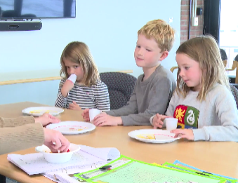
Authentic Formative Assessment (2 of 6)
Let’s watch another video of kindergarten assessment. What differences do you notice from previous?
Composing Numbers

Slide 8
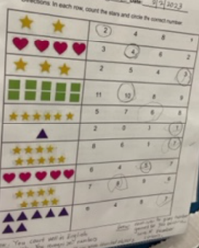
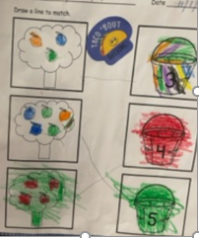
Authentic Formative Assessment (3 of 6)
Let’s Taco ‘Bout This!! What do these assess?

Slide 9
Authentic Formative Assessment (4 of 6)
K.CC.B.: Count to tell the number of objects
4. Understand the relationship between numbers and quantities; connect counting to cardinality.
a. When counting objects, say the number names in the standard order, pairing each object with one and only one number name and each number name with one and only one object.
b. Understand that the last number name said tells the number of objects counted. The number of objects is the same regardless of their arrangement or the order in which they were counted.
c. Understand that each successive number name refers to a quantity that is one larger.
5. Count to answer “how many?” questions about as many as 20 things arranged in a line, a rectangular array, or a circle, or as many as 10 things in a scattered configuration; given a number from 1–20, count out that many objects.

Slide 10
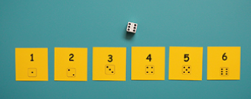
Authentic Formative Assessment (5 of 6)
Now observe this game that can be played in a small group. Think about…
How can a teacher use games such as this in small groups to assess learning?
What standards and skills can teachers assess using this activity? Let’s discuss!
https://youngmathematicians.edc.org/math_games/count-and-see-board-games/

Slide 11
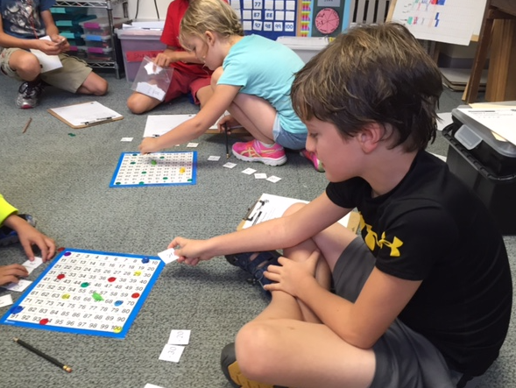
Authentic Formative Assessment (6 of 6)
Games enable teachers to observe and assess students' understanding of skills and concepts throughout the learning experience. Good games seamlessly assess children as they play them. Instead of trying to quickly capture a moment in time through a unit assessment or quiz, assess through math games, centers, and activities.

Slide 12
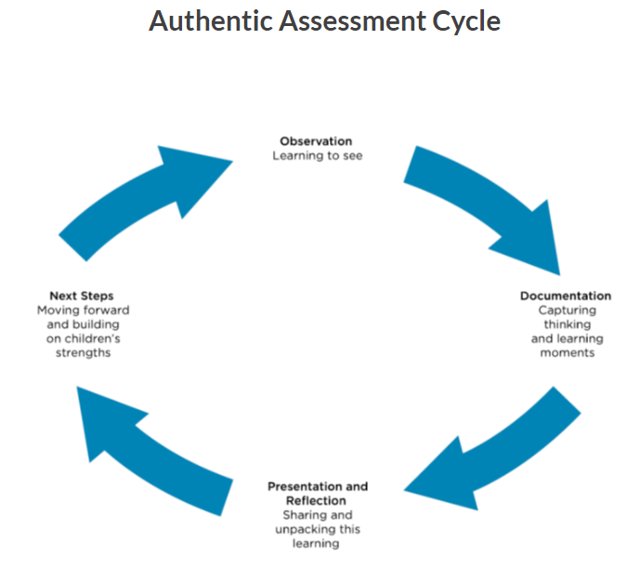
Authentic Assessment Cycle (1 of 4)
There are four steps in the authentic assessment cycle. When an educator applies these four steps, it helps various audiences in addition to the educator, including children, families, and the community, understand and value children’s thinking, learning, and development.
(Seitz, 2023)

Slide 13
Authentic Assessment Cycle (2 of 4)
Observation and Documentation
Kidwatching
Intensely observing and documenting what children know and can do.
Documenting children's ways of constructing and building knowledge (anecdotal notes, portfolios).
Tailoring activities to individual strengths and needs.
Teachers form relationships with children and understand the whole child i.e., language, family, culture, interests.
Photos and videos of children engaged in activities with children’s writing or quotations, noticing and capturing even small things about each child’s learning. (Preschool Standards)
Factual, not based on interpretations.
Based on observations, teachers can plan learning experiences; respond to children’s interests, strengths, and needs; decide how to guide interactions and play; and offer evidence of children’s learning and development.

Slide 14
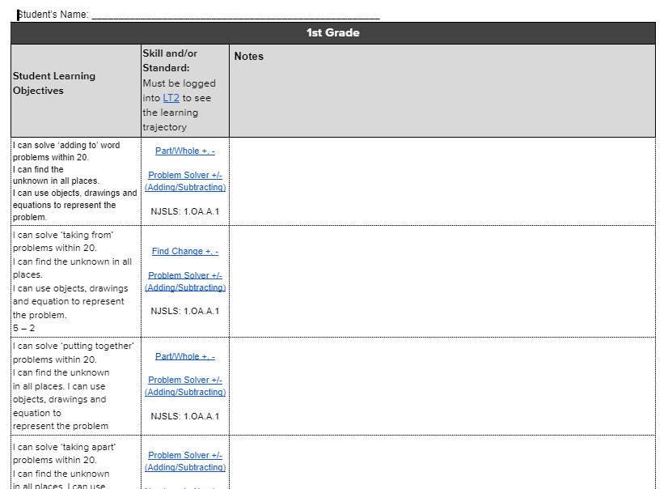
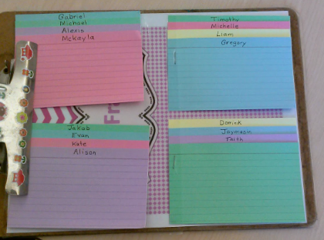
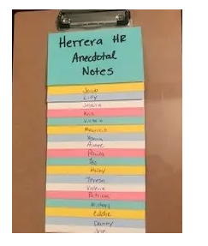
Authentic Assessment Cycle (3 of 4)
Observation and Documentation

Slide 15
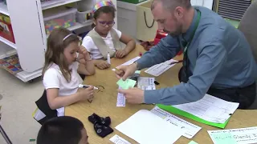
Authentic Assessment Cycle (4 of 4)
Observation and Documentation
Document observations!

Slide 16
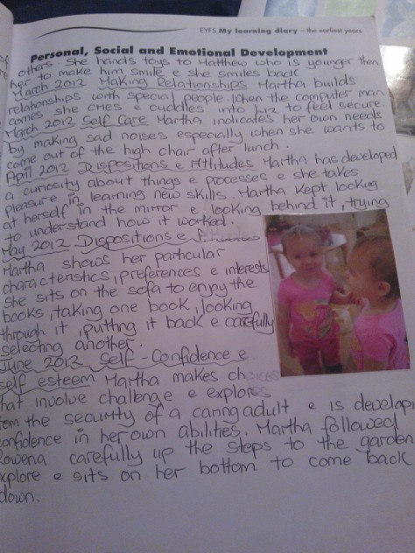
Portfolios
One way to document visual and auditory evidence of a child’s growth and learning abilities is to create a portfolio, hard copy or digital, that includes photos, transcripts, and videos.
To do this, teachers need an ongoing system to collect dated documentation (observations, photos, and work samples) on each child. This provides assessment data for a particular date. If this process is repeated every month or two and then put together, these pieces will tell a story, and the documentation (authentic assessment) will show how the child is growing and developing.

Slide 17
Using Formative Assessment (1 of 6)
Formative assessments are largely built on observation, therefore are most easily done during small group time and center activities.
Start with these simple questions:
What does this child understand about the concept, I’m teaching?
What is the child’s level of thinking in this concept?
What ideas or skills does this child need to move to next level of development?
What activities will I plan to bring this child to the next level?

Slide 18
Using Formative Assessment (2 of 6)
Formative assessments help teachers to determine what to do next to help a child move along their learning trajectory. Of all conceptual teaching tools, formative assessment is possibly the most powerful.
Keep the end in mind.
Ongoing monitoring of each child’s learning so teachers can determine where the child stands developmentally. Use some type of anecdotal notecatcher (sample).
Teachers modify their teaching in response to what they learned.

Slide 19
Using Formative Assessment (3 of 6)
Formative Assessment during intentionally planned small group instruction: Copy My Dots
What information about students' abilities can we glean from this activity?
How can teachers reflect on and modify their instruction based on what they learned?

Slide 20
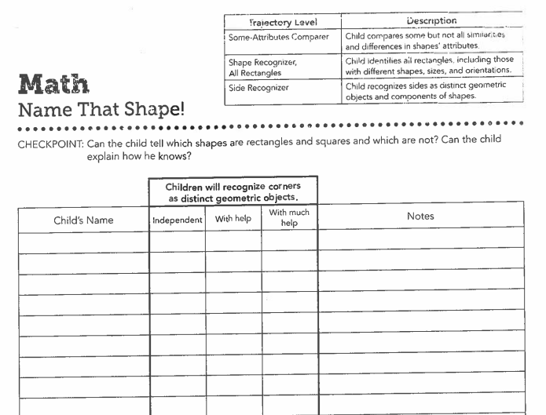
Using Formative Assessment (4 of 6)
Formative Assessment during intentionally planned small group instruction: Hiding Shapes
What information about students' abilities can we glean from this activity?
How can teachers reflect on and modify their instruction based on what they learned? 2D Shapes

Slide 21
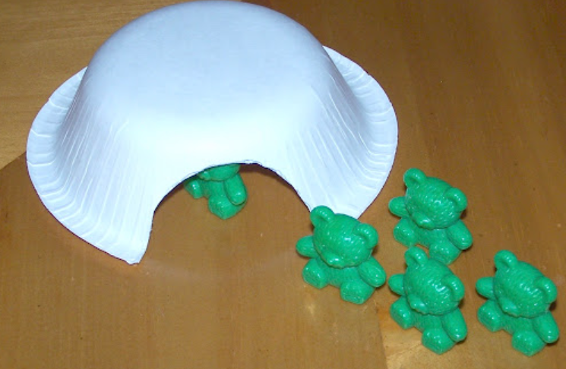
Using Formative Assessment (5 of 6)
How many are hiding?
Bears in a Cave

Slide 22
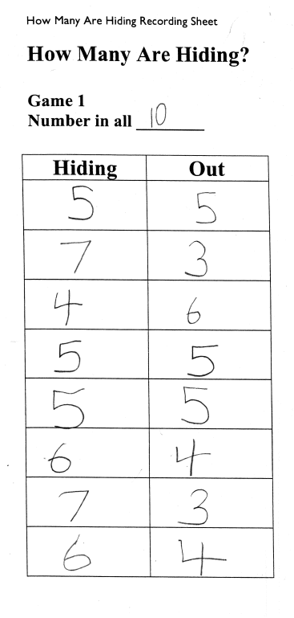
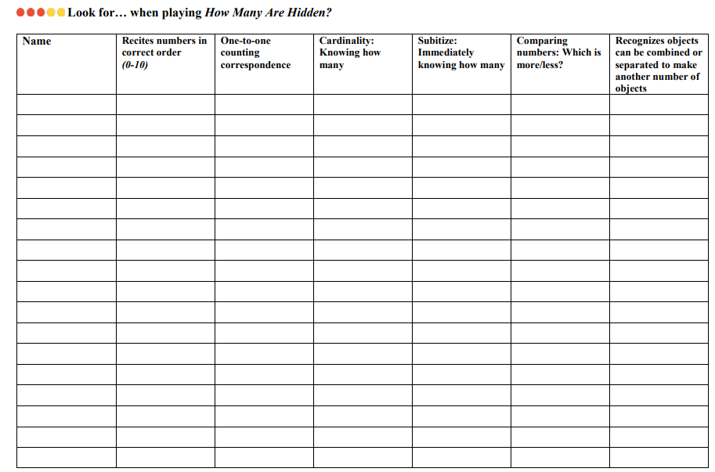
Using Formative Assessment (6 of 6)

Slide 23
Feedback (1 of 2)
Wiggins (2012) explains feedback as “goal-referenced; tangible and transparent; actionable; user-friendly (specific and personalized); timely; ongoing; and consistent”.
Developmentally appropriate quality feedback increases learning and motivation and predicts student achievement. Based on its potential positive effects on a variety of child outcomes, intentional feedback should be a priority in early math classrooms.

Slide 24
Feedback (2 of 2)
Consider the WRAP protocol to offer specific, meaningful, and actionable feedback:
Well: Share what the child did well. Children also reflect on what went well.
Refer: Refer to the child’s prior learning.
Action and agency: Provide a strategic action to foster the child’s agency.
Practice: Communicate what and how the child can practice.
(Moises, 2023)

Slide 25
Performance Based Assessments using Rich Tasks (1 of 3)
Performance tasks can be a good way to assess students’ knowledge. Through rich performance-based tasks, students demonstrate the knowledge, skills, and material that they have learned. This practice measures how well a student can apply or use what he or she knows, often in real-world situations.
Research has shown that performance-based assessment provides a means to assess higher-order thinking skills and helps teachers and principals support students in developing a deeper understanding of content.

Slide 26
Performance Based Assessments using Rich Tasks (2 of 3)
What is a good performance task?
Aligned to important goals.
Gives us evidence of understanding and the students ability apply their learning effectively (transfer).
Involves application as well as explanation.
Will yield a tangible product and/or performance, well aligned to the goals.
Includes a criteria/rubric.
Interdisciplinary.

Slide 27
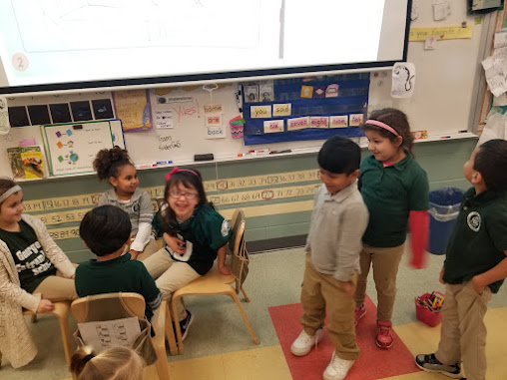
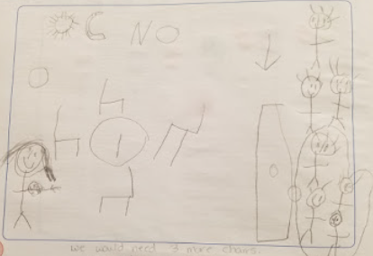
Performance Based Assessments using Rich Tasks (3 of 3)
Examples and Resources
Stanford
Inside Mathematics
Virginia DOE
Achieve the Core
Engage NY
Problems of the Week: NCTM
PBL Works
Use your core resource!

Slide 28
Assessing for Accuracy, Efficiency, and Flexibility (1 of 5)
PK 4.2: Children demonstrate an initial understanding of numerical operations.
K.OA.C.5: Demonstrate accuracy and efficiency for addition and subtraction within 5.
1.OA.C.6: Add and subtract within 20, demonstrating accuracy and efficiency for addition and subtraction within 10. Use strategies such as counting on; making ten (e.g., 8 + 6 =8 + 2 + 4 = 10 + 4 = 14 ); decomposing a number leading to a ten (e.g., 13 – 4 = 13 – 3 – 1 = 10 – 1 = 9) using the relationship between addition and subtraction (e.g., knowing that 8 + 4 = 12, one knows that 12 - 8 = 4) and creating equivalent but easier or known sums (e.g., adding 6 + 7 by creating the known equivalent 6 + 6 + 1 = 12 + 1 =13).
2.OA.B.2: With accuracy and efficiency, add and subtract within 20 using mental strategies. By end of Grade 2, know from memory all sums of two one-digit numbers.
3.OA.C.7: With accuracy and efficiency, multiply and divide within 100, using strategies such as the relationship between multiplication and division (e.g., knowing that 8 * 5 = 40, one knows that 40/5 = 8) or properties of operations. By the end of Grade 3, know from memory all products of two one-digit numbers.

Slide 29
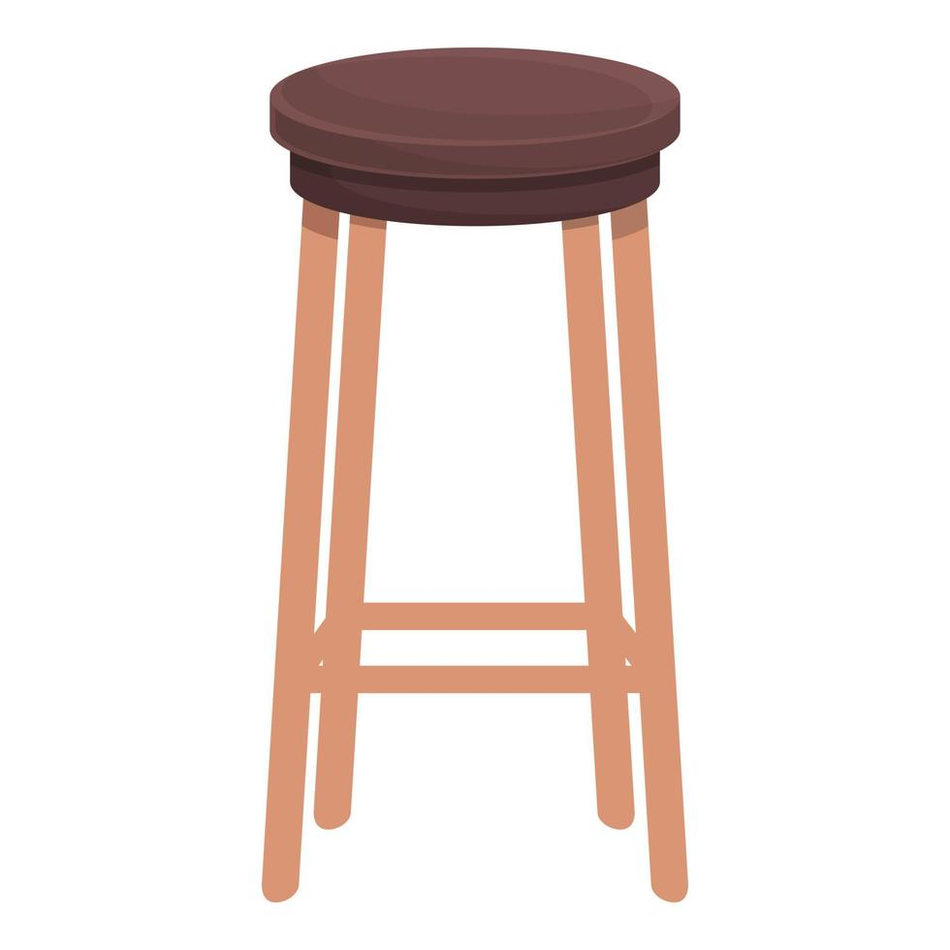
Assessing for Accuracy, Efficiency, and Flexibility (2 of 5)
When assessing basic facts, we cannot assess for only accuracy, neglecting efficiency and flexibility. Timed tests do not assess fact proficiency and can negatively affect students, therefore should be avoided (Boaler, 2014; Kling & Bay-Williams, 2021; NCTM 2020; Ramirez, Shaw, & Maloney 2018).
Fluency is a four-legged stool…. Accuracy, flexibility, efficiency and eventually automaticity. If a leg is missing the stool won't stand! (Newton, 2019)
What are the alternatives?

Slide 30
Assessing for Accuracy, Efficiency, and Flexibility (3 of 5)
Alternatives:
Two-color probe
Observations
Running Records
Interviews
Written Prompts

Slide 31
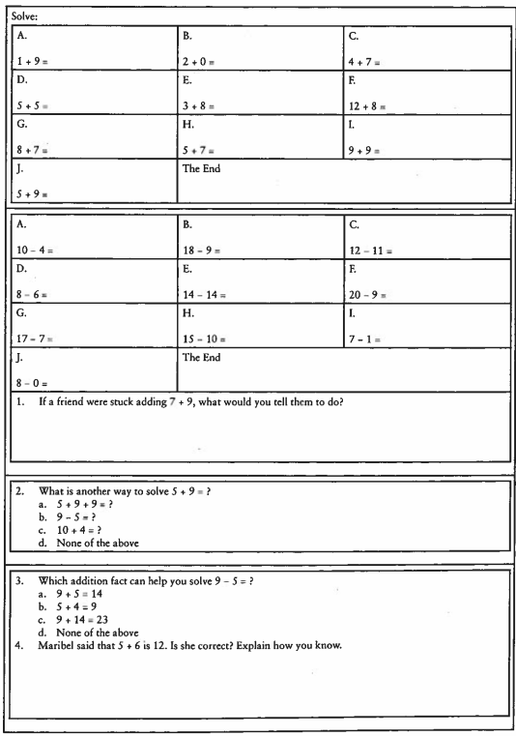
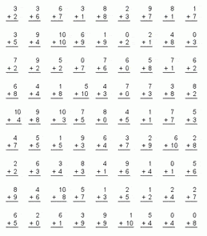
Assessing for Accuracy, Efficiency, and Flexibility (4 of 5)
Alternatives:
Two-color probe

Slide 32
Assessing for Accuracy, Efficiency, and Flexibility (5 of 5)
Alternatives:
Two-color probe
Observations
Running Records
Interviews
Written Prompts

Slide 33
Evaluative Assessments (1 of 2)
Summative or Evaluative Assessments
Final Score is not sufficient
Error Analysis
Targeted Small Group Instruction

Slide 34
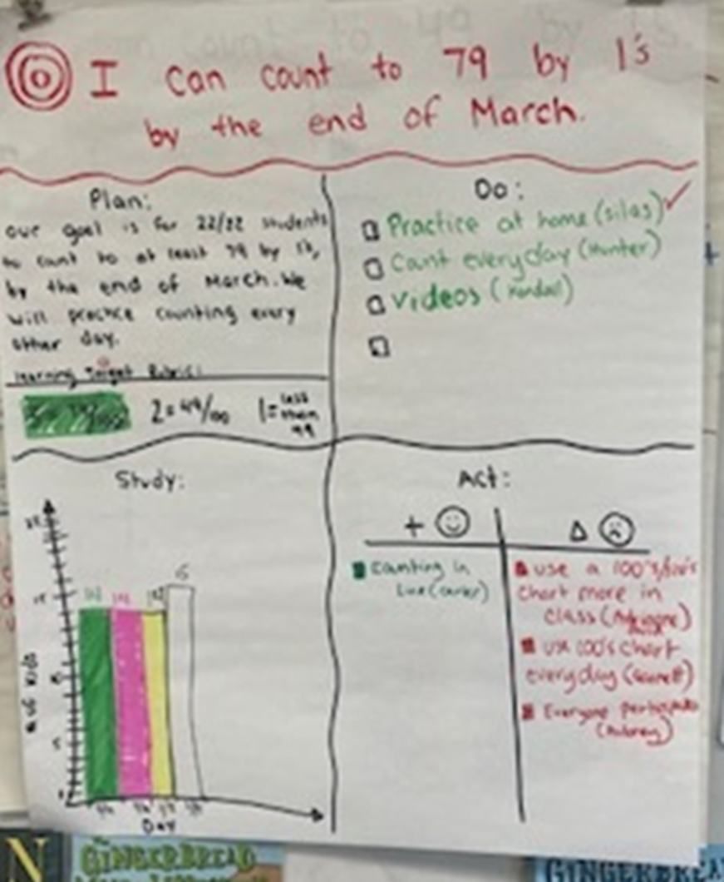
Evaluative Assessments (2 of 2)
We took the test now what?
Small Group Instruction
Differentiated Workstations
Interviews
How did I do on this unit test?
What did I do well on?
What do I still need to practice?
What is my action plan for doing it?
Goal Setting

Slide 35
Conclusion
Balanced assessment is an integral part of planning and successfully implementing targeted small group instruction, differentiated centers and ultimately reaching or surpassing grade level goals.
Think about elements you could add to your strategic assessment plan to successfully create a balanced assessment plan.

Slide 36
References
Bay-Williams, J. M., & Kling, G., (2019). Math fact fluency: 60+ Games and assessment tools to support learning and retention. ASCD.
Bay-Williams, J. M., & SanGiovanni. J. (2021). Figuring out fluency in mathematics teaching and learning, Grades K–8. Corwin.
Bohart, H., & Procopio, R. (2018). Spotlight on young children: Observation and assessment. NAEYC.
Boaler, J. (2014). Research suggests that timed tests cause math anxiety. Teaching Children Mathematics 20, no. 8 (April): 469–74.
Kling, G., & Bay-Williams, J.M. (2021). Eight unproductive practices in developing fact fluency. Mathematics Teacher: Learning and Teaching PK–12. 114(11), 830–38.
Moses, A. (2023). Developmentally appropriate assessment practices: Gathering, understanding, and using information. Young Children, 78(1), 4-5.
NCTM (2023). Procedural fluency reasoning and decision-making, Not Rote Application of Procedures Position.
Ramirez, G., Shaw, S., & Maloney, E. (2018). Math anxiety: Past research, promising interventions, and a new interpretation framework. Educational Psychologist 53( 3), 145–64.
Safir, S., & Dugan, J. (2021). Street data: A next-generation model for equity, pedagogy, and school transformation. Corwin.
Seitz, H. (2023). Authentic assessment: A strengths-based approach to making thinking, learning, and development visible. Young Children, 78(1), 6-11.
Wiggins, G. (2012). Seven keys to effective feedback. Feedback, 70(1), 10-16.

Slide 37
Follow Us on Social Media
Facebook: @njdeptofed
Instagram: @newjerseydoe
LinkedIn: New Jersey Department of Education
Threads: @NewJerseyDOE
X: @NewJerseyDOE
YouTube: @newjerseydepartmentofeduca6565

Slide 38
Thank You!
New Jersey Department of Education: nj.gov/education
K-3Office@doe.nj.gov

