Slide 1
Using Developmental Progressions and the Learning Trajectories across the P-3 Continuum
Office of K–3
Division of Early Childhood Services

Slide 2
Agenda
History of Learning Trajectories (LTs)
Defining Learning Trajectories
Pitfalls of LTs
Using the LTs
(Please be advised that neither the New Jersey Department of Education, nor its employees, specifically promotes, endorses, recommends, or favors any of the entities or resources listed herein. Instead, this list of entities and resources is provided for informational purposes only. School districts must always evaluate and determine, based on the individualized needs of its student population, whether to utilize and/or expend its resources on the entities or resources herein.)​

Slide 3
History of Learning Trajectories
Addition and Subtraction Framework (Carpenter and Moser, 1984)
Hypothetical Learning Trajectories (Simon, 2020)
Cognitively Guided Instruction (Carpenter, et. al., 2015)

Slide 4

Definition of Learning Trajectories
Learning Trajectories are descriptions of children’s thinking and learning in a specific domain and a route through a set of developmental levels using instructional tasks designed to move students through a developmental progression.
What are developmental progressions and the learning trajectories?

Slide 5
Value of Learning Trajectories
Support understanding of student conceptual development and understandings.
Identify clusters of related concepts at grade level.
Unify the theory of student learning in the domain.
Suggest rich uses of classroom assessment.
Clarify what to expect about students’ preparation from last year, and what will be expected of your students this year, next year, on so on.
Support cross-grade (vertical) instructional collaboration and coordination.
Support managing the range of preparation and needs of students—the more you understand about student learning of concepts and skills, the more readily you can identify tasks and discourse that supports improved proficiency.

Slide 6
Pitfalls of Learning Trajectories
LTs represent the common patterns of learning concepts in mathematics.
LTs may not address the variety of cultural practices learners bring to learning situations.

Slide 7
Three parts of a Learning Trajectory
Goal
Developmental Progression
Activity

Slide 8
Using Progressions to teach to a Grade 1 Standard
Represent and solve problems involving addition and subtraction
1.OA.A.1: Use addition and subtraction within 20 to solve word problems involving situations of adding to, taking from, putting together, taking apart, and comparing, with unknowns in all positions, e.g., by using objects, drawings, and equations with a symbol for the unknown number to represent the problem
Problem Solving Situations by Grade Level
Coherence Map

Slide 9
Using Progressions to teach to a Preschool Standard
Demonstrate an initial understanding of numerical operations
4.2.2 Begin to represent simple word problem data in pictures and drawings
Adding and Subtracting Learning Trajectory

Slide 10
Navigating the LT2 site
You must create a free account to use [LT]2.
Visit the website learningtrajectories.org watch the introductory videos on the homepage and create an account if you are a new user.
A complete manual on navigating the website and setting up an account is available in a user instructions document, “Learning and Teaching with Learning Trajectories [LT]2—User Instructions”.

Slide 11
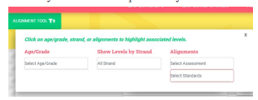
Navigating the LT2 site (1 of 3)
Using Learning Trajectories for Learning & Teaching
Start with a goal: You can start with any learning trajectory, but if you’re stuck, the Counting trajectory is a good place to start.
Consider your students’ development: To determine which trajectory levels might apply best for your students. Select the alignment tool on the left side of the Learning Trajectories page. Select the age/level that you feel best represents your classroom.

Slide 12
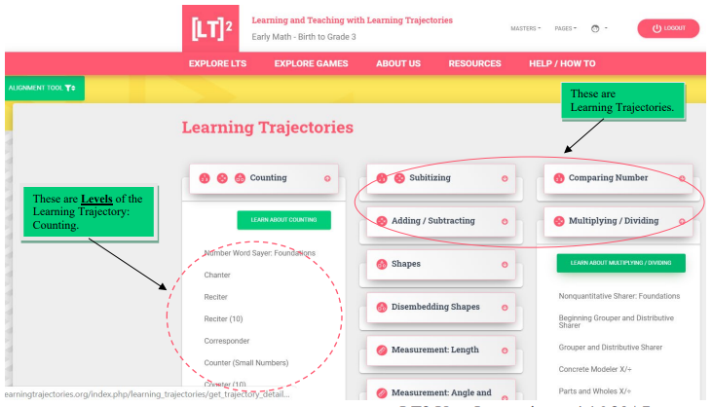
Navigating the LT2 site (2 of 3)
3. Learn about the expected developmental progression:
Read through the descriptions listed at the top of each trajectory's page. On the detail pages, watch the video(s) which provides examples of that level of mathematical thinking. Some of your students may be at the level before or after the age/grade associated with the level on the alignment tool.

Slide 13
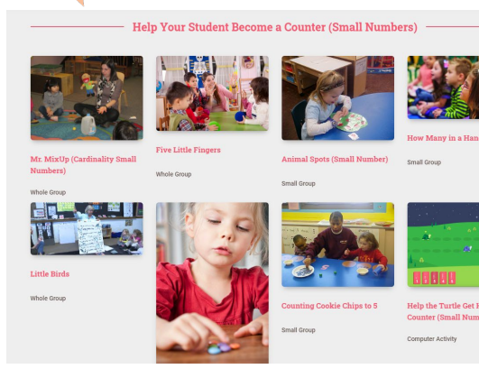
Navigating the LT2 site (3 of 3)
4. Choose an instructional activity: Use the activities to help teach the concepts to your students.

Slide 14
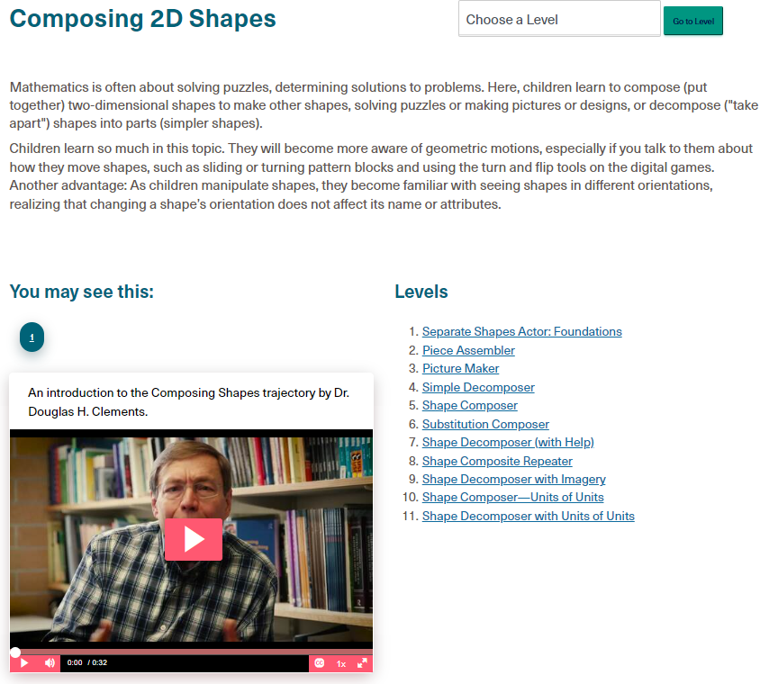
Composing 2D Shapes
PS 4.4.3: Manipulate, compare and discuss the attributes of: (a) two-dimensional shapes (e.g., use two dimensional shapes to make designs, patterns and pictures by manipulating materials such as paper shapes, puzzle pieces, tangrams; construct shapes from materials such as straws; match identical shapes; sort shapes based on rules [something that makes them alike/different]; describe shapes by sides/angles; use pattern blocks to compose/decompose shapes when making and taking apart compositions of several shapes).
K.G.B.6: Compose simple shapes to form larger shapes
1.G.A.2: Compose two-dimensional shapes or three-dimensional shapes to create a composite shape and compose new shapes from the composite shape.
1.G.A.3: Partition circles and rectangles into two and four equal shares. Understand for these examples that decomposing into more equal shares creates smaller shares.
2.G.A.2:Partition a rectangle into rows and columns of same-size squares and count to find the total number of them.
2.G.A.3: Partition circles and rectangles into two, three, or four equal shares, describe the shares using the words halves, thirds, half of, a third of, etc., and describe the whole as two halves, three thirds, four fourths. Recognize that equal shares of identical wholes need not have the same shape.
3.M.B.3.b: Recognize area as an attribute of plane figures and understand concepts of area measurement. A plane figure which can be covered without gaps or overlaps by unit squares is said to have an area of square units.
3.M.B.5: Relate area to the operations of multiplication and addition.
https://www.learningtrajectories.org/math/learning-trajectories
https://www.youtube.com/watch?v=d8Nr7VoRasQ

Slide 15
Let’s Review!
Are learning trajectories asset-based or deficit-based?
True or False…Learning trajectories march children through a narrow set of skills.
True or False…Learning trajectories do not consider differences in cultures, ethnicities, and children, including a wide range of approaches to teaching and learning.
True of False…Learning trajectories are a rigid sequence?

Slide 16
Conclusion
Learning trajectories connect research and practice.
Once teachers understand the learning trajectories and how to implement them in their classrooms, they-and the children they teach-will be changed for the better forever.

Slide 17
References
Carpenter, T. P., Fennema, E., & Franke, M. L. (2015). Cognitively guided instruction: A knowledge base for reform in primary mathematics instruction. The elementary school journal, 97(1), 3-20.
Carpenter, T. P., & Moser, J. M. (1984). The acquisition of addition and subtraction concepts in grades one through three. Journal for research in Mathematics Education, 15(3), 179-202.
Simon, M. (2020). Hypothetical learning trajectories in mathematics education. In Encyclopedia of mathematics education (pp. 354-357). Cham: Springer International Publishing.

Slide 18
Follow Us on Social Media
Facebook:
@njdeptofed
Instagram:
@newjerseydoe
LinkedIn:
New Jersey Department of Education
Threads:
@NewJerseyDOE
X: @NewJerseyDOE
YouTube: @newjerseydepartmentofeduca6565

Slide 19
Thank You!
New Jersey Department of Education: nj.gov/education
K-3Office@doe.nj.gov

