Slide 1
Centers in the
P–3 Mathematics Classroom Part 2
Office of K–3
Division of Early Childhood Services
1/25/24

Slide 2
Agenda
Getting Started
  The First 20 Days
  Mindset, perseverance, cognitive demand
  Environment and Tools
Managing Centers
  Differentiation
  Assessment and Learning Trajectories
(Please be advised that neither the New Jersey Department of Education, nor its employees, specifically promotes, endorses, recommends, or favors any of the entities or resources listed herein Instead, this list of entities and resources is provided for informational purposes only. School districts must always evaluate and determine, based on the individualized needs of its student population, whether to utilize and/or expend its resources on the entities or resources herein.)​​

Slide 3
Getting Started (1 of 6)
The First 20 Days
Establish routines
Organize the systems
Set expectations
Environment

Slide 4
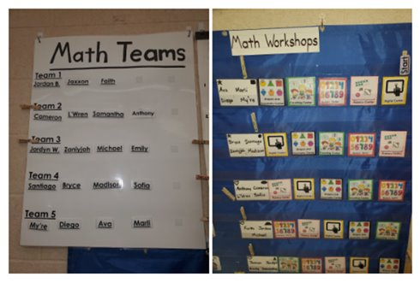
Getting Started (2 of 6)
The First 20 Days (sample schedule)
Establish routines
Schedules
Rotation charts
Expectations for each component (i.e., what happens during the Debrief?)
  (Newton, 2021)

Slide 5
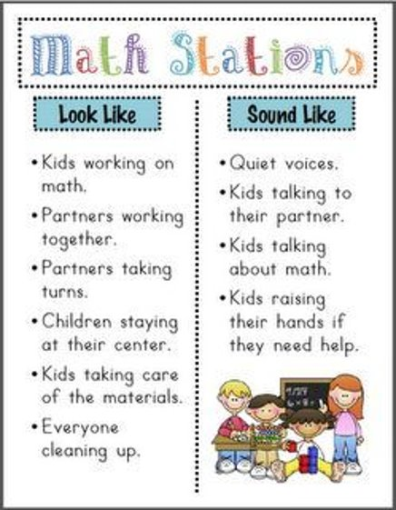
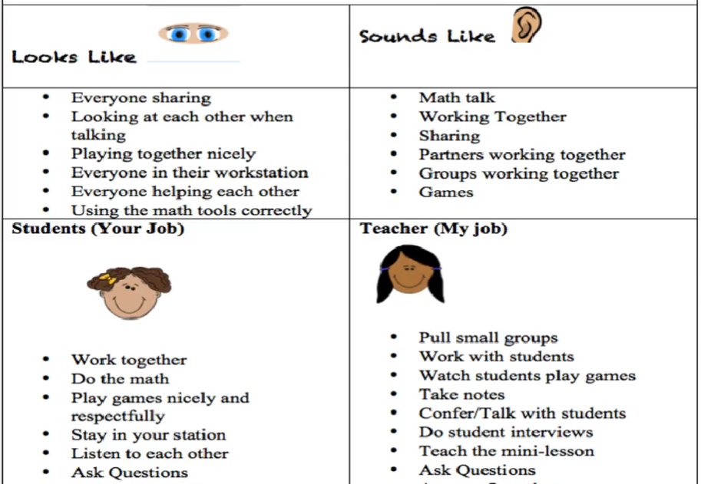
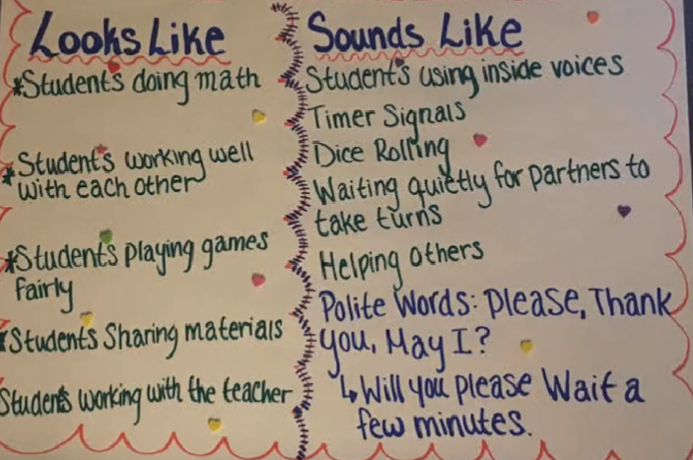
Getting Started (3 of 6)
What does ‘working in centers’ look like, sound like, and feels like?

Slide 6
Text Version: Looks like and sounds like chart
What does ‘working in centers’ look like, sound like, and feels like?
Looks like:
Everyone sharing
Looking at each other when talking
Playing together nicely
Everyone in their workstation
Everyone helping each other
Using the math tools correctly
Sounds like:
Math talk
Working together
Sharing
Partners working together
Groups working together
Games
Teacher (my job):
Pull small groups
Work with children
Watch students play games
Take notes
Confer/talk with students
Do student interviews
Teach the mini-lesson
Ask questions
Students (your job):
Work together
Do the math
Play games nicely and respectfully
Stay in your station
Listen to each other
Ask questions

Slide 7
Text Version: Math Stations Poster
Looks Like
Sounds Like
Kids working on math
Partners working together
Partners taking turns
Children staying at their center
Kids taking care of the materials
Everyone cleaning up
Quiet voices
Kids talking to their partner
Kids talking about math
Kids raising their hands if they need help

Slide 8
Text Version: Looks Like and Sounds Like Chart 2
Looks Like
Sounds Like
Students doing math
Students working well with each other
Students playing games fairly
Students sharing materials
Students working with the teacher
Students using inside voices
Timer signals
Dice rolling
Waiting quietly for partners to take turns
Helping others
Polite words: please, thank you, may I? will you please wait a few minutes?

Slide 9
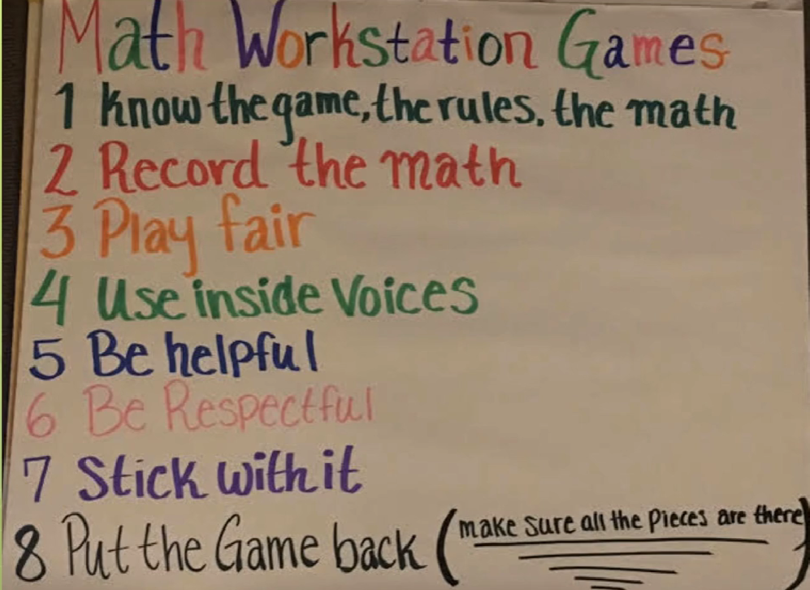
Getting Started (4 of 6)
Setting Expectations
Practice familiar games, how to use recording sheets (or exit slips), playing fair, being helpful, being respectful, perseverance, clean up.
Centers 1

Slide 10
Text Version: Math Workstation Games
Know the game, the rules, the math.
Record the math
Play fair
Use inside voices
Be helpful
Be respectful
Stick with it
Put the game back (make sure all the pieces are there)

Slide 11
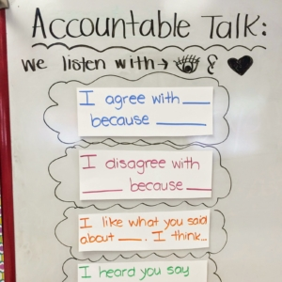
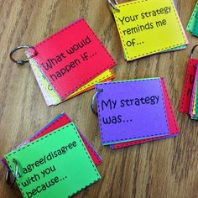
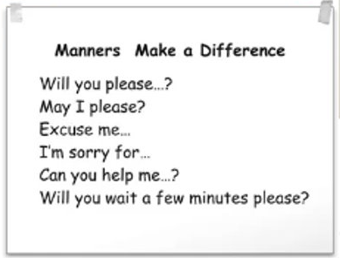
Gettting Started (5 of 6)
Setting Expectations

Slide 12
Text Version: Getting Started (5)
Discussion Cards
What would happen if…
Your strategy reminds me of…
I agree/disagree with you because…
Manners Make Difference
Will you please…?
May I…?
Excuse me…
I’m sorry for…
Can you help me…
Will you wait a few minutes please?
Accountable Talk
We listen with our brains and hearts:
I agree with [blank] because [blank]
I disagree with [blank] because [blank]
I like what you said about [blank]. I think [blank]
I heard you say [blank]

Slide 13
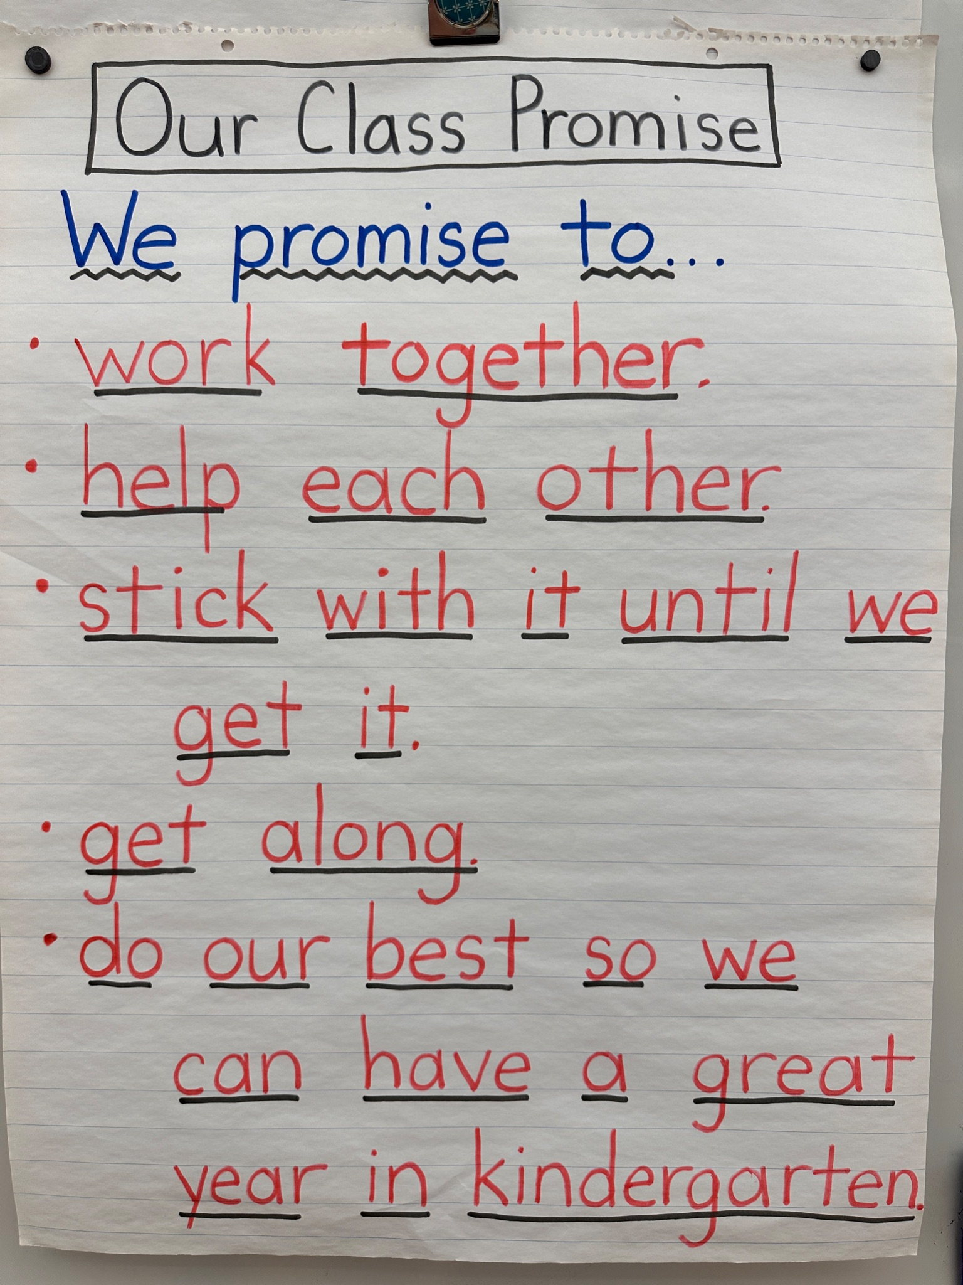
Getting Started (6 of 6)
Setting Expectations
Notes:
Sean

Slide 14
Text Version: Our Class Promise Poster
We promise to:
Work together
Help each other
Stick with it until we get it
Get along
Do our best so we can have a great year in Kindergarten

Slide 15
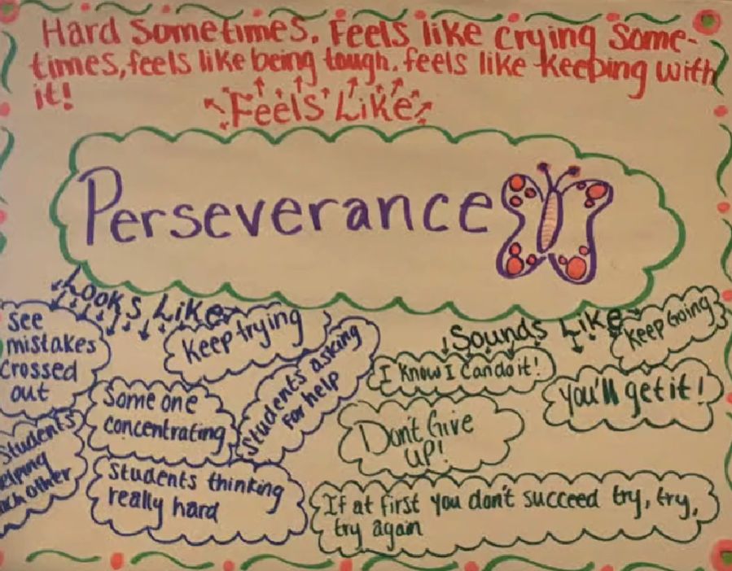
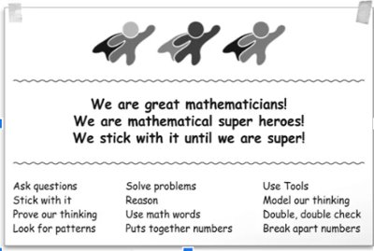
Mindset (1 of 3)
Perseverance

Slide 16
Text Version: Math Superheroes Poster
We are great mathematicians! We are superheroes! We stick with it until we are super!
Ask questions
Stick with it
Prove our thinking
Look for patterns
Solve problems
Reason
Use math words
Put together numbers
Use tools
Model our thinking
Double, double check
Break apart numbers

Slide 17
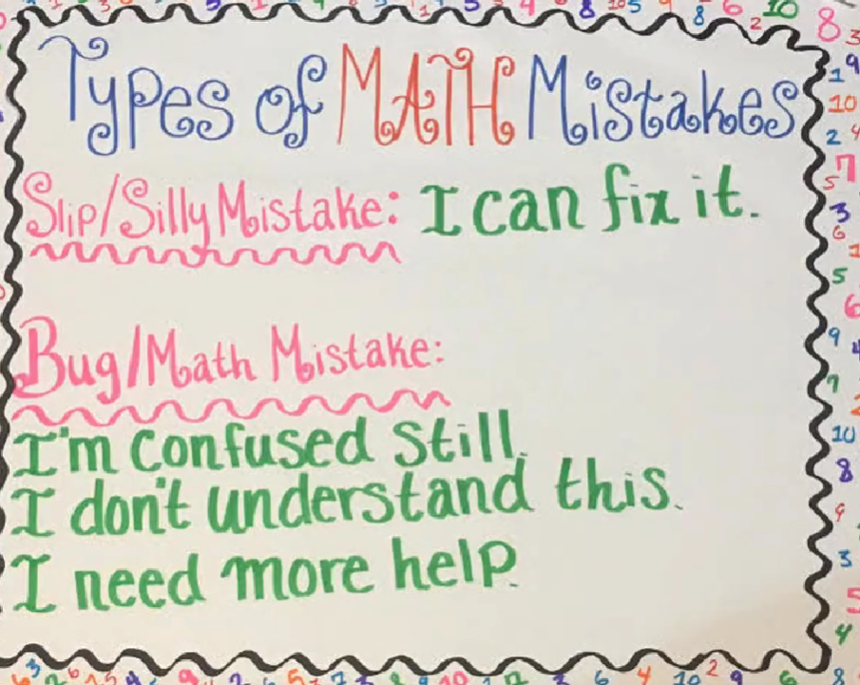
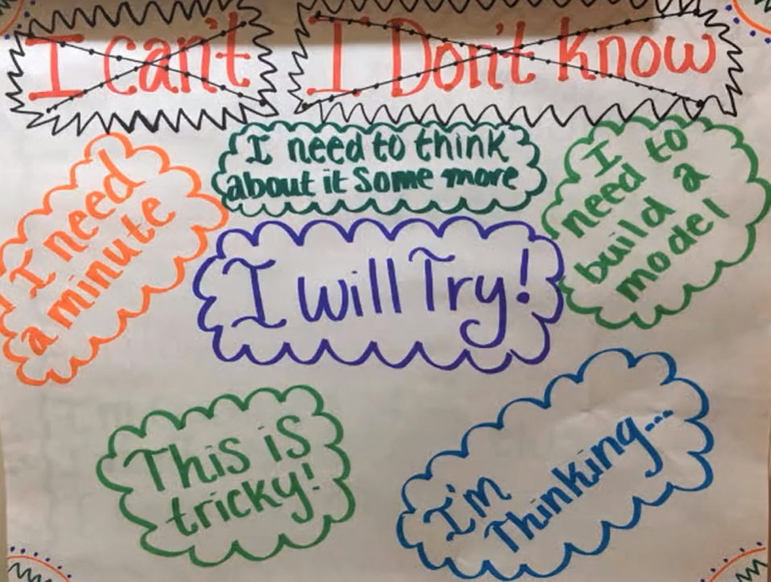
Mindset (2 of 3)
Perseverance

Slide 18
Text Version: Mindset 2
Types of Math Mistakes
Things to Say When You’re Stuck
Slip/Silly Mistake: I can fix it.
Bug/Math Mistake:
I’m confused still.
I don’t understand this.
I need more help.
Don’t say:
I can’t
I don’t know
Do say:
I need a minute
I will try!
I need to think about it some more
I need to build a model
This is tricky!
I’m thinking….

Slide 19
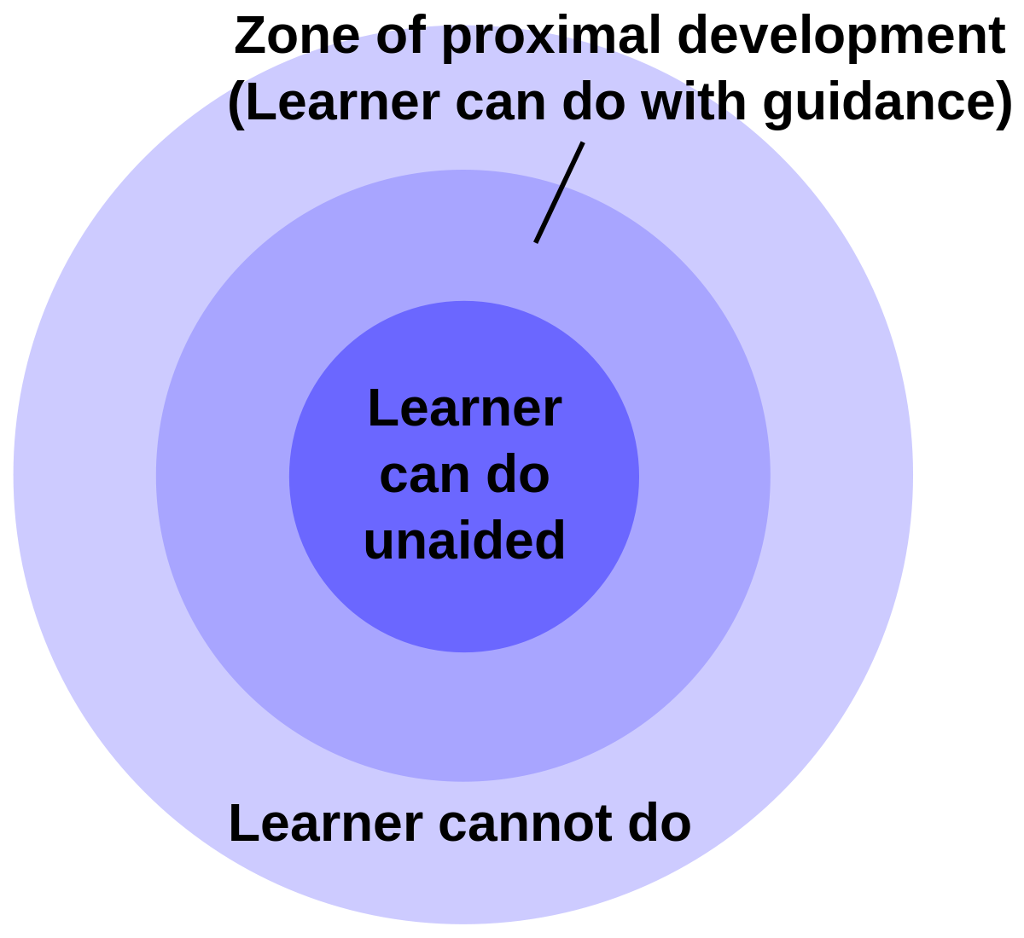
Mindset (3 of 3)
Don’t steal the struggle!
By “helping” too much we take away our students’ agency and the ability to attach real meaningful value to their learning and allow them to feel ownership in that learning. Students need to engage in a productive struggle to feel that the mathematics they are learning is meaningful to them. Let’s change our definition of “help”!

Slide 20
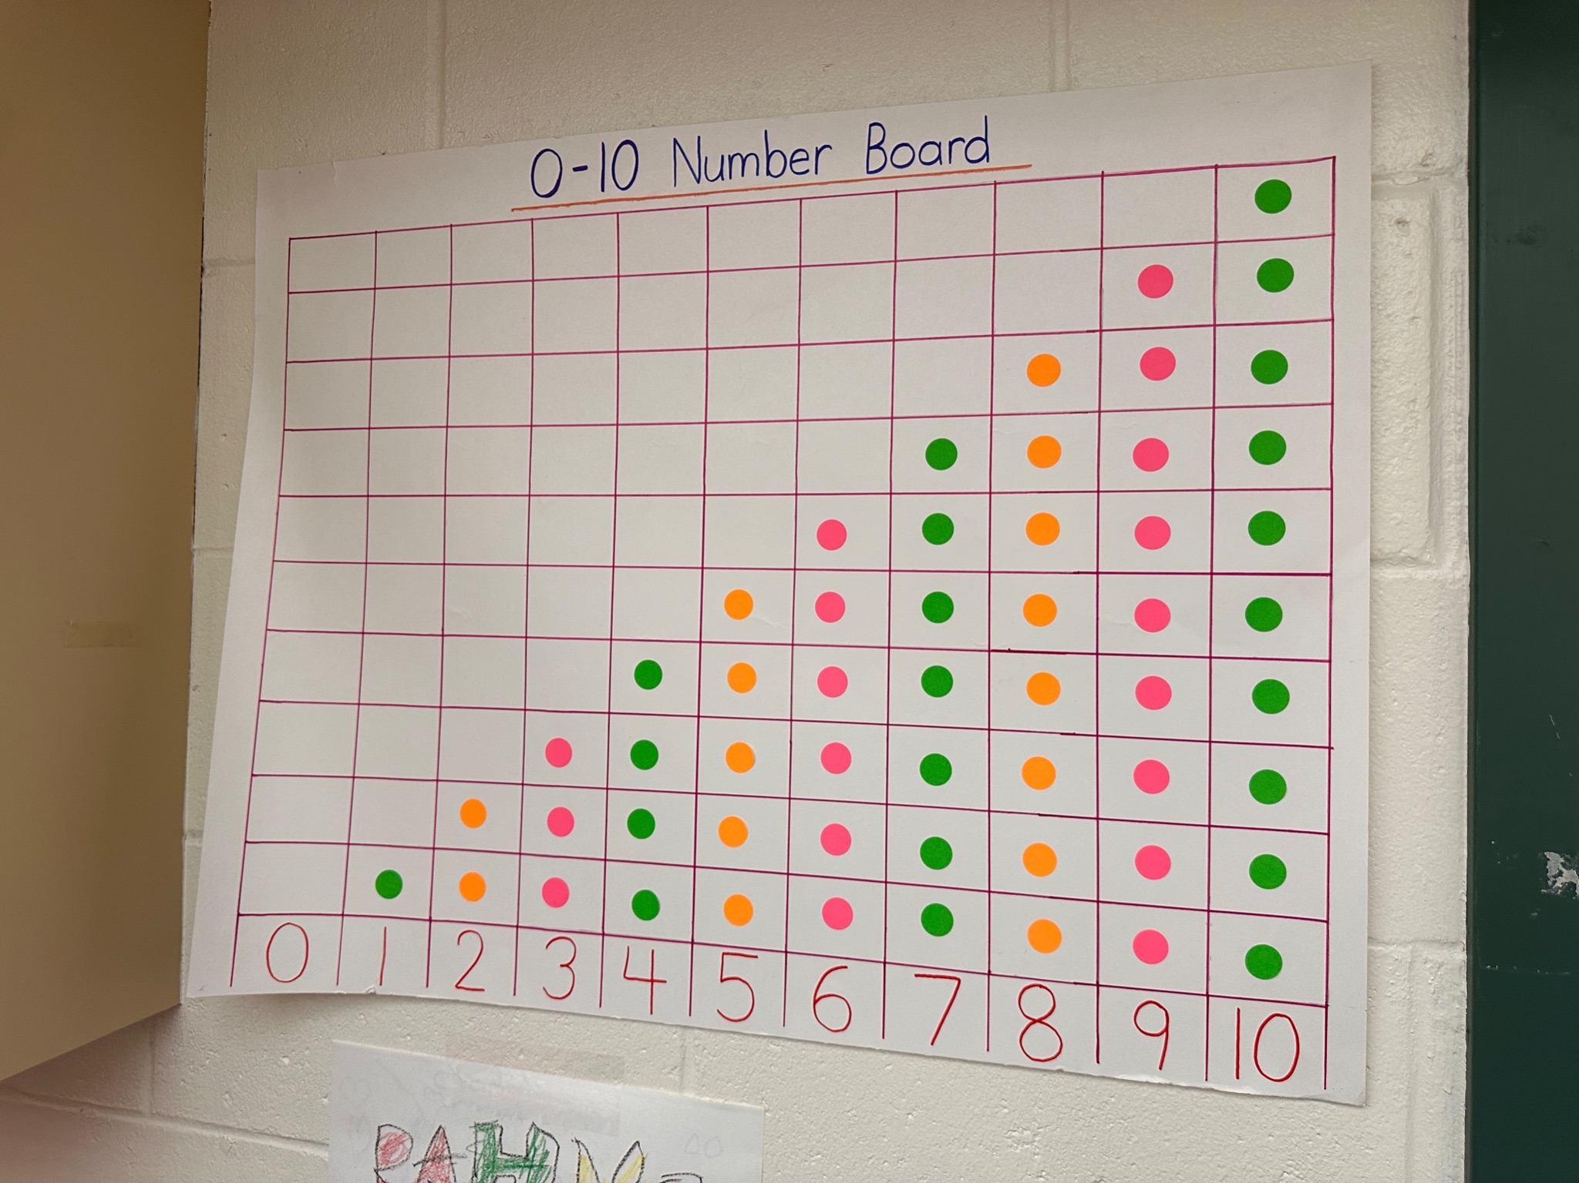
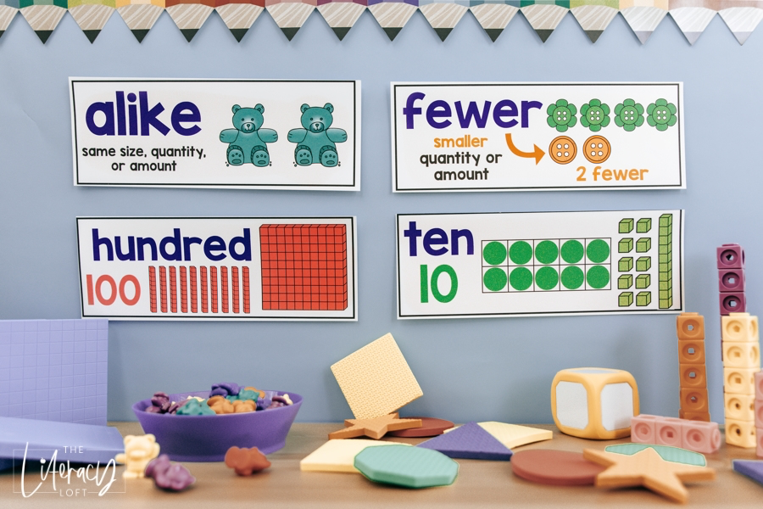
Environment (1 of 5)
Mathematize your environment: Anchor Posters

Slide 21
Text Version: Math Word Wall
Alike: Same size, quantity or amount
Example: two bears
Fewer: smaller quantity or
amount
Example: Two circles is two fewer than four circles
Hundred: 100
Examples: 10 groups of 10 blocks,
100 blocks
Ten
A ten frame (each frame has a circle)
Ten blocks
A group of ten blocks

Slide 22
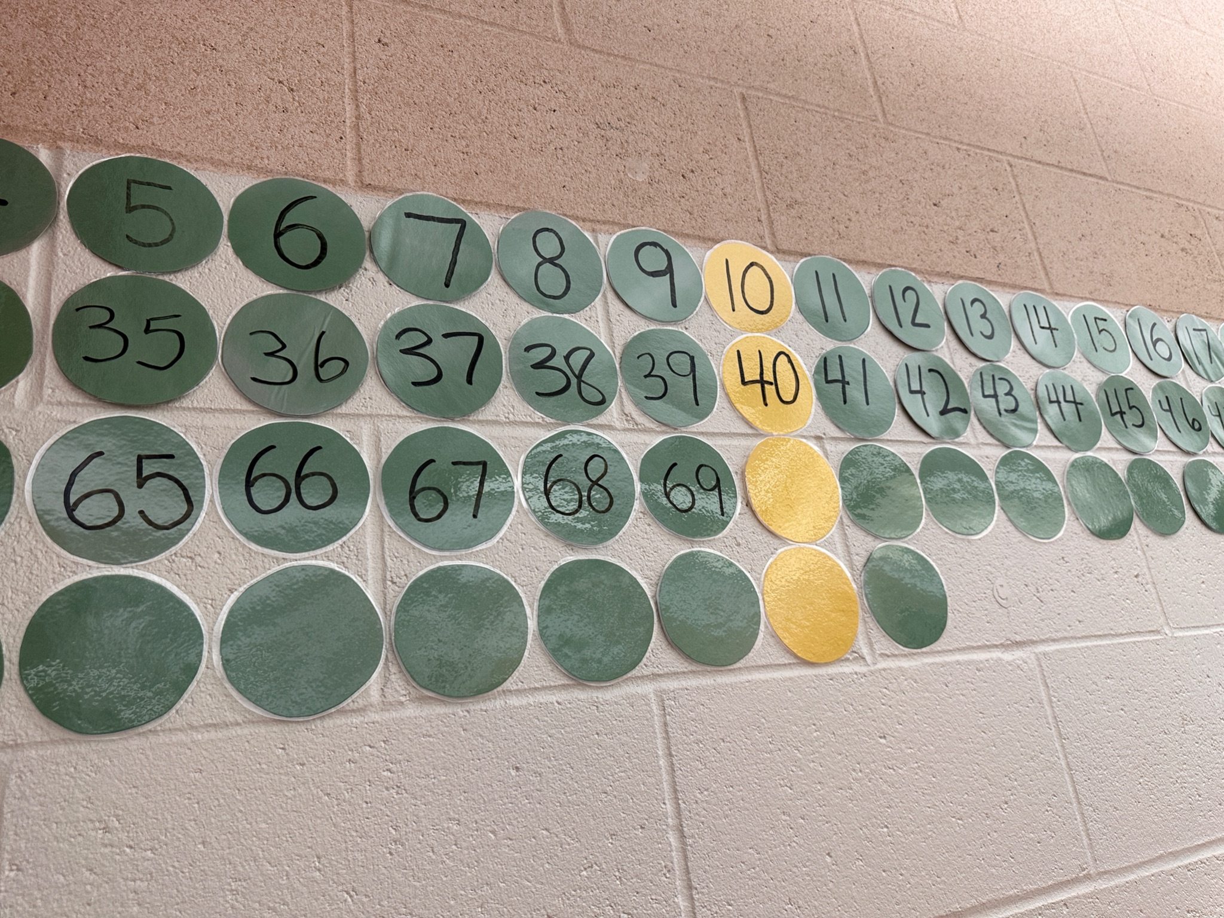
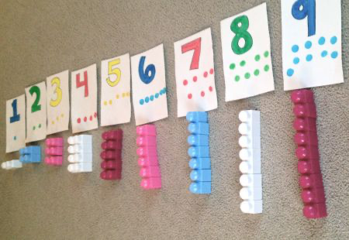
Environment (2 of 5)

Slide 23
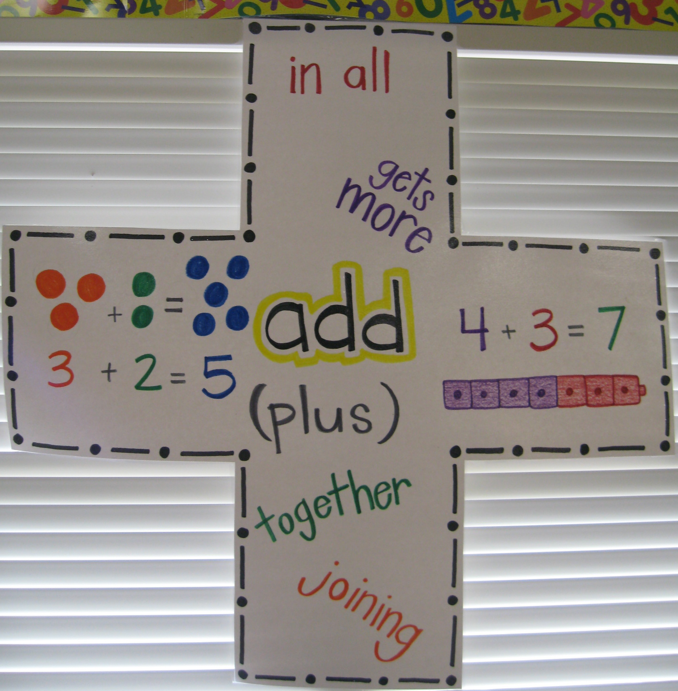
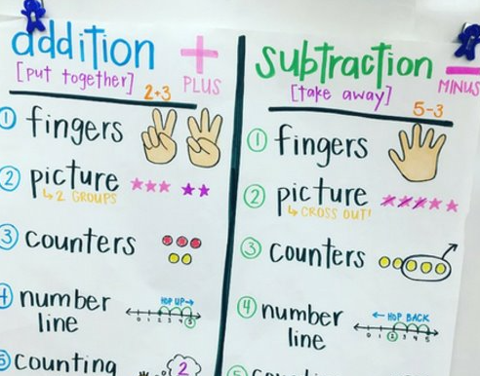
Environment (3 of 5)

Slide 24
Text Version: Addition Anchor Poster
Add (plus):
In all
Gets more
Together
Joining
Three two equals five (three circles plus two circles equals five circles)
Four plus three equals seven (four cubes plus three cubes equals seven cubes)

Slide 25
Text Version: Addition and Subtraction Anchor Poster
Addition
(Put together, Plus +, Two Plus Three)
Subtraction
Take Away (minus, Five minus three)
Fingers :two fingers plus three fingers
Picture (2 Groups): Three stars and two stars
Counters: Three counters and two counters
Number Line: Start at the two and jump forward three spots to the five
Counting
Fingers: five fingers then take away three fingers
Picture (cross out): Five stars and cross out three
Counters: Five counters and take away three counters
Number Line: Start at the five and jump back three to the two

Slide 26
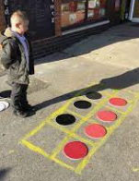
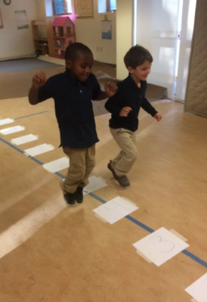
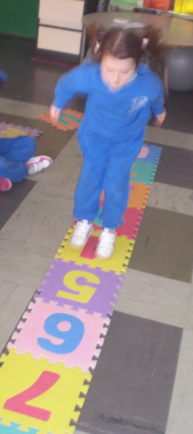
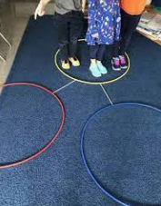
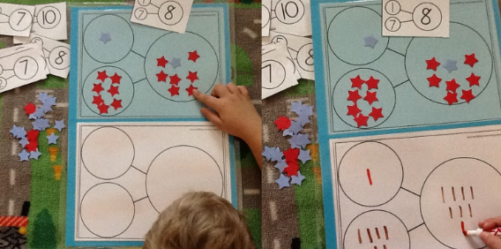
Environment (4 of 5)
Mathematize your environment
Large Ten Frames, Number Bonds, Number Lines, and Number Paths.
Your classroom can be a toolkit!

Slide 27
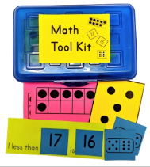
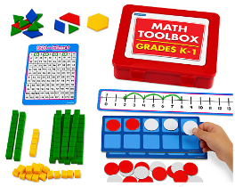
Environment (5 of 5)
Mathematize your environment
Introduce your students to math tools and the idea of math toolkits.
Toolkits contain small individual sized versions of the large-scale tools you use during math instruction.
Students should have a few opportunities to use/revisit the tool before it goes into the toolkit.
Toolkits

Slide 28


Exploring Math Centers/Workstations (1 of 3)
Differentiating/Leveling Centers
In a joint position paper, NAEYC and NCTM state that “highly specific timetables for skill acquisition pose a serious threat, especially when accountability pressures are intense. They tend to focus teachers’ attention on getting children to perform narrowly defined skills by a specific time, rather than on laying the conceptual groundwork that will serve children well in the long run. So everyone is rushed and learning is often ‘superficial’ at best ‘at the expense of real understanding.’”

Slide 29
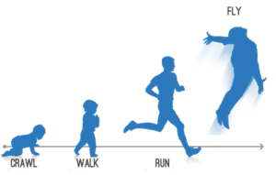
Exploring Math Centers/Workstations (2 of 3)
Differentiating/Leveling Centers
"In differentiated classrooms, teachers begin where students are, not the front of a curriculum guide.“ Carol Tomlinson

Slide 30
Exploring Math Centers/Workstations (3 of 3)
Pacing Calendars: the Good, the Bad, and the Ugly
The Ugly | The Bad | Good
Teacher ignores individual needs of the students. Teacher sees academic timeline as something that is “fixed.” Moving forward with superficial understanding of topics, leaving students behind unnecessarily. Teacher: “I have to cover all these topics!” | Teachers have a difficult time linking the pacing guide to their formative assessment data. Planning interventions for students is lost in the frenzy to keep up with the pacing guide. | Pacing guides can be thought of as a timeline marked by entry points. Nudge us along, help us understand how to effectively evaluate the progress of our students. Should help plan instruction with the understanding that it needs to also be flexible. (Teacher: “Have I reached the next entry point? “Do I have to re-adjust the timeline based on feedback obtained through formative assessment?”)

Slide 31
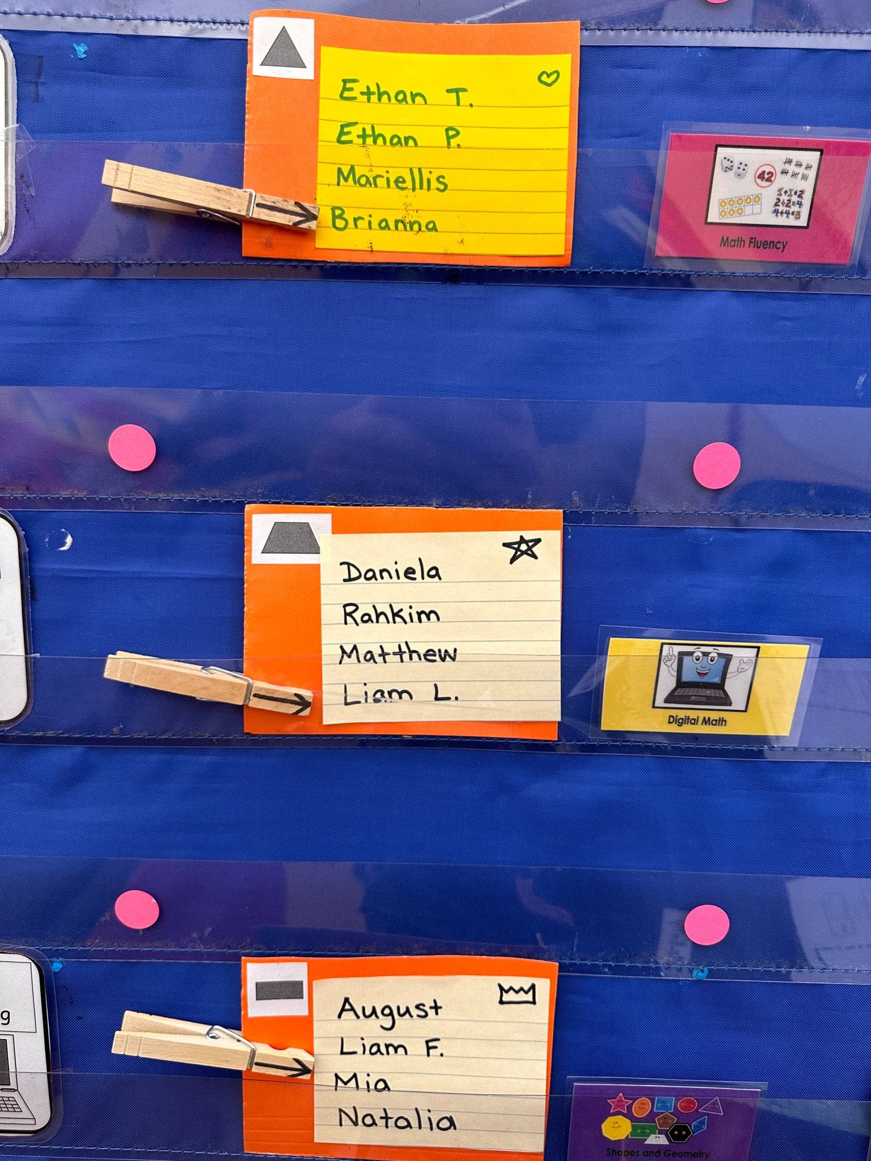
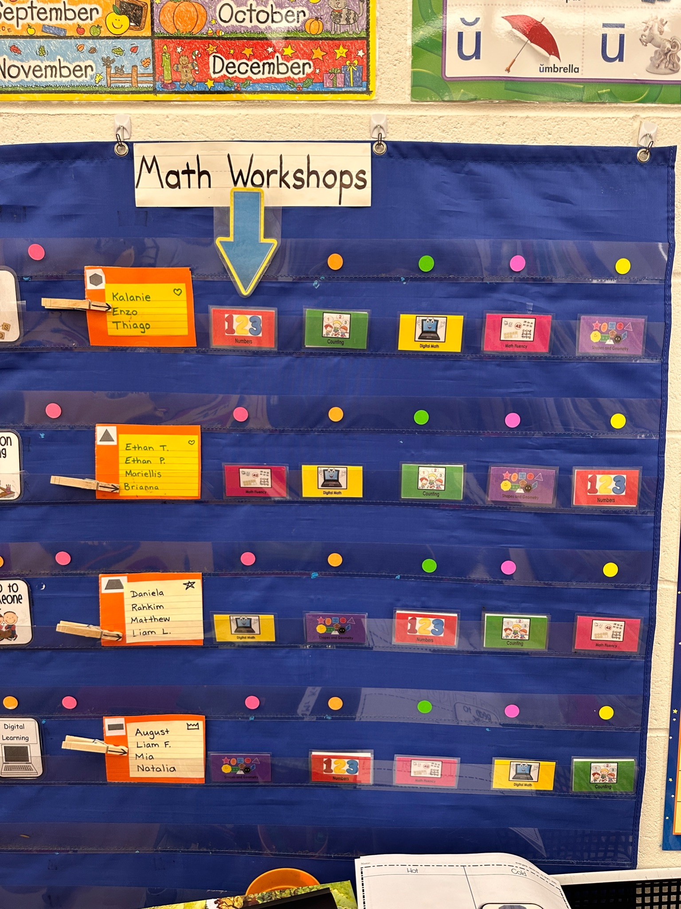
Managing Centers (2 of 16)
Start small and begin with what you can manage!
Establish your centers/workstations.
Plan various games, activities, and projects that are meaningful, standards-based, and reflect math learning trajectories.
Carve out time where students work to make sense of the math they are learning with a variety of scaffolded experiences.

Slide 32
Managing Centers (3 of 16)
Establish your centers/workstations based on your grade level's priority goals as well as your unit of study.
  PK Centers: Numbers and Counting; Spatial Relations and Measurement; and Geometry.
  K Centers: Counting, Numbers and Operations; Geometry, Measurement, and Data Literacy; Problem Solving (second half of the year or earlier).
  1st Grade Centers: Adding and Subtraction; Place Value; Geometry, Measurement and Data Literacy; Problem Solving.
  2nd Grade Centers: Addition and Subtraction; Place Value; Geometry/Describing Analyzing Shapes, Measurement and Data, Problem Solving.
  3rd Grade Centers: Operations, Fractions, Geometry, Measurement and Data, Problem Solving.

Slide 33

Managing Centers (4 of 16)
Differentiating/Leveling Centers using the Cycle of Engagement
Centers are a space for students to practice what they are learning and what they are supposed to know. They practice in various ways:
Concrete
Pictorial
Abstract
Continual exposure using the concrete, pictorial, abstract cycle leads to a formation of links among the representations into a collective structure. When the symbolic math (6 + 6 = 12) symbols become the dominant representation in a collective structure that the state of ‘learned’ is reached (Chang et al., 2017).

Slide 34
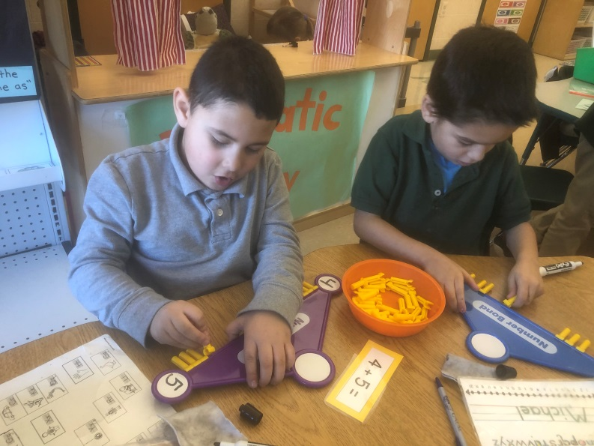
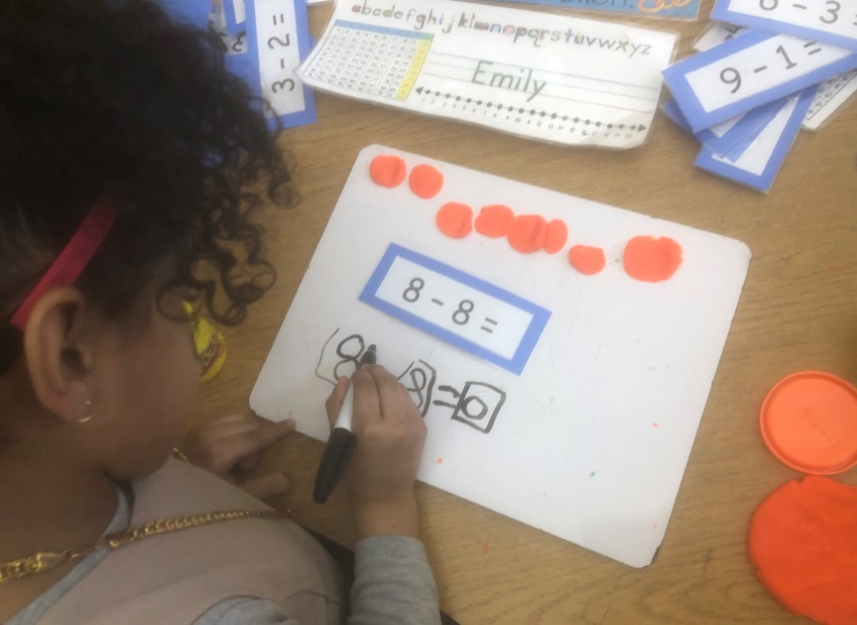
Managing Centers (5 of 16)
Differentiating/Leveling Centers using the Cycle of Engagement: Concrete

Slide 35
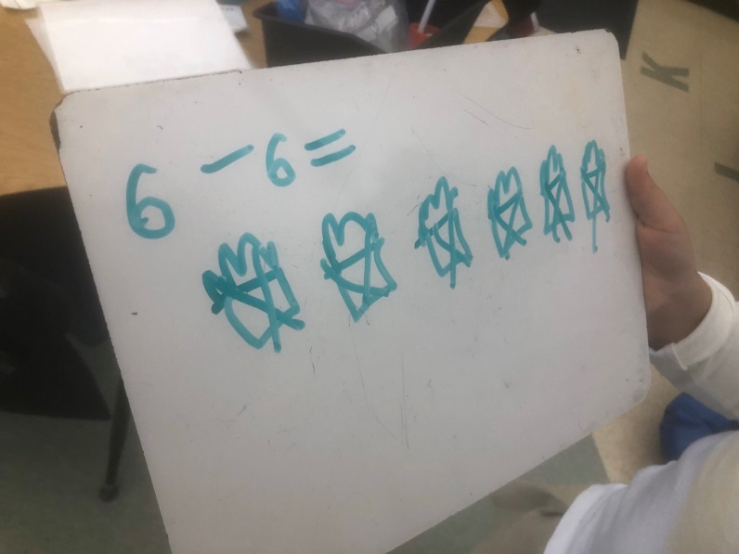
Managing Centers (6 of 16)
Differentiating/Leveling Centers using the Cycle of Engagement: Pictorial

Slide 36
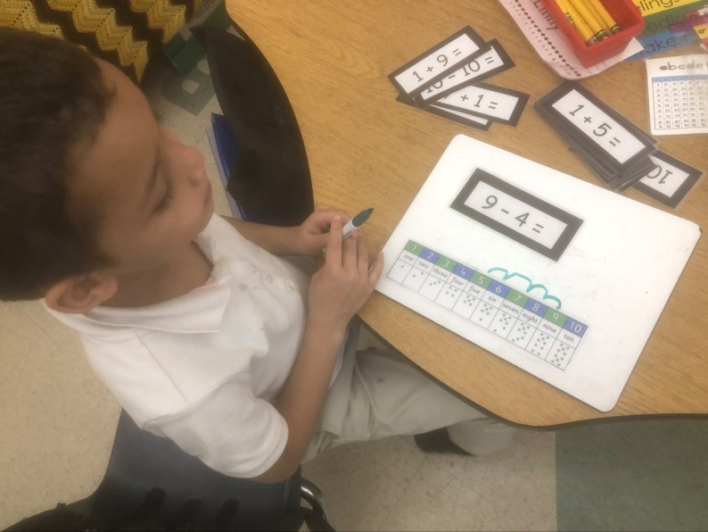
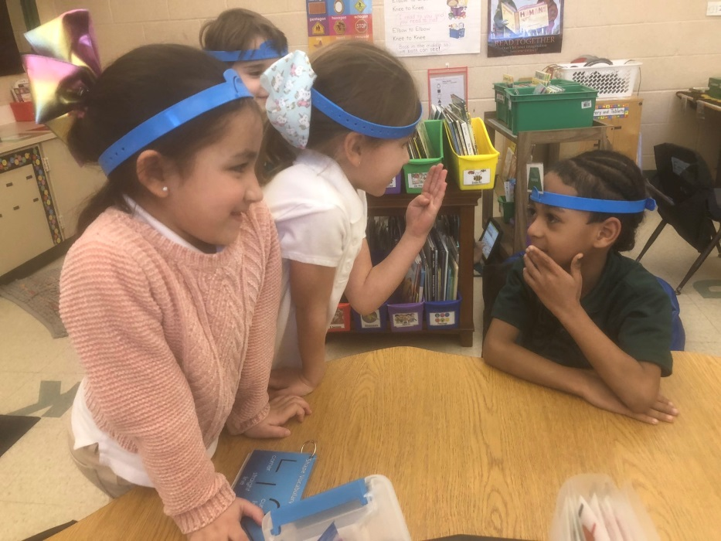
Managing Centers (7 of 16)
Differentiating/Leveling Centers using the Cycle of Engagement: Abstract

Slide 37
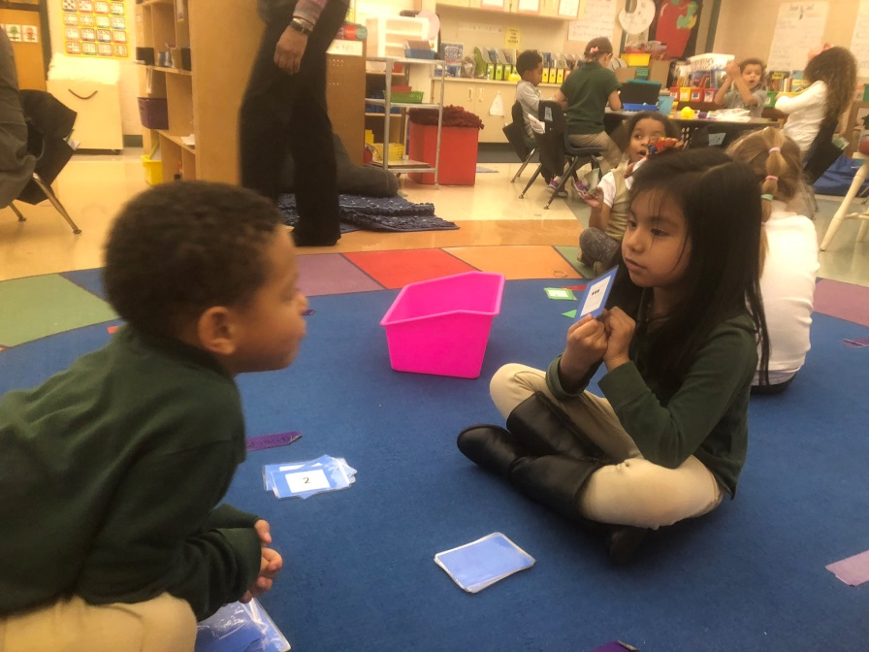
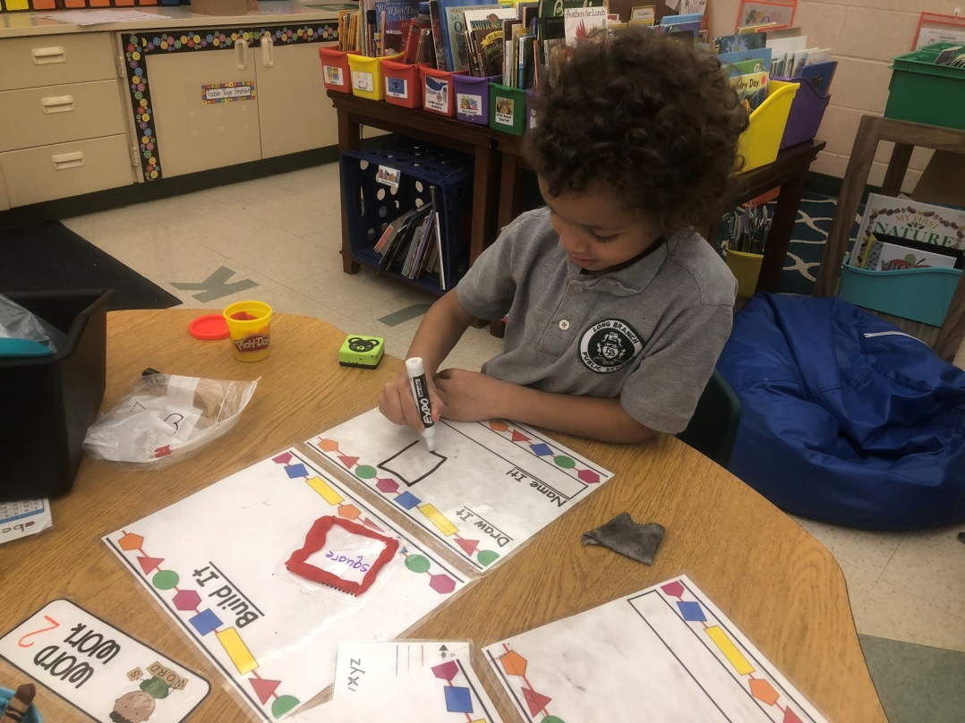
Managing Centers (8 of 16)
Differentiating/Leveling Centers
Levels are based on the understanding that students learn at their own pace.
Students working in their zone of proximal development (ZPD).

Slide 38
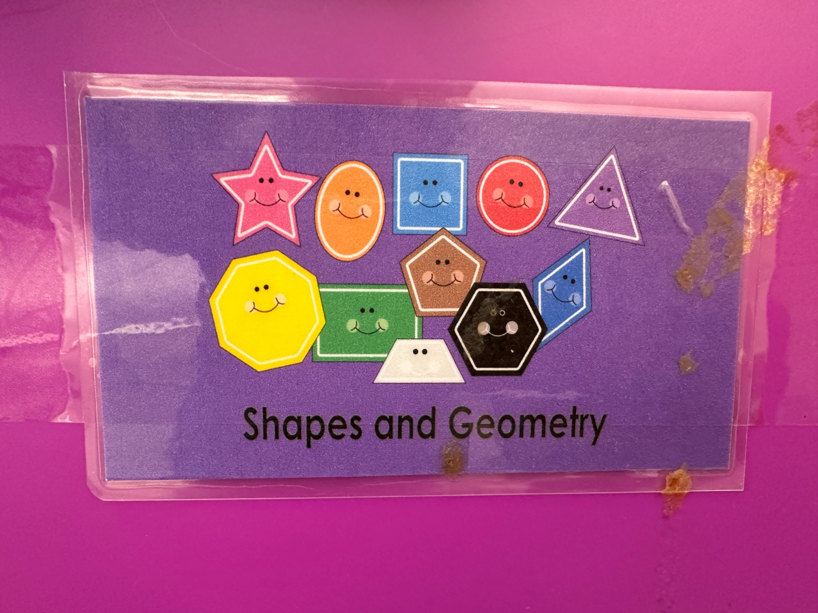
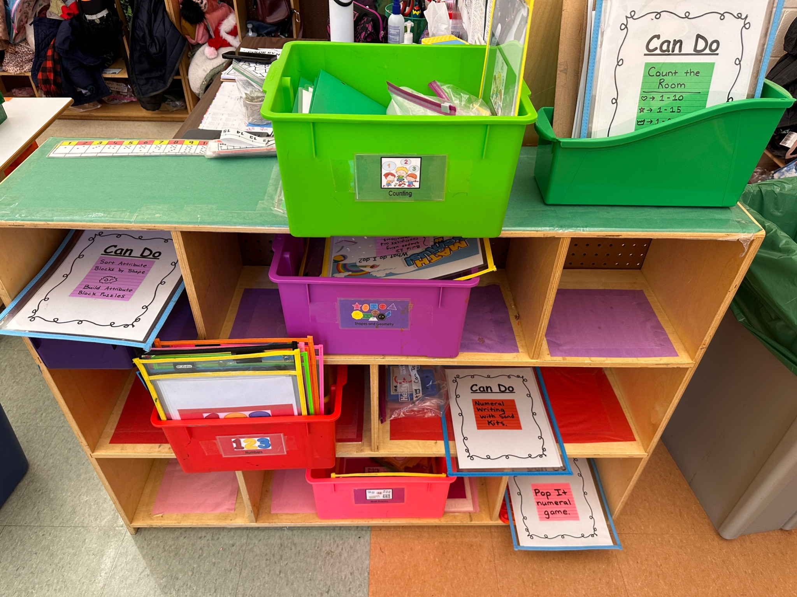
Managing Centers (9 of 16)
After establishing your centers/workstations, differentiate for one center.
  Start with 2 levels and expand from there.

Slide 39
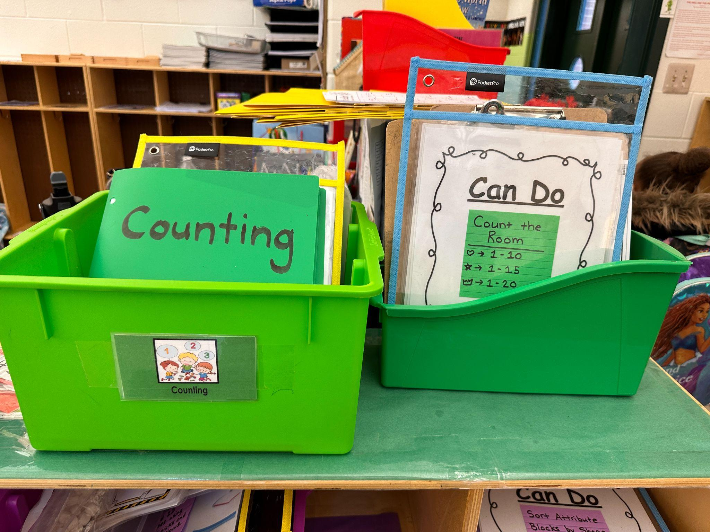
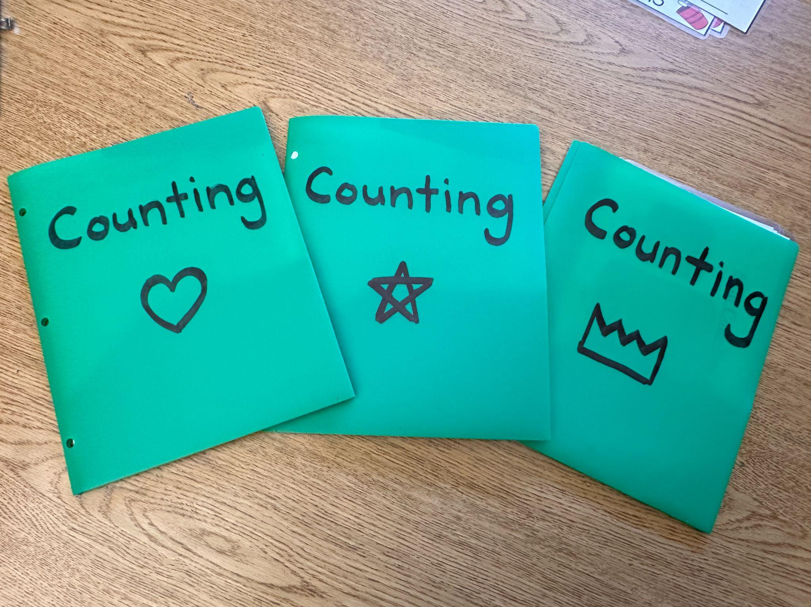
Managing Centers (10 of 16)
Leveling Centers

Slide 40
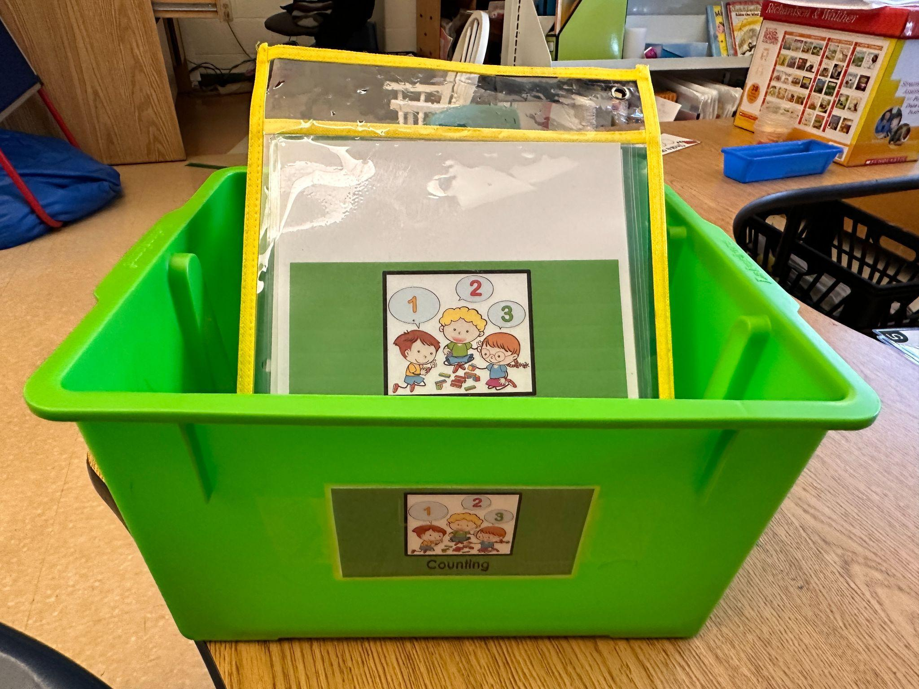
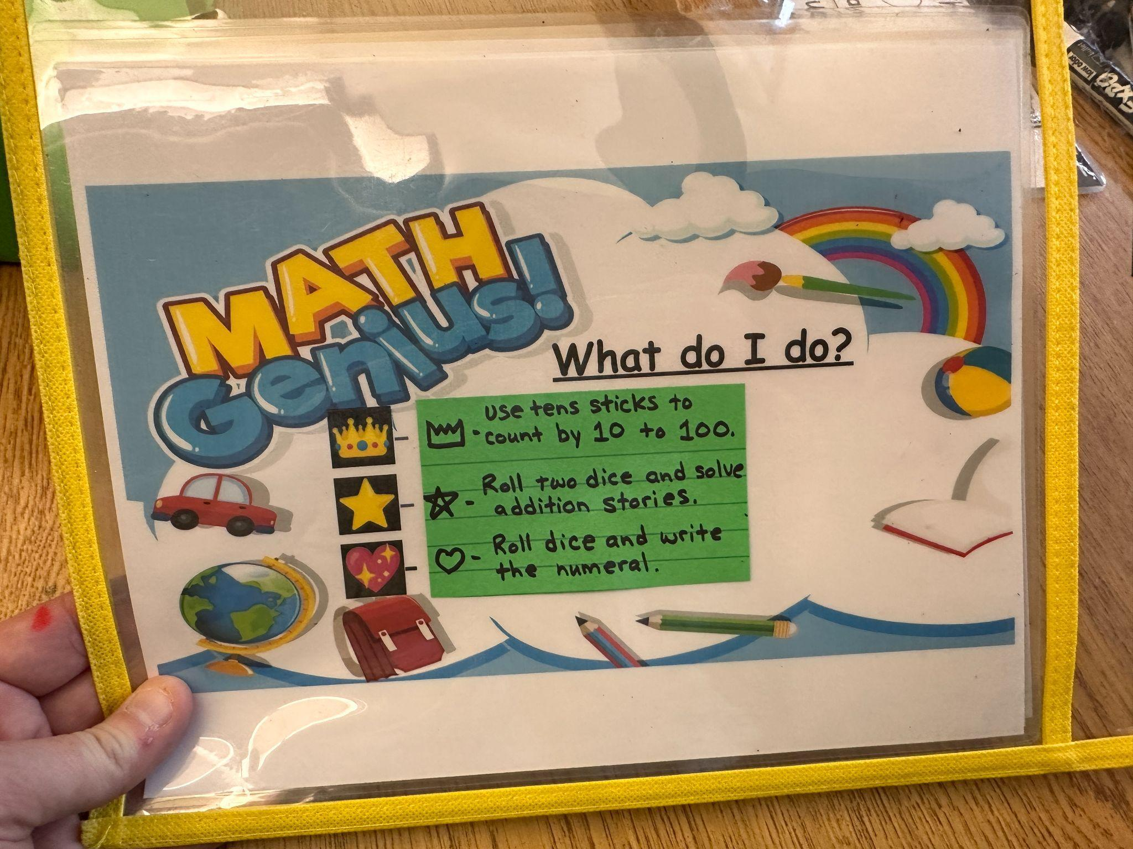
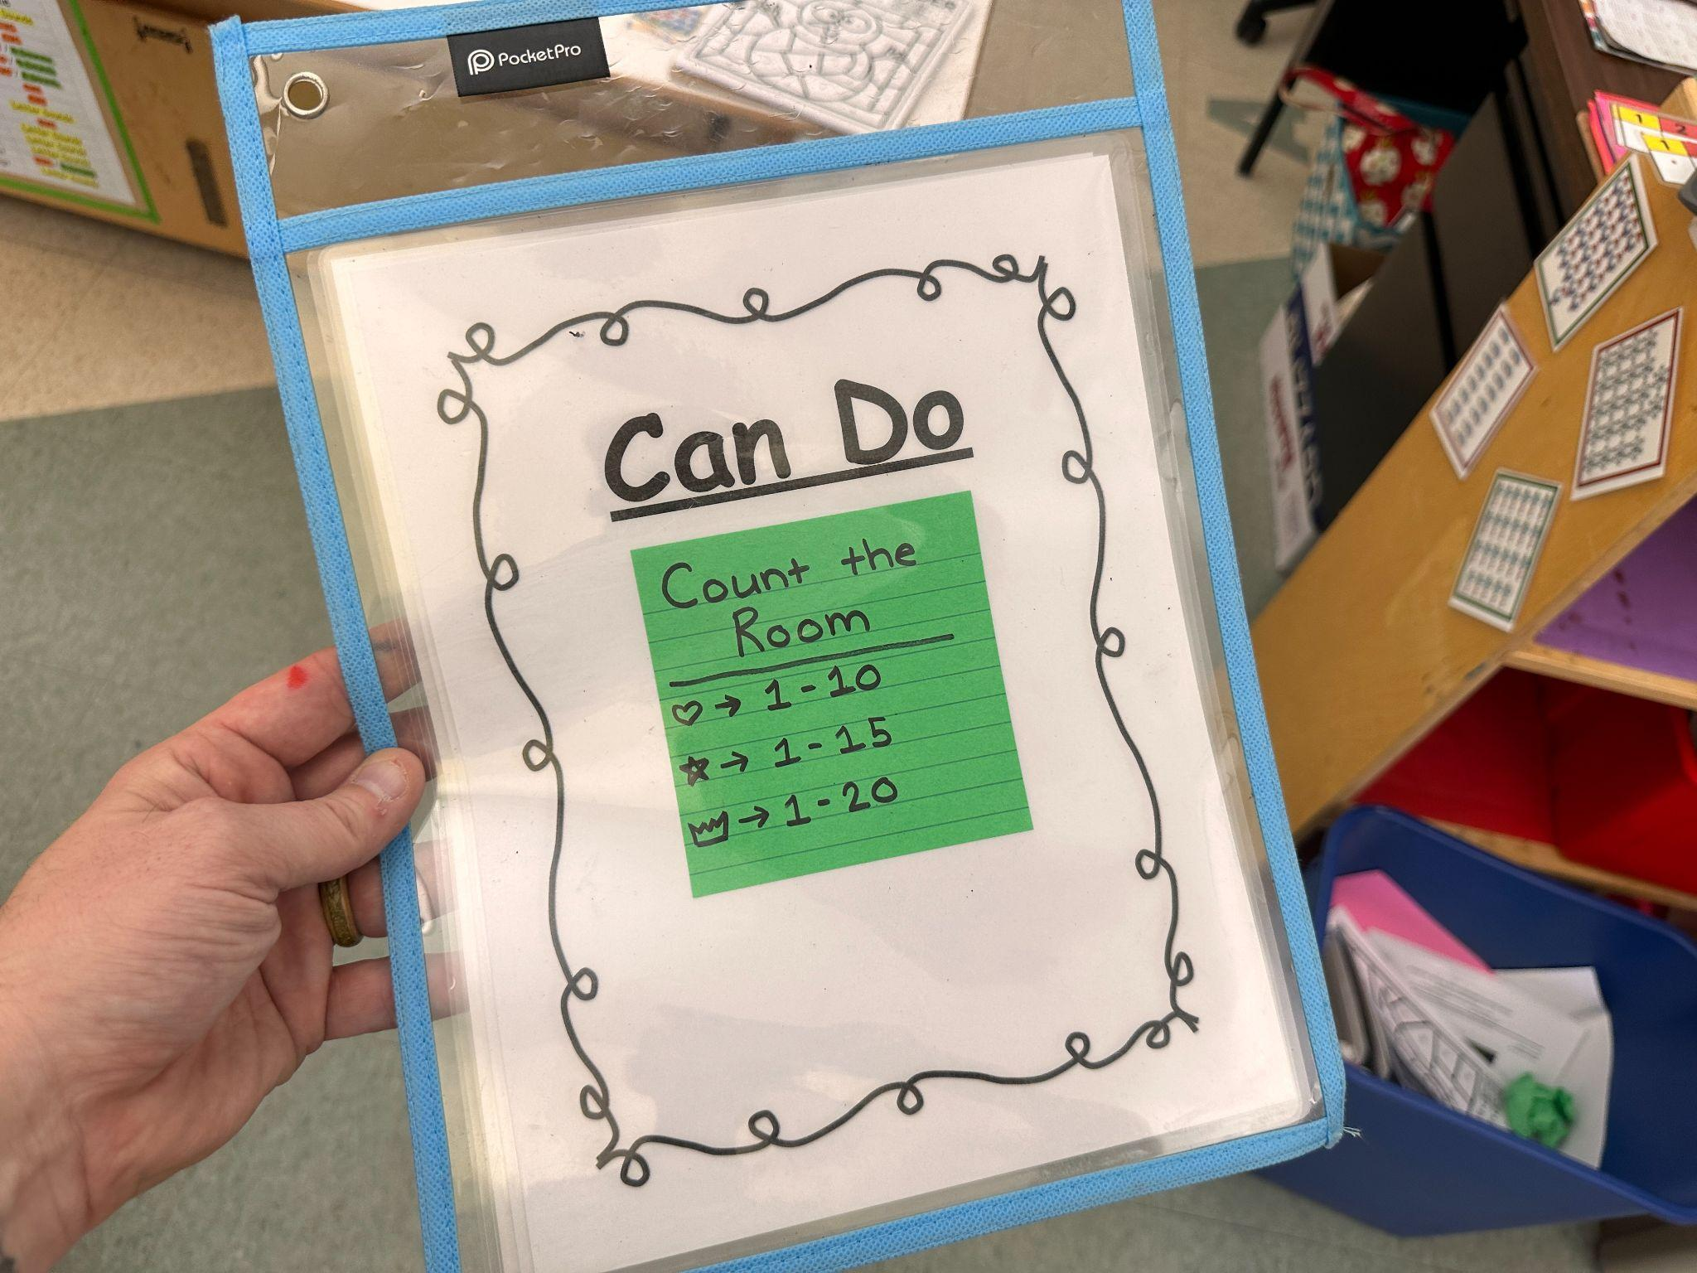
Managing Centers (11 of 16)
Leveling Centers

Slide 41
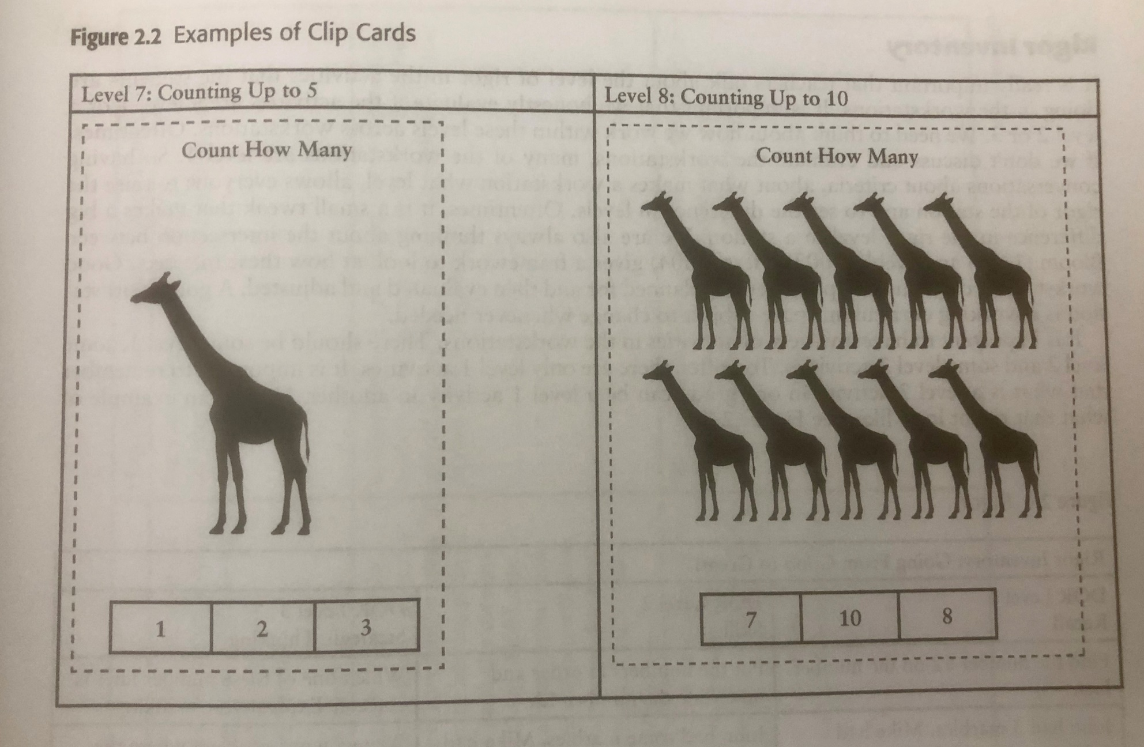
Managing Centers (12 of 16)
Leveling Centers

Slide 42
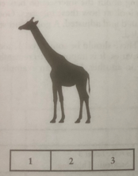
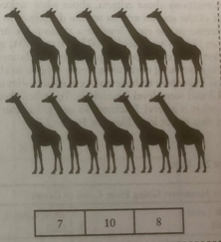
Text Version: Giraffe Clip Cards
Level 7: Counting up to Five
Count How Many
Level 8: Counting up to 10
Count How Many

Slide 43
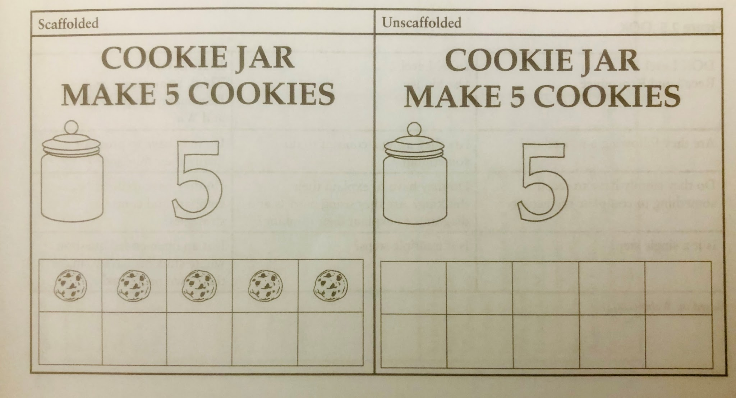
Managing Centers (13 of 16)
Leveling Centers

Slide 44
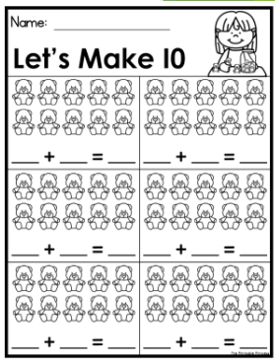
Managing Centers (14 of 16)
Assessment
Recording Sheets or Exit Tickets
  Creates an artifact of the learning taking place.
  Demonstrates level of mastery.
  Keeps students accountable for participation.
  The teacher can’t always be there when the learning happens.
  Not busy work!

Slide 45
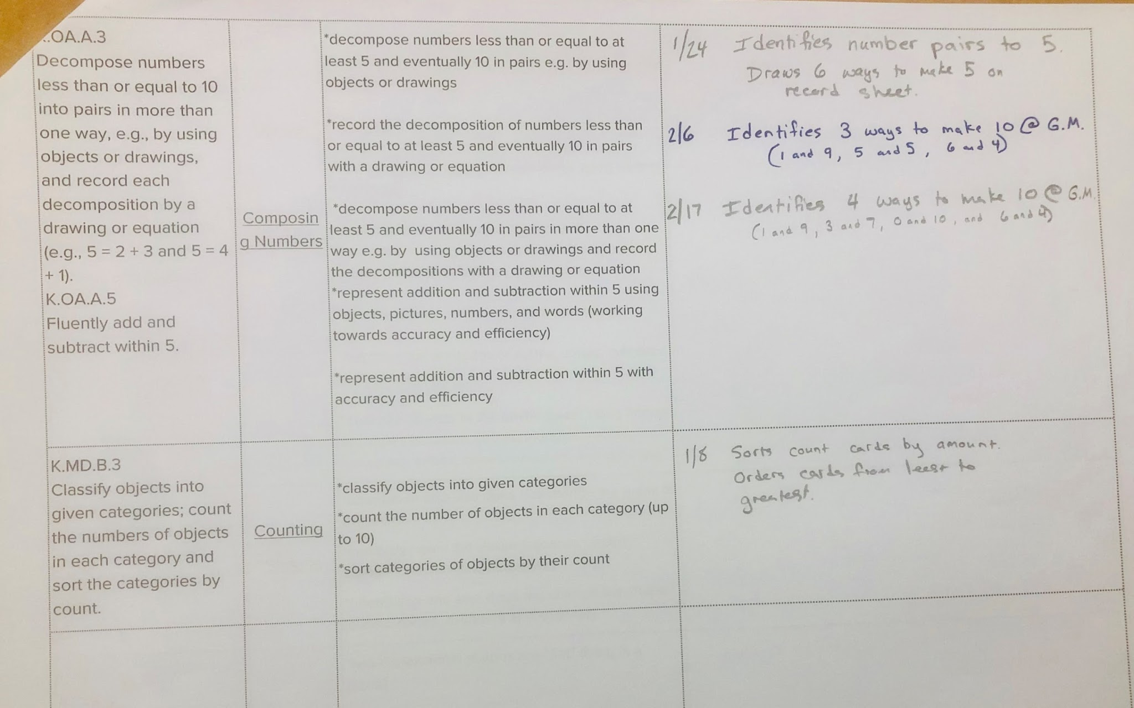
Managing Centers (15 of 16)
Assessment
Anecdotal Notes using observations or artifacts.

Slide 46


Managing Centers (16 of 16)
Assessment
Using formative assessment data, create centers that meet student in their zone of proximal development.
Learning Trajectories can help get you there!
Why we should use Learning Trajectories.

Slide 47
Text Version of Managing Centers
“I Can” Poster
Composing Numbers
I can…
Use manipulatives to make ten
Write an equation equal to ten
Show how I made ten on the recording sheet
Learn about composing numbers:
Actors on Parts: Foundations
Parts Combiner
Inexact Part-Whole Recognizer
Composer to 4, then 5
Composer to 7
Composer to 10
Composers with Tens and Ones
Deriver (plus / minus)
Problem solver (plus / minus) [CN]

Slide 48
References
Chang, S. H., Lee, N. H., & Koay, P. L. (2017). Teaching and learning with concrete-pictorial-abstract sequence: A proposed model.
Newton, N. (2021). Guided math in action: Building each student's mathematical proficiency with small-group Instruction. Routledge.
(Please be advised that neither the New Jersey Department of Education, nor its employees, specifically promotes, endorses, recommends, or favors any of the entities or resources listed herein Instead, this list of entities and resources is provided for informational purposes only. School districts must always evaluate and determine, based on the individualized needs of its student population, whether to utilize and/or expend its resources on the entities or resources herein.)​

Slide 49




Just Start!
Teachers should start small, start slow, but just start!

Slide 50
Follow Us on Social Media
Facebook:
@njdeptofed
Instagram:
@newjerseydoe
LinkedIn:
New Jersey Department of Education
Threads:
@NewJerseyDOE
X: @NewJerseyDOE
YouTube: @newjerseydepartmentofeduca6565

Slide 51
Thank You!
New Jersey Department of Education: nj.gov/education
DECS: https://www.nj.gov/education/earlychildhood/
K-3Office@doe.nj.gov
skelly@longbranch.k12.nj.us

