Slide 1
Mathematics Routines across the P-3 Continuum
Office of K–3
Division of Early Childhood Services
Notes:
2

Slide 2
Agenda
What are math routines: Key features of routines
What not to do for the first few minutes of class and how to improve student engagement
Some examples and practical tools
(Please be advised that neither the New Jersey Department of Education, nor its employees, specifically promotes, endorses, recommends, or favors any of the entities or resources listed herein Instead, this list of entities and resources is provided for informational purposes only. School districts must always evaluate and determine, based on the individualized needs of its student population, whether to utilize and/or expend its resources on the entities or resources herein.)​

Slide 3
When we know better, we do better!
“Do the best you can until you know better. Then when you know better, do better.”
~Maya Angelou

Slide 4
What are Daily Math Routines?
Daily morning math routines can help students strengthen their understanding of many mathematics standards as well as enhance habits of mind and engagement. They can also help with classroom management and organization and promote positive relationships between students and teachers.
No matter what program you use, the National Council of Mathematics recommends and suggests that every classroom have mathematical daily routines in place.

Slide 5
Calendar ‘Math’
Why ‘Calendar Time’ or ‘Calendar Math’ may be a waste of time?
Our number system is base 10 not base 7.
There is minimal practice with transitions between sets of tens.
Yesterday/Today/Tomorrow concepts are extremely abstract for preschool- and kindergarten- aged children and unnecessary for 1st - 3rd grade.
Patterns tend to be rote and lower level.
Spending time "doing calendar" takes up minutes that could be spent in effective, child-centered math experiences.

Slide 6
Position Statement
“It is vital for young children to develop confidence in their ability to understand and use mathematics, in other words, to see mathematics as within their reach. In addition, positive experiences with using mathematics to solve problems help children to develop dispositions such as curiosity, imagination, flexibility, inventiveness, and persistence that contribute to their future success in and out of school”. (NAEYC and NCTM, 2002)

Slide 7
Other Time Sinkers!
‘Do Now’ or ‘Warm-up’
Homework Check

Slide 8
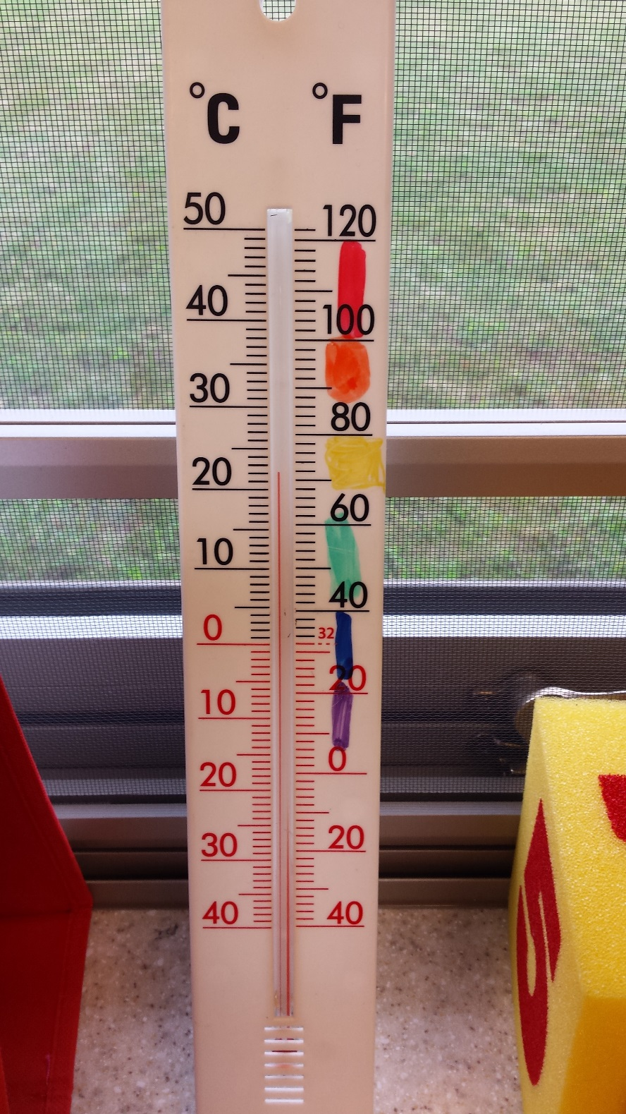
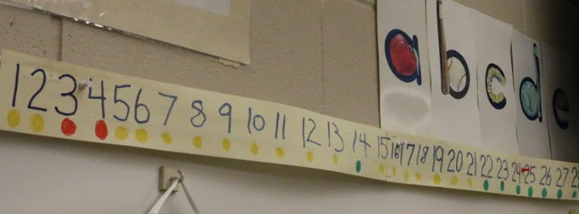
Alternatives to Calendar ‘Math’ (1 of 2)
Linear Calendar

Slide 9
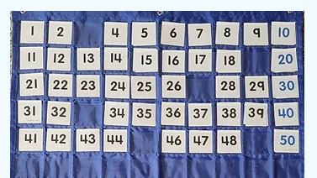
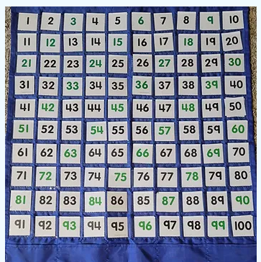
Alternatives to Calendar ‘Math’ (2 of 2)
What can we do with a hundreds chart?

Slide 10
Hundred Chart Routine: The Missing
The Missing
Interactive Hundreds Chart

Slide 11
Alternatives to a ‘Do Now’ (1 of 2)
Number Bio
6
A number before it
A number after it
What it looks like on a domino
On a 10 frame
Another way on a 10 frame
Things I might have

Slide 12
Alternatives to a ‘Do Now’ (2 of 2)
77
265
Is closest to 0, 50, or 100
Break it apart
Break apart a different way
Is close to 9, 500, or 1,000
Break it apart
Added to 125
The ten that it is closest to
5 more and 5 less
On a number line
The closest hundred
10, 100, and 200 more
How much more to 1,000?

Slide 13
Math Routine Themes
Top 4 themes:
Number Sense:
Students understand numbers and their relationships
Fluency:
Students select efficient strategies and adapt, modify, or change out strategies with flexibility to find solutions with accuracy.
Problem Solving:
Students make sense of problems and work to persevere in solving them.
Vocabulary:
Students engage with math vocabulary.

Slide 14
The Meaning of Number Sense
“As students work with numbers, they gradually develop flexibility in thinking about numbers, which is a hallmark of number sense… Number sense develops as students understand the size of numbers, develop multiple ways of thinking about and representing numbers, use numbers as referents, and develop accurate perceptions about the effects of operations on numbers.”
~NCTM Principles and Standards for School Mathematics

Slide 15
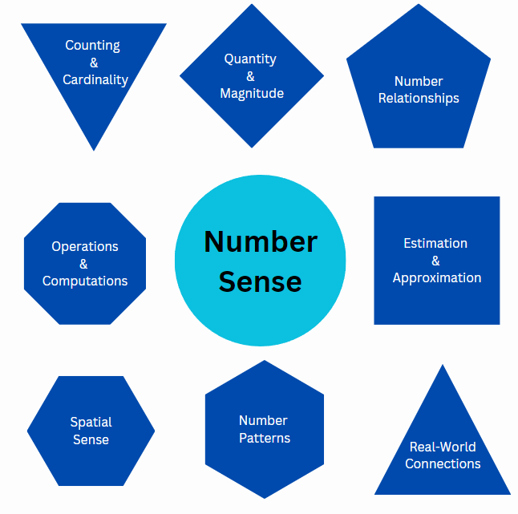
Number Sense

Slide 16
Text Version: Number Sense Diagram
Number sense:
Counting and cardinality
Quantity and magnitude
Number relationships
Operations and computations
Estimation and Approximation
Spatial Sense
Number patterns
Real-world connections

Slide 17
Number Sense: Magnitude (1 of 2)
¼
½
15
35
1
23
201
199
2
10
210
2,202
2,002
4
2,020

Slide 18
Number Sense: Magnitude (2 of 2)
Big or Small
7
Big or Small
½
Big or Small
25

Slide 19
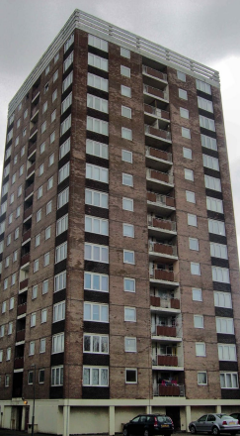
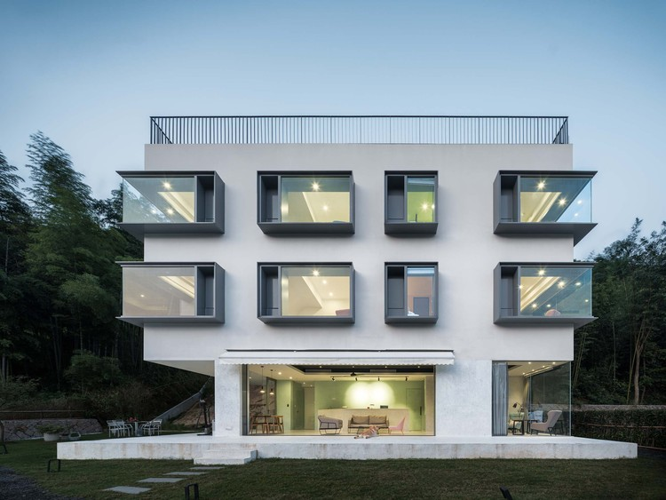
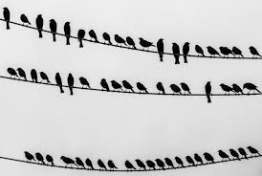
Picture It: Estimation and Magnitude

Slide 20
Number Sense: Estimation
Estimation Clipboards
Esti-Mysteries
3 Container Estimation

Slide 21
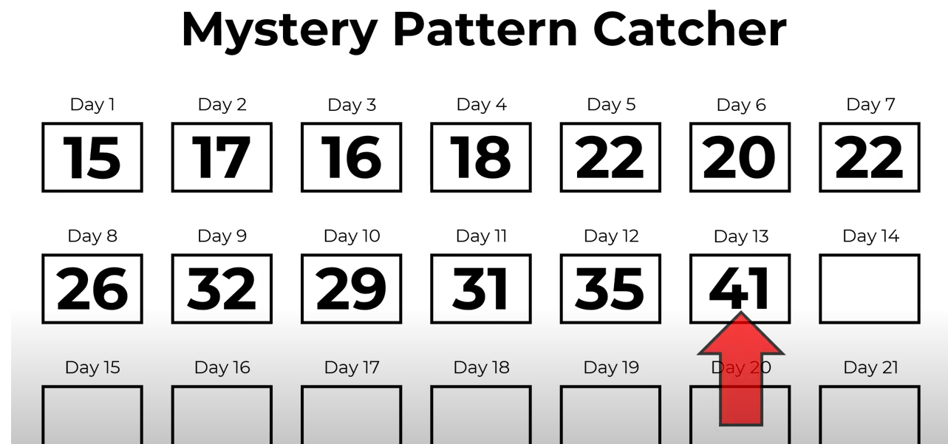
Number Patterns
Leaping Numbers
There are 20 short videos. Each one has a mystery pattern with a missing number - which turns into a clue. As the clues build up a new Mystery Pattern emerges leading to: "What is the final number on Day 21?"
Leaping Numbers - How it Works​
Example (of a daily problem)

Slide 22
Fluency Routines
Fluency practice is an opportunity to practice all of the fluency actions described in this diagram, with the goal of eventually being able to make efficient choices to solve a given problem.
(Bay-Williams & SanGiovanni, 2021)

Slide 23
Text Version: Procedural Fluency Diagram
Components are efficiency, flexibility, accuracy.
The Actions are:
Selects an appropriate strategy (efficiency)
Trades out or adapts a strategy (efficiency and flexibility)
Gets correct answer (accuracy)
Solves in a reasonable amount of time (efficiency)
Applies a strategy to a new problem type (flexibility)
Completes steps accurately (accuracy)

Slide 24
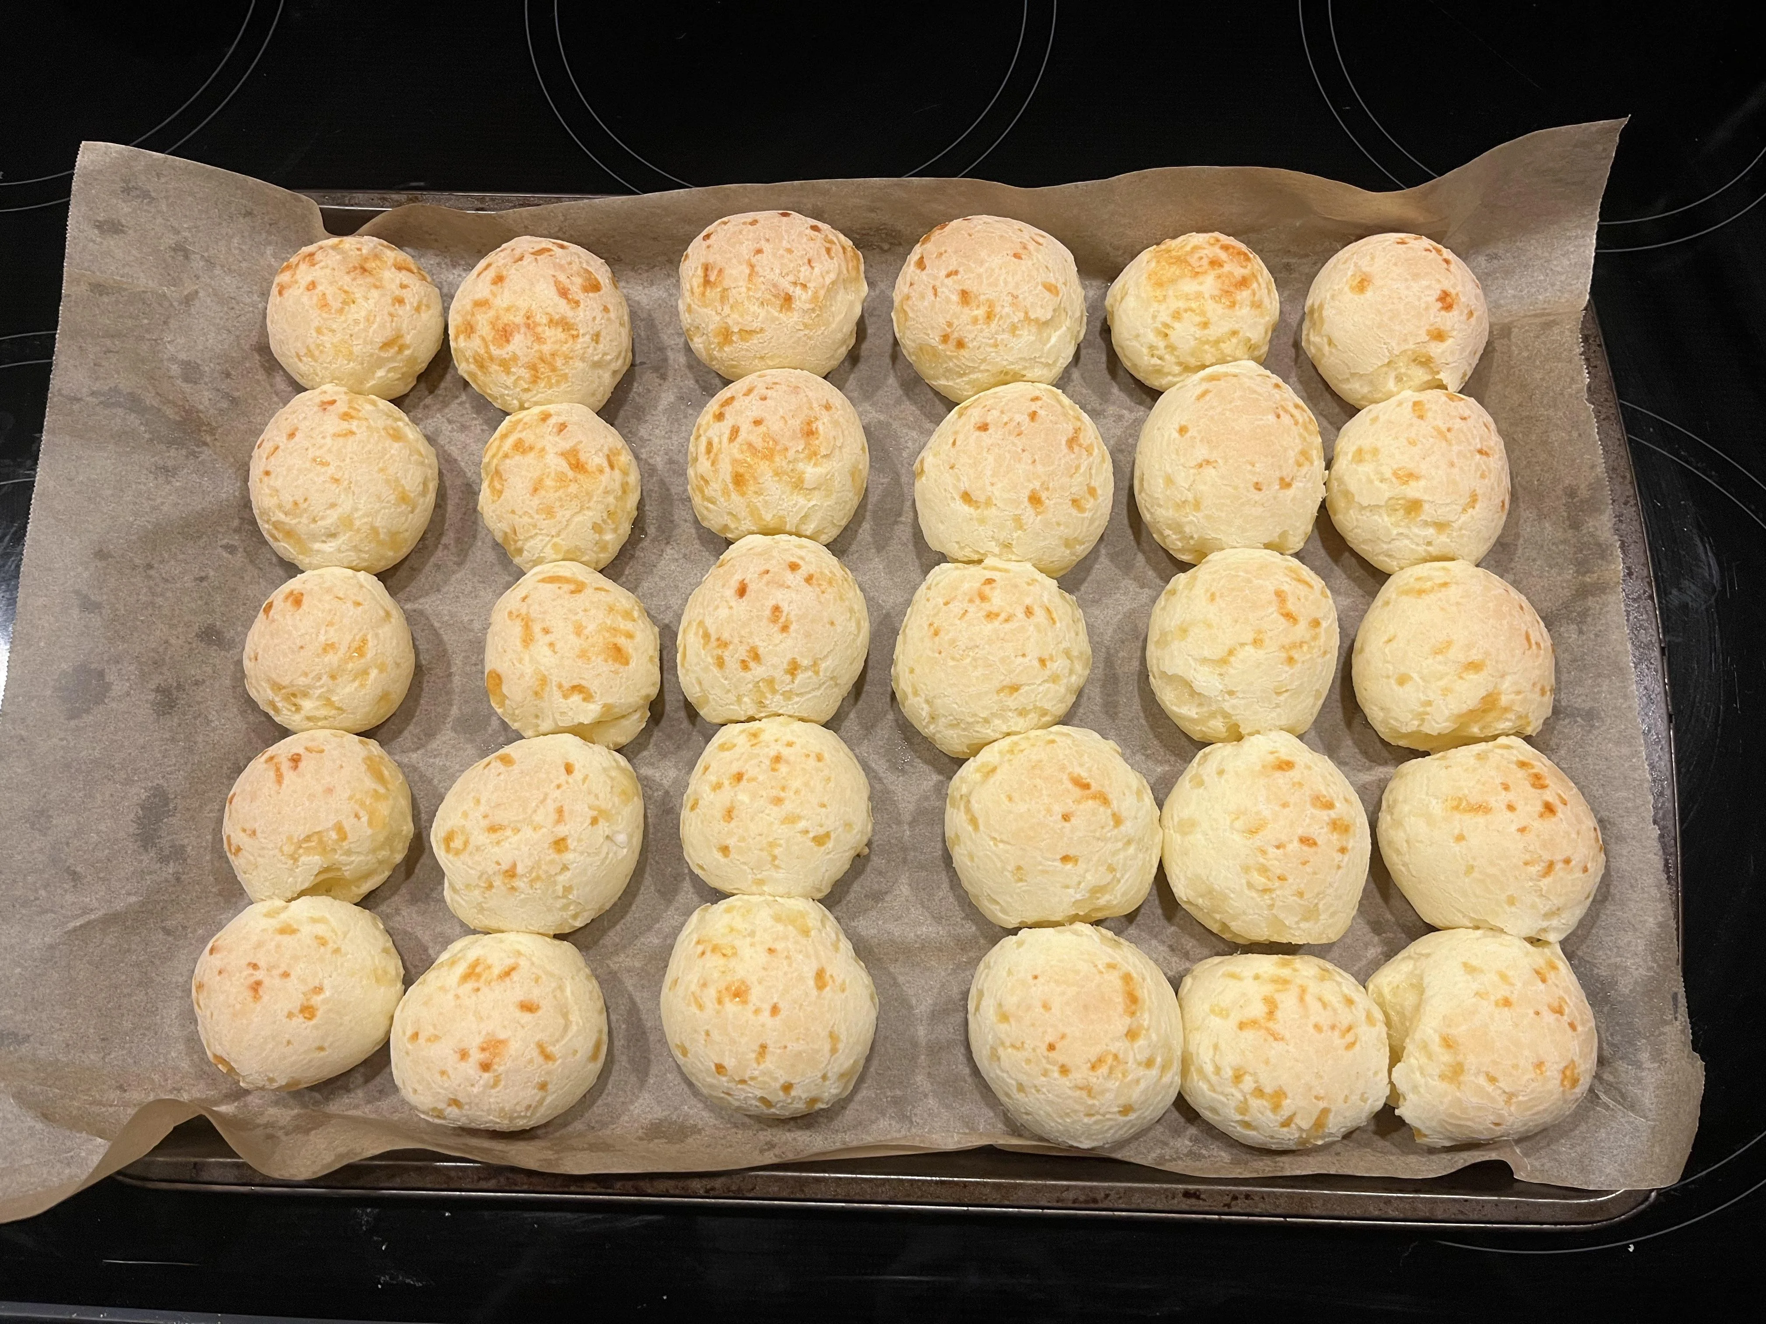
Number Talks
Number Talks…Use Pictures!
Berkely Everett
5 Weeks of Number Sense Routines
Number Talk Images on Weebly

Slide 25
Representing Numbers
Show it 3 Different Ways
How Can you Make It?
67
¾
5 + 8
84
triangle
15
6 * 4

Slide 26
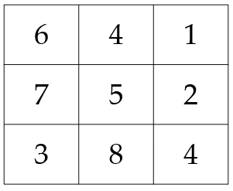
More Fluency Routines (1 of 3)
‘Make 10’

Slide 27
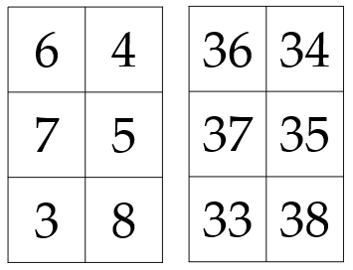
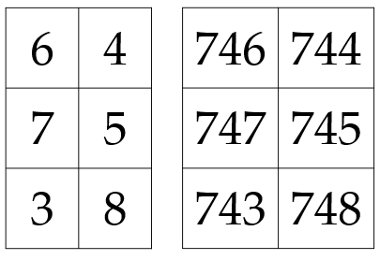
More Fluency Routines (2 of 3)
‘Make 40’
‘Make 750’

Slide 28
More Fluency Routines (3 of 3)
Splat! (@SteveWyborney) asks students to use algebraic reasoning and conversation to determine the value of dots hidden under a “splat.”
SPLAT! 40 lessons
Splat 3-10
Splat 12-20
Multiple Splats

Slide 29
Problem Solving Routines (1 of 4)
What’s the Story?
What’s the Problem? 12 + 2 = _____

Slide 30
Problem Solving Routines (2 of 4)
Legs and Feet
Some of the animals in the barn are chickens and some are pigs.
There are 20 legs in all.
How many pigs and chickens could there be?
4 of the animals in the barn are chickens and some are pigs.
There are 20 legs in all.
How many pigs are there?

Slide 31
Problem Solving Routines (3 of 4)
Legs and Feet
There are ducks and cows in the barn. There are 10 legs. How many ducks and cows are there.

Slide 32
Problem Solving Routines (4 of 4)
Problem Solving in P-3
Which One Doesn’t Belong?
3-Act Tasks

Slide 33
Vocabulary Routines (1 of 4)
Tier 1: basic everyday words.
Tier 2: multiple meaning words.
Tier 3: domain specific words

Slide 34
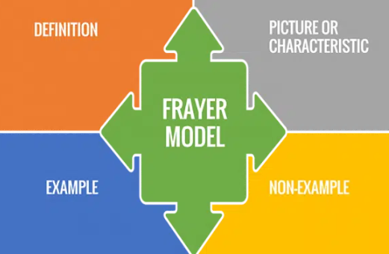
Vocabulary Routines (2 of 4)
Frayer Model

Slide 35
Text Version: Frayer Model Diagrams
Frayer Model
Quadrilateral (Frayer Model)
Definition
Picture of characteristic
Example
Non-example
Definition: a flat shape with four sides and four corners.
Examples: drawings of two rectangles shown (each oriented a different way)
Characteristics: flat shape (not 3-d), 4 sides and 4 corners, all corners are square
Non-examples: drawings of a circle and a triangle

Slide 36
Vocabulary Routines (3 of 4)
Mystery Word
Guess my shape

Slide 37
Vocabulary Routines ( 4 of 4)
ABC’s of...

Slide 38
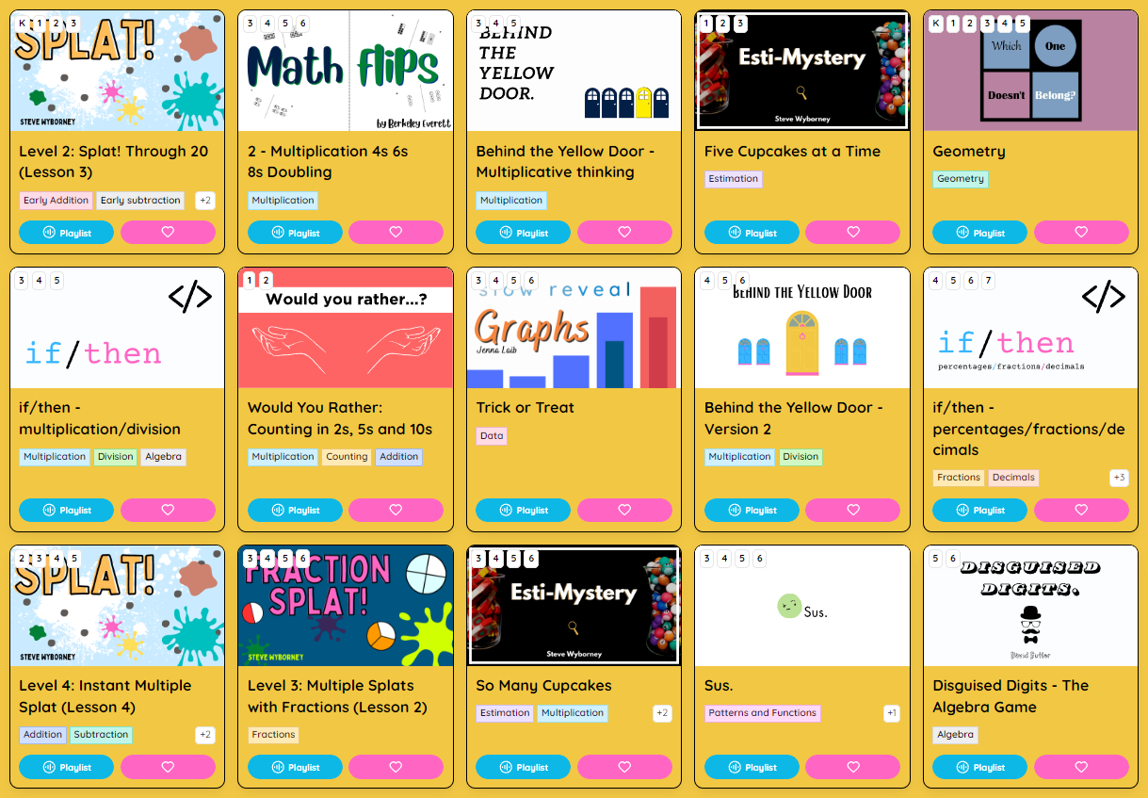
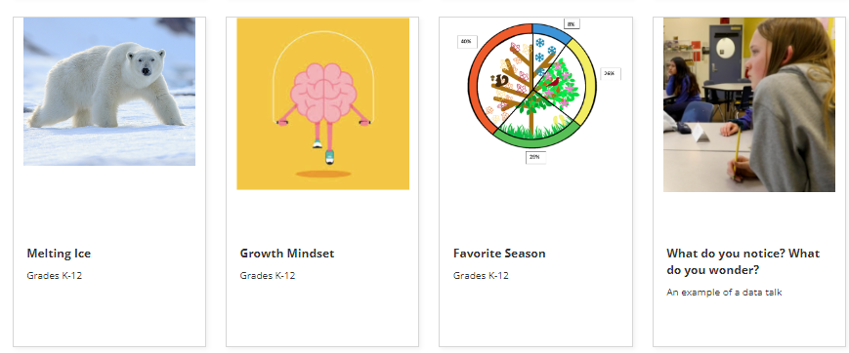
Data Analysis and More
Sembl
youcubed

Slide 39
Let’s Get Started

Slide 40
References
Bay-Williams, J. M., & SanGiovanni, J. J. (2021). Figuring Out Fluency in Mathematics Teaching and Learning, Grades K-8: Moving Beyond Basic Facts and Memorization. Corwin.
NAEYC & NCTM (National Council of Teachers of Mathematics). 2002. Early childhood mathematics: Promoting good beginnings. A joint position statement of NAEYC and NCTM. www. naeyc.org/about/positions/mathematics.asp
Newton, N. (2020). Day-by-day Math Thinking Routines in Third Grade: 40 Weeks of Quick Prompts and Activities. Routledge.
Parrish, S. D. (2011). Number talks build numerical reasoning. Teaching children mathematics, 18(3), 198-206.
SanGiovanni, J. J. (2019). Daily Routines to Jump-start Math Class, Elementary School: Engage Students, Improve Number Sense, and Practice Reasoning. Corwin Press.

Slide 41
Follow Us on Social Media
Facebook: @njdeptofed
Instagram: @newjerseydoe
LinkedIn: New Jersey Department of Education
Threads: @NewJerseyDOE
X: @NewJerseyDOE
YouTube: @newjerseydepartmentofeduca6565

Slide 42
Thank You!
New Jersey Department of Education: nj.gov/education
K-3Office@doe.nj.gov

