Slide 1
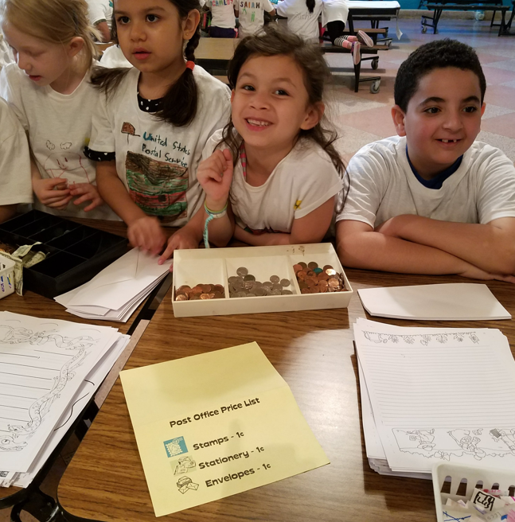
Joyful Play: Engaging Children in Learning in the P–3 Classroom
Muriel K. Rand, Ed.D., M.S.W.
Professor of Early Childhood Education
New Jersey City University
mrand@njcu.edu
Notes:
Hello! Welcome to our video on Joyful Play: Engaging Children in Learning from preschool through third grade. I am Dr. Muriel Rand, a professor of early childhood education at New Jersey City University and an instructional coach for the Center for Literacy Development at Rutgers University. In this video, I will explore play-based learning, different types of play, and how we can meet the NJ Student Learning Standards through play-based activities.

Slide 2
What is play-based learning?
Self-chosen
Enjoyable
Process-Oriented
Notes:
Let’s start with defining play-based learning. These are activities that are self-chosen by the children, they are enjoyable, and they are process-oriented.

Slide 3
Continuum of Pedagogical Strategies for Play-Based Learning (1 of 2)
Notes:
There are many different types of play-based learning. This graphic shows the continuum of different types of play-based learning that varies by the amount of direction from the teacher versus the amount of control that children have over the activities. On the right, we see learning games that are teacher planned and focused on skills. Next we have playful learning that is also teacher-planned, such as a thematic play center, but the children have more control in terms of how they use the center. In the middle is collaborative play in which children control the activities, but the teacher plays an important role in guiding the activity. Next is inquiry learning, in which children decide the topic and how the activity will be done, and the teacher provides support from the side rather than being directly involved. Finally, we have free play at the left side in which children work independently of the teacher and consolidate their learning, having complete control of the activity.

Slide 4
Text Version: Continuum of Pedagogical Strategies for Play-Based Learning
Strategy | Description | Location on Continuum
Free play | Observe and reflect Facilitate time space and things | Child Directed
Inquiry | Extend child-initiated ideas and exploration through questions, provocations, and investigations | Child Directed and Educator Guided
Collaborative Play | Use opportunities to enter children’s play and incorporate targeted skills into their play | Educator Guided
Playful Learning | Focus on targeted skills in learning experiences that can incorporate children’s play narrative | Educator Guided and Educator Directed
Learning Games | Prescribed activities —focused skills; usually literacy and numeracy skills | Educator Directed
Adapted from Pyle and Danniels, 2017

Slide 5
Play and Learning are Not Separate
Play-based learning positively influences children’s reading and math scores
Guided, play-based learning can be more effective than direct instruction or free play
Notes:
As you can see from the continuum, play and learning are not separate. Too often we assume that play is just for fun and learning must be more controlled, but there are many ways to integrate learning into play-based activities. Research shows that play-based learning practices positively influence children’s reading and math scores (Marcon, 2002; Stipek et al., 1998), and
Overall, it can more effective than direct instruction (Han et al., 2010; Stipek, Feiler, Daniels, & Milburn, 1995) or free play (Chien et al., 2010;vHonomichl & Chen, 2012).

Slide 6
Benefits of Play-Based Learning
Builds executive function skills, content knowledge, creative thinking
Enhances problem solving skills
Develops reading, vocabulary, and writing skills
Builds mathematical skills, numerical operations, measurement & patterning
Builds confidence, collaboration, and expression
Produces opportunities to expand thinking and try new things
Notes:
There are many other benefits of play-based learning. It builds executive function skills, content knowledge, creative thinking. Play-based learning enhances problem solving skills, develops reading, vocabulary, and writing skills, builds mathematical skills, numerical operations, measurement & patterning; Play-based learning also builds confidence, collaboration, and expression and produces opportunities to expand thinking and try new things.

Slide 7
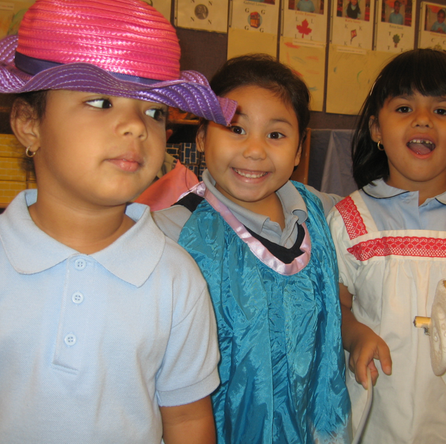
Playful Learning and Social-Emotional Skills
Self-regulation
Communication
Turn Taking
Perseverance
Empathy
Tolerating frustration
Notes:
Many teachers and administrators have been concerned about the social and emotional development of young children, especially since the disruptions of Covid 19. The good news is that research shows that play-based learning is one of the best ways to support the development of self-regulation and social skills. Seatwork in whole group lessons does not support that development of these necessary skills. Children need to be actively engaged in talking and interacting with one another to develop these skills.

Slide 8
Finding the Balance
Balancing what children are interested in, and what we want to make sure is covered in the curriculum
Trusting that children will learn what they need through play-based experiences
Notes:
So, in thinking about the daily schedule in P-3 classrooms, we need to find a balance between what children are interested in and what we want to make sure is covered in the curriculum. We need to trust that children will learn what they need through play-based experiences.

Slide 9
What About Meeting the Standards?
Standards lay out what skills and content needs to be learned, not how to learn them.
Playful learning can help children achieve standards.
Notes:
But what about meeting the rigorous, NJ student learning standards. First, it’s important to understand that standards tell us WHAT skills and content knowledge children need to learn, but they don’t tell us HOW the children should learn them. Play-based learning can help children achieve our standards. Let’s take a look at some examples of meeting the standards. We’ll use the continuum of play-based learning activities to do this.

Slide 10
Text Version: Icons on New Jersey Standards webpage
Career Readiness, Life Literacies, and Key Skills
Comprehensive Health and Physical Education
Computer Science and Design Thinking
English Language Arts
Mathematics
Science
Social Studies
Visual and Performing Arts
World Languages

Slide 11
Continuum of Pedagogical Strategies for Play-Based Learning (2 of 2)
Notes:
Take another look at this continuum of play-based learning. Notice the categories that go from highly teacher-directed, to free play at the other end. I am going to use these categories to give examples of how we can meet student learning standards through play-based experiences.

Slide 12
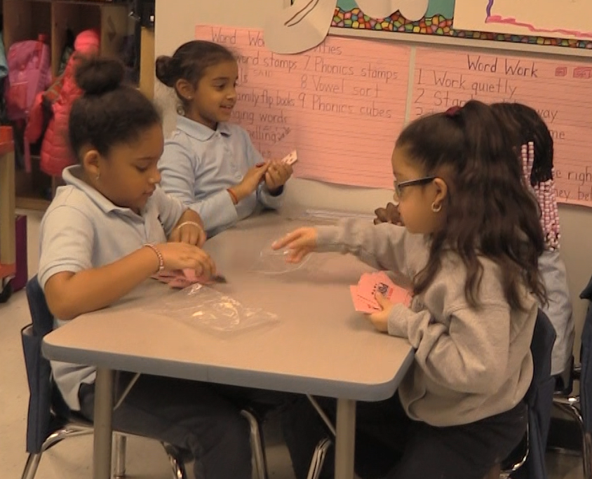
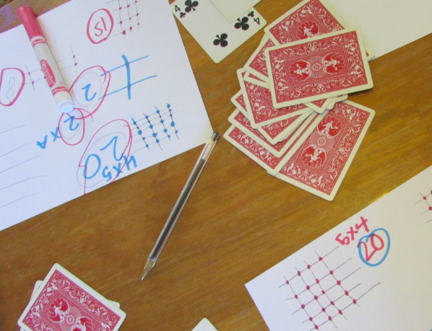
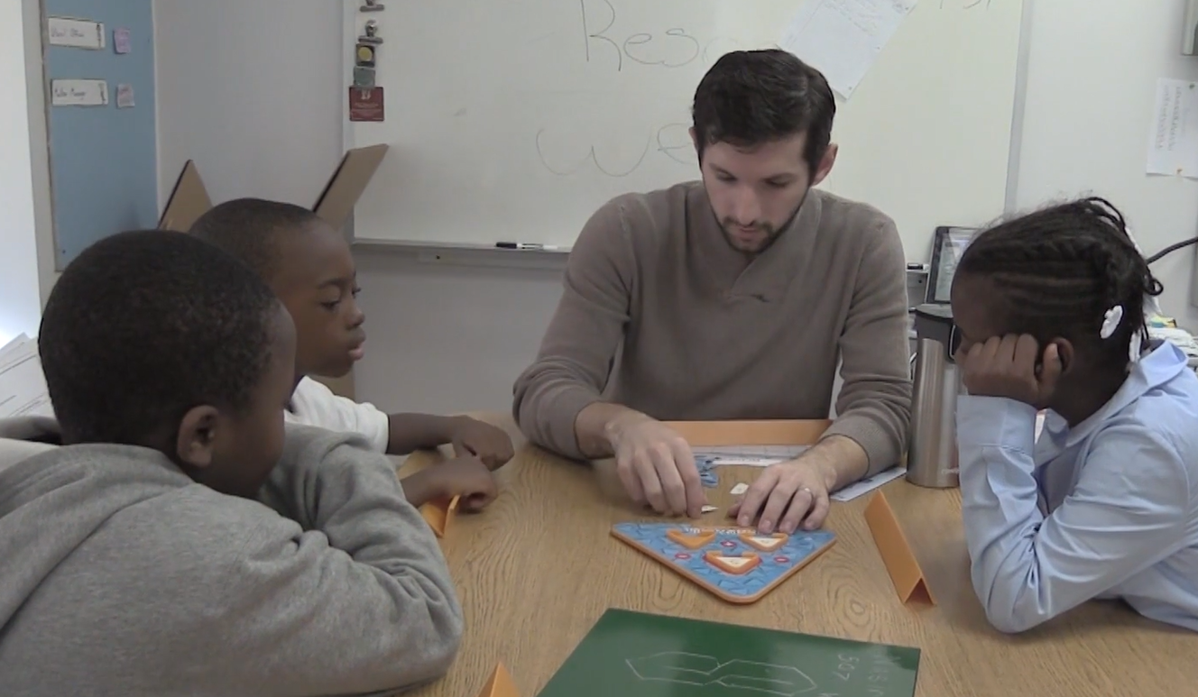
Learning through Games (1 of 3)
Teacher directed and focused on discrete skills:
Letter/Sound bingo
Writing the room
Fishing for numbers
Card games
Making playdough numbers
Simulations
Notes:
Learning through games is a way to provide joyful, motivating activities that are teacher directed and focused on specific skills.

Slide 13
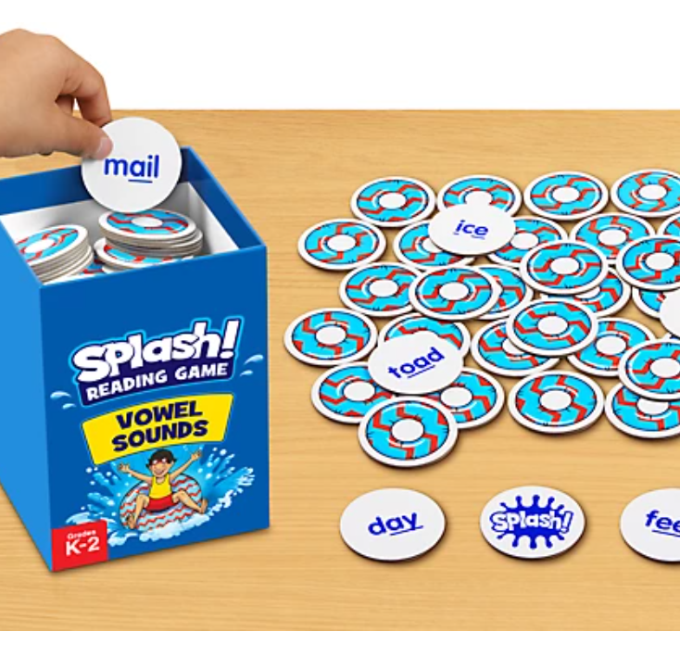
Learning Through Games (2 of 3)
Adult directed games that are focused on skills
English Language Arts Standard Grade 2: Know spelling-sound correspondences for common vowel teams.
Notes:
One example is this Splash reading game that gives students practice in meeting the second-grade standard for spelling-sound correspondences for common vowel teams.

Slide 14
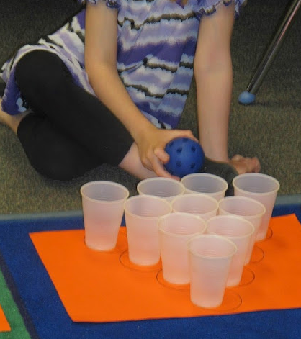
Learning Through Games (3 of 3)
Addition Bowling Game
Mathematics 1st Grade: Operations and Algebraic Thinking - Add and subtract within 20, demonstrating accuracy and efficiency for addition and subtraction within 10
Notes:
Another example is this addition bowling game that helps meet with 1st grade mathematics standards to add and subtract within 20. The children keep track of the score as the bowl, and then compare their scores to each other to determine who wins.

Slide 15
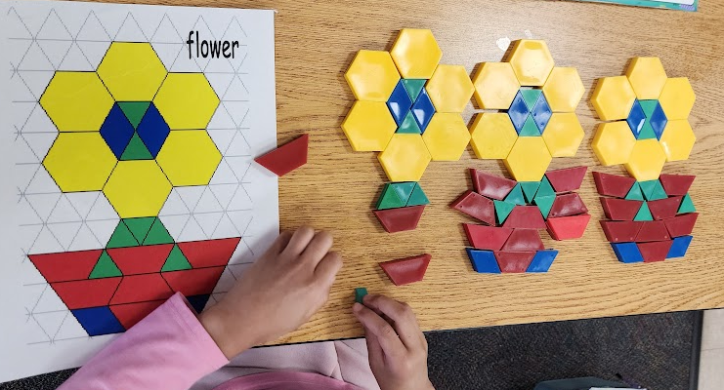
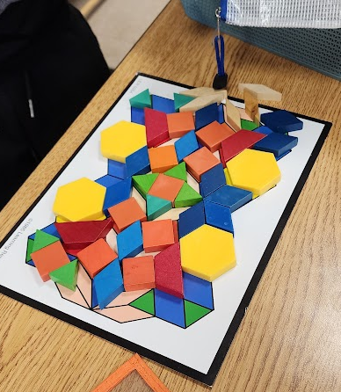
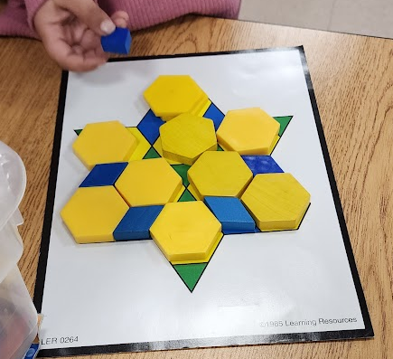
Playful Learning: Differentiated Responses with Open-Ended Materials
Kindergarten Mathematics Standard: Compose simple shapes to form larger shapes
Notes:
Now let’s look at the next category of Playful Learning. Playful learning is planned by the teacher, but the children have more control over how to complete the process. This slide shows a kindergarten activity in which the children were to copy the pattern block shapes to meet the kindergarten standard of composing simple shapes to form larger shapes. What’s interesting here is how this activity allows for differentiation. These three children were all in the same class doing the activity at the same time. You can see how these open-ended materials allowed that children to get practice at a basic level, move towards more competency, and also exceed the expectations of the standard. This differentiation is hard if not impossible to do with math workbooks.

Slide 16
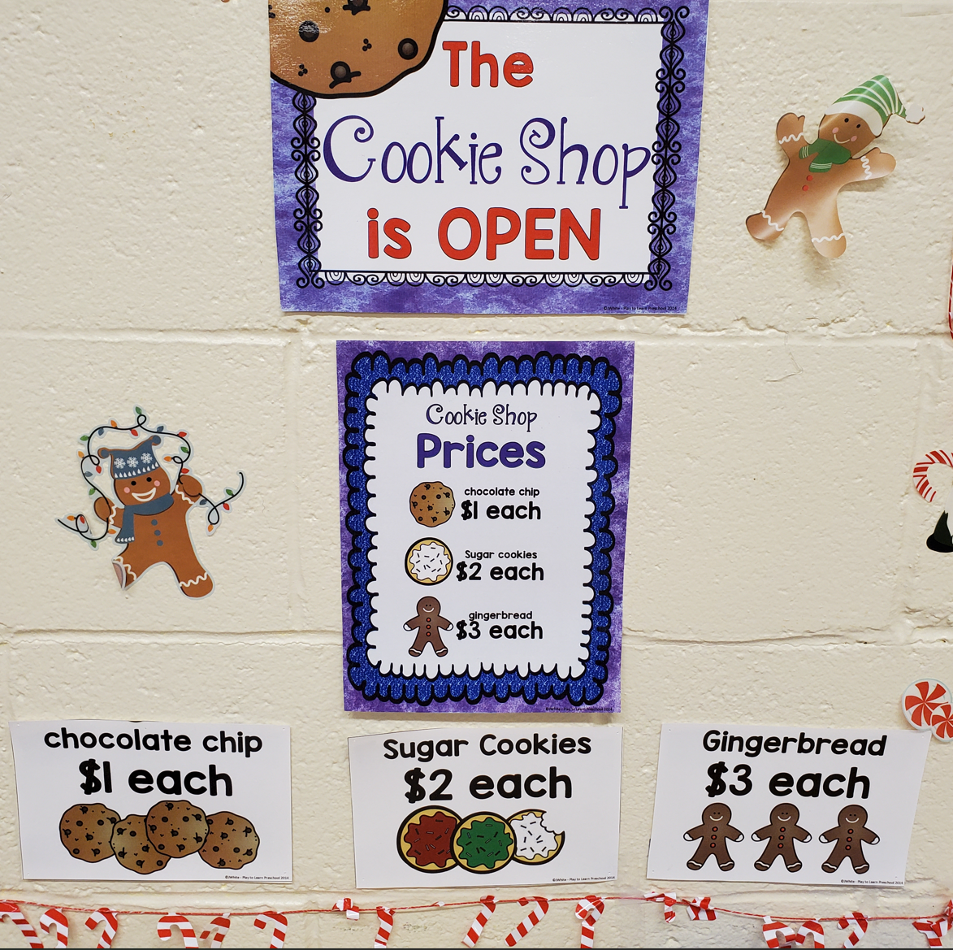
Playful Learning (1 of 2)
Teacher planned and initiated with children’s active involvement
Bakery Cookie Shop during center time
Mathematics Standard—K: Solve addition and subtraction word problems, and add and subtract within 10, e.g., by using objects or drawings to represent the problem.
Notes:
This Cookie Shop is another example of playful learning in which the teacher planned the activity to focus clearly on specific mathematics skills, meeting the kindergarten standard for solving addition and subtraction problems. This is considered playful learning because the teacher (or teaching assistant) would guide the children in the center, asking them what cookies they want to buy, and supporting them doing the math for paying for the items. Although the activity is teacher planned and guided, the children also have some freedom to make choices within the activity.

Slide 17
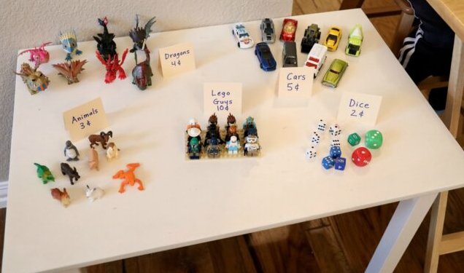
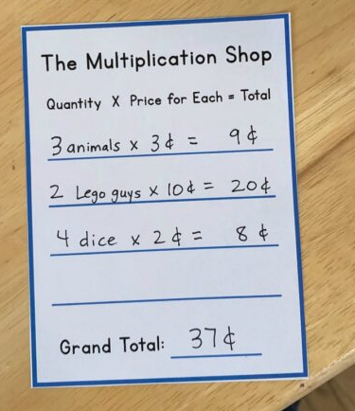
Playful Learning (2 of 2)
The multiplication Shop
3rd Grade Mathematics Standard: Represent and solve problems involving multiplication and division
Notes:
Here’s a similar activity in third grade to meet the standards for representing and solving multiplication problems. The children pretend to shop and the cashier must calculate the total owed. Even better, this activity helps to meet the standard for solving multiplication problems with money.

Slide 18
Playful Learning Acting out “Gary and Harry” story
Small Group Literacy Center in Preschool
Preschool Standard: With prompting and support, identify characters, settings, and major events in a familiar story.
Notes:
In this video, you can see playful learning in preschool that meets the standard for identifying characters, settings, and major events. The teacher has already had the children act out the story of Gary and Harry in large group, then she practices with the children in small group. Eventually, they can manage the activity on their own, as seen here.

Slide 19
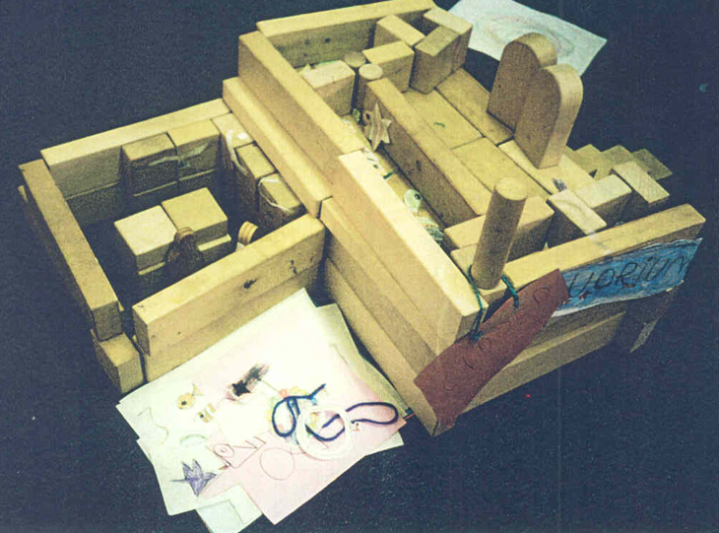
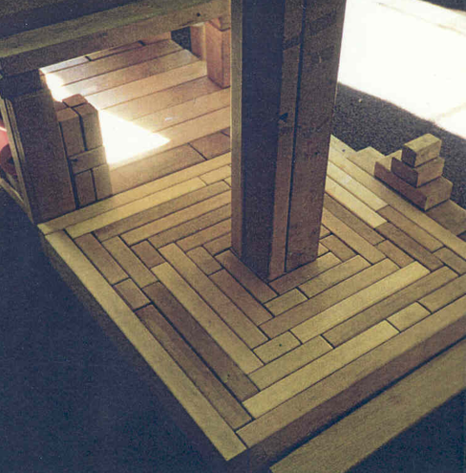
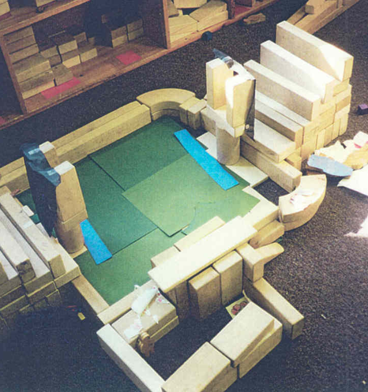
Collaborative Play (1 of 2)
Shared control of teacher and students, collaboratively designed activities
K–2 Grade Social Studies Standard: Economics, Innovation and Technology: Exchange and Markets — “Goods and services are produced and exchanged in multiple ways.”
Notes:
Collaborative play includes activities in which the teacher and the students play equal roles in the decision making and guiding the activity. In this slide, you see a social studies activity to meet the K-2 standard for learning that goods and services are produced and exchanged in multiple ways. In this 1st grade class, the students built the types of goods and services found in their own community.

Slide 20
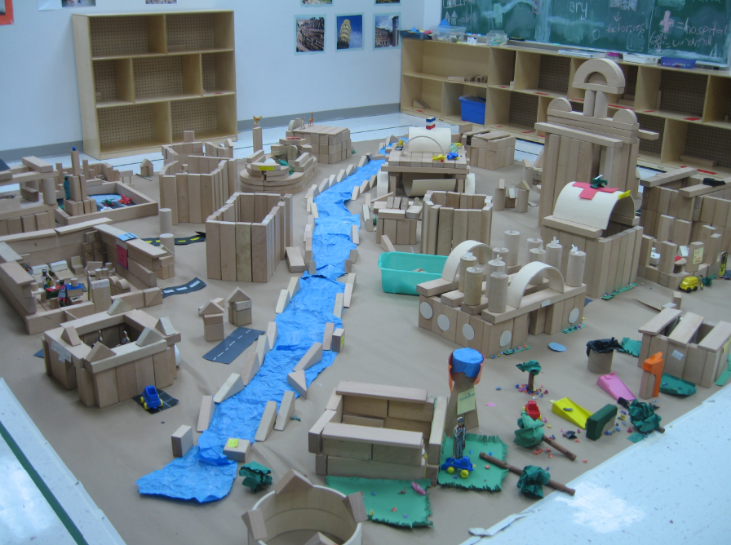
Collaborative Play (2 of 2)
Recreating a City with Blocks
Social Studies Standard (grades 3–5)
Environmental and cultural characteristics influence where and how people live.
Notes:
In this school, they have a small room dedicated to block play. Here we see the older students have recreated a city and are meeting the grade 3-5 standard for understanding the environmental and cultural characteristics that influence where and how people live. They were specifically focused on emergency services that could help after an earthquake.

Slide 21
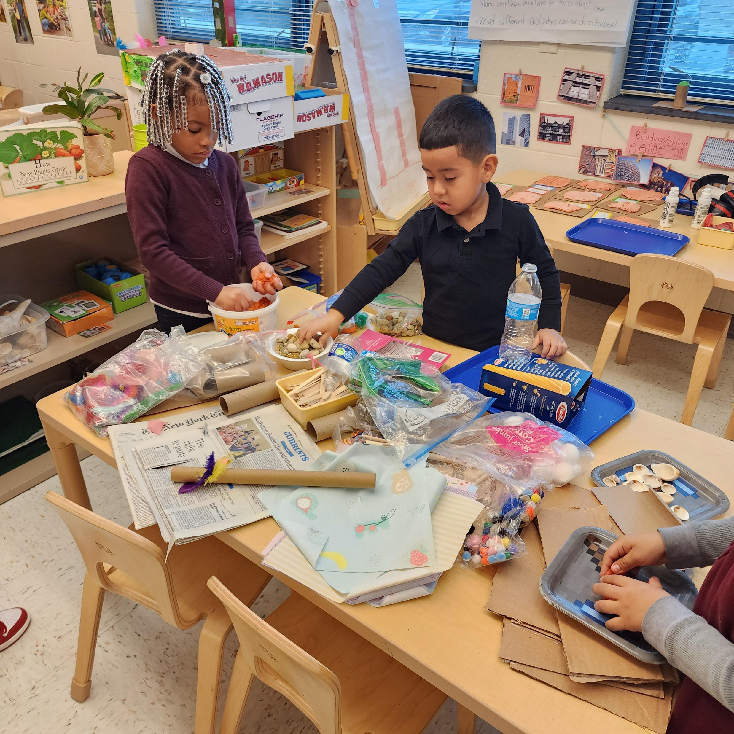
Inquiry Play/ Project-Based Learning
Child initiated and directed
Teacher builds on children’s interests
Preschool Science Standards: “Observe, question, predict, and investigate materials, objects, and phenomena during classroom activities indoors and outdoors and during any longer-term investigations in progress.”
Notes:
The next category is inquiry play or project-based learning. These activities begin with students’ interests and then the teacher provides materials or creates activities to support those interests. In this preschool classroom the children had spent time acting out the Three Little Pigs. The children wanted to try building their own strong houses that would protect the pigs. After they built their houses from recyclable materials, the teacher got out a fan to simulate the wolf and they tested out the strength of the houses.

Slide 22
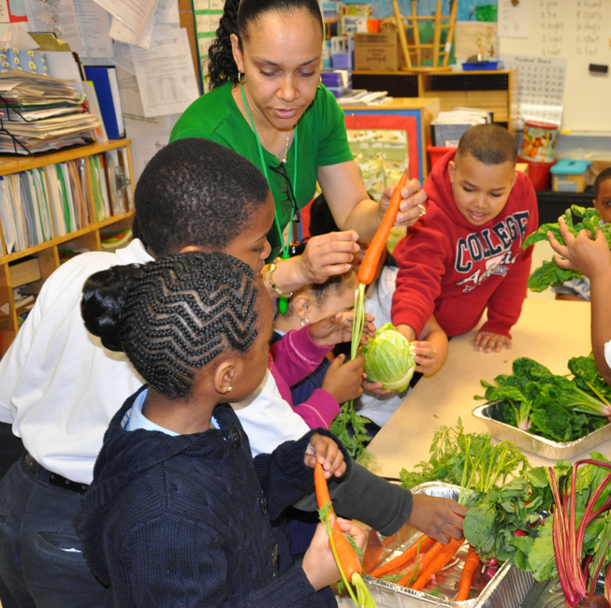
Inquiry Play
Exploring vegetables and gardening
1st Grade Science Standard: Make observations to construct an evidence-based account that young plants and animals are like, but not exactly like, their parents.
Notes:
In this first grade classroom, the students showed a lot of interest in plants and gardening. The teacher provided the materials for their observations and learning. This generated more interest and excitement in growing plants and comparing the young plants to the mature plats, while meeting the 1st grade science standard to make observations to construct an evidence-based account that young plants and animals are like, but not exactly like, their parents

Slide 23
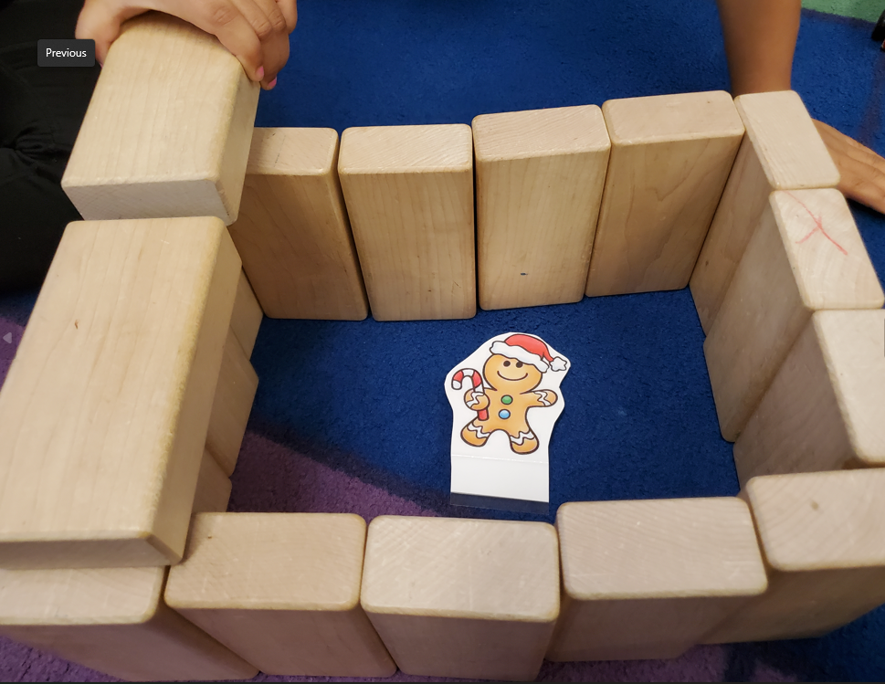
Free Play (1 of 2)
Children direct their own play narratives and choose materials to use
Teacher has little to no involvement
Building a house to save the Gingerbread Man - Kindergarten ELA standard: With prompting and support, identify characters, settings, and major events in a story.
Notes:
Finally, at the end of the continuum, we have free play that is directed by the students. The teacher still plays a role in setting up the environment and supporting the learning, but the children take more control of the activity. In this kindergarten classroom, the children were doing a study of 5 different versions of the Gingerbread Man. One day, during center time, the children in the block area built a house to protect the gingerbread man from the wolf. This activity was perfect for meeting the kindergarten ELA standard of identifying characters, settings, and major events in a story.

Slide 24
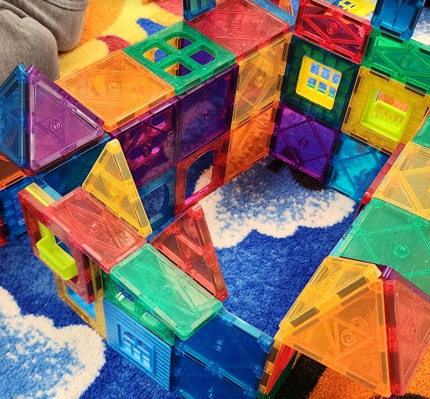
Free Play (2 of 2)
Center time activities
K Mathematics Standards: Model shapes in the world by building shapes from components; Compose simple shapes to form larger shapes
Notes:
In this kindergarten classroom, the children choose to create buildings with the magnatiles. This was an ideal activity to meet the K Mathematics Standards: Model shapes in the world by building shapes from components; and Compose simple shapes to form larger shapes

Slide 25
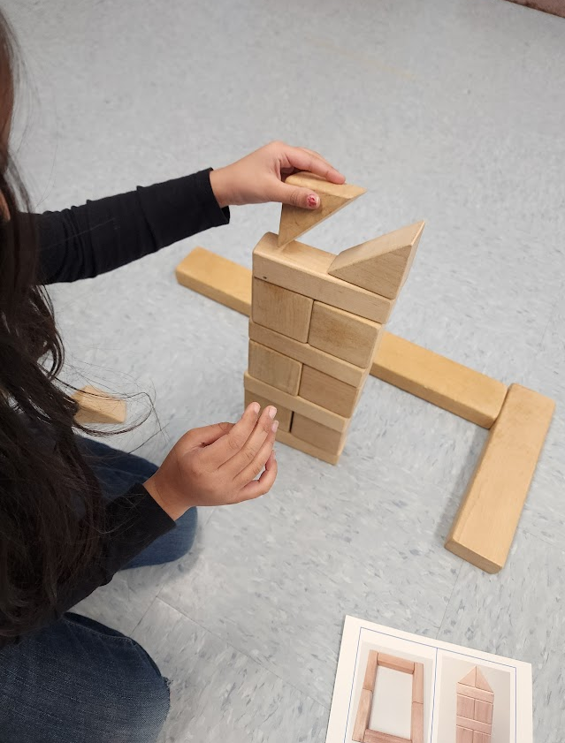
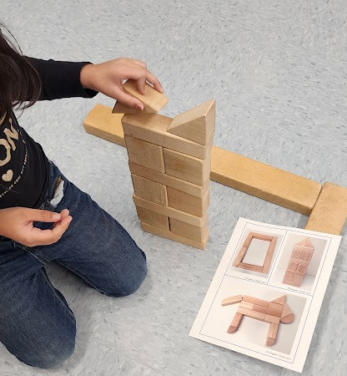
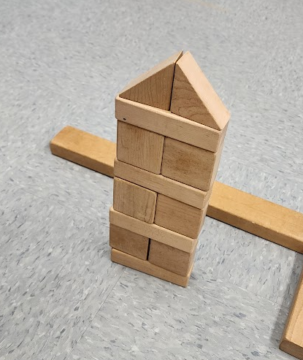
Free Play: Mathematical Problem Solving
Mathematics Standard: Make sense of problems and persevere in solving them
Notes:
In this classroom, you can see how children are encouraged to persevere and are motivated to do so. This kindergarten student spent a few minutes building the tower, but struggled when she tried to create the triangular shape at the top. She tried several different blocks, different orientations, and then went back to the cabinet to see if there was a shape that matched what she was looking for. After a few more attempts at turning the shapes around, she finally created the larger triangle from two smaller ones. She beamed with satisfaction! I have never seen a child use this type of perseverance and determination to complete a challenging workbook problem.

Slide 26
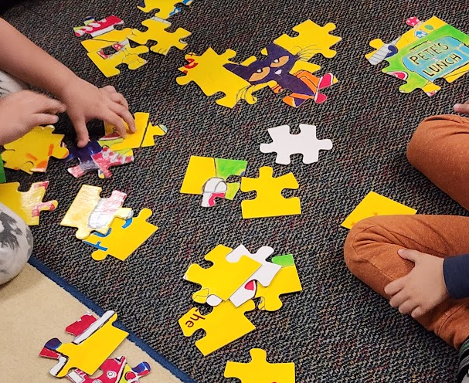
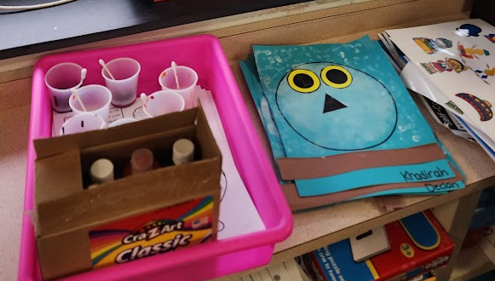
General Cognitive Skills
Logical reasoning
Problem solving
Following directions
Communicating ideas
Making connections
Developing vocabulary
Using memory strategies
Comparing & contrasting
Notes:
I want to end this section with a focus on general cognitive skills that underly all of the standards. Students who participate in play-based activities have a better chance of developing these cognitive skills. Seatwork, workbooks, and drills can be important to introducing skills and knowledge, however, children need time to practice using those skills and knowledge through active, engaged learning.

Slide 27
Four Shifts for Play-Based Learning in P–3
Adapting the schedule for time for play-based learning
Providing materials
Adapt the roles of the teacher: Guiding play-based learning
Notes:
How do you begin to integrate more play-based learning? I have four recommendations. First, find time in the schedule that can be devoted to play-based learning. Some schools that I work with have a dedicated period each day to play, centers, or project-based learning.
Second, classrooms with play-based learning need appropriate materials. Classrooms should have block center, math manipulatives, games from ELA and math, science center materials, art materials, and play centers. However, many workbooks are inappropriate for the younger grades and are not needed. Use of workbook pages, if needed, should be the result of an intentional teaching point. Considering utilizing hands on manipulatives to engage students in active learning.
Finally, We can adapt the roles of the teacher to be more of a guide and less controlling of the activities. Teachers can balance whole group direct instruction with periods of time in which students to take control of their learning and work in groups or independently while the teacher guides the learning process.

Slide 28
Summary
Children learn through play
Play-based learning is on a continuum
Standards can be met through play-based activities
Guidance during play leads to academic gains
Notes:
In summary, research shows that children learn a great deal academically through play. Play-based learning comes in different styles on a continuum of teacher-student control and decision making. Play-based learning supports children meeting rigorous academic standards. Guidance during play leads to the most academic gains.

Slide 29
References
Bodrova, E., & Leong, D. J. (2019). Making Play Smarter, Stronger, and Kinder: Lessons from Tools of the Mind. American Journal of Play, 12(1), 37-53.
Manship, K., Farber, J., Smith, C., & Drummond, K. (2016). Case Studies of Schools Implementing Early Elementary Strategies: Preschool through Third Grade Alignment and Differentiated Instruction. Office of Planning, Evaluation and Policy Development, US Department of Education.
Pyle, A., & Danniels, E. (2017). A continuum of play-based learning: The role of the teacher in play-based pedagogy and the fear of hijacking play. Early Education and Development, 28(3), 274-289.
Rand, M. K., & Morrow, L. M. (2021). The contribution of play experiences in early literacy: Expanding the science of reading. Reading Research Quarterly, 56, S239-S248.
Taylor, M.E., Boyer, W. Play-Based Learning: Evidence-Based Research to Improve Children’s Learning Experiences in the Kindergarten Classroom. Early Childhood Educ J 48, 127–133 (2020).
Toub, T. S., Hassinger-Das, B., Nesbitt, K.T., Ilgaz, H., Weisberg, D.S., Hirsh-Pasek, K., Golinkoff, R. M., Nicolopoulou, A., & Dickinson, D. K. (2018). The language of play: Developing preschool vocabulary through play following shared book-reading. Early Childhood Research Quarterly, 45, 1–17.
Zosh, J. M., Hirsh-Pasek, K., Hopkins, E. J., Jensen, H., Liu, C., Neale, D., Solis, S. L., & Whitebread, D. (2018). Accessing the inaccessible: Redefining play as a spectrum. Frontiers in Psychology, 9, 1-12.

