Slide 1
Counting on Small Group Work
Dr. Nicki Newton

Slide 2
Questions to Consider
What is developmentally appropriate practice?
What is the role of play in learning math?
How does small group work help us to reach all learners?

Slide 3
Guided Math Groups
Small guided math groups help us to reach each and every learner. It is a great way to get up close and personal with our students.

Slide 4
Make Math Meaningful
Worksheet Or Bingo?
Students should be doing math, talking math, creating math in small groups.

Slide 5
Key Ideas
Group of 3–4 students
5–10 Minutes
Hands-on — Concrete, Pictorial, Abstract
Minds On experiences — Open Questions
Focus on Math Practices & Content
Heterogeneous & Homogenous

Slide 6
Play (1 of 3)
In the Guided Math group we learn through play. We play card games, board games, dice and domino games. Play is an important vehicle for developing self-regulation as well as for promoting language, cognition, and social competence.

Slide 7
Games

Slide 8
Play (2 of 3)
[Play] gives [children] opportunities to develop physical competence and enjoyment of the outdoors, understand and make sense of their world, interact with others, express and control emotions, develop their symbolic and problem-solving abilities, and practice emerging skills (NAEYC 2009, 14).

Slide 9
Play (3 of 3)
“It is not either play or learning:
It is both/and….both are a part of a developmentally appropriate practice” (Pizzolongo & Snow, n.d.; Copple & Bredekamp 2009).

Slide 10
Playing Together
Peer collaboration involves students in sharing problem solving strategies, which expands content knowledge and
produces comradeship between peers instead of competition (Rotgans et al., 2011; Stipek et al., 1998).

Slide 11
“Hard Fun!” Dr. Seymour Papert

Slide 12
Open Questions
l looked out the window and I saw ten legs. What could I have seen?

Slide 13
Playful Learning or Guided Play
Researchers have found that "playful learning or guided play actively engages children in pleasurable and seemingly spontaneous activities that encourage academic exploration and learning.…Teachers using guided play have a set of learning goals in mind" (Hirsh-Pasek et al. 2009).

Slide 14
Interactive Number Lines

Slide 15
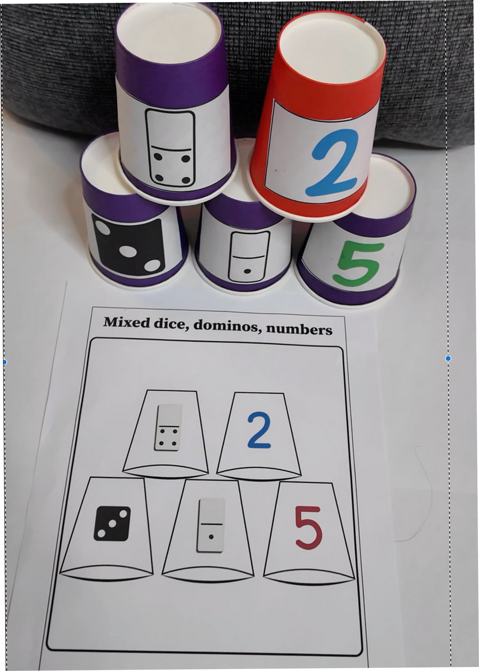
Building Number Sense One Cup at a Time

Slide 16
Guided Math Groups Help Teachers to Differentiate!

Slide 17
Why Is Everybody Working on The Number 4?
Tomlinson stated that at its most basic level, differentiating instruction means “shaking up” what goes on in the classroom so that students have multiple options for taking in information, making sense of ideas, and expressing what they learn (2001).
**Data Informed-Kid Watching- Looking at Whole Child**

Slide 18
Engaging and Academically Rigorous Activities. Hands-on, Minds-on, Talk-on

Slide 19
Differentiate Based on Data Guided by The Learning Trajectories
Learning trajectories help us to understand the development of mathematical concepts (Clements and Sarama,2014), (Confrey and Kazak,2006); (Sztajn, Confrey, Wilson, and Edgington 2012); (Bermejo, 1996; Wright et al. 2015).

Slide 20
Learning Trajectories
The learning trajectory is not a fixed path that all students will travel but rather a "developmental progression that describes a typical path that children follow in developing an understanding and skill about that math topic.”

Slide 21
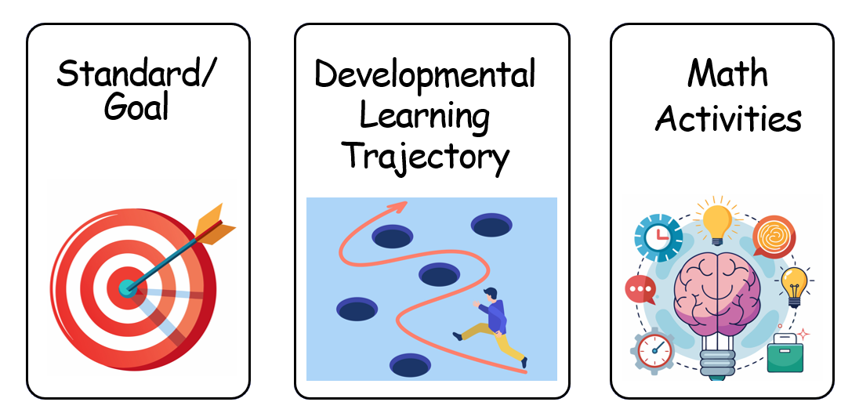
3 Parts Of The Learning Trajectory

Slide 22
Number Path Games
Counter to 5; Counter to 10; Counter beyond 10

Slide 23
Subitizing
Conceptual subitizer to 5; Conceptual subitizer to 7;
Conceptual subitizer to 10; Conceptual subitizer to 20

Slide 24
Composing And Decomposing
Composer to 4, then 5; Composer to 7; Composer to 10

Slide 25
Guided Math Can Make A Real Difference For Our Students
Practice in their zone of proximal development
Engage in rigorous thinking
Make meaning together
Play while learning
Learn to persevere - to stick with it

Slide 26
Stay In Touch
www.drnickinewton.com
drnicki7@gmail.com
drnickimath (twitter)
guidedmath123 (facebook)
Phone: 347-688-4927
https://www.pinterest.com/drnicki7/
guidedmathinaction (instagram)
math running records (facebook page)
www.mathrunningrecords.com

Slide 27
References
Slides 8 & 9:
Copple, C., & Bredekamp, S. (2009). Developmentally appropriate practice in early childhood programs serving children from birth through age 8. [Position Statement] National Association for the Education of Young Children. https://www.naeyc.org/sites/default/files/globally-shared/downloads/PDFs/resources/position-statements/PSDAP.pdf.
Slide 9:
Pizzolongo, P., & Snow, K.(n.d.). A Conversation About Play. NAEYC. https://www.naeyc.org/resources/pubs/books/spotlight-young-children-exploring-play-a-conversation-about-play.
Slide 10:
Rotgans, J. I., & Schmidt, H. G. (2011). Situational interest and academic achievement in the active-learning classroom. Learning and instruction, 21(1), 58-67.
Stipek, D., Givvin, K. B., Salmon, J. M., & MacGyvers, V. L. (1998). Can a teacher intervention improve classroom practices and student motivation in mathematics?. The Journal of Experimental Education, 66(4), 319-337.
Slide 11:
Papert, S. (n.d.). Hard Fun. The Daily Papert. https://dailypapert.com/hard-fun/
Slide 13:
Hirsh-Pasek, K., Michnick-Golinkoff, R., Berk, L., Singer, D., (2009). A mandate for playful learning in preschool: Applying the scientific evidence. Oxford Press.
Slide 17:
Tomlinson, C. A. (2009). Intersections between differentiation and literacy instruction: Shared principles worth sharing. New England Reading Association Journal, 45(1), 28.
Slide 19:
Bermejo, V. (1996). Cardinality development and counting. Developmental Psychology, 32(2), 263.
Clements, D. H., & Sarama, J. (2014). The importance of the early years. Science, technology & mathematics (STEM), 5-9.
Sztajn, P., Confrey, J., Wilson, P. H., & Edgington, C. (2012). Learning Trajectory Based Instruction: Toward a Theory of Teaching. Educational Researcher, 41(5), 147-156. https://doi.org/10.3102/0013189X12442801
Wright, R., Martland, J.& Stafford, A. (2006). Early Numeracy: Assessment for Teaching and Intervention 2nd ed. Sage. Thousand Oaks, CA.

