Slide 1

New Jersey Department of Education
Elementary and Secondary School Emergency Relief (ESSER) Roundtable Series:
After School Programs/Summer Learning/
Grant Deadlines
New Jersey Department of Education
Division of Educational Services
June 15, 2022
Notes:
Anthony

Slide 2
Agenda
Housekeeping Dr. A. Charles Wright, Executive Director/Deputy Assistant Commissioner,
Division of Educational Services
Welcome Dr. A. Charles Wright, Executive Director/Deputy Assistant Commissioner
After School Programs Ms. Shawanda Beale, Assistant Director, Office of Student Support Services
Summer Learning Mr. Cory Radisch, Acting Director, Office of Learning Interventions
Grant Deadlines Mr. Marty Egan, Director, Office of Grants Management
District Presentations
Elizabeth Public Schools
Midland Park Public Schools
Notes:
Anthony

Slide 3

Using Microsoft Teams
  Chat
    We welcome your participation in discussions by asking questions and adding comments in the chat box.
  Raise Hand
  Please use the raise hand feature if you want to speak.
  Mute/Unmute
    Please remain muted whenever you are not speaking.
Notes:
Peggy

Slide 4
Welcome
Notes:
Next slide

Slide 5
Afterschool Programming
Office of Student Support Services
Division of Educational Services
June 2022

Slide 6

Afterschool Programming: Provide academic enrichment opportunities during non-school hours for children of all ages.
Afterschool Alliance
The Afterschool Alliance, nonprofit organization, has identified out-of-school time (OST) programs, such as before/afterschool and summer enrichment programs, as critical supports within high-functioning education systems.
Quality OST programs have demonstrated an increase in academic gains and student engagement among participating youth, while also supporting working families. Additionally, these programs build stronger connections between schools and communities.
Source: Afterschool Alliance, 2016, http://afterschoolalliance.org//AA3PM/Concentrated_Poverty.pdf

Slide 7
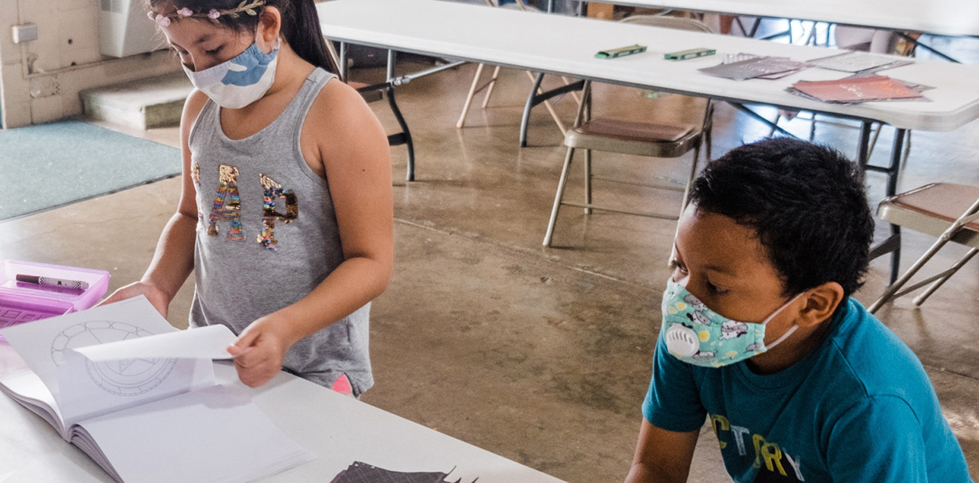

High Quality Tutoring
Afterschool Programming and Student Performance
When districts establish an afterschool program, they have increased opportunities to provide targeted high quality tutoring to students. Research has found that high quality tutoring is the most efficient way to close learning gaps for students.
  Increase in English language arts (ELA) assessment outcomes for participating youth in 11th grade, compared to nonparticipants*
  Increase in mathematics assessment outcomes for high-attending youth in fourth and eighth grades, compared to low-attending youth*
  For most grade levels, lower unexcused school-day absence rates than non-attending peers*
*American Institutes for Research, Nita M. Lowey 21st Century Community Learning Centers Evaluation Report

Slide 8
Afterschool Programming and the Impact on Students
Determine the Purpose:
Include academic enrichment activities
Identify themes: Science, Technology, Engineering and Mathematics (STEM); Civic Engagement; Career Awareness and Exploration; and Visual and Performing Arts
Reinforce and complement the students’ regular academic program
Provide active and meaningful opportunities for family engagement
Ensure equal access and opportunities for all students
Determine the Impact and Gather Program Data:
Who are the student participants?
Which schools will offer the program?
Will you offer summer programming?
Who will staff the program (teachers/counselors/SEL specialists)?
What is the staff/student ratio?
Will you provide nutritional snacks?
What student data will you measure (attendance, discipline, standardized test results)?

Slide 9

Equity in Afterschool Programming
Access:
Identify youth who may need additional academic enrichment, and social, emotional, or mental health supports.
Identify youth who may serve as peer leaders and engage others in activities.
Opportunity:
Youth build skills through hands-on and personalized learning.
Youth explore new areas, gain teamwork and communication skills.
Fairness:
Programs provide a safe environment for youth while parents are working.
Programs engage families with active and meaningful opportunities to learn.

Slide 10

Resources
The New Jersey Department of Education offers a competitive grant, the Nita M. Lowey 21st Century Community Learning Center (21st CCLC) Program grant:
  Project design considerations
  Budget design considerations
New Jersey School Age Care Coalition (NJSACC) is the current 21st CCLC statewide training and technical assistance provider. There are preexisting resources:
  NJ Quality Standards for Afterschool
  Afterschool program assessment tool
Implement professional development for staff:
  Conferences
  Training workshops
  E-learning opportunities

Slide 11
After School Resources
https://www.nj.gov/education/esser/arp/docs/PlanningResources_Evidence-basedComprehensive_BeyondSchoolDay_Activities_Grant.pdf
https://www.state.nj.us/education/safety/afterschool/

Slide 12
Thank You! 1
New Jersey Department of Education Website
nj.gov/education
Shawanda Beale, Assistant Director
Office of Student Support Services
Shawanda.Beale@doe.nj.gov
Follow Us!
Facebook:
@njdeptofed
Twitter: @NewJerseyDOE
Instagram:
@NewJerseyDoe

Slide 13
Summer Learning
Office of Learning, Intervention and Support
Field Support and Services
Cory Radisch, Acting Director

Slide 14

Summer Learning Slide
Summer Learning Loss - YouTube

Slide 15
Office of Learning, Intervention, and Support
The Office of Learning, Intervention, and Support (OLIS) will focus its responsibilities on:
Summer Learning
Extended Learning Opportunities
Learning Acceleration and Intervention

Slide 16

Equity of Access and Opportunity 1/2
Credit: www.Summerlearning.org

Slide 17
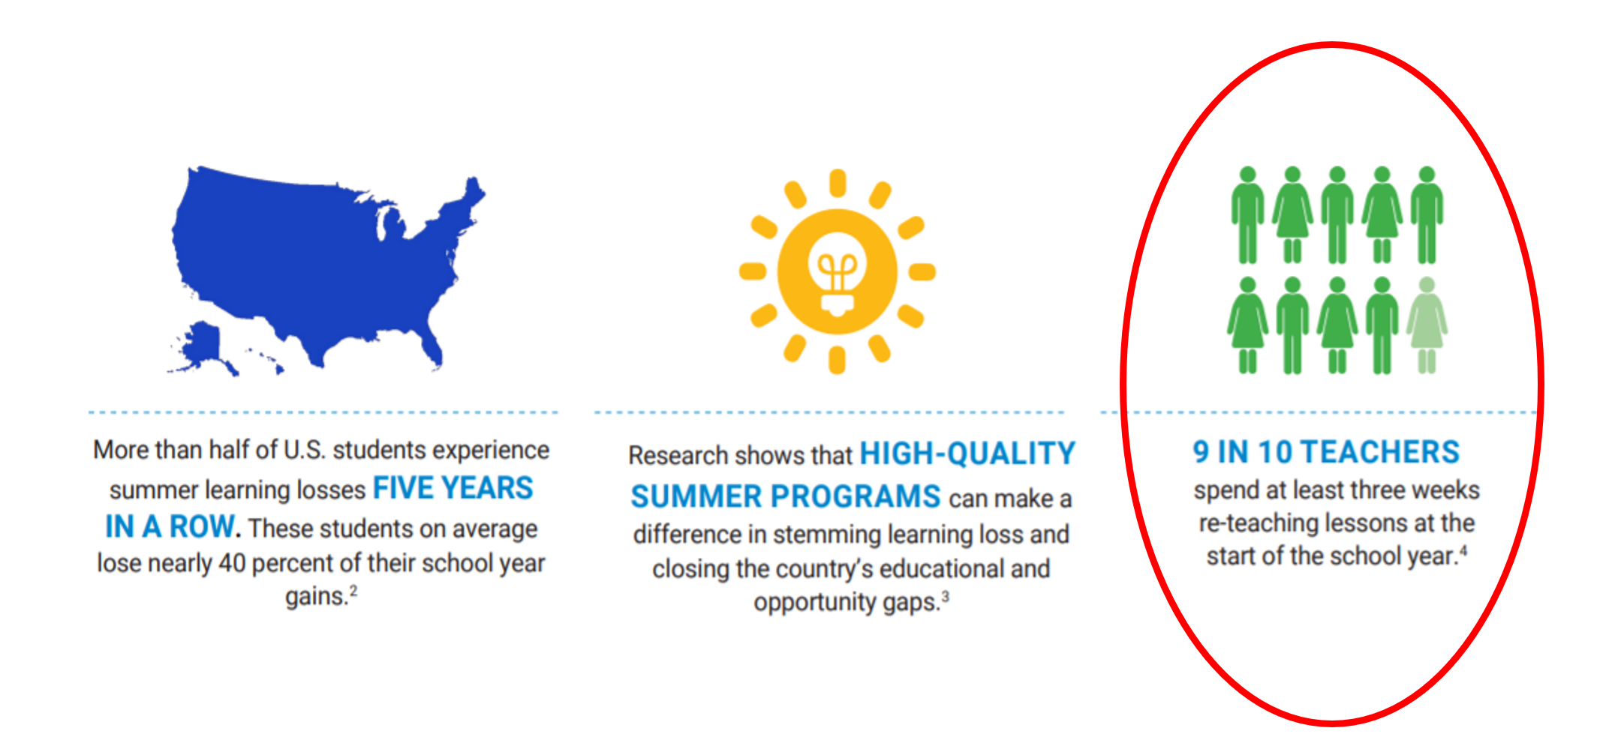
Equity of Access and Opportunity 2/2
Credit: www.Summerlearning.org

Slide 18

Summer: A Unique and Underleveraged Time
Time for Improvement
Provide students and staff opportunity to catch up, keep up and develop new skills.
Time for Innovation
Empower staff to test and try out and measure new ideas, solutions, strategies before scaling.
Time for Integration
Break down silos in education and partner leaders and organizations in rare, new ways.
Time for Impact
Learning from hands-on summer programs is immediate, measurable and lasting.
Credit: Dworkin, Alan. “Summer Bootcamp.” NSLA, 1 Mar. 2021

Slide 19

Heart sets and Mindsets

Slide 20
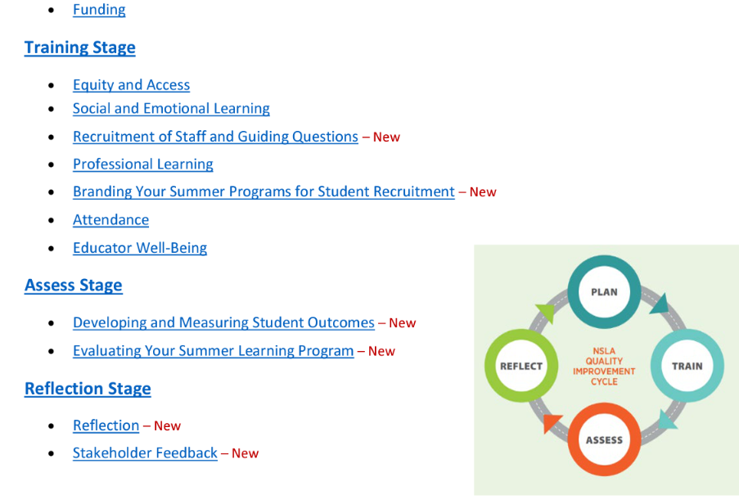
How To Use the 2022 Summer Learning
Resource Guide (SLRG)
The PDF Version of the SLRG features an interactive table of contents.
Each section is a hyperlink that will take you directly to the desired section of the document
New information is denoted with a red-New.
Source: NSLA
Notes:
Discuss the NSLA four-part quality improvement cycle for summer planning, be sure to acknowledge the difficulties all LEAs are facing as well as acknowledge districts may be in different portions
Of the planning cycle.
Be sure to put links in the chat.

Slide 21
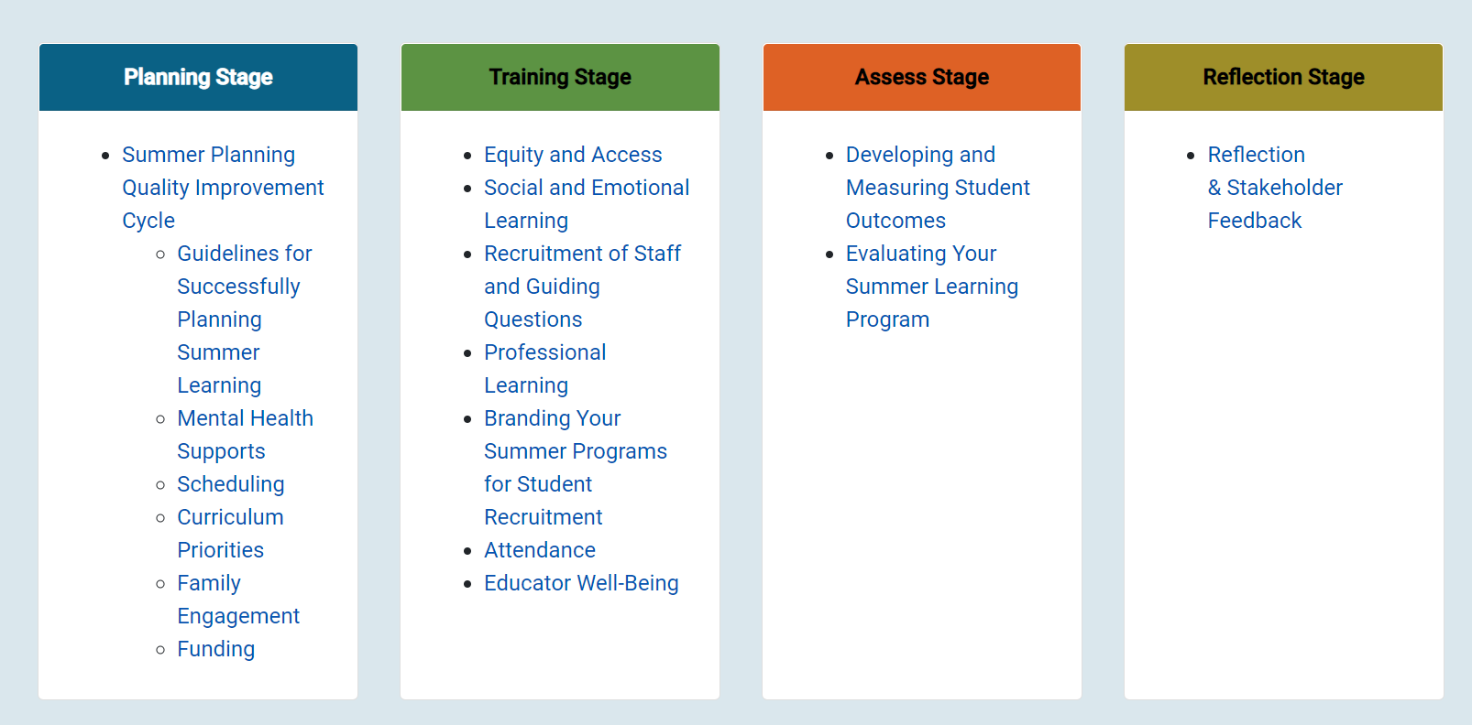
How To Use the 2022 Summer Learning
Resource Guide
Notes:
Details the electronic version on the website

Slide 22
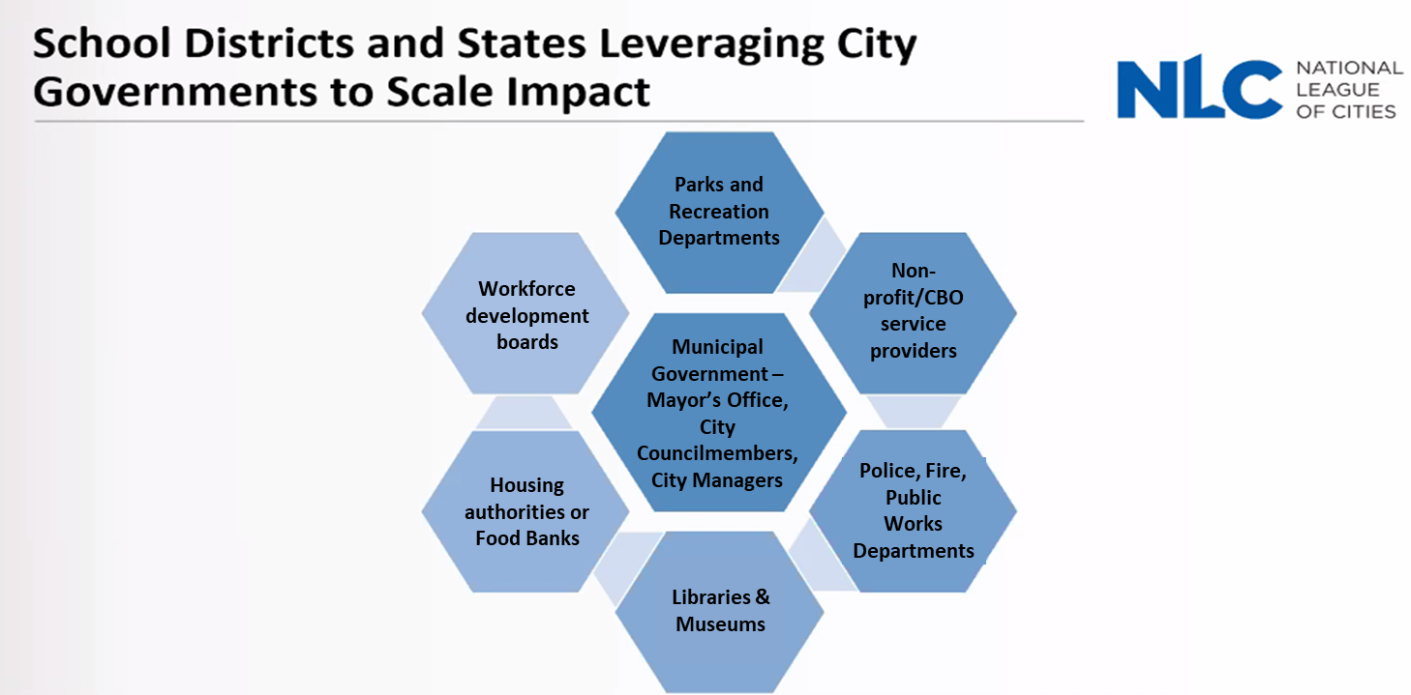
Leveraging Partnerships
Credit: National League of Cities

Slide 23
Possibilities
  Bridge Academies
  STEAM Camps
  Project Based Learning
  High Dosage Tutoring
  Service-Related Projects
  Thematic Learning
  SEL Opportunities
  Design Thinking Projects
  Acceleration does not and should not be done in isolation of enrichment activities

Slide 24
Grant Deadlines

Slide 25
Office of Grants Management
Mr. Martin Egan, Director
Ms. Jill Dobrowansky, Planning Associate
Division of Finance and Business Services
Notes:
Next slide

Slide 26
Important Dates
 | ESSER I (CARES) | ESSER II (CRRSA) | ESSER III (ARP)
Project Period | March 13, 2020 – September 30, 2022 | March 13, 2021 – September 30,2023 | March 13, 2022 – September 30, 2024
Amendments Due By | July 15, 2022 | July 15, 2023 | July 15, 2024
Reimbursement Request Deadline | September 15, 2022 | September 15, 2023 | September 15, 2024
Liquidation Period Ends | October 15, 2022 | October 15, 2023 | October 15, 2024
Final Expenditure Report Available | TBD | TBD | TBD
Final Expenditure Report Due By | TBD | TBD | TBD
* All dates are subject to change as determine by State and/or Federal Guidance
Notes:
Next slide

Slide 27
Electronic Web-Enable Grants (EWEG)
Online system for grants management
  Central Contacts
  Unique Entity Identifier (SAM.gov)
  Applications & Amendments
  Reimbursements
  Reports
  Have questions about EWEG? EWEG Help Desk

Slide 28
Approval Process
  Submission
    After running and passing Consistency Check your application will be locked.
    Submit to NJDOE
  Tier I
    County Level
      Alignment of Needs
      Safe Return Plan
      Programs & Allocations
      Fiscal Review
Notes:
Timely review process due to the nature & scope of the grant. In addition, please remember we are reviewing over 600 applications for just ARP ESSER.

Slide 29
Approval Process (cont.)
  Tier II
    Office of Grants Management
      Fiscal Review
      Allocation Alignment
  After Tier II approval, districts must file an amendment for any program or fiscal changes.
Notes:
Timely review process due to the nature & scope of the grant. In addition, please remember we are reviewing over 600 applications for just ARP ESSER.

Slide 30
Substantially Approved
  When an LEA successfully submits an application, they receive an automatic email notification through the EWEG system that the application has been submitted in “substantially approved form.”
  This is only a preliminary approval; the application will be reviewed and given final approval by the NJDOE staff.
  Pursuant to federal guidance, if the LEA submits the application by the due date, they may begin to encumber funds as of the project start date.
Notes:
Begin to encumber funds if submitted on time but won’t be able to file a Reimbursement Request until Tier I and Tier II approvals.

Slide 31
Substantially Approved (cont.)
  If the application is submitted after the due date, they may only encumber funds as of the date of submission.
  Applications will be considered on time if they were submitted by November 24, 2021.
  NJDOE staff will be available for support Monday through Friday during regular business hours.
Notes:
Begin to encumber funds if submitted on time but won’t be able to file a Reimbursement Request until Tier I and Tier II approvals.
Remind about EWEG Help Desk & ESSER Help Desk

Slide 32
District Presentations
Notes:
Anthony

Slide 33




ARP/ESSER 1
presented by
Olga Hugelmeyer
Superintendent of Schools
June 10, 2022

Slide 34
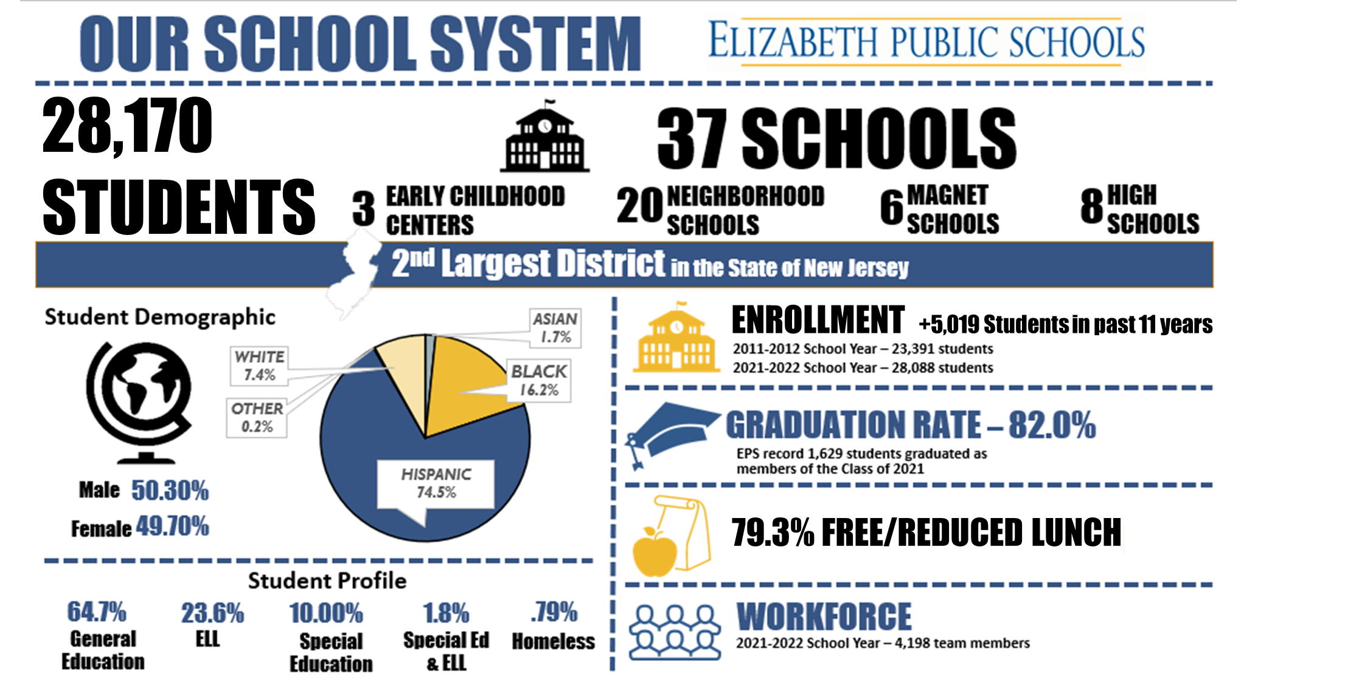
Our School System

Slide 35

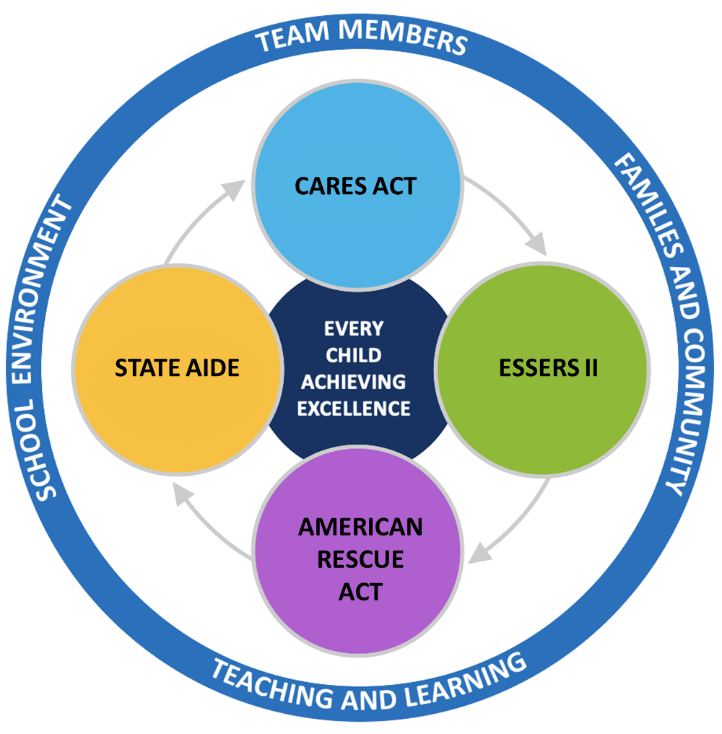
How do we define
Every Child
Achieving
Excellence?

Slide 36

End of High School
Consistent Attendance (95%)
Earns a minimum of 120 credits as outlined in Policy 6146
Completes 60+ hours of Community Service
Take at least 1 AP course/Dual Enrollment course/earn vocational certificate
Achieve a competitive score on the SAT (1050 or better)
Participation in at least 2 extracurricular clubs/athletics/community involvement
End of Grade 9
Consistent Attendance (95%)
Earn 30 credits
GPA 3.0 or better and/or demonstrates consistent growth
80% Benchmark Score (Mathematics, English, Social Studies, Science)
End of Grade 8
Consistent Attendance (95%)
Overall Grade of 80% or better and/or demonstrate consistent growth in all courses:
  English Language Arts/Literacy 80% Benchmark Score or better
  Algebra I 80% Benchmark Score of Better
End of Grade 5
Consistent Attendance (95%)
Overall Grade of G or better and/or demonstrate consistent growth in:
  English Language Arts/Literacy 80% Benchmark Score or better
  DRA (Developmental Reading Assessment) Score of 50
  Mathematics 80% Benchmark Score or better
End of Grade 3
Consistent Attendance (95%)
Overall Grade of G or better and/or demonstrate consistent growth in:
  English Language Arts/Literacy 80% Benchmark Score or better
  DRA (Developmental Reading Assessment) Score of 30
  Mathematics 80% Benchmark Score or better
End of Pre-K 4
Consistent Attendance (95%)
Score of a 5 on the Early Learning Scale (ELS), Oral Language
Strand: Speaking and Storytelling Items

Slide 37
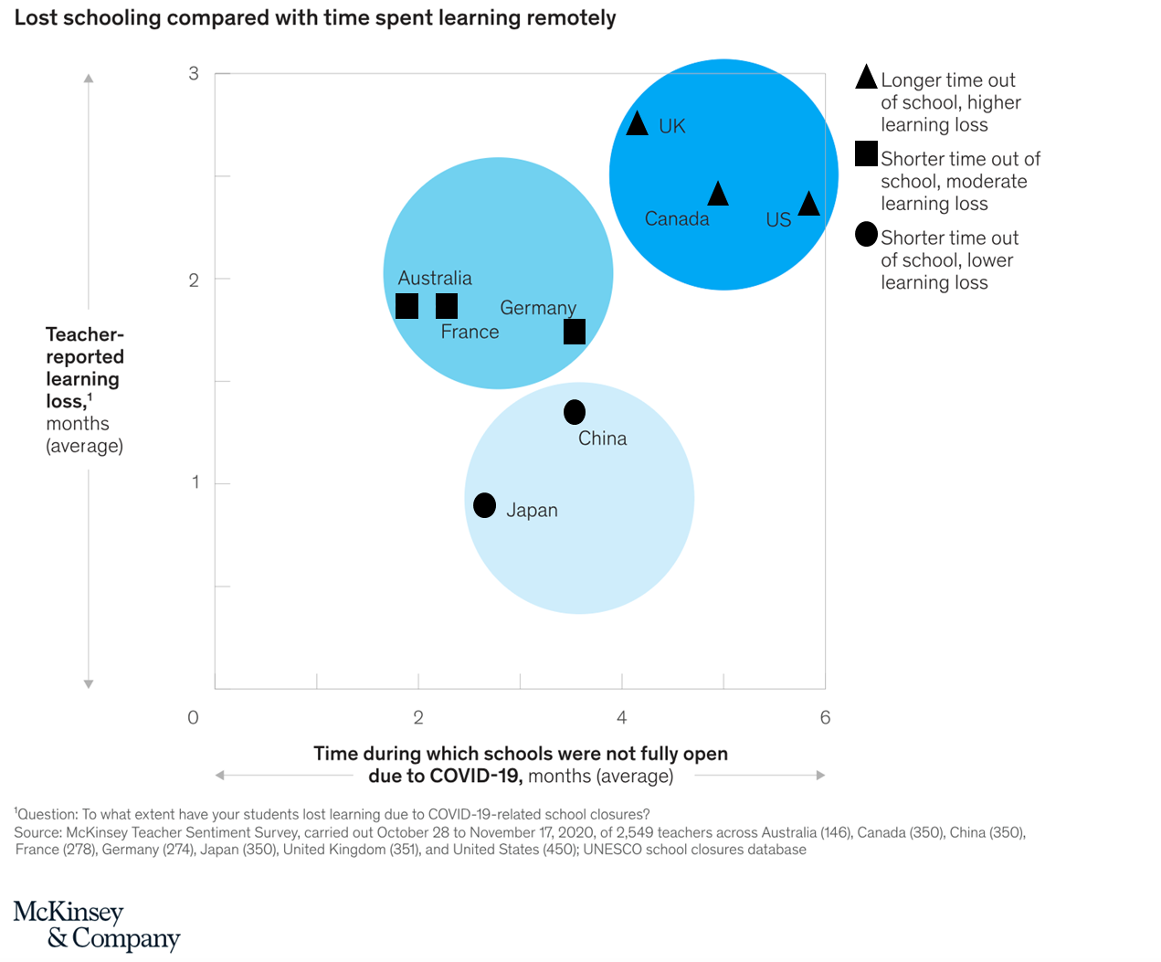
Defining the impact of COVID-19 on learning loss
Notes:
Understanding the impact of school closures on the students’ academic, social, emotional and mental health needs due to the COVID-19 pandemic
L ife in the classroom has changed because of the pandemic. Among other things, most schools have implemented physical distancing, simultaneous remote instruction, and health safeguards that limit both teacher–student and peer interactions. Many students are also dealing with added trauma, including economic dislocation, hunger, and mental health challenges—all of which clearly affect learning, regardless of how it takes place.

Slide 38
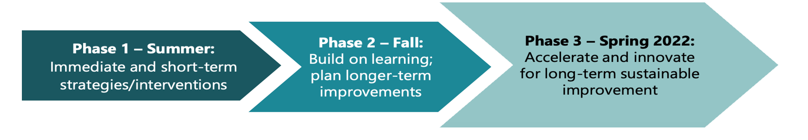
How will EPS will Address Learning Loss?
Phase 1 - June 2021: Initial plan for academic and student well-being recovery and acceleration strategies to be implemented for the summer and early fall of 2021
Phase 2 - November 2021: Review and analyze student data from the implemented Phase 1 strategies/interventions for each student group identified. Reflect and build on learning. Adjust and begin oner-term planning of recovery and acceleration strategies/interventions for implementation over the winter and throughout the school year 2021-2022. Continue to collect data.
Phase 3 - April 2022: Continue improvement cycle for strategies/interventions implemented in Phases 1 and 2 by reviewing and analyzing the collected data to inform next steps and engage in long-term sustained strategies for the next school year and beyond (2022-23).
Notes:
Due to extended gaps or interruptions in education (time gaps – attendance/technology maintenance/connectivity
19-20 March16, 2019 – June 15, 2020 –half day - 4 hours only and one hour support
Pk-2 independent learning versus 3-12 virtual instruction
20-21 Sept 11, 2020 –April 16, 2021 - half day/ virtual instruction
20-21 April 19 – PK-3 half day/ hybrid instruction
20-21 April 26 4-5 half day/ virtual hybrid instruction
20-21 May 3 6-12 half day/ virtual hybrid instruction

Slide 39
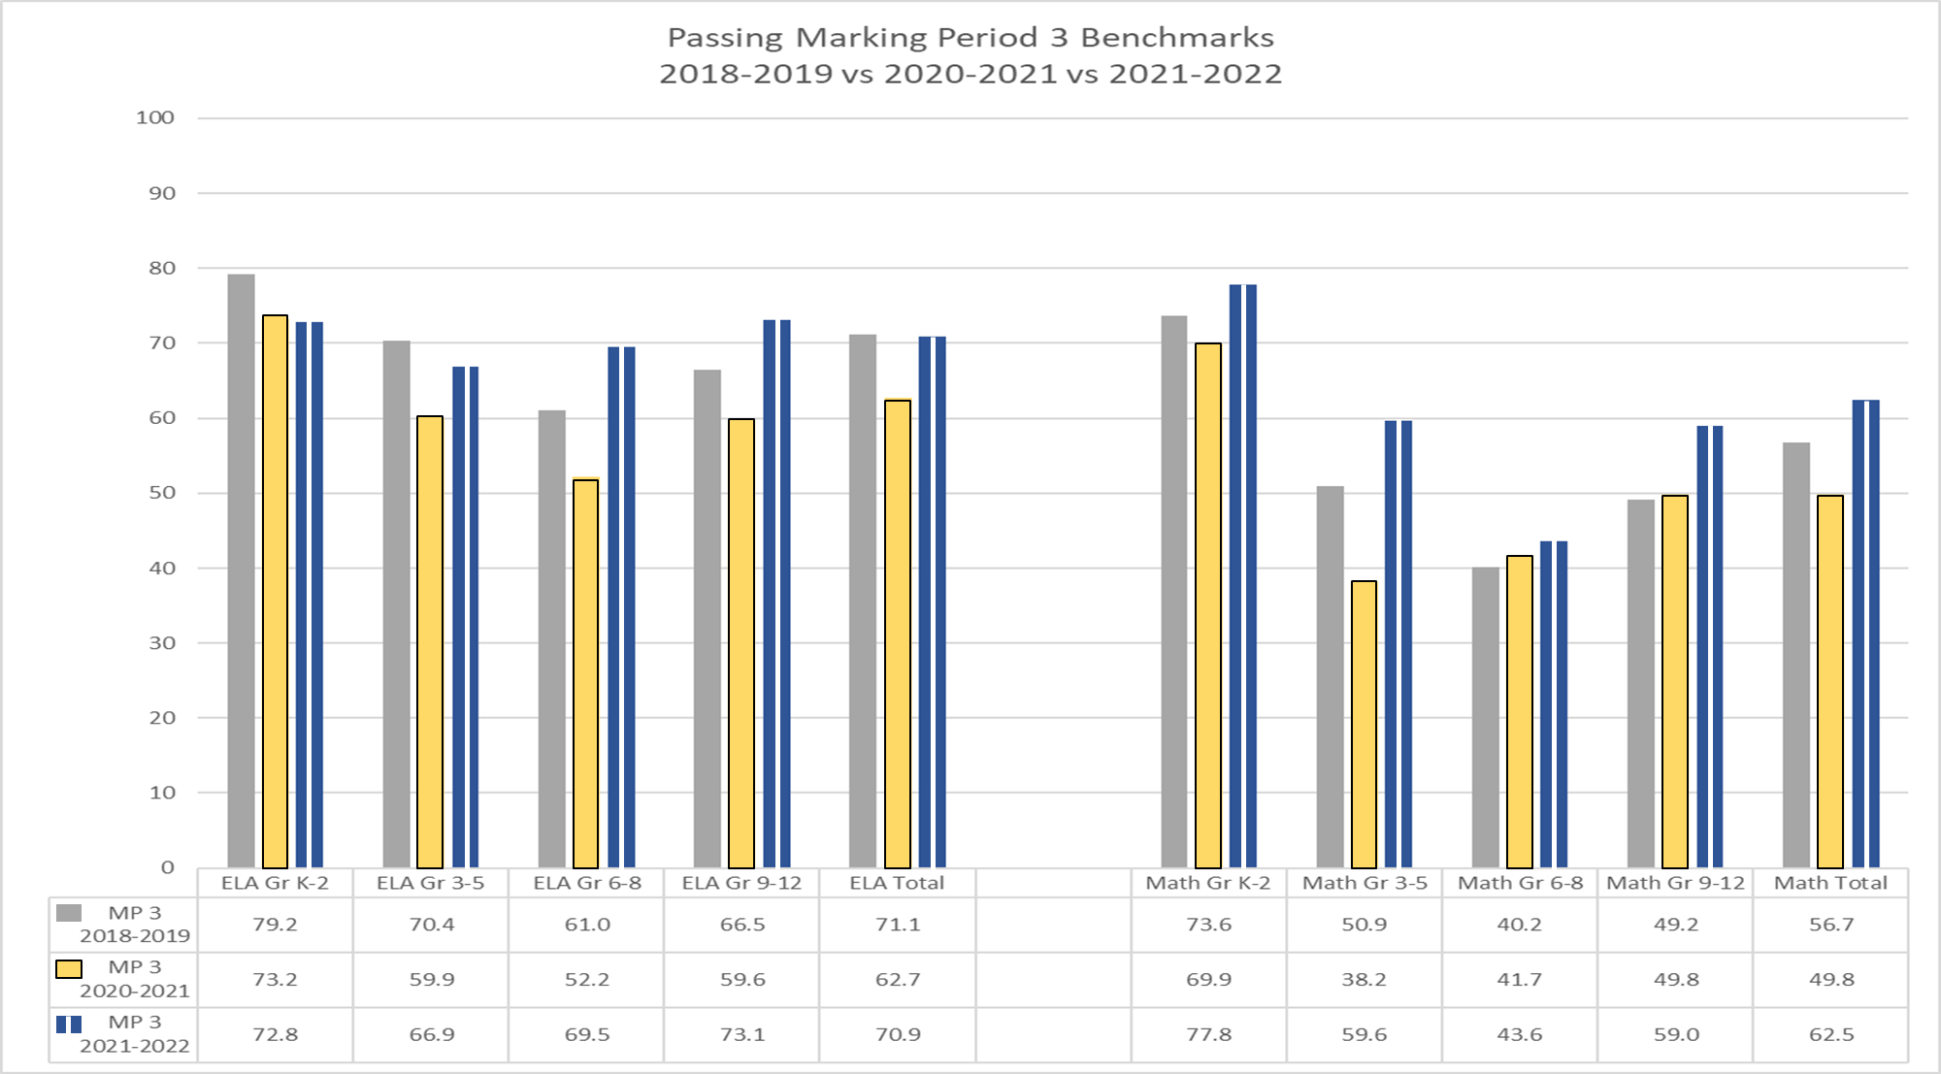
What data was collected and synthesized to determine student needs caused by learning loss?

Slide 40
How Does a school district create A path forward: Curb Learning loss and accelerate learning?
The summer of 2021 and Fall 2021 presents a promising opportunity.
A recent RAND analysis of 43 summer programs suggests that 75 percent were effective in improving at least one outcome, especially in reading.
Promising examples include Acceleration Academies, which has helped students gain up to three months of learning through 25 hours of targeted instruction in a single subject (math or English-language arts).
A proven catalyst for accelerated learning is one-on-one support for students to provide tutoring and coaching.
Recent research from the New Teacher Project suggests that well-intentioned approaches that pull students out of grade-level instruction to “reteach” earlier-grade content can reinforce low expectations and create vicious cycles of underachievement.²The better approach is for instructors to provide exposure to grade-level content, while scaffolding students with “just-in-time support” so they can access such content. This is a natural way of prioritizing the building-block content from previous grades that is required to progress.
Source: Covid-19 and Learning Loss – Disparities Grow and Students Need Help. McKinsely & Company.
Notes:
Understanding the impact of school closures on the students’ academic, social, emotional and mental health needs due to the COVID-19 pandemic
L ife in the classroom has changed because of the pandemic. Among other things, most schools have implemented physical distancing, simultaneous remote instruction, and health safeguards that limit both teacher–student and peer interactions. Many students are also dealing with added trauma, including economic dislocation, hunger, and mental health challenges—all of which clearly affect learning, regardless of how it takes place.

Slide 41
ESSERS II
THE ELEMENTARY AND SECONDARY EMERGENCY RELIEF FUND AUTHORIZED BY THE CORONAVIRUS RESPONSE AND RELIEF SUPPLEMENTAL APPROPRIATIONS (CSSSA) ACT

Slide 42
ESSERS BACKGROUND INFORMATION
The purpose is to support students, teachers, and schools during this historic pandemic.
Period of availability is March 13, 2020 to September 30, 2023.
$ 1.2 billion was dedicated to K-12 education to New Jersey delivered to local school districts based on the Title I funding formula.
Elizabeth Public Schools received $28,568,451 ESSER II Funds. In addition, $1,833,378 Learning Acceleration and $147,496 Mental Health Supports and Services.
Notes:
The purpose is to support students, teachers, and schools during this historic pandemic.
Period of availability is March 13, 2020 to September 30, 2023.
$ 1.2 billion was dedicated to K-12 education to New Jersey delivered to local
school districts based on the Title I funding formula.
Elizabeth Public Schools received $28,568,451 ESSER II funds. In addition, $1,833,378 Learning Acceleration and $147,496 Mental Health Supports and Services.

Slide 43

ALLOWABLE USE OF FUNDS 1
Coordinate emergency response
Ensure preparedness and coordination
Purchase cleaning supplies
Educational technology
Mental health supports
Supplemental learning
Added needs of at-risk population
Coordinate long-term closures
Addressing needs of individual
schools.
Professional development
ESSA
IDEA (Special Education)
Perkins (Career & Technical Education)
McKinney-Vento Homeless Assistance Act
Adult Education and Family Literacy Act
Other activities for continuity of services
Address learning loss
School facility repairs and improvements
Improving air quality
⇒ The three new activities were previously allowable, but have been called out as separate uses.

Slide 44
ESSER II
Academic/Enrichment/Intervention K-12 Programs - Summer and Afterschool
Intensive Literacy Summer/Afterschool Program K-3 ($813,584)
Program for K-3 students. These are students identified by teacher tutors who will participate in small group literacy instruction.

Slide 45


Dr. Dorothy McMullen
Director of Special Projects

Slide 46
ESSER ARP Lunchtime Tutoring
Criteria
Student Selection
Staffing
Collaboration with Principals
Training and ongoing coaching
Data Analysis and Progress Monitoring
Notes:
District analysis of first marking period grades

Slide 47
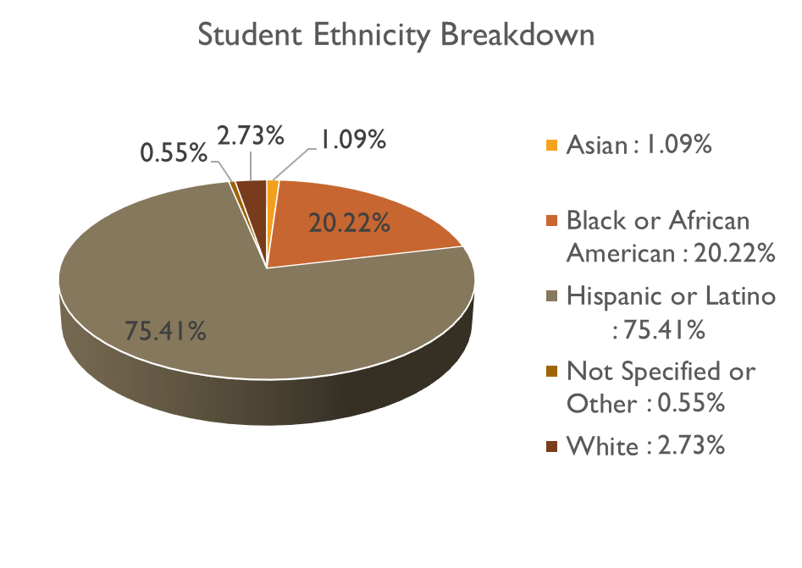
Student Demographics 1
Program Design 1
Students participated in either LAL or Math tutoring
26 Schools
48 Tutors
3x per week
22.5 hours total
200+ Students
Notes:
Participated in only one content area

Slide 48
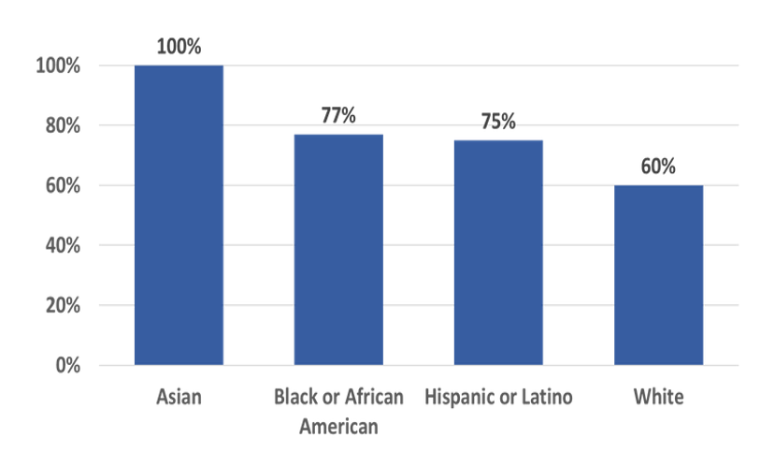
Performance by Ethnicity: Met MAP Growth Projection
Notes:
Baseline and expected

Slide 49
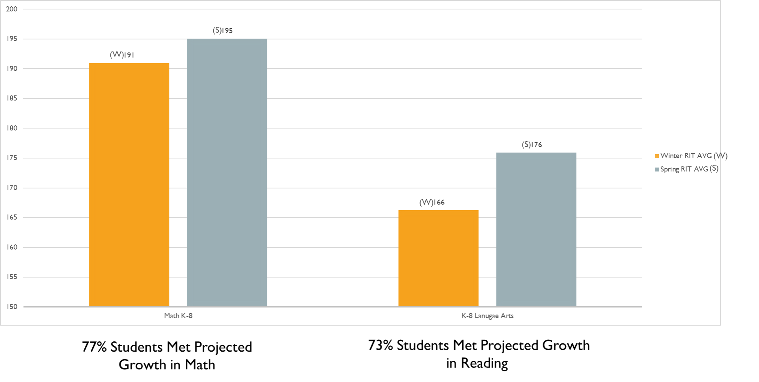
Overall Growth: Winter to Spring
Notes:
? Pretest and Post test

Slide 50
NEXT STEPS 1
Analyze MAP data to benchmarks and final grades
Survey staff for feedback
Provide analysis to schools for action planning

Slide 51
APR ESSER
THE AMERICAN RESCUE PLAN ELEMENTARY AND SECONDARY SCHOOL EMERGENCY RELIEF FUND

Slide 52
AMERICAN RESCUE PLAN
On January 14, 2021, President-Elect Biden announced a proposal for additional COVID relief.
The American Rescue Plan provided $122 billion for K-12 education to safely reopen, sustain safe operation of schools, and address the impacts of the COVID-19 pandemic on the nation’s students.

Slide 53
AMERICAN RESCUE PLAN BACKGROUND INFO
ARP ESSER funds are directed at the development of a safe return to in-person and at least 20% for learning loss activities that address social, emotional and academic needs. The remaining funds can be used on the same categories as ESSER I and II.
Period of availability is May 24, 2021 - September 30, 2024.
$2,764,587,703 billion will be dedicated to New Jersey delivered to local school districts based on the Title I funding formula.
The Elizabeth Public Schools District received a consolidated total of $64,160,682 defined as American Rescue Plan ESSER in $42,773,788 and a reserve of $21,386,894 to be determined by NJDOE pending approval of the State's plan by the USDOE.

Slide 54
ALLOWABLE USE OF FUNDS 2
Coordinate emergency response
Ensure preparedness and coordination
Purchase cleaning supplies
Educational technology
Mental health supports
Supplemental learning
Added needs of at-risk population
Coordinate long-term closures
Addressing needs of individual
schools.
Professional development
ESSA
IDEA (Special Education)
Perkins (Career & Technical Education)
McKinney-Vento Homeless Assistance Act
Adult Education and Family Literacy Act
Other activities for continuity of services
Address learning loss
School facility repairs and improvements
Improving air quality

Slide 55
Dr. Sandra Nunes
Director of Bilingual and ESL Education

Slide 56
AMERICAN RESCUE PLAN ESSER 1
Every Student Succeeds Act
Point of Entry Afterschool Program K-8 for ELLs Expansion ($664,981) *2 years
Point of Entry Afterschool Program K-8 for ELLs Expansion- This afterschool program is designed for new entrant elementary ELLs. The purpose of the program is to provide students with leveled instruction in ELA, Math, Science and Social Studies via engaging activities. Social emotional support and activities is provided by our district bilingual psychologist.

Slide 57
K-8 ESL Point of Entry (POE)
After-School Program
Criteria
New entrants
Teacher Recommendation
Curriculum and Planning
Data Analysis and Progress Monitoring
Notes:
District analysis of first marking period grades

Slide 58

Student Demographics 2
Program Design 2
Languages | Number of ELLs
Albanian | 1
Amharic | 1
Arabic | 5
French | 1
Haitian/Creole | 15
Persian (Farsi) | 2
Portuguese | 30
Pushto | 3
Spanish | 686
Social Emotional Learning
Grade Level | Number of ELLs
0 | 112
1 | 95
2 | 87
3 | 88
4 | 75
5 | 71
6 | 71
7 | 60
8 | 85
Development of Four Language Domains
WIDA English Language Development Standards: Social and Instructional, Language Arts, Mathematics, Science, and Social Students
744 English Language Learners

Slide 59
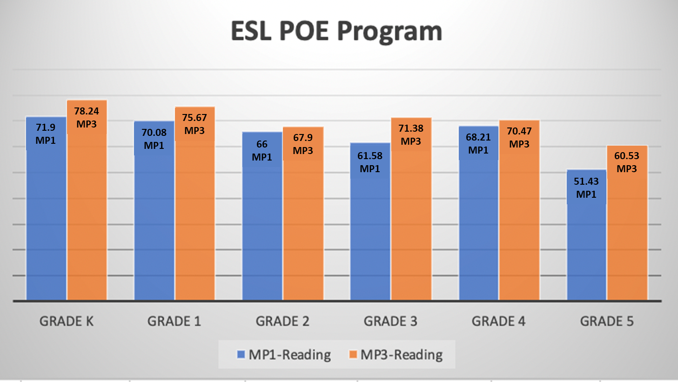
Overall Growth on District
ESL Benchmarks MP1 to MP3
Grades K-5 Reading
Notes:
Only participated in one content area

Slide 60
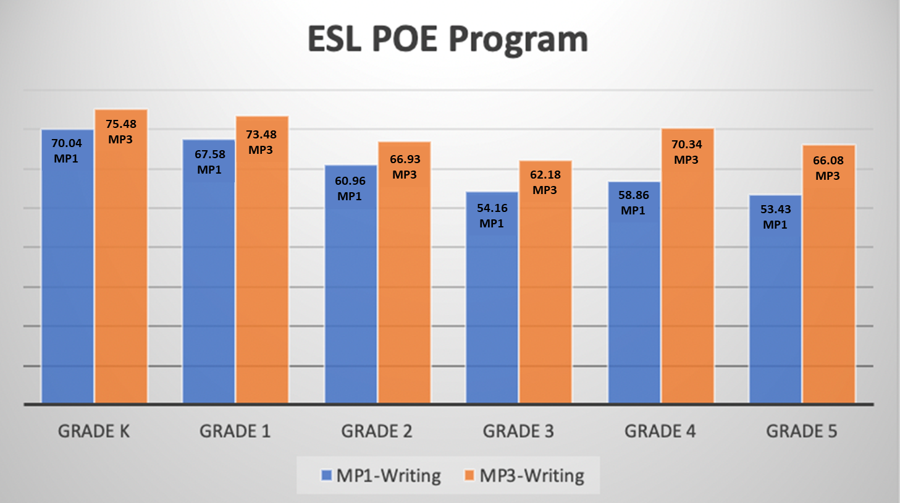
Overall Growth on District
ESL Benchmarks MP1 to MP3
Grades K-5 Writing
Notes:
Only participated in one content area

Slide 61
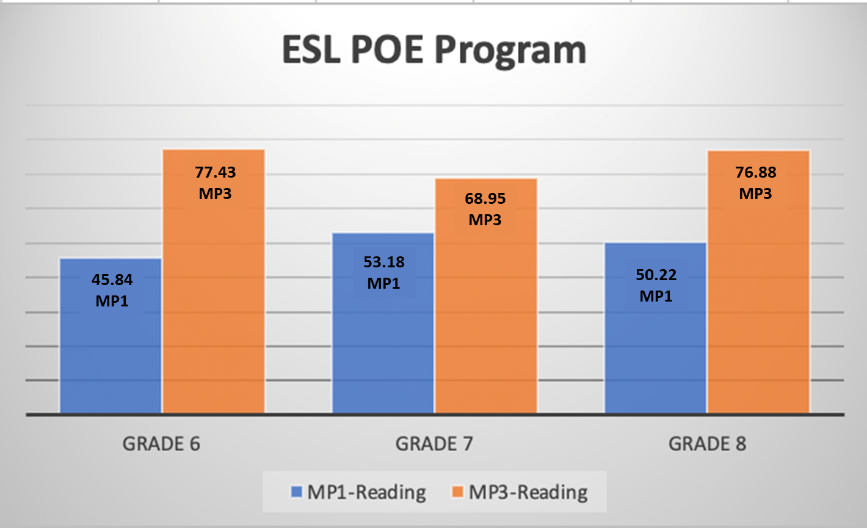
Overall Growth on District
ESL Benchmarks MP1 to MP3
Grades 6-8 Reading
Notes:
Only participated in one content area

Slide 62
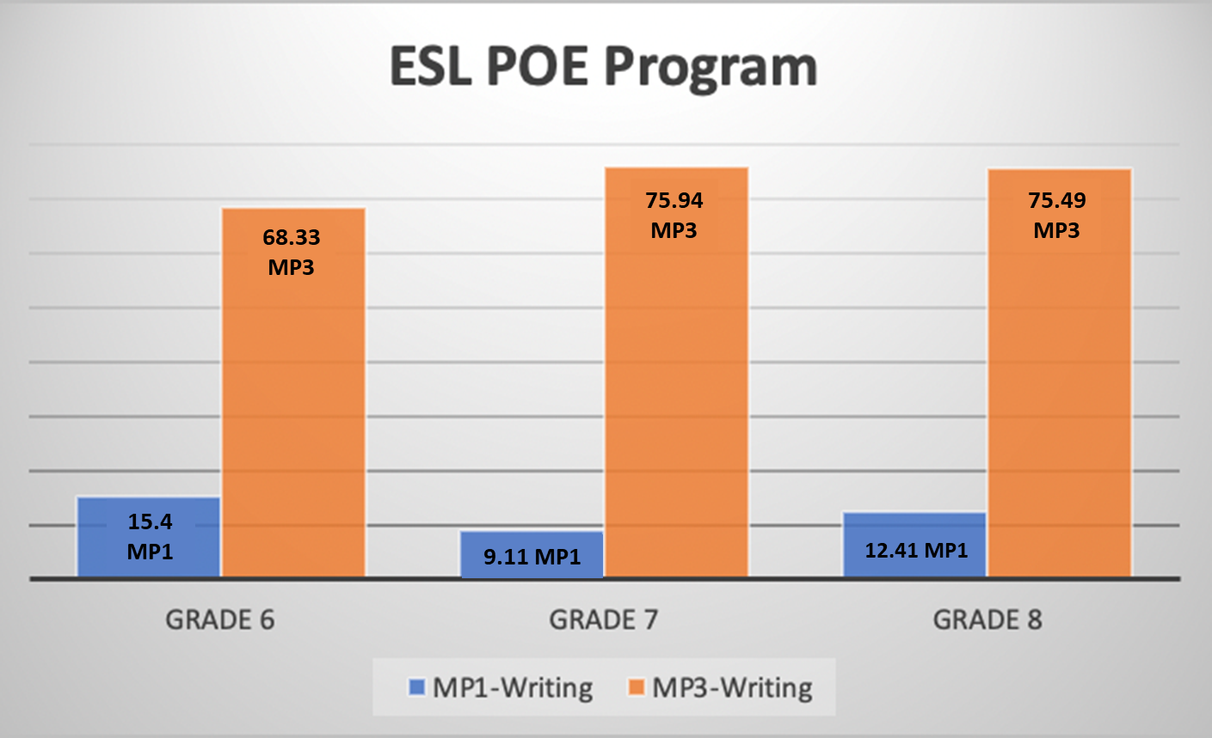
Overall Growth on District
ESL Benchmarks MP1 to MP3
Grades 6-8 Writing
Notes:
Only participated in one content area

Slide 63
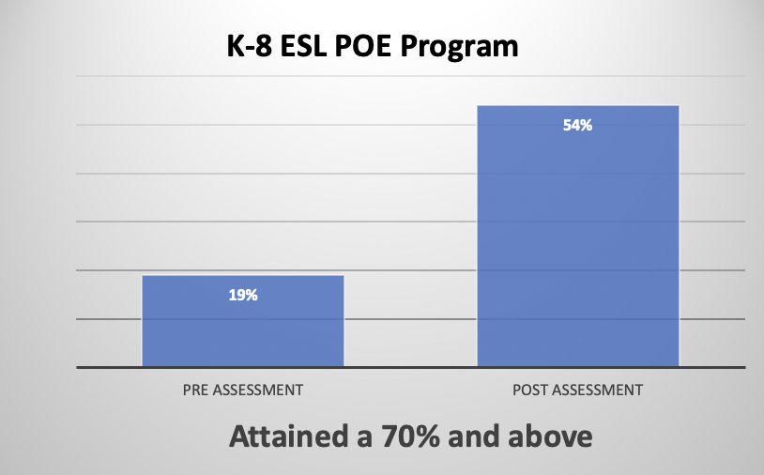
Overall Growth
Pre and Post Program Assessment
Grades 6-8 Listening, Speaking, Reading and Writing

Slide 64
NEXT STEPS 2
Analyze Pre and Post data to district benchmarks
Program feedback
Use data to inform POE curriculum and program design

Slide 65
AMERICAN RESCUE PLAN ESSER 2
Literacy and Mathematics Professional Development and In-Person Classroom Support for Teachers
Children’s Literacy Initiative (CLI) currently serves K-3 classrooms in 15 schools by providing teachers with in-person classroom support in literacy. Through the proposal, the partnership would expand to the remaining 11 schools for grades K-3 and also will expand to grades 4 & 5 in all 26 schools. CLI Literacy Coaches work alongside teachers in the classrooms to model literacy skills.
CLI will support and further develop teachers, instructional coaches, school administrators and district leaders in implementing strategies and systems for continuous improvement of early literacy instruction. Supports include one on one teacher coaching, grade-level coaching, small group coaching sessions and leadership coaching.
  Children’s Literacy Initiative Job-embedded Coaching and Professional Development General Education and Special Education ICS ($5,040,703)
  Children’s Literacy Initiative Job-embedded Coaching and Professional Development Bilingual Education & ESL ($2,442,410)

Slide 66
Children’s
Literacy
Initiative
Time frame of Professional Development and Coaching: November 2021 to June 2022
Serviced 2193 ELLs in Bilingual Spanish Self-Contained K-5 Classrooms
Supported and Coached 104 K-5 Bilingual Teacher
Data Analysis:
District Bilingual ELA Spanish Benchmarks
Notes:
District analysis of first marking period grades

Slide 67

CLI supports and further develops teachers in grades K-5 in implementing strategies and systems for continuous improvement for early literacy instruction.
CLI Literacy coaches work alongside teachers in the classroom to model literacy skills
One-on-one teacher coaching
Grade-level coaching, and small group sessions
Notes:
Participated in only one content area

Slide 68
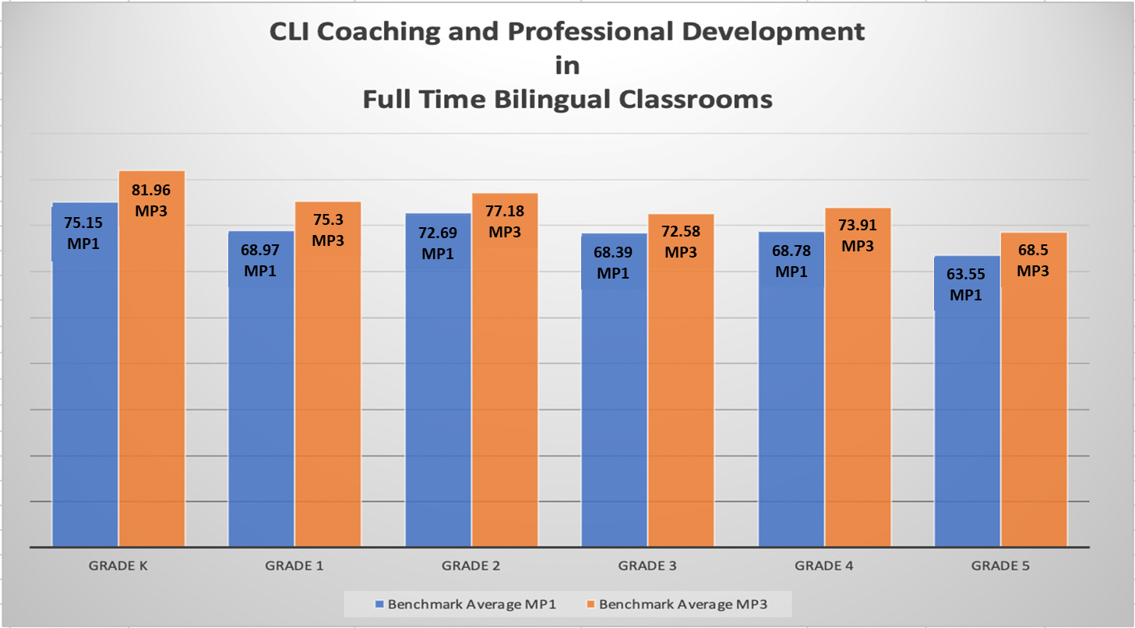
Overall Growth on District
Bilingual ELA Spanish Benchmarks
MP1 to MP3
Notes:
Only participated in one content area

Slide 69
NEXT STEPS 3
Analyze district benchmarks and EDL
Program Feedback
Use data to inform professional development and teacher-coaching

Slide 70

“We know from research and documented practice that all students regardless of zip code and related factors can rise to meet these demands but realizing the potential calls for consistently high-quality instructional leadership and high- quality instructional practice and support in every classroom, in every school, every day.
Dr. Larry Leverett

Slide 71
ARP/ESSER 2
presented by
Olga Hugelmeyer
Superintendent of Schools
June 10, 2022

Slide 72
Midland Park Public Schools District
Mr. Peter Galasso, ESEA Coordinator
Notes:
Anthony

Slide 73
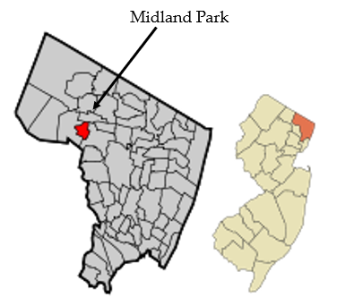
Demographics of Midland Park
Suburban District in Bergen County with a household median income of $121,000 with just over 7,000 residents.
  Neighboring towns Ridgewood, Glenn Rock, Waldwick
School district consist of 3 schools, pK-2, 3-6, 7-12 with close to 1,100 students.
Midland Park SD houses the Bergen County Special Services Hearing Impaired Program (HIP/SHIP) programs for students with partial and profound hearing loss.
Notes:
Midland Park, New Jersey

Slide 74
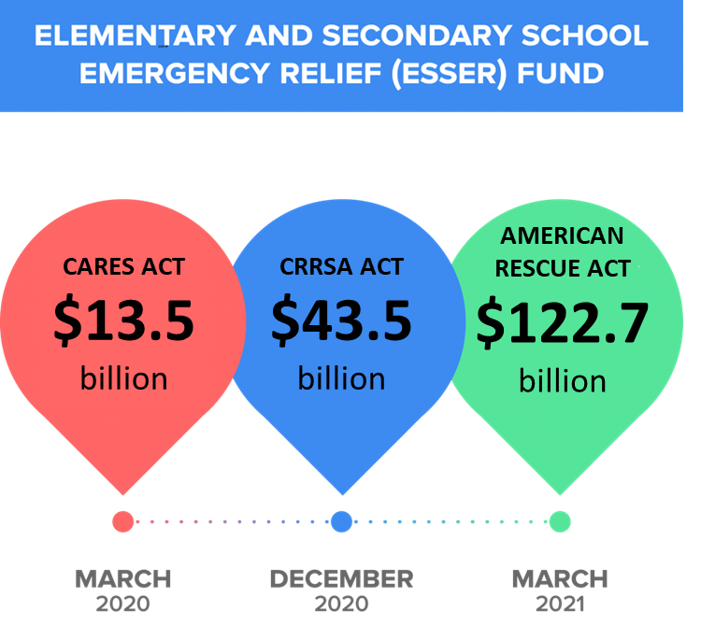
Title Allocation: ARP/ESSER III
MP Total Allocation: $965,999
ARP: $770,819
Accelerated Learning/ Support: $70,180
Summer Learning/ Enrichment: $40,000
Comprehensive Beyond the School Day: $40,000
Mental Health Support: $45,000

Slide 75
Greatest Areas of Need (GAN)
To help identify needs:
  Community Survey and Community Forums
  Consulted Union and Pandemic Response Teams
  Met with key stake holders, i.e. BOE, town council, PTA
Results focused on 3 aspects of district and identified GAN’s for each:
Student
Learning
Mental
Health
Facility

Slide 76

Community Feedback results:
1
With this feedback and our data to guide and support decisions we came up with the district plan.
Social Emotional Learning and transition back to school cited as the greatest concern from parents.
2
Safety of students from pandemic including, masks, cleaning and air quality as second concern.
Learning Loss across Reading, Writing and Math, along with return to normalcy with sports cited as a second concern.

Slide 77

GAN - Facility
Observation/ Realized Need:
  Air quality/ Stagnant Air
  Cleaning/ Sanitization
  Maximization of space to reduce large groups
Evidence:
  Largest Spaces (gymnasium/cafeterias) have NO air flow or filtration and little access to windows for ventilation.
  Space was available to prevent overcrowding, but not enough staff to supervise those spaces.
  Enhanced cleaning protocols mean increased staff as needed and more supplies.

Slide 78
Facility Solutions
Air Filtration and Air Conditioning budgeted for cafeteria and gymnasiums across 2 buildings (ARP).
Hiring of more staff, i.e. lunch and recess aides, before care and aftercare supervision; to allow different entrance points, spread out student population in more spaces (ARP)
Create new space; i.e. outdoor classrooms (ARP)
Purchase more cleaning product and increase staff/overtime as needed to clean facility. (ARP)

Slide 79

GAN - Learning
Observation/ Realized Need
  Make up for lost seat time (learning recovery).
  Lack of participation in arts, specifically band, but also other co-curricular activities.
  Referrals to I &RS, BSI, CST increased significantly.
Evidence:
  March of 2020- June 2021 40% less seat time in building offered.
  Co- curricular Decrease:
    Band participation decreased 40%
    Club participation decreased by 85%
  Referrals increased:
    I &RS referrals up 25%
    CST referrals up 15%
    BSI referrals up 225%

Slide 80
Learning Solutions
Summer Seat time: (Summer Learning/ Enrichment)
  SOAR (Summer Opportunities for Acceleration & Remediation) offered to all Gen. Ed. students K-6 for month of July (ELA, Math, SEL, Escape Rooms)
  Summer Support Lab/ Boot Camp: Offered to grades 7-12 as part of targeted intervention for most at risk students.
Additional seat time Before/After School: (Accelerated Learning/ Support)
  Academic Support Lab (HW clubs) for targeted+ students grades 3-12
  ELA and Math intervention (grades K-6): After/Before school offering for students in small group
  Executive Functioning Intervention: Before School interventions offered to those who need mindfulness and organizational strategies (case load based)
  Intense Interventions (1:1 Orton, ELL, extreme interventions for most at risk)

Slide 81
Learning Solutions Cont.
Visual/ Performing Arts and Clubs: (Accelerated Learning/ Support)/ARP)
  New instruments purchased to replace old, but also offer new instruments to appeal to more students. Ex. tuba offering for first time, New Drums, etc.
  Stage Crew Revamp for musical to appeal to techy’s (interactive lights/audio via I- pad)
  New Clubs and activities offered with new resources based on interest survey
    Community Service Club, Pottery and Sewing based off of survey (Elementary)
    Wellness Club (High School) / baby sitting cert after school course (MS)
  Other: Outside programming brought into schools; Hands on Science labs pushed into classrooms (Elementary) Schoolwide Science assemblies, Field Trips, etc.
  Additional certified Staff to lower student to teacher ratio with focus on Reading (BSI)
    Sent teachers to be Orton Trained (Accelerated Learning/ Support)

Slide 82
Mental Health
Mental Health
  Family dynamics affecting students
  Distractibility and accountability increase
  More at risk students identified
  Under staffed to deal with increases
  Lack of training and resources to identify students sooner.
Evidence:
  DCP & P referrals up 12%
  Handle with Care orders from police up almost 300%.
  Students with suicidal ideation, debilitating anxiety, school refusal increased 150%.
  Chronic absenteeism increased to 13%
  Elementary Guidance: 1:600 counselor to student ratio

Slide 83
Mental Health Solutions
Elementary Guidance Counselor: (Mental Health Support)
  Contracted with West Bergen Mental Health for a school based counselor K-2, which in turn allowed us a full time counselor 3-6.
  Also access to West Bergen Mental Health Resources for students and staff
SEL Outside Programming: (ARP/ Accelerated Learning)
  School Assembly Speakers centered around SEL (Overcoming obstacles/perseverance)
  Additional Field Trips centered around SEL (ex. Therapeutic Ropes course, Team building trips)
  SEL training for staff (mindfulness and 7 mindsets)

Slide 84
Reflections:
As we look to amend allocations/programs based on realized need, we will take the following into consideration;
SEL maintained, but shift to increased focus on accountability.
  Teacher re-training in classroom management, communication, responsive classroom, perseverance, etc..
Increased emphasis on mindfulness to counter distractibility.
  Great success with Executive Functioning Intervention with case managed cohort.
Intense Intervention successful for very specific interventions; Orton based.
Support Lab very successful providing students an appropriate/quiet space with staff to work on HW and school work after school. May increase to before school as well.

Slide 85
Thank You! 2
New Jersey Department of Education Website
nj.gov/education
Questions may be submitted to:
ESSER@doe.nj.gov
Have a Great Remainder of The Year
Follow Us!
Facebook:
@njdeptofed
Twitter: @NewJerseyDOE
Instagram:
@NewJerseyDoe
Notes:
Anthony

