Slide 1
Elementary and Secondary School Emergency Relief (ESSER) Roundtable Series: Allowable Uses
New Jersey Department of Education
Division of Educational Services
November 17, 2021

Slide 2
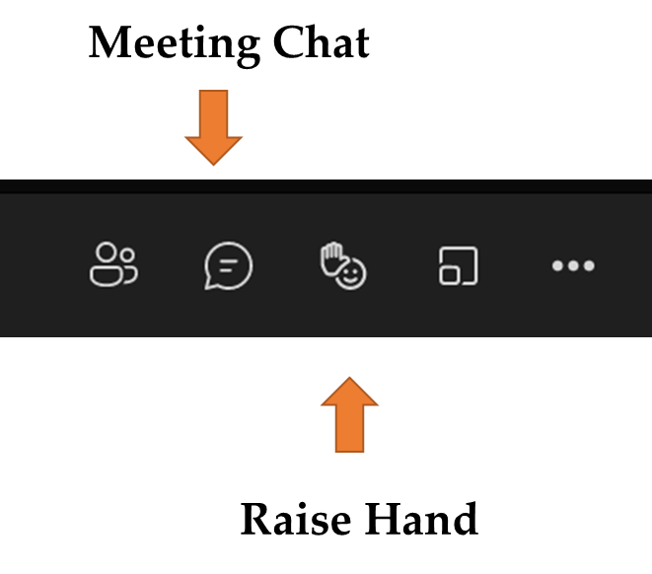
Using Microsoft Teams
Chat
We welcome your participation in discussions by asking questions and adding comments in the chat box.
Raise Hand
Please use the raise hand feature if you want to speak.
Mute/Unmute
Please remain muted whenever you are not speaking.

Slide 3
Agenda
Housekeeping Ms. Peggy Porche, Planning Associate, Division of Educational Services, Office of the Executive Director/Deputy Assistant Commissioner
Welcome Dr. A. Charles Wright, Executive Director/Deputy Assistant Division of Educational Services
Allowable Uses Mrs. Kathleen Ehling, Assistant Commissioner, Division of Educational Services
District Presentations
Hackensack Public School District Dr. Lauren Kazmark, Curriculum Director/Grants
Lawrence Township Public School District Dr. Andrew M. Zuckerman, ESEA Project Director
Paulsboro Public Schools District Christine Lindenmuth, Director of Curriculum, Instruction, and Assessment

Slide 4
Allowable Uses of Funds

Slide 5
Allowable Uses
How Can LEAs Use the Funds to Respond to COVID-19 | ESSER I | ESSER II | ESSER III
Anything authorized by ESSA, IDEA, AEFLA, Perkins, and McKinney-Vento | Yes | Yes | Yes
Coordination of COVID preparedness and response efforts | Yes | Yes | Yes
Activities for low-income, SWD, EL, racial and ethnic minorities, homeless, and foster | Yes | Yes | Yes
Developing and implementing procedures and systems | Yes | Yes | Yes
Training and PD on minimizing spread of infectious diseases | Yes | Yes | Yes
Purchasing supplies to sanitize and clean | Yes | Yes | Yes
Planning for, coordinating, and implementing activities, incl. meals | Yes | Yes | Yes
Technology for students and staff | Yes | Yes | Yes
Mental health services and supports | Yes | Yes | Yes
Summer learning and supplemental afterschool programs | Yes | Yes | Yes
Providing principals with resources necessary to address individual needs of schools | Yes | Yes | Yes*
Implementing public health protocols | Yes* | Yes* | Yes
Addressing learning loss (assessments, evidence-based activities, parents, attendance) | Yes* | Yes | Yes
School facility repairs to reduce risk of virus transmission | Yes* | Yes | Yes
Air quality improvements | Yes* | Yes | Yes
Other activities that are necessary to maintain operation and keep staff employed | Yes | Yes | Yes
*Not explicit in statute, but still allowable
Credit Massachusetts Department of Public Instruction: https://www.doe.mass.edu/federalgrants/esser/esser3-webinar.pdf.

Slide 6
Allowability Considerations
Generally, in determining whether an activity is an allowable use of funds, a State or LEA must determine:
Is the use of funds intended to prevent, prepare for, or respond to the COVID-19 pandemic, including its impact on the social, emotional, mental health, and academic needs of students?
Does the use of funds fall under one of the authorized uses of ESSER funds?
Is the use of funds permissible under the Uniform Administrative Requirements, Cost Principles, and Audit Requirements for Federal Awards (Uniform Guidance, 2 CFR Part 200)? In particular, is it necessary and reasonable for the performance of the ESSER award?

Slide 7
ARP ESSER Use of Funds Requirements
LEAs must reserve at least 20% of funds to address learning loss through implementation of evidence-based interventions and ensure that those interventions respond to students’ social, emotional, and academic needs and address the disproportionate impact of COVID-19 on underrepresented students subgroups:
Each major racial and ethnic group
Children from low-income families
Children with disabilities
Children and youth in foster care
English learners
Gender
Migrant students
Students experiencing homelessness

Slide 8
Braiding Funds
ESSER funds may be “braided” or used in combination with, but not “blended” with, funding under ESEA, IDEA, AEFLA, Perkins V, and McKinney-Vento, or any other education funds.
“Blending” occurs when different funding streams are combined and lose their original identity. Funds can be used for any allowable activity.
“Braiding” occurs when different funding streams are used together to leverage the support provided for different needs while maintaining documentation to support the charging and allocation of costs to multiple separate funding streams or programs.

Slide 9
Braiding Funds Example 1/2
A district plans to utilize ARP ESSER, IDEA, Title I-A, Title II and Title III funds to offer a summer academy to mitigate learning loss.
ARP ESSER | IDEA | Title I, Part A | Title II | Title III
Can be used for costs related to teacher salaries and benefits | Can be used for costs related to supplemental intervention programming for students with disabilities attending the academy or for modified curriculum costs | Can be used for costs related to supplemental materials and supplies for the summer academy | Can be used for costs related to professional development for teachers and paraprofessionals for the academy program | Can be used for costs related to supplemental programming to support English Learners for the academy program
The above is meant to be illustrative and is not an exhaustive list.

Slide 10
Braiding Funds Example 2/2
A district plans to utilize ARP ESSER and IDEA funds to purchase adaptive software and supplies for the summer academy. The total expense is $50,000 which is allocated to IDEA and ARP ESSER based on the ratio of those programs’ personnel costs (salaries and applicable benefits) to the total personnel cost.
Grant | Personnel Costs | Percentage | Amount Allocated
IDEA | $100,000 | 67% | $33,500
ARP ESSER | $50,000 | 33% | $16,500
Total | $150,000 | 100% | $50,000

Slide 11
Coordinating ESSER Funds by Expiration Date
ESSER I | ESSER II | ESSER III
Use: Pivoting Education for Pandemic Pedagogy. Federal Grants for LEAs (March 2020) Expiration Date (Including 12-Month Carryover via Tydings Amendments): September 30, 2022 | Use: ESSER I & Addressing Learning Loss, and Enhancing Air and Building Quality, with services to nonpublic schools, and learning loss reporting. Federal Grants for LEAs (March 2021) State Grants For LEAs (Due June 1, 2021) Learning Acceleration Mental Health Support and Services Expiration Date (Including 12-Month Carryover via Tydings Amendments): September 30, 2023 | Use: ESSER I, II, and Safe Return to Schools. Federal Grants for LEAs (May 2021) Note: At least 20% of an LEA’s funds for addressing the academic impact of COVID19 State Grants For LEAs (Due June 1, 2021) (Due November 24, 2021) NJTSS Mental Health Support Staffing Accelerated Leaning Coaching and Educator Support Evidence-based Summer Learning and Enrichment Activities Evidence-based Comprehensive Beyond the School Day Activities Expiration Date (Including 12-Month Carryover via Tydings Amendments): September 30, 2024

Slide 12
Coordinating ESSER Funds for Academic and SEL Needs
Priority Areas | ESSER I | ESSER II | ESSER III | ESSER II State Set-aside Grants | ESSER III State Set-aside Grants
Learning Acceleration Professional Learning | Yes* | Yes | Yes | Learning Acceleration Grant | Accelerated Learning Coaching and Educator Support Grant
Out-Of-School Time Activities | Yes | Yes | Yes | Learning Acceleration Grant | Evidence-based Comprehensive Beyond School Day Activities Grant
Summer Time Activities | Yes | Yes | Yes | Learning Acceleration Grant | Evidence-based Summer Learning and Enrichment Activities Grant
Mental Health Professional Learning | Yes | Yes | Yes | Mental Health Support and Services Grant | NJTSS Mental Health Support Staffing Grant & Accelerated Learning Coaching and Educator Support Grant
Mental Health Programs | Yes | Yes | Yes | Mental Health Support and Services Grant | NJTSS Mental Health Support Staffing Grant
General Use Responding to COVID-19 | Yes | Yes | Yes | See Allowable Uses | See Allowable Uses
*Not explicit in statute, but still allowable

Slide 13
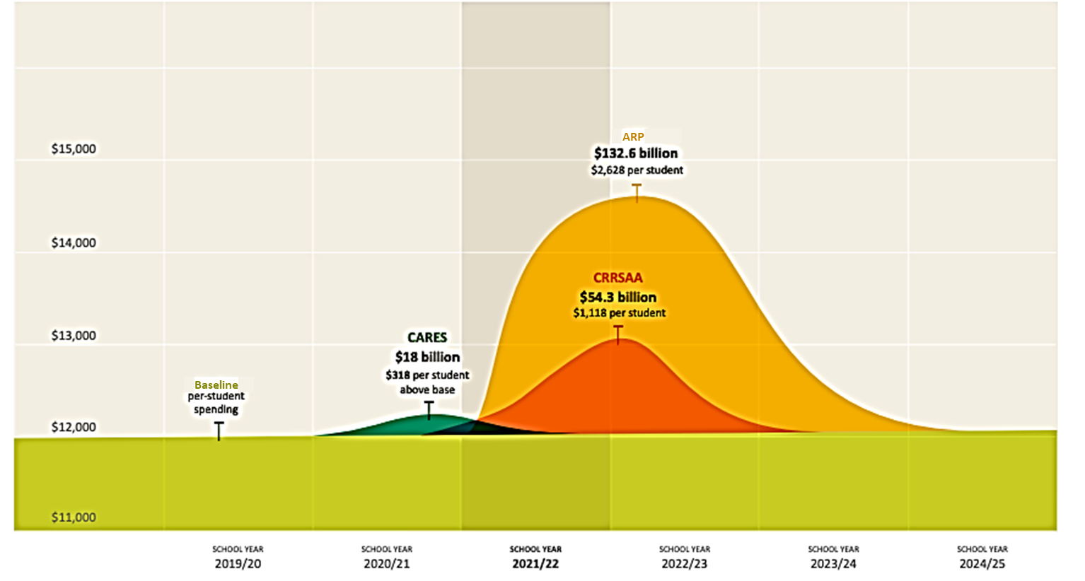
WestEd: Ramping Fund Usage Strategy
Credit: West-Ed-Meeting the Moment How Education Leaders Can Maximize Federal COVID Relief Aid to Support More Equitable Student Learning

Slide 14
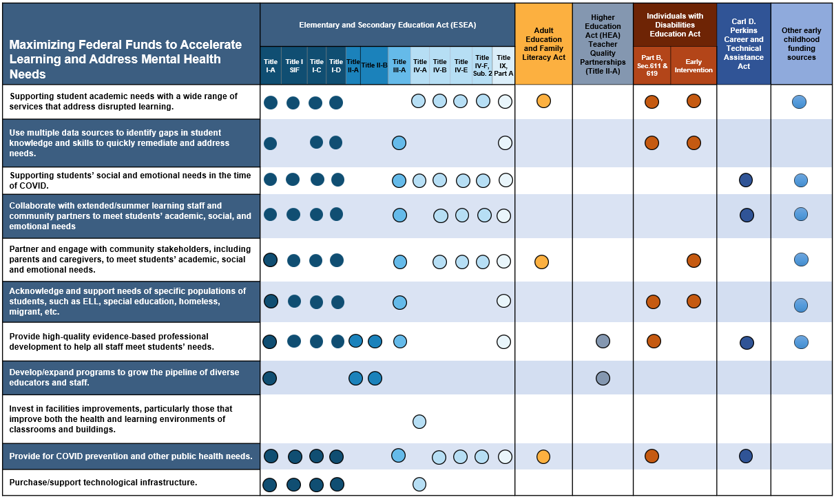
Maximizing Federal Funds to Accelerate Learning and Address Mental Health Needs

Slide 15
District Presentations

Slide 16
Hackensack Public School District
Notes:
Anthony

Slide 17
ARP ESSER Round Table
Lauren Kazmark, Ed.D

Slide 18
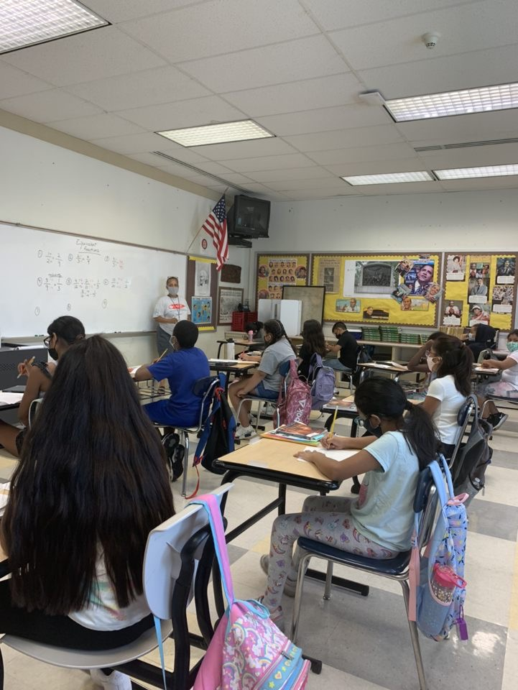
District Needs
Hackensack Public Schools returned to in person instruction January 25, 2020.
The district never had more than 38% of students in person from January through June 2020.
62% of our student population had been virtual for approximately 13 months.
Hackensack Middle School houses over 1300 students in grades 5 through 8.
The majority of our students were entering middle school having not been in school personally since 3rd grade.
There was a need for transition program for incoming fifth graders, and an opportunity to continue support throughout the school year for all middle school students.

Slide 19
Program Structure 1/2
Hackensack Middle School partnered with the Boys and Girls Club of Lower Bergen County to offer a summer program for incoming 5th graders, and an after school program for all middle school students.
Our goals were to combine academics with enrichment activities, as well as offer mentorship opportunities to students.
Our summer program ran for four weeks in August, from 8:30-12:30.
Our after school program began October 25th and runs three days a week from 3:15-6:00.

Slide 20
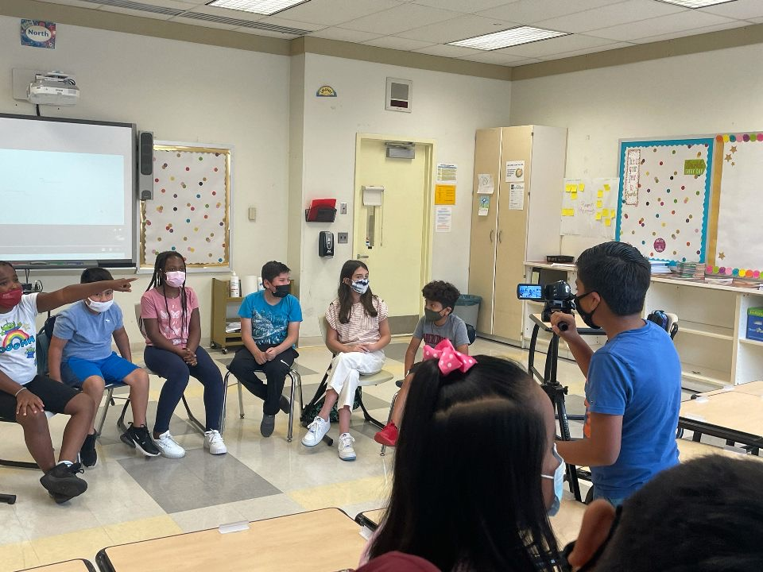
Program Structure 2/2
Activities Include:
STEM
Physical Education
TV Production
ELA Intervention
Math Intervention
Student Mentoring by Boys and Girls Club Youth Development Counselors
Future activities are planned for Art and Coding.

Slide 21
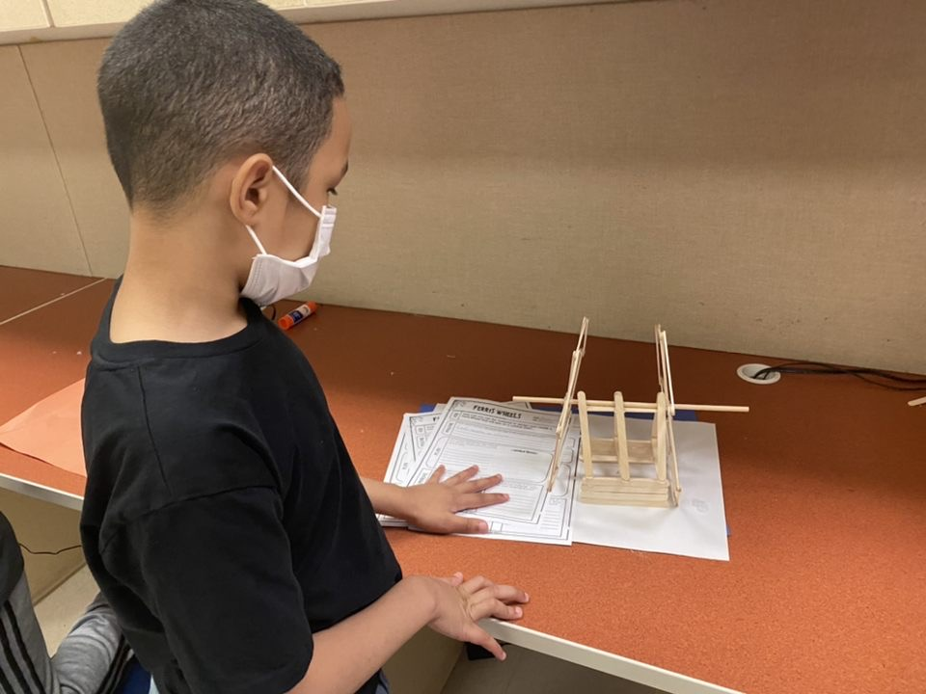
Benefits to a Community Partnership
Pooling of resources
Staff
Materials
Access to various curriculum resources that are specifically designed for after school programs.
Opportunities for activities, resources, and extended hours that are often difficult to maintain when programs are solely district/school operated.

Slide 22
Lawrence Township Public School District

Slide 23
Lawrence Township Public Schools Extended Day / Year Programs 1/2
Andrew Zuckerman, Ed.D.
Assistant Superintendent
November 17, 2021

Slide 24
Lawrence Township Public Schools Extended Day / Year Programs 2/2
Andrew Zuckerman, Ed.D.
Assistant Superintendent
November 17, 2021

Slide 25
Lawrence Township Public Schools
3700 +/- Students
7 Schools (4-PK-3, 4-6, 7&8, 9-12)
3 Targeted Assistance Schools
1 Schoolwide program as of 2021

Slide 26
District Demographics
Ethnicity | % of Student Population
Asian | 18%
Black | 14.5%
Hispanic | 21.1%
2 or More Races | 6.4%
Other | 0.2%
White | 39.8%

Slide 27
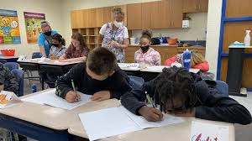
Student Needs
Academic
Socialization
Mental Health

Slide 28
Academic Programs 1/3
Destinations
After School and Extended School Year
Focused on addressing academic gaps
Must meet the district’s “at risk” criteria
After School Program: hour to hour and a half 3x/week
Extended School Year: three and a half hours 4x/week for 4 weeks
Focus:
ELA
Math
Mental Health Related to the Pandemic

Slide 29
Academic Programs 2/3
EAGLES
After School and Extended School Year
Focused on addressing academic gaps for ELL students
Must meet the ELL eligibility criteria
After School Program: hour to hour and a half 3x/week
Extended School Year: three and a half hours 4x/week for 5 weeks
Focus:
Language acquisition
ELA
Math
Acclimation to the American school system

Slide 30
Academic Programs 3/3
Jumpstart
Extended School Year
Focused on acclimating students to school, routines and expectations
FY22: All Transition grade levels
All other years, Incoming Kindergarten and students new to the country
Extended School Year: three hours 4x/week for 2/3 weeks
Focus:
Acclimation to their school
ELA
Math
Socialization
Baseline Testing

Slide 31
Challenge Success

Slide 32
Any Questions?

Slide 33
Paulsboro Public School District

Slide 34
Paulsboro Public Schools
PreK Through Grade 12

Slide 35
Our inspiration
The mission of the Paulsboro School District is to work with students, parents, educators, and community to develop excellence in education. Our goal is to develop the unique potential of the whole student by creating a challenging and diverse learning climate…rich in tradition and pride.

Slide 36
Trust the Process 1/4
WHAT DO WE NEED?
Extended School Year
Credit Recovery Options
Academic and SEL Intervention for Staff and Students
Enrichment Activities
WHY DO WE NEED IT?
IDEA
Credit loss due to excessive absences/poor performance
Provide immediate and summer support
It’s what they asked for
***OFFER TO ALL GRADES Pre-K to 12***

Slide 37
Trust the Process 2/4
HOW DO WE DO IT?
EXTENDED SCHOOL YEAR
*Focus additional attention on secondary population and increase participation of potentially eligible students (prevent behavioral regression)
*Provide TRANSPORTATION to ALL
EXPAND CREDIT RECOVERY OPTIONS
*Increase offered subjects
*Expand grade band to include middle school

Slide 38
Trust the Process 3/4
HOW DO WE DO IT?
ACADEMIC AND SEL INTERVENTION (STAFF AND STUDENTS)
*Support offered during school year, after school, SATURDAYs and summer
*Make on-line support an option
*Invest in student directed, standards-based, digital curriculum
*Hire interventionists, behavior analysts, hall monitors, SROs
*Invest resources in staff development training in equity, teaching strategies, differentiation, mindset (include funds to support staff training after school, substitutes/class covers)

Slide 39
Trust the Process 4/4
HOW DO WE DO IT?
ENRICHMENT ACTIVITIES
*STEAM program
*Music – Instrumental and Vocal
*Art
*Cultural Explorations – in History and through food
*Nutrition/Fitness/Sports Wellness
*Field trips

Slide 40
Summer Program Data
EXTENDED SCHOOL YEAR
JUMP START
CREDIT RECOVERY
Grade | # of Students
3F | 5
4F | 2
K | 1
1 | 2
2 | 4
3 | 12
4 | 3
5 | 6
6 | 5
8 | 3
9 | 1
ADA | 56%
Grade | # of Students
K | 19/82
1 | 15/92
2 | 21/86
3 | 7/94
4 | 13/82
5 | 7/84
6 | 3/100
ADA | 63%
Grade | # of Students
9 | 15/101
10 | 24/103
11 | 20/75
12 | 21/83
ADA | 79%

Slide 41
Summer Program Final Thoughts
TAKE-AWAYS ON SUMMER PROGRAMS
All programs saw ADA above 50%
ESY - refocus efforts to increase participation in secondary level
Increase participation in credit recovery/intervention for grades 7 and 8
Collect data on Summer Enrichment Activities
Pleased with overall participation and student commitment to participating in the summer programs
Tailor intervention courseware more appropriately with individual student needs
Consider having summer teachers in prior to start of summer program to plan

Slide 42
PAULSBORO PUBLIC SCHOOLS
INVESTING IN OUR CHILDREN
INVESTING IN OUR SCHOOLS
INVESTING IN OUR FUTURE

Slide 43
Thank You!
New Jersey Department of Education Website nj.gov/education
Questions may be submitted to:
ESSER@doe.nj.gov
Registration now open for the December 15, 2021, ARP ESSER Round Table
Follow Us!
Facebook: @njdeptofed
Twitter: @NewJerseyDOE
Instagram: @NewJerseyDoe

