Slide 1
Elementary and Secondary School Emergency Relief (ESSER) Roundtable Series 4: Maximizing Federal Funds
To Engage, Recover, and Reimagine
Education in New Jersey
Division of Educational Services
January 26, 2022

Slide 2
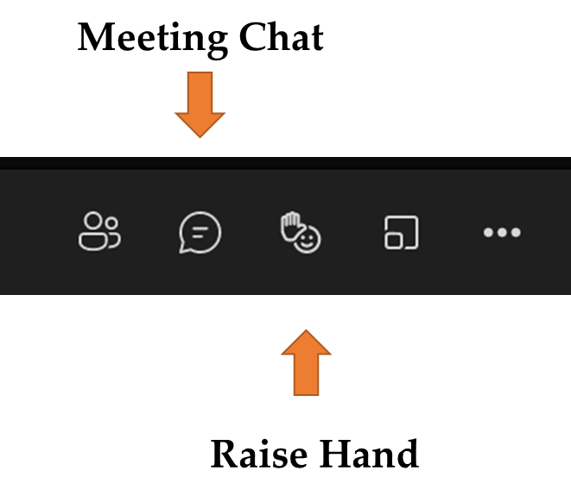
Using Microsoft Teams
  Chat
    We welcome your participation in discussions by asking questions and adding comments in the chat box.
  Raise Hand
  Please use the raise hand feature if you want to speak.
  Mute/Unmute
    Please remain muted whenever you are not speaking.

Slide 3
Goals for Today’s Presentation
Provide strategies for maximizing Federal funds to support learning acceleration, social-emotional learning, and mental health. Topics include:
Reviewing ESSER I, II, and III Funds.
Braiding and Blending to Maximizing Federal Funds.
Coordinating ESSER Funds and State Set-Aside Grants.
Maximizing Federal Funds Beyond Recent Emergency Funds.

Slide 4
Federal Relief Funds Received by New Jersey
New Jersey received over $4 billion in Federal emergency funds including:
ESSER I
$310,371,213
ESSER II
$1,230,971,757
ARP ESSER III
$2,766,529,533*
ARP IDEA
$79,863,122
ARP HCY
$18,118,224
*At least 20% must be spent on activities to address learning loss/academic impact of COVID.

Slide 5
ESSER Overview
“These Federal emergency resources are available for a wide range of activities to address diverse needs arising from or exacerbated by the COVID-19 pandemic, or to emerge stronger post-pandemic, including responding to students’ social, emotional, mental health, and academic needs and continuing to provide educational services as States, LEAs, and schools respond to and recover from the pandemic.”
Source: USED Frequently Asked Questions Elementary and Secondary School Emergency Relief (ESSER) Fund and Governor’s Emergency Education Relief (GEER) Fund. Retrieved from ​https://oese.ed.gov/files/2021/12/Fact-Sheet_COVID_connection_12.29.21_Final.pdf

Slide 6
State Set-aside Grants
ESSER II State Set-aside Grants ($105 million)
  Learning Acceleration Grant
  Mental Health Grant
ESSER III State Set-aside Grants ($238.6 million)
  NJTSS Mental Health Support Staffing Grant
  Accelerated Learning Coaching and Educator Support Grant
  Evidence-based Summer Learning and Enrichment Activities Grant
  Evidence-based Comprehensive Beyond the School Day Activities Grant

Slide 7
Effective Practices for Using Federal Funds: Needs Assessment & Braiding and Blending

Slide 8
Goals of Effective Practices for Using Federal Funds
Identify short- and long-term goals that align with LEA priorities
Use data to drive your decision-making
Identify up front how you will know if this expenditure was effective
  What data do you need to collect at the beginning, along the way, at the end?
Involve stakeholders
Balance and vary spending
  People; programs/trainings; materials

Slide 9
Comprehensive Needs Assessment
A process, not a one-time event
Foundation for use of ALL ESSER funds (ESSER I, ESSER II, & ARP ESSER)
Determine needs, examine root causes, and set priorities for future action
Expenditures not supported by comprehensive needs assessment are not “necessary, reasonable, and allocable” [Uniform Grant Guidance – 2 C.F.R. Part 200]

Slide 10
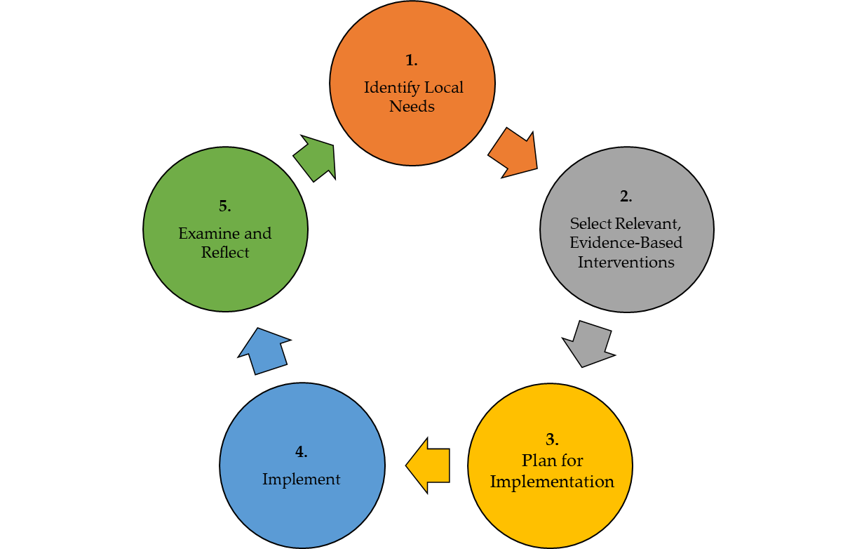
Needs Assessment and Continuous Improvement Cycle
Considerations:
Based on analysis of data and the experiences of those involved, was the intervention successful and should the intervention continue as is, be modified, or be abandoned?
How can experience
with the intervention inform future decision making?
Considerations:
What evidence do you have of the need? Is there any data?
What tools, programs or processes are in place that you could build upon to meet the need?
Considerations:
Local capacity, cost, and sustainability
Impact (focus on interventions with highest impact in your setting)
Considerations:
Are implementation timelines being followed? Do they need to be adjusted?
What are barriers (anticipated and unforeseen) to successful implementation? How can these be addressed?
Considerations:
What are the measurable goals associated with the intervention?
How will implementation and performance be monitored?
Source: USED State Support Network. (2018). Needs assessment guidebook: Supporting the development of district and school needs assessments. Washington, DC: American Institutes for Research. Retrieved from https://oese.ed.gov/files/2020/10/needsassessmentguidebook-508_003.pdf

Slide 11
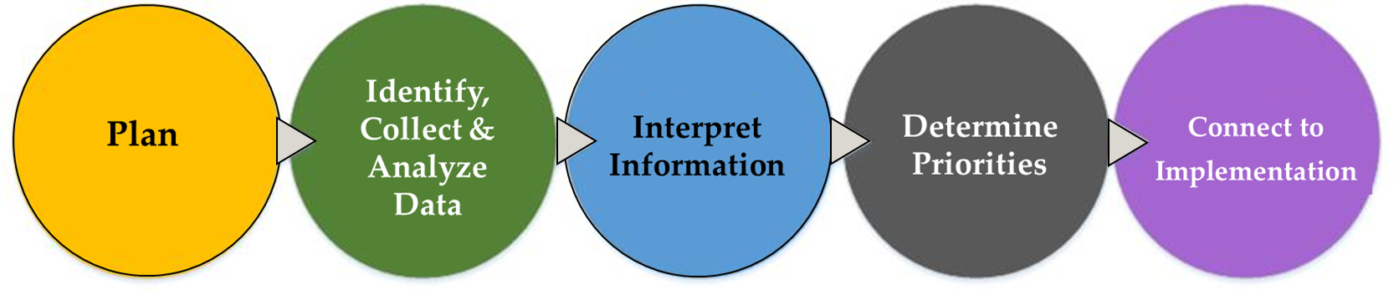
Phases of Needs Assessment Implementation
Source: USED State Support Network. (2018). Needs assessment guidebook: Supporting the development of district and school needs assessments. Washington, DC: American Institutes for Research. Retrieved from ​https://oese.ed.gov/files/2020/10/needsassessmentguidebook-508_003.pdf

Slide 12
Identify Data Sources
Types of Data
  Student Demographics
  Academic Achievement
  School Climate & Culture
  Student Attendance
  College & Career Readiness
  Parent & Family Engagement
  School Operations & Management
  Instructional Data
  Professional Development
  Personnel (Teacher Readiness & Qualifications)
  School Schedules/Course Offerings
  Perceptions/Expectations
  Fiscal (Resource Allocation)
Quantitative Sources of Data
  Surveys
  Focus Groups
  Questionnaires
  Anecdotal Records
Qualitative Sources of Data
  State Assessments
  Benchmark Assessments
  Teacher Generated Assessments
  Classroom Grades & Report Cards
  Lesson Plans & Student Work
  Curriculum & Assessment Materials

Slide 13
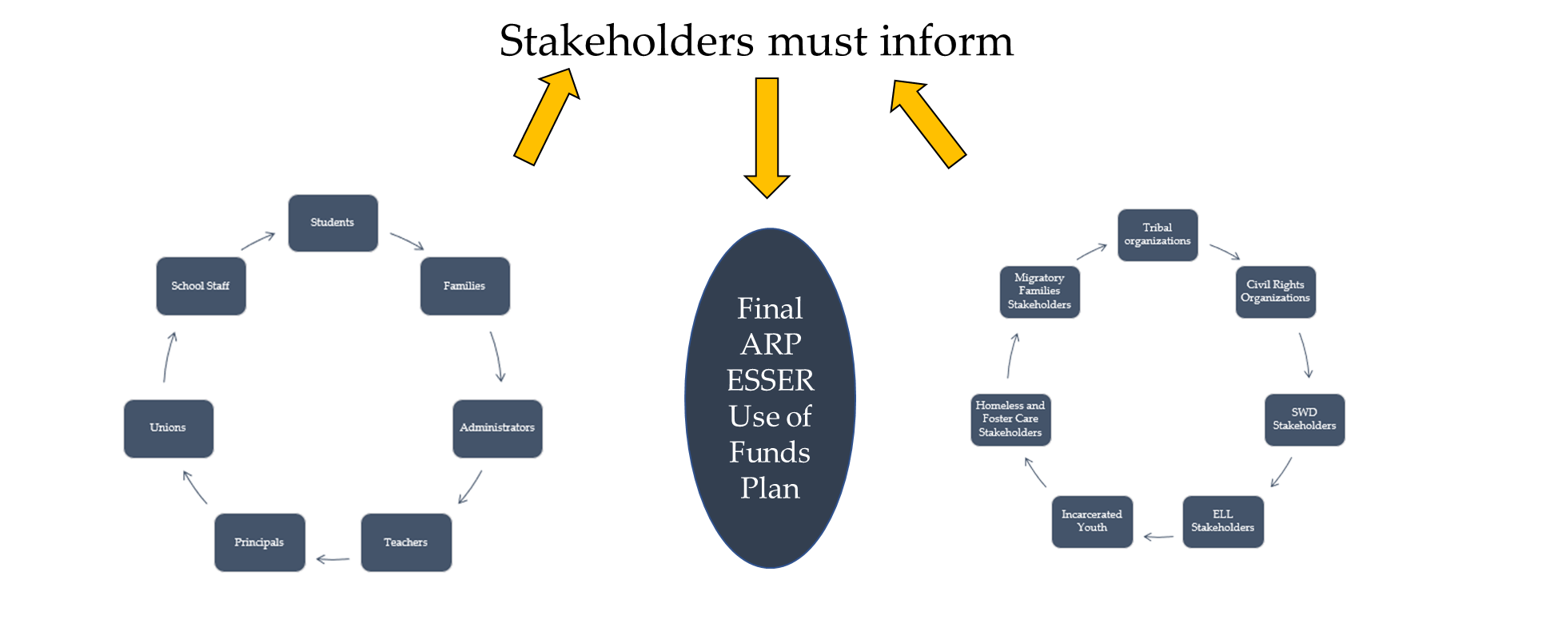
ARP ESSER Use of Funds Plan

Slide 14
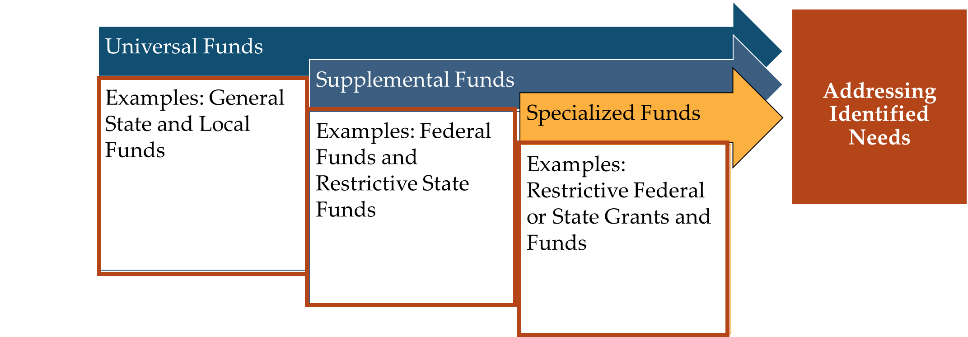
Types of school funds
Credit: West-Ed-Blending and Braiding Funds to Mitigate the Impact of COVID-19 on the Most Vulnerable Students

Slide 15
Braiding and Blending Funds
Braiding Funds
Blending Funds
Coordinated to meet one purpose.
Individual funding streams maintains identity for eligibility and reporting.
Consolidated into one funding stream to meet one purpose.
Individual funding streams loses its identity
ESSER funds may be “braided” or used in combination with, but not “blended” with, funding under ESEA, IDEA, AEFLA, Perkins V, and McKinney-Vento, or any other education funds.
Credit: West-Ed-Blending and Braiding Funds to Mitigate the Impact of COVID-19 on the Most Vulnerable Students

Slide 16
Braiding Funds Example (1 of 2)
A district plans to utilize ARP ESSER, IDEA, Title I-A, Title II and Title III funds to offer a summer academy to mitigate learning loss.
The above is meant to be illustrative and is not an exhaustive list.
ARP ESSER | IDEA | Title I, Part A | Title II | Title III
Can be used for costs related to teacher salaries and benefits | Can be used for costs related to supplemental intervention programming for students with disabilities attending the academy or for modified curriculum costs | Can be used for costs related to supplemental materials and supplies for the summer academy | Can be used for costs related to professional development for teachers and paraprofessionals for the academy program | Can be used for costs related to supplemental programming to support English Learners for the academy program.

Slide 17
Braiding Funds Example (2 of 2)
A district plans to utilize ARP ESSER and IDEA funds to purchase adaptive software and supplies for the summer academy. The total expense is $50,000 which is allocated to IDEA and ARP ESSER based on the ratio of those programs’ personnel costs (salaries and applicable benefits) to the total personnel cost.
Grant | Personnel Costs | Percentage | Amount Allocated
IDEA | $100,000 | 67% | $33,500
ARP ESSER | $50,000 | 33% | $16,500
Total | $150,000 | 100% | $50,000

Slide 18
A Few Cautions
Be aware of “braiding” vs. “blending”
  “Braiding” means combining funds but still tracking funding streams
  “Blending” means consolidating funds into one funding stream (usually occurs in Title I, Part A schoolwide programs)
Existing Federal laws still prevail for non-ESSER funding sources:
  Remember “supplement, not supplant” and “maintenance of effort” provisions
  If uncertain about allowable costs, check before using other Federal funds

Slide 19
Coordination of ESSER Funds and Grants

Slide 20
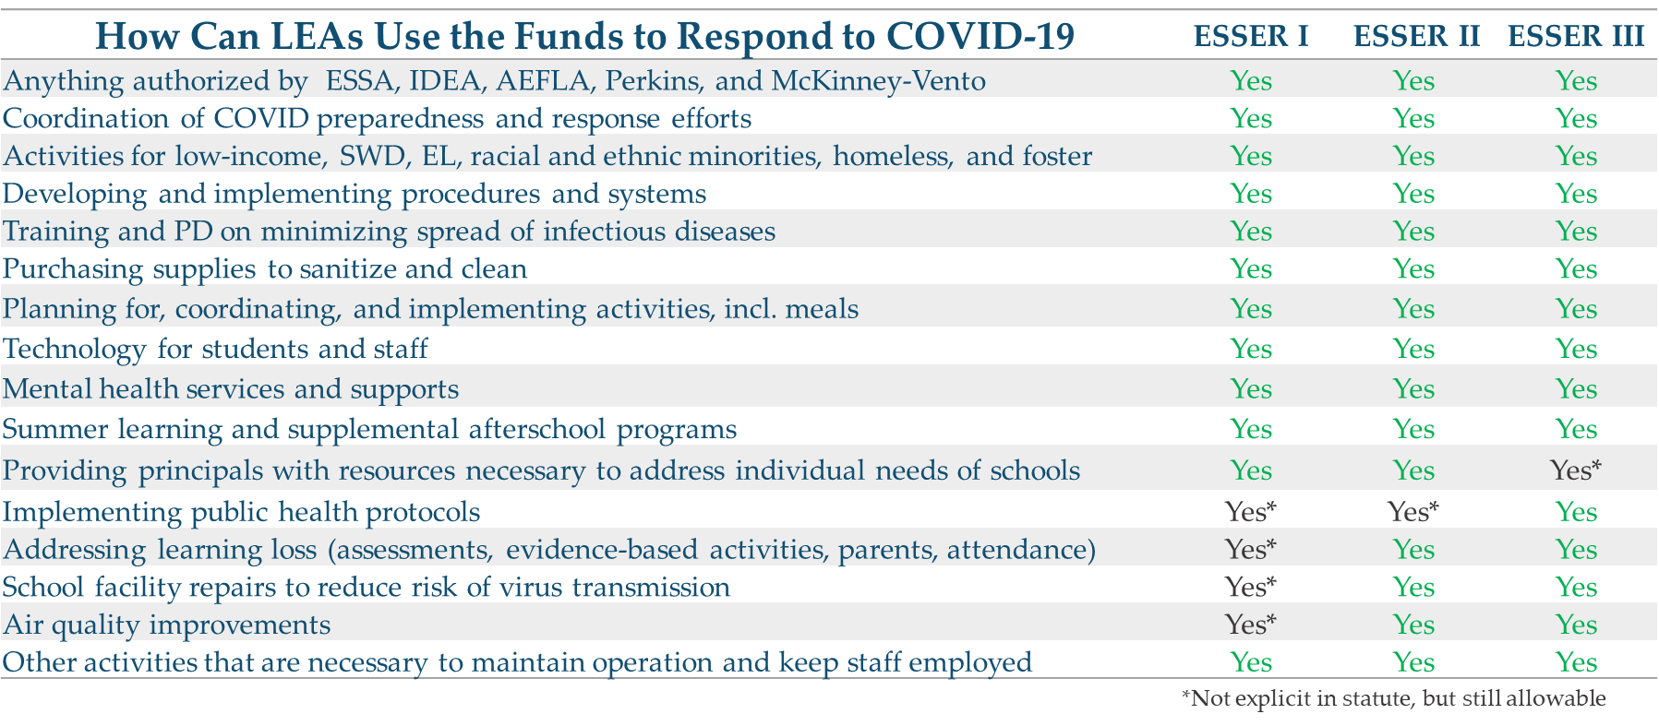
Allowable Uses
Credit Massachusetts Department of Public Instruction: https://www.doe.mass.edu/federalgrants/esser/esser3-webinar.pdf.

Slide 21
Coordinating ESSER Funds by Expiration Date
ESSER I (CARES ACT) | ESSER II (CRSSA ACT) | ESSER III (ARP ACT)
Use: Pivoting Education for Pandemic Pedagogy. Federal Grants for LEAs (March 2020) Expiration Date (Including 12-Month Carryover via Tydings Amendments): September 30, 2022 | Use: ESSER I & Addressing Learning Loss, and Enhancing Air and Building Quality, with services to nonpublic schools, and learning loss reporting. Federal Grants for LEAs (March 2021) State Grants For LEAs (Due June 1, 2021) Learning Acceleration Mental Health Support and Services Expiration Date (Including 12-Month Carryover via Tydings Amendments): September 30, 2023 | Use: ESSER I, II, and Safe Return to Schools. Federal Grants for LEAs (May 2021) Note: At least 20% of an LEA’s funds for addressing the academic impact of COVID19 State Grants For LEAs (Due June 1, 2021) (Due November 24, 2021) NJTSS Mental Health Support Staffing Accelerated Leaning Coaching and Educator Support Evidence-based Summer Learning and Enrichment Activities Evidence-based Comprehensive Beyond the School Day Activities Expiration Date (Including 12-Month Carryover via Tydings Amendments): September 30, 2024

Slide 22
Coordinating ESSER Funds for Academic and SEL Needs
Priority Areas | ESSER I | ESSER II | ESSER III | ESSER II State Set-aside Grants | ESSER III State Set-aside Grants
Learning Acceleration Professional Learning | Yes* | Yes | Yes | Learning Acceleration Grant | Accelerated Learning Coaching and Educator Support Grant
Out-Of-School Time Activities | Yes | Yes | Yes | Learning Acceleration Grant | Evidence-based Comprehensive Beyond School Day Activities Grant
Summer Time Activities | Yes | Yes | Yes | Learning Acceleration Grant | Evidence-based Summer Learning and Enrichment Activities Grant
Mental Health Professional Learning | Yes | Yes | Yes | Mental Health Support and Services Grant | NJTSS Mental Health Support Staffing Grant & Accelerated Learning Coaching and Educator Support Grant
Mental Health Programs | Yes | Yes | Yes | Mental Health Support and Services Grant | NJTSS Mental Health Support Staffing Grant
General Use Responding to COVID-19 | Yes | Yes | Yes | See Allowable Uses | See Allowable Uses
*Not explicit in statute, but still allowable

Slide 23
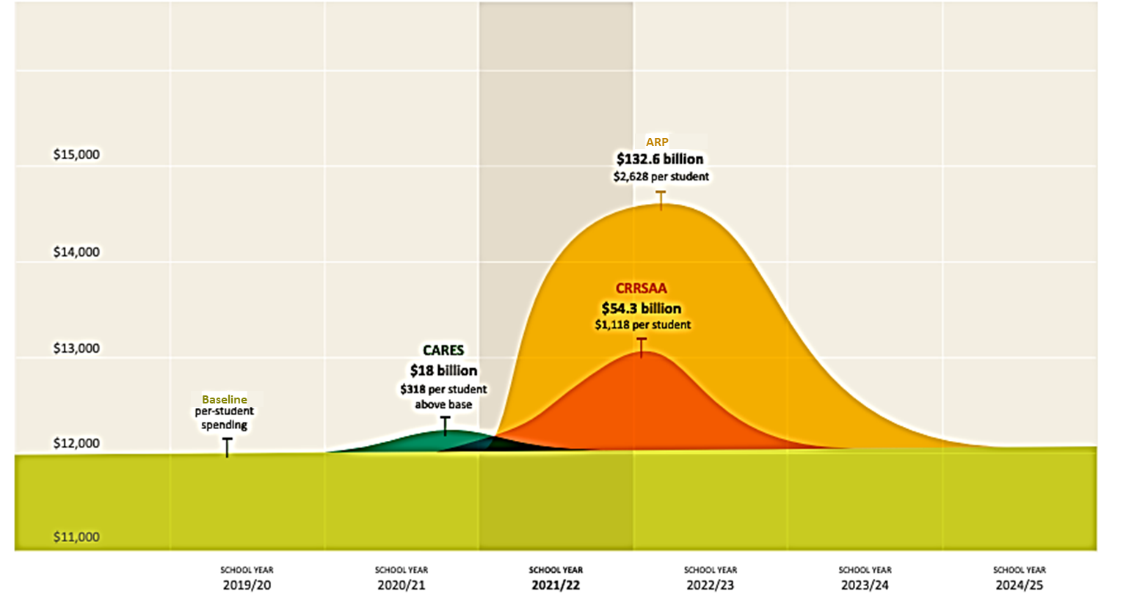
WestEd: Ramping Fund Usage Strategy
Credit: West-Ed-Meeting the Moment How Education Leaders Can Maximize Federal COVID Relief Aid to Support More Equitable Student Learning

Slide 24
Maximizing Federal Funds Beyond
Recent Emergency Funds

Slide 25
Federal Funding Beyond ESSER
This section previews tools that are being developed to help the
planning process.
These slides provide conversation starters to prompt collaborative discussions about how emergency and pre-existing Federal funding streams can best support the needs of all students.
This guidance provides a general overview of allowable activities, but whether a particular cost can be supported with federal funds depends
on the underlying facts and circumstances.
Credit: West-Ed-Meeting the Moment How Education Leaders Can Maximize Federal COVID Relief Aid to Support More Equitable Student Learning

Slide 26
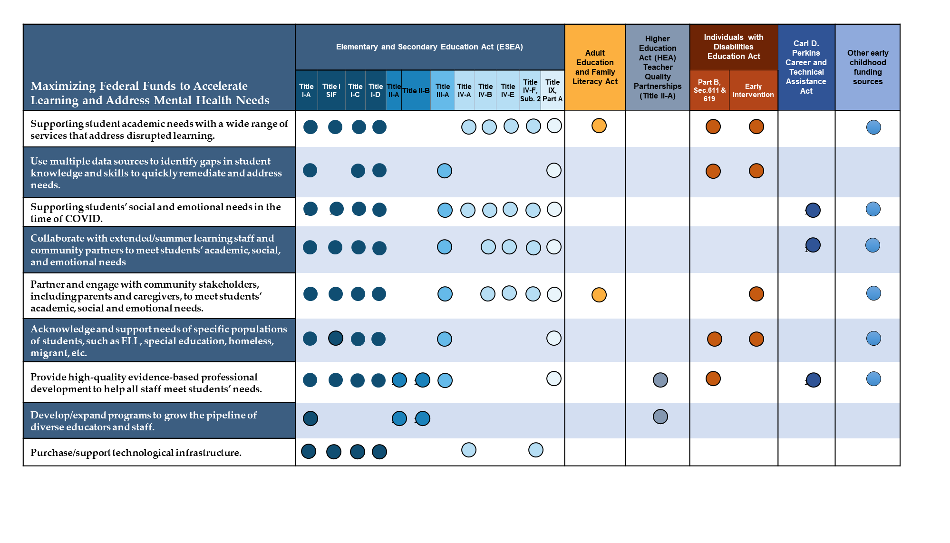
Maximizing Federal Funds to Accelerate Learning and Address Mental Health Needs

Slide 27
Connections to Learning Acceleration Principles
Is organized by the four learning acceleration principles included in the NJDOE’s 2021 Learning Acceleration Guide:*
  Provide conditions for teaching and learning that will foster social and emotional well-being of students, families, and educators.
  Improve equitable access to grade level content and high-quality resources for each student.
  Prioritize content and learning by focusing on the depth of instruction, rather than the pace.
  Implement a K–12 accelerated learning cycle to identify gaps and scaffolds as needed.
*Please refer to the Learning Acceleration Guide released in June 2021

Slide 28
Discussion and Questions

Slide 29
Thank You! (3 of 3)
New Jersey Department of Education Website
nj.gov/education
Questions may be submitted to:
ESSER@doe.nj.gov
Registration now open for the February 16, 2022, ARP ESSER Round Table
Follow Us!
Facebook:
@njdeptofed
Twitter: @NewJerseyDOE
Instagram:
@NewJerseyDoe

