Slide 1
Elementary and Secondary School Emergency Relief (ESSER) Roundtable Series: Strategies for Addressing Teacher Shortages with ARP ESSER Funds
New Jersey Department of Education
Division of Educational Services
November 16, 2022
Notes:
Anthony

Slide 2
Agenda
Housekeeping Ms. Peggy Porsche, Office of the Executive Director
Greetings/Welcome Dr. A. Charles Wright, Executive Director/Deputy Assistant Commissioner
Division of Educational Services
Teacher Shortage Ms. Tanisha Davis, Director
Office of Recruitment, Preparation, and Certification
District Presentations
Newark Public Schools
Paterson City Public School District
West Windsor-Plainsboro Regional Public School District
Notes:
Anthony

Slide 3
Using Microsoft Teams
Chat
We welcome your participation in discussions by asking questions and adding comments in the chat box.
Raise Hand
Please use the raise hand feature if you want to speak.
Mute/Unmute
Please remain muted whenever you are not speaking.
Notes:
Peggy

Slide 4
Greetings/Welcome Dr. A. Charles Wright Executive Director/Deputy Assistant Commissioner Division of Educational Services
Notes:
Kathy
The next few slides review the allowable uses of the ESSER funds.
Next slide

Slide 5
Strategies for Addressing Teacher Shortages with ARP ESSER Funds
Notes:
Kathy
The next few slides review the allowable uses of the ESSER funds.
Next slide

Slide 6
Ms. Tanisha R. Davis, Director Office of Recruitment, Preparation, and Certification
Notes:
Anthony

Slide 7
Identifying Educator Shortages
Supply, demand and composition
Percentage of teachers out of field
Student enrollment data
Projected retirements
Retention rates
Number of new certificates issued
Hire rate of newly certified educators
Number of emergency certificates issued

Slide 8
Addressing Educator Shortages
Substitute credential flexibility
Limited CE/CEAS five-year pilot program
Retired educators re-entering workforce
Expedited certification process for employed applicants
Emergency educational services certification
Minority Teacher Development Grant
Minority Teacher Quality and Retention Grant
Men of Color Hope Achievers (Partnership w/ Rowan University)

Slide 9
District Strategies
Collaborate with educator preparation programs at colleges/universities
Host clinical interns (student teachers)
Paid residencies
Grow your own programs (students, paraprofessionals, community members, parents)
Limited CE/CEAS Pilot Program
Certification guidance and financial support
Social media

Slide 10
Questions and Contact
Contact Information
Tanisha Davis
Director, Office of Recruitment, Preparation, and Certification
Division of Field Support and Services
New Jersey Department of Education
Tanisha.davis@doe.nj.gov

Slide 11
District Presentations
Notes:
Anthony

Slide 12
Newark Public Schools
Notes:
Anthony

Slide 13
Newark

Slide 14
The Next Decade: 2020-30

Slide 15
Priority 1: United and Aligned Systems
Strategy 1.4: Attract and recruit highly effective and qualified staff who are excellent matches for the district, develop a pipeline of candidates for hard-to-fill areas, and provide support to all employees that enables and empowers them to fulfill their role in our mission.

Slide 16
Problems Facing New Jersey Public Schools
The Global Pandemic
The Great Resignation
Why U.S. public school teachers are quitting their jobs, for good
Public school enrollment continues to rise in Newark

Slide 17
Our Reality in Newark
Over this past summer, we anticipated that we had to recruit for:
+ 84 Vacancies from previous school year
+ 286 New positions created for the current school year
+ 250 Attrition pattern in one decade over the summer
= 620

Slide 18
Our Reality in Newark (cont.)
The over one-decade attrition pattern changed over the summer for this school year. It increased by 154 additional separations.
+ 84 Vacancies from previous school year
+ 286 New positions created for the current school year
+ 404 Attrition pattern in one decade over the summer
= 774

Slide 19
What now?

Slide 20
Teach Newark
$62,000 Starting Salary
$4,000 Hard to Staff Signing Bonus (Special Education, Bilingual/ESL, Mathematics, Science)
$4,000 Student Teacher Sign-on Bonus
$1,000 Referral Bonus for Current Teachers who Recruit Teachers
$4,000 Current Teachers Recruited for Bilingual/Bicultural Endorsement

Slide 21
Chapter 408 & Chapter 224
Chapter 408 (Returning Retirees)
“As we continue to identify creative ways to place certified individuals in our classrooms, we are excited about the ability to hire retired teachers and to provide a pathway for new teachers to get certified,”
Superintendent Roger León (April 2022)
Chapter 224 (Limited CE)
“I could not be more pleased about these two programs and I am confident that they will further increase our pool of qualified applicants, which will help fill many of our critical need teaching positions as outlined in the applications.” Board President Dawn Haynes (April 2022)

Slide 22
Collaboration
+

Slide 23
Red Hawk Rising - East Side High School Teacher Academy

Slide 24
Pathways to Teaching

Slide 25
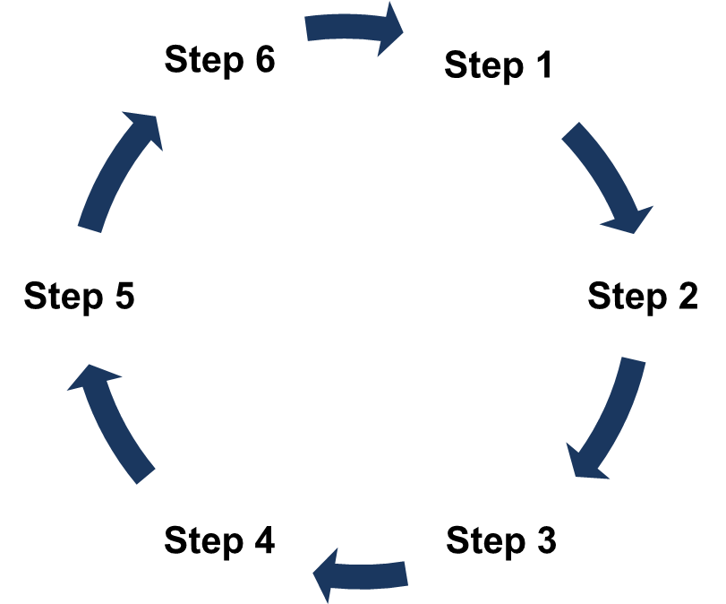
Pathways to Teaching 1
1. Identify the Staff
4. Draft MOU
2. Host Information Sessions
5. Program Begins
3. Collaborate with University Partners
6. Monitor and Adjust

Slide 26
Pathways to Teaching 2.0
Pathways to Teaching 2.0 / Our enhanced version of Alternate Route
Collaborated with University Partners to support increased enrollment for upcoming semester (hybrid model)
Worked with Principals, administrators, HRS Recruitment team to Identify viable (Degree bearing ) candidates (Possessed Substitute Licenses)
Created Contingent Contract language specified completion of program(s) towards certification (CE)
Paid candidates full starting salary and full benefits

Slide 27
NBOE-Montclair State University-TESL Cohort

Slide 28
Rutgers University
Opens Bilingual and Bicultural Bachelors Program

Slide 29
Principal Pipeline
Foundation

Slide 30
Additional Retention Strategies
Buddy Systems for Novice Teachers
Increased Administrative Support
Professional Development Opportunities (school year and summer)
Declaration of Intent/Stay conversations

Slide 31
NBOE Job Openings

Slide 32
NBOE well

Slide 33
Recruitment Supports

Slide 34
NBOE Mass Media Recruitment Efforts

Slide 35
Qualtrics - Engagement & Exit Surveys

Slide 36
Questions and Contact (NPS)
Contact Information
Roger Leon, Superintendent RLeon@NPS.K12.NJ.US Dawn Haynes, Board President d1haynes@NPS.K12.NJ.US
Valerie Wilson, Business Manager/Financial Officer VWilson@NPS.K12.NJ.US

Slide 37
Paterson City Public School District
Notes:
Anthony

Slide 38
Teacher Vacancies
2017-2018: 132 Teachers
2018-2019: 338 Teachers (RIF)
2019-2020: 111 Teachers
2020-2021: 131 Teachers
2021-2022: 249 Teachers
September 2022: 125 vacancies

Slide 39
ESSER – Paterson Recruitment Efforts
(2) Full-Time HR Recruiters
Teaching and Non-Certificated positions moved from Local Funding to the ESSR Grant
83 total positions – freeing up $9,135,000 in local funds
Human Resources advertisements – local newspapers/advertising websites
Local Job Fair Fees and supplies
Virtual Job Fairs

Slide 40
ESSER – Paterson Recruitment Efforts (cont.)
Pre-Employment Bonus Agreement
Program took effect – September 2022
92 Bonus Agreements offered as of 11/9/2022

Slide 41
Questions and Contact (PPS)
Contact Information
Eileen F. Shafer – Superintendent
Luis M. Rojas – Assistant Superintendent
Paterson Public Schools
eshafer@paterson.k12.nj.us
lrojas@paterson.k12.nj.us
(973) 321-0980

Slide 42
West Windsor-Plainsboro Regional Public School District
Notes:
Anthony

Slide 43
Mitigating the Teacher Shortage
West Windsor-Plainsboro Regional School District
Dr. David Aderhold, Superintendent of Schools
Charity Comella, Director of Human Resources

Slide 44
Best Practices in Staffing
Recruit
HIRE
Retain

Slide 45
Recruit
Join a network or consortium such as CJ PRIDE

Slide 46
HIRE
Unified Talent
Frontline Central
Interview Stream
Digital Personnel Files

Slide 47
Retain
Develop a Strong Mentoring Program
Job Embedded Professional Development
Consider Staff Requests Humanely

Slide 48
Questions and Contact (WWPRSD)
Contact Information
Dr. David Aderhold
Superintendent of Schools
david.aderhold@wwprsd.org
Charity Comella
Director of Human Resources
charity.comella@wwprsd.org
West Windsor-Plainsboro Regional School District
609-716-5000 ext. 5015

Slide 49
Teaching and School Personnel Resources
Regional Educational Laboratory (REL) Program –
Understanding and Predicting Teacher Shortages
https://ies.ed.gov/ncee/rel/Products/Publication/4008
Addressing Educator Workforce Shortages: A State Comparison Brief
https://region12cc.org/addressing-educator-workforce-shortages-a-state-comparison-brief/?utm_content=&utm_medium=email&utm_name=&utm_source=govdelivery&utm_term=
Teacher Recruitment
https://ies.ed.gov/ncee/rel/topics?page=1&topics=Teacher+Recruitment&utm_content=&utm_medium=email&utm_name=&utm_source=govdelivery&utm_term=

Slide 50
Teaching and School Personnel Resources
Educator Shortages in Special Education: A Toolkit for Developing Local Strategies
https://ceedar.education.ufl.edu/shortage-toolkit/?utm_content=&utm_medium=email&utm_name=&utm_source=govdelivery&utm_term=
Addressing Educator Burnout and Demoralization: Actions for Administrators
https://safesupportivelearning.ed.gov/sites/default/files/Addressing%20Educator%20Burnout%20and%20Demoralization_Actions%20for%20Administrators.pdf?utm_content=&utm_medium=email&utm_name=&utm_source=govdelivery&utm_term=

Slide 51
Thank You!
New Jersey Department of Education Website nj.gov/education
Questions may be submitted to:
ESSER@doe.nj.gov
Registration is now open for the December 14, 2022, ARP ESSER Round Table:
https://homeroom5.doe.state.nj.us/events/details.php?t=2;recid=40425
Follow Us!
Facebook: @njdeptofed
Twitter: @NewJerseyDOE
Instagram: @NewJerseyDoe
Notes:
Anthony

