Slide 1

Elementary and Secondary School Emergency Relief (ESSER) Roundtable Series
Maximizing The Value of Federal Funds
New Jersey Department of Education
Division of Educational Services
January 25, 2023
Notes:
Anthony

Slide 2
Agenda
Housekeeping Ms. Peggy Porche, Planning Associate
Office of the Executive Director/Deputy Assistant Commissioner
Greetings/Welcome Dr. A. Charles Wright,
Executive Director/Deputy Assistant Commissioner
Division of Educational Services
Maximizing the Value of Federal Funds Ms. Diana Pasculli, Executive Director
Dr. Peter Frank, Project Specialist
Ms. Jill Dobrowansky, Grants Specialist
Office of the Assistant Commissioner
Eatontown Public Schools Mr. Scott McCue, Superintendent
Ms. Tara Micciulla, Principal
Weehawken Public Schools Mr. Eric Crespo, Chief School Administrator
Ms. Francesca Amato, ESEA Project Director
Notes:
Anthony

Slide 3
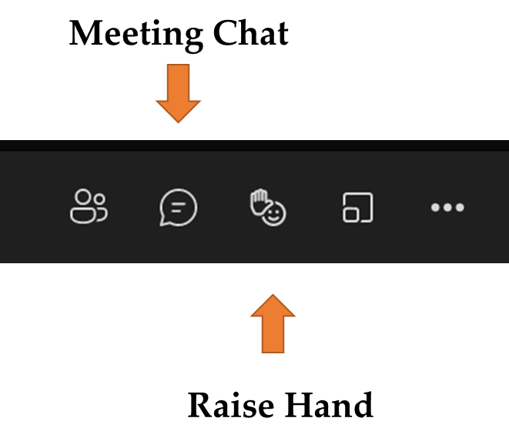
Using Microsoft Teams
  Chat
    We welcome your participation in discussions by asking questions and adding comments in the chat box.
  Raise Hand
  Please use the raise hand feature if you want to speak.
  Mute/Unmute
    Please remain muted whenever you are not speaking.
Notes:
Peggy

Slide 4
Greetings/Welcome
Dr. A. Charles Wright
Executive Director/Deputy Assistant Commissioner
Division of Educational Services
Notes:
Kathy
The next few slides review the allowable uses of the ESSER funds.
Next slide

Slide 5
Maximizing the Value of Federal Funds
Divisions of Educational Services and Teaching and Learning and
Finance and Business Services
Ms. Diana Pasculli, Executive Director
Dr. Peter Frank, Project Specialist
Ms. Jill Dobrowansky, Grants Specialist
Notes:
Kathy
The next few slides review the allowable uses of the ESSER funds.
Next slide

Slide 6
Maximizing Website: Aim and Agenda
Session Aim: Leverage the Maximizing Federal Funds website to support the strategic and efficient spending of funds for a lasting impact.
Introduction
Overview
Recommended Navigation
Combining Funds
Resource in Action
Closing and Questions
Notes:
Diana
Our goal for today is to introduce you to our website tool and provide some ideas for strategic and efficient spending of funds. As you can see from our agenda, we will provide some background as everyone on this call is coming with different levels of federal funding knowledge and then in the second half, my colleague Jill will walk you through an example scenario of how a district could braid and blend different Federal funding streams. .
As we at the Department are always looking to continually improve our sessions and our tools, we will seek your feedback following this session.
Next Slide

Slide 7
Maximizing Federal Funds:
Background
Notes:
Diana
I’m now going to provide a quick overview of what our resource is and why we have provided it now.
We anticipate that some school communities are still figuring out how to spend ESSER dollars, here are some ideas, and you don’t have to be as worried as you might think about sustainability
Finally, we hope that this tool helps educators in your VERY busy lives identifies ways to combine and maximizing Federal dollars.
What is Maximizing Federal Funds?
Next Slide

Slide 8
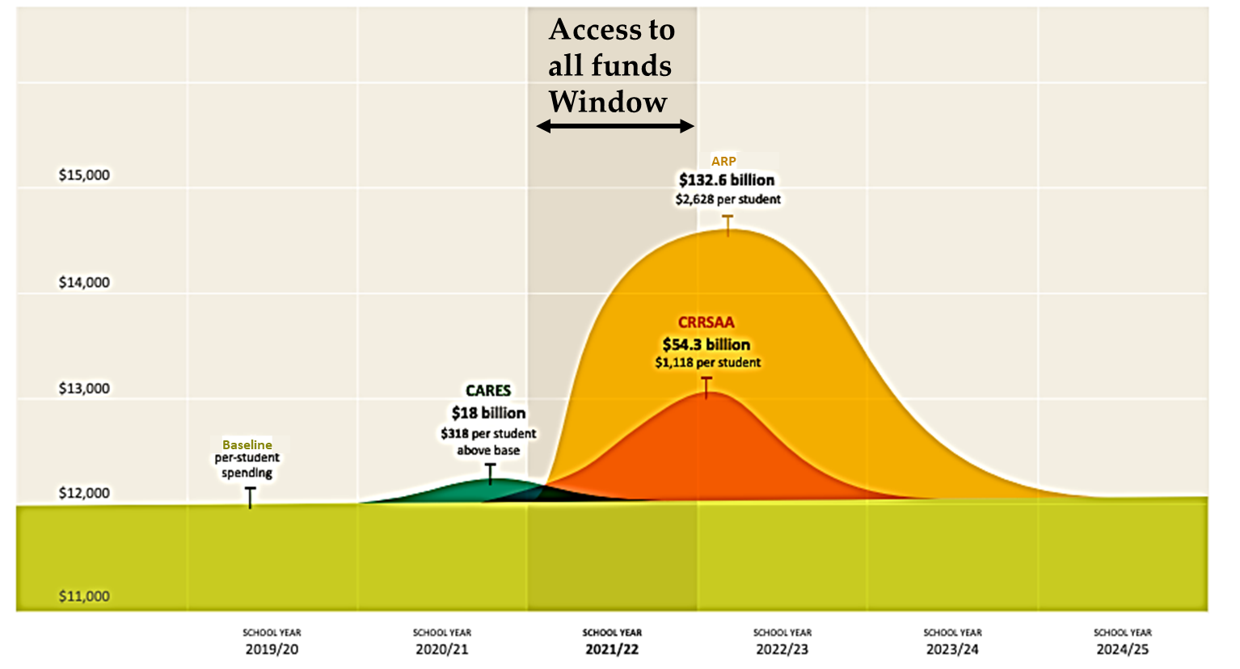
Fiscal Landscape Requiring Smart Spending
Yearly Non-ESSER Funds Accessible to LEAs (Example: Individuals with Disabilities Education Act or IDEA, etc.)
Notes:
Diana
1) I'm going to use the term local education agency, or LEA interchangeably with the word district.
LEAs have access to a large influx of funds through the three rounds of emergency funds collectively knowns as ESSER.
This visual shows both the opportunities and approaching fiscal cliffs with these funds.
The Light green baseline shows all the funding that most LEAs have to work with yearly.
The dark green curve represents the CARES funds
The orange curves represent the CRRSAA funds
The yellow curve represents the ARP funds
LEAs have access to all their local, state, and federal funds. Today’s session will be focused on sustainable funds in that green section, but you'll also see more ways you can spend the yellow, orange, and green funds. And as I will discuss in the next slide, more than $4.5 BILLION Federal dollars will have been allocated to NJ school districts Elementary and Secondary School Emergency Relief Fund.
Next Slide
(Citation Credit: West-Ed-Meeting the Moment How Education Leaders Can Maximize Federal COVID Relief Aid to Support More Equitable Student Learning)

Slide 9
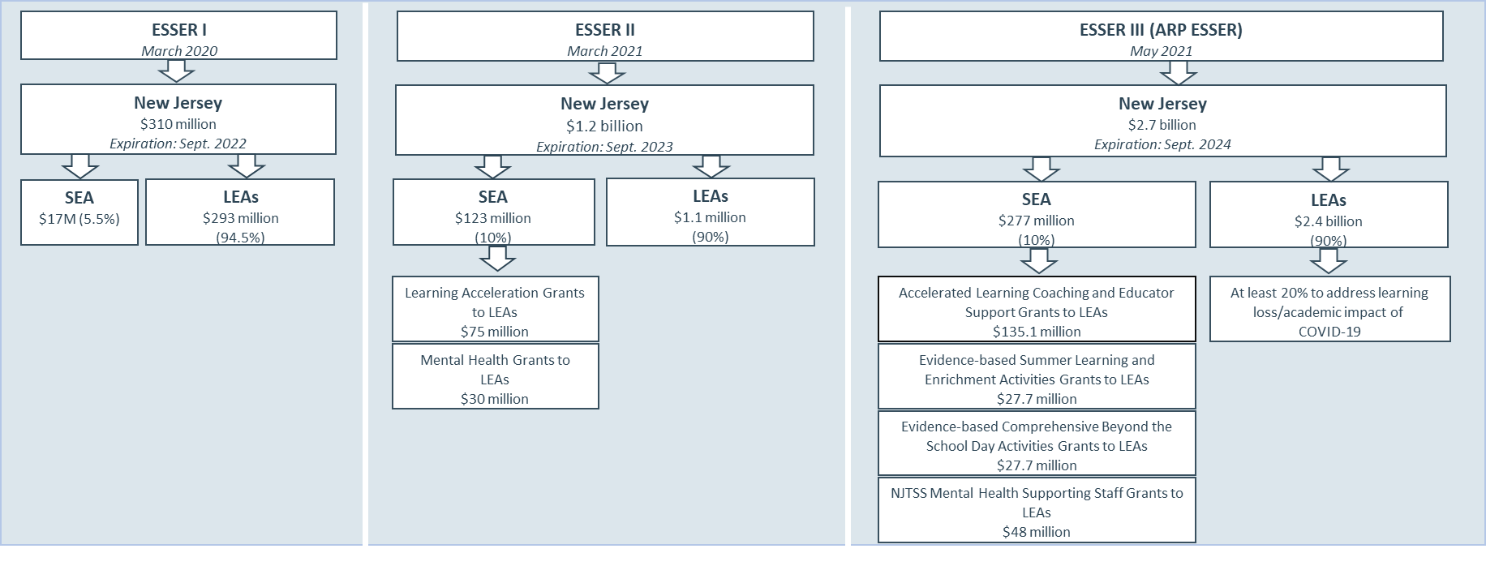
Maximizing Federal Funds: ESSER Timeline
The guidance summarizes the three rounds of ESSER funds.
Notes:
Diana
For background, Here is a high-level overview of the ESSER funds from the website on this slide.
These Federal emergency funds are available for a wide range of activities to address diverse needs arising from or exacerbated by the COVID-19 pandemic, or to emerge stronger post-pandemic, including responding to students’ social, emotional, mental health, and academic needs, and continuing to provide educational services as States, LEAs, and schools respond to and recover from the pandemic.”
School districts are required to ensure that the funds goes where they are needed most, which is by the students disproportionally impacted by the pandemic.
We cannot emphasize this enough and we are seeing bright spots around the state of where districts are targeting this unprecedented amount of dollars toward the students who need the most supports.
Next Slide

Slide 10
Maximizing Federal Funds: Entitlement Guidance (1 of 2)
The guidance summarizes the Federal entitlement grants
Federal Entitlement Grants | Information Link
Title I (Title I, Part A: Improving the Academic Achievement of the Disadvantaged) | https://oese.ed.gov/offices/office-of-formula-grants/school-support-and-accountability/
Title II (Title II, Part A: Supporting Effective Instruction; Title II-B: Teacher and School Leader Incentive Fund) | https://oese.ed.gov/offices/office-of-formula-grants/school-support-and-accountability/instruction-state-grants-title-ii-part-a/
Title III (Title III, Part A: Language Instruction for English Learners and Immigrant Students) | https://oese.ed.gov/offices/office-of-formula-grants/school-support-and-accountability/english-language-acquisition-state-grants/
Title IV (Title IV, Part A: Student Support and Academic Enrichment Program; Title IV, Part F, Subpart 2: Community Support for School Success) | https://oese.ed.gov/offices/office-of-formula-grants/school-support-and-accountability/
Title V (Title V, Part B: Rural Education Achievement Program) | https://oese.ed.gov/offices/office-of-formula-grants/school-support-and-accountability/essa-legislation-table-contents/title-v-flexibility-accountability/#TITLE-V-PART-A
Notes:
Diana
The maximizing Federal Funds also identifies and focuses on the other Federal programs that may be used for various activities. We include these programs, recognizing that of course not every district gets funding from all these sources.
Some of you on this call may have many many years of experience in working with these grants and others’ may be seeing these words for the first time. Again, as a reminder, this toolkit and webinar is meant to be a conversation starter for diverse stakeholders and so we will attempt to strike the balance between giving you information most of you find helpful while avoiding the many potential rich and technical tangents and topics that some experts could spend days discussing.
When serving a broader range of students, LEAs are well positioned to combine Federal funds to increase both impact and longevity as you will learn later in our presentation.
Also, now if you haven’t guessed already, this is the place in the airplane ride when the flight attendant reminds you of the destination. If your school community does not receive any federal entitlement grants, you may be on the wrong plane ride for today☺
Next Slide
(OPTIONAL MENTIONS BELOW)
ESEA Titled Programs
Title I, Part A – Improving basic programs for children from low-income families to help them meet state academic achievement standards
Title II, Part A - Increasing students’ academic achievement by improving teacher and principal quality
Title III, Part A – Supporting limited English proficient (LEP) students to attain English proficiency
Title III, Immigrant – Supporting LEP immigrant students to meet academic achievement standards
Title IV, Part A –Providing students with access to a well-rounded education, improving school conditions, and improving the use of technology

Slide 11
Maximizing Federal Funds: Entitlement Guidance (2 of 2)
The guidance summarizes the Federal entitlement grants
Federal Entitlement Grants | Information Link
McKinney-Vento (Title IX, Part A: Education for Homeless Children and Youth Program) | https://oese.ed.gov/offices/office-of-formula-grants/school-support-and-accountability/education-for-homeless-children-and-youths-grants-for-state-and-local-activities/
Adult Education and Family Literacy Act | https://www2.ed.gov/about/offices/list/ovae/pi/AdultEd/index.html
Individuals with Disabilities Education Act or IDEA (Part B: Sections 611 and 619; Part B: Early Intervention) | https://sites.ed.gov/idea/
Perkins Strengthening Career and Technical Education for the 21st Century Act | https://cte.ed.gov/
Early Childhood programs Child Care and Development Block Grant or CCDBG; Head Start | https://www.acf.hhs.gov/occ/fact-sheet https://www.acf.hhs.gov/ohs
Notes:
Diana
The maximizing Federal Funds also identifies and focuses on the other Federal programs that may be used for various activities. We include these programs, recognizing that of course not every district gets funding from all these sources.
Some of you on this call may have many many years of experience in working with these grants and others’ may be seeing these words for the first time. Again, as a reminder, this toolkit and webinar is meant to be a conversation starter for diverse stakeholders and so we will attempt to strike the balance between giving you information most of you find helpful while avoiding the many potential rich and technical tangents and topics that some experts could spend days discussing.
When serving a broader range of students, LEAs are well positioned to combine Federal funds to increase both impact and longevity as you will learn later in our presentation.
Also, now if you haven’t guessed already, this is the place in the airplane ride when the flight attendant reminds you of the destination. If your school community does not receive any federal entitlement grants, you may be on the wrong plane ride for today☺
Next Slide
(OPTIONAL MENTIONS BELOW)
ESEA Titled Programs
Title I, Part A – Improving basic programs for children from low-income families to help them meet state academic achievement standards
Title II, Part A - Increasing students’ academic achievement by improving teacher and principal quality
Title III, Part A – Supporting limited English proficient (LEP) students to attain English proficiency
Title III, Immigrant – Supporting LEP immigrant students to meet academic achievement standards
Title IV, Part A –Providing students with access to a well-rounded education, improving school conditions, and improving the use of technology

Slide 12
Maximizing Federal Funds Website:
What is it?
Notes:
Diana
I’m now going to provide a quick overview of how our resource could be best used.
We are excited to hear from you throughout and the end how this tool is helpful and how we can improve it.
Next Slide

Slide 13
Smart Spending For Collective Impact
The guidance encourages the following smart spending strategies:
Needs Assessment and Continuous Improvement
Meaningful Stakeholder Engagement
Decision Considerations
Notes:
Diana
This tool is designed to be used within a decision making process that is driven by
models of continuous improvement,
With extensive stakeholder engagement
To result in shared community decisions that result in the best supports for students being provided at the right time.
The next three slides illustrate what we mean.
EXTRA
The guidance encourages:
A robust needs assessments that incorporates continuous improvement,
Meaningful Stakeholder Engagement for collectively informed priorities, and
considerations before finalizing spending decisions.
Next Slide

Slide 14
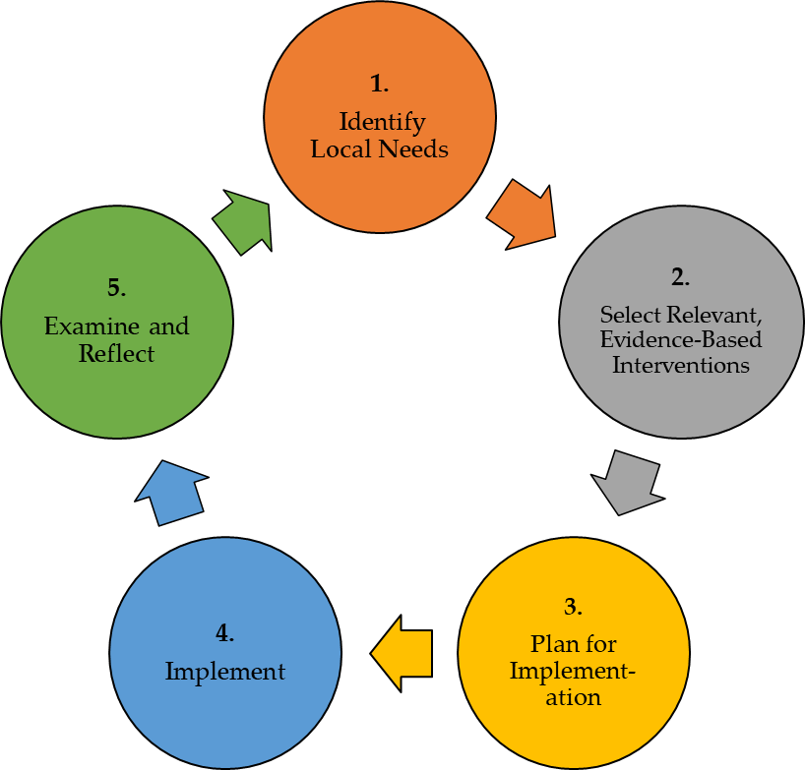
Needs Assessment And Continuous Improvement Cycle
Considerations:
Based on analysis of data and the experiences of those involved, was the intervention successful and should the intervention continue as is, be modified, or be abandoned?
Considerations:
What evidence do you have of the need? Is there any data?
What tools, programs or processes are in place that you could build upon to meet the need?
How can experience
with the intervention inform future decision making?
Considerations:
Local capacity, cost, and sustainability
Impact (focus on interventions with highest impact in your setting)
Considerations:
Are implementation timelines being followed? Do they need to be adjusted?
What are barriers (anticipated and unforeseen) to successful implementation? How can these be addressed?
Considerations:
What are the measurable goals associated with the intervention?
How will implementation and performance be monitored?
Notes:
Diana
Schools and LEAs develop the best spending plans using collaborative, data-driven processes. New Jersey’s Annual School Planning process and its guidance.
This visual is actually from USED but we think is well shows the continuous improvement process.
Most important flagor step is that when thinking about how to use federal funds, it is important to start with figuring out WHAT YOUR STUDENTS MOST NEED. Look it sounds simple, but it is not. Educators and families are VERY busy people. Not everyone will agree, it involves collecting data, etc.
We understand that sometimes these steps are aspirational, but we also know it is the most effective process for making financial and programatic decisions that most effectively help all of our students..
Next slide
Citation Credit: USED State Support Network. (2018). Needs assessment guidebook: Supporting the development of district and school needs assessments. Washington, DC: American Institutes for Research. Retrieved from https://oese.ed.gov/files/2020/10/needsassessmentguidebook-508_003.pdf
(ALTERNATIVE LANGAUGE)
In the graphic, identifying priority needs is the first in a series of closely interconnected steps that also include understanding root causes that contribute to the areas of need, selecting appropriate evidence-based interventions or strategies that address those areas of need, preparing for and implementing selected interventions and strategies, and continually evaluating whether those strategies are addressing improvement needs and achieving desired outcomes.
The Needs Assessment and Continuous Improvement Cycle allows us to identify short- and long-term goals that align with the most pressing priorities.
It is not a linear process or not a one-time event.
It is an evidenced-based cyclical framework to determine needs, examine root causes, and set priorities for future action to enhance and advance the enterprise of educating learners.
It is the foundation for the use of ALL ESSER funds (ESSER I, ESSER II, & ARP ESSER)
It is important to note that Expenditures not supported by a comprehensive needs assessment are not “necessary, reasonable, and allocable” a requirement in using Federal funds [Uniform Grant Guidance – 2 C.F.R. Part 200]

Slide 15
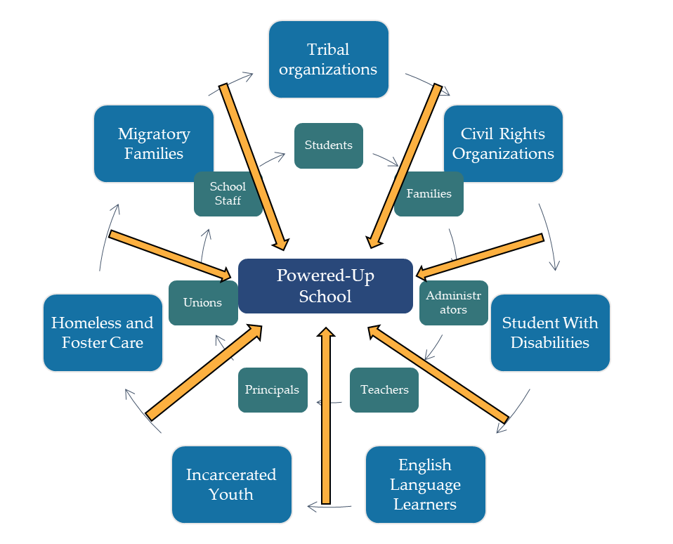
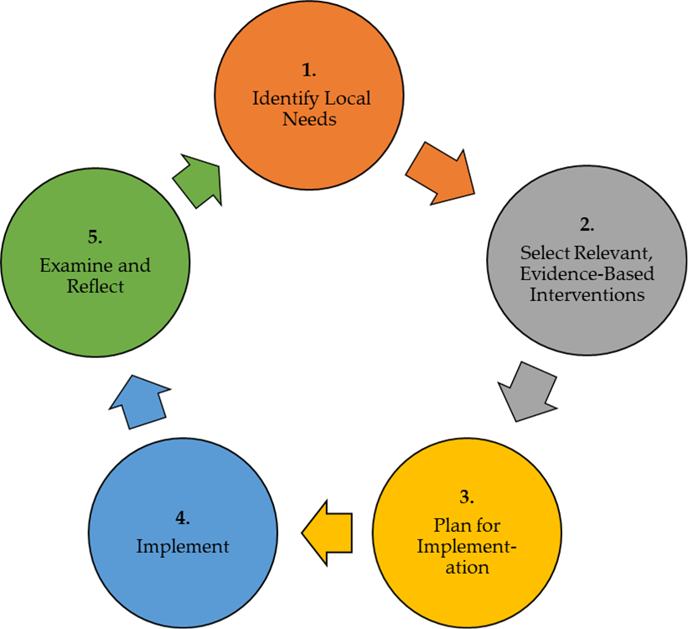
Meaningful Stakeholder Engagement
Stakeholders informing all aspects of the need assessment cycle
Notes:
Diana
Stakeholder Engagement matters!
Engaging stakeholders with diverse perspectives is one of the most important elements of the needs assessment and planning process, and why we pulled out this step for greater distinction.
Stakeholders must inform every step from data gathering, creating a plan and monitoring for effectiveness. To truly understand the needs of the school community and to get a holistic picture of the effectiveness of the programs, diverse voices must review data, provide input and feedback. For example, if An LEA has implemented a new math curriculum and formative assessment system, it is important to get feedback from the users (students and teachers) and the many individuals who are affected (e.g. parents, administrators).
This is first and foremost a best practice and a value strongly supported in New Jersey. It is also a federal requirement for any districts using federal entitlement grants.
(Little hint – you can often use many of the Federal funds we are mentioning to engage families and community members in these conversations!
Next Slide
Extra;
For ARP ESSER, an LEA must engage in meaningful consultation with stakeholders and give the public an opportunity to provide input in the development of its plan. Specifically, an LEA must engage in meaningful consultation with students; families; school and district administrators (including special education administrators); and teachers, principals, school leaders, other educators, school staff, and their unions.
Additionally, an LEA must engage in meaningful consultation with each of the following, to the extent present in or served by the LEA: Tribes; civil rights organizations (including disability rights organizations); and stakeholders representing the interests of children with disabilities, English learners, children experiencing homelessness, children in foster care, migratory students, children who are incarcerated, and other underserved students.

Slide 16
Decision Considerations
The guidance provides consideration questions for strategic spending.
The questions help LEAs to consider a few big picture ideas:
How are you making decisions about expenditures now?
How are you thinking about sustainability beyond 2024?
How are you preparing for the funding cliff, especially regarding personnel spending?
Notes:
Diana
Data- driven
Finally, the guidance provides consideration questions to support strategic spending.
When making data-informed and collaborative spending decisions we encourage districts to ask:
Who are your students most adversely impacted by the pandemic and likely to need scaffolded supports towards post-secondary success?
What are your existing LEA priorities? What is in your LEA strategic plan emerging from the pandemic? Tie your short- and long-term goals to those existing documents and make spending decisions accordingly.
Consider also how you will track the impact of your spending. What data do you need to collect as baseline information, what needs to be collected along the way, and what needs to be collected at the end of an intervention to determine how effective it was?
In sum, The Maximizing Federal Funds website may be a conversation starter within schools and with community stakeholders, as apart of a robust decision-making tool such as Annual School plan and the Need Assessment.
Next Slide
Finally, spending usually falls into a few broad categories:
People, like hiring staff, providing stipends or bonuses, or hiring specialists or consultants
Programs or trainings, such as a new reading program or a staff training
Materials, such as PPE, technology, classroom supplies or instructional materials, or facilities improvements
Consider balancing how you spend money across these categories to spread out impact and when money is spent
Next Slide

Slide 17
Maximizing Federal Funds
Provides guidance to help local education agencies (LEAs) strategically use Federal entitlement grants.
Organizes evidence-based activities around supporting students' needs in specific areas (e.g., Learning Acceleration, Mental Health, and Career Readiness).
Serves as a conversation tool to use with programmatic staff, fiscal staff, and other key stakeholders.
Sustains effective programs that were started using Federal emergency funds (ESSER I, II, III).
Increases the likelihood that every dollar of funding is being used appropriately, including blending or braiding multiple funding streams.
Notes:
Diana
First, we are going to be talking about federal funds. For even the most creative and audacious educators, this topic can be a little scary and so we are hoping this tool will help the dreamers, innovators and the strategizes among you feel a little more comfortable in understanding some of your options when using federal funds particularly beyond that fiscal cliff that we just highlighted.
This tool is intentionally designed around district priorities and ways you are supporting your students. It is meant to support the decision-making process that starts with
understanding your students’ needs,
understanding your school and district priorities, and
then identifying the ways to financially support.
We hope that it provides a starting point for conversations in each school community that receives federal entitlement dollars. To provide meaningful input, stakeholders need to have some level of understanding of what is being discussed. We hope that the website can be used and understood by all educators and even families so they engage with you in discussions about how to best meet the needs of the students in your community.
Disclaimer
Although this resource discusses Federal laws and regulations, it is intended solely to provide general information and does not constitute legal advice.
This guidance provides a general overview of allowable activities, but whether or not a particular cost can be supported with Federal funds depends on the underlying facts and circumstances and State and Federal rules (e.g. New Jersey Treasury Office of Management and Budget (OMB) and Uniform Grant Guidelines, respectively). Therefore, an activity listed in this resource may not be allowable in all circumstances, and conversely, an activity not listed in this resource may be allowable.
This guide was created to demonstrate how programs, strategies, or initiatives may be supported with Federal funds.
Please note a school or local education agency is under no obligation to use its Federal funds for those programs or activities highlighted in this guide.
Finally, throughout this presentation, I will be using the term LEAs (Local education agencies and districts interchangeably)
I'm now going to hand over the presentation to Dr. Peter Frank who will show you some of these resources..
Next slide
As you could see on the last side, we are in the midst of a window in which districts have received a great deal of federal emergency funding. Some of that money went to or are going to short-term pandemic-driven costs. However, we know that many of you have also used this emergency funding to design and implement innovative programs that are designed to meet the needs of your students who need the greatest support. If as a community you find these programs to be effective, you will be looking for alternative funding steams in the next few years.
This tool will help you figure out how to sustain high quality programs.
Extra notes
What districts should avoid:
NOT a planning template
NOT a shopping list of activities
NOT enough to justify allowability alone.
Districts may use the resource:
As a pathway to sustain effective and innovative investments realized through ESSER fund use.
A tool to help programmatic staff, fiscal staff, and board understand how and why each decision is being made.
Overall, a method for increasing the likelihood that every dollar of funding is being used appropriately, including that blending or braiding multiple funding streams.
When ESSER ends, the (good) programs you’ve started don’t necessarily have to; think about these other funds as a way to sustain.
If you’re still figuring out how to spend ESSER dollars, here are some ideas, and you don’t have to be as worried as you might think about sustainability.
Next slide

Slide 18
Maximizing Federal Funds
Website Overview:
Recommended Navigation
Notes:
Diana to Peter
(Switch to the website and resume on slide 20 if possible; or continue to screen shots)
Next Slide

Slide 19
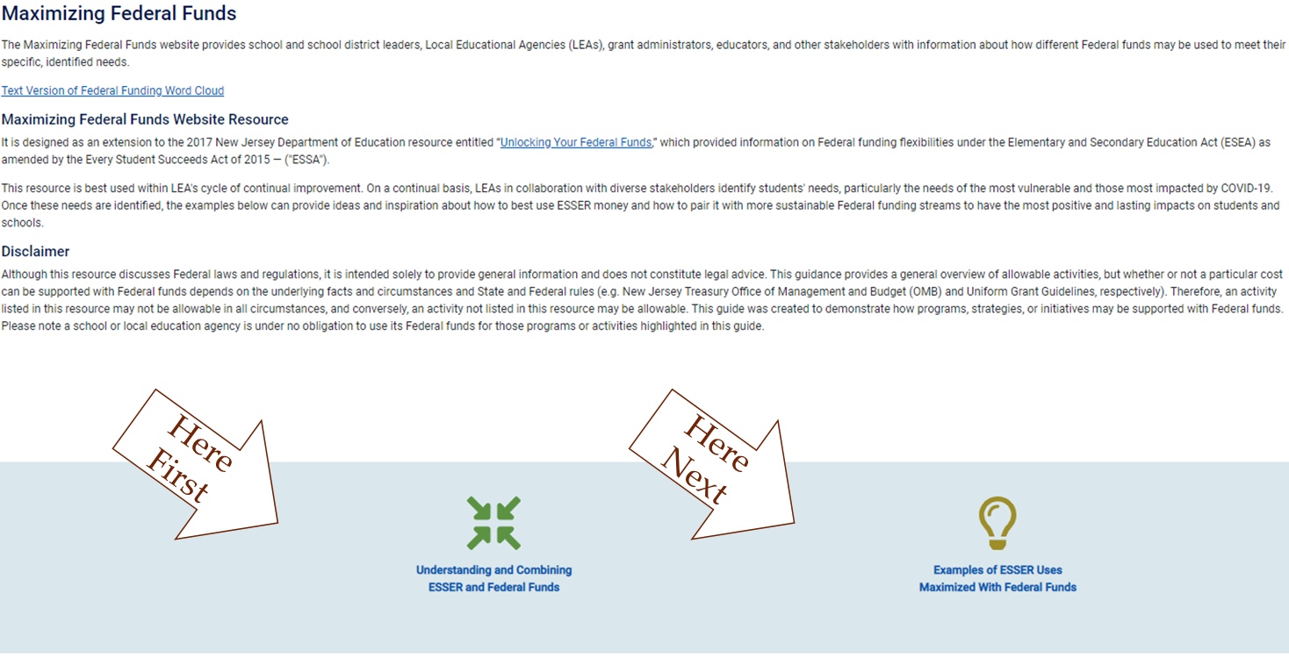
Recommended Navigation From The Homepage
Notes:
Welcome to the Maximizing Federal Funds Homepage!
You may have already browsed, so I will only provide a high-level overview of navigating the website. The goal here is to support you in knowing how to guide others through the website. Based on what we covered about effective decision making and to provide a preview before an opportunity to navigate the website in breakout groups.
Maximizing Federal Funds offers three significant value propositions to users:
The first is an overview of the large influx of Federal funds currently within reach of local education agencies, ESSER funds, and the Federal Entitlement Grants;
The second is the allowable provisions on how to combine by braiding or blending, within the context of our existing frameworks to make data-driven and stakeholder-engaged decisions that are aligned with LEAs' Need Assessment in a cycle of continual improvement; and
Finally, the examples of promising activities are organized in current strategic priorities to demonstrate how activities started under ESSER can be sustained beyond 2024 with Federal Entitlement Grants.
First time you user, are recommended to first visit the guidance under the understanding Tab and Icon, before looking at the activities under the sample ESSER Uses.
Next Slide

Slide 20
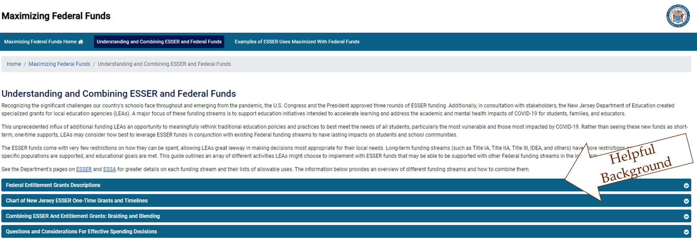
Understanding And Combining Federal Funds
The guidance summarizes and explains how to combine funds effectively.
Notes:
The webpage provides guidance to understand All the federal Funds that Districts have at their disposal, how to combine them, and provide consideration questions when making spending decisions. It is best to start here to better understand the fund braiding rows under the examples tab.
Next Slide

Slide 21
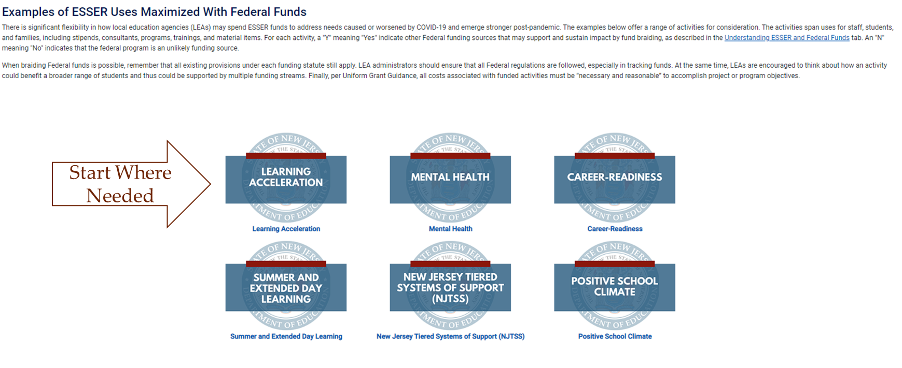
Examples Of ESSER Uses By Strategic Priorities
The guidance organizes activities by current strategic priorities.
Notes:
The feature that makes this resource special and invaluable to LEAs, is that the guide provides organized example uses that may be covered with ESSER funds and sustained by the Federal Entitlement Grant programs.
The strategic priorities for the examples span learning acceleration, extended learning opportunities, mental health and the climate conditions for educational communities to thrive, as well as activities that expand the career-readiness of learners,
Clicking on one of these strategic priority will take you to an extensive list of activities that can be covered by ESSER Fund and other Federal grant programs.
Next Slide
together ensures that LEAs can find tangible ways meet each learner and their institutions where they are, and holistically mend and enhance relationship for effective learning that prepares learners for post-secondary careers and have our educational practices emerge stronger post pandemic.

Slide 22
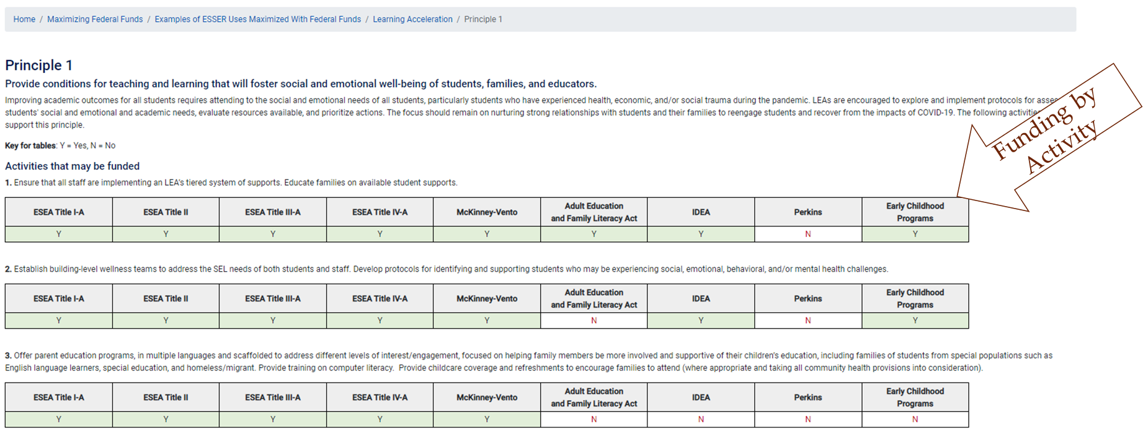
Exemplary ESSER Uses With Braiding Rows
The guidance provides 70+ rows of activities and likely funding sources.
Notes:
Here is just an example of a few lines of activities that we have identified that you might consider funding under Learning Acceleration Principle 1, and the different Federal programs that might be available to support these activities. These activities are promising practices towards promoting the mental well being of learners who we know have all had their mental health impacted by the pandemic and related events.
Across all the strategic priorities, there are more than 70 rows like these (and with more specifics) to provide LEAs with a wealth of possibilities and options in using Federal Funds
As a reminder:
Although, these are generally allowable activities, whether or not a particular cost can be supported with Federal funds depends on the underlying facts and circumstances of the LEA and the rules of the funds.
Furthermore, an activity listed in this resource may not be allowable in all circumstances, and conversely, an activity not listed in this resource may be allowable.
Finally, LEAs are under no obligation to use their Federal funds for the activities highlighted in this guide.
We will revisit the activities rows later in the presentation
Next slide

Slide 23
Maximizing Federal Funds:
Combining Funds
Notes:
Jill

Slide 24


Combining Federal Funds
Braiding Funds
Blending Funds
Coordinated to meet one purpose.
Individual funding streams maintain identity for eligibility and reporting.
Consolidated into one funding stream to meet one purpose.
Individual funding stream loses its identity.
ESSER funds may be “braided” or used in combination with, but not “blended” with, funding under ESEA, IDEA, AEFLA, Perkins V, and McKinney-Vento, or any other education funds.
Credit: West-Ed-Blending and Braiding Funds to Mitigate the Impact of COVID-19 on the Most Vulnerable Students
Notes:
With an awareness of the available Federal funds, it is important to know how funds can be combined.
“Braiding” funds is a way for LEAs to use multiple Federal and State funding streams to support various parts of an initiative or activity to meet one purpose. As a result, individual funding streams maintain their identities for eligibility and reporting. Federal and State law allows LEAs to coordinate spending from different funding programs, as long as LEAs maintain documentation on how the funds are spent and the expenditures are allowed under the program.
“Blending” funds is a way for LEAs to consolidate multiple funds into one stream to meet one purpose. The individual funding streams lose their original identity and gather into a larger funding program. Under the Every Students Succeeds Act (ESSA) an LEA may choose to blend Titles I, II, III and IV. Under the Individuals with Disabilities Education Act (IDEA) an LEA may choose to consolidate all funds into a schoolwide program or to blend their Early Intervening Services (CEIS) funds to maximize impact.
We will be focusing on braiding for the sake of this presentation.
Next Slide
(OPTIONAL MENTIONS IF THE NEXT SLIDE ON “COMBINING CAUTIONS” SLIDE IS NOT USED)
A few general rules apply to consolidating funds in a school operating a schoolwide program:
a. Supplement, not supplant: Consolidating funds does not exempt a school from the Title I-A “supplement, not supplant” requirement, which requires each LEA to ensure that each school receives all the State and local funds it would otherwise receive in the absence of Title I-A or other Federal funds.
b. Meeting the intent of Federal programs: If a school consolidates Federal funds, it must maintain records that demonstrate that it meets the intent and purposes of each Federal program that was consolidated. For example, if a school consolidates Title III-A funds with other funds, it must demonstrate how it is still providing supplemental activities/services to English learners and, if applicable, immigrant students, as this is the purpose of Title III-A funds.

Slide 25
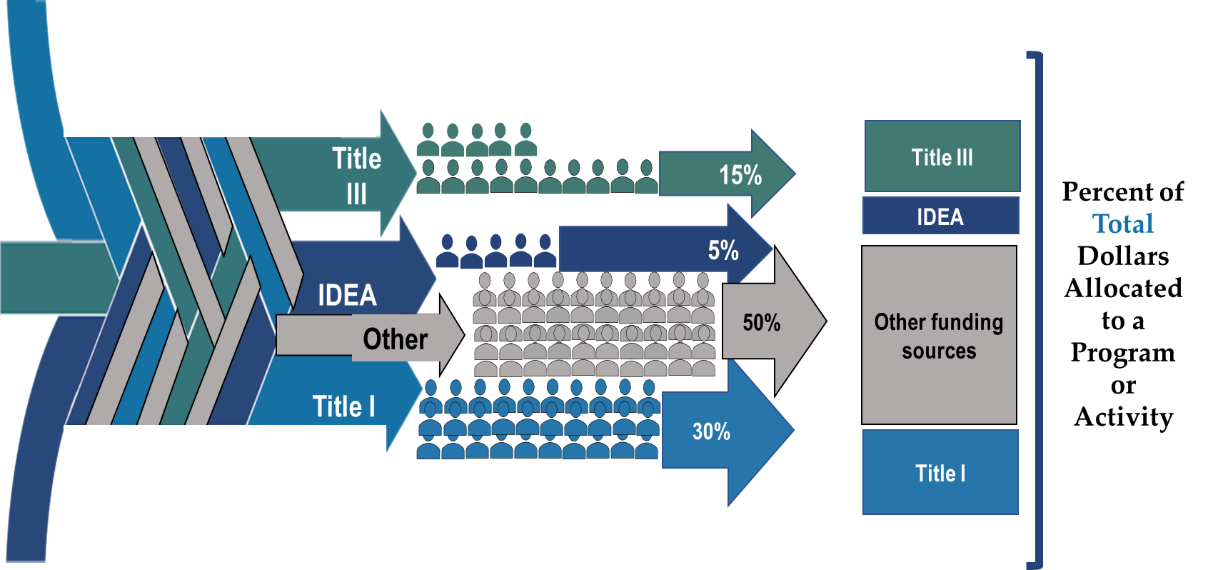
Braiding Funding Streams By Student Groups
Notes:
A visual aid to show braiding when serving a broad group of students in a program or goal.
funds follow students and can be braided into a target program by percent participation
Each student group are still afforded the unique services that they need to succeed

Slide 26
Combining Federal Funds Reminders
A few cautions for LEAs…
Be aware of “braiding” vs. “blending”
  “Braiding” = combining funds but still tracking funding streams
  “Blending” = consolidating funds into one funding stream (i.e., usually occurs in Title I, Part A: schoolwide programs)
  Federal funds are usually braided in most LEAs
Existing federal laws still prevail for non-ESSER funding sources:
  Remember “supplement, not supplant” and “maintenance of effort” provisions
  If uncertain about allowable costs, check before using other Federal funds!
Notes:
A few words of caution and disclaimers.
In some cases an LEA can blend funds, where different Title funds can be consolidated into one stream and there is more flexibility on how an LEA spends and tracks money. This is mainly true in Title I-A schoolwide programs. Otherwise, you can look at “braiding” funds, where you layer different funding streams together to support an activity, but you still must track explicit expenditures on the different populations that the funds were originally intended for.
Supplement not supplant and maintenance of effort rules still apply, even if funds are consolidated. An LEA is still responsible for ensuring that each schools receives all the funds it would otherwise receive if funds were not consolidated.
Finally, do not take this guide as the final authority on the allowability of any particular expenditure of a funding stream. This is not a legal document and should not be read as such. It simply gives ideas on how ESSER money could be spent and ways that other Federal funds might support some of those expenditures. Please consult with your business office, NJDOE program office staff, or other Federal guidance to ensure you are not running afoul of existing Federal regulations.

Slide 27
Maximizing Federal Funds:
In Action
Notes:
Jill (Peter drops link to website)
Finally, let’s put it all together now with sample scenarios.
This next part will model how federal funds beyond the recent emergency Funds can be combined. The idea is to provide you with as many options as possible as we know you are balancing so many different issues in your daily work and trying to maximize use of short-term influxes of federal funds.
Next Slide

Slide 28
Sample Scenario: Braiding Row
A district plans to offer a summer program to mitigate learning loss.
IDEA | Title I, Part A | Title II | Title III | Other
Can be used for costs related to programming for students with disabilities attending the program or for modified curriculum costs | Can be used for costs related to materials and supplies for the summer program | Can be used for costs related to professional development for teachers and paraprofessionals for the program | Can be used for costs related to supporting English Learners in the program | Varies
The above is meant to be illustrative and is not an exhaustive list.
Notes:
Jill
In this example the school wants to use multiple funding streams to support their summer program.
Because the funds may be used in various ways the district would need to look at both WHO is participating in the program and allocate accordingly, AND WHAT monies are being spent on (i.e., Title II cannot be spent on transportation costs). You’ll see highlighted on the slide that the ARP ESSER can be used for the entire program. What other funding streams could possibly be used in some way to support this program?
Next slide

Slide 29
Sample Scenario: Braiding Breakdown
A district plans to utilize a variety of funds for its summer program. The total cost of the program will be $150,000 (Table 1), which the district covers through various funding streams based on the estimated ratio of student populations served (Table 2).
Table 1. Estimated costs of a
summer program
Table 2. Funding allocations for summer programming based on estimated percent of students served
Summer Program Components | Estimated costs
Personnel | $100,000
Materials and supplies | $10,000
Transportation | $15,000
Staff training | $10,000
Other | $15,000
Total | $150,000
Grant | Estimated percent of students served | Percent of Total costs covered | Total Dollars Allocated
IDEA | 15% | 15% | $22,500
Title IA | 20% | 20% | $30,000
Title II | N/A | 10% | $15,000
Title III | 10% | 10% | $15,000
Other | 45% | 45% | $67,500
Total |  | 100% | $150,000
Notes:
Jill
In this example the school will charge a percentage of the total cost based upon the students/activity. There are columns here for personnel, materials, and other, but the school will likely break these columns into more detailed categories.
Once you identify what percentage of students/costs can be covered by different funding streams, you can budget accordingly.

Slide 30
Maximizing Federal Funds: Key Takeaways
Non-regulatory guidance;
Conversation tool;
Part of a needs assessment;
Source of model activities examples; and
Living resource that expands with time and user insights.
Notes:
Diana

Slide 31
A Call Towards Emerging Stronger
“Education cannot return to what it was in March 2020; that system did not work for everyone.
Creating a culture of intentional collaboration and looking at the whole child and the whole educator is probably more important now than ever before.
Success is within reach but getting there will require a collective effort. We need all hands-on deck here. To level up our education system, we must involve teachers, school leaders, families, students and entire communities.
This is the best time to be in education. Let’s make a difference.”
- Excerpts from U.S. Department of Education Secretary Miguel Cardona’s keynote address at the March 2022 Association for Supervision and Curriculum Development (ASCD) Annual Conference.
Notes:
Diana

Slide 32
Thank You! (1 of 2)
New Jersey Department of Education Website
nj.gov/education
Maximizing Federal Funds URL
https://www.nj.gov/education/federalfunding/index.shtml
Email Contact
esser@doe.nj.gov
Follow Us!
Facebook:
@njdeptofed
Twitter: @NewJerseyDOE
Instagram:
@NewJerseyDoe
Notes:
Diana

Slide 33
District Presentations
Notes:
Anthony

Slide 34
Mr. Scott McCue, Chief School Administrator; and
Ms. Tara Micciulla, Principal and Director of Education (Grades 5-8)
Eatontown Public Schools
Notes:
Anthony

Slide 35
Eatontown Public Schools ESSER Planning
District Profile
  Preschool to 8th Grade District in Monmouth County with 970 students
  Diverse Student Population
  44% Free and Reduced Lunch Population
  22% Special Education Population
  8-10% ELL Population
  Reductions in state aid due to S-2
Developing the Funding Plan
  Engaged the school community through surveys as well as discussions at school and BOE meetings
  Priorities were developed in order support students both academically as well as socially and emotionally
  Educational programs and initiatives needed to target student needs with an eye on sustainability for the future
  Other funded projects needed to provide sustainability and long-term gains such as HVAC system replacement, technology investments, and outdoor playground renovations.

Slide 36
Eatontown Public Schools ESSER Expenditures
Academic Support
  School-Data Teams (Title II Funds/District PD Funds)
  High Dosage Tutoring (Title I Funds/After-School Program Funds)
  Lunch Options Program (Title I/III)
  Winter and Summer Learning Academies (Title I/Title III/IDEA)
  Technology Enhancements (Ten-Year Technology Plan)
Social and Emotional Support
  Added Two School Counselors to Provide More Equitable Services (Retirements/Revaluate Positions)
  Expanded Student Mental Health Through YMCA Counseling Program, VNA, and InSite Health (Title IV)
  Leader In Me Program (Title IV/Title II/Curriculum Budget)

Slide 37
Eatontown
Questions may be submitted to:
Mr. Scott McCue
Superintendent
smccue@eatontown.org
Ms. Tara Micciulla
Principal & Director of Education (Grades 5-8)
tmicciulla@eatontown.org

Slide 38
Mr. Eric Crespo, Chief School Administrator;
Ms. Francesca Amato, ESEA Project Director
Weehawken Public Schools
Notes:
Anthony

Slide 39

Following the Pandemic What Do We Know?

Slide 40

Based on how long this district’s schools operated remote or hybrid and its mix of student characteristics and prior performance levels, recent research helps us estimate that
WTSD
Lost and average of:
18 weeks of learning in MATH
12 weeks of learning in READING

Slide 41
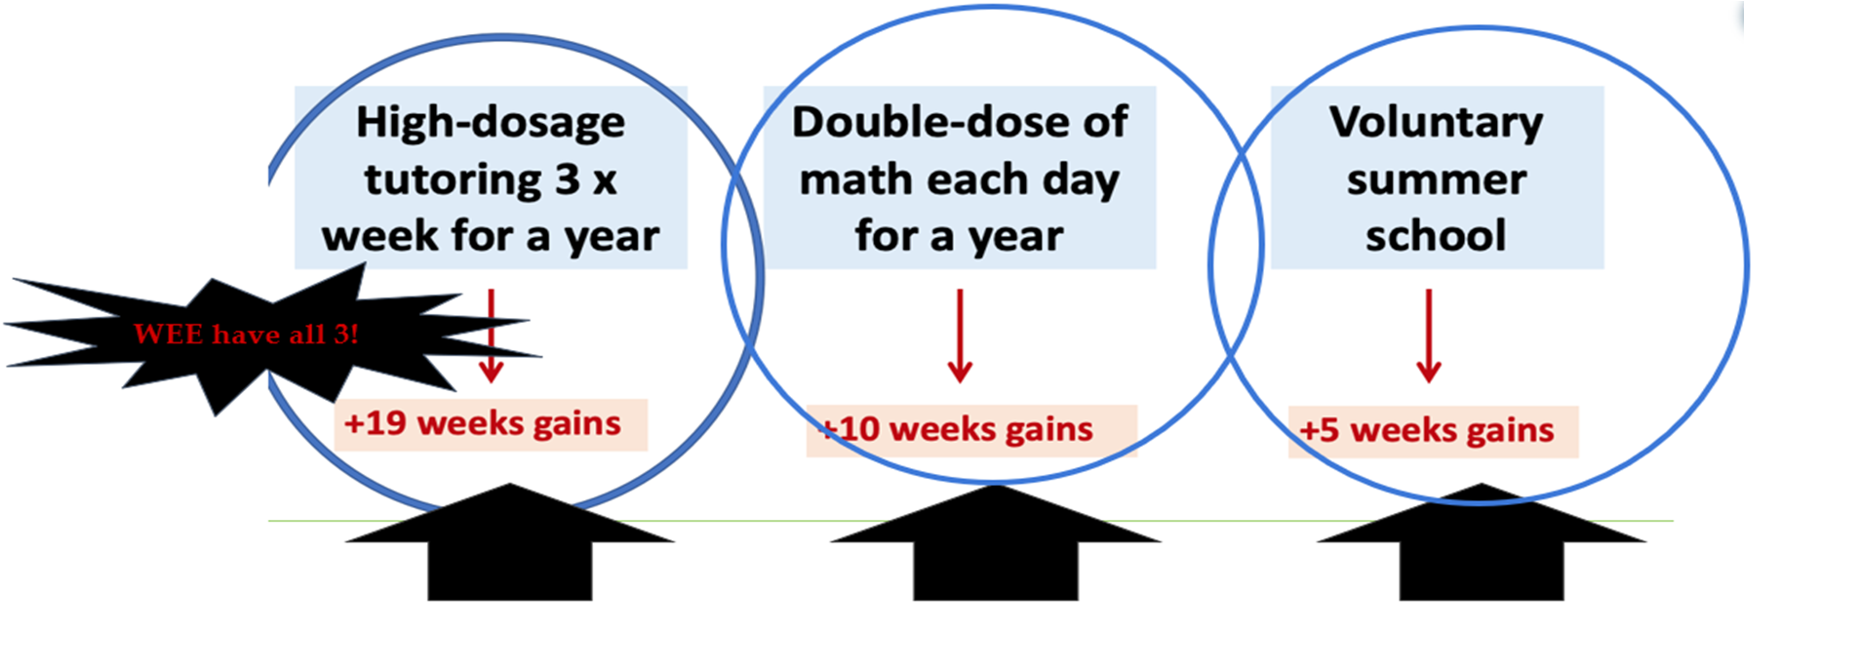
We compare estimates of the learning gaps to effect sizes of interventions…

Slide 42

SUMMER PROGRAMS
PROGRAM | ENROLLMENT
Summer STEAM Camp | 191
Algebra I Prep Boot Camp | 28
Financial Lit | 56
AP Physics Boot Camp | 5
AP Humanities Boot Camp | 4
AP STEAM | 4
Geometry Prep Boot Camp | 18
Credit Recovery | 25
Credit Recovery ESS | 8
ESY | 22
Brain Camp/Math (Intervention Program) | 96
Math Camp 3-6 & HS | 5
Command Education College Boot Camp | 33
Total: 495
38%

Slide 43

Back By Popular Demand
We are excited to offer you a fantastic opportunity called WISE. This program, which stands for the Weehawken Intervention Supports and Enrichment program, provides academic assistance, enrichment, additional related services, and counseling. We hope this wrap-around service will help your child gain confidence in particular skills that might be difficult or excel in other areas. Morning, afternoon, and personalized schedules are available for attendance multiple times a week.

Slide 44
DWS (PREK-2ND GRADE)
Intervention (Extra help) | Enrichment
PreK Wednesdays 3:00-3:50 PM | PreK Thursday 3:00-3:50 PM
Kindergarten Mondays & Wednesdays 7:15-8:10 AM | Kindergarten Tuesday & Thursday 7:15-8:10 AM
1st Grade Mondays & Wednesdays 7:15-8:10 AM | 1st Grade Tuesday & Thursday 7:15-8:10 AM
1st Grade Mondays & Wednesdays 3:00-3:50 PM | Speech Monday & Wednesday
2nd Grade Monday & Wednesday 7:15-8:10 AM | 2nd Grade Tuesday & Thursday 7:15-8:10 AM
2nd Grade Monday & Wednesday 3:00-3:50 PM | 2nd Grade Tuesday & Thursday 3:00-3:50 PM
Counseling available Tuesday and Thursday

Slide 45
TRS (3RD - 6TH GRADE)
Intervention (Extra help) | Enrichment
3rd Grade Monday & Wednesday 7:15-8:10 AM | 3rd Grade Tuesday & Thursday 7:15-8:10 PM
3rd Grade Monday 3:00-3:50 PM | 3rd Grade Tuesday 3:00-3:50 PM
4th Grade Monday & Wednesday 7:15-8:10 AM | 4th Grade Tuesday & Thursday 7:15-8:10 AM
4th Grade Monday 3:00-3:50 PM | 4th Grade Tuesday & Thursday 3:00-3:50 PM
5th Grade Monday & Wednesday 7:15-8:10 AM | 5th Grade Tuesday & Thursday 7:15-8:10 AM
5th Grade Math Mon 7:15-8:10am; Wed 3:00-3:50 PM | 5th Grade Math Tues 7:15-8:10 AM
6th Grade Math Monday & Wednesday 3:00-3:50 PM | 6th Grade Math Tuesday & Thursday 3:00-3:50 PM
Speech Monday & Wednesday
Counseling Tuesday & Thursday

Slide 46
WHS (7TH - 12TH GRADE)
Intervention (Extra help) | Enrichment
7th & 8th Gr Math Monday & Wednesday 7:15-8:10am | 7th & 8th Gr Math Tuesday & Thursday 7:15-8:10am
WHS ELA Monday & Wednesday 7:15-8:10am | WHS ELA Tuesday & Thursday 7:15-8:10am
WHS AP SS & ELA Monday & Wednesday 7:15-8:10am | WHS AP SS & ELA Tuesday & Thursday 7:15-8:10am
All SS Monday & Wednesday 7:15-8:10am | All SS Tuesday & Thursday 7:15-8:10am
WHS Math Monday & Wednesday 7:15-8:10am | WHS Math Tuesday & Thursday 7:15-8:10am
Speech Monday & Wednesday
Counseling Tuesday & Thursday

Slide 47

What’s Next?
Planning
Spring Break?
PERSONALIZE ACCELERATION PLAN

Slide 48


HOW DO WE PREPARE FOR THE FISCAL CLIFF?
AVOID RECURRING COSTS (BUDGET BACKFILLING, NEW HIRES, PERMANENT RAISES)
TARGETED PROGRAMS
STRATEGIC REDUCTION
USE THE DATA (READING SCORES/MATH SCORES/STUDENT INFO - Attendance/Transiency)
FOLLOWING THE PANDEMIC, PROGRAMS INCLUDED ALL
AS FURTHER REMOVED FROM THE PANDEMIC THE LIST IS SHORTER AS THERE IS LESS NEED
** MOST VULNERABLE MUST ALWAYS REMAIN **

Slide 49

WHAT PROGRAMS NEED TO CONTINUE?
THOSE ASSOCIATED WITH MENTAL HEALTH

Slide 50

Mental Health (1 of 2)

Slide 51



Mental Health (2 of 2)

Slide 52
Weehawken
Questions may be submitted to:
Mr. Eric Crespo,
Chief School Administrator
ecrespo@weehawken.k12.nj.us
Ms. Francesca Amato
ESEA Project Direcor
famato@weehawken.k12.nj.us;

Slide 53
Thank You! (2 of 2)
New Jersey Department of Education Website
nj.gov/education
Questions may be submitted to:
ESSER@doe.nj.gov
Registration now open for the February 15, 2023, ARP ESSER Round Table at
https://homeroom5.doe.state.nj.us/events/
Follow Us!
Facebook:
@njdeptofed
Twitter: @NewJerseyDOE
Instagram:
@NewJerseyDoe
Notes:
Anthony

