Slide 1
Completing the FY 2023 ESSER Performance Report Due March 8, 2024
Office of Fiscal and Data Services
Division of Educational Services
February 2024

Slide 2
Completing the ESSER Performance Report
This PowerPoint presentation will cover the following:
Purpose of the report;
Creating the report in the Electronic Web-Enabled Grant (EWEG) system;
Completing the different report tabs;
Notes for new/updated required reporting sections;
Submitting the report;
Supports available to LEAs as they complete the report; and
EWEG helpful hints.

Slide 3
Before we begin...
How many people have filled out the ESSER Performance Report before?
What is your role?
Keep your eye out for Clippy!
There is something new here!
Notes:
CLIPPY is a trademark of Microsoft Corporation.

Slide 4
Purpose of the ESSER Performance Report
Inform the conversation, for years to come, on the impact of this historic investment in our public education system.
Provide a well-rounded picture of the use of ESSER funds in your LEA. Doing so will likely require convening a team of administrators.
Fulfill a Federally mandated reporting requirement.

Slide 5
Purpose of the ESSER Performance Report (con’t.)
This report is: | This report is not:
Focused on the past. What LEAs did with ESSER funds from July 1, 2022 to June 30, 2023. Based on paid reimbursement requests. LEAs will report only on ESSER expenditures that were reimbursed by the NJDOE between July 1, 2022 and June 30, 2023. Expenditure totals are provided in the ESSER Allocation Overview table of the report. | Based on ESSER-funded programs LEAs implemented after June 30, 2023. About accountability. Responses are not expected to fully align with grant application(s); we can work with LEAs to amend their application(s) if necessary. Estimates about future fund use are non-binding.

Slide 6
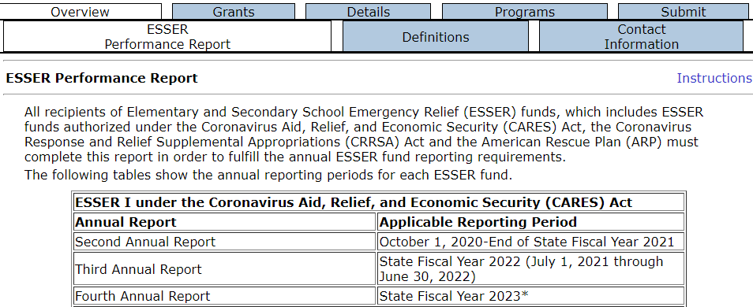
Overview Tab
The overview tab includes three subtabs. These provide the purpose and relevant reporting periods, the definitions USED provided for this report, and LEA contact information.

Slide 7
Contact Information Subtab
You will need to enter contact information for your LEA’s ESSER fund point person at the bottom of this subtab (shown above) in order to submit.
Any other changes to this subtab should be made in the LEA Central Contact system. NJDOE staff use this information to contact LEA personnel.

Slide 8
Grants Tab
The Grants tab includes five subtabs.
The ESSER Allocation Overview subtab provides detailed information about your LEA's ESSER allocations and expenditures.
The other subtabs ask how your LEA used, and plans to use, the two federal categories of ESSER grant funds (mandatory grants and state set-aside grants).

Slide 9
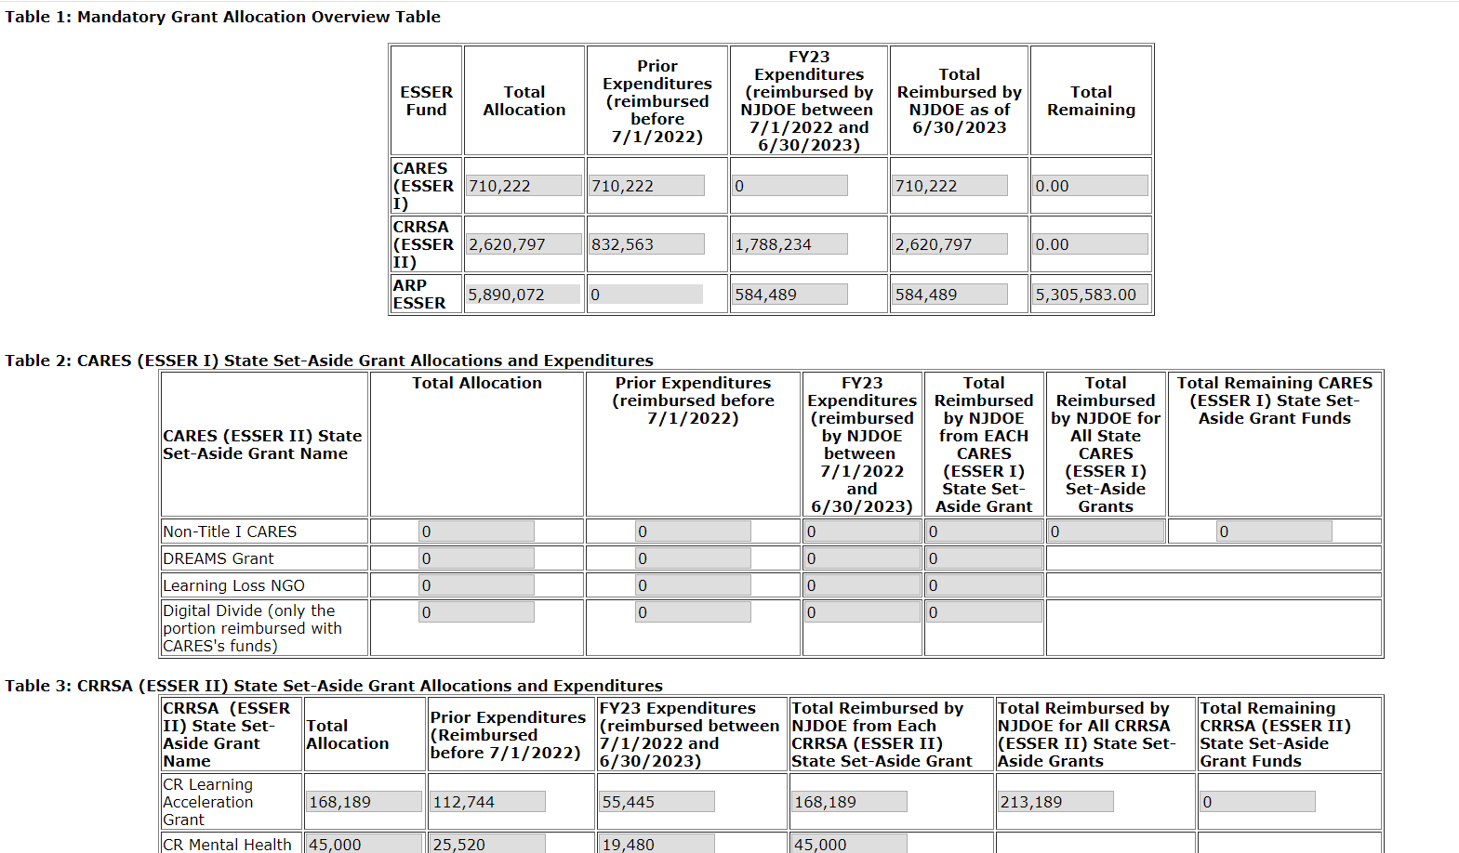
Grants Tab, ESSER Allocation Overview
Refer to the ESSER Allocation Overview subtab to identify your LEA’s ESSER state set-aside grant funds versus your mandatory grant funds and how much was expended during the reporting period.

Slide 10
Definition of Expenditure
ESSER expenditures are reimbursement requests paid by the NJDOE between July 1, 2022 and June 30, 2023.
Included as an Expenditure
Excluded from Expenditures
An LEA pays for an ESSER-eligible good or service on May 31, 2023 and submits the expenditure to the SEA for reimbursement on June 21, 2023. The LEA receives the reimbursement from the SEA on June 29, 2023.
An LEA pays for an ESSER-eligible good or service on May 31, 2023 and submits the expenditure to the SEA for reimbursement on June 21, 2023. The LEA receives the reimbursement from the SEA on July 7, 2023.
Note: In the Programs tab, activities will be reported regardless of when ESSER Reimbursements have occurred.

Slide 11
Grants Tab, State Set-Aside Use of Funds
Important: On this subtab, all ARP ESSER reporting refers only to the “Other State Set-Aside Grants,” found in the bottom table of the ESSER Allocation Overview subtab.

Slide 12
Grants Tab, Mandatory Expended Uses Part I
This subtab asks you to distinguish between two categories of ARP ESSER expenditures—those that go towards the ARP ESSER 20% Reserve to Address Learning Loss and those that do not. An ARP ESSER expenditure should be included in only one of these two categories.

Slide 13
ARP ESSER 20% Reserve to Address Learning Loss
The ARP Act requires LEAs to reserve at least 20% of their mandatory ARP ESSER subgrants to address learning loss through the implementation of evidence-based interventions and ensure that those interventions respond to students’ social, emotional, and academic needs and address the disproportionate impact of COVID-19 on underrepresented student groups.
We are referring to these funds as the “ARP ESSER 20% reserve to address learning loss.”
These state set-aside grants are not part of the ARP ESSER 20% Reserve
ARP ESSER 20% reserve to address learning loss comes from this grant

Slide 14
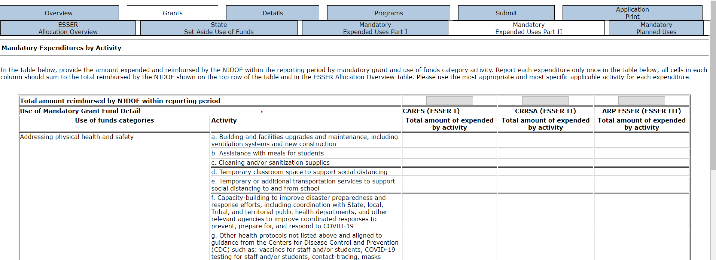
Grants Tab, Mandatory Expended Uses Part II

Slide 15
Details Tab
The Details tab includes six subtabs:
The Safe In-Person and Internet Access subtabs ask “Yes” or “No” questions on ESSER funds used for specific items related to maintaining safe, in-person instruction and to providing home internet access to students.
The Reengagement subtab asks "Yes" or "No" questions about whether and how students were reengaged, regardless of whether ESSER funds were used to carry out these efforts.
The School Distribution subtab asks if your LEA allocated ESSER funds to individual schools to use as each saw fit.
The Staffing subtab asks you to report on the total number of positions supported with any ESSER funds.
The Access to Select Staff subtab ask you to report on the count of FTE staff assigned to serve each school regardless of whether ESSER funds were used.

Slide 16
Programs Tab
The Programs tab includes eight subtabs:
The ARP 20% Reserve subtab asks about how your LEA has expended funds from the ARP 20% Reserve to Address Learning Loss.
The Summer, Afterschool, Extended Time, Tutoring, Early Childhood, Community Schools, and Technology subtabs ask about specific programs your district has implemented using ESSER funds.

Slide 17
Programs Tab, ARP 20 Percent Reserve (1 of 3)
You are required to enter the amount your district reserved for all reporting periods to Address the Impact of Learning Loss.
Note: The “Total amount reimbursed towards the ARP 20% Reserve to Address Learning Loss during this reporting period” is the subtotal of the amount reimbursed towards the ARP 20% Reserve to Address Learning Loss on the Mandatory Expended Uses Part I page.

Slide 18
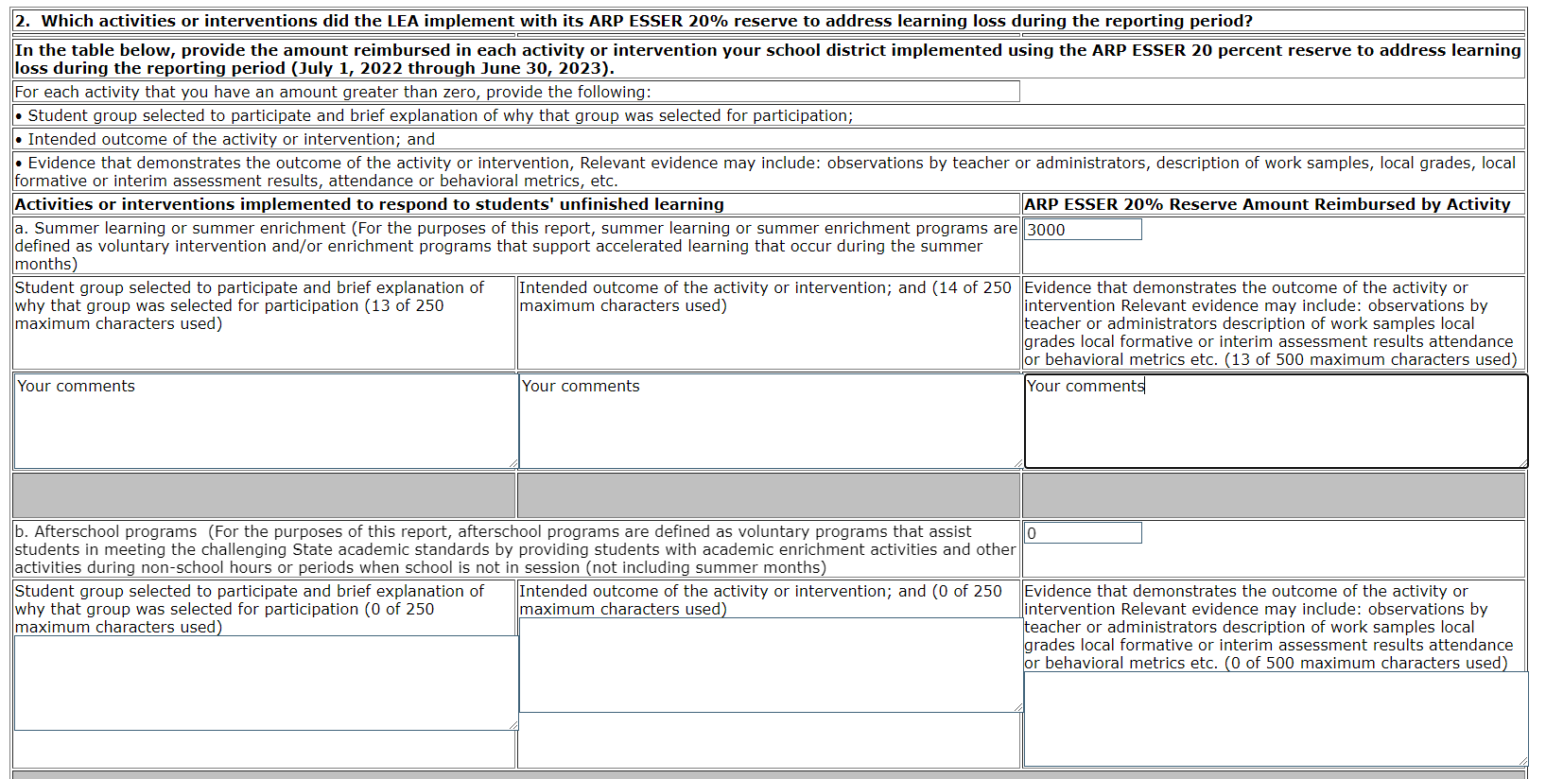
Programs Tab, ARP 20 Percent Reserve (2 of 3)

Slide 19
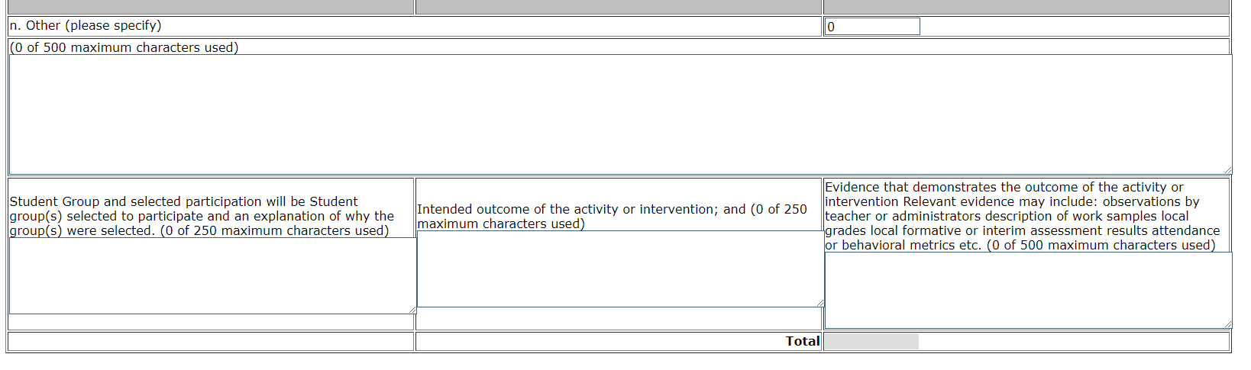
Programs Tab, ARP 20 Percent Reserve (3 of 3)

Slide 20
Programs Subtabs, All Remaining
The Summer, Afterschool, Extended Time, Tutoring, Early Childhood, Community Schools, and Technology subtabs ask about specific programs your district has implemented using ESSER funds, regardless of when ESSER reimbursements occurred.

Slide 21
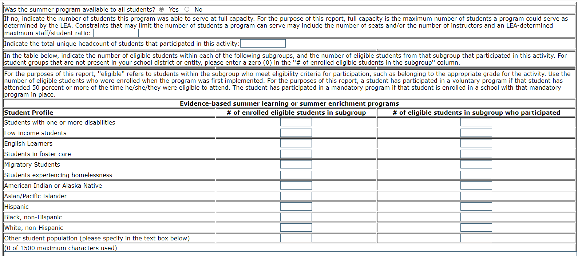
Programs Subtabs, New Participation Requirement

Slide 22
Questions?
For ESSER Performance Report and data questions, please contact the Office of Fiscal and Data Services (OFDS) at: ESSER.Report@doe.nj.gov
60-minute Office Hour Sessions will be held every Friday in February from 10-11 am. Links to the Office Hours are located on the NJDOE Events Page.
For EWEG or authorization questions, please contact the EWEG Help Desk at: EWEGhelp@doe.nj.gov

Slide 23
New Jersey Department of Education
@NewJerseyDOE
@newjerseydoe
Thank You!
New Jersey Department of Education
New Jersey Department of Education
@newjerseydoe
Notes:
Francine

Slide 24
Accessing the Report in EWEG
The report is accessed via the Electronic Web-Enabled Grant (EWEG) system at: EWEG Logon Page.
On the EWEG Logon Page, enter your EWEG user ID, password, and six-digit county district code and hit the “LOGON” button. User IDs are limited to eight characters. Federal regulations require that each user have their own unique ID and password. Passwords are case sensitive. Please allow 48 hours for your permissions to become active.

Slide 25
Creating the Report in EWEG
Once you have logged into EWEG, select GMS Access / Select
At the top of the next page, use the drop down to select 2023 as the Fiscal Year.
Scroll down to “Available” section and click the “Create” button next to the ESSER Performance Report
3/8/2024

Slide 26
Opening the Report in EWEG
Once the report is created, it will appear in the FY 2023 “Performance Report” section of the GMS Access / Select page. Select the “Open” button associated with the ESSER Performance Report for future edits.

Slide 27
Submit Tab—Consistency Check
Prior to submission, a consistency check must be performed by clicking the “Consistency Check” button. This highlights any remaining errors, which must be corrected prior to submission.
Once the consistency check is successful, the report is considered locked but not submitted to the NJDOE.

Slide 28
Submit Tab (con’t.)
If revisions need to be made, the report can be unlocked by selecting the “Unlock Application” button. After unlocking the report and revising any data, a consistency check will need to be re-run to verify that the data passes the programmed edits.
If the consistency check is successful, the “Submit to NJDOE” button should appear on the tab and needs to be clicked for the report to be considered submitted to the Department.

Slide 29
Amendments
If you realize data were incorrectly entered and your report has been successfully submitted to the Department, you will need to create an amendment.
An amendment can be created by clicking the “Amend” button on the GMS Access / Select screen in the ESSER Performance Report row.
Once the data has been amended, a consistency check must be re-run and any errors corrected prior to submission.

Slide 30
Helpful Hints for Navigating EWEG
Do not use the browser “back” button when you are working in the EWEG system. This will cause errors and may log you out of the system. All navigation within the system can be accomplished by clicking on the different tabs.
White cells are available for entering data; grey cells are not.
The “Save Page” button at the bottom of each tab must be clicked before you leave that tab, or you will lose the data entered.
The EWEG system has built-in edits that interact to verify column totals and cross-references tables, if appropriate. If totals do not correlate, you may receive an error message when you try to save, or after running a consistency check prior to submitting the report.

